Slide 1


2026 Economic Forecast Forum + 16th Annual Economic Conditions Survey March 11, 2026

Slide 2
2026 Economic Outlook: National and Local Trends
March 11, 2026
Dr. Sarah Dickerson, PhD
Kenan Institute of Private Enterprise

Slide 3
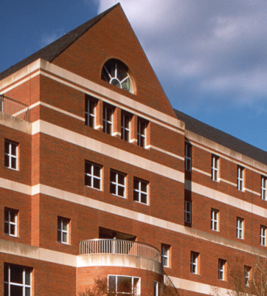
Background on Kenan Institute of Private Enterprise
Nonpartisan business think tank in the Kenan-Flagler Business School
Promote economic prosperity in our state and across the US

Slide 4
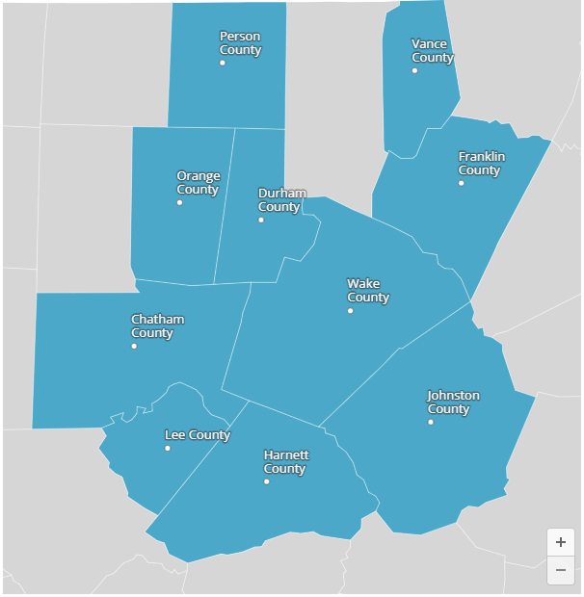
The American Growth Project
Raleigh-Durham EMA
Identify trends across microeconomies
Created 150 Extended Metro Areas (EMAs)
Geographic areas that fully capture American microeconomies
GDP, employment, and housing permit growth forecasts

Slide 5
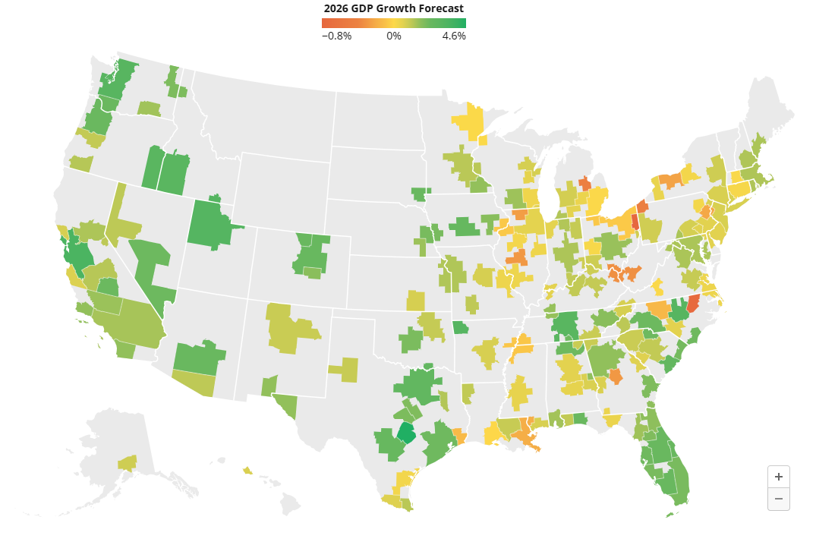
2026 GDP Growth Forecast
We expect slow yet positive growth
Stagnant or negative in several metros

Slide 6
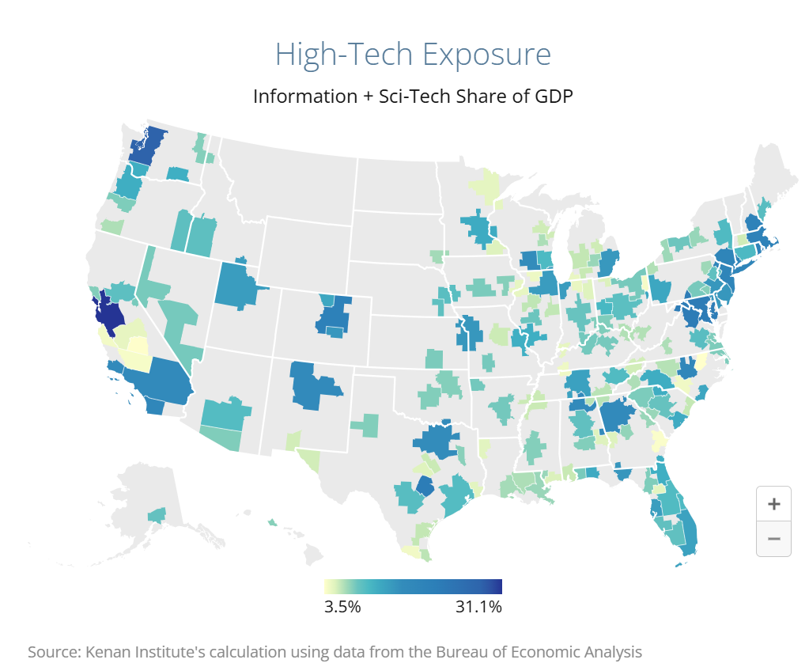
AI Investment and GDP Growth
Spending on:
Data centers
Infrastructure
Software

Slide 7
National Themes
Uncertainty: tariffs and interest rates
Firms delay investment and hiring
Consumers pull back on spending & delay major purchases
Tax cuts may bolster consumer and business confidence
Higher Child Tax Credits, new deductions for tips and overtime, and lower corporate and individual rates

Slide 8
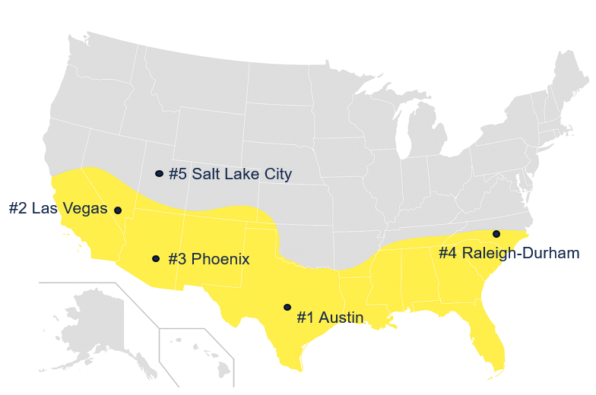
The Sun Belt Outperforms in Employment Growth

Slide 9
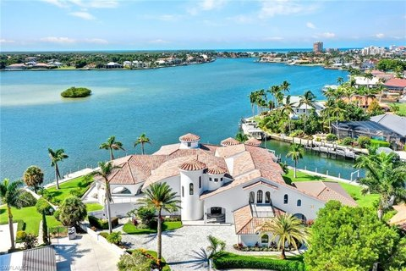
Inland Cities and Florida Metros Outperform in Housing
Top five:
Columbus, OH
Miami, FL
Pittsburgh, PA
Tampa, FL
Oklahoma City, OK

Slide 10

Fastest- and Slowest-Growing Large EMAs
5 fastest
growing
Austin Texas
San Francisco Bay Area California
Salt Lake City Utah
Raleigh & Durham North Carolina
Seattle Washington
5 slowest
growing
Detroit Michigan
Cleveland
Ohio
Memphis Tennessee
Greensboro
North Carolina
New Orleans Louisiana

Slide 11
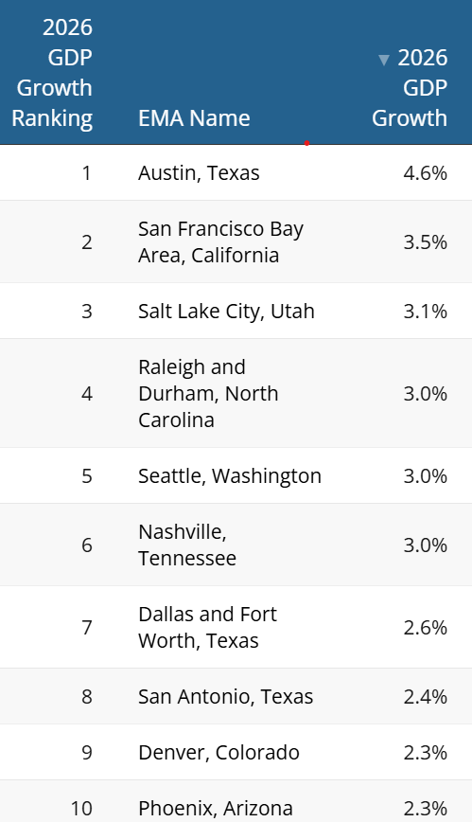
The Triangle’s 2026 Forecasts
Among 50 largest US metros:
GDP growth: 4th
Employment growth: 4th
Housing permit growth: 11th

Slide 12
What Sets the Triangle Apart? Productivity
Productivity: Output per worker
GDP share/employment share
Higher than US average in several key sectors
Sector | RDU | Austin | US
Finance & Real Estate | ⭐ 3.8 | 3.33 | 3.5
Manufacturing | ⭐ 2.33 | 1.6 | 1.25
Trade & Transportation | 1.0 | ⭐ 1.2 | 0.94

Slide 13
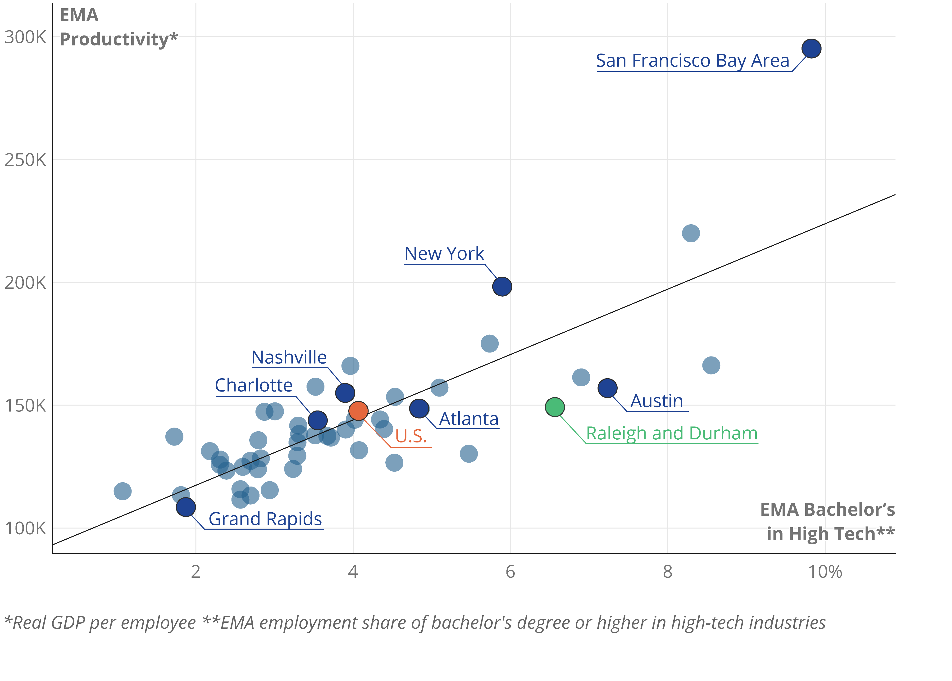
What Sets the Triangle Apart? Talent
6th in tech talent, key for:
Productivity
Innovation
Workforce pipeline
7th in net migration rate
pop growth 2019-24 by county:
Orange (3%)
Durham (7%)
Wake (11%)
Notes:
Data is pulled from the Census's QWI. Our definition of ""high-tech" is the Information sector (NAICS 51) + the Science & Technical Services (NAICS 54)

Slide 14
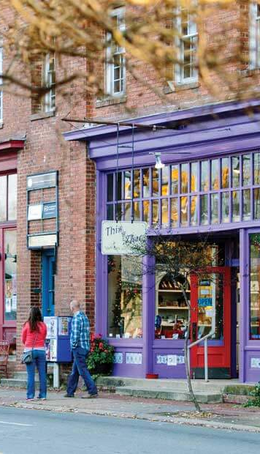
The Appeal of Chapel Hill & Carrboro
For Business:
Local talent pipeline
Available land (Wake and Durham counties), low corporate taxes, reliable infrastructure
For Talent:
More affordable than coastal hubs
Access to amenities
Strong research and academic ecosystem

Slide 15
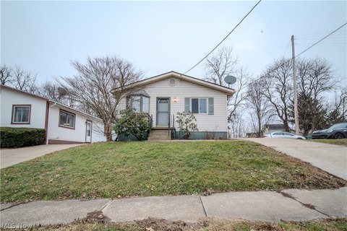
Drawbacks to Chapel Hill & Carrboro
Rising costs
Limited supply of starter homes
Competition from other sun belt metros (e.g., Charlotte)

Slide 16
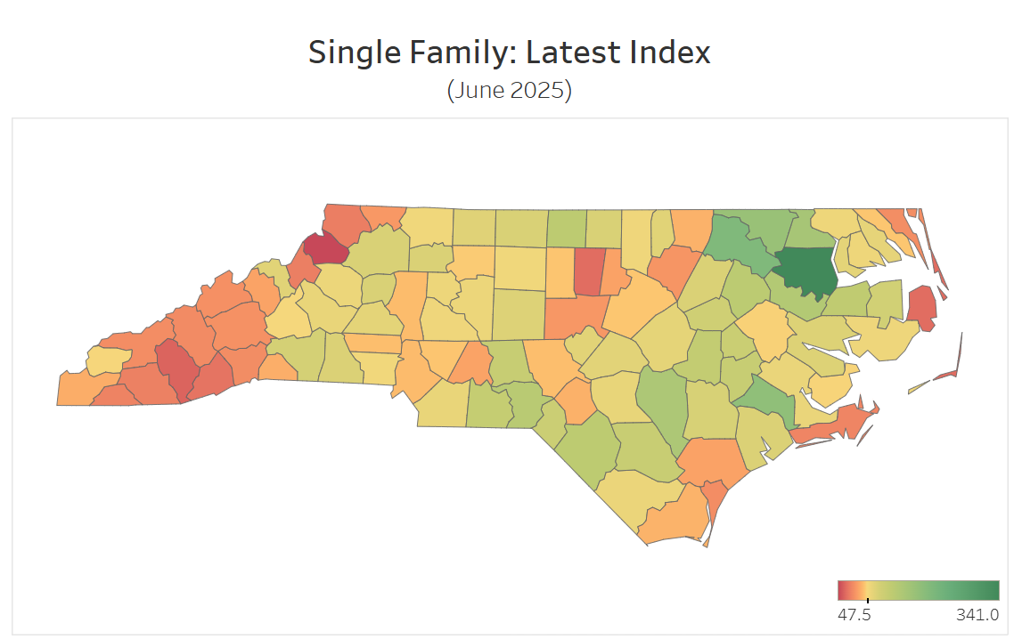
Housing Affordability across NC Counties
Boone
Durham
Chapel Hill
Asheville
Notes:
Housing affordability primarily depends on three factors: the price of homes, mortgage rates and household income. Our index incorporates these elements in an easy-to-interpret measure of the financial burden of purchasing a home for the median household.

Slide 17
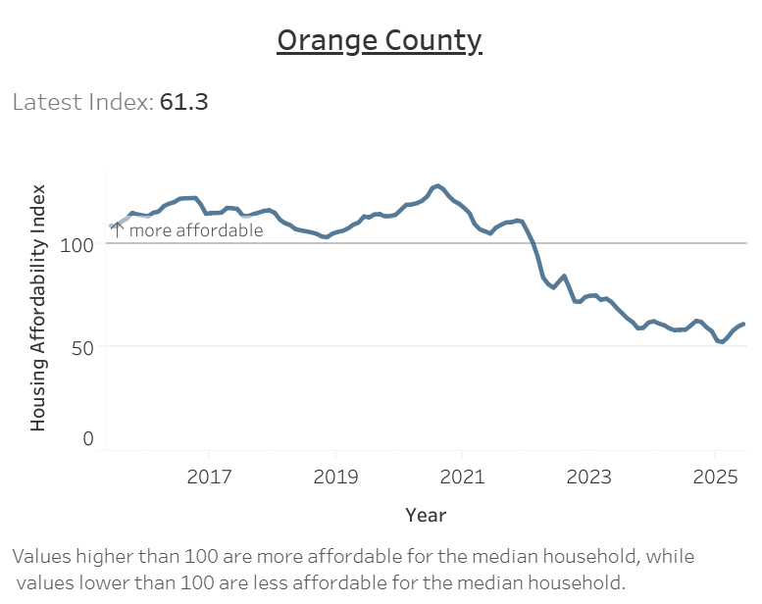
Housing Affordability in Orange County
Less affordable than surrounding counties
Bottom 5 for affordability
More affordable than Watauga, Jackson, and comparable to Dare

Slide 18

Average Monthly Rent
Location | Rent | YoY Change
Cary | $2,095 | Down $55
Chapel Hill | $1,920 | Up $25
Durham | $1,895 | Same as 2025
Carrboro | $1,800 | Up $150
Raleigh | $1,800 | Down $50
United States | $2,000 | Down $50
Source: Zillow (March 7, 2026)

Slide 19
Importance of Housing Affordability
Being "house poor" leaves little money for local goods and services
Talent attraction and retention
The pandemic accelerated migration to the South (e.g., Austin, Charlotte, Nashville)
The triangle is competing with these metros for talent

Slide 20
Taking Data-Based Action
Improve housing affordability
Expand “missing middle” homes
Market as high‑amenity, affordable community

Slide 21
Taking Data-Based Action
Gain deeper insights into post-Covid drivers of talent migration
Known drivers: labor market conditions, social networks, quality of life, taxes
The pandemic changed our relationship with home and work:
Do the factors that were important in 2019 still matter today? Do we care more about telework opportunities and housing affordability?
New research on early-career talent drivers

Slide 22
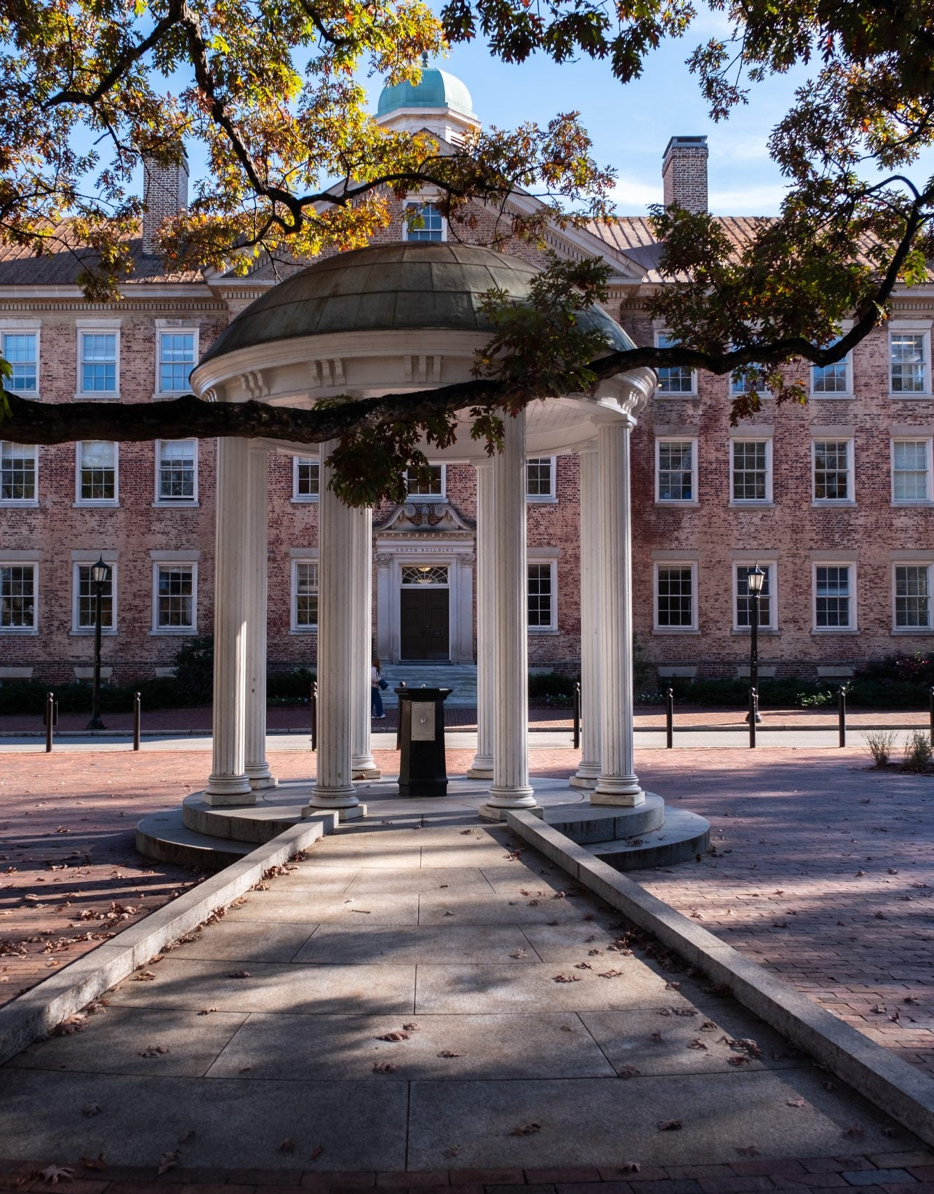
Key Takeaways: National and Local Outlook
Moderate, but slowing national growth, with continued uncertainty
We’re projected to outperform most peers
Addressing affordable housing and retaining talent could boost long-term growth prospects

Slide 23
Pause for Questions? Conversation

Slide 24
The Chamber’s 16th Annual Economic Conditions Survey

Slide 25
How are local businesses doing?

Slide 26
Feeling Pretty Good, Moderating Economic Expectations

Slide 27
Q1 2024: Which best describes your organization's current financial condition?
Feb 2024 Chamber Member Survey (234 respondents)

Slide 28
Q1 2025: Which best describes your organization's current financial condition?
Jan 2025 Chamber Member Survey

Slide 29
Q1 2026: Which best describes your organization's current financial condition?
Feb 2026 Chamber Member Survey (184 respondents)

Slide 30
Which best describes your organization's current financial condition? (2024 v 2025 v 2026)
Feb 2026 Chamber Member Survey (184 respondents)

Slide 31
Q1 2024: How do you expect your organization's financial condition will change over the next 12 months?
Feb 2024 Chamber Member Survey (234 respondents)

Slide 32
Q1 2025: How do you expect your organization's financial condition will change over the next 12 months?
Jan 2025 Chamber Member Survey (207 Respondents)

Slide 33
Q1 2026: How do you expect your organization's financial condition will change over the next 12 months?
Feb 2026 Chamber Member Survey (184 respondents)

Slide 34
How do you expect your organization's financial condition will change over the next 12 months? (2024 v 2025 v 2026)
Feb 2026 Chamber Member Survey (184 respondents)

Slide 35
Impact of Current Economy on Local Enterprises

Slide 36
Positive Impacts of Economy Drop
“How is the current state of the economy affecting your organization?” Percent responding ‘positively,’ with a score of 7, 8, 9 or 10 on a 1-10 scale.
Feb 2026 Chamber Member Survey (176 Responses)

Slide 37
Negative Impacts Continue to Tick Up Slightly
“How is the current state of the economy affecting your organization?” Percent responding ‘negatively,’ with a score of 1, 2, or 3 on a 1-10 scale.
Feb 2026 Chamber Member Survey (176 Responses)

Slide 38
How is the Current State of the Economy Affecting Your Organization?
Feb 2026 Chamber Member Survey (176 Responses)

Slide 39
Economic Impacts Differ By Sector

Slide 40
Q1 2026: How is current state of the economy affecting your organization?
10 = Very Positively
5 = Neutral
1 = Very Negatively
Feb 2026 Chamber Member Survey (174 respondents)
Notes:
Last year’s average – 4.7

Slide 41
Q1 2024: How is current state of the economy affecting your organization?
10 = Very Positively
5 = Neutral
1 = Very Negatively
Feb 2024 Chamber Member Survey
Notes:
Last year’s average – 4.7

Slide 42
Q1 2025: How is current state of the economy affecting your organization?
10 = Very Positively
5 = Neutral
1 = Very Negatively
Jan 2025 Chamber Member Survey (207 respondents_)
Notes:
Last year’s average – 4.7

Slide 43
Q1 2026: How is current state of the economy affecting your organization?
10 = Very Positively
5 = Neutral
1 = Very Negatively
Feb 2026 Chamber Member Survey (174 respondents)
Notes:
Last year’s average – 4.7

Slide 44
Cautious Revenue Optimism

Slide 45
Q1 2026: How do you expect your organization’s sales/revenue to change over the next 12 months?
Feb 2026 Chamber Member Survey (183 respondents)

Slide 46
How do you expect your organization’s sales/revenue to change over the next 12 months?
4% Unsure
Feb 2026 Chamber Member Survey (183 respondents)

Slide 47
Q1 2025: What resources do you need in the next 12 months to help you be successful?
Jan 2025 Chamber Member Survey (206 Respondents)
Notes:
Marketing/Advertising up from 33 to 39; access to grants up from 26%, nothing up to 21 from 15; finding new employees down from 38 to 30; training employees up from 12

Slide 48
Q1 2026: What resources do you need in the next 12 months to help you be successful?
Feb 2026 Chamber Member Survey (185 Respondents)

Slide 49
Hiring Challenges Persist

Slide 50
Q1 2024: Do you expect the size of your workforce to change in the next 12 months?
Feb 2024 Chamber Member Survey

Slide 51
Q1 2025: Do you expect the size of your workforce to change in the next 12 months?
Jan 2025 Chamber Member Survey (207 Respondents)

Slide 52
Q1 2026: Do you expect the size of your workforce to change in the next 12 months?
Feb 2026 Chamber Member Survey (184 Respondents)

Slide 53
Percentage Planning to Add Workers in the Next 12 Months
“Does your organization have plans to increase its workforce in the next 12 months?”
Feb 2026 Chamber Member Survey (184 Respondents)

Slide 54
Percentage Planning to Add Workers in the Next 12 Months
“Does your organization have plans to increase its workforce in the next 12 months?”
Feb 2026 Chamber Member Survey (184 Respondents)

Slide 55
Percentage Planning to Reduce Workforce in the Next 12 Months
“Does your organization have plans to reduce its workforce in the next 12 months?”
Feb 2026 Chamber Member Survey (184 Respondents)

Slide 56
Percentage Planning to Reduce Workforce in the Next 12 Months
“Does your organization have plans to reduce its workforce in the next 12 months?”
Feb 2026 Chamber Member Survey (184 Respondents)

Slide 57
Q1 2025: Has your organization experienced hiring challenges over the past 12 months?
Jan 2025 Chamber Member Survey (207 Respondents)
Notes:
Nearly the same as 2024

Slide 58
Q1 2026: Has your organization experienced hiring challenges over the past 12 months?
Feb 2026 Chamber Member Survey (184 Respondents)
Notes:
Nearly the same as 2024

Slide 59
Q1 2025: Has your organization experienced hiring challenges over the past 12 months?
Jan 2025 Chamber Member Survey (207 Respondents)

Slide 60
Q1 2026: Has your organization experienced hiring challenges over the past 12 months?
Feb 2026 Chamber Member Survey (184 Respondents)

Slide 61
Q1 2025: Which factors contribute to your hiring challenges? (check all that apply) 1
Jan 2025 Chamber Member Survey (207 Respondents)

Slide 62
Q1 2026: Which factors contribute to your hiring challenges? (check all that apply) 1
Jan 2026 Chamber Member Survey (184 Respondents)

Slide 63
What do you need most in order to thrive in 2026?

Slide 64
What do you need most in order to thrive in 2026
Stronger/Stable Economy & Consumer Confidence (24)
“More money in locals’ pockets.”
“Restaurants compete for disposable income… The economy needs to be stable for confidence to build.”
“A stronger economy, stable job market and lower interest rates that would provide confidence to folks to purchase a condo.”
Workforce & Talent Recruitment (16)
“Investment in the trades or funding to help us expand our apprenticeship program to create new licensed plumbers.” “We need to find the right people for the right seat.”
Feb 2026 Chamber Member Survey

Slide 65
What do you need most in order to thrive in 2026?
“We need to raise more money; find more grant funding.”
Access to Capital, Grants, & Funding (15) (Mostly Non-Profit Respondents)
“We need to raise more money; find more grant funding.”
“Financial resources and access to grants, especially for repairing our aging housing stock.” “Partnerships with financial institutions willing to offer low/no interest construction loans.”
Marketing, Visibility & Customer Acquisition (14)
“Advertising my services… I need help in marketing my services and getting exposure.” “More brand recognition within the community”
Feb 2026 Chamber Member Survey

Slide 66
What do you need most in order to thrive in 2026?
Networking, Partnerships & Referrals (13)
“More connections to potential clients.”
“Doctors referring pediatric patients to business organization”
Government Policy, Political Stability & Regulation (13)
“Stability from the Fed, so we can plan more effectively”
“Easier, faster, and less costly building approvals. “For the government not to shut down.”
Feb 2026 Chamber Member Survey

Slide 67
What is the most significant challenge to the future growth of your organization?
Workforce & Talent Shortages (22)
“Limited pool of skilled labor…licensing process takes a minimum of 1.5 years”
“Competing for qualified clinical candidates in a competitive environment”
“Finding qualified people.”
Economic Uncertainty & Macroeconomic Conditions (20)
“Economic pressures on middle-income residents are causing more restrained spending.”
“The overall national business climate."
Feb 2026 Chamber Member Survey

Slide 68
What is the most significant challenge to the future growth of your organization?

Slide 69
What is the most significant challenge to the future growth of your organization?
Costs of Doing Business (17)
“Balancing the cost of doing business against what customers can afford.”
“Living wage increasing. Difficult to stay profitable.”
“Supply chain issues. Rising costs across the board.”
Space, Facilities, & Physical Capacity (10)
“Physical space… we are constantly reimagining the space, which costs money.”
“Facility limitations hinder revenue growth” “Space within our building. We will outgrow it.”
Feb 2026 Chamber Member Survey

Slide 70
If you could change one thing locally to help your organization thrive, what would it be?
Housing Affordability & Supply (15)
“Increase housing supply for middle class young people”
“Housing that is affordable to various income levels”
“Employee access to affordable housing choices in Orange County. Supply chain issues. Rising costs across the board.”
Local Regulation & Development Process (15)
“Professionalize permitting and inspection units to eliminate redundancy.”
“Faster planning and zoning entitlements.” “Regulatory reform, particularly in Carrboro”
Feb 2026 Chamber Member Survey

Slide 71
If you could change one thing locally to help your organization thrive, what would it be?
Networking, Collaboration, & Partnerships (11) “More collaboration between and among businesses”
“Increased institutional partnerships”
“Would love to do some kind of professional services exchange.”
Infrastructure, Transportation, & Parking (10)
“Improve/expand the roads not just bike lanes and sidewalks.”
“Better cross-triangle transport options” “Infrastructure repairs and improvements need to plan around local businesses.”
Feb 2026 Chamber Member Survey

Slide 72
If you could change one thing locally to help your organization thrive, what would it be?
Local Economic Development & Business Environment (9)
“More corporate growth. Retail businesses really don’t help my industry.”
“Make it easier and more enticing for commercial businesses to set up shop”
“Larger companies using local resources instead of companies out of the region.”
Feb 2026 Chamber Member Survey

Slide 73
Q1 2025: How do you expect prices YOU PAY for goods/services to change over the next 12 months?
Jan 2025 Chamber Member Survey (207 Respondents)

Slide 74
Q1 2026: How do you expect prices YOU PAY for goods/services to change over the next 12 months?
Feb 2026 Chamber Member Survey (184 Respondents)

Slide 75
Q1 2025: Do you expect to increase prices YOU CHARGE for goods/services over the next 12 months?
Jan 2025 Chamber Member Survey (207 Respondents)

Slide 76
Q1 2026: Do you expect to increase prices YOU CHARGE for goods/services over the next 12 months?
Feb 2026 Chamber Member Survey (183 Respondents)

Slide 77
Government Sentiment Relatively Strong

Slide 78
2025: Would you say local government here is….
Jan 2025 Chamber Member Survey (207 Respondents)
Notes:
Strongly Pro Business up from 18% in 2024

Slide 79
2026: Would you say local government here is….
Feb 2026 Chamber Member Survey (184 Respondents)
Notes:
Strongly Pro Business up from 18% in 2024

Slide 80
2025: Would you say local government here is….
Jan 2025 Chamber Member Survey (207 Respondents)
Notes:
Strongly Pro Business up from 18% in 2024

Slide 81
2026: Would you say local government here is….
Feb 2026 Chamber Member Survey (184 Respondents)
Notes:
Strongly Pro Business up from 18% in 2024

Slide 82
Orange County 2025: Would you say local government here is….
Jan 2025 Chamber Member Survey (207 Respondents)
Notes:
Strongly Pro Business up from 18% in 2024

Slide 83
Orange County 2026: Would you say local government here is….
150 respondents with Orange County-based businesses
Feb 2026 Chamber Member Survey (184 Respondents)
Notes:
Strongly Pro Business up from 18% in 2024

Slide 84
Chapel Hill 2025: Would you say local government here is…
166 respondents with Chapel Hill-based businesses
Jan 2025 Chamber Member Survey

Slide 85
Chapel Hill 2026: Would you say local government here is…
126 respondents with Chapel Hill-based businesses
Feb 2026 Chamber Member Survey (184 Respondents)

Slide 86
Artificial Intelligence

Slide 87
Q1 2024: Over the past 12 months, did your business incorporate artificial intelligence (AI) tools into normal operations?
Feb 2024 Chamber Member Survey

Slide 88
Q1 2025: Over the past 12 months, did your business incorporate artificial intelligence (AI) tools into normal operations?
Jan 2025 Chamber Member Survey (207 Respondents)

Slide 89
Q1 2026: Over the past 12 months, did your business incorporate artificial intelligence (AI) tools into normal operations?
Feb 2026 Chamber Member Survey (184 Respondents)

Slide 90
Diverse and Representative Respondents *184 Respondents in 2026

Slide 91
Respondents by Industry Type
174 Total Respondents
Feb 2026 Chamber Member Survey

Slide 92
How many people do you employ locally? (Full+Part-Time)
Feb 2026 Chamber Member Survey (183 respondents)

Slide 93
Respondents by Geography (selecting all that applied)
Feb 2026 Chamber Member Survey (184 Respondents)

Slide 94
Questions? Discussion

