Slide 1
BEAUFORT, SC REGIONAL CHAMBER OF COMMERCE
MARCH 2026

Slide 2
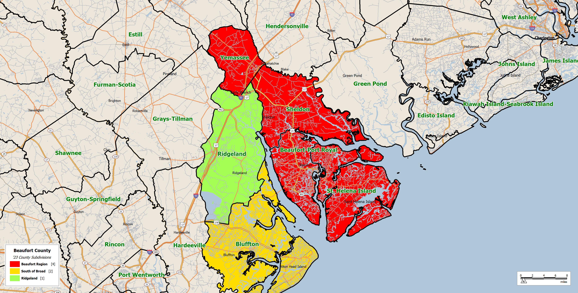
REGIONAL CCDs
Source: SCAN US, Beaufort Chamber of Commerce

Slide 3
POPULATION

Slide 4
POPULATION GROWTH 2010-2030
Source: SCAN US, U.S Census Bureau

Slide 5
KEY FINDINGS – POPULATION
The region is growing steadily — from 74,400 in 2010 to a projected 83,800 by 2030 — but that growth (0.8% annually) lags behind the state average of 1.3%, and significantly behind Ridgeland (3.8%) and South of Broad (2.4%). It should be noted that South Carolina is now the fastest growing state in the U.S.
Growth is concentrated in Beaufort-Port Royal and St. Helena, which together account for 92.5% of the region's population.
The community should be investing in targeted residential development in underperforming areas like Sheldon and Yemassee to distribute growth pressure more evenly. As noted, Sheldon is projected for robust growth in the next few years.
The community should actively market the region to attract in-migration at a pace closer to the state average.

Slide 6
INCOME

Slide 7
REGION MEDIAN HOUSEHOLD INCOME TRENDS – 2010-2030
Source: SCAN US, U.S Census Bureau

Slide 8
AVERAGE HOUSEHOLD INCOME DISTRIBUTION 2025
Source: SCAN US

Slide 9
KEY FINDINGS - INCOME
Median household income in the Beaufort region ($76,188 in 2025) sits 9% below the national average and is projected to remain so through 2030.
One in three households earns under $50,000. The income gap is geographically stark — St. Helena/Lady's Island averages $90,927 while Yemassee averages just $42,993. South of the Broad River, the median exceeds $100,000.
This inequality is not just a social issue — it's an economic development constraint. The community should focus on wage-level economic recruitment (targeting industries that pay above the median), supporting small business growth in lower-income areas, and connecting workforce training directly to higher-paying career pathways.

Slide 10
HOUSING

Slide 11
MEDIAN HOME VALUE 2020-2025
Source: zillow.com

Slide 12
MEDIAN HOME VALUE – BLUFFTON, HILTON HEAD
Source: zillow.com
Source: zillow.com

Slide 13
MEDIAN HOME VALUE CHANGE
Source: zillow.com

Slide 14
KEY FINDINGS – HOME VALUES
Home values have surged dramatically — zip code 29902 went from $110,000 in 2000 to over $407,000 in 2025. Median gross rent in the county is up 50% since 2010.
Vacancy rates (26.3%) are much higher than state (13.1%) and national (10.4%) averages, partly due to seasonal/vacation homes.
The gap between rising housing costs and wages that remain below national averages in every sector is the defining affordability challenge. The community needs a deliberate attainable housing strategy — including incentivizing multi-family development (building permits show multi-family is rising but still only 25% of new construction), preserving workforce housing stock, and pushing for employer-assisted housing programs.

Slide 15
AGE

Slide 16
MEDIAN AGE 2010-2030
Source: SCAN US, U.S. Census Bureau

Slide 17
MEDIAN AGE BY CCD
Source: SCAN US, U.S. Census Bureau

Slide 18
AGE PROFILE 2025
Source: SCAN US

Slide 19
KEY AGE COHORTS
Source: SCAN US, U.S. Census Bureau

Slide 20
MEDIAN AGE BY REGION
Source: SCAN US, U.S. Census Bureau

Slide 21
KEY FINDINGS – AGE DISTRIBUTION
This is one of the most urgent signals in the data.
The region's median age jumped from 34 in 2010 to 44.2 in 2025 — a dramatic increase compared to the national rise from 37 to 39.3.
Without the military, the median age in Beaufort-Port Royal would be 40.1, but the military presence masks a deep structural gap: the 25–54 working-age cohort is underrepresented (32% locally vs. 39% nationally), and the 65+ cohort is growing fast — projected to hit 24% by 2030.
This is a workforce retention and succession crisis in the making. The Chamber's Cradle-to-Career Pipeline work is directly responsive to this, and the case for keeping young talent in Beaufort has never been stronger.

Slide 22
LABOR FORCE AND EMPLOYMENT

Slide 23
UNEMPLOYMENT RATE 2010-2024
Source: Bureau of Labor Statistics

Slide 24
EMPLOYMENT BY SECTOR 2020 AND 2024
2020
2024
Source: Bureau of Labor Statistics

Slide 25
SERVICE SECTOR EMPLOYMENT 2024 – INDEXED TO U.S.A.
Source: Bureau of Labor Statistics

Slide 26
AVERAGE WEEKLY EARNINGS
Source: Bureau of Labor Statistics

Slide 27
KEY FINDINGS – LABOR FORCE & ECONOMY
The headline is good — unemployment at 3.8% (below state and national) and the labor force is growing.
But beneath that is a structural vulnerability: nearly 75% of employment is in Services and Retail Trade, compared to 65% nationally, and average weekly earnings in every sector trail national benchmarks.
Hospitality and Arts/Entertainment are significantly over-indexed relative to the U.S. but are among the lowest-paying jobs in the economy.
The community should prioritize economic diversification — especially attracting professional, scientific, and tech employers — and leverage military-related assets to grow higher-wage federal and defense-adjacent jobs.

Slide 28
IMPLICATIONS
Beaufort is growing, but growing older, growing more expensive, and still over-reliant on a low-wage service economy. The data makes a compelling case that the community's next chapter requires intentional collaboration on four fronts: housing affordability, workforce development and talent retention, economic diversification, and equitable investment across all sub-regions.

Slide 29
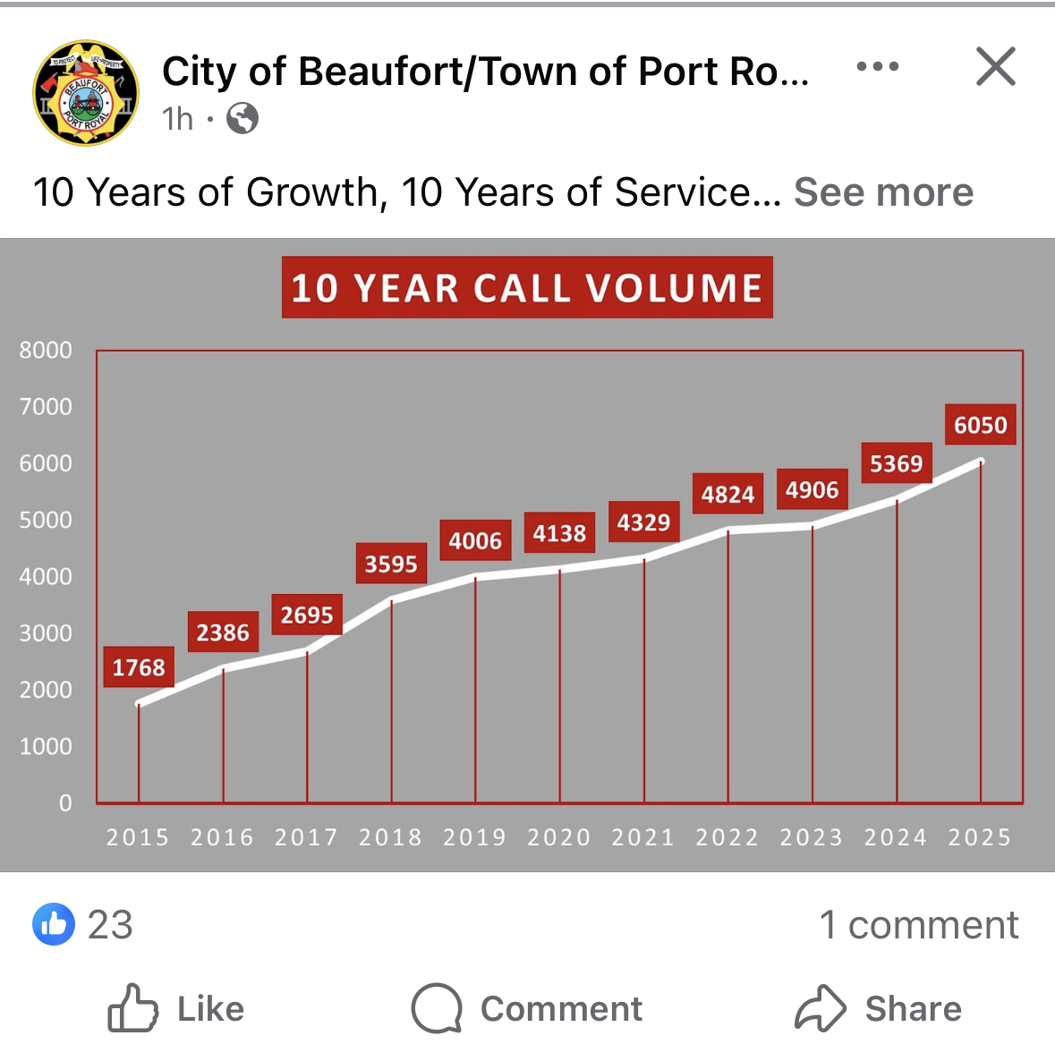
REAL WORLD IMPACT OF GROWTH

