Slide 1
South Yorkshire Employer Insights on Artificial Intelligence and Jobs of the Future
Research Report Headlines

Slide 2
Contents
Background
AI adoption, regulation and ambition
AI skills pipeline
Training provision and employer engagement
Future outlook
Summary of findings
Next steps / questions
01

Slide 3

Research Background
02
02

Slide 4
Background
Sixth in a series of employer insights.
Purpose - to gain employer knowledge and understanding of local skills priorities.
Questionnaire - agreed with providers, businesses and stakeholders.
This report looks at AI adoption in South Yorkshire and future skills and support needs.
We spoke to 45 firms in 1-2-1 interviews– they can’t represent the whole sector and offer a snapshot of their requirements.
Referrals via South Yorkshire Chambers and Sheffield Digital.
Designed to inform the valuable work and thinking of local stakeholders.
03

Slide 5
Background (cont.)
The UK AI market was worth more than £72 billion in 2024 (£1 trillion by 2035).
Over the past 70 years AI has experienced a rapid evolution through machine and deep learning to the present-day establishment of generative AI, which can create original content in response to user requests.
Generative AI is already beginning to be superseded by agentic AI which can autonomously make decisions and act with the ability to pursue complex goals with limited supervision.
AI is transforming how we live and work. It provides businesses in South Yorkshire with new groundbreaking opportunities. It has a versatility of applications that can improve efficiency, automate routine work, and uncover insights in almost any industry.
04

Slide 6
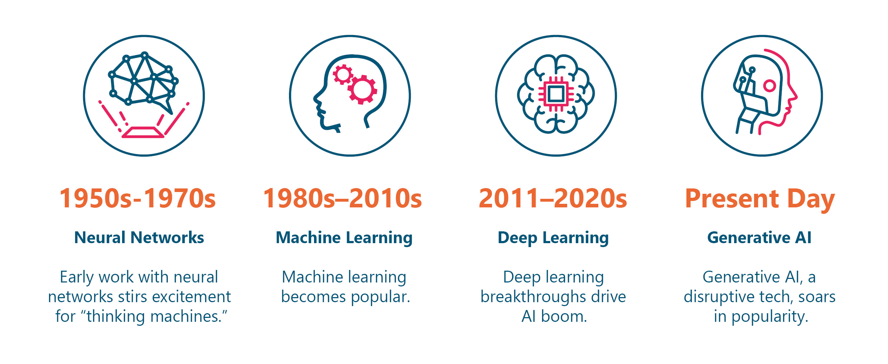

Slide 7
“AI’s biggest strength is its versatility. It can improve efficiency, automate routine work, and uncover insights in almost any industry. From speeding up medical diagnoses to helping businesses work smarter, AI is transforming how we live and work. As the technology advances, its ability to spark innovation and solve big challenges will only grow.”
University of Cincinnati, 9 benefits of Artificial Intelligence in 2025, 2025
“Their ability [agentic AI systems] to autonomously anticipate needs, make decisions and learn from their environment might make them more efficient and cost-effective, complementing the general capabilities of LLMs and increasing AI's accessibility across industries.”
IBM, The future of AI: trends shaping the next 10 years, 2024

Slide 8
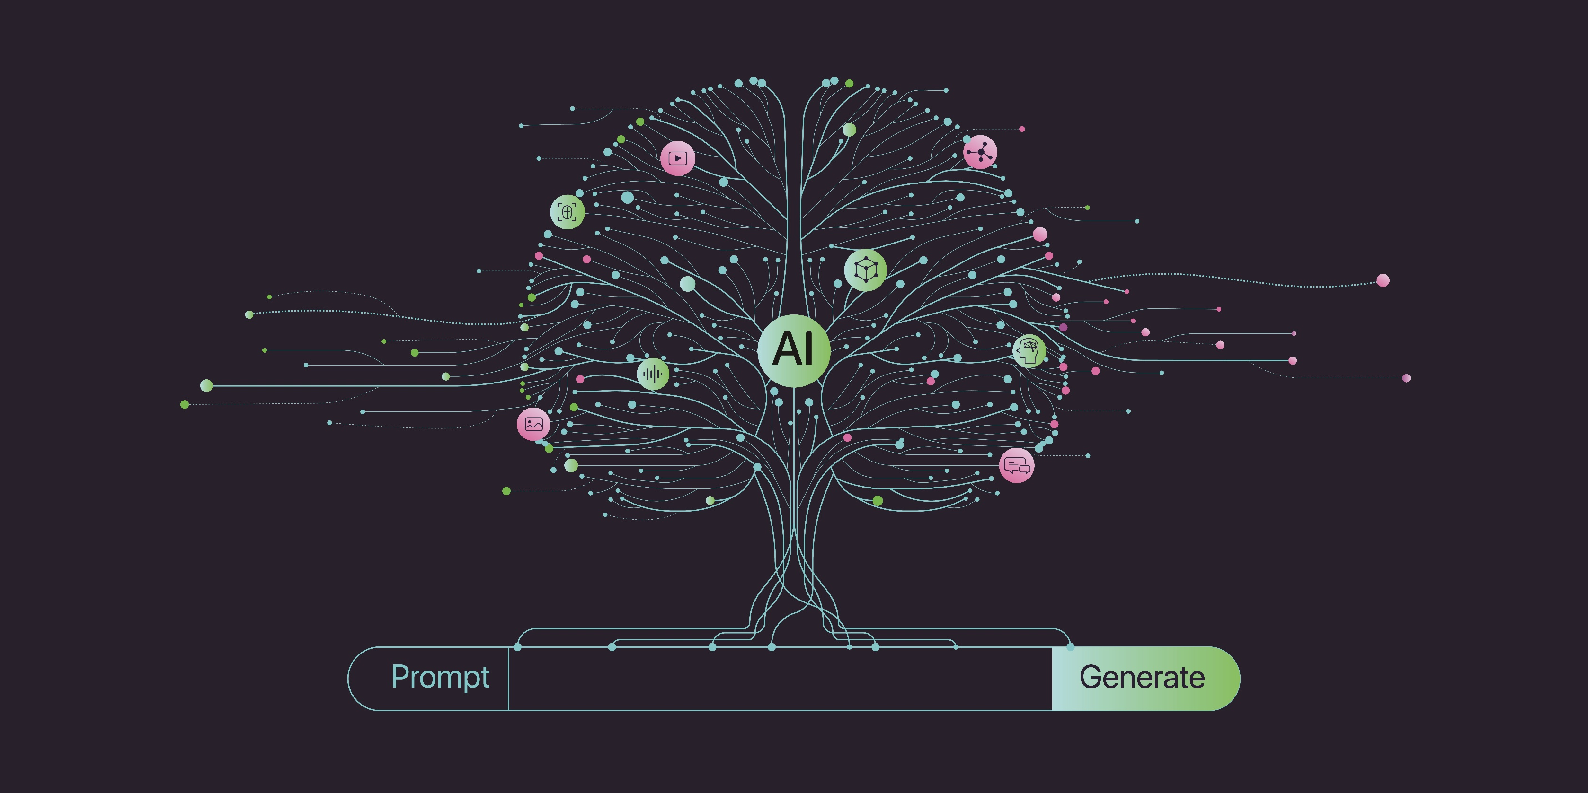

Slide 9
Adoption, regulation and ambition
05
02

Slide 10
Adoption, regulation and ambition
AI has widespread integration across diverse sectors and firms from those that could be described as ‘digital natives’ to other service and manufacturing industries.
Adoption rates vary considerably. There are both ‘pioneers’ and ‘current or potential adopters or followers’ across five broad categories of AI use.
Employers' experiences and engagement with AI vary significantly, ranging from adopting AI products and services to achieve efficiencies to AI playing a more fundamental role.
Some are creating AI bespoke products and infrastructure, such as building large language models, developing customised AI pipelines, and creating automated AI platforms. A handful of non-adopters would like to understand more or had more pressing priorities.
06
Notes:
Based on the consultations it is possible to identify five broad categories of AI use:
Creators of AI infrastructure including hardware, software, platforms etc.
Developers of AI products producing bespoke, value adding AI solutions
AI service providers offering skills and expertise to support AI adoption
Current adopters of AI products or services
Potential adopters.

Slide 11
Adoption, regulation and ambition (cont.)
There is an appetite for knowledge sharing, to learn more and deepen understanding.
Despite increasing deployment, the adoption of AI policies to regulate its use is not widespread, they were often subsumed into wider digital and data policies. That said many were looking to adopt a formal policy.
Generally, teams are not discouraged from using AI and these frameworks are designed to ensure its use is ethical, in line with regulation and protects company data. There is some good practice which could be shared with firms looking to develop policies.
Most employers are moderately optimistic about AI's potential to improve efficiency and productivity and for some it will play a key role in sales and marketing applications.
07
Notes:
6-In larger firms its use was more likely to be covered by company procedures and/or AI working groups or forums.

Slide 12
Adoption, regulation and ambition (cont.)
AI leaders anticipate its future contributions in product or service development, data analysis, and predictive insights, including coding, platforms, software, and hardware. A few firms were more cautious despite the inevitability of AI.
AI tool usage and application skills were mentioned frequently; and the awareness and ability to use AI software effectively and understanding how to prompt and guide AI outputs.
More specific technical AI skills (software development, programming, machine learning and the use of large language models) are required by those businesses at the forefront of AI development. Several firms sought more sector-specific or functional AI use. A few were considering recruiting new AI related roles or jobs with AI responsibilities.
Employees who took a ‘learning through experimentation’ approach towards AI were highly valued. Employers like staff to keep up to speed with AI trends and share internal knowledge and best practice, recognising these traits were as crucial as technical skills.
08

Slide 13
Adoption, regulation and ambition
AI Usage
“We're actually building a physics-based methodology to machine learning and AI that helps mainly small businesses through the platforms they already use, predict their operational needs.”.
AI Regulation
“We have quite stringent controls around it, which means we can deploy AI in some areas of the business in others we cannot. We've got about four or five AI policies relating to AI usage in different areas.”
AI Ambition
“AI is probably underutilised at the moment but has potential for us for predictive analysis, to look at trends and look at data that's out there and to see whether we can map opportunity and tailor our approach with a better understanding of the data that's out there but using AI to access that data."
09

Slide 14
Examples
“We have AI functions built into the drone platform so you can detect people, vehicles, or boats. Say for instance, you've got the autonomous missions in terms of flight, flight path missions - that's artificial intelligence, the drone's flying itself.”
“We've built a legal management system where lawyers can use this platform to manage their legal work….it has CRM capabilities and document management.”
“We're building a physics-based methodology to machine learning and AI that helps mainly small businesses through the platforms they already use, predict their operational needs.”

Slide 15
Skills pipeline
10
02

Slide 16
Skills pipeline
For certain technical or senior roles industries such as engineering and data science, qualifications remain essential. But the more routine use of AI simply requires an understanding of how to use the tools. This requires adaptability, problem solving and curiosity with digital skills best advanced through real-world application.
New AI models and technologies make it difficult for qualifications and training to keep pace with employers wishing to build the knowledge to implement AI effectively.
Traditional interview techniques may not be suitable for candidates to demonstrate their technical capabilities for roles with an AI component. One employer required candidates to demonstrate coding skills.
There are a few wholly AI roles being advertised. Employers are focused on upskilling their existing employees and embedding AI roles into job descriptions.
11
Notes:
1-This requirement is particularly well suited to courses with on-the-job training such as apprenticeships.

Slide 17
Skills pipeline (cont.)
The hardest vacancies to fill were in more specialist technical areas particularly within engineering where the pool of candidates is more limited.
Employers were confident that future generations would enter industry with an understanding of AI and a willingness to work with it but were concerned that AI-generated CVs were making recruiting harder to identify quality candidates.
The provision of work experience and ‘real life’ experiences was a priority for inspiring the next generation, offering insights into industry and the use of technology in business.
The concept of role models was frequently mentioned in the context of technology adoption and the value of meaningful work encounters for primary as well as secondary students.
AI is playing a more integral role in industry-education partnerships with some interest in hiring AI-specialised graduates in the future. Employers had a range of strong partnerships with education providers some of which were AI specific such as STEM ambassador programmes and AI roundtables.
12
Notes:
7-There is an openness to engaging with providers and some interest in engaging with young people with special educational needs and disabilities through outreach activities.
9-Employers wanted education systems to adapt and shift towards teaching AI much more routinely within curricula.

Slide 18
Skills pipeline
Hard to fill vacancies
“Finding people with both technical accuracy and domain-specific understanding is a major recruitment barrier.”
Inspiring the next generation
"It’s that kind of real work, real life exposure and just making sure that what they’re learning in a formal setting, they can actually put into practice in a live work environment."
Provider engagement
“One of the first things I did was build a relationship with the university…I’m very keen on bridging the link between industry and academia.”
13

Slide 19
Training Provision
14
02

Slide 20
Training Provision
Across South Yorkshire, the availability and visibility of AI support varies widely, awareness is low, and it is fragmented and difficult to navigate. While there are pockets of expertise, many depend heavily on internal knowledge, self-directed learning, and personal networks rather than on established, clearly signposted support systems.
For providers and brokers, the opportunity lies in being visible in those early stages, offering guidance that is both sector-specific and product-agnostic, and presenting services in ways that are easy to understand, access, and implement.
Keeping pace with AI is an ongoing journey and there is real enthusiasm about the possibilities, but also a clear sense of how fast things are moving and how hard it can be to decide where to focus. The volume of information is daunting.
A recurring theme was that while technical skills matter, critical thinking, adaptability, problem-solving and willingness to change are seen as even more important.
15

Slide 21
Training Provision (cont.)
There is a clear role for organisations to act as trusted guides. Offering opportunities for different generations to share knowledge was used to build confidence across the workforce.
Short workshops, hackathon-style sessions and “fail-fast” pilots help companies to develop strategies around what works.
Recruitment for AI positions was putting more weight on attitude, curiosity and willingness to learn alongside technical skills. For those in employment some offered a baseline training offer on AI and/or CPD followed by specialist training.
There is openness to engaging with every training format when the content is practical, sector and role specific, and easy to fit around the working day.
Confident adopters often see themselves as contributors as much as learners, and they want spaces to share insights while continuing to deepen their capabilities.
15
Notes:
8- Sessions should be framed around specific, practical outcomes. Short, focused courses appeal to teams that need learning they can act on straight away. A single approach will not reach everyone. A mix of learning modes will allow people to choose what suits them.
9- Early-stage adopters want orientation that can be quickly applied and grounded in real work.

Slide 22
Training Provision (cont.)
Tailored online tools and resources are valued to complement and reinforce live sessions. They help time poor teams, support dispersed workforces and allow people to revisit materials when they need them. Employers still look for in person encounters for inspiration and networking opportunities to helps ideas take root.
Introductions to key notes speakers, experts and advisers are seen as especially helpful when those experts understand the realities of a given sector.
Employers want structured help for senior teams to set direction, commission safe experimentation and empower internal champions who can carry learning across the organisation. They also asked for model policies, ethics guidance and places to compare approaches with peers.
Willingness to engage depended on the value they expected to receive, the quality of delivery and a clear link to business outcomes.
15

Slide 23
Training Provision
AI support landscape
“It would be really useful if there was something available from either the government or from industry that was able to advise on the use of AI and support people in developing that. At the moment, it’s essentially best practices from credible sources, and then trying to adapt that for our context”
Keeping pace
“If you try to keep up with everything, you’ll get lost in the noise. What works for us is weaving it into how we already work. Every new project starts with research on the best AI tools, the newest processes. It’s not an extra task; it’s part of doing the job well.”
AI best practice
“We build in time for independent research so people can try new tech and show how it could help the business.”
16

Slide 24
Future outlook
17
02

Slide 25
Future outlook
Lack of knowledge is the primary barrier to AI adoption for instance how different AI functions and models can enhance business processes. One in three businesses would welcome tailored support highlighting how AI can improve operations and productivity.
Adoption barriers include firms and sectors with older workforces, employer scepticism, market uncertainty, lack of confidence in returns, and gaps in specialist support.
AI risks include data security including potential hacking or data breaches, perceived content inaccuracy and job loss which can lead to low workplace morale.
Companies engaged in the development and creation of AI services and products recognized the value of undertaking bias mitigation measures and critically assessing AI generated content.
18

Slide 26
Future outlook (cont.)
The importance of internal policies, frameworks and guidance was highlighted and for those working with LLMs or agentic AI compliance with regulatory frameworks to ensure the use and development of AI is safe and unbiased.
As noted, adoption of AI software is more likely when business-specific training demonstrates AI in action. Businesses would like to see training providers consult industry bodies frequently to gain a deeper understanding of how to tailor training content to meet their needs.
Further demystification of AI and signposting is needed to support businesses to adopt applicable AI solutions.
Financial support for businesses looking to adopt AI would be welcomed by some. Examples included subsidised training grants, assistance with purchase agreements, and links to provider and creator deals to make the adoption of AI more financially viable.
19
Notes:
7- Businesses recognised the role of the Chambers and other business organisation as impartial conveners and sign posters to businesses that create, develop or supply AI services and training.
8- For those who have embedded AI, support to pay licensing fees would be appreciated and pooling of AI resources and/or infrastructure to enable new entrants to keep pace with some faster developing firms.

Slide 27
Future outlook
AI barriers
“The biggest barrier is most people don't know what [AI] can do or what it does, so it's not really a barrier to them adopting it but they don't actually know that they could adopt, so that the education piece is massive.”
AI risks
“If you ask [AI] for something, it's intention is generally to help you so it will conjure up stuff that helps you, even if it's not rooted in fact.”
Education
“There is an educational need for people to evaluate the outputs of AI systems and compare them against protected characteristic data from the Data Protection Act, and … see if they're giving bias of one form or another.”
20

Slide 28

21
02

Slide 29
Summary of findings
21
02

Slide 30
Summary
Despite some concerns, there is a clear appetite for AI adoption. Additional opportunities for training, building on the services of those already provided AI to businesses in the sub-region, would help to consolidate the benefits of AI adoption, providing tangible, industry-specific outcomes for those looking to use AI more frequently.
The sub-region is well-placed to harness to potential of AI, highlighting the importance of raising awareness of uses, providing meaningful opportunities for training, and supporting smaller businesses to keep pace with technological advances.
22

Slide 31
Next Steps/Questions
24
02

Slide 32
Next Steps/Questions
Continue to disseminate sector insights and share slide decks
Phase 2 topics: - Veterans
What messages stood out for you?
Where are the opportunities to galvanise providers and decision makers to respond to employer insights?
25

