Slide 1
Employer Insights from South Yorkshire’s Aviation Sector
Research Report Headlines

Slide 2
Contents
Background – why are aviation skills important for SY?
Future priorities – where is the sector heading?
Current skills – where are we now?
Training provision and employer engagement – how is this done?
Summary of findings
Next steps / questions
01

Slide 3

Research Background
02
02

Slide 4
Background
Fourth in a series of employer insights (target 20-30 SY employers per quarter)
Purpose - to gain employer knowledge and understanding of local skills priorities
Questionnaire - agreed with providers and stakeholders
This report looks at current and future skills for aviation
We spoke to 18 firms in 1-2-1 interviews in addition to a morning workshop with key local, national and global players – they can’t represent the whole sector and offer a snapshot of their requirements
Designed to inform the valuable work and thinking of local stakeholders
03

Slide 5
Background (cont.)
A very diverse range of career opportunities both:
  Airport services (activities and operations essential for the safety and comfort of passengers, and smooth running of the airport) and
  Airport operations including aeronautical services for passengers and airlines, and non aeronautical services like parking and ground transportation.
Many wider supply chain opportunities at DSA and SY: clean energy such as SMRs, hydrogen and sustainable aviation fuel, next generation aircraft (lightweighting, fuel efficiency and reduced emissions).
The current aviation ecosystem is varied and complex and there is a difference between larger and small airports and different skills needed for both commercial and general aviation
04

Slide 6
Future Priorities
05
02

Slide 7
Future Priorities
Most aviation businesses were ‘person centred’ and had a strong commitment to their workforce. Cost constraints held employers back and an overreliance on shift managers, a geographically dispersed workforce and quite distinct roles made promoting a strong workforce culture sometimes challenging.
Aviation businesses are impacted by geopolitical issues such as trade deals and global unrest as well as socio economic shocks including the UK’s Exit from the EU, Covid-19, and energy costs. These have resulted in market volatility and disrupted staffing and income models. Local issues include the closure of DSA and wider legitimate concerns around sustainability.
Despite these challenges businesses were looking to scale up and achieve growth through investment and workforce expansion. For some the decision to re-open DSA and announcements of new investment to support this has influenced their investment plans.
Future skills and qualifications were varied given the nature of the aviation industry and were spread across generic, themed, and specific needs. Soft skills, particularly around people skills, were highly valued.
06
Notes:
1- Any support to help embed people centred cultures needs to be flexibly delivered in what is often a complex, multi-site and highly regulated environment.

Slide 8
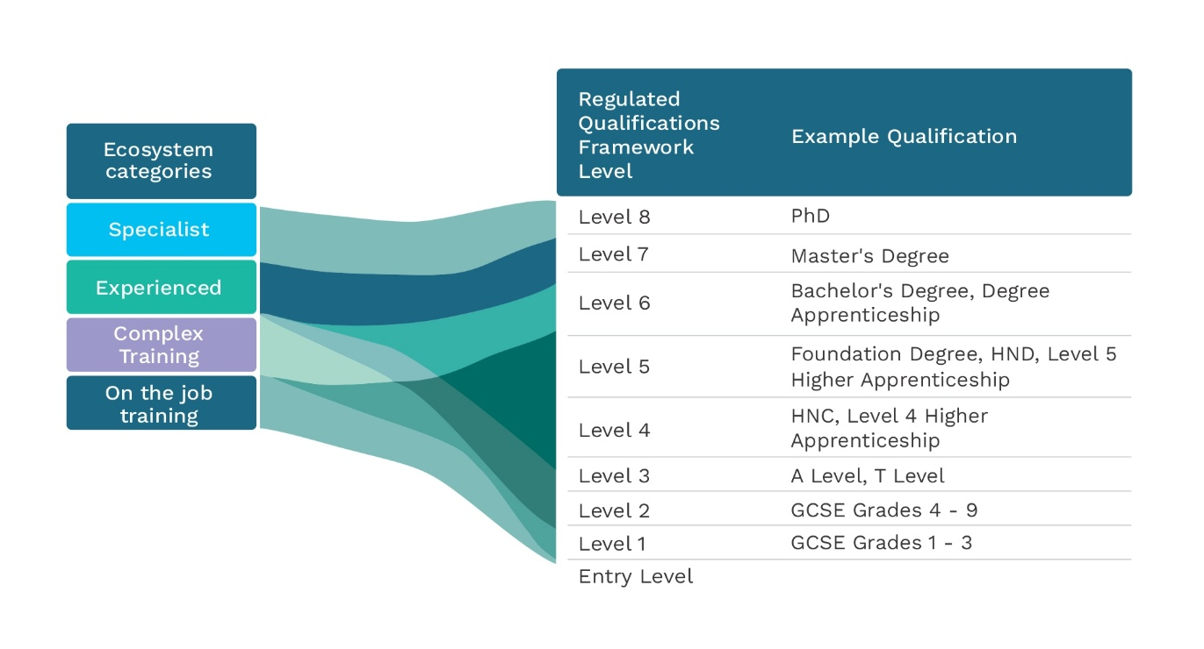
Current Skills Pathways
Source: Future Aviation Skills Strategy, Engagement Report - Skills needs in Aviation, July 2023, p25

Slide 9
Future Priorities (cont.)
You can enter the industry with L1 skills. For entry level ground handling jobs technical qualifications were not required and practical experience welcomed and on the job training given.
A considerable number of specialised roles:
  NVQ levels 3-5 are required for engineering professions,
  Degree level qualifications for supervisor and management roles
  Industry specific certifications for environmental specialisms.
  More experienced and specialist roles require level 7 and 8 post graduate qualifications.
Engineers and technical talent across design, production, maintenance, and data were a priority and in high demand. Poor local supply is forcing some firms to look elsewhere. There needs to be investment in Maintenance, Repair, and Overhaul (MRO) skills development including maintenance engineers trained for specific aircraft types and propulsion systems.
07

Slide 10
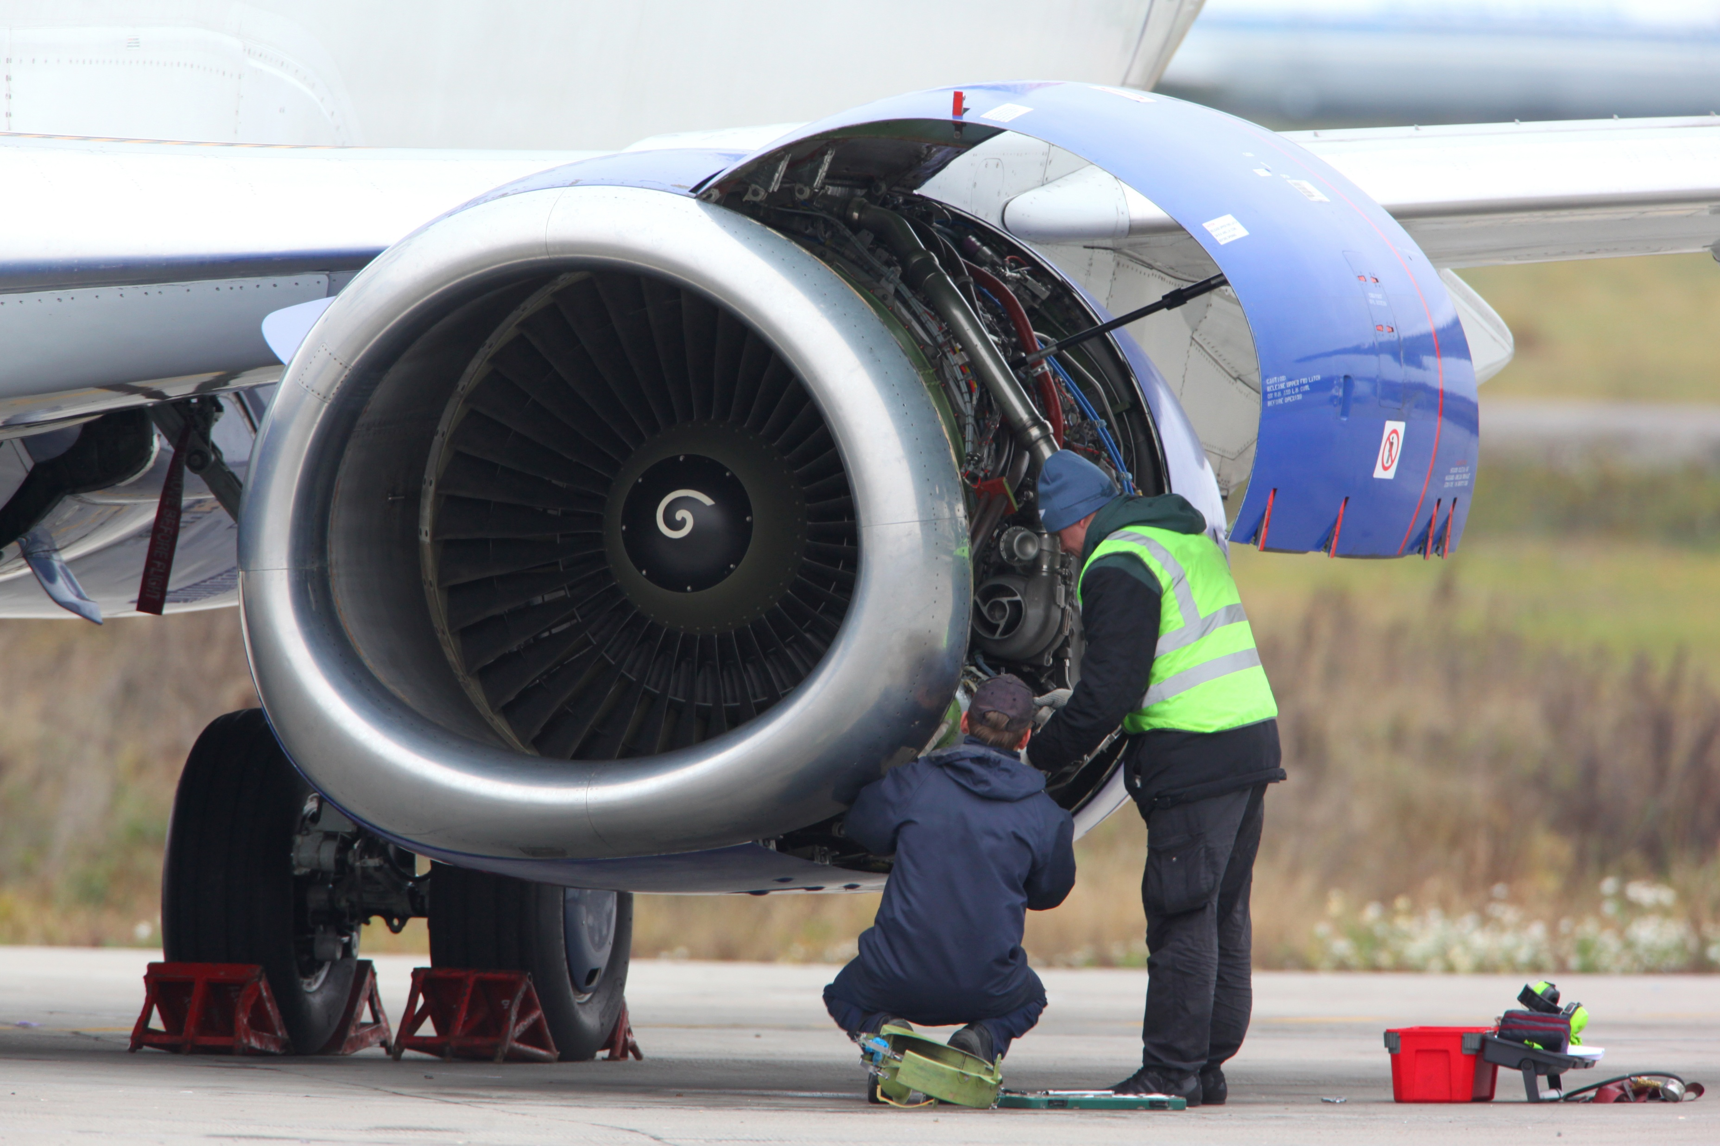

Slide 11
Future Priorities (cont.)
Significant adoption of digital systems and processes and recognition of the need for continuous training and development given the pace of technology development. Security, ground handling and airspace management have all witnessed increasing digitisation and automation. Employers sought generic rather than application specific digital literacy such as the ability to use Microsoft packages which underpin a lot of the broader operational processes.
Core digital literacy is a requirement for entry level roles with tiered customised digital learning pathways that align with real-world tasks and software systems.
There will be more autonomous systems, advanced sensors, security verification and increasing demand for cybersecurity requiring increasingly specialised digital skills, data handling and technology skills including an understanding of quantum and supercomputing. Access to foundational AI/automation literacy and awareness courses alongside industry specific applications will give employers a broader understanding of how integrate digital advancements into operations.
The focus on sustainability will create new demand for green skills including those around hydrogen, nuclear and aerospace supply chain technologies such as lightweighting. The transition from conventional fuel will require new or adapted training or apprenticeship standards for maintenance, logistics and ground storage workers, health and safety workers and fire and rescue staff to deal with new risks.
08
Notes:
11- Access to foundational AI and automation literacy and awareness courses alongside industry specific applications will give employers a broader understanding of how it can be safely and effectively integrated into operations.
12- Publicising sustainable aviation business practice training and support would be welcome.

Slide 12
Future Priorities
People Centred Cultures
“Our entire business is centred around training people so we would rate ourselves close to ten. We are a pure service organisation…people are at the core of what we do.” .”
Required Skills
“What you need is that exposure to real-life… advanced degrees and all the rest of it, they're great for theory, but that practical application in real world scenarios [is what is needed].”
Using AI
“AI is not going to take away anybody's job. What it is going to do is it should make us more efficient and effective.”
09

Slide 13
Current Skills
10
02

Slide 14
Current Skills
There is a growing recognition that apprenticeships can support the development of aviation skills, opening pathways for young people and contribute to long term workforce planning. In engineering and maintenance and for back-office roles apprenticeships are a natural fit.
Employers working in regulated parts of aviation discussed the unsuitability of apprenticeships, some roles required years of prior experience meaning apprentices could not step into them easily.
Employers need help identifying suitable roles for apprenticeships, preparing for supervision, and setting realistic employee learning expectations. Stronger communication between providers and employers could help prevent early dropout and ensure a good fit. A lack of visibility around apprenticeship options, and limited understanding of how to make them work, contributed to amongst some hesitancy.
Future occupations will result in new and adapted apprenticeships. These could include those resulting from technological advancements such as hydrogen, fully electric aircraft, or drones. A review of existing provision is required to ensure it is future proofed with clear progression pathways from technician to manager.
11
Notes:
2- For those considering apprenticeships there is scope to partner with providers to ensure apprenticeships can meet their needs.

Slide 15


Slide 16
Current Skills (cont.)
A critical requirement will be securing air traffic controllers and young people appropriate STEM skills for tower control and radar control opportunities. DSA will need 14-15 air traffic control staff. Ground handing operations will be required by DSA and flight instructors as well as airport rescue and fire-fighting services (RFFS). Engineering and electrical engineering are the most difficult areas to recruit into.
Employers take different recruitment routes, some take a more structured approach with anonymised CVs, others rely on networks and reputation, and several introduced practical assessments.
Larger employers typically had structured induction programmes with regular performance reviews and appraisal processes whilst smaller businesses were still developing these formal processes.
Flexible working is not common in aviation. Many roles require staff to be present onsite due and much of it is customer facing.
Larger employers often had formalised wellbeing support through dedicated services with employers emphasising the importance of staff feeling involved in shaping what was available to them. Employee wellbeing for smaller employers was more focused on culture than policy, favouring personal gestures.
12
Notes:
7- Employers could be supported to embed staff development practices that are flexible, meaningful, and inclusive or simple tools to support learning on the job.
9- There is an opportunity to share good practice and support employers by embedding wellbeing into leadership development and staff training offers and design affordable, relevant wellbeing strategies.

Slide 17
Current Skills
Openness to apprenticeships
“You just breed this amazing group of professionals within our own organisation. They’ve grown up in the company. They’re skilled and they’re good people.”
Hard to fill vacancies
“We used to refer to it as a grey tsunami. People getting into their mid-fifties and then thinking I have not got a mortgage anymore. Kids have left home. Do I need to be standing in an aircraft hangar?”
Supporting Employee Wellbeing
"If you ignore how people tick, you won’t get the best from them. But if you listen, adjust and make space for difference, you can build loyalty and resilience."
13

Slide 18
Training Provision
14
02

Slide 19
Training Provision
Training methods vary widely across aviation employers. Larger firms had in house capabilities. Smaller firms often relied on informal training processes, led by experienced team members, offering a tailored approach.
Aviation businesses highlighted the importance of aligning training provision with future airport-related demand and employers were keen to partner with providers to develop tailored courses and proactively address skill gaps.
Compliance and safety training are often outsourced, for example airport security awareness.
For management positions in particular internal staff development was prioritised over hiring externally. Mentoring and practical training plays a key role in leadership development. Often leadership development occurred less formally though some employers identified the desire to invest more in formal training and qualifications.
15

Slide 20
Training Provision (cont.)
In Munich Airport the team have a dedicated airport training academy on-site that exposes people to what an airport is like offering apprenticeships and dual degree programmes. They also offer CPD, internships and trainee programmes and entry level positions with hands-on experience and an innovation lab for new start-ups and spin outs.
All employers emphasised the importance of continuous training and upskilling especially in relation to maintaining industry standards for roles such as engineers and pilots. Upskilling and training are often built into career development pathways. Employers said it was important to find a balance between meeting industry standards and not overwhelming employees.
Businesses were keen to work with colleges and providers to shape new courses linked to identified skills gaps and new opportunities. Short, practical training sessions are preferred over content rich courses.
The aviation industry is ahead of many others in relation to on-the-job training using VR/AR immersive environments with many organisations using it for workforce training. Despite reservations, most businesses are open to adopting VR/AR training and would be interested in learning more about the adaptability of these resources and any potential financial support towards new equipment/software.
15
Notes:
8- Examples of where VR/AR training may be welcomed include flight simulations and bridge inspections. This training must be developed in line with industry regulations and standards..

Slide 21
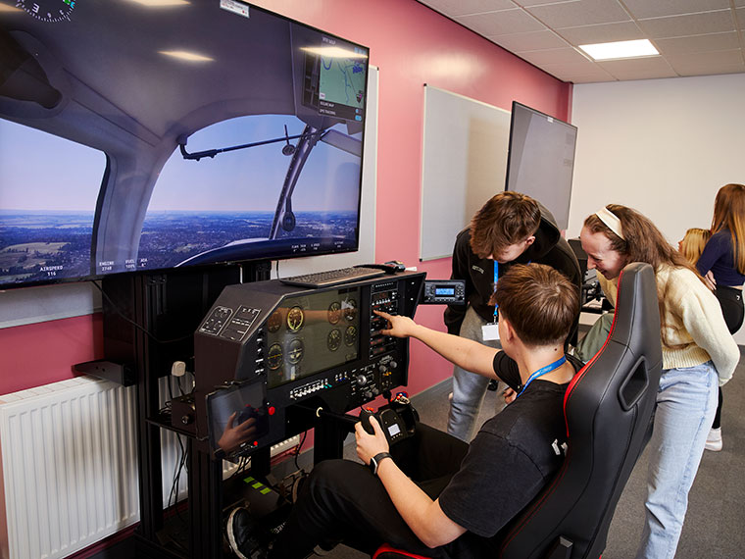
Aviation simulator (Rotherham
College)

Slide 22
Training Provision
Training Models
“We have a clear induction plan... within operations we have competencies, and they form a
pack. During probation, they go through these. It’s kind of ‘show me, tell me.”
Engaging with Training Providers
“It's got to be something that’s engaging and relevant to all middle managers. When it's too in
depth, people start switching off. Often it is the practical side people relate to.”
CPD and Upskilling
“It is in the context of our approach to training and development and the fact that we are a regulated industry. There are different types of training required - whether it is compliance, a holistic approach to individual development, or to match our values.”
16

Slide 23
Employer Engagement
17
02

Slide 24
Employer Engagement
The extent to which employers engaged with those further from the labour market is limited given the regulatory nature of the sector and its security clearance requirements.
That said, there is some good practice in the engagement of veterans and service leavers who are well suited to roles requiring discipline, resilience, and teamwork. Support from providers on reasonable adjustments, role matching and regulation support may overcome barriers to recruitment.
Increasing the visibility of aviation and STEM opportunities in schools and colleges is vital to inspiring to next generation. The sector is facing growing competition for attention from other sectors and digital media campaigns, and promotions are required.
Providers have a critical role in bridging the awareness gap collaborating with employers to co-design outreach activities that illustrate the full range of aviation careers, challenge stereotypes, and connect with young people early on.
18

Slide 25
Employer Engagement (cont.)
Some employers felt there was a mismatch between education curriculums and the aviation industry, resulting in industry skills gaps. They would be willing to support curriculum advisors to respond to these.
While collaborations across the sector for training exist and there are strong sector specific networks in place, there is still some reticence to collaborating amongst smaller and more specialist firms where engagement can be driven by a desire to maintain market presence.
19

Slide 26
Employer Engagement
Inspiring the next generation
“For me, you have to touch it, see it, smell it to really understand the industry. PowerPoint slides don’t cut it. Outreach only works if it sparks something and that means being there in person, showing them how things work.”
Partnering with education and skills providers
“Last year our school teams reached about 65,000 students, so there’s a huge amount of engagement on that side.”
20

Slide 27
Summary of findings
21
02

Slide 28
Summary
The skills pipeline will need to support the 5,000 or so jobs required to sustain the reopening of DSA and adjacent sites. This will require generic, more specialist and tailored provision to support the upskilling of the sector’s future workforce.
To facilitate this the skills ecosystem needs to be mobilised. Training will need to be sequenced in parallel to employer and DSA opportunities as they emerge.
This report has begun to identify areas of future demand with skills requirements from L1-L8. Partners need to mobilise around the skills pipeline opportunities afforded by DSA. This is likely to require workstreams around Maintenance and Repair Operation (MRO), engineering and ground opportunities and ancillary services.
22

Slide 29
Summary
It is recommended that more detailed work is undertaken to assess the likely ebbs and flows of skills needed overtime and an academy type approach to procuring skills development is considered.
As the sector embeds advancements in technology and progresses beyond the need for fossil fuels into more sustainable energy sources, specialisms in engineering and sustainable aviation will increase employer demand for new recruits and retraining of employees to keep pace with the sector’s development.
The airport’s reopening provides a once in a generation opportunity to support skills development around an exciting cluster of sustainable aviation at the Gateway East Strategic site and beyond.
23
Notes:
1st bullet- Activity focused on inspiring the next generation and attracting digital savvy apprentices and graduates is an important consideration.

Slide 30
Next Steps/Questions
24
02

Slide 31
Next Steps/Questions
Continue to disseminate sector insights and share slide decks
Phase 2 topics:
- AI and jobs of the future
- Veterans
What messages stood out for you?
Where are the opportunities to galvanise providers and decision makers to respond to employer insights?
25

Slide 32
Consultees
Hybrid Air Vehicles
Mo The Airport Guy
Munich Airport
SCC Steel Construction
Special Metal Products
The Aviation Ground School
TransGlobal
Travelmaster
Xais PTS
2Excel
Anglo World Cargo
Children’s Air Ambulance
Chris Cain
Chris Harcombe
Danum Fulfilment
Dolphin ICT
First Aviation
FP Airports
26

