Slide 1
The Sheffield College Offer

Slide 2
Employer Skills Academies
The Sheffield College Offer / April 2024
02

Slide 3
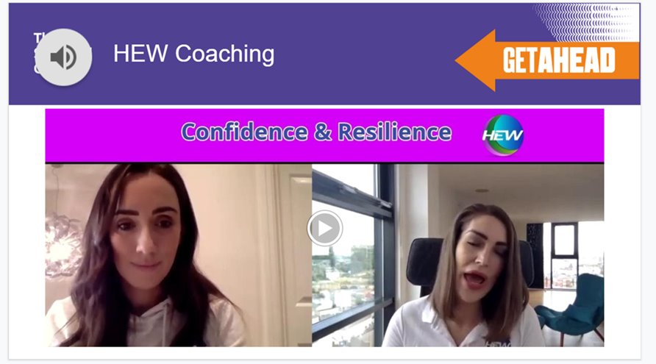
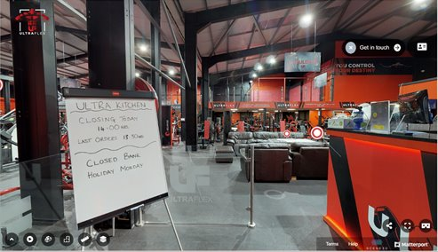
Employability & VR
We have 25 VR Experiences including:​​
Sheffield Wednesday FC​​
Virgin Money​​
Ultra Flex Gym​​
Cubanas Tapas & Bar​​
Powers Martial Arts Centre​​
Kier Group​
Gripple​
Henry Boot​
Sheffield Theatres
The Sheffield College Offer / April 2024
03

Slide 4
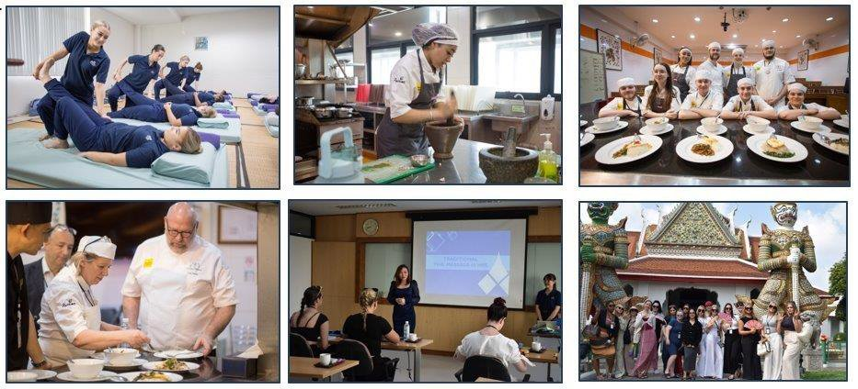
Turing Scheme
The Sheffield College Offer / April 2024
04

Slide 5
Digital Badges
“A digital badge is a visual, shareable, and verifiable representation of an accomplishment or skill, often used to recognise and showcase learning or professional development achievements.”
Each badge contains metadata, which is data about the badge itself, including details about the achievement, the issuing organisation, and the criteria for earning the badge. So, as an employer you can see what the individual has done to achieve their badge!
Benefits:
For learners: They provide a way to showcase their skills and achievements to potential employers or educational institutions.
For employers: They help identify qualified candidates for open positions.
For us: They offer a way to recognise and reward learning that is over and above their study programme.
The Sheffield College Offer / April 2024
05

Slide 6
What our Employer Engagement has allowed us to do!
The Sheffield College Offer / April 2024
06

Slide 7
Finally!
Shani Clifford, Head of Student Employability
Shani.Clifford@sheffcol.ac.uk
The Sheffield College Offer / April 2024
07

