Slide 1
The National Network of Institutes of Technology

Slide 3
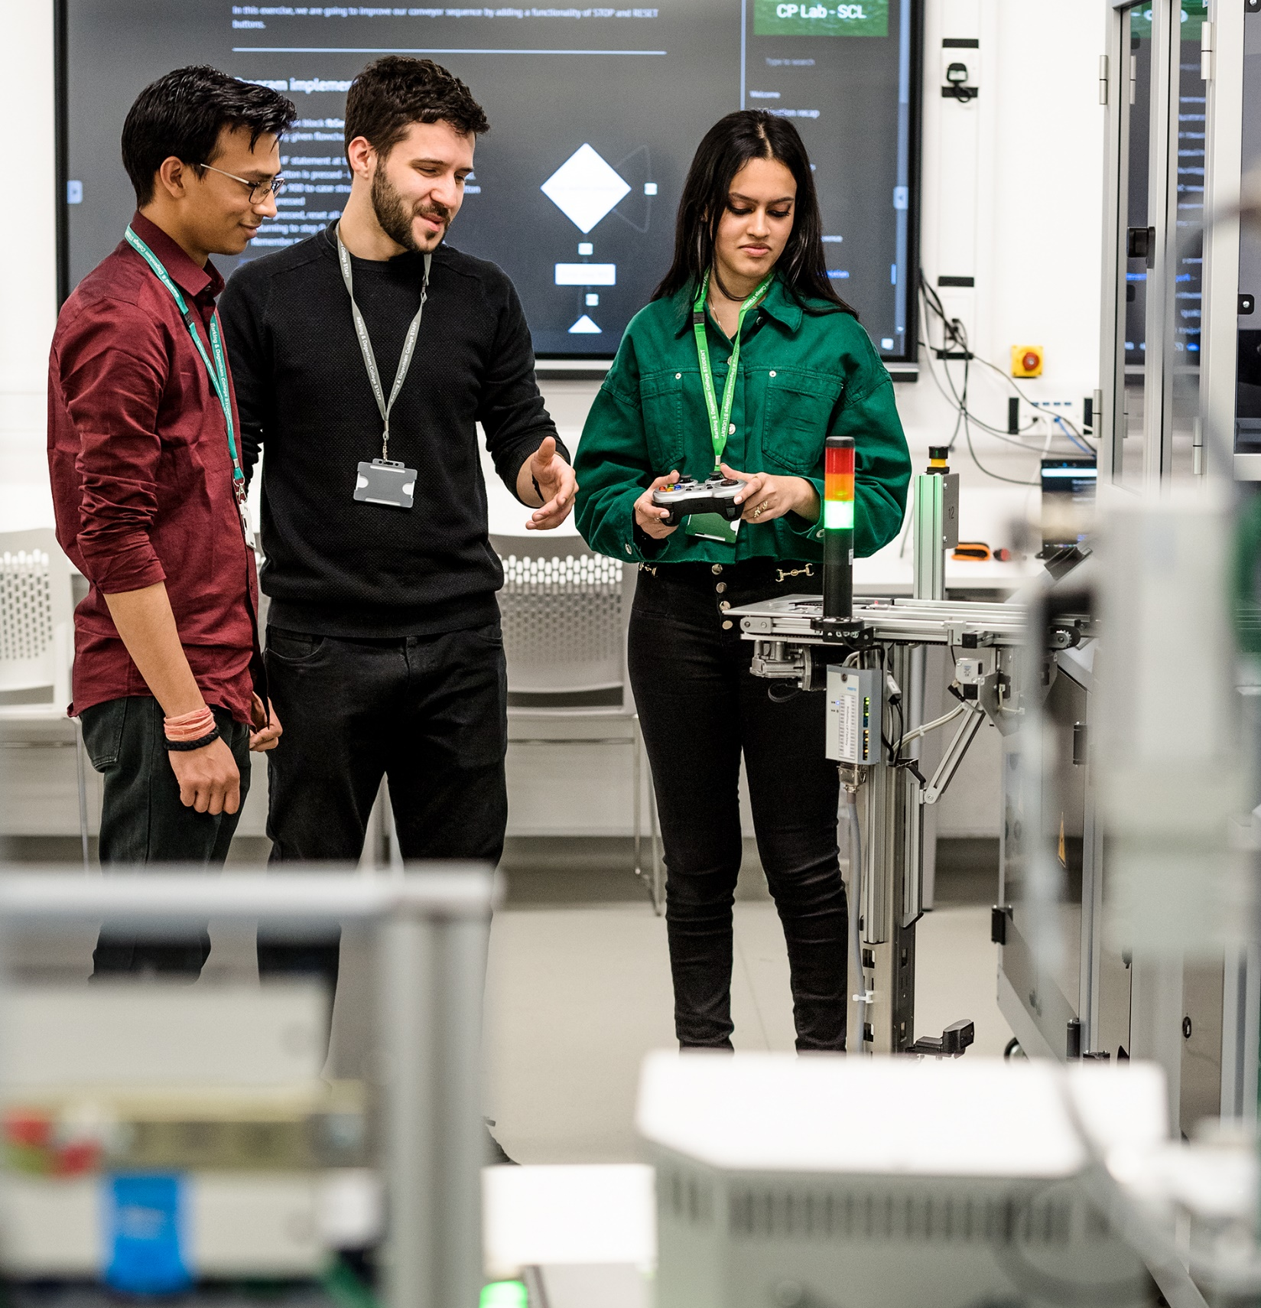
IoTs
Institutes of Technology (IoTs) are the Government’s flagship programme designed to spearhead the delivery and growth of higher technical education (Levels 4 & 5) in STEM subjects.
Backed by £290 million of government investment, each Institute of Technology (IoT) is a regional partnership between further education colleges, universities and leading employers, ensuring that students get the skills that will secure them good jobs, as well as progression pathways to degree level.
£21m invested in South Yorkshire including partners own investment.
Every IoT has its own specialisms including:
Advanced Manufacturing;
Construction;
Digital Technology;
Healthcare.

Slide 4
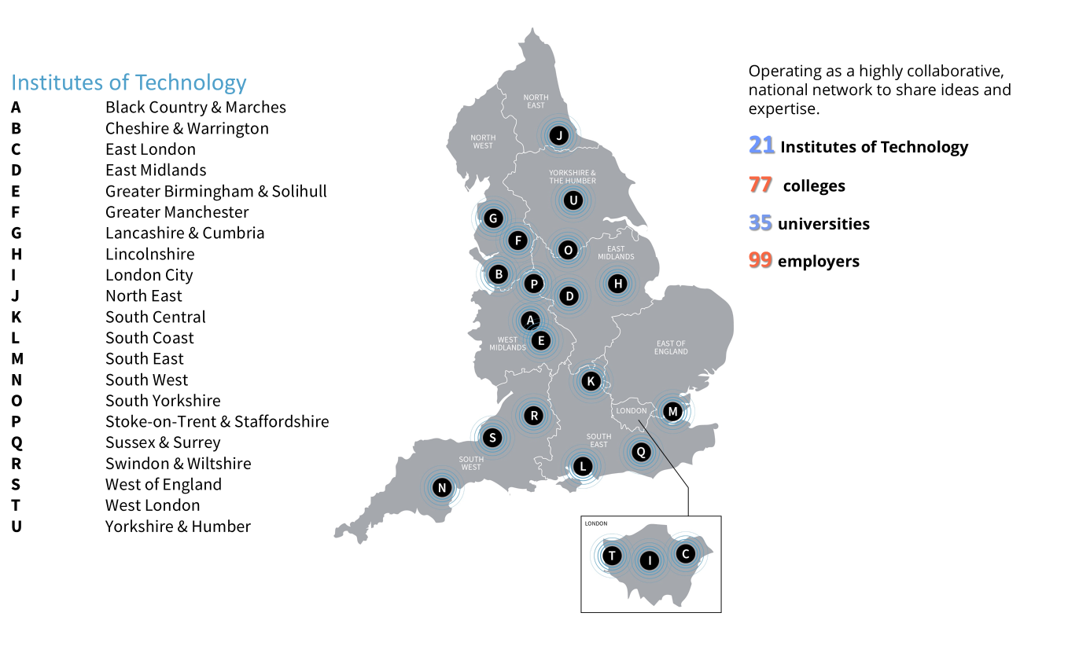

Slide 5
Employer Partnerships
Institutes of Technology (IoTs) are distinctive to the education landscape because of their strong relationship with employers, particularly SMEs. Employers sit at the heart of IoTs as core partners, customers and members of their governing bodies.
Across the Network there are over 100 anchor employer partners feeding into IoT strategy and designing and delivering curriculum.
SYIoT core employers are HLM Architects, Pendo and AESSEAL.
Underrepresented Groups
IoTs have a strong ambition to increase participation among underrepresented groups.
Enabling young people from non-traditional backgrounds to access higher education locally.
Increasing the representation of women in STEM.

Slide 6
SYIoT
A partnership of employers and education providers, regional leaders in the provision of high-quality, higher-level technical education and training across a range of STEM occupations and industries.
DN Colleges Group
Sheffield Hallam University
Barnsley College
University of Sheffield AMRC Training Centre
RNN Group
The Sheffield College
Engineering and Manufacturing Technologies
Construction, Planning and the Built Environment
Digital Technologies
Healthcare Science
Science
Media and Communication

Slide 7
Employers - WIFM
An IoT offer focuses on:
A focus on level 4 – 5 provision – HNC/D, Fd, HTQ, apprenticeships, accredited/non accredited short courses
Employer engagement to influence, design, develop and deliver curriculum
SYIoT employer partnership offers opportunities through our education partners:
Visit SYIoT sites
Access a broader range of equipment
Promote employment opportunities
Offer apprenticeship services
Set live projects
Host a student visit at employers sites
Offer work experience placements
Deliver industry talks and masterclasses
Deliver employability activities
Become a sponsor
Attend career fairs
Deliver career talks

Slide 8
What’s different for our providers?
The IoT is led by the SYIoT board
Original IoT investment in facilities and equipment
Potential to secure additional funding
As members of SYIoT there are wider opportunities for providers which will benefit employers
research opportunities through our universities which will support upskilling of our staff and potentially engage our employers
potential to recruit staff for the IoT direct – adding capacity and specialisms
provider staff upskilling – shared staff development opportunities adding to our staff’s capability and specialisms
regional IoT design, development and delivery of curriculum – sharing expertise and enabling access
sharing of equipment and resources across partners – adding to the resources available to employers
Partnership Collaboration Teamwork

Slide 9
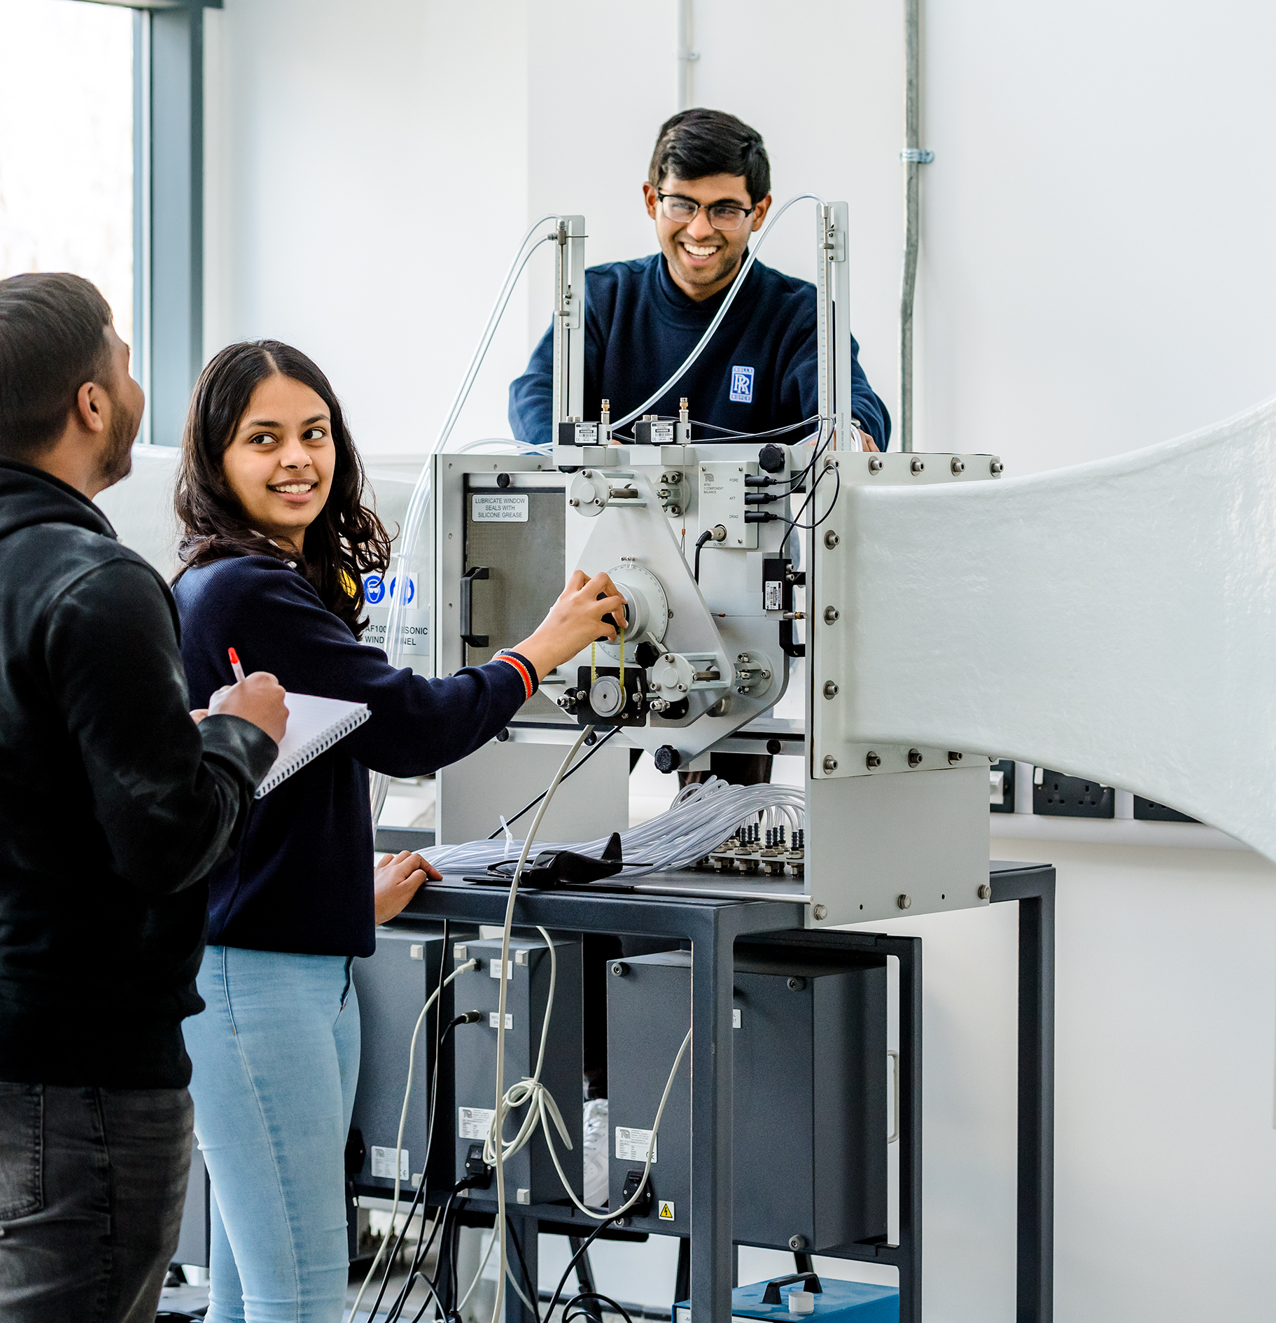
Further Information
IoT National Website: www.institutesoftechnology.org.uk
South Yorkshire Institute of Technology:
www.syiot.ac.uk

