Slide 1

The Centre for Business Growth and Transformation
Sheffield Business School
A Catalyst for Collaboration

Slide 2


Slide 3
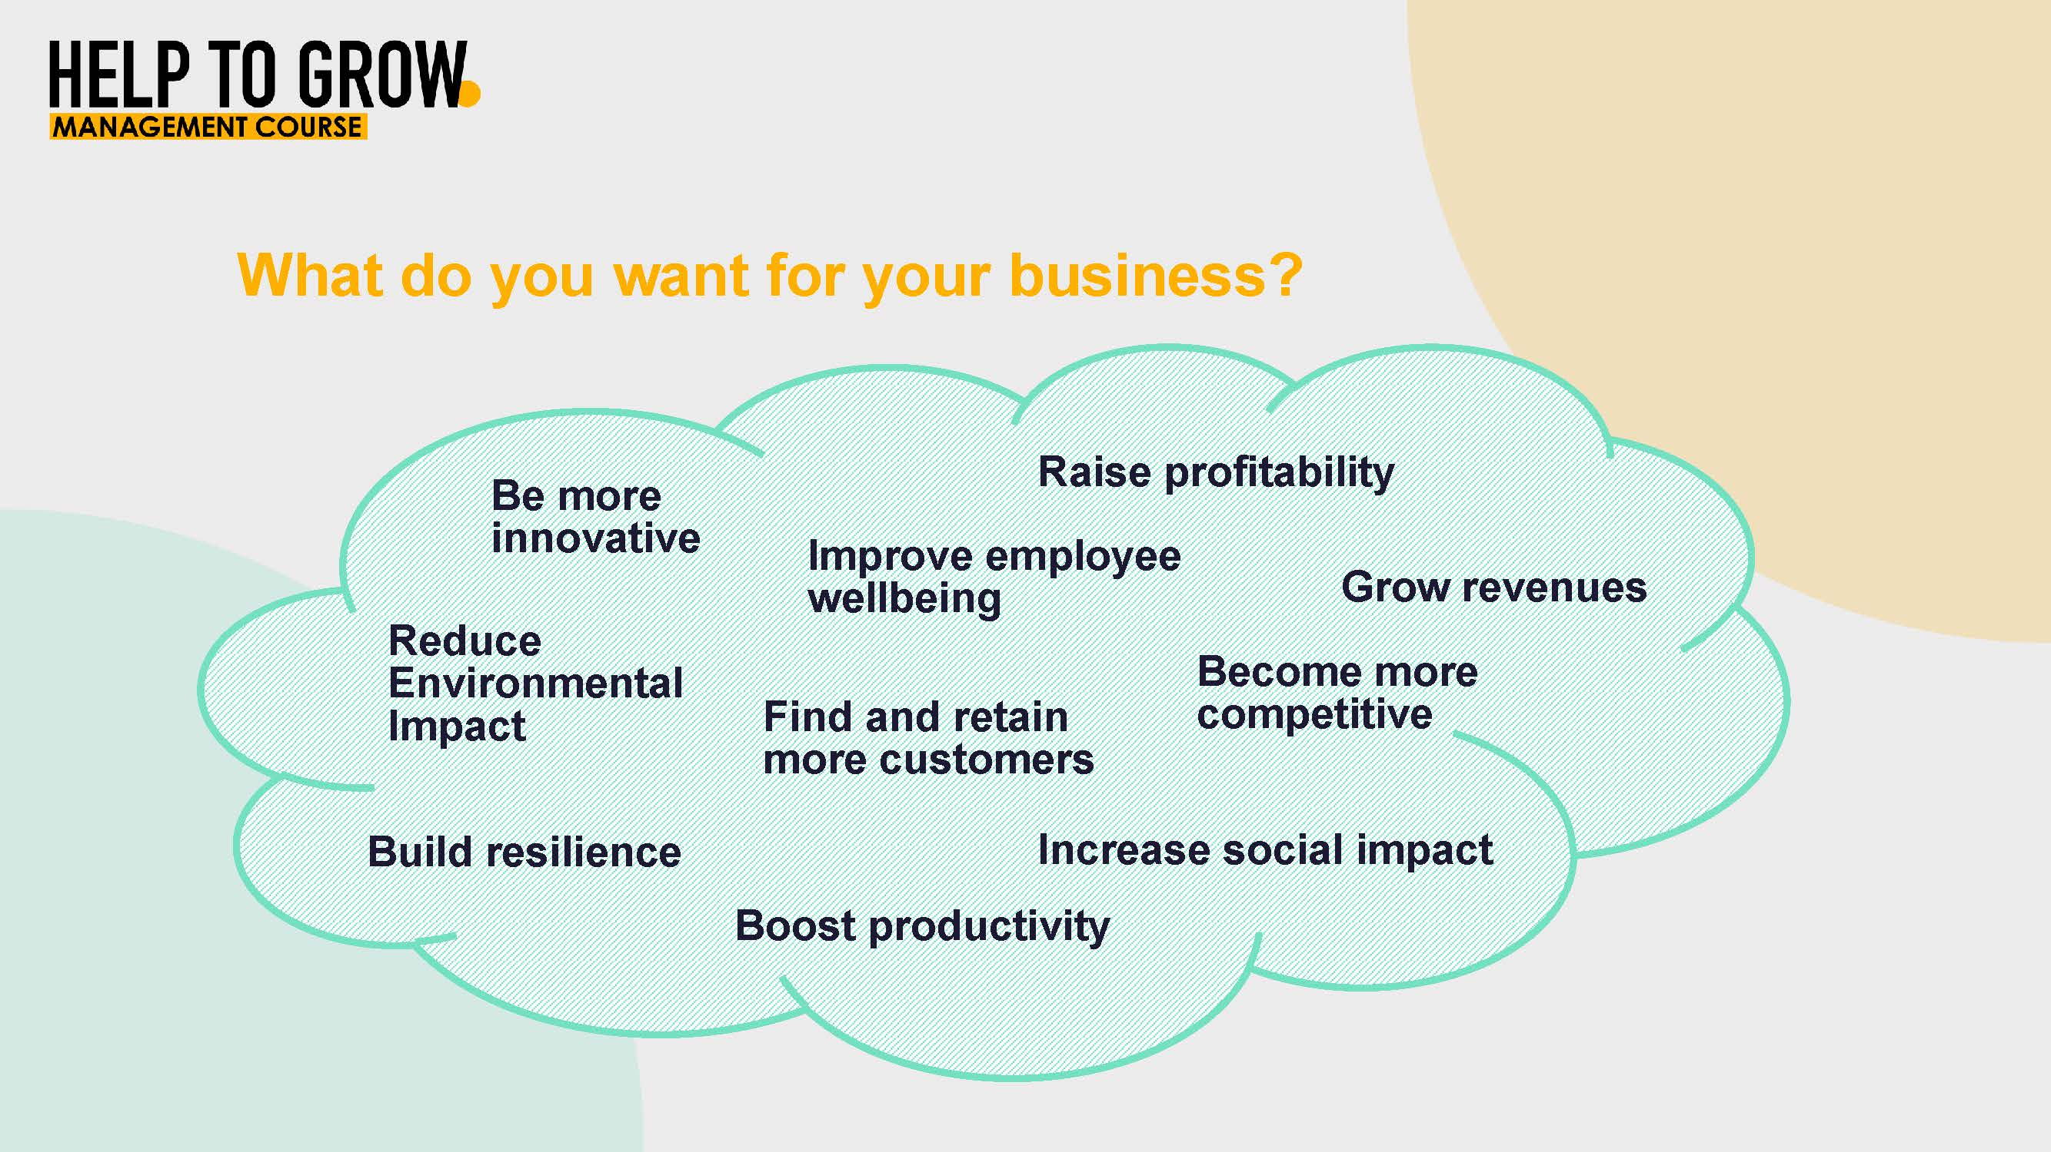

Slide 4


Slide 5
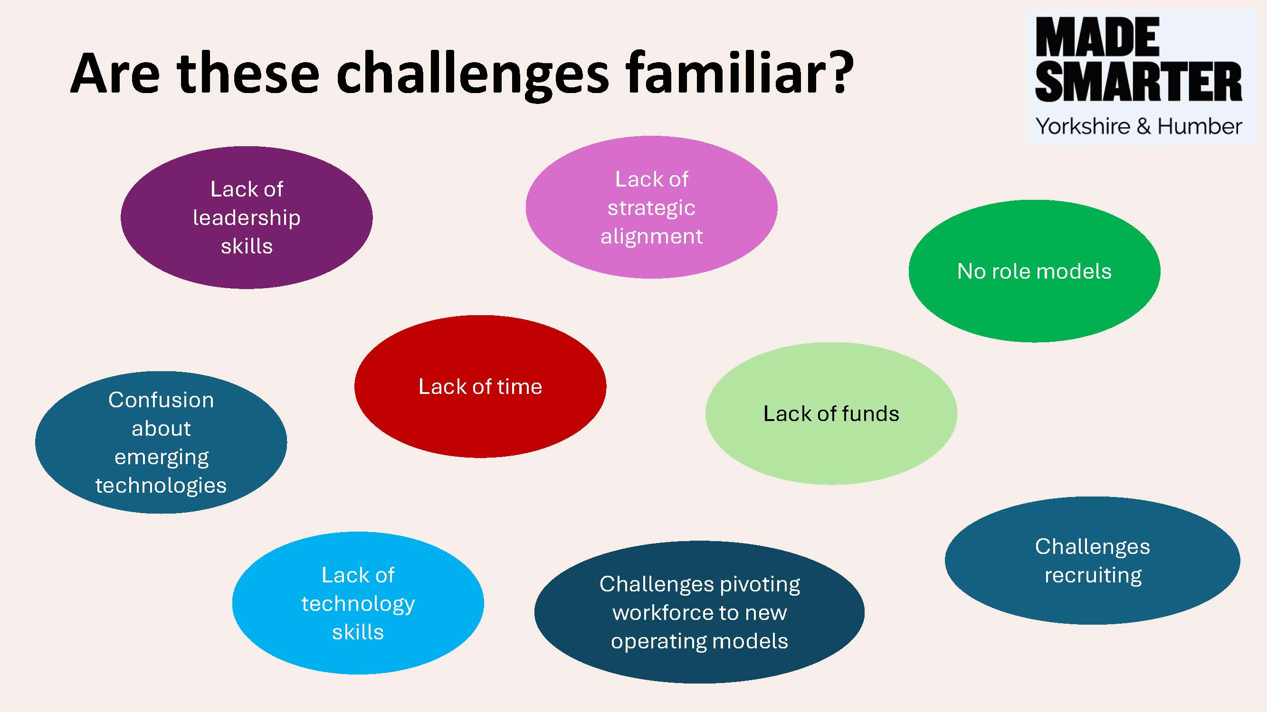

Slide 6


Slide 7


Slide 8


Slide 9


Slide 10


