Slide 1
June 2024

Slide 2
We are the South Yorkshire Mayoral Combined Authority (SYMCA).
Skills Bank is more than just a fund; it’s part of the South Yorkshire Mayoral Combined Authority’s vision for a stronger, greener, and fairer region. Aligned with the strategic economic plan, we aim to support businesses in creating a prosperous South Yorkshire.
Notes:
(note the above statement was taken from the Skills Bank website)
Before click next slide – INTRO TO Skills Bank supports business growth and investment in skills.
Skills Bank provides employers, who are based and operating in South Yorkshire with access to high-quality training and a financial contribution towards the cost of upskilling its workforce.
Skills Bank operates flexibly to ensure businesses across the region can access financial support with immediate and emerging skills needs. The range of support funded is broad and can include; full qualifications, modules and bespoke training packages. All training identified must support business growth.
Skills Bank is an important mechanism to secure progress towards the overarching policy objectives of the South Yorkshire Mayoral Combined Authority, to keep people and businesses moving and help them grow, attracting investment to create a stronger, greener, fairer South Yorkshire by 2040.

Slide 3
What you can expect
What is Skills Bank
Skills Bank myth busters
Skills Bank journey for a business
Skills Advisors – what we do, benefits of referring to a SA
Case Studies
Skills Bank / June 2024
01

Slide 4
What is Skills Bank?
Skills Bank supports business growth and investment in skills in South Yorkshire
Flexible Grant Funding – providing up to 60% contribution
Available to all businesses regardless of size, sector or industry
£2m of available funding towards employee development and learning crucial to business growth and resilience until July 2025
Support from SYMCA Skills Advisors
Must be operating for 12 months plus
PAYE – employees must be on the books
Training can be bespoke, accredited and non-accredited
Skills Bank / June 2024
01

Slide 5
Myth Busters
A bank of training providers
Fully funded training
A 100-page application form to complete
Complicated
One size fits all
A need for every detail – keep it simple, facts, figures, goals and business growth plan.
One time wonder – you can apply more than once if your growth plan displays the need
Skills Bank / June 2024
01

Slide 6
Skills Bank Journey
Identify training needs of the business
Explore training providers
Consult with a Skills Advisor
Start the application
Have the application reviewed by a Skills Advisor
Submit the application online
Panel review of the application
Outcome if successful of a Skills Deal, book the training
Not successful learn why and reapply
Complete the training and submit the request for reimbursement of the award %
Case studies and review
Skills Bank / June 2024
01

Slide 7
Skills Advisors
Help identify challenges, explore opportunities, and ensure businesses maximise the benefits they’re eligible for.
Help navigate the different support within the funded Skills Landscape
Guide through the Skills Bank application process
Aiming to secure the best outcome for the business growth
Conduct organisational training needs analysis
Knowledge Sharing
Keep abreast of local business economy updates across South Yorkshire
Skills Bank / June 2024
01

Slide 8
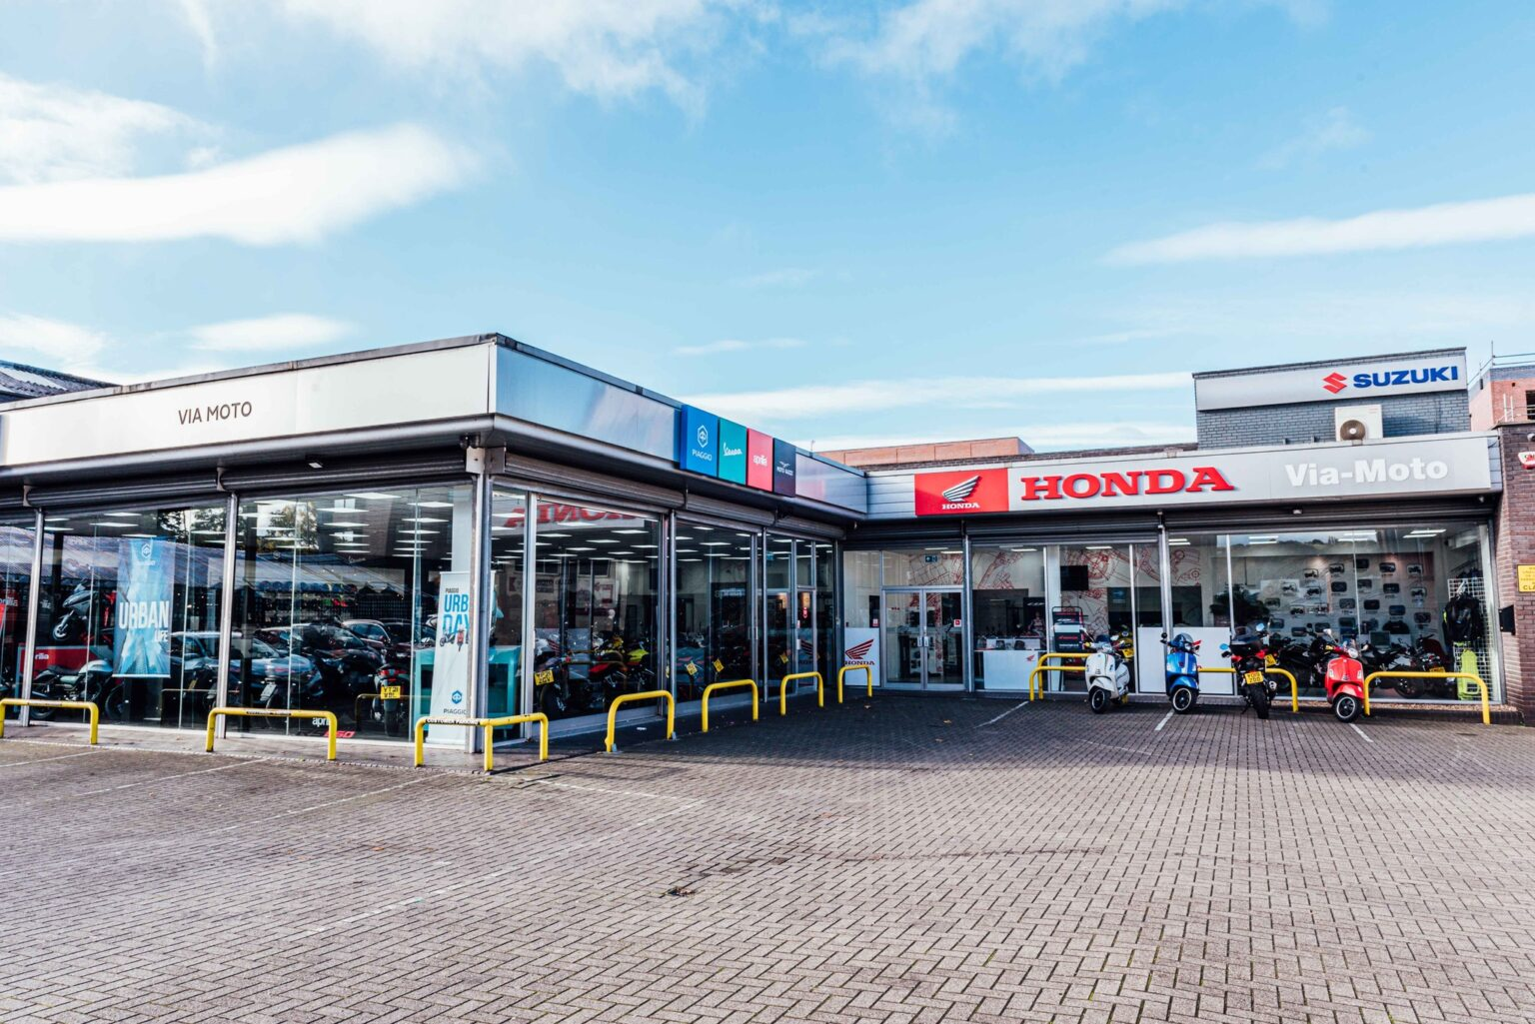
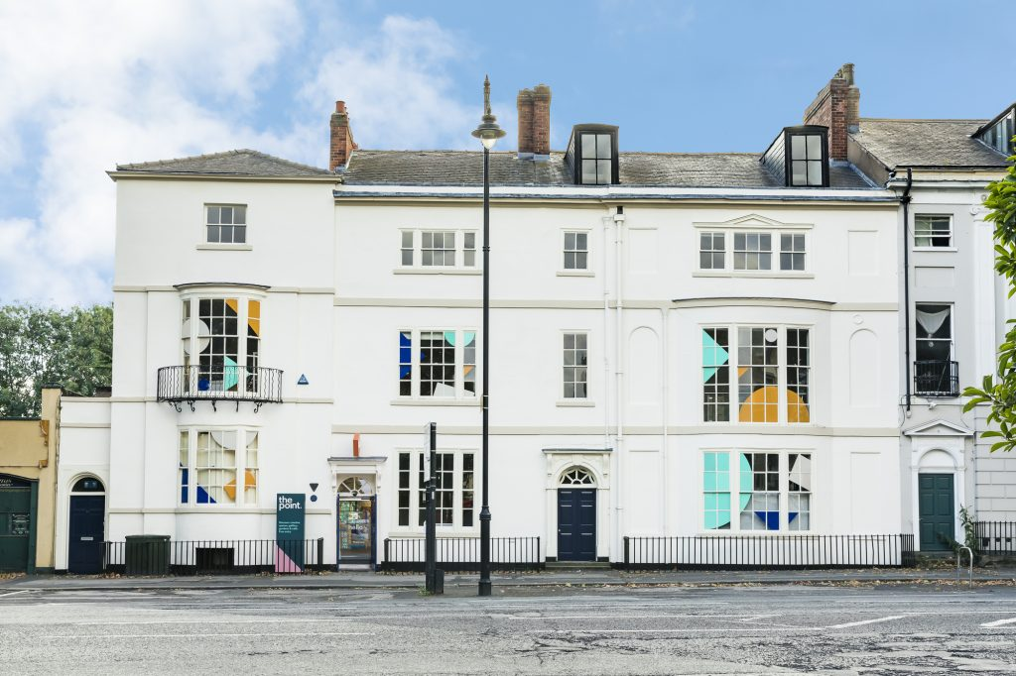
Results - don’t take our word for it!
Notes:
MOTO:
Matthew Gilder, owner at Via Moto, said: “The training, which South Yorkshire Skills Bank helped us access, has really helped to get our business to the next level.
“Since the training was delivered, our staff within the clothing department have more time available to serve customers as less time is being spent doing admin work. Overall turnover and profitability has also increased in that department because of the changes.
“The time saved due to the new system has allowed the staff to serve more customers per day. As a result, turnover is now up 10.4 percent on last year.”
Darts….

Slide 9
Thank you
Skills Advisors
Jo Keen
Doncaster and Barnsley
Joanne.keen@southyorkshire-ca.gov.uk
07767384513
Vernon Tolson ​
Sheffield and Rotherham
Vernon.tolson@southyorkshire-ca.gov.uk ​
07919111375
South Yorkshire Mayoral Combined Authority 11 Broad Street West Sheffield United Kingdom S1 2BQ

