Slide 1
Skills Street

Slide 10
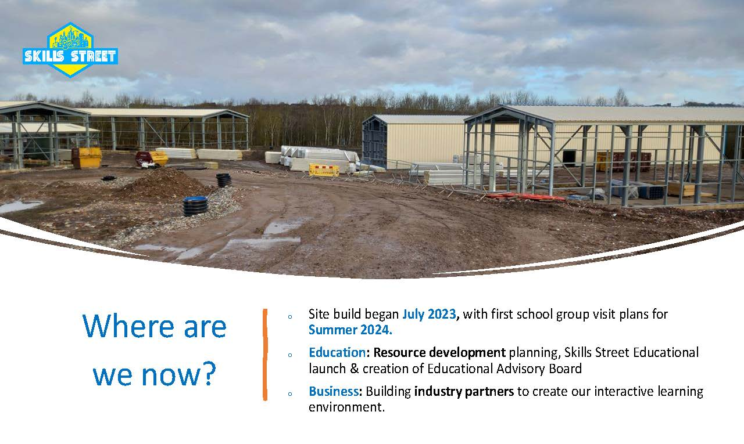

Slide 11
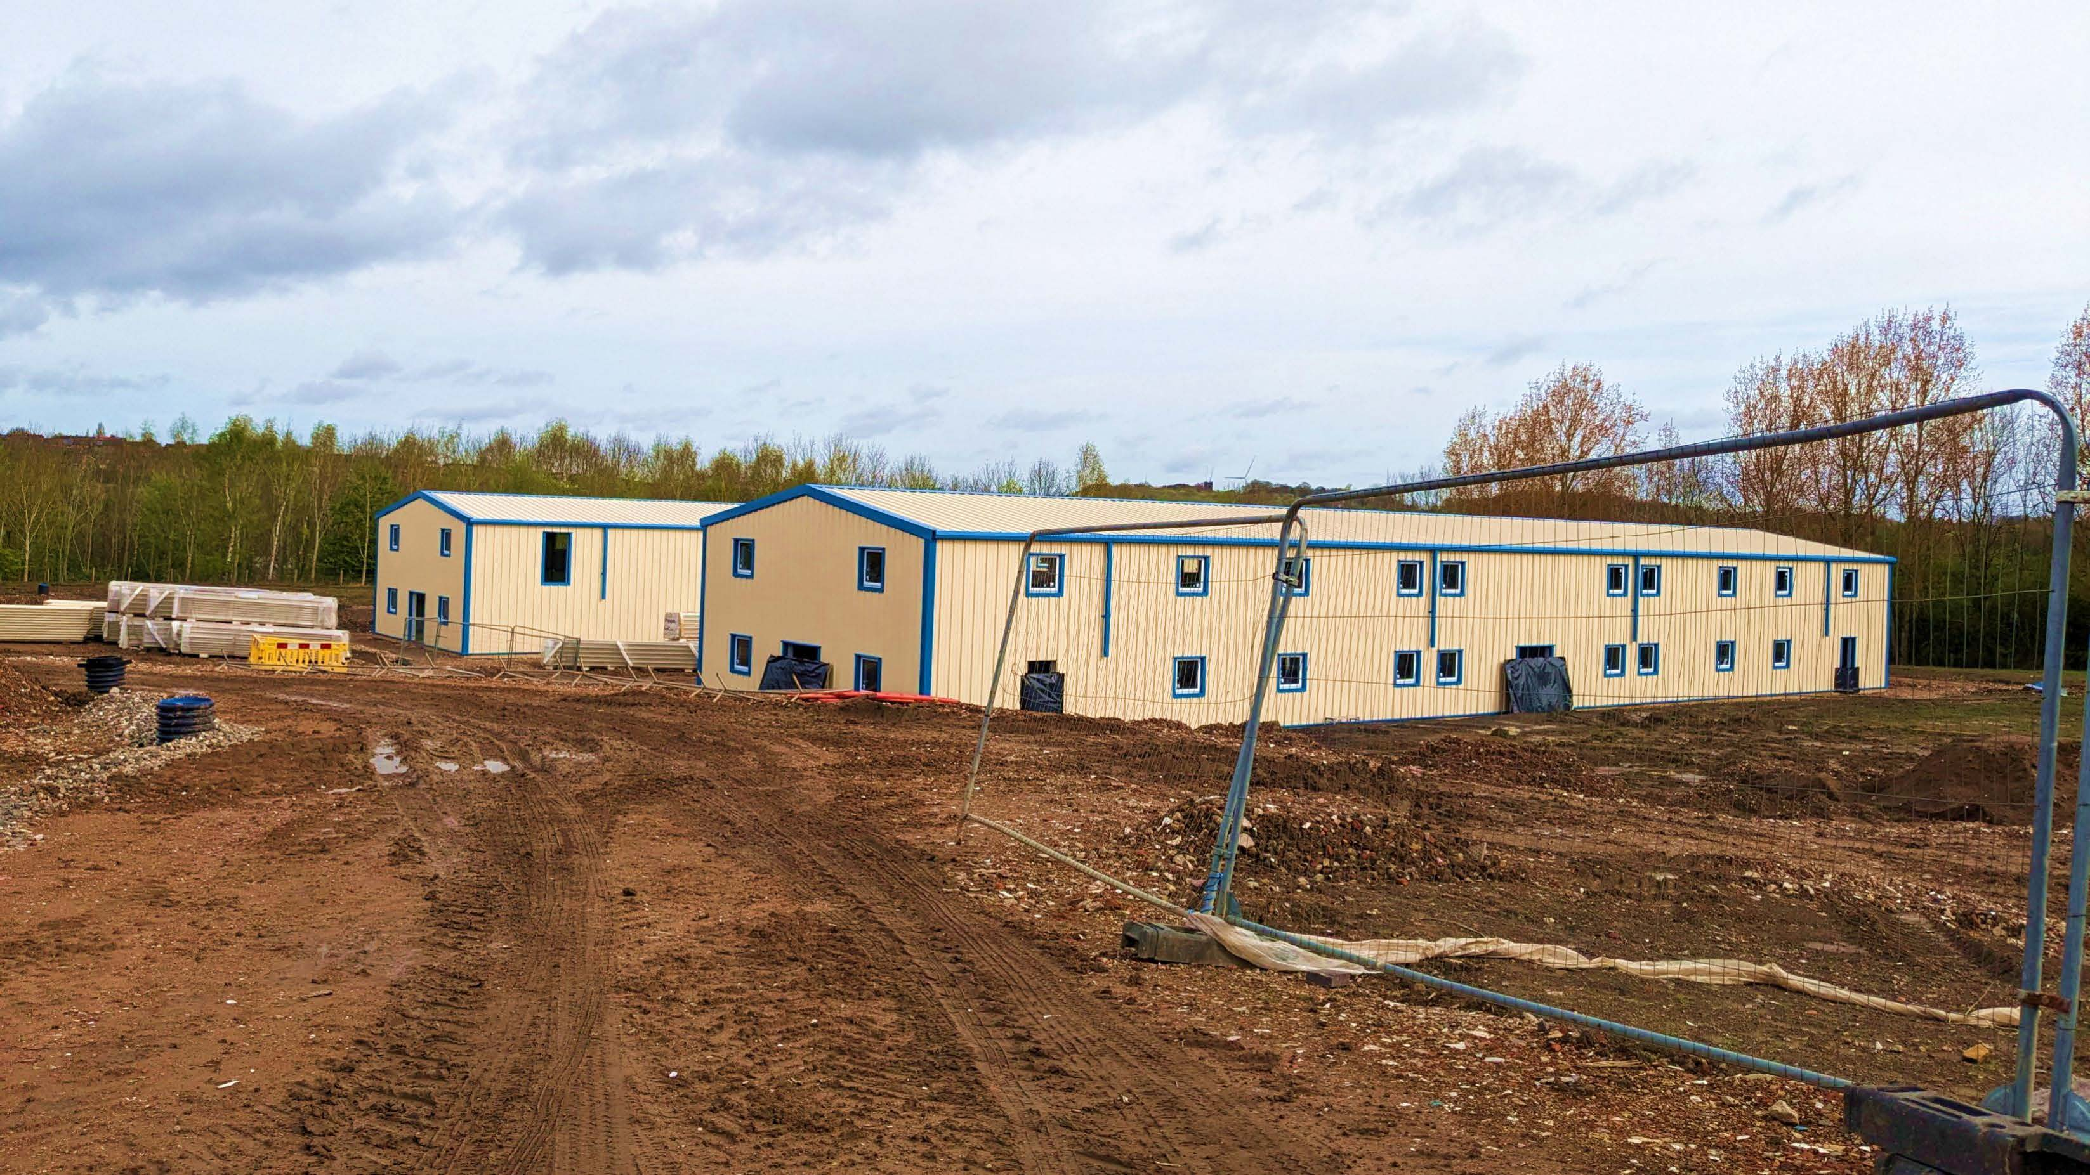

Slide 12
