Slide 1
Carolynn McConnell

Slide 3
Key Achievements – since 2019
Delivered more than 503 interventions/projects
90+ voluntary sector organisations have benefitted
600 employers/charities in the network
See it Be it engaged 16,000 young people last year
In kind value to the city in excess of 1 million

Slide 4
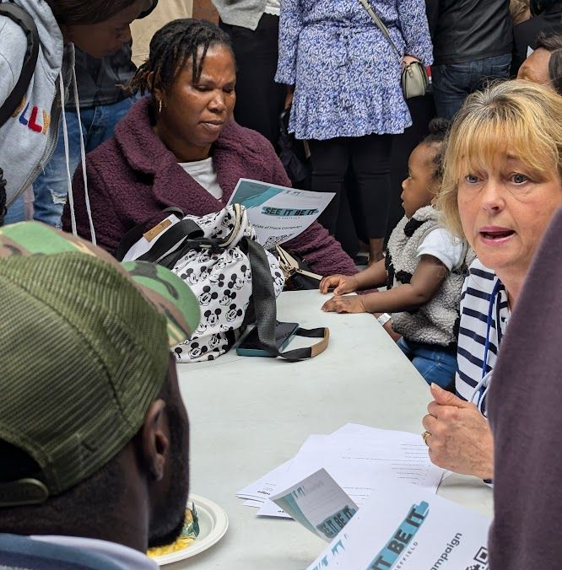
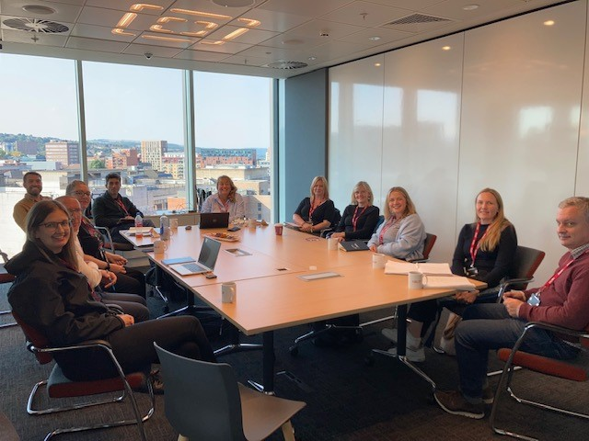
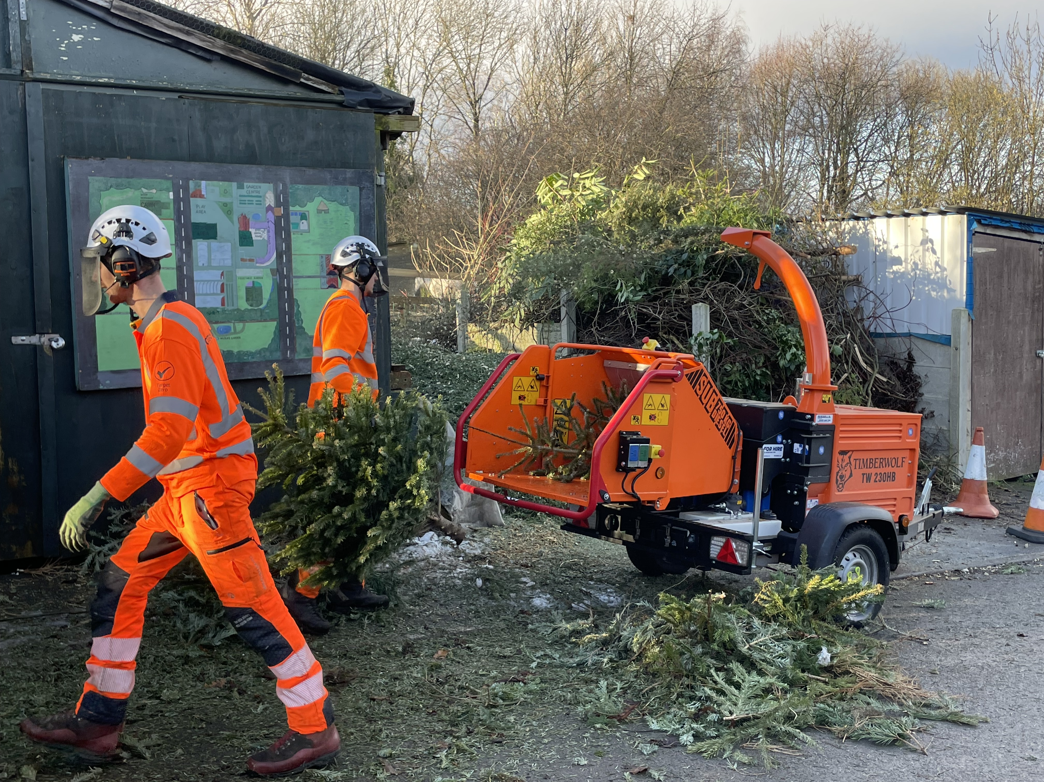
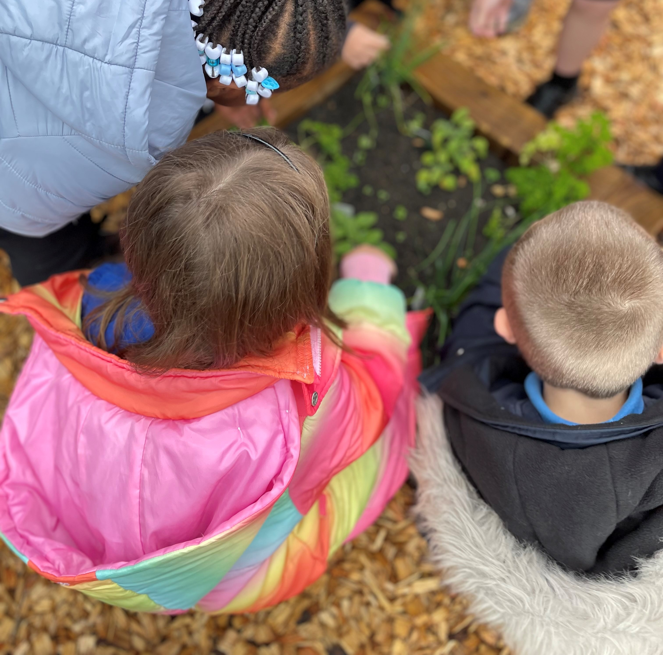
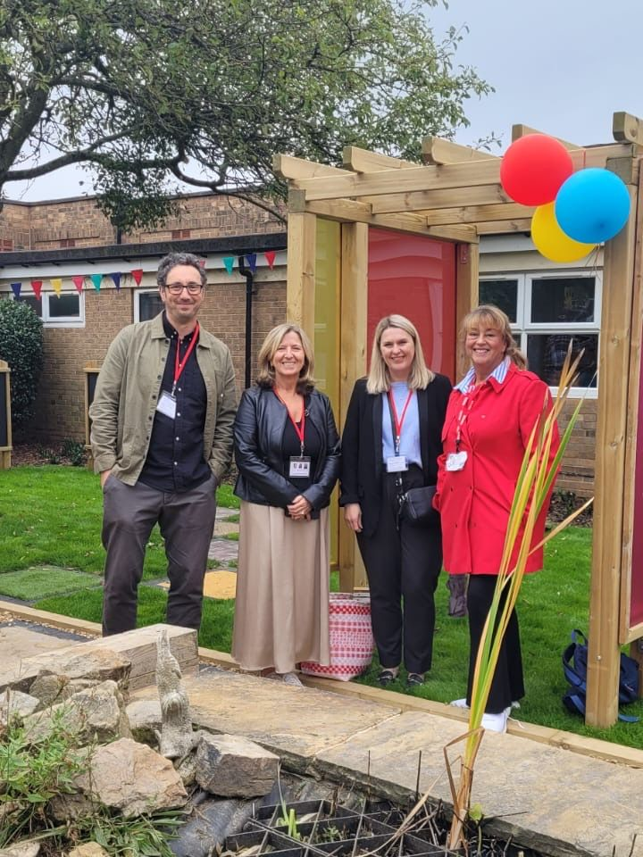
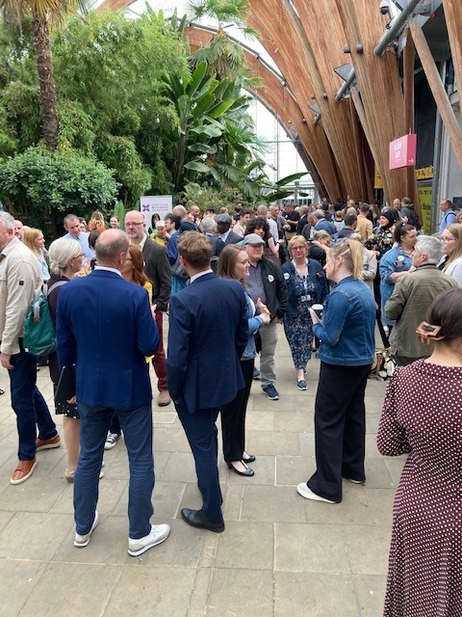

Slide 5
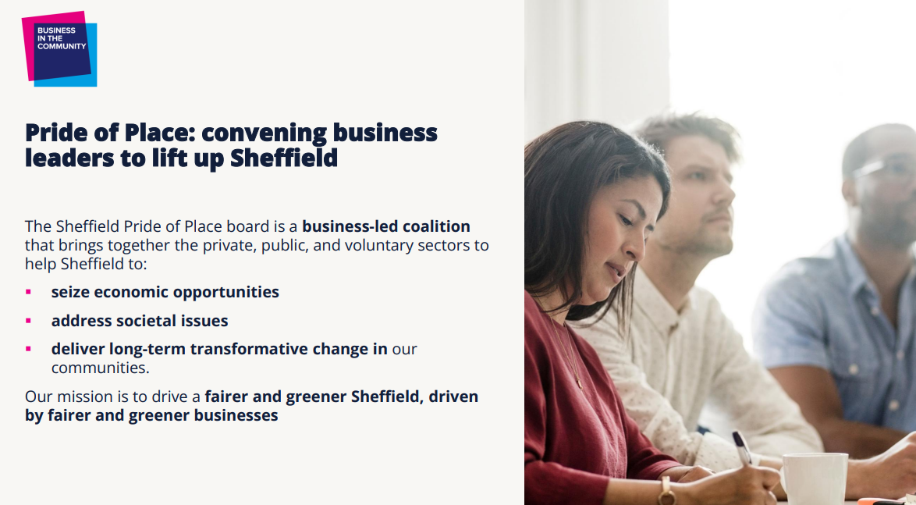

Slide 8
Project name goes here / April 2024
02

Slide 9
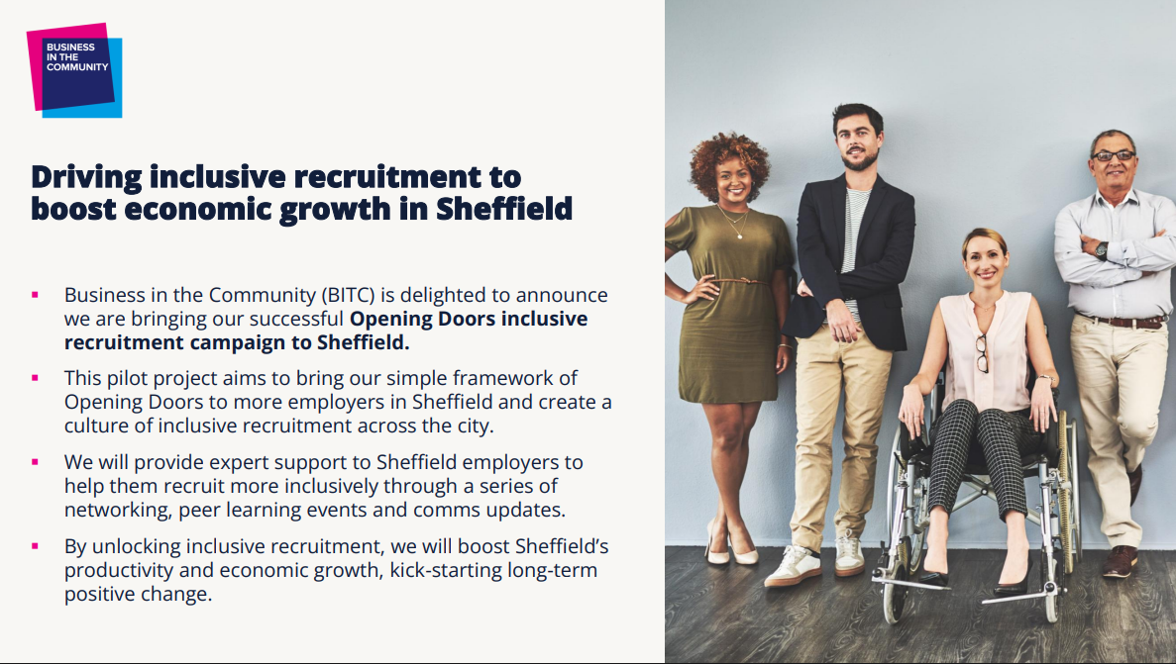

Slide 12
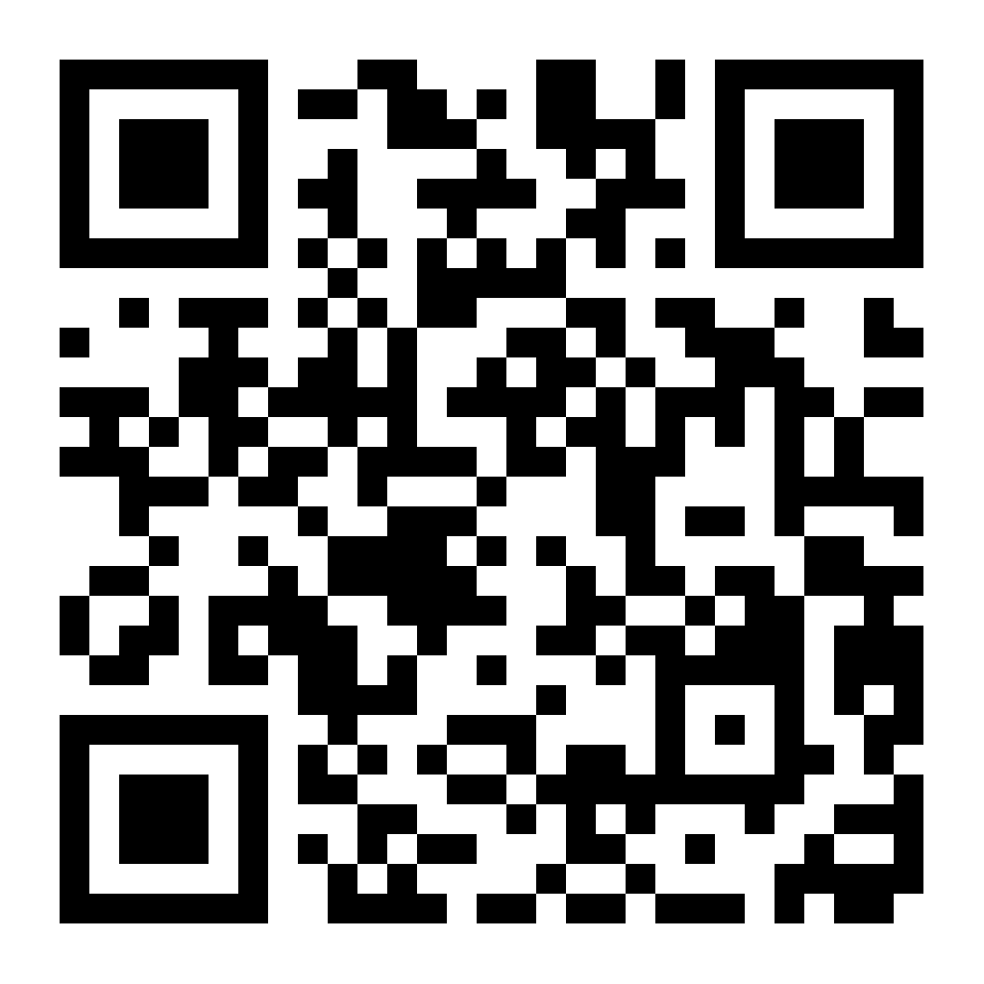
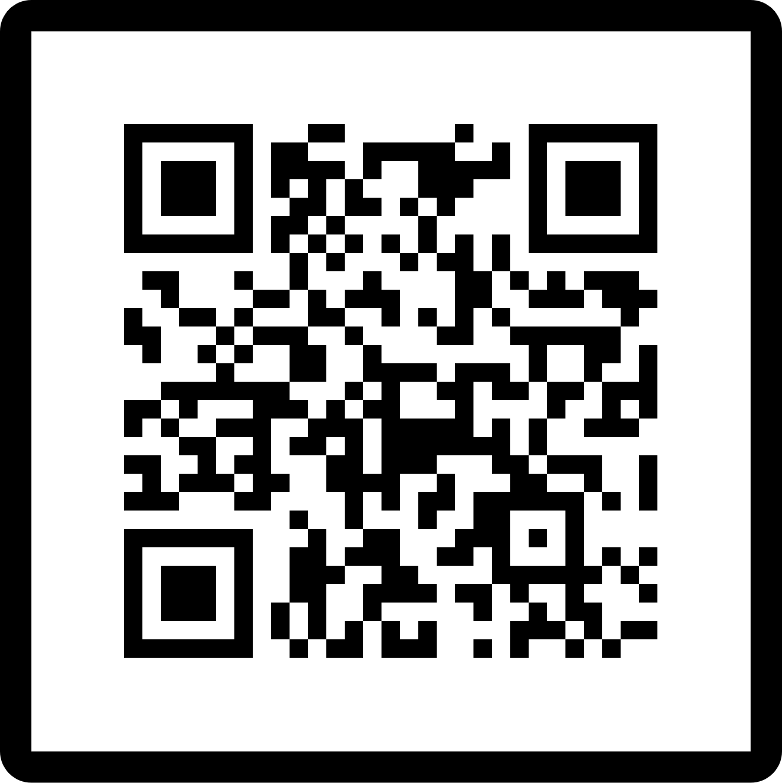
How to get involved
Inclusive Recruitment event-26th of June 9am-11.30am
Join Sheffield Business Together

