Slide 1
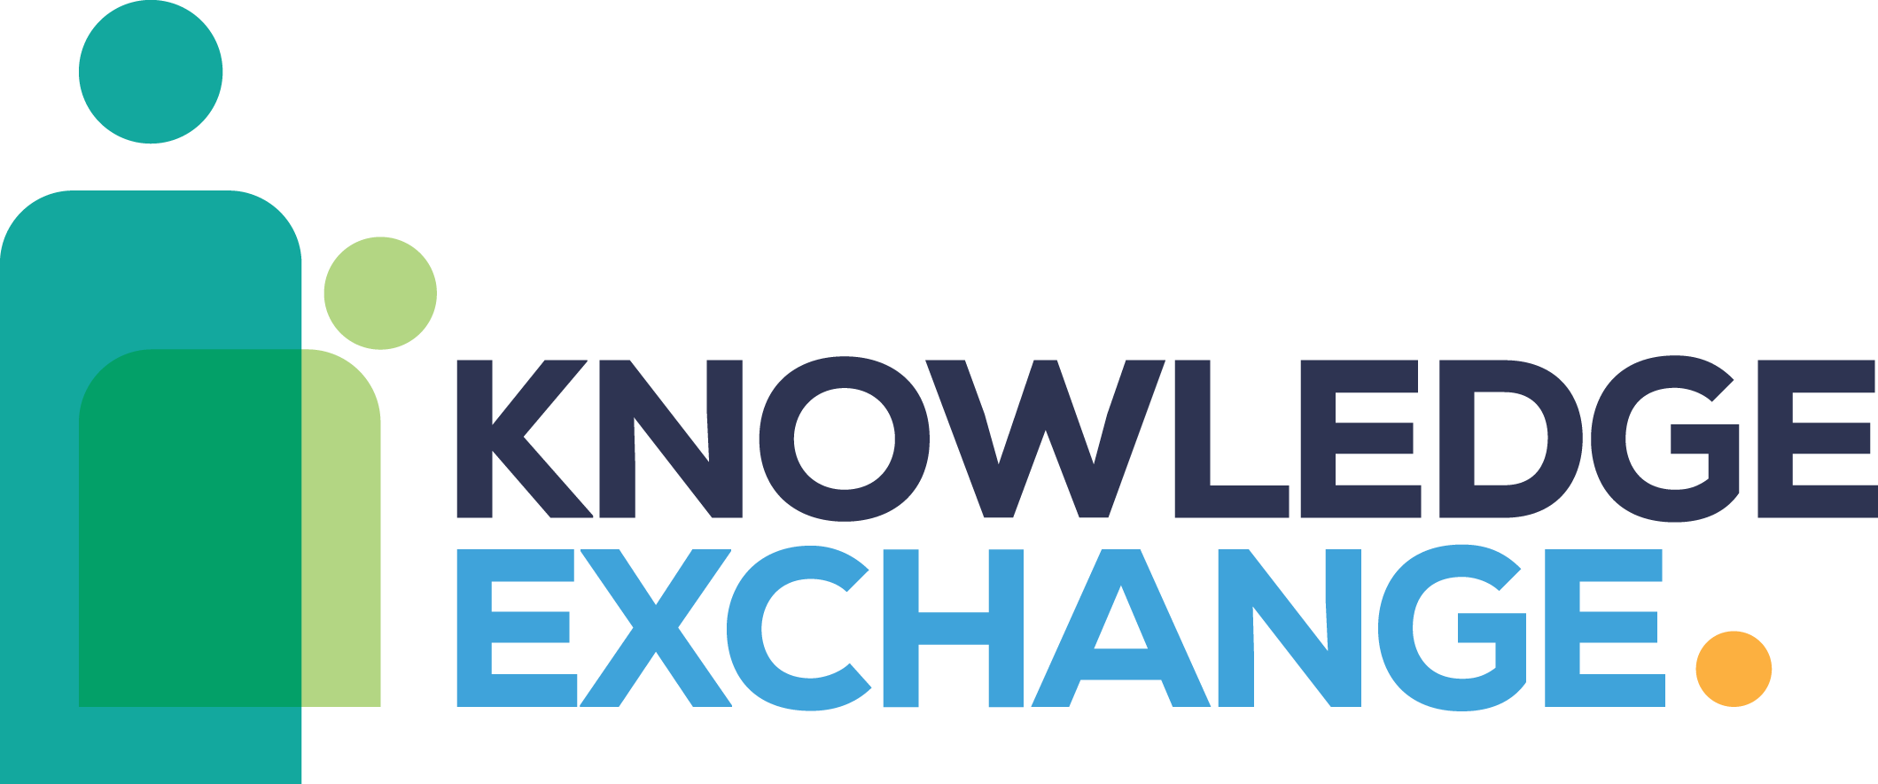
Knowledge Skills Event SYMCA Skills Bootcamps

Slide 3
Skills Bootcamps.
Skill Bootcamps are Department for Education (DfE) funded, flexible courses up to 16 weeks for adults 19 +. They are designed to help people develop or enhance in-demand job-specific skills. Skills Bootcamps are delivered between April - March each year.
SYMCA have commissioned £3 million from DfE for 24/25, and we have bid for £4.8 million for 25/26.
Who are they for?
Unemployed.
Self-employed.
Employed.
Outcome
Supported into a job
Outcome
Secured new work or contracts
Outcome
Offered a new role or responsibility through existing employer
Funding
Fully funded for the learner
(100% funded by SYMCA)
Funding
Fully funded for the learner
(100% funded by SYMCA)
Funding
90% funded for SMEs, 70% funded for businesses with over 250 employees

Slide 4
Skills Bootcamp Model.
Milestone 1
Course
started
Milestone 2
Course completed
Milestone 3
Positive job outcome
Successful completion of course and for:
Unemployed - offer of an interview
Self- employed – offer of new work/contracts
Employed – Offer of a new job role/responsibility
Within 6 months of course completion:
Unemployed - a new job or apprenticeship
Self- employed – new work/contract
Employed – a new job role/ responsibility with their existing employer
Learner completing 14 qualifying days or a minimum of 10 guided learning hours.

Slide 5
The benefits to a business.
Increased retention
Design a course around their needs
No recruitment fees
Increased productivity
Gain trained employees
Decreased skills gap
Decreased skills gap
Business growth

Slide 6
What Skills Bootcamps are available (1 of 2).
Learning Organisation | Course | Sector | Location | Type of learning
Construction Help Line Ltd | Domestic Energy Assessment Retrofit Coordination and Management L5 Construction Supervision Construction Contracts & Project Management | Construction and the Built Environment | South Yorkshire | Online
Construction skills | Multi-Trade Construction Skills Insulation Installation with Construction Green Skills Operative | Construction and the Built Environment Green | Rotherham & Doncaster | Face-to-face
Momentum | Introduction to Retrofit | Construction and the Built Environment | Sheffield | On-site
TRS Training | Training Limited Introduction to Transport Management & Traffic Office | Business and Administration Services | South Yorkshire | Online

Slide 7
What Skills Bootcamps are available (2 of 2).
Learning Organisation | Course | Sector | Location | Type of learning
Just IT Training Ltd | IT Technician | Digital | South Yorkshire | Online
Sheffield City Council | Cyber security | Digital | Sheffield | Blended
Think Employment Ltd | Data Analytics Digital Marketing Accelerator | Digital | South Yorkshire | Online
The Developer Academy Ltd | Software Tester | Digital | South Yorkshire | Online
Life Skills Centres Ltd | Introduction to Broadcasting | Creative | Sheffield | Blended

Slide 8
How to access Skills Bootcamps and what do referrals look like?
Access Skills Bootcamps
Good referrals for Skills Bootcamps
SYMCA website and email:
https://www.southyorkshire-ca.gov.uk/skills
bootcampsbootcamps@southyorkshire-ca.gov.uk
SYMCA team will pick up any requests from businesses and direct them to the Learning Organisations
Struggling to recruit
Investing and retaining their employees
Upskilling their workforce
Filling skills gap quickly

Slide 9
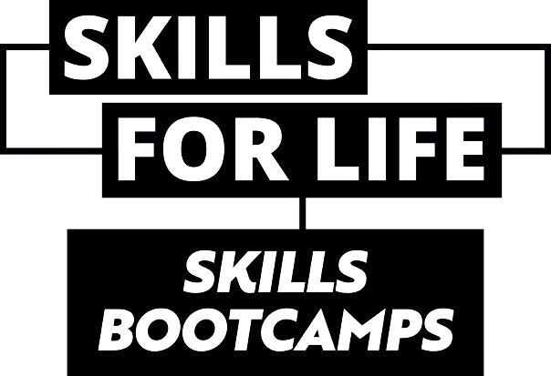
How does Skills Bootcamps fit with the region’s wider skills offer?
Establishing pathways into work from sector routeways > Bootcamps.
Participants applying for bootcamps need to near work-ready in order to be accepted onto the bootcamp.
Provision is unique and does not overlap. In instances where there is overlap, enhances progression rather than redundancy.

Slide 10
How we can work together.
1.
2.
3.
Advisor refer the employers to the Skills Bootcamps email where businesses want to:
Recruit new skilled employees
Upskill current employees.
Skills Bootcamps team will coordinate with business and LO to facilitate introductions explore ways to involve the employer with bootcamps.
Employers may:
Introduce their business and promote vacancies.
Recruit talent from existing Skills Bootcamps.
Collaborate with LOs to design future bootcamps tailored to their needs.

