Slide 1
Remake Learning Days Festival 2025

Slide 3
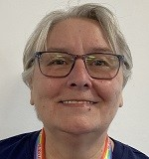
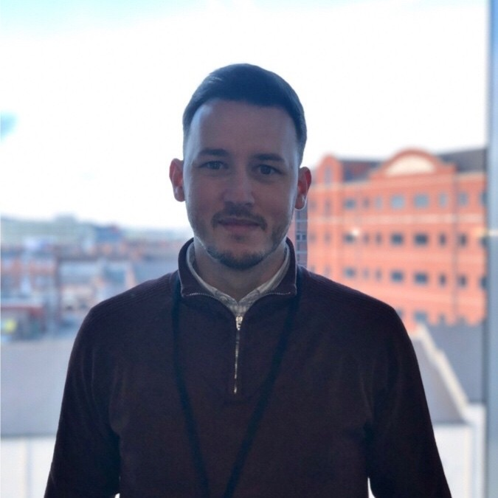
Who are we?
City of Doncaster Council
Councillor Sue Farmer
Cabinet Member for Equalities, Education and Skills
Sean Fearn
Learning Manager
Skills Team

Slide 4
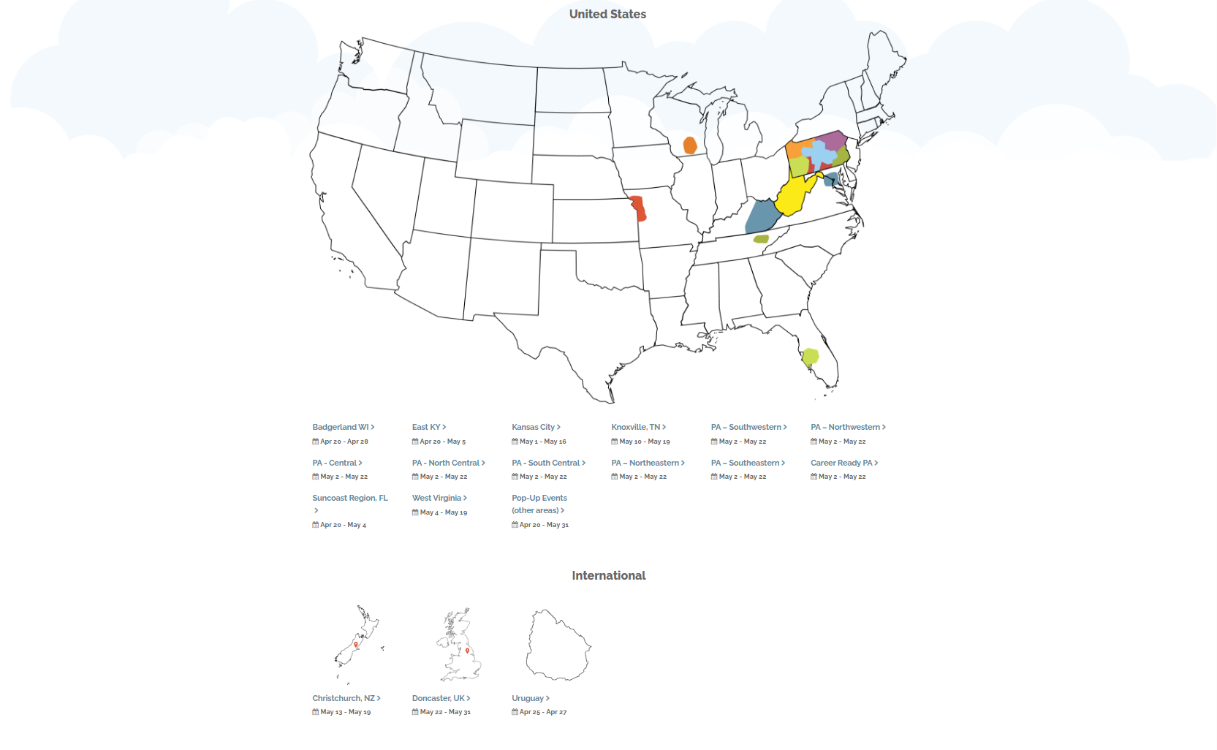
Remake Learning: Background
Background
Remake Learning is an initiative which began in Pittsburgh, USA and which is starting to expand across the globe.
Remake Learning is an open network of people and organisers - they share best practice to keep learning for young people engaging and relevant, in order to raise aspirations and address inequalities within communities
It is also the name of an agenda/movement: to offer inspiring and engaging learning opportunities outside of the classroom, sparking curiosity, passion and interest within learners and communities of all types.
Flagship initiative: Remake Learning Days.
Following Doncaster hosting the UK’s first ever convening of the Global Education Leaders Partnership, Doncaster Commitment to deliver this agenda as a key area of delivery under our Education & Skills 2030 strategy.

Slide 5
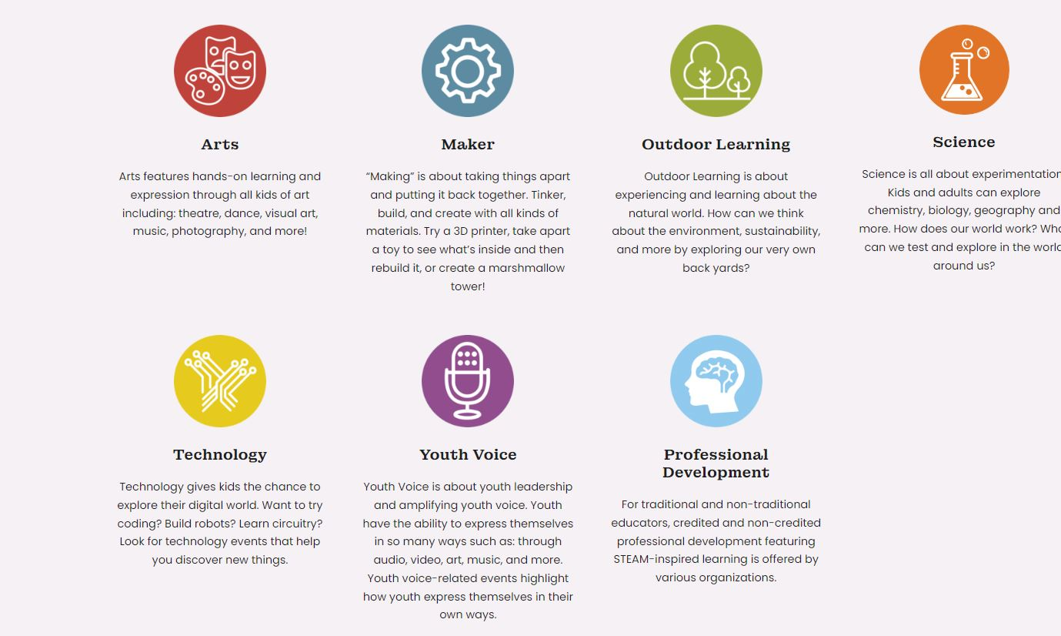
Remake Learning Days Festival
What is it? ​
Launched in 2016 in Pittsburgh USA, Remake Learning Days is a celebration of learning! This festival of events is hosted by a variety of organisations. These events are designed to be hands-on, relevant and engaging educational experiences for youth of all ages and their families, carers and educators. The majority of events are free and open to all ages. Kids become more interested in the learning process when an adult is learning with them. With that in mind, events are designed for a parent/carers to learn alongside their children and to wonder and explore together.
Remake Learning Days is one of the world’s largest open house for hands-on learning for youth, families, grandparents and educators to discover creative ways of learning. To help navigate all the events, below are different learning themes. Please note that events may feature multiple learning themes

Slide 6
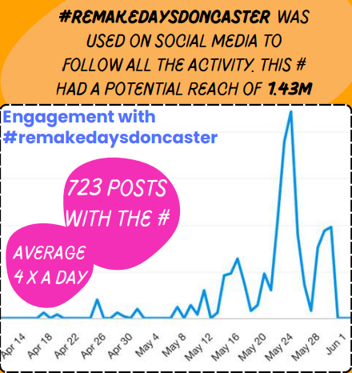
Remake Learning Festival delivery So far
Delivery so far
Doncaster became the first place in Europe to host the Remake Learning Days Festival in 2023, hosting a 10-day event across May half term.
Delivered 2 City wide Festivals reaching every locality/ward in Doncaster. (2023 & 2024)
Hugely successful with 20,000 residents taking part in creative learning experiences over the past 2 years.
Total of £36,874 of funding awarded to Organisations to host events.
90 different event hosts! These are made up of organisations and services within them.

Slide 7
2024 At a Glance
May 22-31, 2024
Hosted unique events with a total of festival events
267
348
Free Events
events with a form of accessibility provided
340
317
virtual
in-person
1
266
unique event hosts participated in the festival
97
Arts
Maker
Outdoor Learning
Science
Tech
Youth Voice

Slide 8
Remake Learning Days Festival 2025!
Dates : 22nd May – 31st May
Night at the museum Lunch event: Wednesday 21st May

Slide 9
Remake Learning Festival
How can you get involved?
We are currently accepting expressions of interest for organisations, CIC’s, learning providers and businesses to take part in this festival by:
Applying to host one or more new events/activities for young people, families and adults
Letting us know what extra-curricular/parental engagement activities you already have planned for these dates
Letting us know if you would be willing to provide a venue for an event
Promoting the festival
ALTERNATIVELY if you are already planning to host an event during the festival dates and you believe it fits the criteria of a Remake Learning event, you can still register to be part of the festival and apply for funding to increase your event offer or the number of people who can attend
What's in it for you?
Opportunity to promote and showcase your organisation; invite the community.
Opportunity to provide additional extra-curricular activities for children (no HAF programme in the May HT)
Opportunity to develop life skills for people in the community
Opportunity to apply for grant funding to support your activities
We want to showcase every learning activity that is happening across Doncaster!
How can you find out more?
Dedicated website: www.doncaster.gov.uk/remakelearningsdays
Dedicated inbox: remake.learning@doncaster.gov.uk
More info at: https://remakelearningdays.org/

Slide 10
Expectations of hosts
You will need to design, run and staff the event/s yourself including sourcing a venue if you don't already have access to one, which the funding can support with.
Free or Low-cost sessions. (Grants Available to support)
Deliver in venues right across Doncaster. (areas with high NEET, UC CLAIMENT)
Promote your event/s on any channels you have, but we will be running a full marketing campaign on behalf of all events taking place as part of the festival & we will provide a marketing pack for you to use with Remake Branding.
Make sessions accessible (Drop in or bookable)
Complete Participation & Host surveys.
Hosts Must provide
DBS Certificate.
Safeguarding policy and DSL with Appropriate level of safeguarding qualification.
Risk assessments.
Public Liability insurance.
Health & Safety policy.

Slide 11
Grant Funding
Grants will need to be applied for and the applications will be awarded on a rolling basis.
How to apply
Grant awards
After you submit your Expression of interest, you will then receive the Grant application pack.
Fill out application form and you MUST submit your event on the Remake Learning days website. Send back with ALL supporting documents.
Application will be assessed by our Grant Panel.
We will then either Approve, Decline or ask you to make further amendments to the application.
Grants will be issued on a rolling basis with a deadline for applications 31/01/2025
Small: £50-£200
Medium: £200-£500
Large: £500 +
If you wish to apply for a Large grant, we will need to make sure that the application is in depth of why you would need this amount. With the number of sessions, The impact you will have and also if you are able to work with any other organisations to support the delivery.

Slide 12
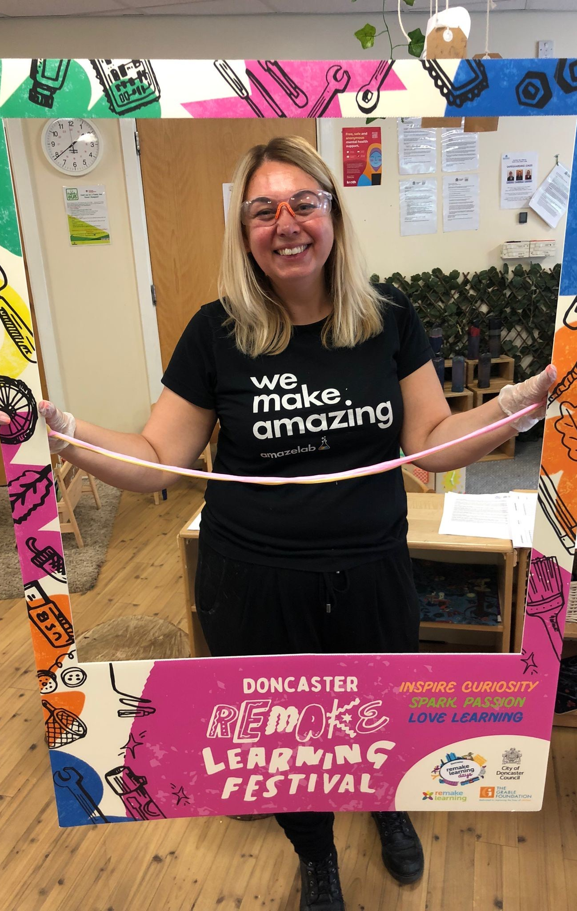
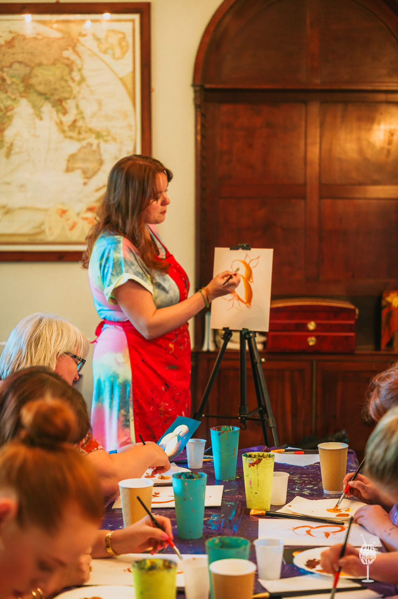
Remake Learning Days Event Host v2.mp4

Slide 13
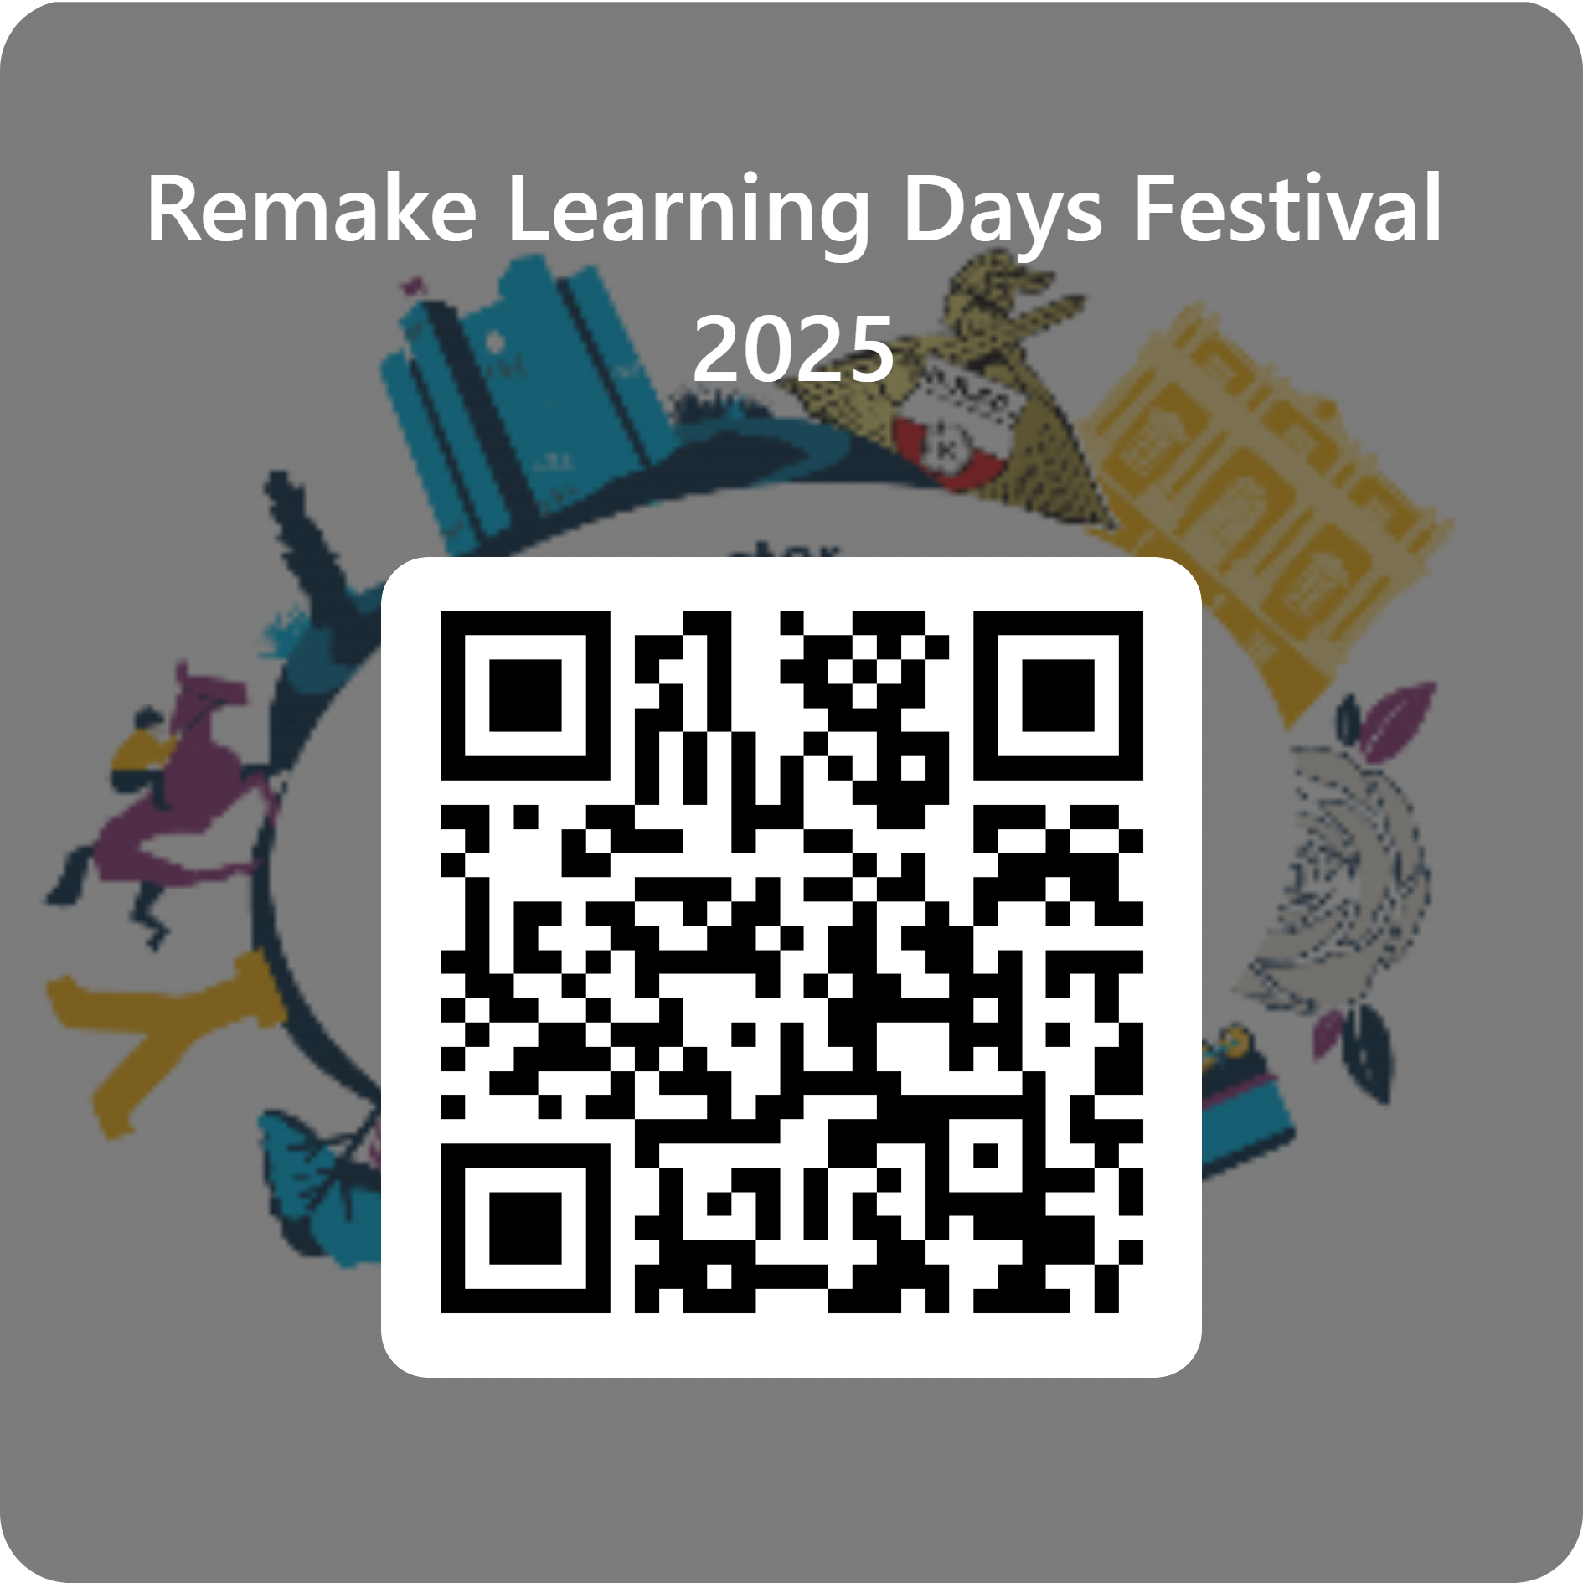
Getting Involved!
You can get involved by registering your interest
Scan QR Code
Or
Email Remake.Learning@doncaster.gov.uk

Slide 14
Any Questions
Sean Fearn
Sean.Fearn@Doncaster.gov.uk
01302 736534
Dani Adams
dani.adams@doncaster.gov.uk
Remake Learning DEDICATED INBOX
Remake.Learning@doncaster.gov.uk

