Slide 1
‘CLEAR IDEAS’ Creativity and Innovation Training Workshops
Professor Kamal Birdi
Sheffield University Management School
Tuesday 22nd October 2024

Slide 2
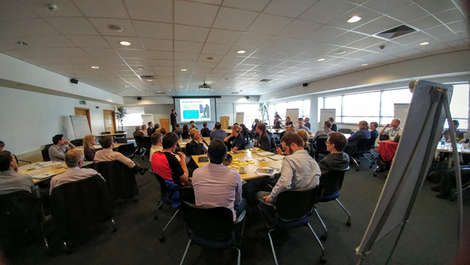
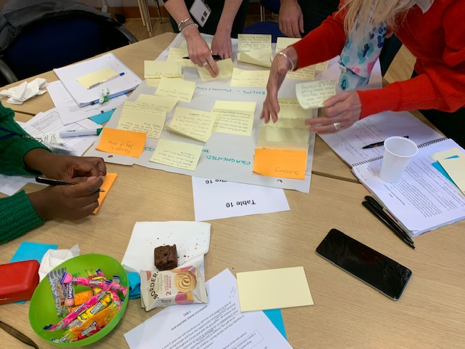
Background
Companies facing increasingly complex challenges and more limited resources.
→ Need to become more innovative in doing something NEW (products, services, processes, strategies) to survive and thrive. How?
Extensive research at Sheffield University Management School into barriers and facilitators of innovation.
‘CLEAR IDEAS’ (CI) model created in 2005 as a means of translating research findings into practical guidance.
Our CI training workshops aim to develop the skills of clients to both creatively generate new solutions and be more effective at putting them into practice.

Slide 3
Examples
Over the past 20 years, hundreds of organisations from private, public and third sectors have taken part in our workshops.
Evaluation shows the model is well-received, improves innovation competencies and can lead to significant improvements in efficiency and performance e.g.
Council redesign of adult social care service led to savings of £1.5m in first year
SME in water industry redesigned its strategy to generate substantial business growth
International hotel chain improved its customer engagement and satisfaction levels
Icelandic energy company set up a training school for its engineers

Slide 5
“How can the South Yorkshire Chambers of Commerce bring in significantly more investment from the U.S.??”
Principles of creative idea generation:
Generate lots of ideas
Do not judge ideas during this stage – Lots of Ands, no Buts!
Try and be as wild and original as you can
Try some creative thinking prompts – encourage you to think from different perspectives

Slide 7
Who’s it for?
“the process has become embedded into my approach to any situation”
Leaders, managers or others wanting to know how to become better at producing something new / solving problems to help their organisation.
Developing a collaborative innovation culture in an organisation.
Skills applicable to any sector or context.
Uniqueness in combination of creativity with change management skills; strong research and practice base.
Good referrals where company needs more creative approaches to grow and is not well equipped to do it. Could be around a specific problem.
“elegantly simple”

Slide 8
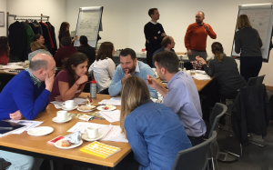
Upcoming Workshops
SYMCA Skills Bank funded – only £25 per delegate (usually £250); max 2 per organisation
One-day, face-to-face
Target SMEs or non-profits in South Yorkshire
Development of creative, analytic, strategic planning skills through collaborative working on real challenges
Creation of tailored innovation action plan + Follow-up online innovation coaching session
Sheffield Crucible December 5th 2024 + one in Jan/Feb 2025
Other workshops can be arranged

Slide 9
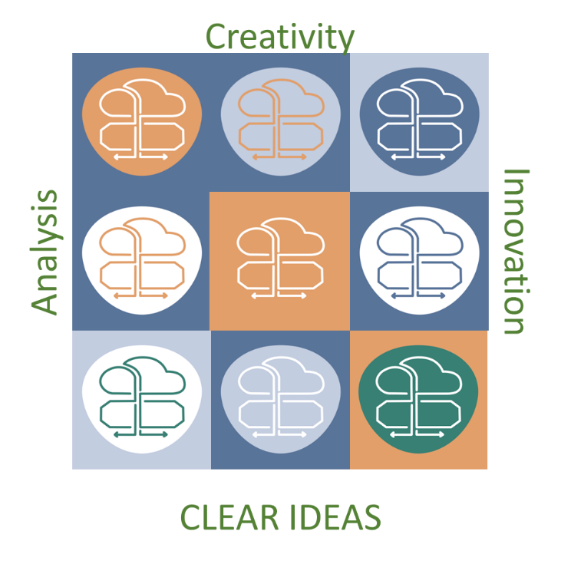
So….
CLEAR IDEAS training for companies needing to improve their creativity, innovation and collaboration skills.
Flyers to be sent out for upcoming December and Jan/February workshops.
Contacts for those and other workshops
Professor Kamal Birdi: k.birdi@sheffield.ac.uk
Sarah Stanley (Business Partnerships Manager): sarah.stanley@Sheffield.ac.uk
Any questions?

