Slide 1
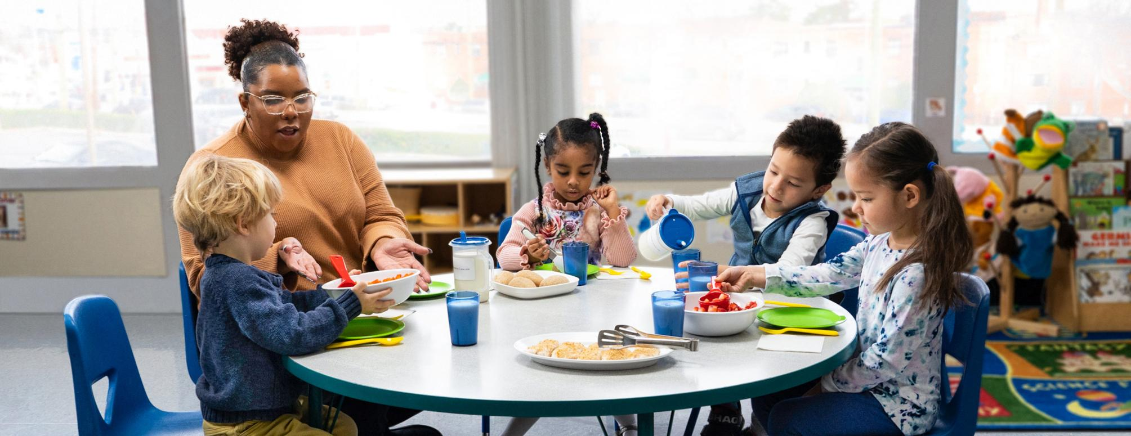


Family Style Meal Service With Children
in the Child and Adult Care Food Program
Notes:
Script: Welcome to the “Family Style Meal Service With Children in the Child and Adult Care Food Program” training today. During the training, we will refer to the Child and Adult Care Food Program as the CACFP.

Slide 2
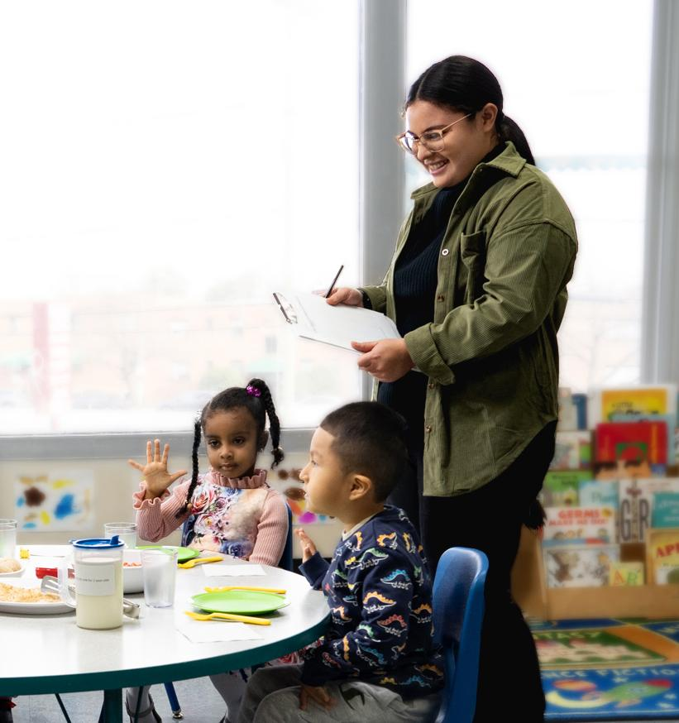



How Do You Support Meal
Service?
Plan the menus
Cook the food
Eat and talk with the children
Purchase food
Clean
Administer the CACFP program
Other duties
2
Notes:
Script: We all have different roles and responsibilities to support successful meal service with children at our sites. Before we get started, I’d like to hear from you. How do you support meal service? What are your roles and responsibilities?
Note: If training is conducted in person, name the different roles and responsibilities on the slide. Have participants raise their hands if they perform these responsibilities. If training is on-line, consider doing a polling question or have participants type their role(s) in the chat box.

Slide 3
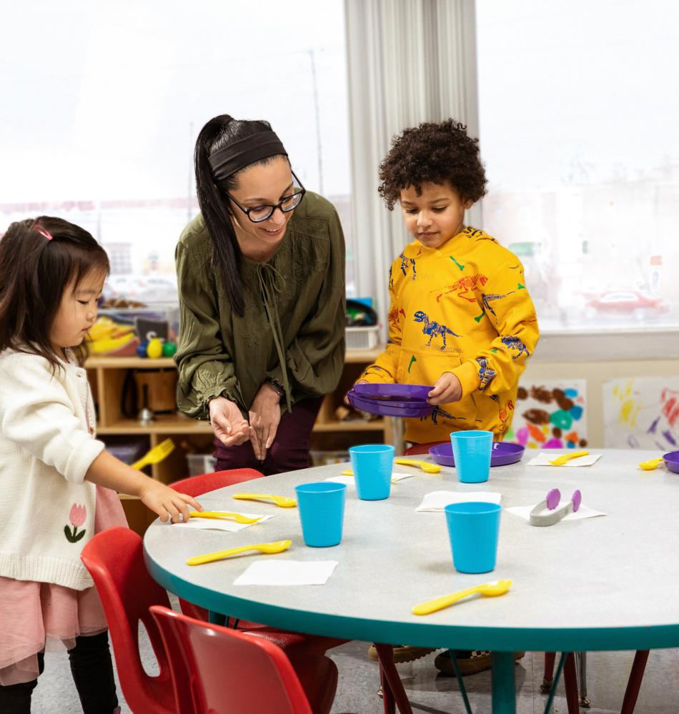
What is Family Style
Meal Service?
A type of meal service where children:
Help set the table.
Serve themselves from bowls, plates, and/or pitchers on the table.
Talk with others at mealtime.
3
Notes:
Script: Today, we will focus on understanding family style meal service and gaining the knowledge and tools to implement this style of meal service in the CACFP. In family style meal service, children can help set the table; serve themselves from bowls, plates, and/or pitchers on the table; and talk with others at mealtime. Family style meal service is optional in the CACFP.
Another type of common meal service in the CACFP is pre-plated meals. This is when all meal components with at least the minimum portion size are placed on each plate and given to every child.

Slide 4
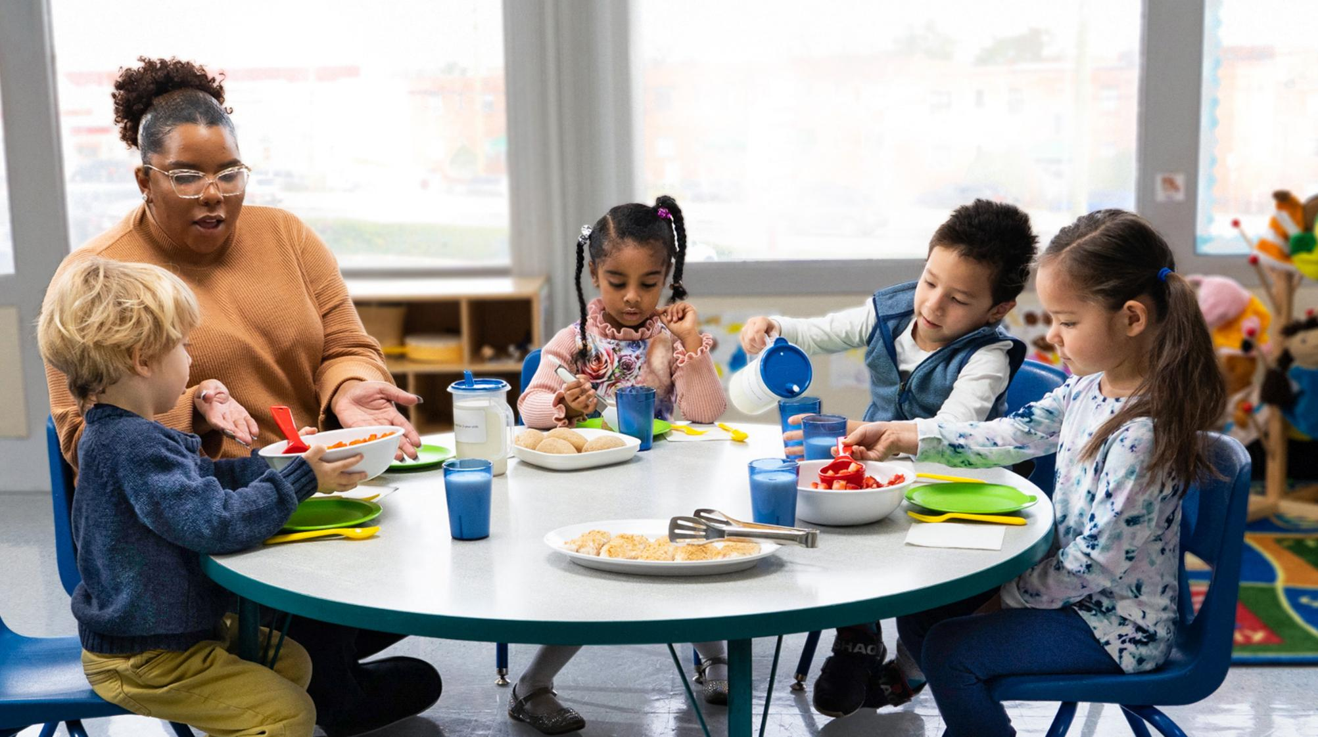
What aspects of family style meal service do you see in this picture?
4
Notes:
Script: What aspects of family style meal service do you see in this picture? ​
Note: Discuss the picture in detail, highlight the different components of family style meal service in action. Areas of discussion may include socializing between children and adults; passing of serving bowls, plates, and pitchers; children serving themselves; and child-size utensils and equipment.

Slide 5
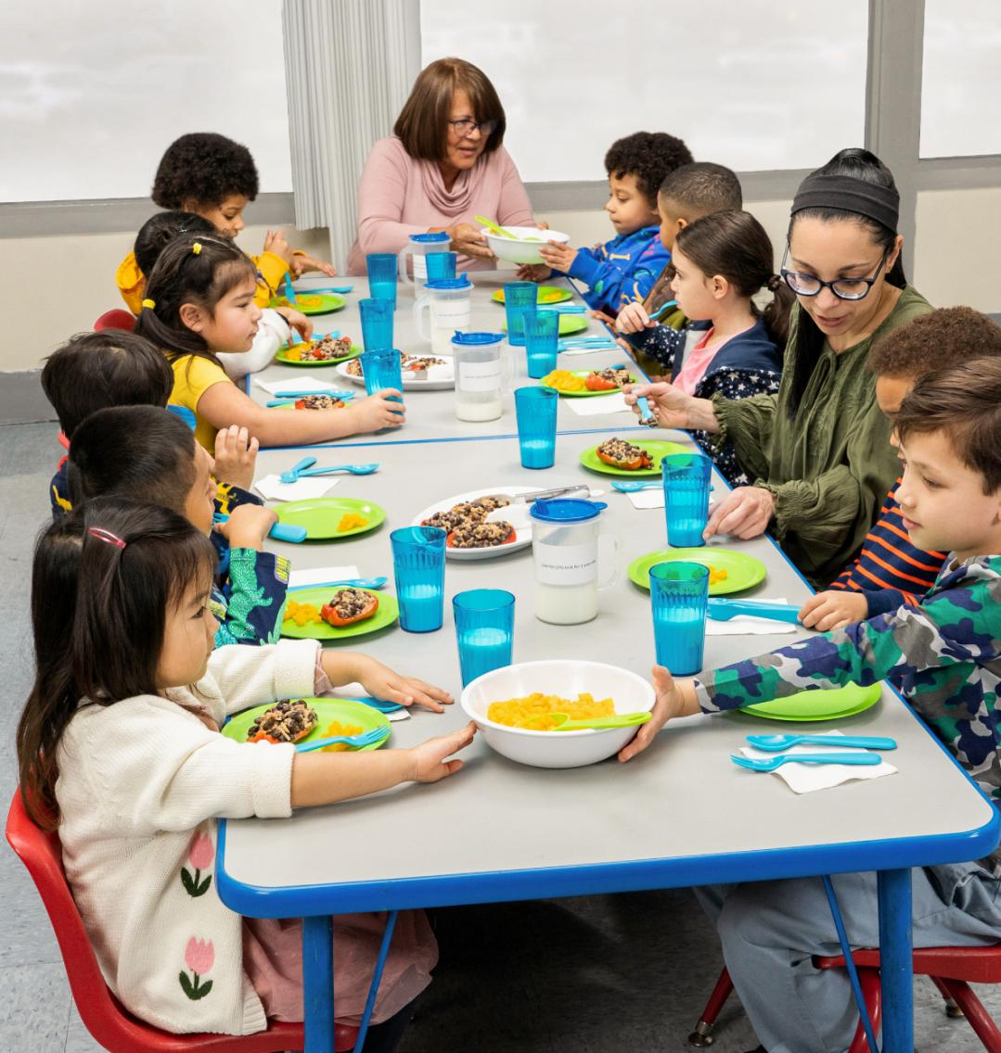
About Family Style
Meal Service
Benefits of Family Style
Meal Service
Children can:
Eat without pressure.
Practice their fine motor skills.
Build self-esteem and confidence.
Develop healthy eating behaviors.
Practice their social and language skills.
Get to know other children and teachers.
If you cannot fully implement family style meals, aspects can still be used.
5
Notes:
Script: There are many benefits to serving meals family style. Children can:
Eat without pressure—eat when they feel hungry and stop when they feel full.
Practice their fine motor skills—strengthening the small muscles in their hands and fingers—while learning to serve and feed themselves.
Build self-esteem and confidence by serving themselves.
Develop healthy eating behaviors, such as trying new foods and making food choices.
Practice their social and language skills by talking with other children and teachers.
Get to know other children and teachers. Eating together can give children a sense of belonging and is valued in many cultures.
If you cannot fully implement family style meal service, like during a public health emergency, aspects of this style of meal service can still be used. Help children continue to practice language and social skills by encouraging conversation and good table manners even when food is pre-plated.

Slide 6

The Team Nutrition Initiative
Supports the Child Nutrition Programs by:
Providing training and technical assistance to food service professionals.
Providing technical resources to support healthy school and child care environments.
Developing nutrition education resources that help children learn about agriculture and make informed food choices.
6
Notes:
Script: The Team Nutrition initiative supports the Child and Adult Care Food Program by:
Providing training and technical assistance to food service professionals that prepare meals for the programs,
Providing the programs with technical resources to support healthy school and child care environments, and
Developing nutrition education resources that help children learn about agriculture and become self‐sufficient in making informed food choices.

Slide 7
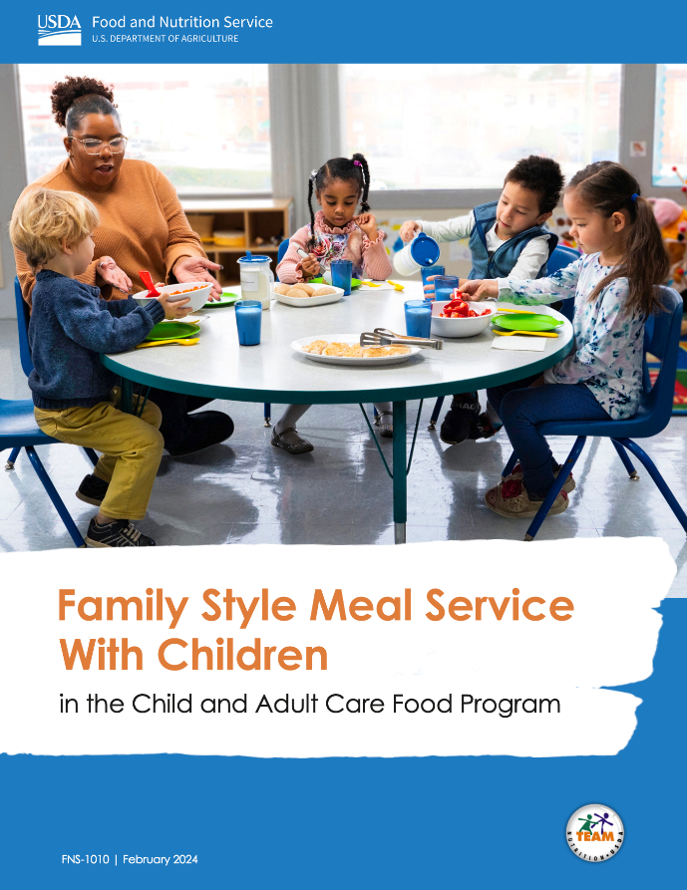
Family Style Meal Service With
Children in the CACFP (Part 1)
Preparing for Family Style Meal Service
What Supplies Do I Need to Start? Pg. 3
How Can I Prepare Children Before Starting? Pg. 4
What Can I Do to Help Staff and Parents/Guardians
Before Starting? Pg. 5
Following Requirements During Family Style Meal Service
How Do I Make Sure I’m Providing Enough
Food for Each Child? Pg. 6
How Do I Accommodate Special
Dietary Needs? Pg. 10
7
Notes:
Script: USDA Team Nutrition developed an operator booklet titled, "Family Style Meal Service With Children in the Child and Adult Care Food Program." This resource helps answer questions about family style meal service. Topics include, preparing for family style meal service and following requirements during family style meal service.

Slide 8
Family Style Meal Service With
Children in the CACFP (Part 2)
Supporting Children at Mealtime
How Can I Help Children Learn to Serve Themselves? Pg. 11
How Can I Encourage Good Food Safety Habits? Pg. 12
How Can I Encourage Children to Try New Foods? Pg. 13
Practicing What You Have Learned
Practice Your Understanding Pg. 14
8
Notes:
Script: Additional topics in the resource include supporting children at mealtime and practicing your understanding. This booklet is a go-to resource for implementing family style meal service in the CACFP. During this training, we will refer to the specific pages that information can be found in this operator booklet.

Slide 9
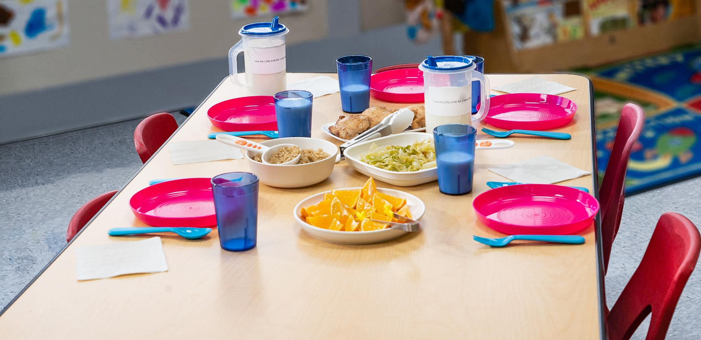

Preparing for Family Style Meal Service
What Supplies Do I Need to Start? Pg. 3
How Can I Prepare Children Before Starting? Pg. 4
What Can I Do to Help Staff and Parents/Guardians Before Starting? Pg. 5
9
Notes:
Script: We will start by answering three questions about “Preparing for Family Style Meal Service.” Please turn to page 3 in the operator booklet where this section begins.

Slide 10
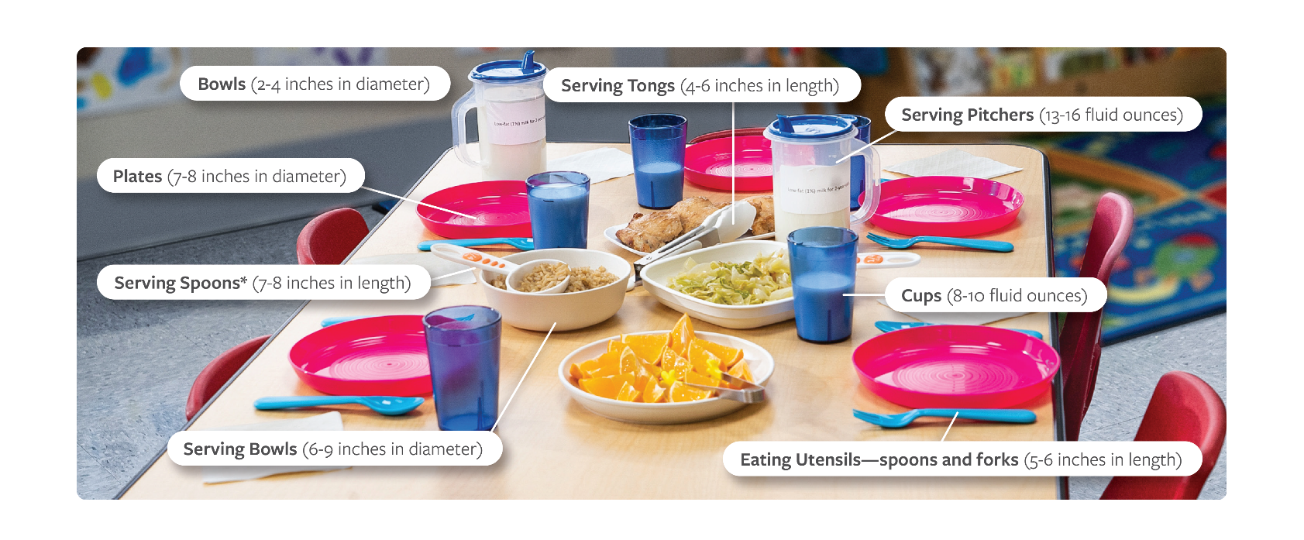
What Supplies Do I Need to Start?
(Part 1)
Child-Size Dishes and Utensils With Estimated Sizes
10
Notes:
Note: This image can be found on page 3 of the operator booklet.
Script: Special equipment for family style meal service is not required. However, most servingware and dishes are made for adults and can be too big or heavy for young children. If possible, try to buy supplies that are child-sized and unbreakable. On the slide are examples and measurements of child-size equipment. Options may include durable plastic items or stainless steel utensils and dishes. Check with your sponsoring organization or State agency about using CACFP funds to buy equipment to get you started.

Slide 11
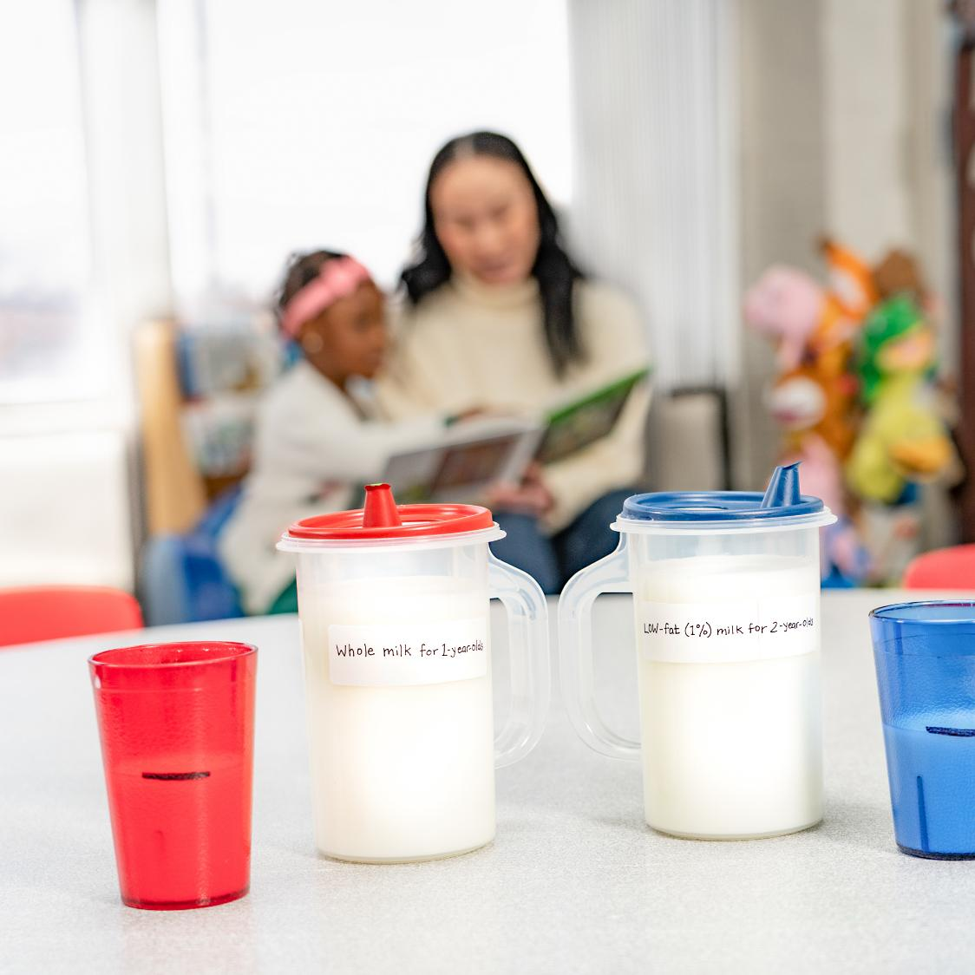
What Supplies Do I Need to Start?
(Part 2)
Tips for Supplies
Measuring cups and spoodles
as serving spoons.
Different colors of pitchers and
cups to help children get the
required milk types.
11
Notes:
Script: To support meeting CACFP meal pattern requirements, here are a couple tips for supplies:
Measuring cups and spoodles make great serving spoons. Match the size of the serving spoon to amounts listed in the CACFP meal pattern requirements for each meal component. For example, if the meal pattern calls for ½ cup of fruit, use a ½-cup measuring cup or 4-ounce spoodle.
Use different colors of pitchers and cups to help children get the type of milk required in the CACFP for their age. For example, 1-year olds must be offered unflavored whole milk. So, put whole milk in a red pitcher labeled “whole milk” and give each 1-year old a red cup. Two-year olds must be offered unflavored low-fat (1%) or fat-free (skim) milk. Put their milk in a blue pitcher labeled “low-fat (1%) milk” or “fat-free (skim) milk” and give them blue cups. This way you can quickly tell which child should get which type of milk at mealtime.

Slide 12

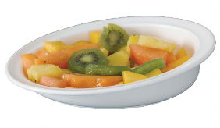
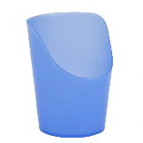
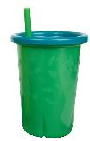
What Supplies Do I Need to Start?
(Part 3)
Sample Adaptive Utensils and Dishes
Utensils with larger handles
Scooped-rim bowls with a bottom suction
“Cut-out” cups or straw cups with lids
12
Notes:
Script: Individual adaptive equipment for children with a disability may be needed to help every child be successful at mealtime. Examples of common adaptive equipment include: utensils with larger handles, scooped-rim bowls with a bottom suction, and “cut-out” cups or straw cups with lids.

Slide 13
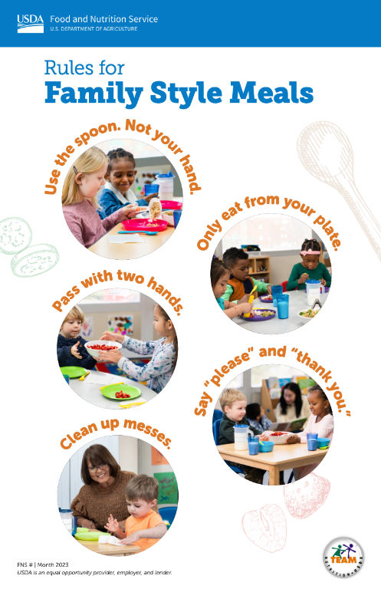

How Can I Prepare Children
Before Starting? (Part 1)
Talk About How Meals Will Be Served
Tell children that their classroom will start to serve meals and snacks in a different way.
Talk about the rules for serving themselves in family style meals.
  Use USDA Team Nutrition’s “Rules for Family Style Meals” poster.
Discuss important steps for family style meal service and the children’s role.
  Use USDA Team Nutrition’s “Let’s Eat ‘Family Style’” poster.
TeamNutrition.USDA.gov
13
Notes:
Note: This information can be found on page 4 in the operator booklet.
Script: You can prepare children before starting family style meal service by talking to them about how meals will be served. Start by telling children that their classroom will start to serve meals and snacks in a different way. The food will be on the tables in shared bowls and plates. Children will take the food from the shared bowls and plates and put it on their own plates. Milk may be available in pitchers for children to pour from and serve themselves.
USDA Team Nutrition has three posters to support family style meal service at your site(s). They include "Rules for Family Style Meals" which is shown on the slide, "Let's Eat 'Family Style'", and "Let's Talk at Mealtime.” The "Let's Eat 'Family Style'" poster shows the steps to family style meal service. It can serve as a visual aid when introducing family style meal service to children. Lastly, the "Let's Talk at Mealtime" poster shares prompts, phrases, and conversation starters child care providers may use at mealtime to support healthy eating and social development. All posters can be accessed at TeamNutrition.USDA.gov.

Slide 14
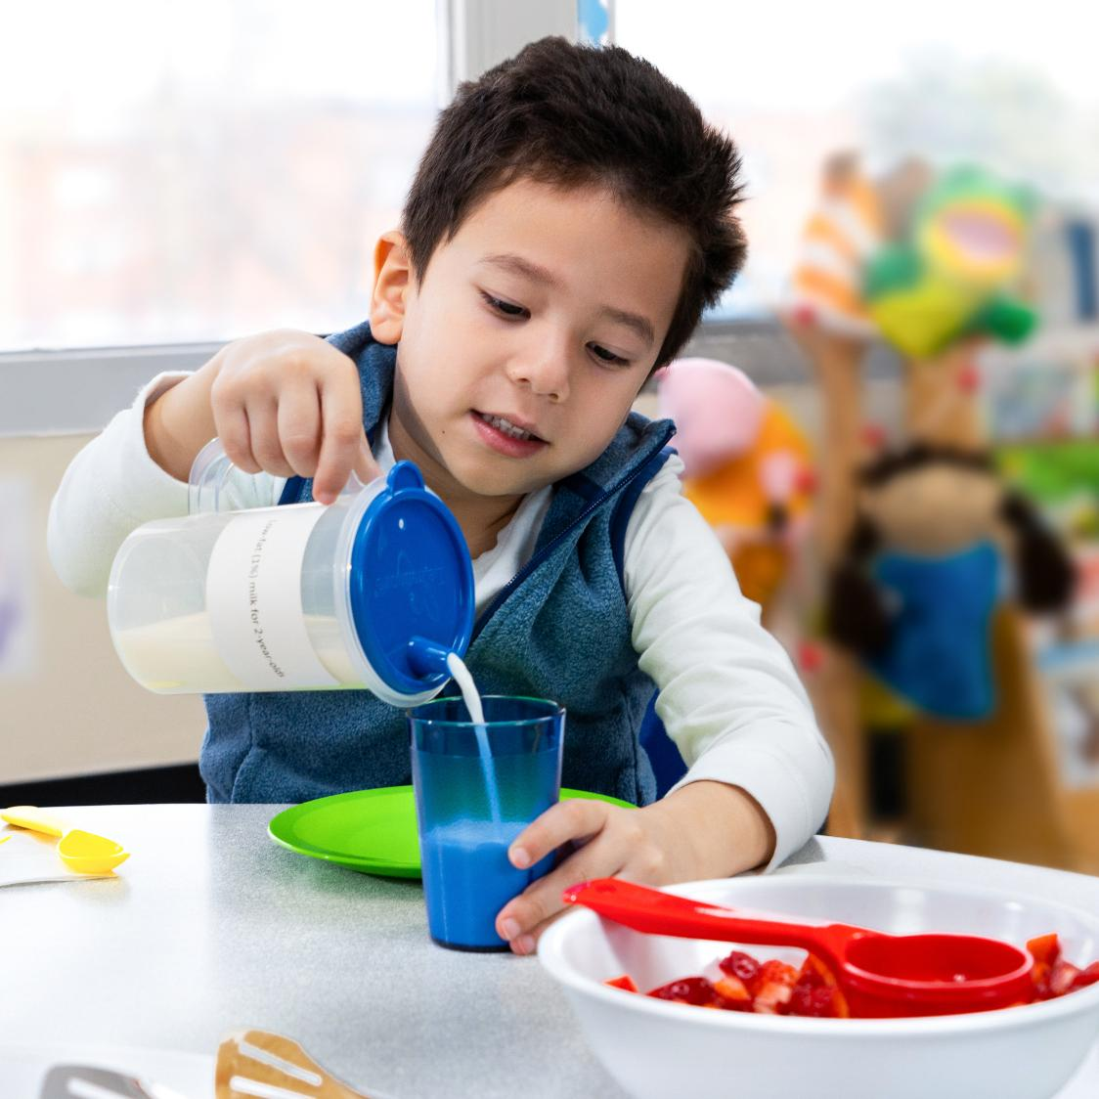
How Can I Prepare Children
Before Starting? (Part 2)
Provide Opportunities for Children to Learn Through Play
Add child-size serving spoons, tongs, and water pitchers to play areas. For example, children can practice:
Pouring liquid from a pitcher into a cup at the
water table.
Scooping cotton balls with a measuring cup and putting them in a small bowl.
Using child-size tongs to move pretend food or
pieces of yarn from one plate to another.
Practice setting the table using place mats, plates, cups, forks and spoons in the play area.
14
Notes:
Script: Another way to prepare children for family style meal service is by providing opportunities for children to learn through play. Your child care site can add child-size serving spoons, tongs, and pitchers to play areas. This will allow children to strengthen their fine motor skills (grasping, pinching, and picking up small objects) that they need to serve themselves. For example, children can practice:
Pouring liquid from a pitcher into a cup at the water table.
Scooping cotton balls with a measuring cup and putting them in a small bowl.
And, using child-size tongs to move pretend food or pieces of yarn from one plate to another.
Also, have children practice setting the table using place mats, plates, cups, forks and spoons in the play area.

Slide 15
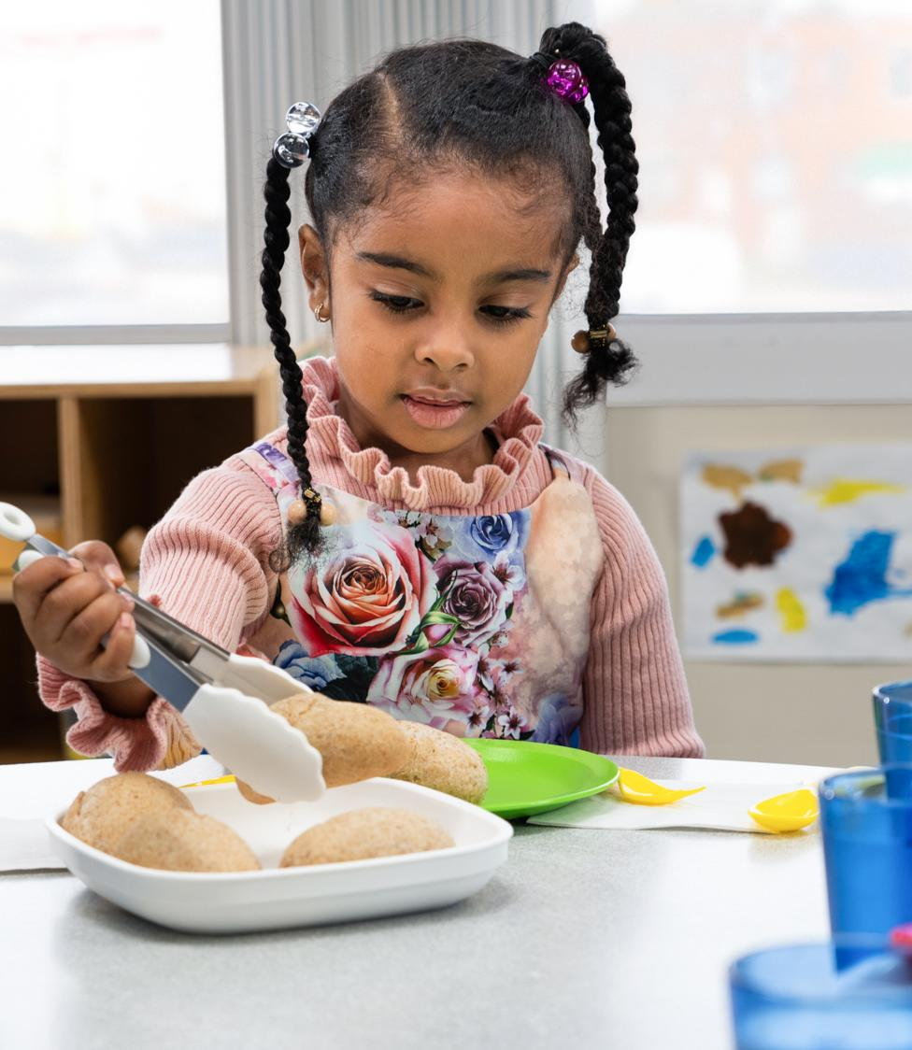
How Can I Prepare Children
Before Starting? (Part 3)
Start Family Style Meal Service Slowly
Practice with one meal component before serving all meal components.
Begin with a snack.
15
Notes:
Script: Another way to prepare children before starting family style meal service is by having the children practice with one meal component before serving all meal components "family style." For example, when starting with one component, children can pass around dinner rolls for the grains component while you pre-plate the rest of the meal components.
Your child care site may also want to begin this style of meal service with a snack rather than other meals (breakfast, lunch or supper). A snack requires less meal preparation and tends to include foods that are easier for children to serve themselves. You can begin serving more items "family style" as children strengthen their skills.

Slide 16
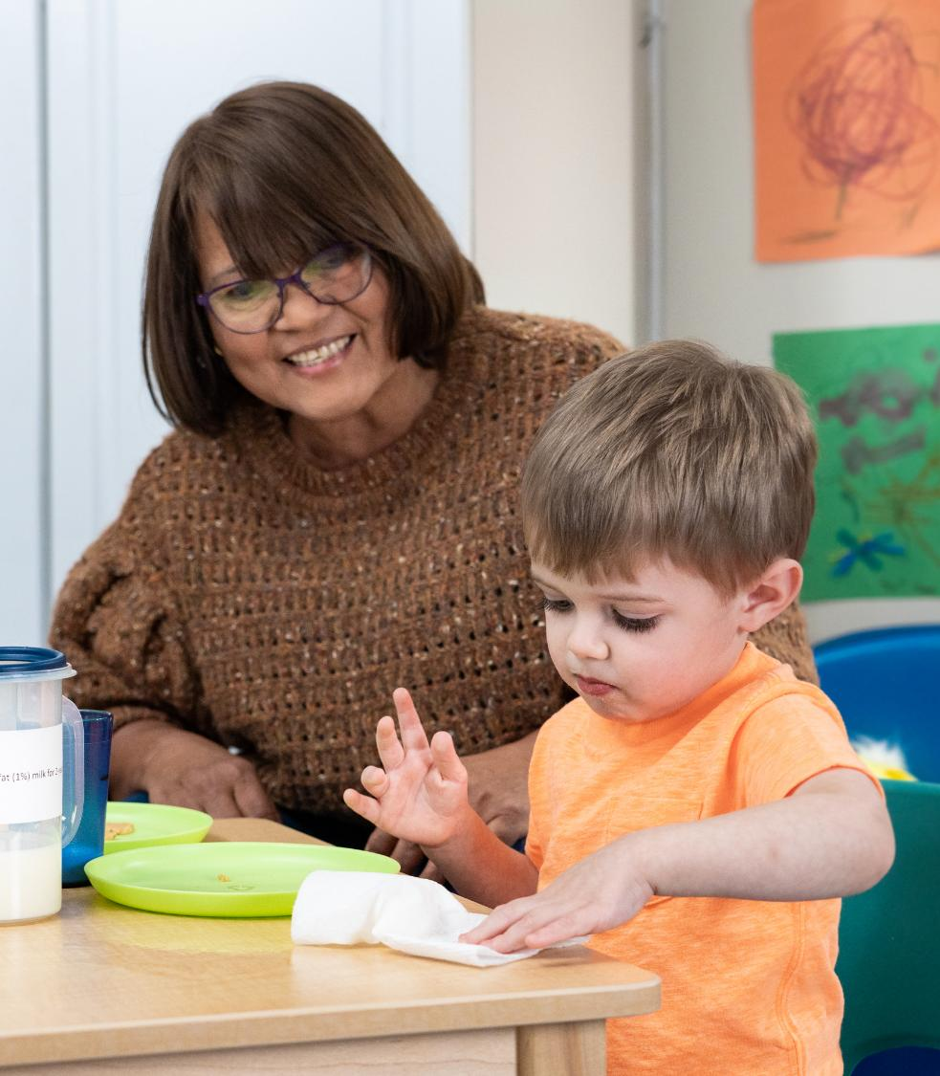
How Can I Prepare Children
Before Starting? (Part 4)
Explain That Children Can Be “Special Helpers” At Mealtime
Tasks may include:
Setting individual place settings (bowls, plates, cups, napkins, and utensils).
Placing serving bowls and plates of food on
the table.
Cleaning up messes.
16
Notes:
Script: Before starting family style meal service, you may also want to explain that children can be "special helpers" at mealtime and that you may assign a role to them. Some of these tasks may include:
Setting individual place settings (bowls, plates, cups, napkins, and utensils).
Placing serving bowls and plates of food on the table.
Cleaning up messes.

Slide 17
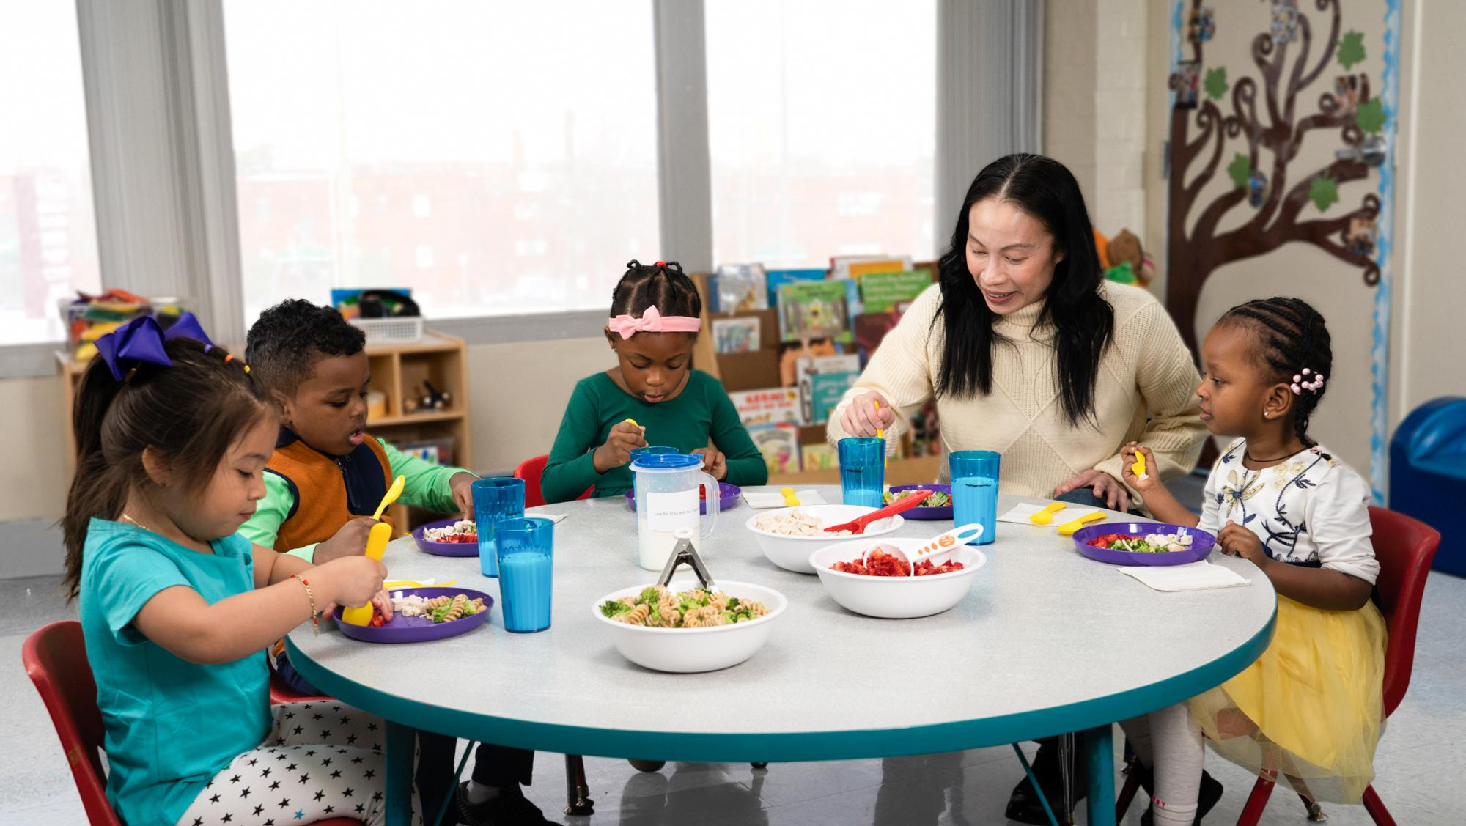
What are other strategies you could use to help children prepare for family style meal service?
17
Notes:
Group Discussion: What are other strategies you could use to help children prepare for family style meal service?
Note: For this group discussion during in-person trainings, ask participants to turn to a peer to discuss this question and then ask 2 groups to share. For on-line trainings, ask participants to list out their other strategies in the chat box.

Slide 18
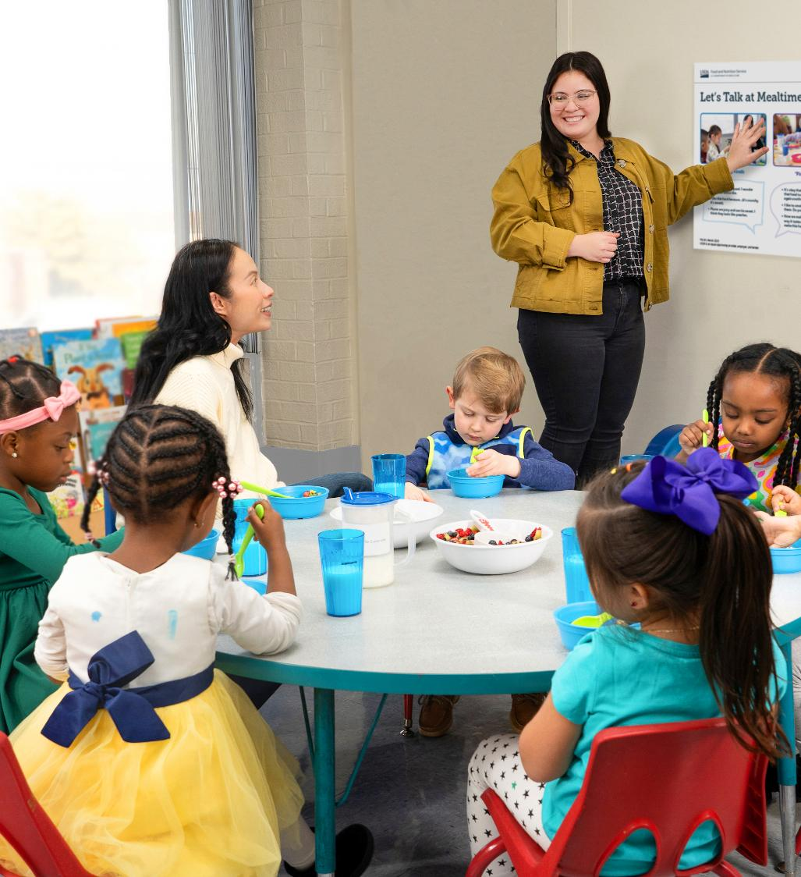

What Can I Do to Help Staff and Parents/Guardians Before Starting?
(Part 1)
Child Care Staff
  Offer training and discuss the following topics:
  The benefits to children.
  The steps and rules to family style meal service.
  How to encourage children to try new foods.
  That food can be offered but does not need to be put on a child’s plate.
  Ways to help children learn to serve themselves.
TeamNutrition.USDA.gov
18
Notes:
Note: This information can be found on page 5 in the operator booklet.
Script: Before starting family style meal service, your child care site can support staff by gathering teachers, food service staff, and others to explain this new style of serving meals. If possible, serve a meal or snack during this training to allow staff to practice family style meal service while they’re learning. It may be helpful to discuss the following topics:
The benefits to children.
The steps and rules to family style meal service.
How to encourage children to try new foods.
That food must be offered but does not need to be put on a child’s plate.
Ways to help children learn to serve themselves.
All of these topics are covered throughout the operator booklet and in the Family Style Meal Service Posters, including “Rules for Family Style Meals”, “Let’s Eat ‘Family Style’”, and “Let’s Talk at Mealtime”. You can even use today's training slides to train your staff. The slides are available at TeamNutrition.USDA.gov.

Slide 19
What Can I Do to Help Staff and Parents/Guardians Before Starting?
(Part 2)
Meal Counts
Assign somebody for each classroom to take meal counts.
Meal counts must be taken while children are eating, not before and not after the meal service is over.
Daily attendance records must not be used in place of meal count records.
19
Notes:
Script: Another important aspect before starting family style meal service is to assign someone for each classroom to take the required meal count at each mealtime. Meal counts must be taken while children are eating, not before and not after the meal service is over. Also, daily attendance records must not be used in place of meal count records; these records are separate.
Note: If applicable, refer attendees to their sponsoring organization or State agency for more information on required documentation for meal counts.

Slide 20
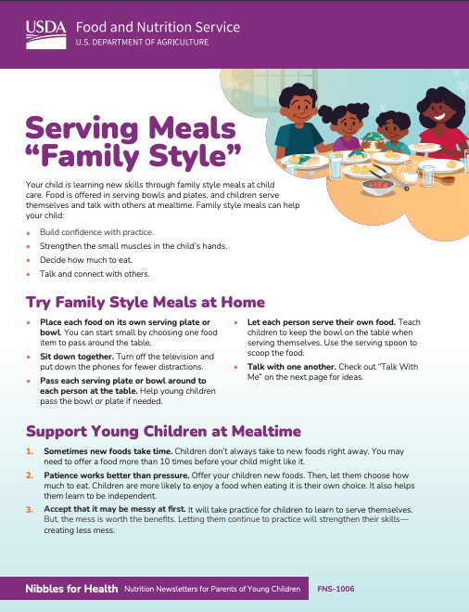

What Can I Do to Help Staff and Parents/Guardians Before Starting?
(Part 3)
Parents and Guardians
Send a message home to let parents/guardians know your site will be starting family style meal service.
Share USDA Team Nutrition’s Nibbles for
Health Parent Newsletter “Serving Meals ‘Family Style.’”
fns.usda.gov/tn/nibbles
20
Notes:
Script: Before starting family style meal service, it is also important to communicate with parents and guardians. Send a message home to let parents/guardians know your site will be starting family style meal service. Share USDA Team Nutrition’s Nibbles for Health Parent Newsletter “Serving Meals ‘Family Style’” at fns.usda.gov/tn/nibbles. Hand it out at pickup time, add it to your newsletter, or share it on social media and/or classroom apps.

Slide 21
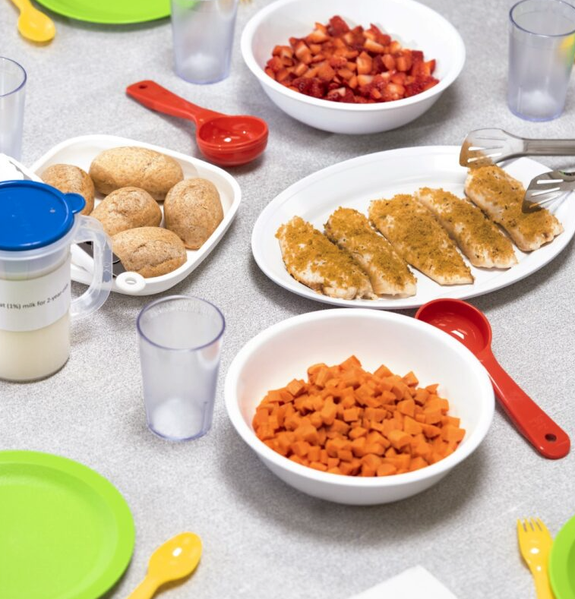
What Can I Do to Help Staff and Parents/Guardians Before Starting?
(Part 4)
Food Service Staff, Caterers, and Food Vendors
Inform them that you would like to start serving meals family style.
Ask to have food in serving bowls or plates.
Communicate and coordinate about the following:
  Number of children in
  each classroom.
  Number of children seated at
  each table.
  Age group of children being served.
21
Notes:
Script: If you work with food service staff, caterers, or food vendors, let them know you would like to start serving meals family style. Explain that you would like to have food in serving bowls or plates, so children can serve themselves. Remember, page 3 in the operator booklet has suggested supplies. Coordination and communication are important. Remember to communicate with food service staff about the number of children in each classroom, number of children seated at each table, and the age groups of children being served. This coordination helps ensure that the common serving bowls and plates placed on each table have enough of the required portions for each child seated at the table.

Slide 22
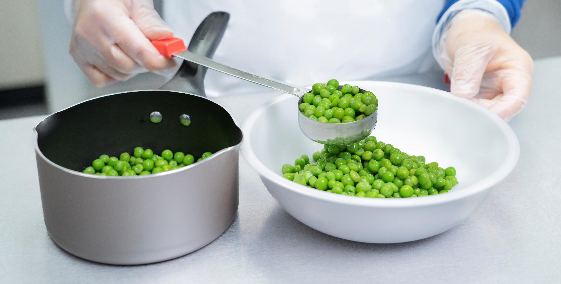

Following Requirements During Family Style Meal Service
How Do I Make Sure I’m Providing Enough Food for Each Child? Pg. 6
How Do I Accommodate Special Dietary Needs? Pg.10
22
Notes:
Script: During this section, "Following Requirements During Family Style Meal Service," we will answer two major questions: “How Do I Make Sure I’m Providing Enough Food for Each Child?” and “How Do I Accommodate Special Dietary Needs?”. Please turn to page 6 in the operator booklet, where this section begins.

Slide 23
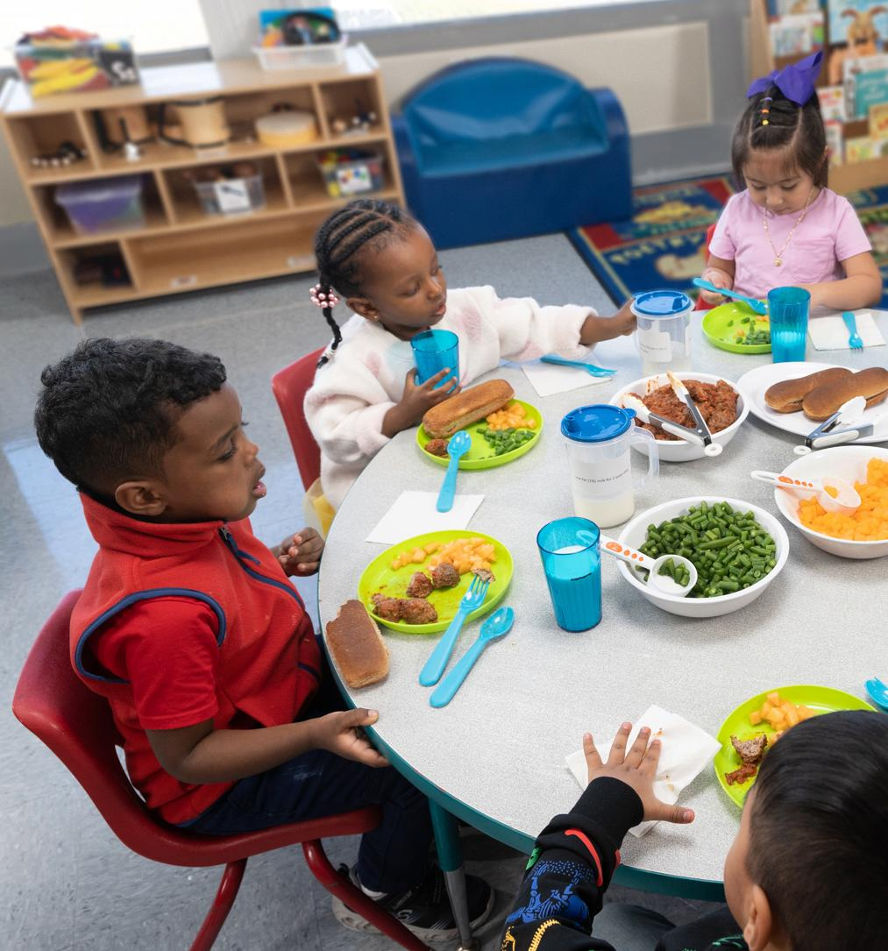

How Do I Make Sure I’m Providing Enough Food for Each Child? (Part 1)
It is a requirement to offer the full portion size in the serving bowl or serving plate for each child.
To provide enough food for each child:
Calculate the minimum amount of food needed for each child at the meal or snack.
Provide the full portion of each meal component for every child seated at the table in serving bowl(s), plate(s),
and/or pitcher(s).
Place all serving bowl(s), plate(s), and/or pitcher(s) on the table where the children are seated for the meal and snack.
Offer each meal component to each child at the table.
A child does not need to put the food on their plate or eat the food for the meal or snack to be reimbursable.
23
Notes:
Note: This information can be found starting on page 6 in the operator booklet.
Script: It is a requirement to offer the full portion size in the serving bowl or serving plate for each child. To provide enough food for each child:
First, calculate the minimum amount of food needed for each child at that meal or snack. On pages 7 and 8 in the operator booklet there are examples for determining how much food to prepare at meals and snacks for children from one or more age groups. We will also practice this shortly.
Second, provide the full portion of each meal component for every child seated at the table in serving bowl(s), plate(s), and/or pitcher(s).
Third, place all serving bowl(s), plate(s), and/or pitcher(s) on the table where the children are seated for the meal and snack.
Last, offer each meal component to each child at the table.
Always remember, a child does not need to put the food on their plate or eat the food for the meal or snack to be reimbursable.

Slide 24
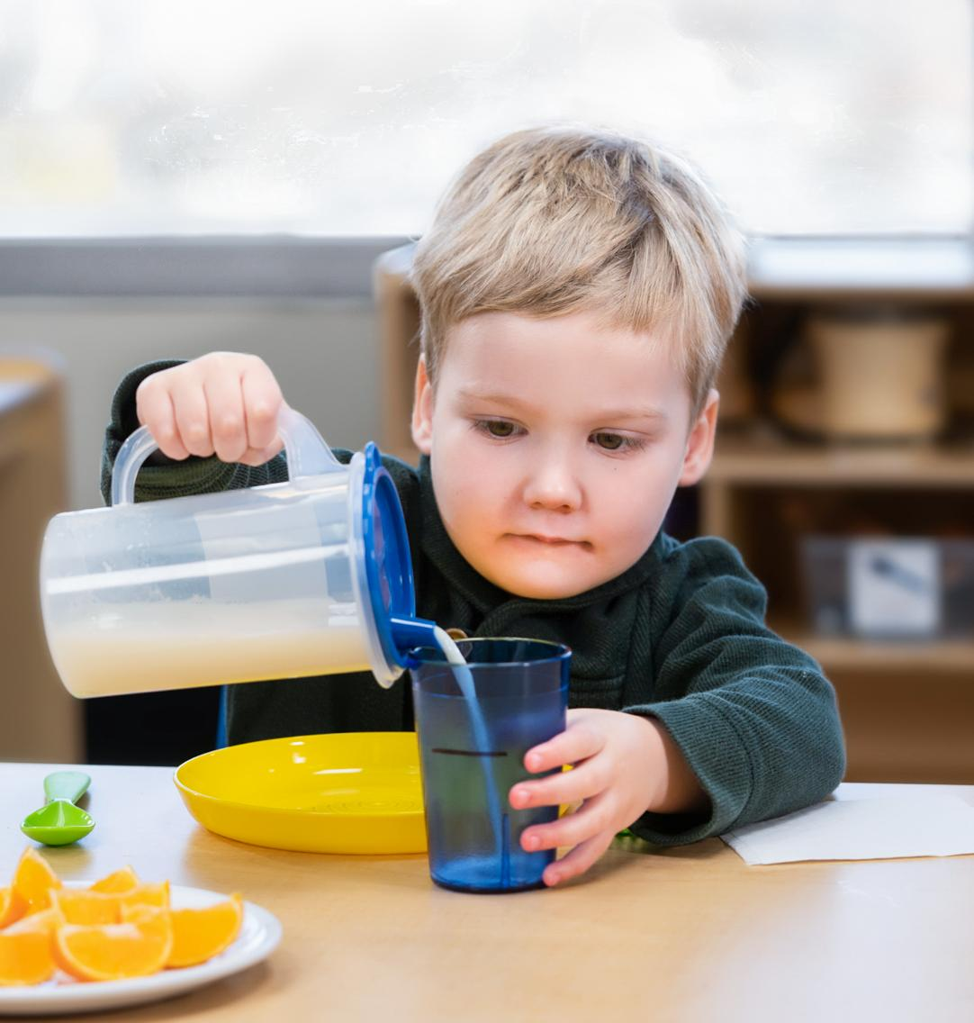
How Do I Make Sure I’m Providing Enough Food for Each Child? (Part 2)
Tip! Add a Line to a Cup
If a child’s cup is larger than the portion size required by CACFP meal pattern requirements, add a line on the outside of the cup to show where to fill.
24
Notes:
Script: If a child’s cup is larger than the portion size required by CACFP meal pattern requirements, add a line on the outside of the cup to show where to fill. For example, a 3-year old must be offered at least 4 fluid ounces (½ cup) of milk at snack in the CACFP. Measure and mark 4 fluid ounces (½ cup) on the outside of each child’s cup so they can see when to stop pouring.

Slide 25

How Do I Make Sure I’m Providing Enough Food for Each Child? (Part 3)
Try It Out!
Question
Play & Learn Child Care served spinach at lunch and provided the full required minimum amount in the serving bowl for each of the three children at the
table. Johnny did not put any on his plate. Mya put some on her plate. Finn put the full minimum amount on his plate. None of them ate everything they put on
their plates.
Are all three meals reimbursable?
25
Notes:
Script: Let’s pause and do a practice question together: Play & Learn Child Care served spinach at lunch and provided the full required minimum amount in the serving bowl for each of the three children at the table. Johnny did not put any on his plate. Mya put some on her plate. Finn put the full minimum amount on his plate. None of them ate everything they put on their plates. Are all three meals reimbursable?
Note: Give participants 30 seconds to think about the response.

Slide 26
How Do I Make Sure I’m Providing Enough Food for Each Child? (Part 4)
Try It Out!
Answer
Yes. All three of the meals are reimbursable.
The child care site must provide enough food so that each child has the option to take the full minimum serving amount of food, if they wish.
They are not required to take or eat the full amount for the meal or snack to be reimbursable.
26
Notes:
Script: The answer is “yes”. All three of the meals are reimbursable.
The child care site must provide enough food so that each child has the option to take the full minimum serving amount of food, if they wish. However, they are not required to take or eat the full amount for the meal or snack to be reimbursable.
Does anyone have questions?

Slide 27
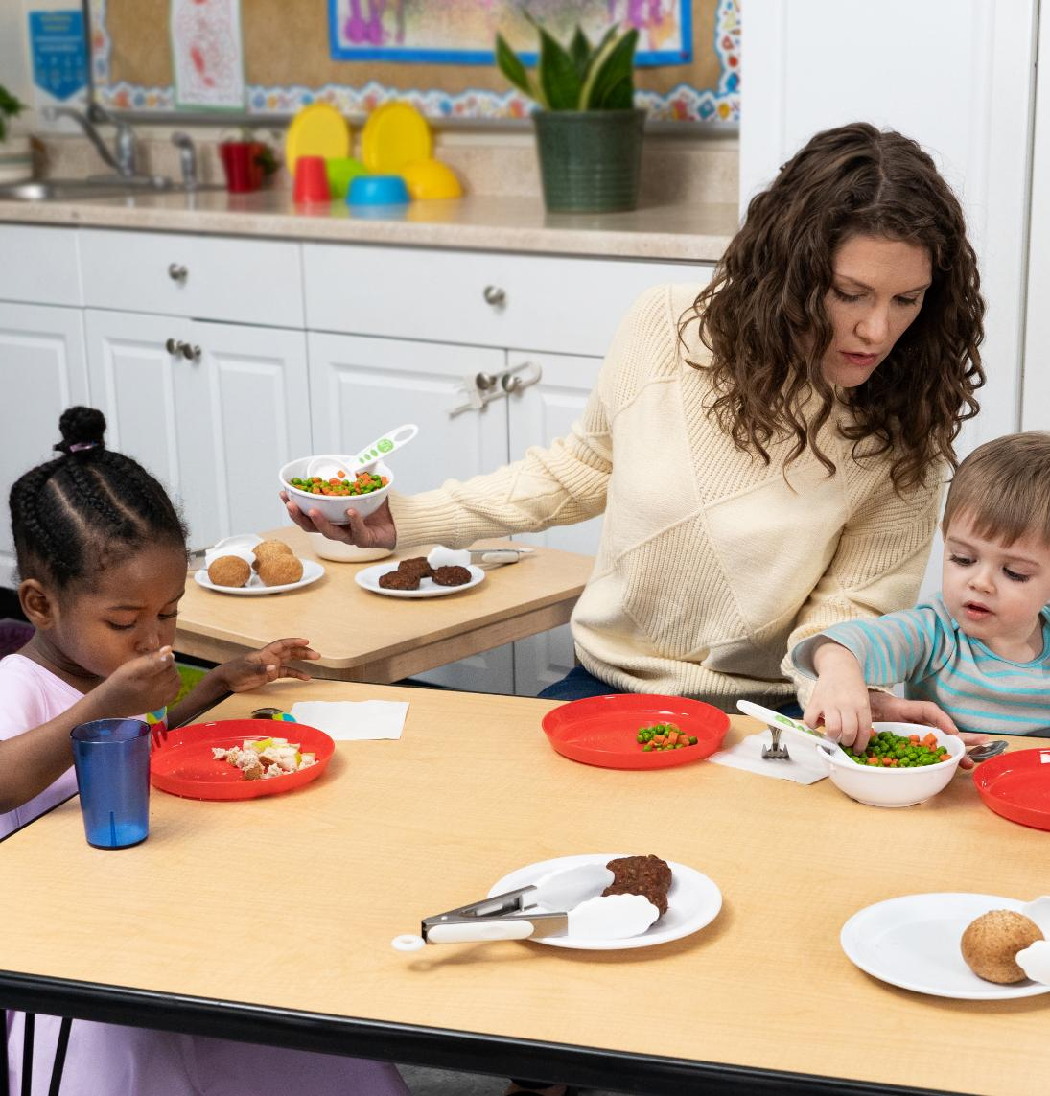
How Do I Make Sure I’m Providing Enough Food for Each Child? (Part 5)
Preparing for Spills, Contamination,
and Offering More Food
You may want to prepare more food in case of spillage, contamination, and/or if a child wants more.
Extra food does not need to be on the table where children are sitting.
Keep the food on another table or cart close by, or in the kitchen.
27
Notes:
Note: This information can be found on page 9 in the operator booklet.
Script: You may want to prepare more food in case of spillage, contamination, and/or if a child wants more. If you prepare more food than is required by the meal pattern, you do not have to put that extra food on the table where the children are sitting. You may want to keep the food on another table or cart close by, or in the kitchen. This way, you can ensure the full portion is on the table for each child but can quickly replace a serving bowl or plate of food if more is needed. You may want to prepare more food in case of spillage, contamination, and/or if a child wants more. Check with your sponsoring organization or State agency about using CACFP funds to buy extra food.

Slide 28
How Do I Make Sure I’m Providing
Enough Food for Each Child? (Part 6)
Calculate for a Single Age Group
1.
Determine the minimum amount of food needed for each child at the meal or snack.
Meal | Age of the Children | Food Item | Required Minimum Amount per Child
2.
Multiply the minimum amount of food (from Step 1) by the number of children at the meal or snack.
Multiplied by… | Number of Participants | Equals | Total
X |  | =
28
Notes:
Note: This information can be found on page 7 in the operator booklet.
Script: There are two steps to follow when determining the total amount of food to provide during meals and snacks to children from a single age group (such as 1- through 2-year olds).
Step 1 is to determine the minimum amount of food needed for each child at that meal or snack. Refer to the meal pattern requirements to identify the minimum portion size needed for each child at the meal or snack.
Step 2 is to multiply the minimum amount of food (from Step 1) by the number of children at the meal or snack.

Slide 29
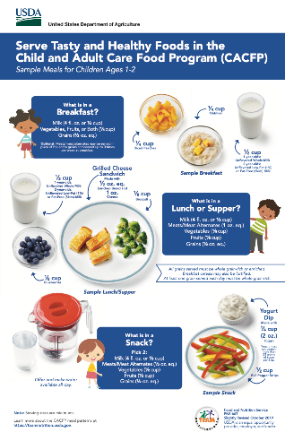
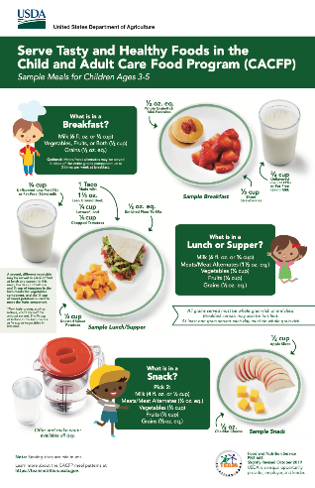
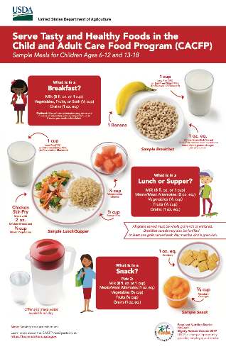
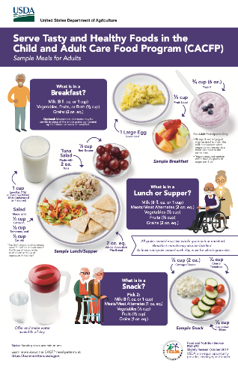

CACFP Meal Pattern Requirements
fns.usda.gov/tn/training-tools-cacfp
29
Notes:
Script: See USDA Team Nutrition’s “Serve Tasty and Healthy Food in the Child and Adult Care Food Program” posters for required minimum amounts of meal components. You can find them at TeamNutrition.USDA.gov.
Note: For more information and training resources on CACFP meal pattern requirements, check out Team Nutrition's website at TeamNutrition.USDA.gov.

Slide 30
How Do I Make Sure I’m Providing
Enough Food for Each Child? (Part 7)
Calculate for a Single Age Group - Example
Happy Day Child Care wants to offer diced peaches at lunch to the 2-year old classroom. This classroom has twelve 2-year olds in class today.
1.
Determine the minimum amount of food needed for each child at the meal or snack.
Meal | Age of the Children | Food Item | Required Minimum Amount per Child
Lunch | 2-year olds | Diced peaches | 0.125 cup
30
Notes:
Script: Let us begin with an example where we calculate the amount of food needed for a single age group. Happy Day Child Care wants to offer diced peaches at lunch to the 2-year old classroom. This classroom has twelve 2-year olds in class today.
The first step is to determine the minimum amount of food needed for each child at the meal or snack. If you're unsure what the required amounts are, remember to check out Team Nutrition's posters on CACFP meal pattern requirements that we discussed on the previous slide. The minimum amount of fruit needed at lunch for each 2-year old is ⅛ cup (or 0.125 cup).

Slide 31
How Do I Make Sure I’m Providing
Enough Food for Each Child? (Part 8)
Calculate for a Single Age Group - Example
Happy Day Child Care wants to offer diced peaches at lunch to the 2-year old classroom. This classroom has twelve 2-year olds in class today.
Meal | Age of the Children | Food Item | Required Minimum Amount per Child
Lunch | 2-year olds | Diced peaches | 0.125 cup
2.
Multiply the minimum amount of food (from Step 1) by the number of children at the meal or snack.
Multiplied by… | Number of Participants | Equals | Total
X | 12 | = | 1.5 cups
31
Notes:
Script: Next, for Step 2, multiply the minimum amount of food (from Step 1) by the number of children at the meal or snack.
In this example, the minimum amount of food is 0.125 cup of diced peaches. Multiply 12 children by 0.125 cup of diced peaches, which equals a total of 1.5 cups of diced peaches.
Happy Day Child Care should provide at least 1.5 cups of diced peaches at lunch for the 12 children. The 1.5 cups of diced peaches can be placed in one serving bowl if all 12 children are sitting at one table. If they are sitting at more than one table, split the 1.5 cups into smaller bowls that may be easier for children to hold and pass at each table.

Slide 32
How Do I Make Sure I’m Providing
Enough Food for Each Child? (Part 9)
Try It Out!
Let’s Practice! Calculate for a Single Age Group
Building Blocks Child Care practices family style meal service. They have seven 3-year olds in attendance today. They want to offer applesauce at breakfast.
What is the total amount of applesauce that should be in the serving bowl(s) on the table?
Meal | Age of the Children | Food Item | Required Minimum Amount per Child | Multiplied by… | Numbers of Participants | Equals | Total
 |  |  |  | X |  | =
32
Notes:
Script: Now it’s time to practice on your own. Calculate the amount of food for a single age group in this example. Building Blocks Child Care practices family style meal service. They have seven 3-year olds in attendance today. They want to offer applesauce at breakfast. What is the total amount of applesauce that should be in the serving bowl(s) on the table?
Remember you will need to look up the required minimum amount per child of fruit for breakfast. You can look at these requirements in USDA Team Nutrition’s “Serve Tasty and Healthy Food in the Child and Adult Care Food Program” posters for required minimum amounts of meal components. For today's purposes, we will provide you with this amount and it is ½ cup (0.5 cup).
Note: Give participants 2 minutes to complete this practice question on their own. For on-line trainings, ask participants to type the answer for the minimum amount to provide in the chat. For in-person trainings, ask a participant to share the answer for the minimum amount to provide with the group.

Slide 33
How Do I Make Sure I’m Providing
Enough Food for Each Child? (Part 10)
Try It Out!
Let’s Practice! Calculate for a Single Age Group - Answer
Building Blocks Child Care practices family style meal service. They have seven 3-year olds in attendance today. They want to offer applesauce at breakfast.
What is the total amount of applesauce that should be in the serving bowl(s) on the table?
Meal | Age of the Children | Food Item | Required Minimum Amount per Child | Multiplied by… | Numbers of Participants | Equals | Total
Breakfast | 3-year olds | Applesauce | 0.5 cup | X | 7 | = | 3.5 cups
33
Notes:
Note: You can ask for a participant to walk through the example and give the answer.
Script: The first step is to determine the minimum amount of food needed for each child at the meal or snack. In this example, each 3-year old child needs a minimum of a ½ cup (0.5 cup) of fruit, vegetable, or portions of both for breakfast. For Step 2, you must multiply the minimum amount of food (from Step 1) by the number of children at the meal or snack. In this example, you need to multiply ½ cup (0.5 cup) by 7 participants, which equals 3.5 cups. That means that Building Blocks Child Care will need to provide at least 3.5 cups of applesauce at breakfast that day. The 3.5 cups of applesauce can be placed in one serving bowl if all 7 children are sitting at one table. If they are sitting at more than one table, split the 3.5 cups into smaller bowls that may be easier for children to hold and pass at each table.

Slide 34
How Do I Make Sure I’m Providing
Enough Food for Each Child? (Part 11)
Try It Out!
Let’s Practice! Calculate for a Single Age Group Using Ounce Equivalents
  Abracadabra Child Care practices family style meal service. They have sixteen 5-year olds in attendance in Ms. Smith’s classroom today. They want to offer cooked lean ground turkey so children can build their own tacos at lunch.
  What is the total amount of cooked lean ground turkey that must be in the serving bowls(s) on the table?
34
Notes:
Script: Now, let’s practice calculating for a single age group using ounce equivalents.
Abracadabra Child Care practices family style meal service. They have sixteen 5-year olds in attendance in Ms. Smith’s classroom today. They want to offer cooked lean ground turkey so children can build their own tacos at lunch. What is the total amount of cooked lean ground turkey that must be in the serving bowl(s) on the table?
Note: Give participants 2 minutes to complete this practice question on their own. For on-line trainings, ask participants to type the answer for the minimum amount to provide in the chat. For in-person trainings, ask a participant to share the answer for the minimum amount to provide with the group.

Slide 35

How Do I Make Sure I’m Providing
Enough Food for Each Child? (Part 12)
Try It Out!
Let’s Practice! Calculate for a Single Age Group Using Ounce Equivalents (continued)
1.
Determine the minimum amount of food needed for each child at that meal or snack.
1.5 oz of cooked ground turkey = 1.5 oz eq
35
Notes:
Script: Step 1 is to determine the minimum amount of food needed for each child at that meal or snack.
Reference the CACFP meal pattern requirements for meats/meat alternates for lunch for 3- through 5-year old children. See USDA Team Nutrition’s “Serve Tasty and Healthy Food in the Child and Adult Care Food Program” posters for required minimum amounts of meal components. The CACFP meal pattern lists the required amounts for meats and/or meat alternates as ounce equivalents (oz eq). Ounce equivalents tell you the amount of meat and/or meat alternate in a portion of food. For example, 1 oz eq is equal to half a large egg or 1 ounce (oz) of cooked lean meat.
As you see on the poster, a 5-year old must be offered at least 1.5-ounce equivalents of meats/meat alternates for lunch. 1.5 ounce equivalents means 1.5 ounces of cooked ground turkey. The key word is “cooked”, because 1.5 ounces of raw ground turkey will become smaller when cooked, and not yield a 1.5-ounce equivalent. USDA’s Food Buying Guide Calculator can support you in meeting ounce equivalent requirements for meats and/or meat alternates. We will reference this resource in a few minutes.

Slide 36
How Do I Make Sure I’m Providing
Enough Food for Each Child? (Part 13)
Try It Out!
Let’s Practice! Calculate for a Single Age Group Using Ounce Equivalents (continued)
  Abracadabra Child Care practices family style meal service. They have sixteen 5-year olds in attendance in Ms. Smith’s classroom today. They want to offer cooked lean ground turkey so children can build their own tacos at lunch.
  What is the total amount of cooked lean ground turkey that must be in the serving bowl(s) on the table?
Meal | Age | Food Item | Required Minimum Amount per Child | Multiplied by… | Numbers of Participants | Equals | Minimum Amount
Lunch | 5-year olds | Cooked lean ground turkey | 1.5 oz eq (1.5 oz eq = 1.5 oz cooked lean ground turkey) | X | 16 | = | 24 oz eq (24 oz)
36
Notes:
Script: Step 2 is to multiply the minimum amount of food (from Step 1) by the number of children at the meal or snack. In this example, there are 16 children, so we multiply 1.5-ounce equivalents by 16.
That means that Abracadabra Child Care should provide at least 24-ounce equivalents (24 ounces) of cooked lean ground turkey in serving bowl(s) on the table for 16 children to build their tacos for lunch.
The 24-ounce equivalents, or 24 ounces, of cooked lean ground turkey can be placed in one serving bowl if all 16 children are sitting at one table.
If they are sitting at more than one table, split the ground turkey into smaller bowls that may be easier for children to hold and pass at each table.

Slide 37

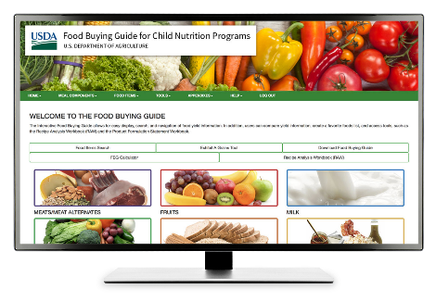
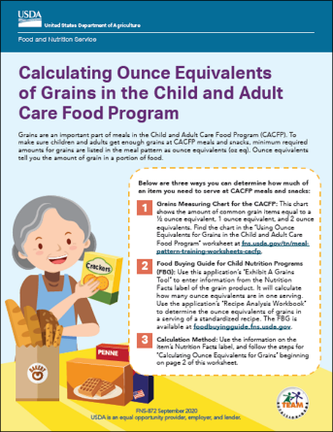
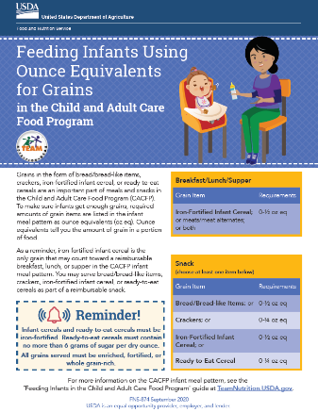
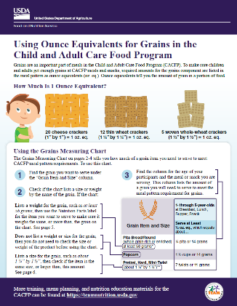
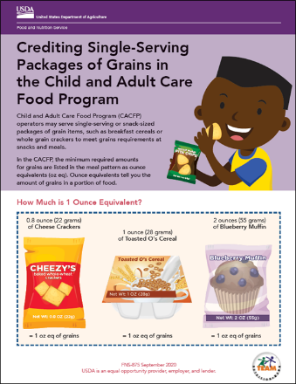

How Do I Make Sure I’m Providing
Enough Food for Each Child? (Part 14)
CACFP Ounce Equivalents Resources
fns.usda.gov/tn/grains-ounce-equivalents-resources-cacfp
37
Notes:
Script: For more information on ounce equivalents, visit USDA’s “Food Buying Guide for Child Nutrition Programs” and Team Nutrition’s “CACFP Grains Ounce Equivalents Resources” webpage. The web address and QR code are shown on the bottom of the slide.

Slide 38
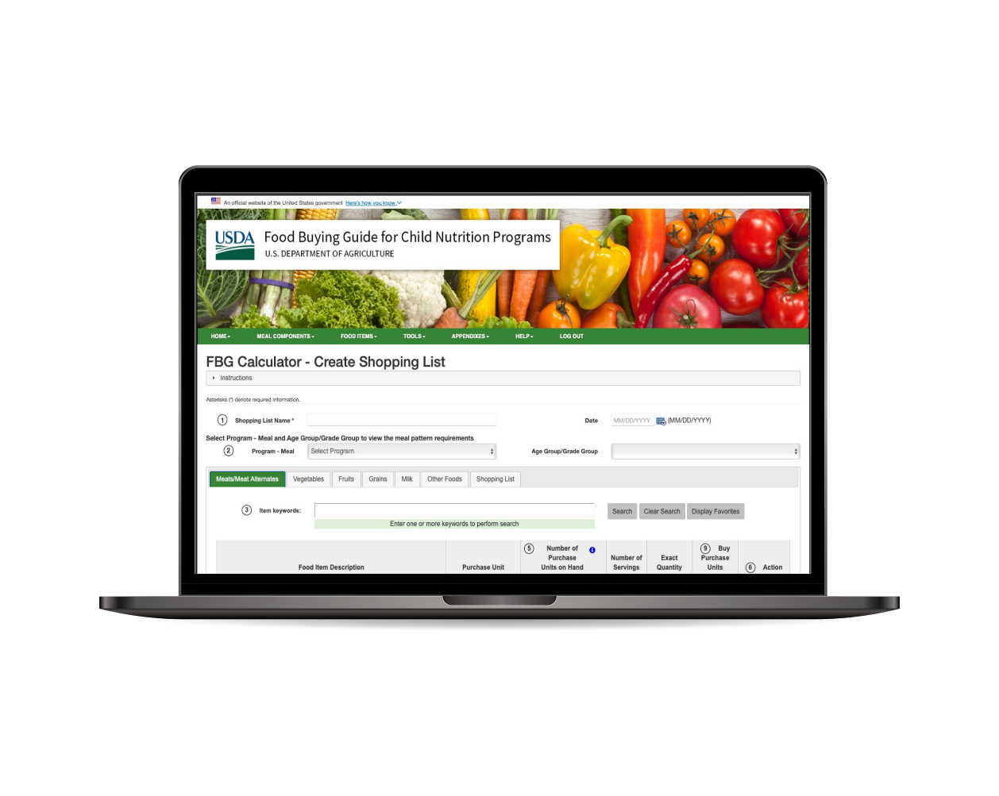

How Do I Make Sure I’m Providing
Enough Food for Each Child? (Part 15)
Resource - USDA Food Buying Guide Calculator for Child Nutrition Programs
Use the Food Buying Guide Calculator to help you determine how much food to purchase.
For more information, check out a training video at
fns.usda.gov/tn/navigating-food-buying-guide-fbg-calculator.
38
Notes:
Script: To determine how much food to purchase, use USDA’s “Food Buying Guide Calculator for Child Nutrition Programs.” For more information on the calculator, check out a training video at the web address or QR code at the bottom of the slide.

Slide 39

How Do I Make Sure I’m Providing
Enough Food for Each Child? (Part 16)
Calculate for Children for Different Age Groups - Example
1.
Determine the minimum amount of food needed for each child at the meal or snack.
Meal | Age of the Children | Food Item | Required Minimum Amount per Child
Lunch | 2-year olds | Diced peaches
Lunch | 3-year olds | Diced peaches
2.
Multiply the minimum amount of food (from Step 1) by the number of children at the meal or snack separately for each age group.
Multiplied by… | Numbers of Participants | Equals | Minimum Amount to Provide
X |  | =
X |  | =
3.
Add the amounts for each age group (from Step 2) to see the total amount to provide.
Total
39
Notes:
Note: This information can be found on page 8 in the operator booklet.
Script: There are three steps to follow when determining the total amount of food to offer during meals and snacks to children from different age groups (such as 1-through 2-year olds and 3-through 5-year olds).
Step 1 is to determine the minimum amount of food needed for children in each age group at the meal or snack. Step 2 is to multiply the minimum amount of food (from Step 1) by the number of children at the meal or snack separately for each age group. And, Step 3 is to add the amounts for each age group (from Step 2) to see the total amount to provide.

Slide 40
How Do I Make Sure I’m Providing
Enough Food for Each Child? (Part 17)
Calculate for Children for Different Age Groups - Example
  Happy Day Child Care wants to offer diced peaches at lunch to the mixed-age classroom. This classroom has six 2-year olds and six 3-year olds.
1.
Determine the minimum amount of food needed for each child at the meal or snack.
Meal | Age of the Children | Food Item | Required Minimum Amount per Child
Lunch | 2-year olds | Diced peaches | 0.125 cup
Lunch | 3-year olds | Diced peaches | 0.25 cup
40
Notes:
Script: The first step is to determine the minimum amount of food needed for each age group at the meal or snack. In this example, the minimum amount of fruit needed at lunch for each 2-year old is ⅛ cup (or 0.125 cup). The minimum amount of fruit needed at lunch for each 3-year old is ¼ cup (or 0.25 cup).

Slide 41
How Do I Make Sure I’m Providing
Enough Food for Each Child? (Part 18)
Calculate for Children for Different Age Groups - Example
Meal | Age of the Children | Food Item | Required Minimum Amount per Child
Lunch | 2-year olds | Diced peaches | 0.125 cup
Lunch | 3-year olds | Diced peaches | 0.25 cup
2.
Multiply the minimum amount of food (from Step 1) by the number of children at the meal or snack separately for each age group.
Multiplied by… | Numbers of Participants | Equals | Minimum Amount to Provide
X | 6 | = | 0.75 cup
X | 6 | = | 1.5 cups
41
Notes:
Script: The second step is to multiply the minimum amount of food (from Step 1) by the number of children at the meal or snack separately for each age group. In this example, ⅛ cup (or 0.125 cup) of diced peaches multiplied by 6 children equals ¾ cup (0.75 cup) of diced peaches. ¼ cup (or 0.25 cup) of diced peaches multiplied by 6 children equals 1½ cups (1.5 cups) of diced peaches.

Slide 42
How Do I Make Sure I’m Providing
Enough Food for Each Child? (Part 19)
Calculate for Children for Different Age Groups - Example
Meal | Age of the Children | Food Item | Required Minimum Amount per Child
Lunch | 2-year olds | Diced peaches | 0.125 cup
Lunch | 3-year olds | Diced peaches | 0.25 cup
Multiplied by… | Numbers of Participants | Equals | Minimum Amount to Provide
X | 6 | = | 0.75 cup
X | 6 | = | 1.5 cups
3.
Add the amounts for each age group (from Step 2) to see the total amount to provide.
Total | 2.25 cups
  0.75 cup + 1.5 cups = 2.25 cups (2 ¼ cups) of diced peaches
42
Notes:
Script: The third and final step is to add the amounts for each age group (from Step 2) to see the total amount to provide. Add ¾ cup (0.75 cup) for the 2-year olds to 1½ cups (1.5 cups) for the 3-year olds, which equals 2 ¼ cups (2.25 cups).

Slide 43
How Do I Make Sure I’m Providing
Enough Food for Each Child? (Part 20)
Try It Out!
Let's Practice! Calculate for Different Age Groups
Meal | Age of the Children | Food Item | Required Minimum Amount per Child
 |  |  | ___ cups
 |  |  | ___ cups
  Magical Day Child Care has a mixed age-group classroom and practices family style meal service. They have four 2-year olds and four 3-year olds in attendance today. They are serving
  fat-free (skim) milk at breakfast.
  What is the total amount of milk they must put in the pitcher(s) on the table?
Multiplied by… | Numbers of Participants | Equals | Minimum Amount to Provide
X |  | =
X |  | =
Total | ___ cups
43
Notes:
Note: This practice question can be found on page 14, practice question #2, in the operator booklet.
Script: It’s time to practice on your own. Magical Day Child Care has a mixed age-group classroom and practices family style meal service. They have four 2-year olds and four 3-year olds in attendance today. They are serving fat-free (skim) milk at breakfast. What is the total amount of milk they must put in the pitcher(s) on the table?
Note: Give participants 2 minutes to complete this practice question on their own. For on-line trainings, ask participants to type the answer for the minimum amount to provide in the chat. For in-person trainings, ask a participant to share the answer for the minimum amount to provide with the group.

Slide 44
How Do I Make Sure I’m Providing
Enough Food for Each Child? (Part 21)
Try It Out!
Let's Practice! Calculate for Different Age Groups
Meal | Age of the Children | Food Item | Required Minimum Amount per Child
Breakfast | 2-year olds | Fat-free (skim) milk | ½ cup (0.5 cup), 4 fl oz
Breakfast | 3-year olds | Fat-free (skim) milk | ¾ cup (0.75 cup), 6 fl oz
  Magical Day Child Care has a mixed age-group classroom and practices family style meal service. They have four 2-year olds and four 3-year olds in attendance today. They are serving
  fat-free (skim) milk at breakfast.
  What is the total amount of milk they must put in the pitcher(s) on the table?
Multiplied by… | Numbers of Participants | Equals | Minimum Amount to Provide
X | 4 | = | 2 cups (16 fl oz)
X | 4 | = | 3 cups (24 fl oz)
Total | 5 cups (40 fl oz)
44
Notes:
Script: The first step when calculating the amount of milk needed for different age groups is to determine the minimum amount of milk needed for children from each age group at that meal or snack. Two-year olds must be offered ½ cup (4 fluid ounces) of milk for breakfast and 3-year olds ¾ cup (6 fluid ounces) of milk for breakfast.
The second step is to multiply the minimum amount of milk (from Step 1) by the number of children at breakfast for each child age group. Since there are four 2-year olds, we multiply a ½ cup (4 fluid ounces) by 4, which equals 2 cups (16 fluid ounces). Since there are four 3-year olds, we multiply ¾ cups (6 fluid ounces) by 4, which equals 3 cups (24 fluid ounces)
The final, third step, is to add the amounts for each age group (from Step 2) to see the total amount to provide. In this case, 2 cups plus 3 cups is 5 cups (or 16 fluid ounces plus 24 fluid ounces is 40 fluid ounces).
That means that Magical Day Child Care must provide at least 5 cups (40 fluid ounces) of fat-free (skim) milk in the pitcher(s) at breakfast to the mixed-age classroom. The 5 cups (40 fluid ounces) of milk can be placed in one pitcher or can be divided into two or more pitchers that may be easier for children to hold, pass, and pour.
Note: Refer participants to page 15 of the operator booklet with the answer.

Slide 45
How Do I Accommodate
Special Dietary Needs? (Part 1)
Accommodating Disabilities
CACFP operators are required to make modifications to meals or meal service to accommodate disabilities, including food allergies.
If the meal modification cannot be made within the meal pattern requirements, ask the parent/guardian for a signed medical statement to keep on file in a secure location at the site.
The medical statement must include:
  the food to be avoided (allergen),
  a brief explanation of how exposure to the food affects the participant, and
  recommended substitute(s).
45
Notes:
Note: This information can be found on page 10 in the operator booklet.
Script: A child may have special dietary needs due to a disability, including a food allergy, which may require a meal modification. Or, there may be circumstances where a parent/guardian requests a special diet due to religious or cultural practices, or dietary preferences. In these cases, food substitutions may be pre-plated on the child’s plate and the remaining meal components may be passed around “family style.”
In the CACFP, operators are required to make modifications to meals or meal service to accommodate disabilities including food allergies. If the meal modification cannot be made within the meal pattern requirements, ask the parent/guardian for a signed medical statement to keep on file in a secure location at the site. The medical statement must include:
the food to be avoided (allergen),
a brief explanation of how exposure to the food affects the participant, and
recommended substitute(s).
Always check with parents/guardians and follow your site and the child's food allergy plan, Individualized Education Program or 504 plan about necessary meal modification(s) before preparing the meal.

Slide 46
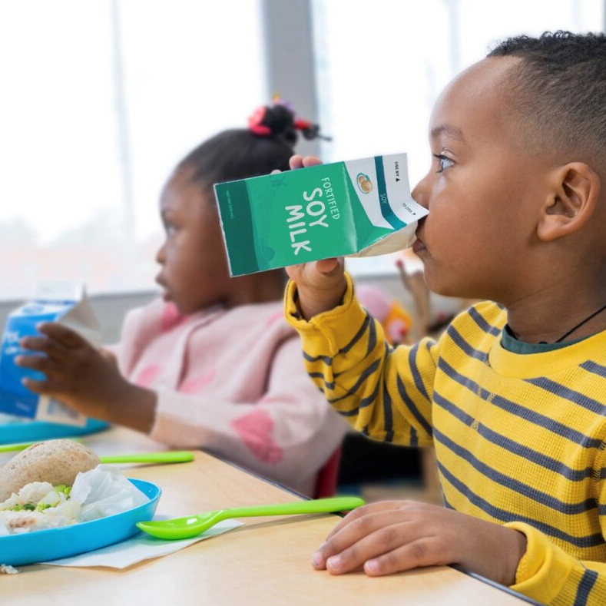
How Do I Accommodate
Special Dietary Needs? (Part 2)
Accommodating Disabilities
Please note: If you have a child that can only eat certain foods, for example gluten-free foods, consider the risk of cross-contact during meal service with the serving spoons and tongs. It may be safer to have their full meal pre-plated to ensure that cross-contact does not occur.
46
Notes:
Script: Please note: If you have a child that can only eat certain foods, for example gluten-free foods, consider the risk of cross-contact during meal service with the serving spoons and tongs. It may be safer to have their full meal pre-plated to ensure that cross contact does not occur.

Slide 47
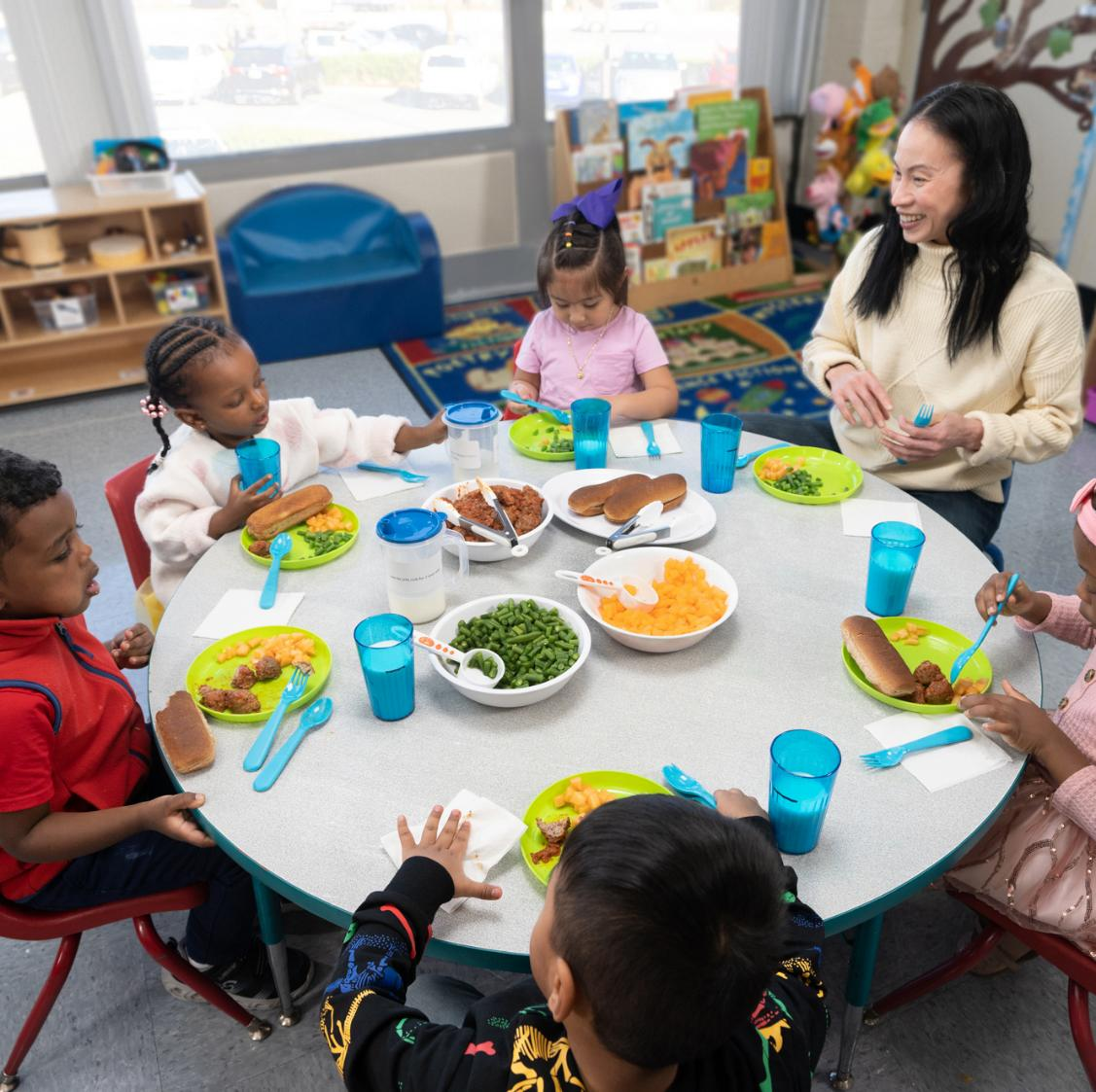
How Do I Accommodate
Special Dietary Needs? (Part 3)
Special Dietary Modifications
Religious or Cultural Practices, or Dietary Preferences
Operators are encouraged to change meals and meal service.
Changes need to meet the CACFP meal pattern.
47
Notes:
Script: For circumstances where a parent/guardian requests a special diet due to religious or cultural practices, or dietary preferences, operators are encouraged to modify meals and meal service. Modifications must meet the CACFP meal pattern requirements.

Slide 48
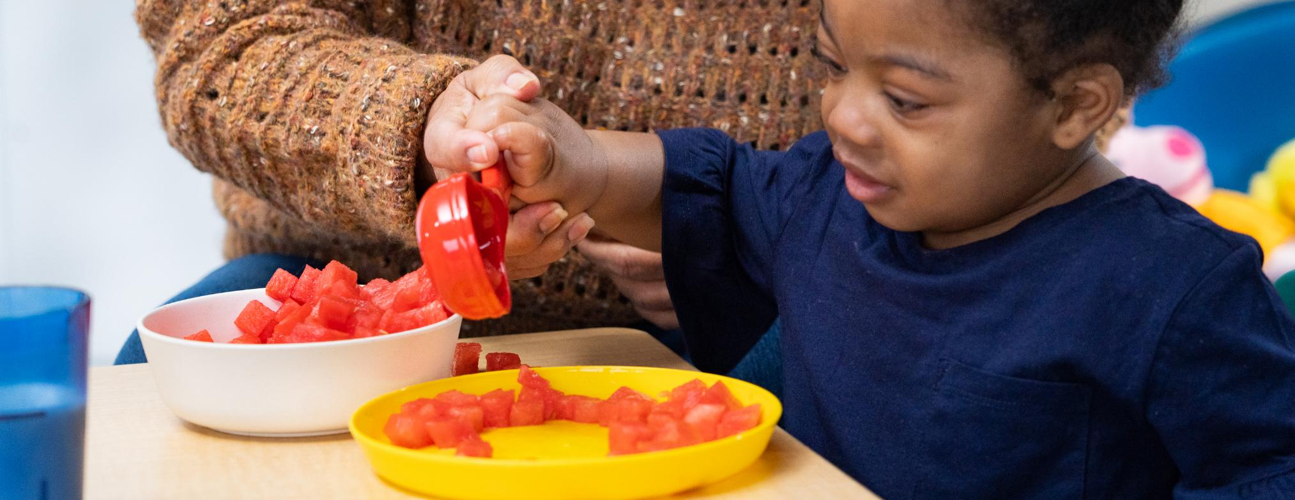

Supporting Children At Mealtime
How Can I Help Children Learn to Serve Themselves? Pg. 11
How Can I Encourage Good Food Safety Habits? Pg. 12
How Can I Encourage Children to Try New Foods? Pg. 13
48
Notes:
Script: During this last section, we will answer three questions about supporting children at mealtime. Please turn to page 11 in the operator booklet, where this section begins.
How Can I Help Children Learn to Serve Themselves? Pg. 11
How Can I Encourage Good Food Safety Habits? Pg. 12
How Can I Encourage Children to Try New Foods? Pg. 13

Slide 49
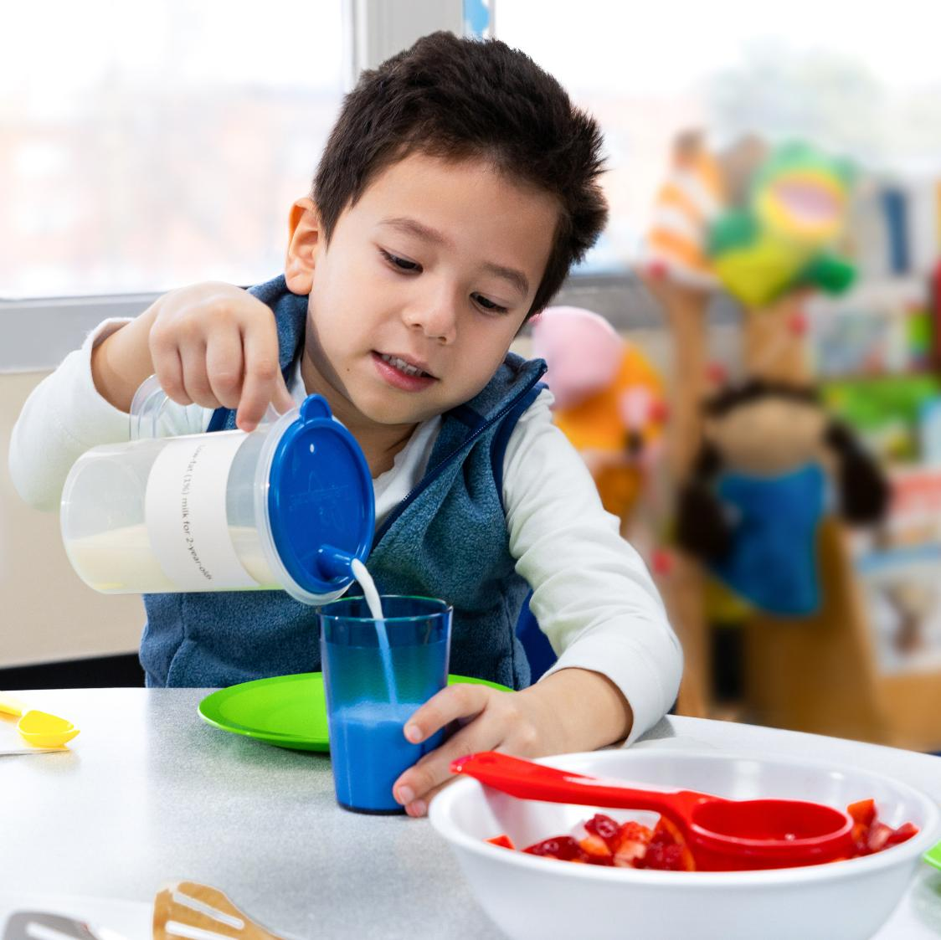

How Can I Help Children Learn to Serve Themselves? (Part 1)
Allow Children to Practice On Their Own
If children need help, use the
hand-over-hand method to guide them.
49
Notes:
Note: This information can be found on page 11 in the operator booklet.
Script: Family style meals provide a great opportunity for children to practice their fine motor skills—strengthening the small muscles in their hands and fingers. These skills are needed for many daily activities, including serving food at mealtime. You can help children learn to serve themselves by allowing children to practice on their own. If they need help, you can use the hand-over-hand method (place your hand over their hand on the serving spoon) to guide them.

Slide 50
How Can I Help Children Learn to Serve Themselves? (Part 2)
Accept It May Be Messy at First
Tips to cut down on the mess:
Put a towel or paper under the children’s chairs.
Teach children to clean up their mess.
Let children continue to practice strengthening their skills—which will eventually lead to creating less mess.
50
Notes:
Script: It will take practice for children to serve themselves family style, and it may be messy at first. But the mess is worth the benefits for children. Try these tips to cut down on the mess:
Put a towel or paper under the children’s chairs.
Teach children to clean up their mess.
Let children continue to practice strengthening their skills—which will eventually lead to creating less mess.

Slide 51


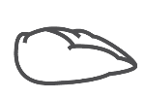



How Can I Help Children Learn to Serve Themselves? (Part 3)
Choose Foods That Are Easier to Scoop
Instead Of…
Spaghetti noodles
Thin soups
Whole chicken
tenderloin
Try…
Macaroni noodles
Thick chili*
Diced or
shredded chicken
*Cook foods, such as beans, until they are soft enough to pierce with a fork to reduce the risk of choking.
51
Notes:
Script: Choose foods that are easier for children to scoop. Here are a few substitutions to consider that may make it easier for young children to serve themselves and create less mess. Instead of spaghetti noodles try macaroni noodles; instead of thin soups try thick soups; and, instead of a whole chicken tenderloin, try diced or shredded chicken.

Slide 52
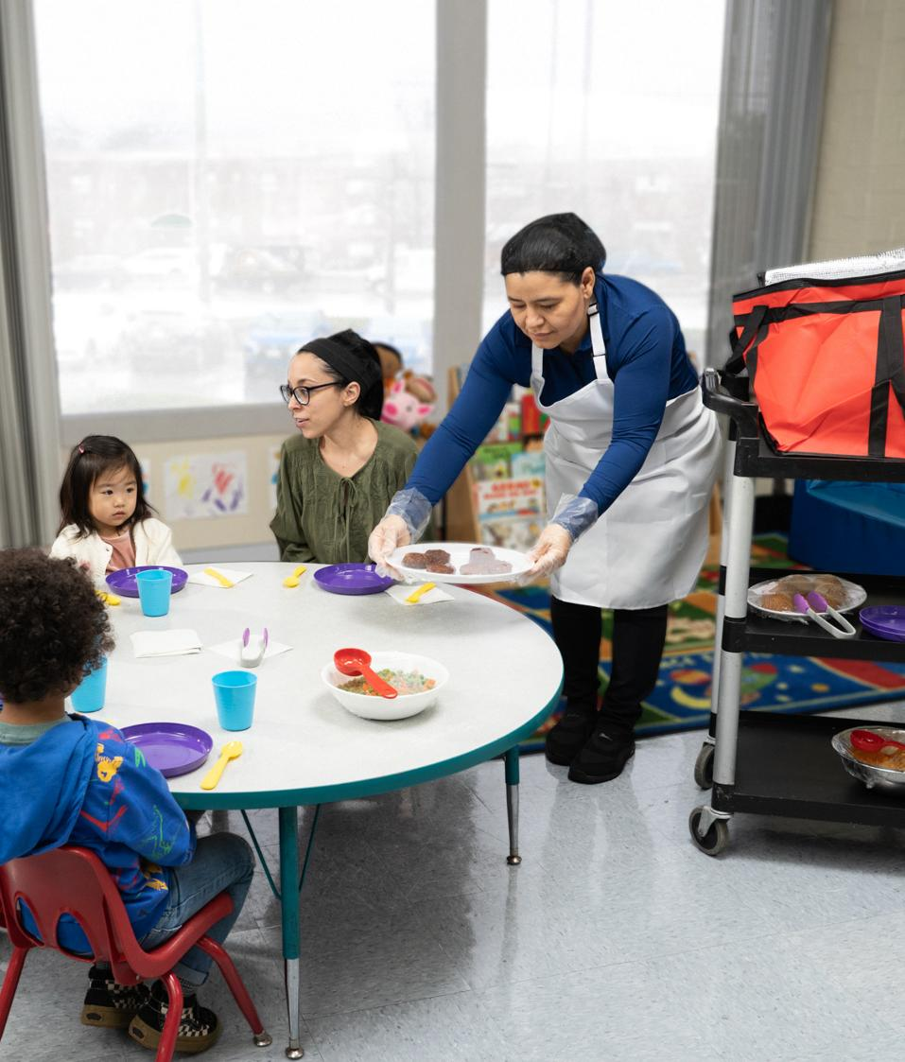

How Can I Encourage Good
Food Safety Habits?
Follow state or local health safety codes and regulations.
Pre-plate a child’s meal if a child is sick or has an open wound.
Use different colors for serving and eating utensils and dishes.
Food safety training and resources that cover these topics can be found at the Institute of Child Nutrition.
theicn.org/icn-resources-a-z/food-safety
52
Notes:
Script: A lot goes into mealtime food safety. Always follow State or local health safety codes and regulations while serving meals family style. Remember to pre-plate a child’s meal if a child is sick or has an open wound. Use different colors for serving and eating utensils and dishes. This may help remind children not to lick the red serving spoon or eat from the red serving bowl or plate. Finally, food safety training and resources that cover these topics can be found at the Institute of Child Nutrition theicn.org/icn-resources-a-z/food-safety.
Note: For more information about how to encourage good food safety habits see page 12 in the operator booklet.

Slide 53
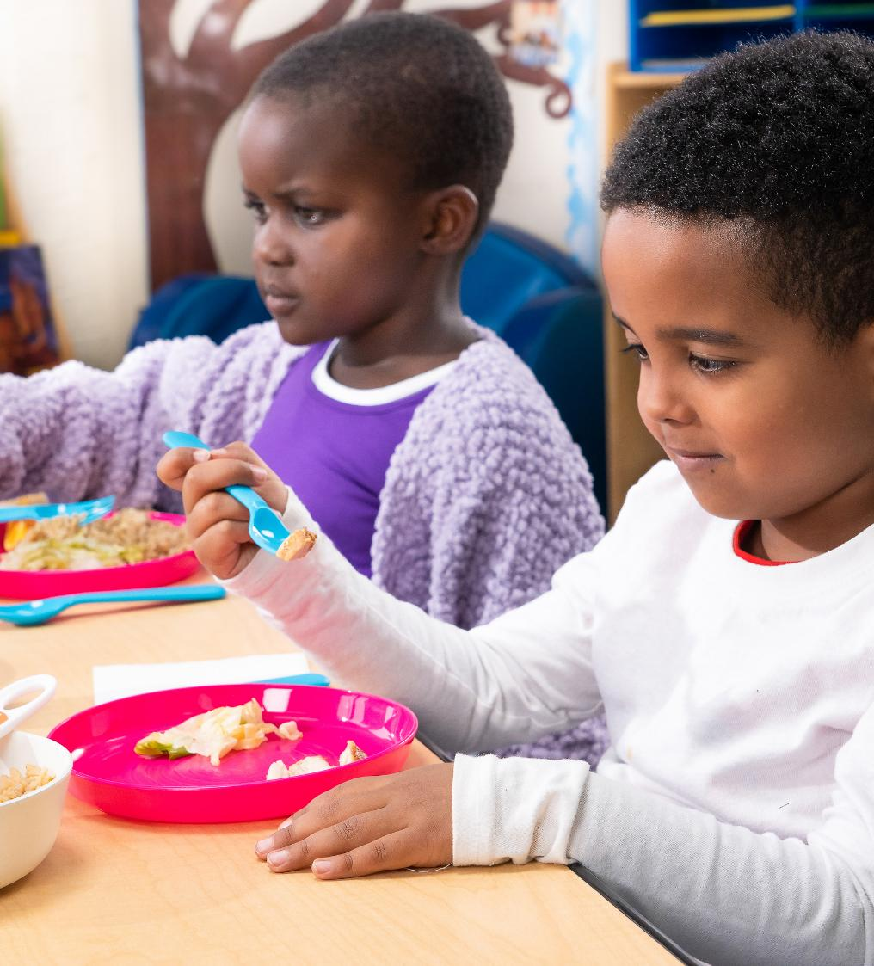
How Can I Encourage Children to Try New Foods? (Part 1)
Introduce New Foods in Different Ways
Outside of mealtime through reading, gardening, and food activities.
One at a time so children are not overwhelmed.
At mealtime with a food they like.
In taste testing activities outside of mealtime.
53
Notes:
Note: This information can be found on page 13 in the operator booklet.
Script: Family style meals allow children to choose if and how much food they want on their plate. This gives them more control and may lead to them trying a new food. You can encourage children by introducing new foods in different ways and by being a role model. You can introduce a new food:
Outside of mealtime through reading, gardening, and food activities.
One at a time so children are not overwhelmed.
At mealtime with a food they like.
In taste testing activities outside of mealtime.
This may allow children, especially those with sensory challenges, to try a food with less pressure.

Slide 54
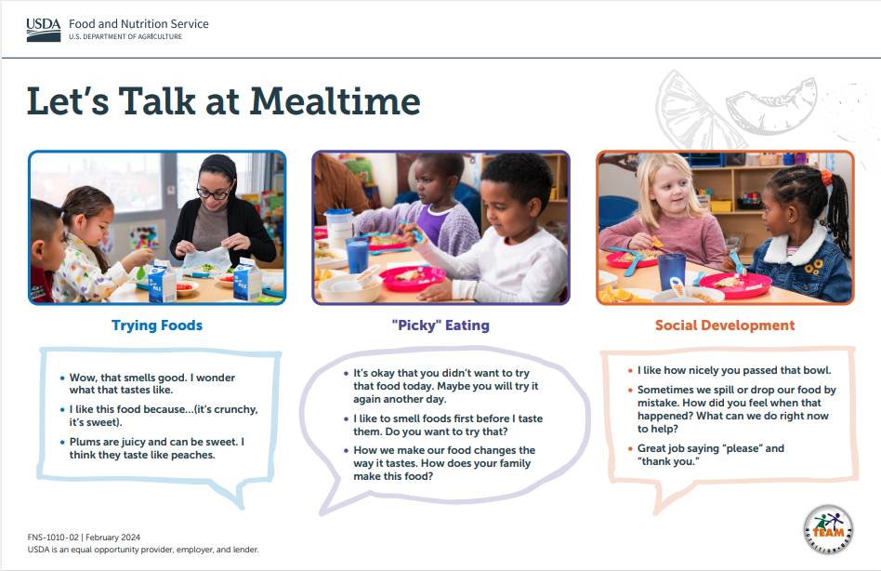
How Can I Encourage Children to Try New Foods? (Part 2)
Be a Role Model
Sit down and eat the same foods as
the children at mealtime.
Have more adventurous eaters sit next to children that need more encouragement.
54
Notes:
Script: Role modeling at mealtime is an important piece of family style meal service. Sit down with the children at mealtime, and if you can, eat the same foods as the children. The supervising adult’s meals are not reimbursable, but the expense of extra creditable food produced for meals is an allowable cost. Check with your sponsoring organization or State agency about using CACFP funds to buy extra food.
Have more adventurous eaters sit next to children that need a bit more encouragement.
Use the USDA Team Nutrition’s "Let’s Talk At Mealtime" poster to share with child care providers prompts, phrases, and conversation starters to support healthy eating and social development.

Slide 55
Review and Next Steps (Part 1)
Try It Out!
Question
What must a site do to claim a reimbursable meal and snack in the CACFP when implementing family style meal service?
Provide the full portion of each meal component for every child seated at the table in serving bowls and plates.
Offer each meal component to each child at the table.
Force children to take a small portion of every food item.
55
Notes:
Script: Let’s review by answering a question, what must a site do to claim a reimbursable meal and snack in the CACFP when implementing family style meal service? Choose a, b, and/or c. There can be more than one answer.
Note: For in-person trainings, call on participants to respond. For on-line trainings, ask participants to type their answers in the chat box or set up a polling question.

Slide 56
Review and Next Steps (Part 2)
Try It Out!
Answer
What must a site do to claim a reimbursable meal and snack in the CACFP when implementing family style meal service?
Both a and b are correct.
Provide the full portion of each meal component for every child seated at the table in serving bowls and plates.
Offer each meal component to each child at the table.
Force children to take a small portion of every food item.
56
Notes:
Script: Both a and b are correct. Provide the full portion of each meal component for every child seated at the table in serving bowls and plates and offer each meal component to each child at the table.
Never force children to take or eat a small portion of food. A child does not need to take or eat all of the food for the meal or snack to be reimbursable.

Slide 57
Review and Next Steps (Part 3)
Try It Out!
Action Plan
Identify an action step you want to take to begin or improve family style meal service.
Action Step | Responsible Staff | Other Staff Involved | Timeframe | Tasks
57
Notes:
Script: Identify an action step you can take at your site to begin or improve family style meal service. Include responsible staff, other staff involved, timeframe, and tasks.
Note: Give participants 3 minutes to think about and write down their responses. For in-person trainings and on-line trainings ask at least one person to share their response. If participants are unfamiliar with actions steps, show the example on the next slide before giving them time to respond.

Slide 58
Review and Next Steps (Part 4)
Try It Out!
Action Plan
Identify an action step you want to take to begin or improve family style meal service.
Action Step | Responsible Staff | Other Staff Involved | Timeframe | Tasks
Provide a 1-hour training to staff on family style meal service | Assistant Director | Food service staff or vendor, CACFP Administrator | Next Staff Meeting (1-month planning period) | Review family style meal service training topics and decide on most important topics for staff. Work with food service staff or vendor to prepare a family style meal service snack during the staff training. Ask a classroom teacher at nearby center (who currently implements family style meal service) to speak and answer questions during the training.
58
Notes:
Script: Here is an example, the action step is to provide a one-hour training on family style meal service. The responsible staff person is the assistant director and other staff involved are food service staff or vendor, and the CACFP administrator. There are three major tasks to complete by next staff meeting, and we are giving ourselves a one-month planning period. First, review family style meal service training topics and decide on most important topics for staff. Second, work with the food service staff or vendor to prepare a family style meal service snack during the training. And, third, ask a classroom teacher at a nearby center (who currently implements family style meal service) to speak and answer questions during the training.

Slide 59

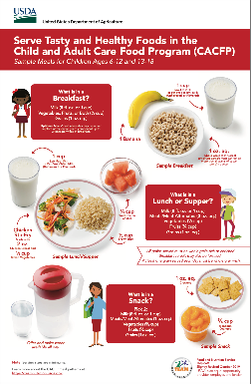
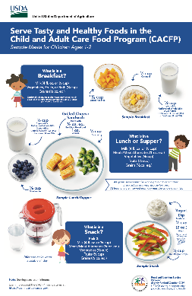
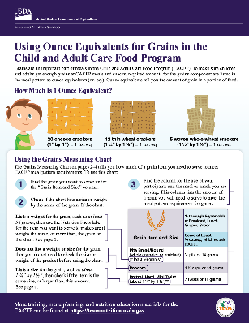

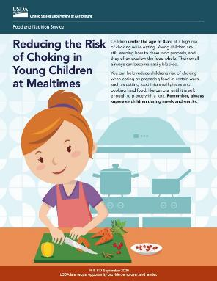
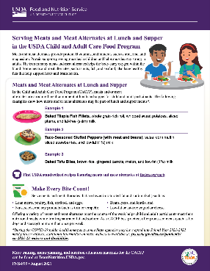
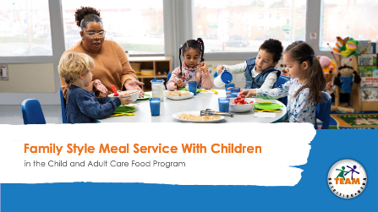
More Team Nutrition Resources
Posters
Training Worksheets
Training Slides
TeamNutrition.USDA.gov
59
Notes:
Script: All Team Nutrition materials shared today are available online from Team Nutrition’s website and are available for free download to anybody who is interested. You can also find many other resources for the CACFP on the Team Nutrition website at TeamNutrition.USDA.gov.

Slide 60



Thank You!
TeamNutrition.USDA.gov
@TeamNutrition
TeamNutrition@USDA.gov
USDA is an equal opportunity provider, employer, and lender.
Notes:
Script: These training slides were provided by U.S. Department of Agriculture's Team Nutrition. If you would like to learn more about Team Nutrition and additional resources available, please visit their website, subscribe to their e-newsletter, connect with them via email at TeamNutrition@USDA.gov, and follow them on Twitter/X.
Thank you!

