Slide 1
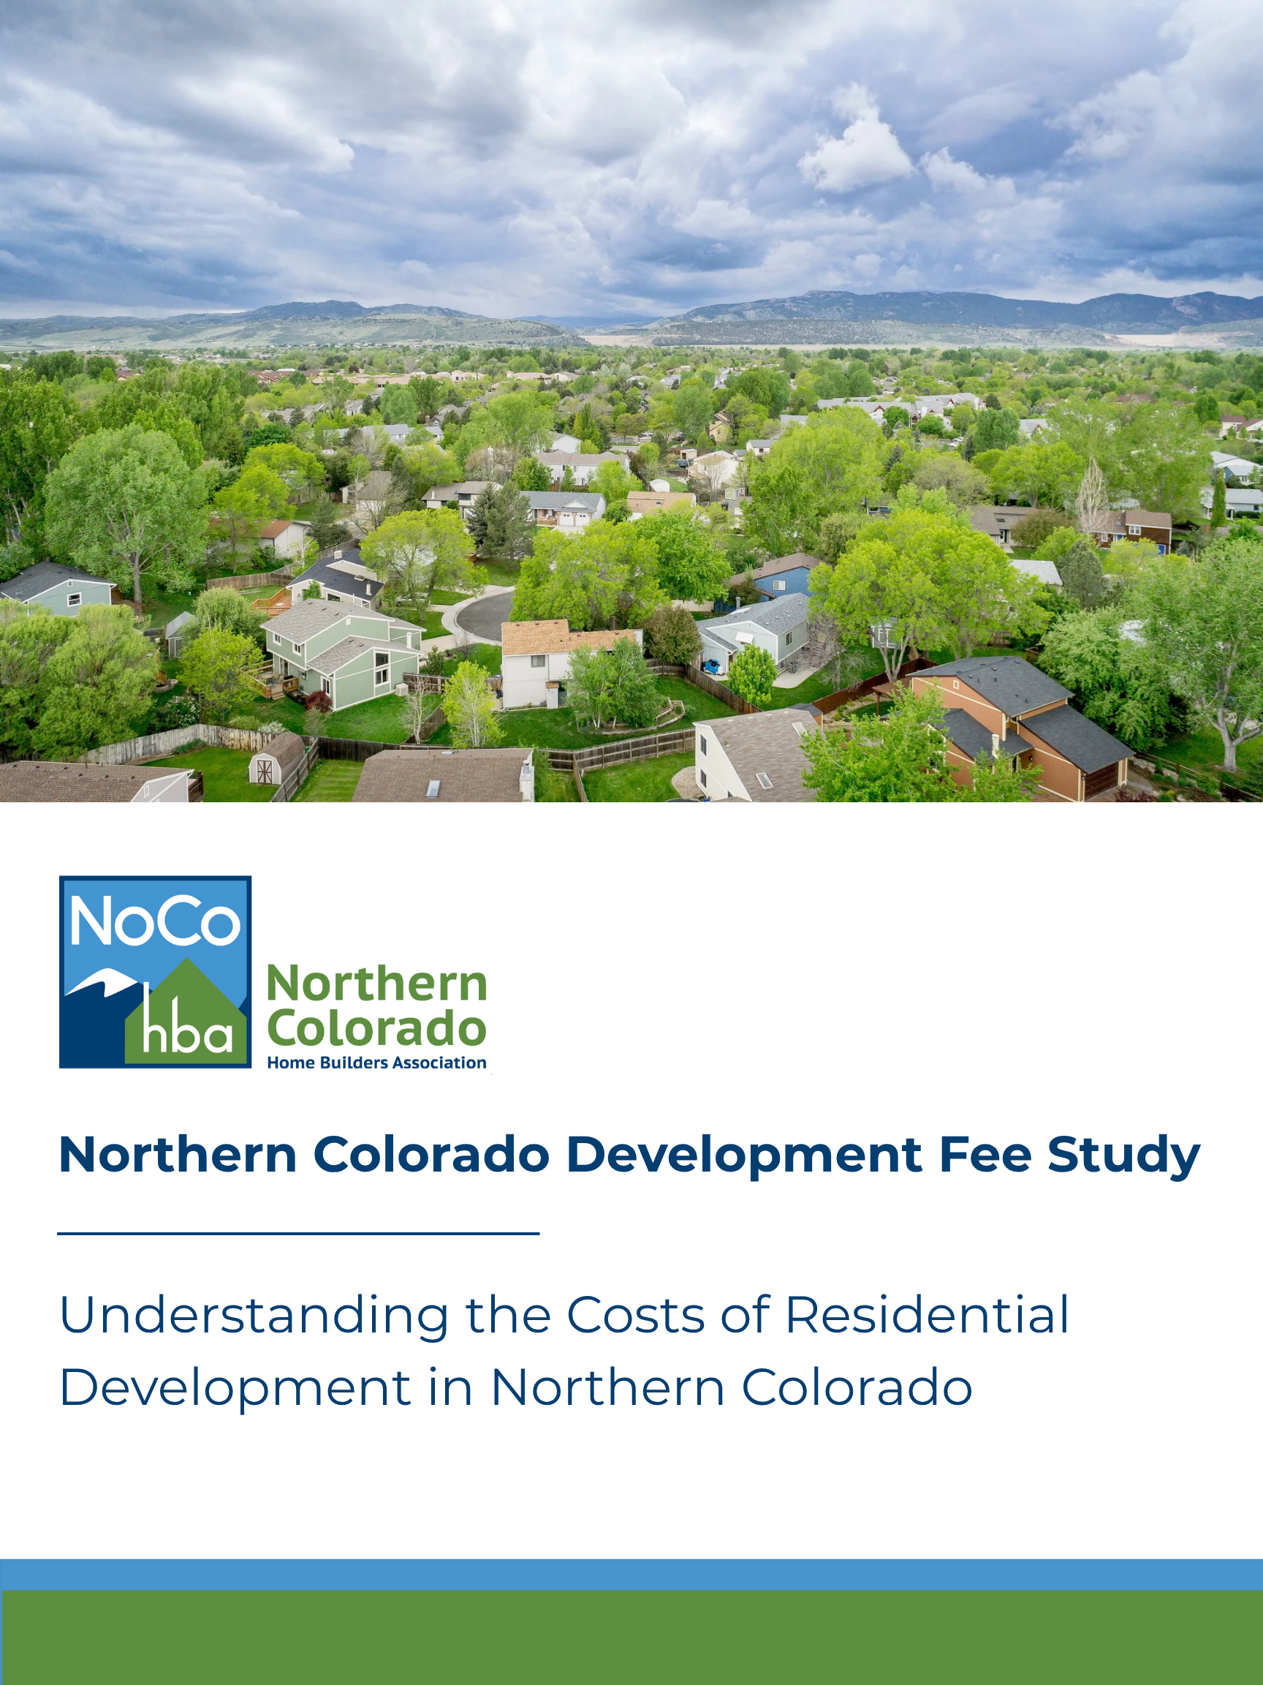
Analysis of building permit, use tax, impact, and system development fees assessed by municipalities in the Denver Metro area

Slide 2
Table of Contents
Purpose and Background Page 3
Understanding Development Fees Page 4
Understanding Water Requirements Page 5
Fort Collins Page 6
Windsor Page 7
Johnstown Page 8
Conclusion Page 9
Methodology Page 10
Methodology Cont. Page 11
The ‘Northern Colorado Development Fee Study’ was developed and authored by Albert Bozoki. For more information, please contact:
Victoria Hall
Executive Officer
Home Builders Association of Northern Colorado
victoria@nocohba.com

Slide 3
Purpose and Background
The Northern Colorado region, like many high-growth areas across the country, continues to face a significant housing affordability challenge. Home prices remain elevated due to a combination of strong demand, constrained housing supply, rising interest rates, labor shortages, increasing construction costs, and the growing cost of securing water resources for new development. While many of these factors receive considerable attention, one cost that often goes unnoticed is the impact of development fees and water-related requirements imposed on new residential construction.
As communities continue to grow, municipalities and water providers must invest in the infrastructure and public services necessary to support new development. To help fund these improvements, local governments assess a variety of development-related fees, while many water providers require developers to dedicate water resources, purchase water rights, or pay fee-in-lieu charges to ensure adequate long-term water supplies.
The home building industry recognizes the importance of responsible growth and supports the principle that new development should pay its fair share. However, these costs ultimately become part of the price of building a home and are reflected in the final purchase price paid by homebuyers. According to the National Association of Home Builders (NAHB), for every $1,000 increase in the median price of a new home, an additional 1,699 Colorado households are priced out of the market.
Unlike the Denver Metro region, where development fees can generally be compared on a one-to-one basis, Northern Colorado presents a far more complex landscape. Water service is often provided by multiple districts with varying requirements, making direct comparisons between municipalities difficult. Rather than ranking jurisdictions solely by total fees, this report examines the unique development process within each community, highlighting how development fees, water acquisition, and local policies influence the cost of housing.
The purpose of this study is not to suggest that development fees or water requirements should be eliminated, but rather to promote transparency and encourage informed discussions about the cumulative impact these costs have on housing attainability. As Colorado works to address its housing shortage, understanding these costs is an important step toward developing policies that balance infrastructure needs, responsible water management, and the goal of keeping homeownership within reach for more Coloradans.
The Northern Colorado region, like many high-growth areas across the country, continues to face a significant housing affordability challenge. Home prices remain elevated due to a combination of strong demand, constrained housing supply, rising interest rates, labor shortages, increasing construction costs, and the growing cost of securing water resources for new development. While many of these factors receive considerable attention, one cost that often goes unnoticed is the impact of development fees and water-related requirements imposed on new residential construction.
As communities continue to grow, municipalities and water providers must invest in the infrastructure and public services necessary to support new development. To help fund these improvements, local governments assess a variety of development-related fees, while many water providers require developers to dedicate water resources, purchase water rights, or pay fee-in-lieu charges to ensure adequate long-term water supplies.
The home building industry recognizes the importance of responsible growth and supports the principle that new development should pay its fair share. However, these costs ultimately become part of the price of building a home and are reflected in the final purchase price paid by homebuyers. According to the National Association of Home Builders (NAHB), for every $1,000 increase in the median price of a new home, an additional 1,699 Colorado households are priced out of the market.
To better understand how these costs vary across Northern Colorado, this report examines development fees and water-related requirements in three of the region's fastest-growing communities: Fort Collins, Johnstown, and Windsor. Using standardized development assumptions, each case study presents representative costs for new single-family and attached residential construction, while also illustrating how development fees, water acquisition requirements, and utility provider policies can influence the total cost of development. The purpose of this report is to provide a consistent, data-driven comparison of these costs, serving as a resource for builders, local governments, policymakers, and other stakeholders seeking to better understand Northern Colorado's development landscape.
The purpose of this study is not to suggest that development fees or water requirements should be eliminated, but rather to promote transparency and encourage informed discussions about the cumulative impact these costs have on housing attainability. As Colorado works to address its housing shortage, understanding these costs is an important step toward developing policies that balance infrastructure needs, responsible water management, and the goal of keeping homeownership within reach for more Coloradans.

Slide 4
Understanding Development Fees
Development fees vary between municipalities, but most jurisdictions assess some combination of building permit fees, use taxes, and impact fees. Together, these fees help fund the infrastructure and public services needed to support new residential development.
Although building permit fees, use taxes, and impact fees are common across Colorado, water-related costs in Northern Colorado are considerably more complex. Depending on the municipality and water provider, developers may be required to pay utility connection fees, dedicate raw water, acquire water rights, or pay cash-in-lieu charges. Because these requirements vary significantly between jurisdictions and utility providers, they are discussed separately in the following section.
Building permit fees are charges collected by a local government when a builder, developer, or homeowner applies for permission to begin construction or major renovation work.
Use tax is a tax on construction materials and equipment purchased without sales tax that are subsequently used within a jurisdiction. For new residential construction, many municipalities estimate use tax by assuming approximately half of a project's valuation is attributable to taxable construction materials.
Impact fees are one-time charges imposed on new development to fund all or part of the public infrastructure required to serve that growth, such as transportation improvements, parks, public safety facilities, and utilities. These fees help fund the infrastructure needed to serve new growth and become one component of the overall cost of residential development.
In Northern Colorado, water-related costs often represent one of the largest components of total development expenses. The following section explains the water acquisition and utility requirements that distinguish the region from many other areas of Colorado.

Slide 5
Understanding Water Requirements
Water acquisition is one of the most significant factors affecting residential development costs in Northern Colorado. Unlike many areas of Colorado where connecting to a public water system typically requires only a water tap fee, many Northern Colorado communities also require developers to dedicate raw water, acquire water rights, or make cash-in-lieu payments to secure long-term water supplies. These requirements vary by municipality and water provider and can substantially influence total development costs.
Water Tap Fees / Utility Plant Investment Fees (UPIFs)
One-time fees paid to connect new development to the public water system.
Raw Water Dedication
Developers dedicate water rights to a municipality or water provider to ensure adequate long-term water supplies.
Fee-in-Lieu
A monetary payment made instead of dedicating water rights, allowing the municipality or provider to acquire future water resources.
Water Rights & Shares
Some jurisdictions require developers to purchase or transfer water rights before development can proceed.
Because water acquisition requirements vary considerably between municipalities—and often between water providers within the same municipality—this report evaluates each community individually rather than applying a single standardized water cost. The following case studies illustrate how these local requirements influence the total cost of residential development.

Slide 6
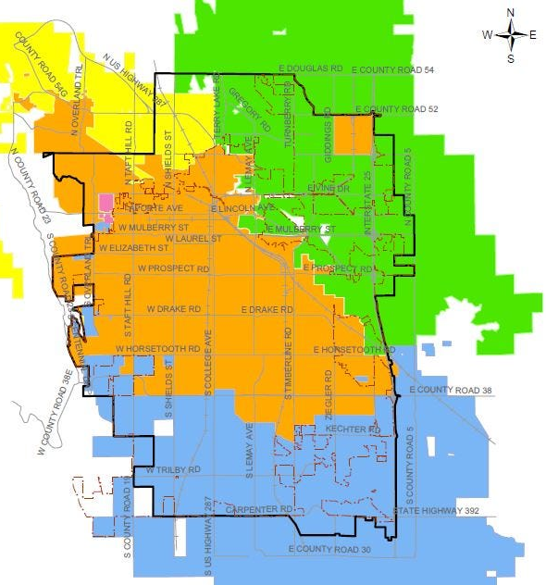
Fort Collins
Population | ~171,000
Average New Home Price | ~$600,000
Median Household Income | ~$85,000
Fort Collins is served by multiple water providers, each with unique raw water requirements and utility fee structures. As a result, total development costs can vary significantly depending on the project's location as is seen in the charts to the right.
Development Fees (Excluding Water)
Development Fee | SFD | SFA
Permit Fees | $2,600.00 | $1,690.00
Use Taxes | $13,092.52 | $8,615.75
Capital Expansion Fees (Impact Fees) | $24,720.00 | $21,273.00
Total | $40,412.52 | $31,578.75
East Larimer County (ELCO)
City of Fort Collins
Fort Collins-Loveland
Key Findings:
Development fees (excluding water): ~$40,400/SFD
Lowest estimated water cost: $18,337 (FCWD)
Highest estimated water cost: $88,775 (FCLWD)
Choosing one water provider over another can increase total development fees by over 120%
City of Fort Collins Water District (FCWD)
CIL Price ($/AF) - $63,800
Water Cost | SFD | SFA
Total Raw Water Required (AF) | 0.2111 | 0.1206
Raw Water Cost | $13,471 | $7,695
Water SIF/PIF Fee | $4,866 | $2,515
Total Cost of Water | $18,337 | $10,210
Total Development Fees
Total Development Fees / Water District | SFD | SFA
City of Fort Collins | $58,749.52 | $41,788.75
Fort Collins-Loveland | $129,187.52 | $90,353.75
East Larimer County | $91,026.52 | $73,762.75
Fort Collins-Loveland Water District (FCLWD)
CIL Price ($/AF) - $120,000
Water Cost | SFD | SFA
Total Raw Water Required (AF) | 0.43 | 0.180
Raw Water Cost | $51,600 | $21,600
Water SIF/PIF Fee | $37,175 | $37,175
Total Cost of Water | $88,775 | $58,775
East Larimer County Water District (ELCO)
CIL Price ($/AF) - $88,571
Water Cost | SFD | SFA
Total Raw Water Required (AF) | 0.4972 | 0.414
Raw Water Cost | $44,038 | $36,704
Water SIF/PIF Fee | $6,576 | $5,480
Total Cost of Water | $50,614 | $42,184

Slide 7
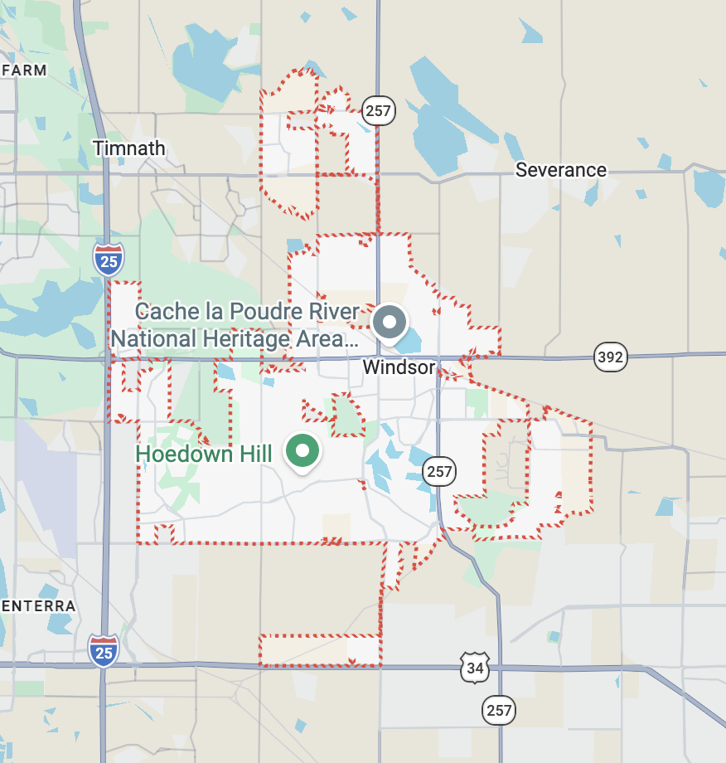
Windsor
Population | ~48,300
Average New Home Price | ~$625,000
Median Household Income | ~$127,000
Windsor has established itself as the leading center of residential development in Northern Colorado. Through the first half of the year, the town issued more residential building permits than any other municipality in the region, reflecting continued demand for new housing. This rapid pace of development has been accompanied by exceptional population growth. Since the 2020 U.S. Census, Windsor's population has grown by approximately 34%. As one of the region's fastest-growing communities, understanding Windsor's development fees and water requirements provides valuable insight into the costs associated with accommodating continued growth.
Water Service Areas: Residential development within Windsor is served by the Town of Windsor Utilities; however, select areas are served by the Fort Collins-Loveland Water District, resulting in different raw water requirements and total development costs.
* North Weld County Water District serves a small area of northern Windsor
Development Fees (Excluding Water)
Development Fee | SFD | SFA
Permit Fees | $3,224.23 | $2,295.72
Use Taxes | $11,395.34 | $7,498.90
Impact Fees | $17,870.00 | $14,680.00
Total | $32,489.57 | $24,473.72
Town of Windsor Water District (WWD)
CIL Price ($/AF) - $110,000
Key Findings:
Highest recent residential permitting activity in Northern Colorado
Population has grown approximately 34% since the 2020 Census
Water costs range from approximately $64,000 to $89,000 depending on the water provider.
Water Cost | SFD | SFA
Total Raw Water Required (AF) | 0.5 | 0.5
Raw Water Cost | $55,000 | $55,000
Water SIF/PIF Fee | $8,708 | $8,708
Total Cost of Water | $63,708 | $63,708
Fort Collins-Loveland Water District (FCLWD)
CIL Price ($/AF) - $120,000
Total Development Fees
Water Cost | SFD | SFA
Total Raw Water Required (AF) | 0.43 | 0.180
Raw Water Cost | $51,600 | $21,600
Water SIF/PIF Fee | $37,175 | $37,175
Total Cost of Water | $88,775 | $58,775
Total Development Fees / Water District | SFD | SFA
Town of Windsor | $96,197.57 | $88,181.72
Fort Collins-Loveland | $121,264.57 | $83,248.72

Slide 8
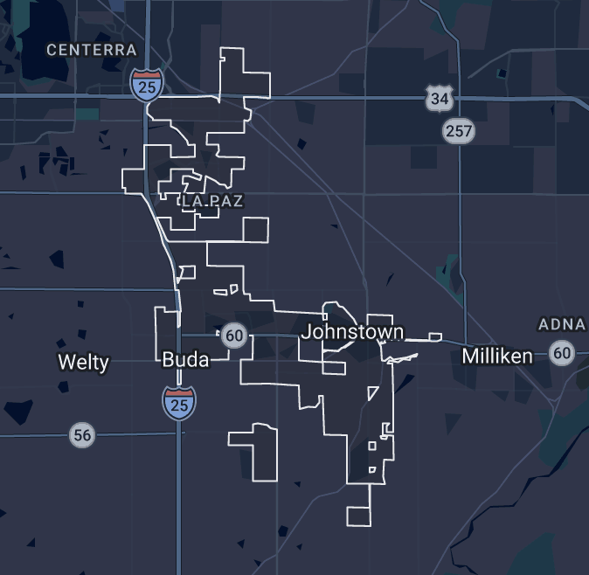
Johnstown
Population | ~22,400
Average New Home Price | ~$500,000
Median Household Income | ~$129,000
Johnstown is one of Northern Colorado's fastest-growing communities and continues to experience rapid residential and population growth. Ranking second in the region for residential building permits issued this year, the town has become a major destination for new housing development. As this growth continues, development fees and water acquisition requirements play an increasingly important role in shaping the cost and feasibility of residential construction.
Town of Johnstown Utilities Department: The town manages its own water distribution, treatment plants, and sewer collection for many residents.
Development Fees (Excluding Water)
Development Fee | SFD | SFA
Permit Fees | $4,061.78 | $2,902.02
Use Taxes | $12,946.07 | $7,996.10
Impact Fees | $12,011.98 | $10,050.48
Total | $29,019.83 | $20,948.60
Town of Johnstown Water District (FCWD)
CIL Price ($/AF) - $75,000
Water Cost | SFD | SFA
Total Raw Water Required (AF) | 0.4448 | 0.387
Raw Water Cost | $33,359 | $29,054
Water SIF/PIF Fee | $13,620 | $13,620
Total Cost of Water | $46,979 | $42,674
Key Findings:
- Second in Northern Colorado for residential building permits issued in 2026.
- Base municipal development fees: ~$29,000 per SFD home (excluding water).
- Estimated water costs: ~$47,000 per SFD home.
- Water represents approximately 62% of total development fees for a representative single-family home.
Total Development Fees
Unlike Fort Collins, most residential development in Johnstown is served by a single municipal utility provider. The Town manages water treatment, distribution, wastewater collection, and utility expansion, resulting in a more standardized fee structure for new development.
Total Development Fees / Water District | SFD | SFA
Town of Johnstown | $75,998.83 | $63,622.60

Slide 9
Conclusion
This report demonstrates that development costs vary considerably across Northern Colorado, reflecting differences in municipal fee schedules, water acquisition requirements, and utility provider policies. While building permit fees, use taxes, and impact fees differ between jurisdictions, the case studies also show that water-related costs often represent one of the largest components of total development expenses.
The case studies further illustrate that development costs are not determined solely by municipality. In communities served by multiple water providers, total costs may vary substantially depending on the applicable utility district and its associated water requirements. As a result, projects located within the same municipality may experience different development costs despite otherwise similar development assumptions.
Because development fees and water requirements are established locally and may change over time, understanding these costs requires evaluating each jurisdiction and utility provider individually. The standardized methodology used throughout this report provides a consistent framework for comparing representative development costs while recognizing that actual project costs will vary.
As Northern Colorado continues to grow, development fees and water requirements will remain important components of the residential development process. By presenting this information in a transparent and consistent format, this report provides a factual resource for understanding how these costs differ across the region.
Summary of Findings
• Water-related costs ranged from approximately $18,000 to nearly $89,000 for a representative single-family home, depending on the municipality and water provider.
• Total estimated development costs for a representative single-family home ranged from approximately $58,700 to $129,200 across the case studies.
• In municipalities served by multiple water providers, total development costs varied by more than $70,000 for otherwise similar development assumptions.
• Windsor, Johnstown, and Fort Collins continue to rank among Northern Colorado's most active residential development markets, illustrating how local fee structures and water requirements differ across rapidly growing communities.

Slide 10
Methodology
This study evaluates municipal development fees associated with constructing representative single-family detached (SFD) and single-family attached (SFA) homes in selected Northern Colorado communities. Building permit fees, use taxes, and impact fees were calculated using standardized home specifications to provide a consistent basis for comparison across municipalities.
Building permit fees were calculated using each municipality's adopted fee schedule and valuation methodology. Where applicable, fees associated with plan review, permits, and related building services were included.
Use taxes were calculated in accordance with each jurisdiction's adopted tax rate and methodology. In municipalities where use tax is assessed on construction materials, taxable value was generally estimated using standard municipal assumptions regarding the portion of a home's valuation attributable to construction materials.
Impact fees were compiled from each municipality's adopted fee schedules and include charges associated with infrastructure such as transportation, parks, public safety, and other capital improvements, where applicable. Only fees directly associated with residential development were included in the analysis.
To ensure comparability, all municipalities were evaluated using the representative home specifications shown in Table 1. While individual projects may vary in size, design, and valuation, applying consistent assumptions allows for an objective comparison of municipal development fees across jurisdictions.
Although every effort has been made to verify the information presented, fee schedules are subject to change and actual development costs may vary based on project characteristics, construction timing, and future municipal policy updates.
Table 1
 | Single-Family Detached (SFD): | Single-Family Attached (SFA):
Lot Size: | 8,000 Square Feet (SF) | 5,000 Square Feet (SF)
Bathroom Count: | 3 | 2
Water Meter Size: | ¾” | ¾” (Except for Aurora)
Total Living Area: | 2,400 SF | 1,600 SF
Garage: | 600 SF | 500 SF
Porch/Patio Cover: | 200 SF | 0 SF
Finished Basement: | 1,000 SF | 500 SF

Slide 11
Methodology Cont.
Unlike building permit fees, use taxes, and impact fees, water-related costs cannot be evaluated using a single standardized fee schedule. Water acquisition requirements vary considerably between municipalities and, in many cases, between water providers serving the same municipality. As a result, each case study evaluates water costs based on the specific policies and fee structures applicable to the municipality or utility provider.
To maintain consistency throughout the study, water costs were calculated using the same representative single-family detached (SFD) and single-family attached (SFA) home specifications presented in Table 1. These standardized home assumptions were used to estimate the anticipated water demand for each home type, providing a consistent basis for comparison across municipalities and water providers.
For each municipality or water provider, the analysis applies the locally adopted raw water dedication requirements or cash-in-lieu (CIL) policies, where applicable, to estimate the cost of securing the required water supply. Utility Plant Investment Fees (UPIFs), Plant Investment Fees (PIFs), System Investment Fees (SIFs), tap fees, and other applicable connection charges were then incorporated to calculate the estimated total water cost per home.
In jurisdictions that do not maintain an adopted cash-in-lieu policy, raw water costs were modeled using current market pricing for residential ("Home Supply") water rights to provide a representative estimate.
Because water acquisition policies vary considerably between Northern Colorado municipalities and water providers, each community was evaluated using its locally adopted requirements. Where a municipality or utility provider maintains an adopted raw water dedication or cash-in-lieu policy, those requirements were applied in the analysis. In jurisdictions without an adopted cash-in-lieu policy, raw water costs were estimated using current residential ("Home Supply") water pricing to provide a representative comparison. Similarly, where multiple water providers serve a municipality, each provider was evaluated separately to reflect differences in water acquisition requirements and utility fee structures.
Although every effort has been made to verify the information presented, water policies, cash-in-lieu values, utility fees, and raw water pricing are subject to change. Actual project costs may vary based on development location, utility service area, project-specific water demands, and future updates to municipal or utility provider policies.

