Slide 1
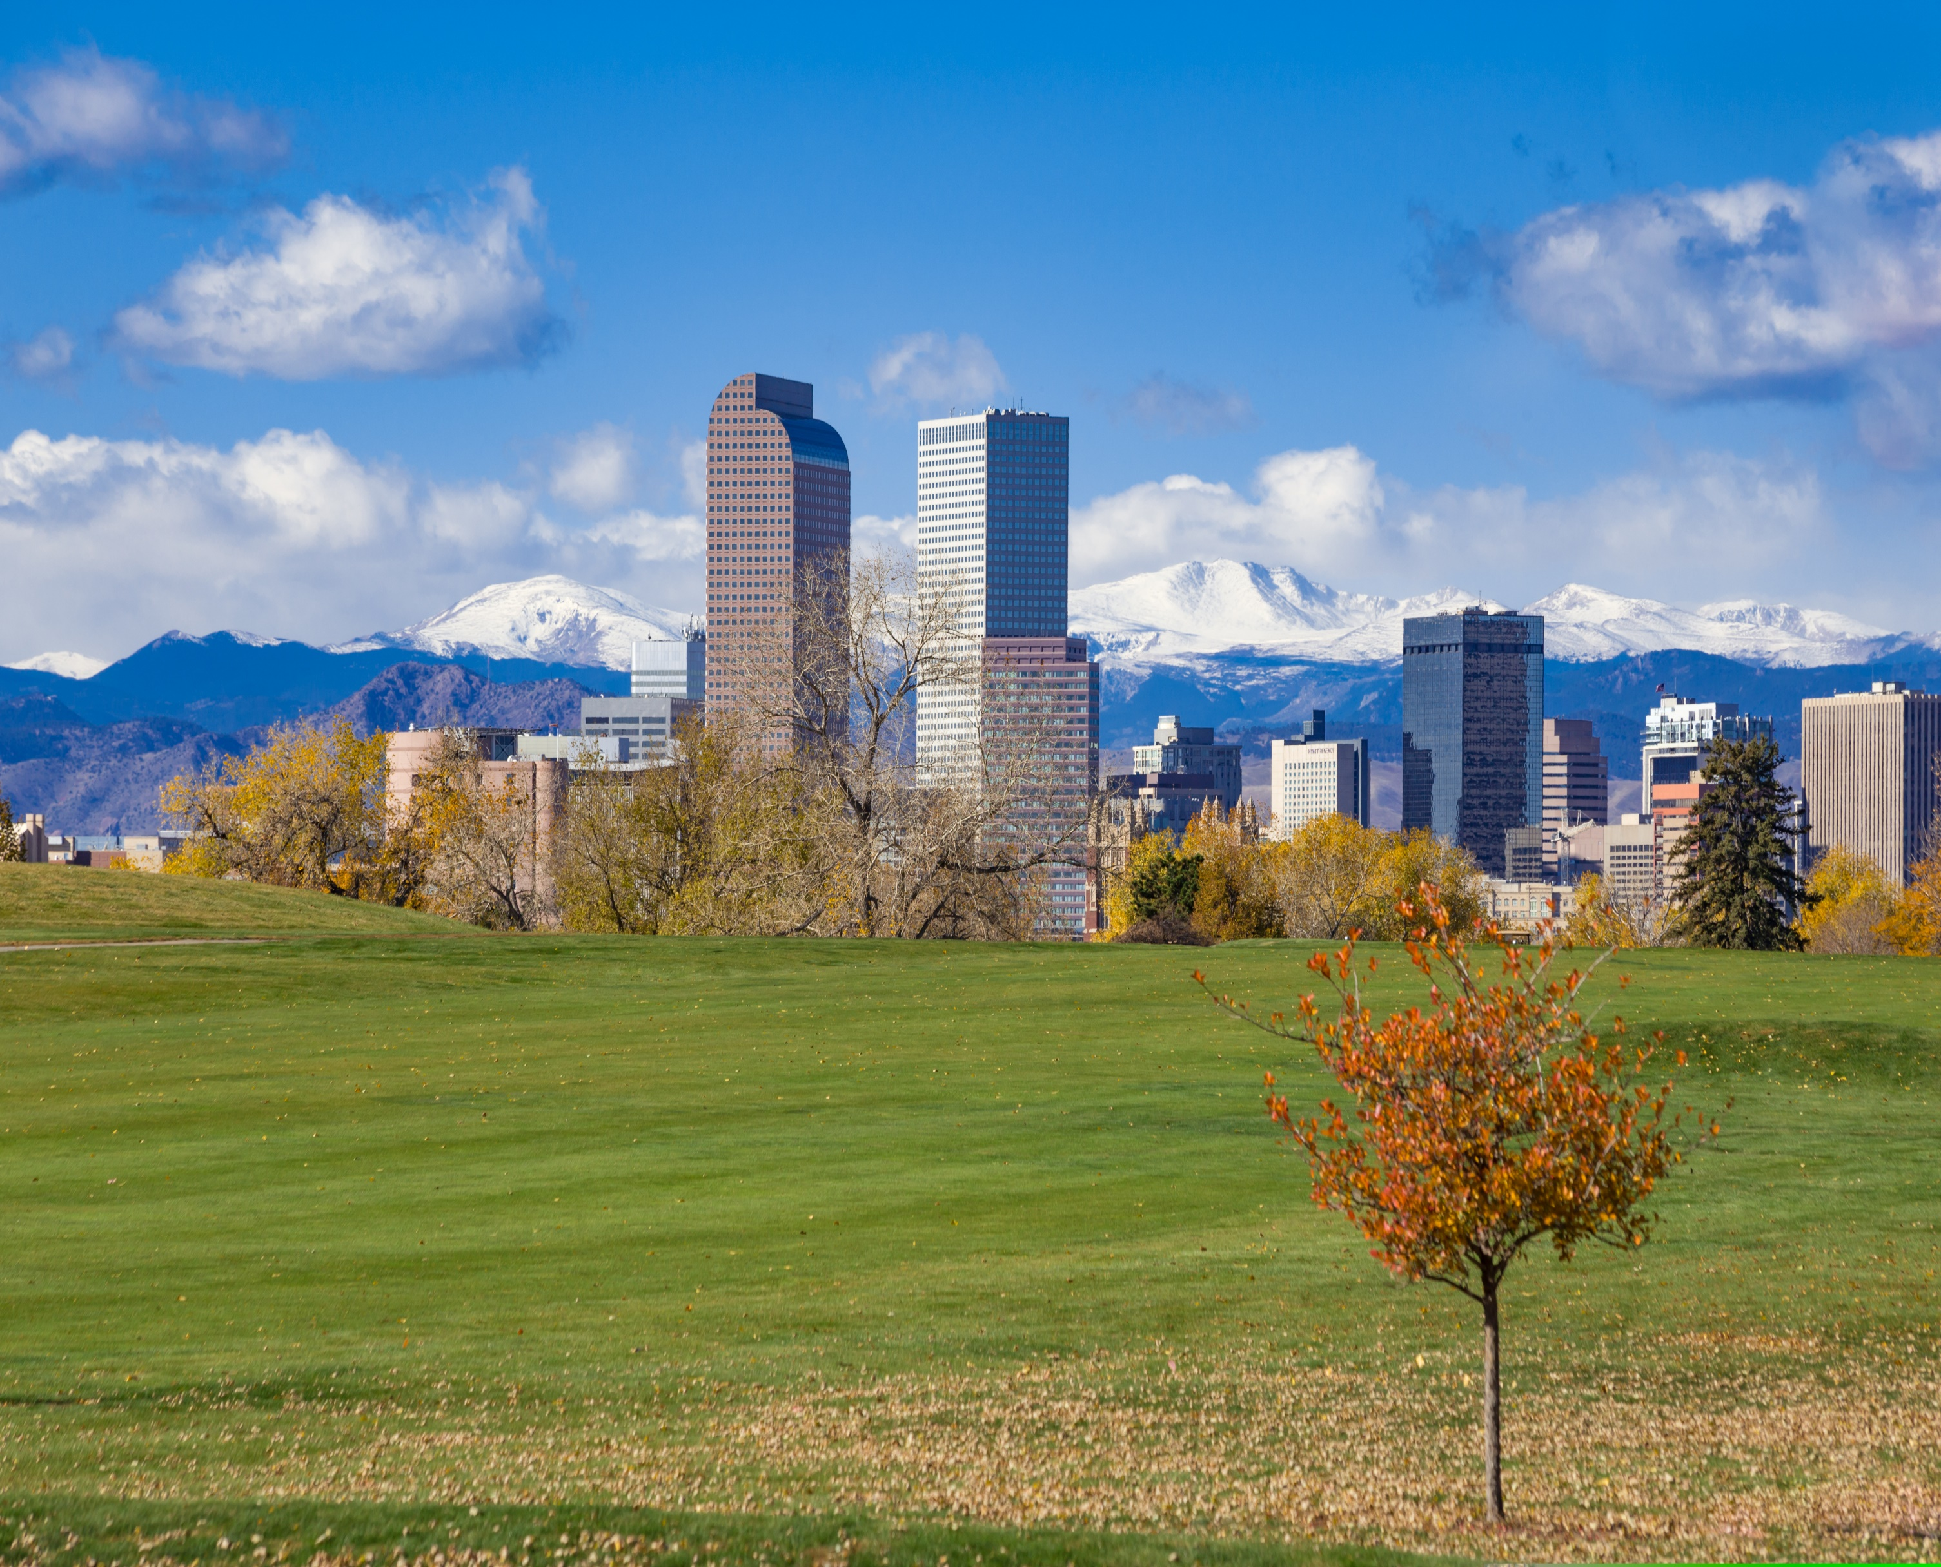

2026 Metro Denver:
Development Fee Study Edition 2
Analysis of building permit, use tax, impact, and system development fees assessed by municipalities in the Denver Metro area

Slide 2
Table of Contents
Introduction Page 3
Understanding Development Fees Page 4
Methodology Page 5
Denver Metro Averages Page 6
Municipality Rankings Page 7
Median Household Incomes Page 8
Average Home Prices Page 9
Full Municipality Fee Rankings (SFD) Page 10
Full Municipality Fee Rankings (SFA) Page 11
The ‘2026 Metro Denver: Development Fee Study Edition 2’ was developed and authored by Albert Bozoki. For more information, please contact:
Morgan Cullen
Director of Government Affairs
Home Builders Association of Metro Denver
mcullen@hbadenver.com

Slide 3
Introduction
The Denver metropolitan region, like many high-growth areas across the country, continues to face a significant housing affordability challenge. Home prices remain elevated due to a combination of strong demand, constrained housing supply, rising interest rates, labor shortages, and increasing construction costs. While many of these factors receive considerable attention, one cost that often goes unnoticed is the impact of development fees imposed on new residential construction.
As communities continue to grow, municipalities must invest in the infrastructure and public services necessary to support new development. To help fund these improvements, local governments assess a variety of development-related fees on new homes, ensuring that growth contributes to the cost of the infrastructure it requires.
The home building industry recognizes the importance of responsible growth and supports the principle that new development should pay its fair share. However, development fees ultimately become part of the cost of building a home and are reflected in the final purchase price paid by homebuyers. According to the National Association of Home Builders (NAHB), for every $1,000 increase in the median price of a new home, an additional 1,699 Colorado households are priced out of the market.
Building on the findings of the inaugural Development Fee Study, this second edition provides updated fee data for the original municipalities while expanding the analysis to include more visuals and comparisons. By tracking changes in development fees over time and broadening the geographic scope of the study, this report offers a more comprehensive look at how local government fees continue to influence housing affordability across Colorado.
The purpose of this study is not to suggest that development fees should be eliminated, but rather to promote transparency and encourage informed discussions about the cumulative impact these costs have on housing attainability. As Colorado works to address its housing shortage, understanding the role of development fees is an important step toward developing policies that balance infrastructure needs with the goal of keeping homeownership within reach for more Coloradans.

Slide 4
Understanding Development Fees
Development fees across municipalities range greatly, however there are some relative constants. Most municipalities will impose variations of permit fees, use taxes, impact fees, and system development fees.
Building permit fees are charges collected by a local government when a builder, developer, or homeowner applies for permission to begin construction or major renovation work.
Use tax, in building and construction, is a tax on materials and equipment that are purchased out-of-state (or sometimes from non-taxed sources) and then used, stored, or consumed within a city, county, or state. Typically, most municipalities will assume that half of the project’s valuation is construction and will therefore impose the use tax on 50% of the valuation.
Impact fees are charges imposed by local governments on new or proposed developments to fund all or part of the public services required by that development. While impact fees help ensure that new developments contribute directly to infrastructure costs, they also shift a significant portion of the financial burden from the general public to a narrower group — primarily homebuilders and ultimately new homebuyers.
System development fees (also called water tap fees) are one-time fees that a builder or property owner pays to connect a new home to the local water system.
As Colorado grapples with its housing shortage, understanding the role of development fees is critical. The following sections provide a detailed breakdown of the development fees imposed by municipalities in the Denver Metro area and how they relate to the respective average home prices.

Slide 5
For example, certain projects may incur additional impact fees based on their specific location, while others may receive fee reductions for similar reasons.
Additionally, this study does not account for costs associated with land, school, or parkland dedication requirements. In some cases, rather than imposing higher impact fees, municipalities require builders to dedicate portions of land or make improvements to existing infrastructure as a condition of development approval. These requirements can represent a significant additional cost to the builder and vary widely between jurisdictions.
Many municipalities assess certain impact fees based on the specific location of a project. Homes built in different areas of a city may be required to pay more or less in fees depending on their proximity to key infrastructure or city resources. The same principle applies to use taxes.
Some municipalities span multiple counties, and the applicable use tax rate can vary depending on the county jurisdiction where a home is located. Additionally, many municipalities are served by multiple water districts, each with different system development fees based on location.
To account for these variations, we calculated averages where location-specific differences exist. For example, if a municipality is served by three different water districts — one charging $20,000, another $40,000, and the third $60,000 — we summed the three amounts and divided by three to arrive at an average system development fee. In this case, the reported system development fee would be $40,000.
Methodology
This study analyzes government-imposed development fees assessed on single-family detached and attached housing across 16 municipalities in the Denver Metro area,
1. Denver 9. Arapahoe County
2. Aurora 10. Jefferson County
3. Douglas County 11. Parker
4. Longmont 12. Castle Rock
5. Erie 13. Arvada
6. Brighton 14. Elbert County
7. Commerce City 15. Adams County
8. Lone Tree 16. Thornton
To minimize the variability across municipalities, this study focuses on assessing the following fees in each jurisdiction: Building Permit, Impact, Use Tax, and System Development (Water) fees.
For both single-family detached and attached homes, fees are evaluated based on homes with identical dimensions to provide as clear a one-to-one comparison as possible. The specific details for each home type are shown in Table 1 below.
Although several municipalities have confirmed the accuracy of the fees reported in this study, it is important to recognize that nuances remain in how these fees are assessed and collected. Building and development departments in each municipality may apply these fees — as well as additional charges — on a case-by-case basis.
Table 1
 | Single-Family Detached (SFD): | Single-Family Attached (SFA):
Lot Size: | 8,000 Square Feet (SF) | 5,000 Square Feet (SF)
Bathroom Count: | 3 | 2
Water Meter Size: | ¾” | ¾” (Except for Aurora)
Total Living Area: | 2,400 SF | 1,600 SF
Garage: | 600 SF | 500 SF
Porch/Patio Cover: | 200 SF | 0 SF
Finished Basement: | 1,000 SF | 500 SF

Slide 6
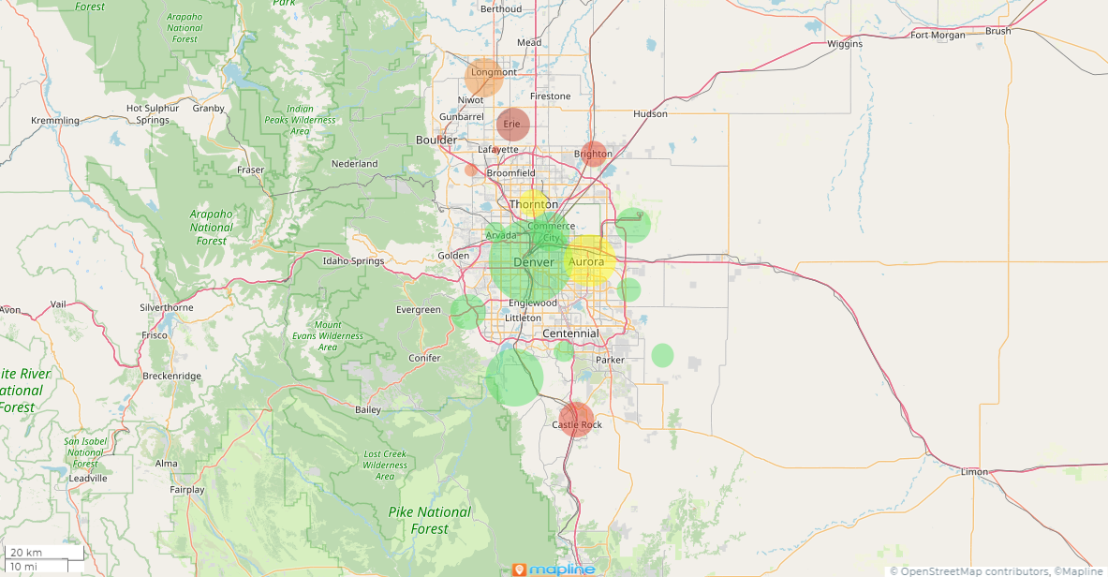
Table 2
Denver Metro Averages | SFD | SFA
Permit Fees | $5,229.73 | $3,145.14
Use Taxes | $8,709.29 | $5,575.65
Impact Fees | $14,006.75 | $10,737.98
Water Tap | $45,281.61 | $37,279.64
Total | $73,227.38 | $56,738.41
Denver Metro Averages
After compiling the data for each municipality within our scope, we calculated the average development fees for the Denver Metro Area. These figures represent the average cost a builder must pay in fees to a municipality, in addition to the separate costs of land, labor, and construction. As shown in Table 2, the average total fees paid per home are approximately $73,000 for single-family detached homes and $57,000 for single-family attached homes. For reference, last year these averages were about $67,000 and $52,000 respectively. That is an 8% increase in just one year.
The pie chart (Table 3) provides a breakdown of how these fees are allocated, with the largest share attributed to system development fees, commonly referred to as water tap fees.
Table 3
This map illustrates the relationship between residential building activity and total development fees across the Denver metropolitan region. Circle size is proportional to the number of residential building permits issued in 2026 to date, with larger circles representing municipalities experiencing higher levels of homebuilding activity.
Circle color represents the relative level of total development fees, with green indicating lower fees, yellow representing moderate fees, and red identifying municipalities with the highest development fees. Together, these measures provide a visual comparison of where residential construction is occurring and the relative fee burden imposed by each jurisdiction.

Slide 7
Table 4
Total Fees | SFD
Erie* | $107,825.66
Castle Rock | $98,668.42
Brighton* | $83.384.51
Parker | $80,322.44
Longmont | $79,821.92
Thornton | $78,746.09
Aurora | $70,242.44
Commerce City | $63,762.62
Arvada | $61,130.17
Denver | $58,396.42
Municipality Rankings
After calculating the development fees for each municipality, we identified the top 10 most and least expensive jurisdictions based on total fees.
Table 4, which highlights the fees of single-family detached homes (SFD), shows that Erie ranks as the most expensive, with development fees nearing $108,000 per home. Castle Rock and Brighton follow, with fees approaching $99,000 and just above $83,000, respectively.
Table 5 ranks the fees of single-family attached homes (SFA). The top four from Table 4 remain the same with slight variability to the order.
Tables 6 and 7 highlight the municipalities with the lowest development fees. Unincorporated areas, such as Adams and Jefferson counties, rank among the least expensive places to build based on these costs.
Table 5
Total Fees | SFA
Erie* | $96,673.35
Castle Rock | $91,529.80
Parker | $69,591.66
Brighton* | $67,966.52
Douglas County | $55,603.82
Longmont | $52,905.46
Aurora | $47,718.59
Lone Tree | $47,596.89
Arvada | $46,376.24
Thornton | $44,834.92
Table 6
Table 7
Total Fees | SFD
Adams County | $36,247.28
Jefferson County | $40,039.07
Denver | $47,134.49
Lone Tree | $52,477.43
Douglas County | $56,872.63
Arapahoe County | $57,032.05
Arvada | $60,997.60
Commerce City | $68,949.62
Aurora | $69,411.96
Longmont | $75,315.30
Total Fees | SFA
Adams County | $24,259.53
Denver | $33,008.79
Arapahoe County | $33,688.68
Jefferson County | $38,889.85
Thornton | $44,674.92
Arvada | $46,237.87
Commerce City | $46,470.66
Lone Tree | $46,487.64
Aurora | $47,497.98
Longmont | $49,331.08

Slide 8
Median Household Incomes
In addition to analyzing the fees assessed by each municipality, it is crucial to include the average household incomes (AHI). In localities where the AHI is higher, residents are able to bear the burden of higher development fees assessed on the average home prices more easily. Adversely, residents in municipalities with lower AHI’s are considered more cost burdened and vulnerable to the added costs of development fees. Below the total fees assessed by single-family detached homes are compared to their respective municipality’s AHI.
Municipality | Average Household Income* | Total SFD Fees | AHI/SFD Fees Ratio
Longmont | $91,696 | $79,821 | 87%
Thornton | $101,096 | $78,746 | 78%
Brighton* | $107,679 | $83,384 | 77%
Aurora | $93,837 | $70,242 | 75%
Castle Rock | $139,427 | $98,668 | 71%
Denver | $92,504 | $58,396 | 63%
Parker | $145,592 | $80,322 | 62%
Erie* | $173,349 | $107,825 | 62%
Arvada | $124,317 | $61,130 | 54%
Commerce City | $124,406 | $63,762 | 51%
Lone Tree | $123,741 | $54,188 | 44%
*Includes Raw Water Fees/Fee-in-lieu of water dedication
Source: United States Census Bureau
Unincorporated Adams, Arapahoe, Douglas, Elbert, and Jefferson Counties were not included. Census data does not provide incomes for unincorporated counties.

Slide 9
Average Home Prices
Considering average home prices is essential to understanding the true impact of development fees. In higher-priced markets, these fees often make up a smaller share of the overall home cost and may be more easily absorbed. Conversely, in jurisdictions with lower average home prices, the same fees can represent a larger financial burden—potentially making new homes less attainable for buyers.
It’s important for the general public to understand what drives the cost of a home, and this analysis helps clarify how much of a home’s price is made up of development-related fees. The comparison below illustrates how total fees for single-family detached and attached homes relate to average home prices across each municipality.
Municipality | 2026 TYD – Average SFD Close Price (ACP)* | Total SFD Fees | ACP/SFD Fees Ratio
Brighton* | $551,883 | $83,384 | 15.1%
Erie* | $841,074 | $107,825 | 12.8%
Thornton | $637,601 | $78,746 | 12.4%
Commerce City | $513,606 | $63,762 | 12.4%
Aurora | $591,508 | $70,242 | 11.9%
Castle Rock | $1,004,942 | $98,668 | 9.8%
Parker | $853,162 | $80,322 | 9.4%
Arvada | $888,997 | $61,130 | 6.9%
Arvada | $888,997 | $61,130 | 6.9%
Longmont | $1,439,922 | $79,821 | 5.5%
Lone Tree | $1,005,570 | $54,188 | 5.4%
Detached
Municipality | 2026 TYD – Average SFA Close Price (ACP)* | Total SFA Fees | ACP/SFA Fees Ratio
Erie* | $555,361 | $96,673 | 17.4%
Brighton* | $446,963 | $67,966 | 15.2%
Castle Rock | $606,333 | $91,529 | 15.1%
Longmont | $484,659 | $52,905 | 10.9%
Aurora | $454,125 | $47,718 | 10.5%
Commerce City | $415,333 | $41,219 | 9.9%
Parker | $714,647 | $69,591 | 9.7%
Thornton | $469,015 | $44,834 | 9.6%
Arvada | $515,930 | $46,376 | 9.0%
Lone Tree | $581,549 | $47,596 | 8.2%
Denver | $894,918 | $39,392 | 4.4%
Attached
*Includes Raw Water Fees/Fee-in-lieu of water dedication
Source: Subdivide
Unincorporated Adams, Arapahoe, Douglas, Elbert, and Jefferson Counties were not included

Slide 10
Full Municipality Fee Rankings (SFD)
Below are the fee breakdowns for single-family detached homes. Municipalipalities or counties that do not have impact fees, use taxes, or water tap fees were not listed.
**Includes Raw Water Fees/Fee-in-lieu of water dedication
Permit fee | SFD
Thornton | $9,868.85
Elbert County | $9,149.58
Arapahoe County | $8,594.88
Commerce City | $7,477.68
Longmont | $5,456.07
Brighton | $5,401.24
Denver | $4,536.42
Aurora | $4,420.00
Lone Tree | $4,219.13
Castle Rock | $4,145.28
Adams County | $4,145.28
Jefferson County | $3,854.40
Erie | $3,224.23
Arvada | $3,166.32
Parker | $3,162.27
Douglas County | $2,854.03
Impact Fees | SFD
Castle Rock | $33,163.00
Denver | $33,680.00
Commerce City | $11,453.00
Parker | $17,392.00
Erie | $16,329.00
Longmont | $14,869.23
Brighton | $14,348.00
Elbert County | $10,854.00
Jefferson County | $9,017.67
Aurora | $9,327.00
Adams County | $5,690.00
Arapahoe County | $3,814.00
Arvada | $2,150.91
Water | SFD
Erie* | $78,350.00
Thornton | $57,203.00
Brighton* | $53,914.93
Parker | $50,160.00
Douglas County | $51,025.00
Aurora | $47,616.00
Castle Rock | $51,890.00
Arvada | $46,800.00
Longmont | $48,006.26
Arapahoe County | $44,916.00
Lone Tree | $43,334.00
Adams County | $28,331.00
Commerce City | $28,331.00
Jefferson County | $29,167.00
Denver | $20,180.00
Use Taxes | Fee
Commerce City | $16,500.94
Castle Rock | $12,309.14
Thornton | $11,674.24
Longmont | $11,490.36
Erie | $9,922.43
Parker | $9,744.72
Brighton | $9,720.34
Arvada | $9,012.94
Aurora | $8,879.44
Lone Tree | $6,635.30
Douglas County | $3,858.60
Elbert County | $2,933.10
Arapahoe County | $539.17

Slide 11
Full Municipality Fee Rankings (SFA)
Below are the fee breakdowns for single-family attached homes. Municipalipalities or counties that do not have impact fees, use taxes, or water tap fees were not listed.
**Includes Raw Water Fees/Fee-in-lieu of water dedication
Permit fee | SFA
Arapahoe County | $5,619.60
Thornton | $4,384.61
Elbert County | $4,131.78
Longmont | $3,835.91
Commerce City | $3,499.30
Denver | $3,107.81
Lone Tree | $3,021.70
Castle Rock | $2,938.53
Adams County | $2,938.53
Aurora | $2,730.00
Jefferson County | $2,705.18
Brighton | $2,476.55
Arvada | $2,311.14
Erie | $2,295.72
Parker | $2,285.08
Douglas County | $2,040.64
Use Taxes | SFA
Commerce City | $10,387.36
Castle Rock | $8,072.27
Thornton | $6,793.31
Longmont | $7,536.39
Erie | $6,529.63
Parker | $6,611.88
Brighton | $6,237.04
Arvada | $5,948.34
Aurora | $5,141.59
Lone Tree | $4,367.44
Douglas County | $2,538.18
Elbert County | $1,848.54
Arapahoe County | $338.08
Water | SFA
Erie | $78,350.00
Castle Rock | $51,890.00
Douglas County | $51,025.00
Parker | $50,160.00
Brighton | $44,904.93
Lone Tree | $40,207.75
Arvada | $36,310.00
Thornton | $33,657.00
Aurora | $32,910.00
Arapahoe County | $32,354.00
Longmont | $31,793.89
Jefferson County | $27,167.00
Adams County | $17,730.00
Commerce City | $17,730.00
Denver | $13,005.00
Impact Fees | SFA
Castle Rock | $29,475.00
Denver | $23,280.00
Brighton | $14,348.00
Parker | $11,068.00
Longmont | $9,739.27
Commerce City | $9,603.00
Erie | $9,498.00
Jefferson County | $9,017.67
Aurora | $6,937.00
Elbert County | $6,564.00
Adams County | $5,152.00
Arapahoe County | $3,105.00
Arvada | $1,806.76

