Slide 1



If I Had More Time, I Would Have Written a Shorter Letter:
Digital Copywriting for Nonprofit Organizations
Bonnie Catena Allyson Goldsmith
Catena Connects USA for UNHCR
#DMAWDigitalDay

Slide 2
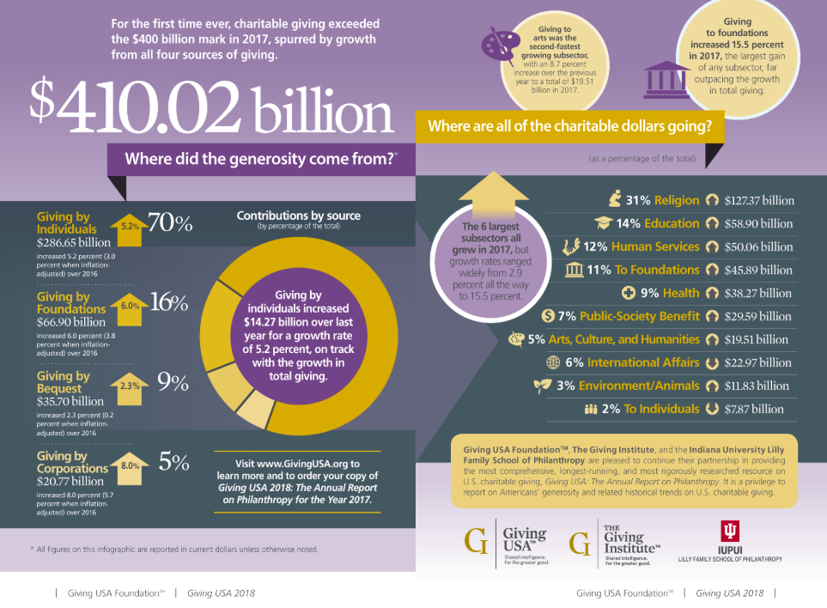

Slide 3
WHY PEOPLE GIVE
It feels good!
Make a difference
Existing relationship
Incentive
Request made
.

Slide 4
GIVING IS AN EMOTIONAL,
NOT A RATIONAL, ACT

Slide 5
System 1
System 2
98% of thinking occurs here
Intuition and instinct
Automatic and fast
Sends suggestions to system 2
2% of thinking occurs here
Rational thinking
On demand and slow
Turns suggestions into beliefs
Notes:
AG:
— SYS 1+2 are terms used in psychology
— Most thinking occurs in S1 — which is about emotional, rather than rational, thinking. As fundraisers we often get internal pressure to explain with facts. but more ppl will give if they fell more than they think, so we make sure our copy is emotional and focusing on refugees. Although we show impact through stats, too many numbers can be numbing.
—Anythin

Slide 6
EMAIL

Slide 7
ANATOMY
Subject line
Sender
Pre-header text
Body
Close

Slide 8
Sender
___@___
Test
Possible signers: organization leaders; program/policy staff; beneficiaries; fellow donors; celebrities
Variation important

Slide 9
Subject Line
Short!
One word
A number
30 characters is best; 65 max

Slide 10
Pre-header Text
Continuation of the subject line
Be mindful of character count—use them all!

Slide 11
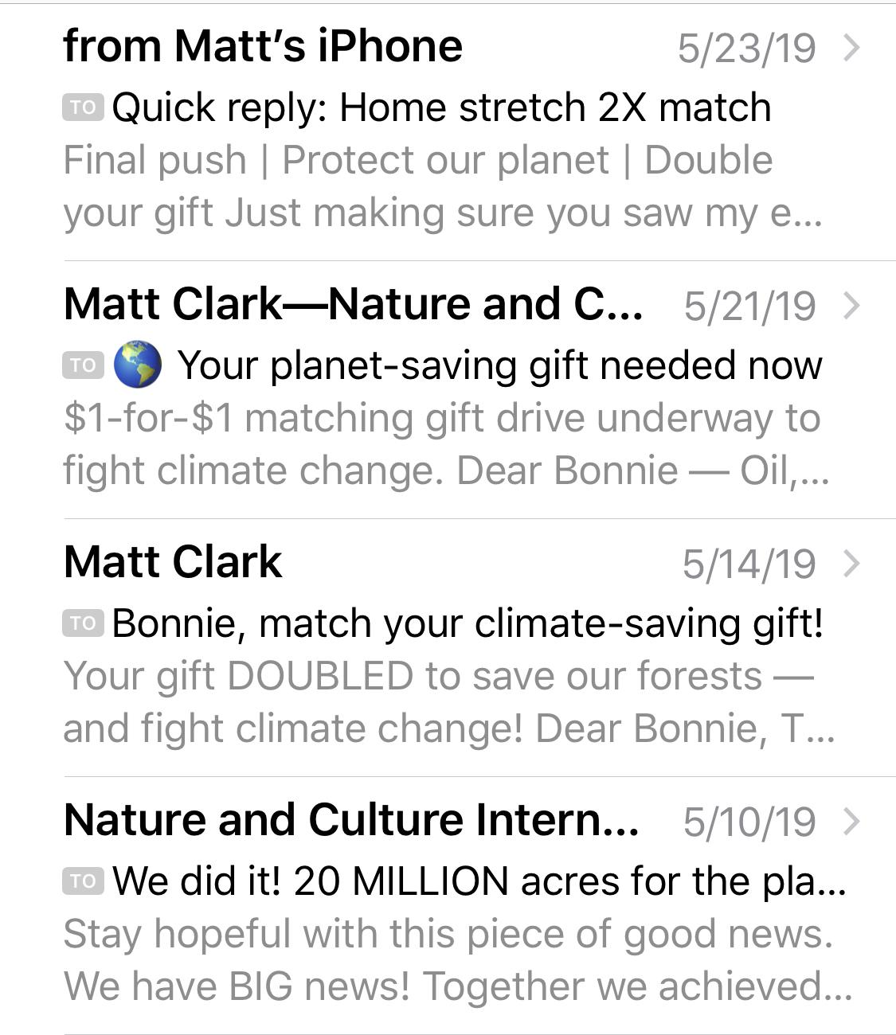
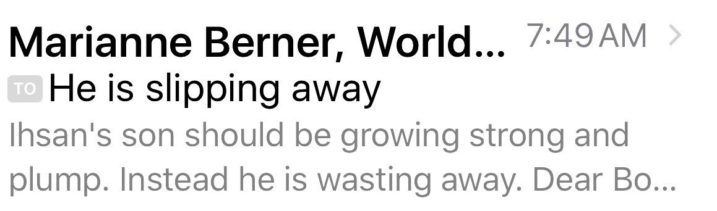
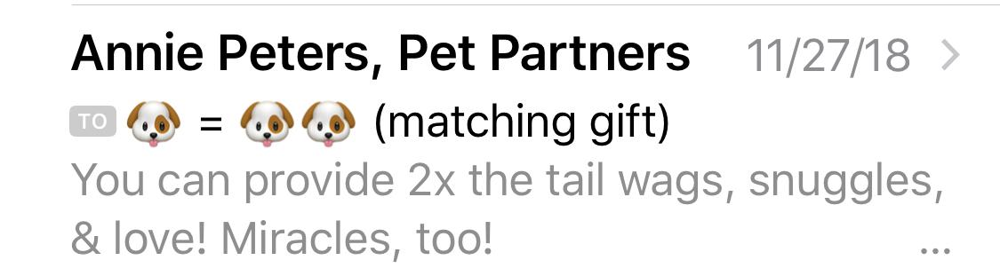
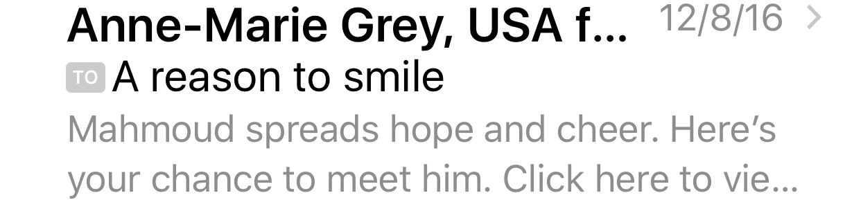
EXAMPLES

Slide 12
BODY
200-250 words, but …
Know your point
Get to it fast
Edit: Did you bury your point?
Edit II: Are you sure you didn’t bury your point?
Sidekick/Hero
Read aloud
“Omit needless words.”
William Strunk, Jr.,
The Elements of Style

Slide 13
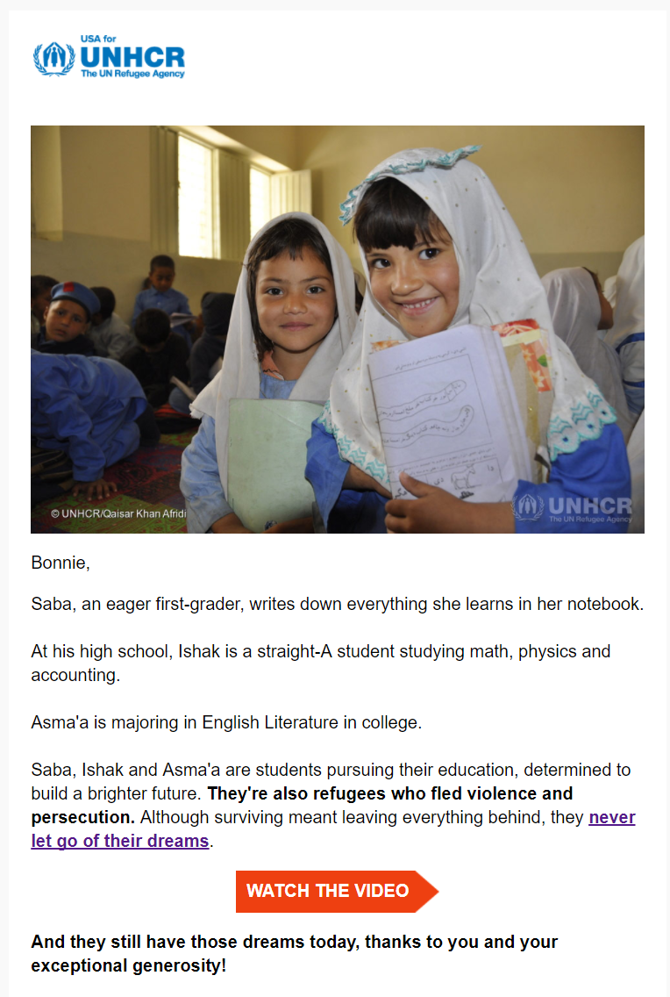
USA FOR UNHCR

Slide 14
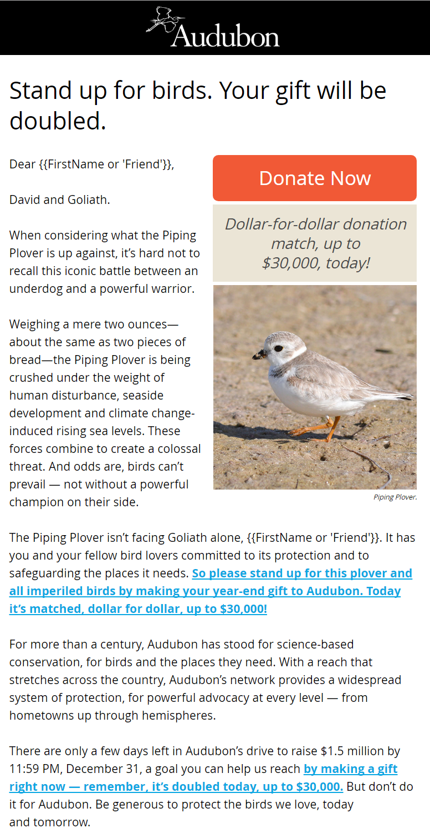
AUDUBON

Slide 15
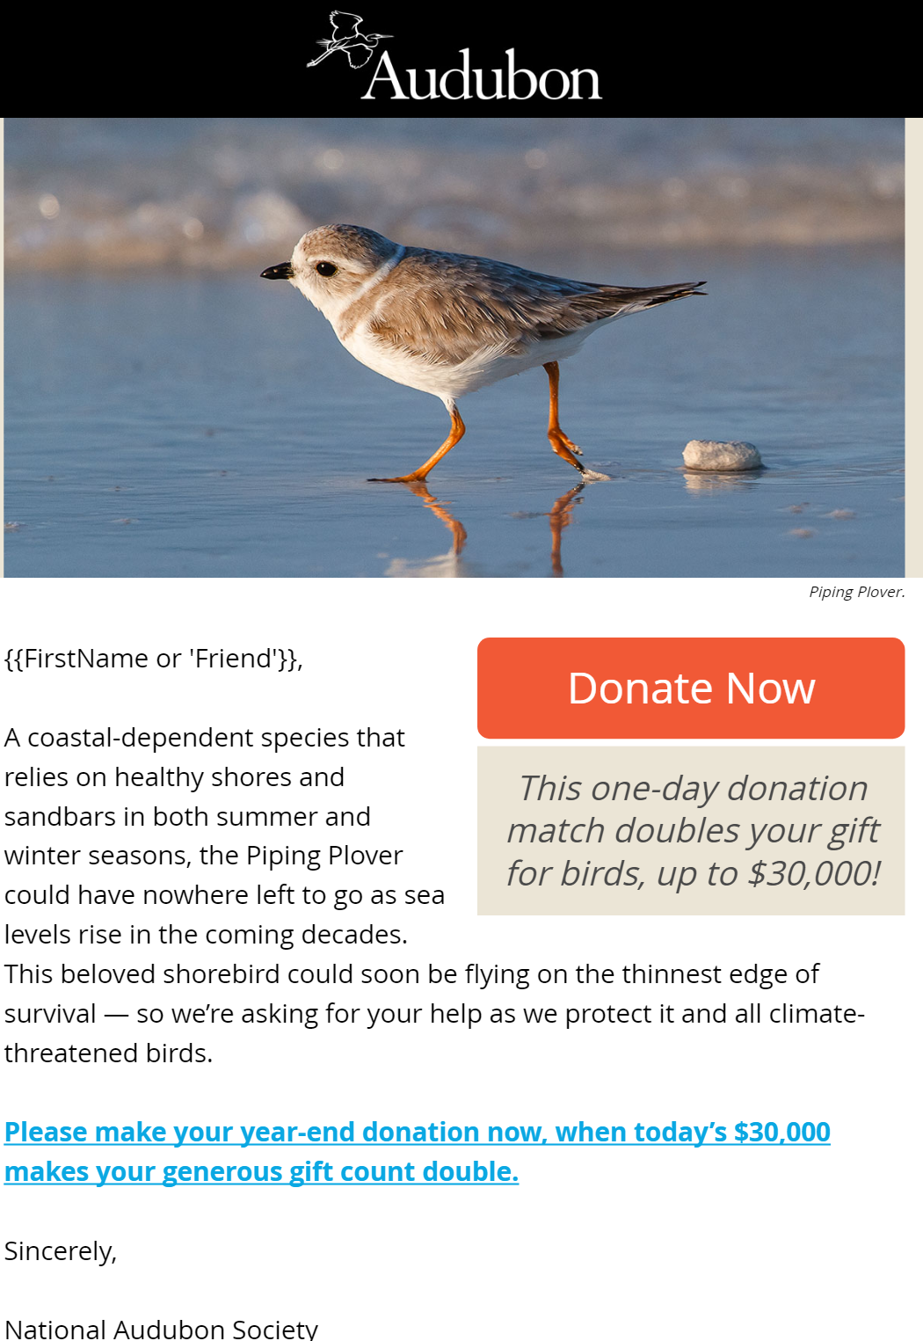
AUDUBON

Slide 16
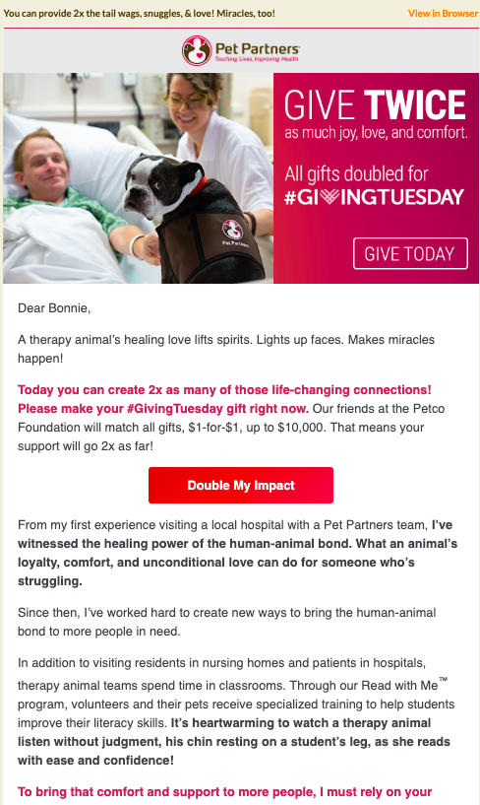
PET PARTNERS

Slide 17
ACQUISITION ADS

Slide 18
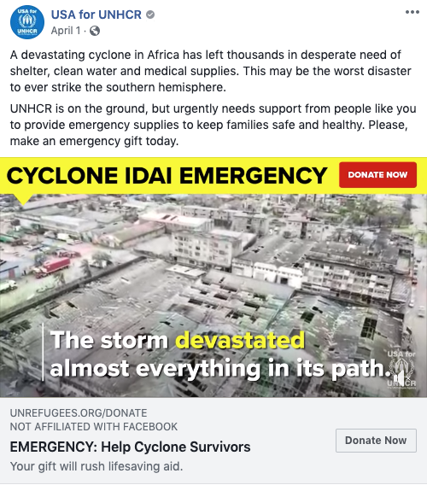

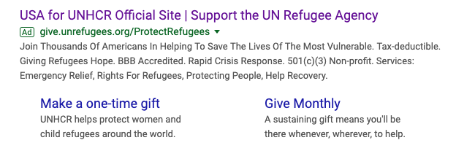

Slide 19
SOCIAL

Slide 20
WAYS TO ENGAGE
Have fun!
Thank and interact with donors
Show the better world the donor is creating

Slide 21
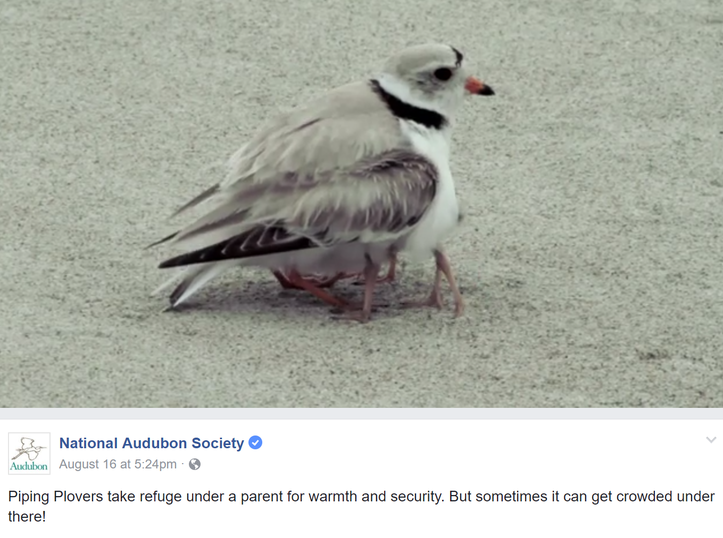
Have Fun!

Slide 22
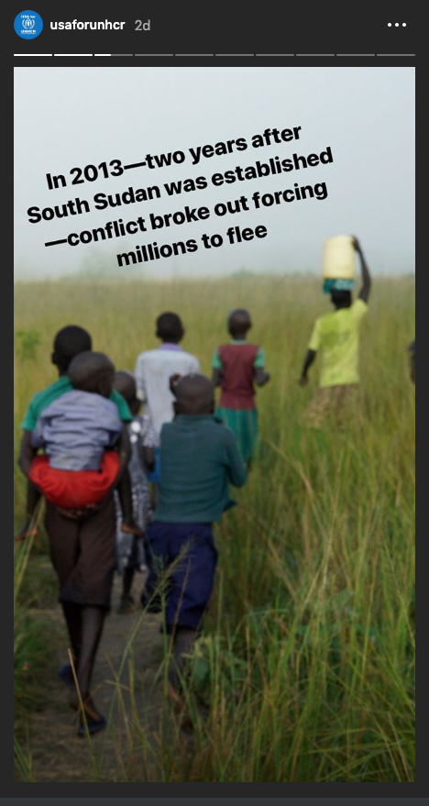
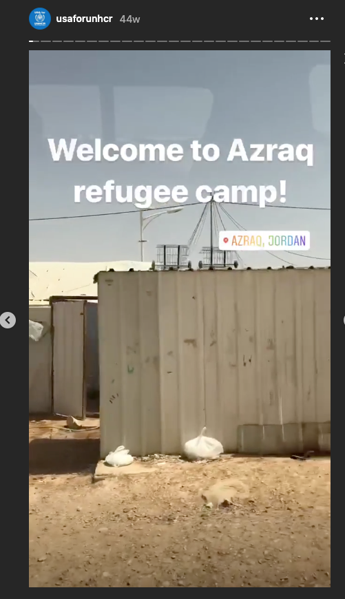
Instagram Stories!
Notes:
social media --
U4U does instagram stories that explain conflict, show you what a refugee camp looks like and shares refugee stories.

Slide 23
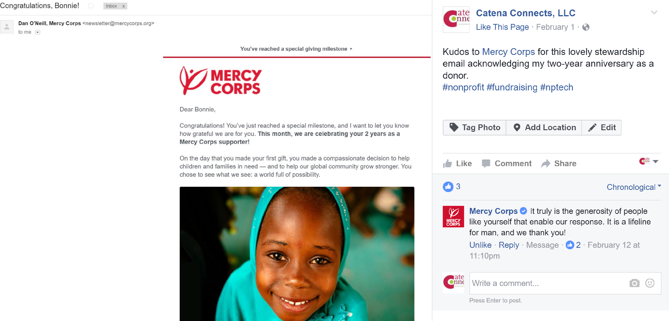
Thank and Interact
Notes:
.

Slide 24


Give a Glimmer of Hope

Slide 25
TESTING
Notes:
Allyson will cover this whole section

Slide 26

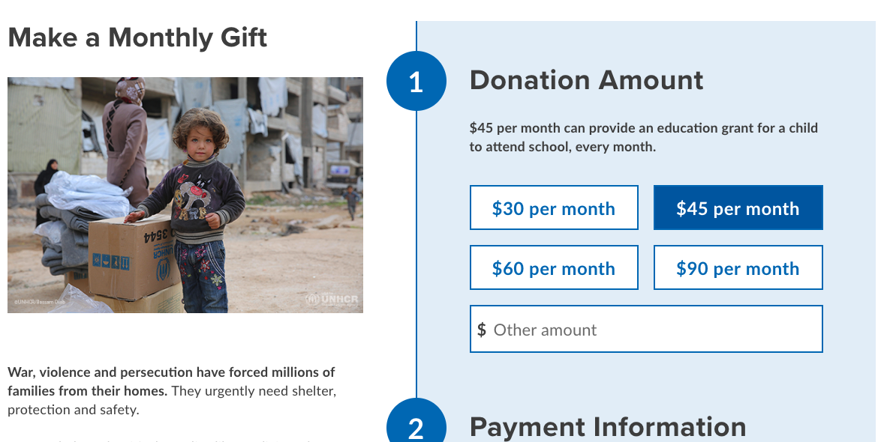
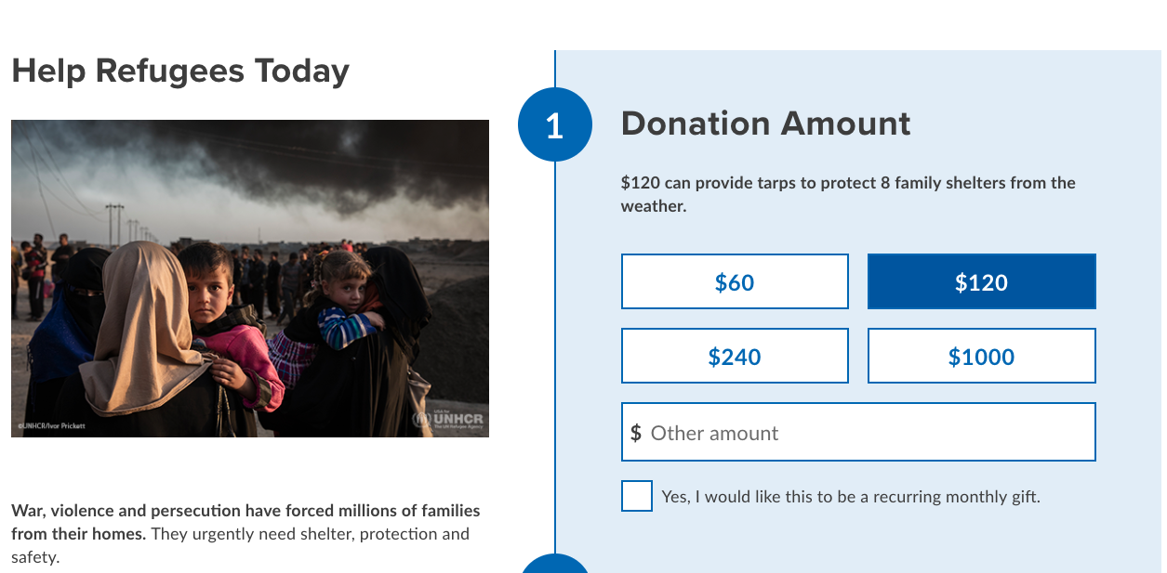

Monthly First vs. One-Time + Checkbox
Test
Control

Slide 27
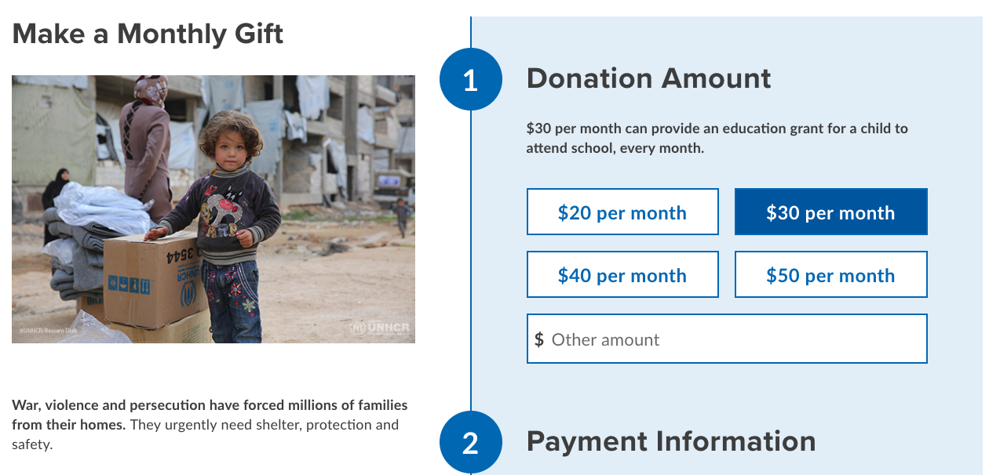
Ask String Optimization
Control
Test

Slide 28
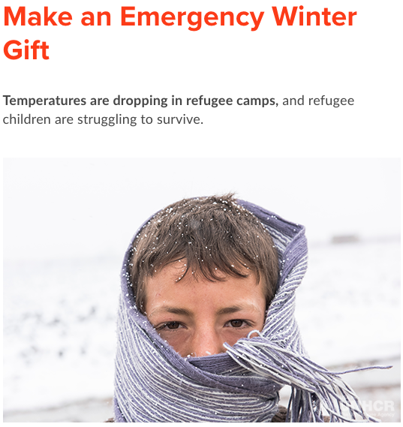
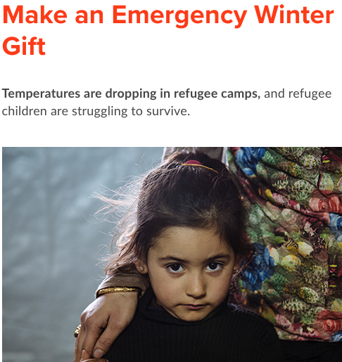

Image Optimization

Slide 29


Best ask for one time donors
Control
Test

Slide 30
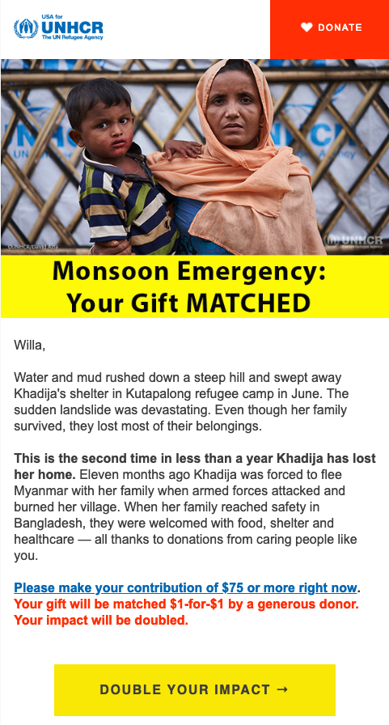

Including Match Amount in Copy
Control
Test

Slide 31

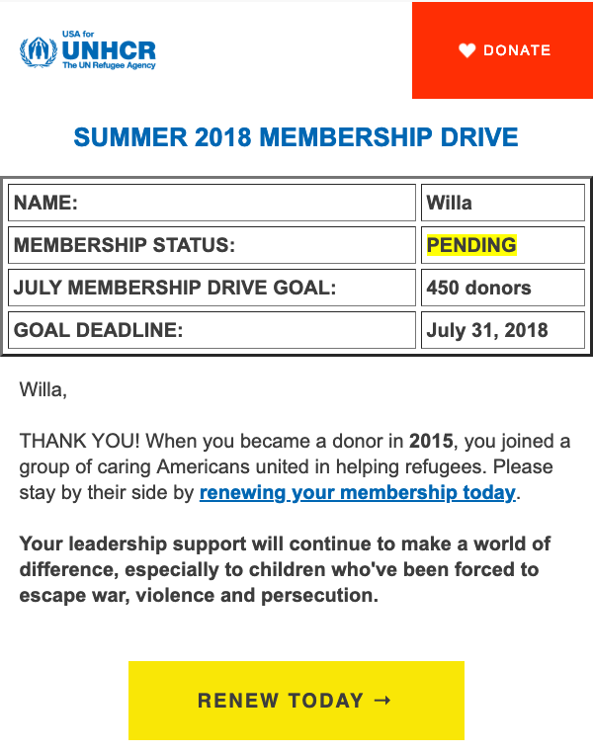
Image vs. Membership Status
Control
Test

Slide 32
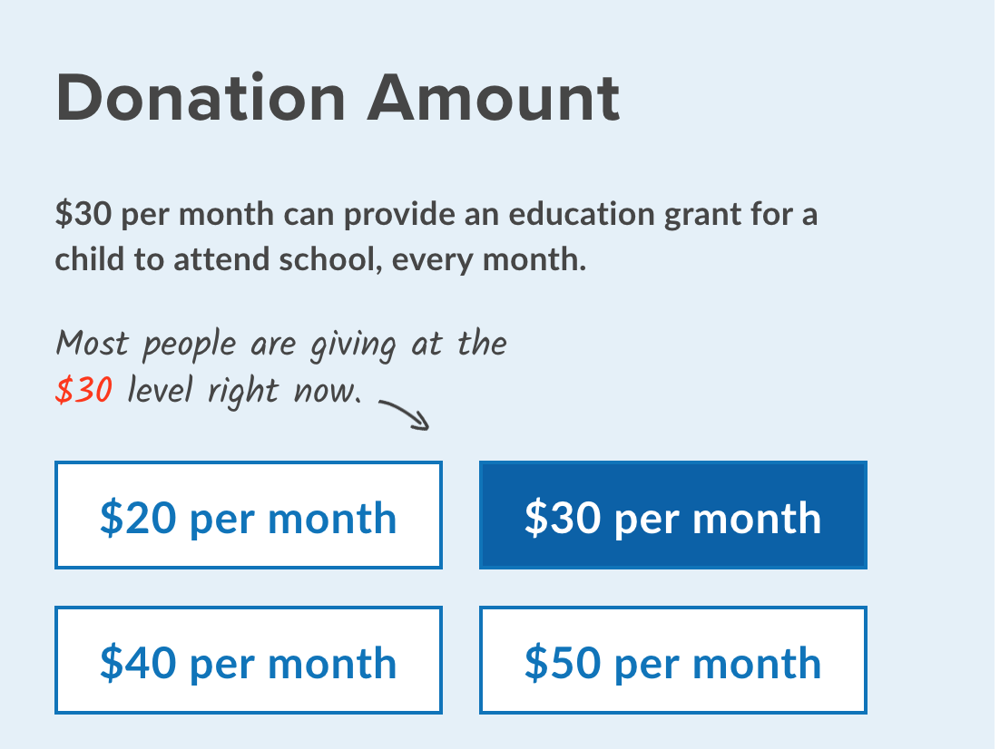
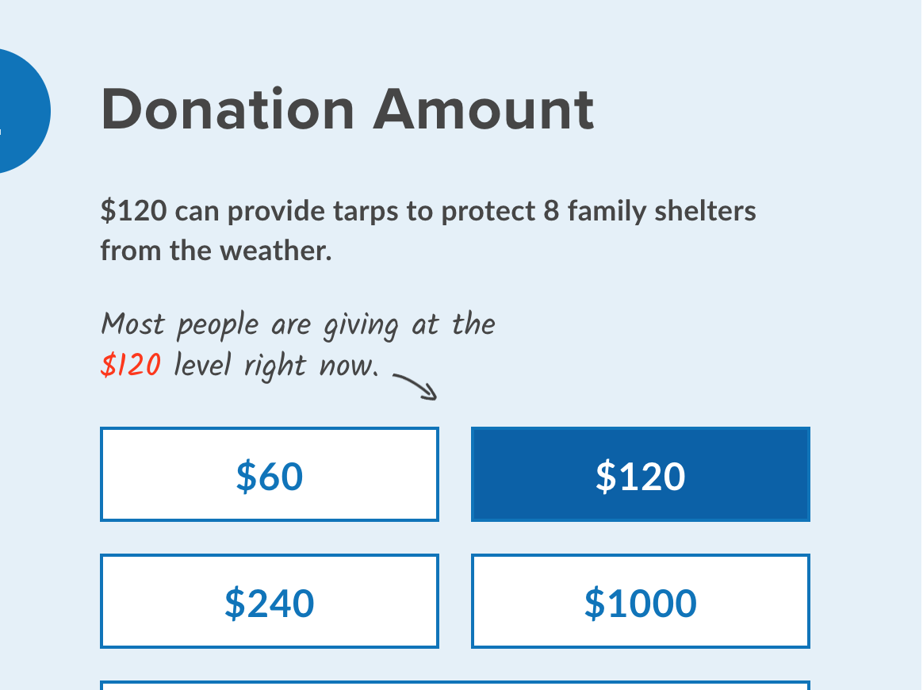
Social Pressure Test
Notes:
Currently running this test.
Tests not worth running: high effort, low impact tests

Slide 33
HOPE VS. NEED
Notes:
! Also, if we’re online I may click on the video since it’s such a good one.
Bonnie: CTA: If fundraising, then the focus should be on the emergency — i.e., people are endangered, rights are under siege, children are sick. Donors respond to an “enemy,” whether a natural disaster or administration.
CTA: If stewardship, then provide hope, demonstrate impact of generosity. Ultimately, donors what to know they are making a difference/creating a better world. Email/social (reference earlier ‘glimmer of hope’ example) and blogs are the ideal vehicles to show that difference.
now we’ll show you examples of both...

Slide 34
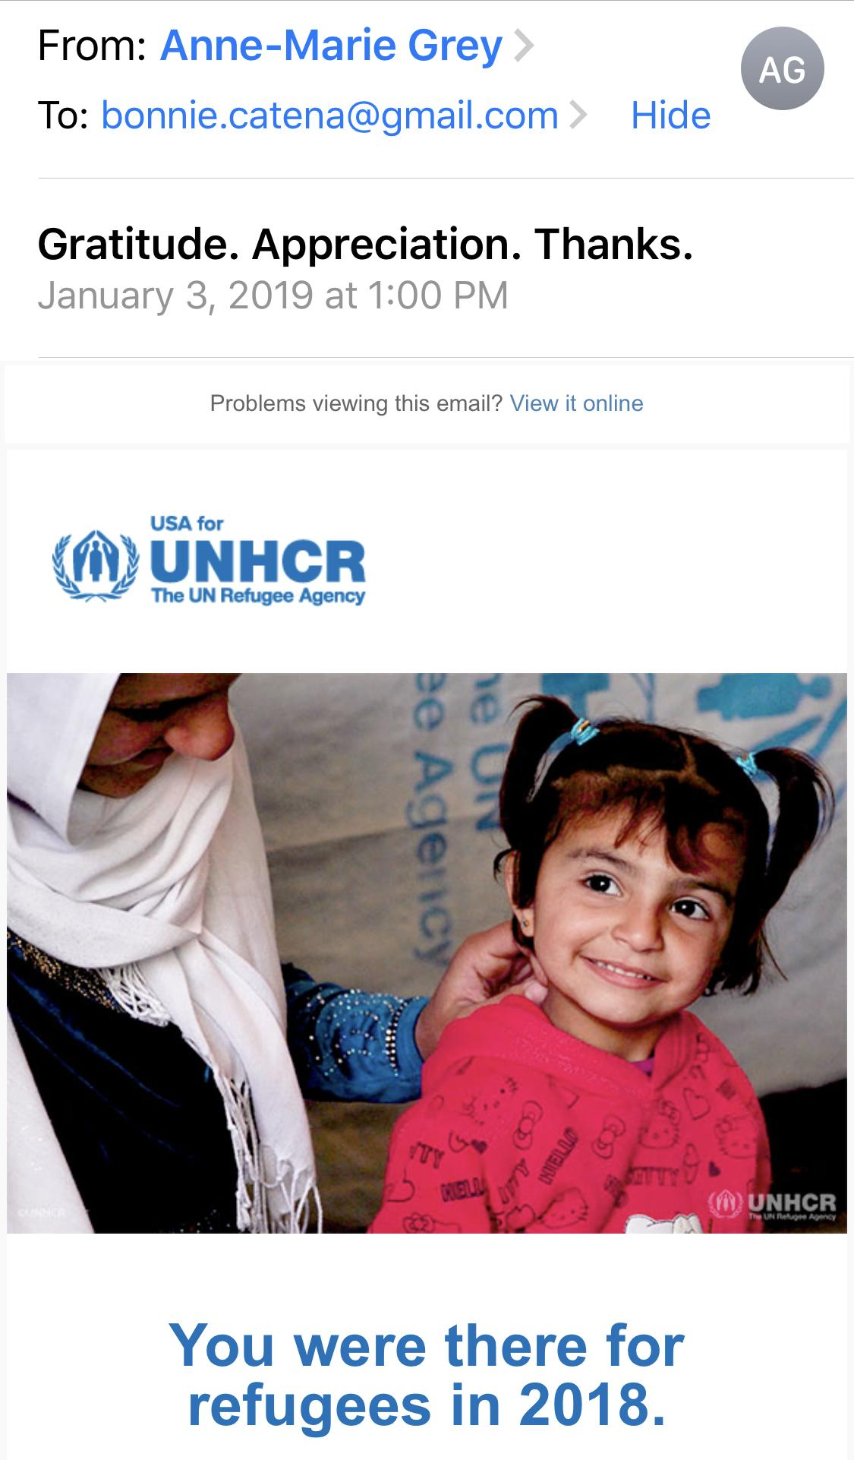
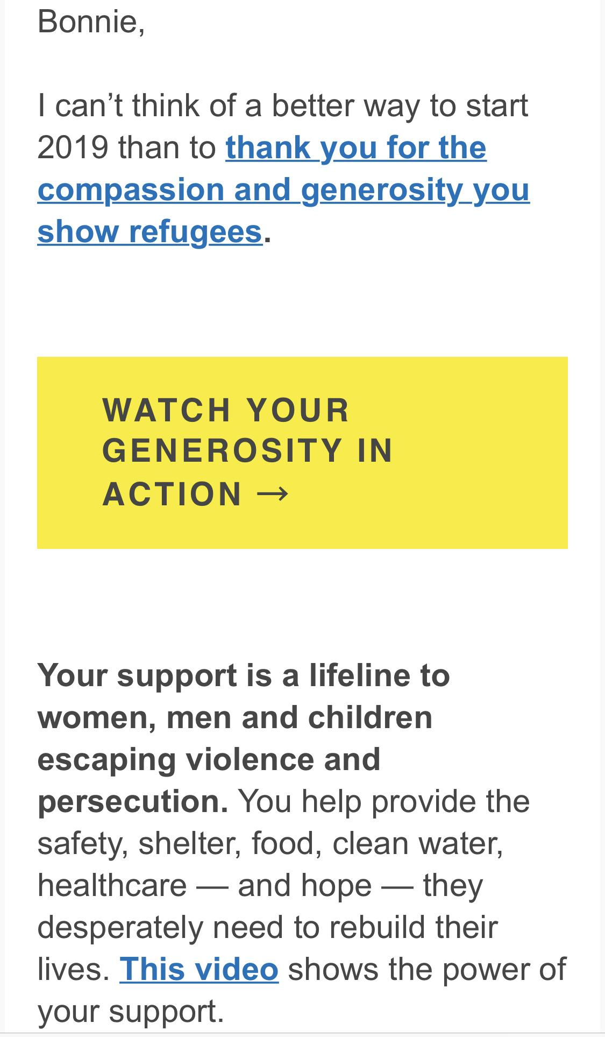
After the year-end barrage...

Slide 35
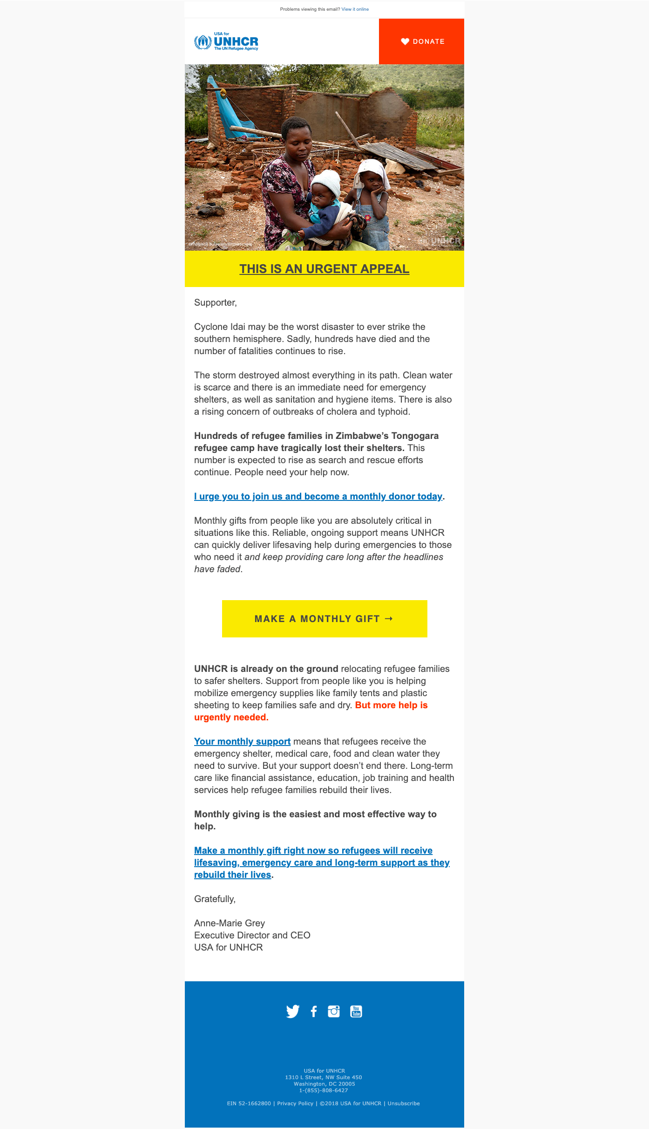
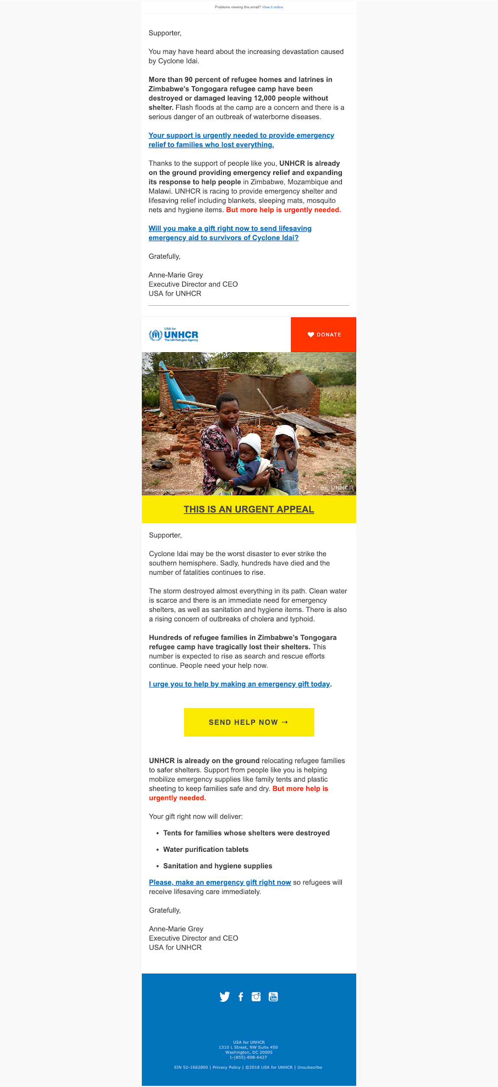
EMERGENCY
Step I
Notes:
These emails make the emergency very clear…

Slide 36
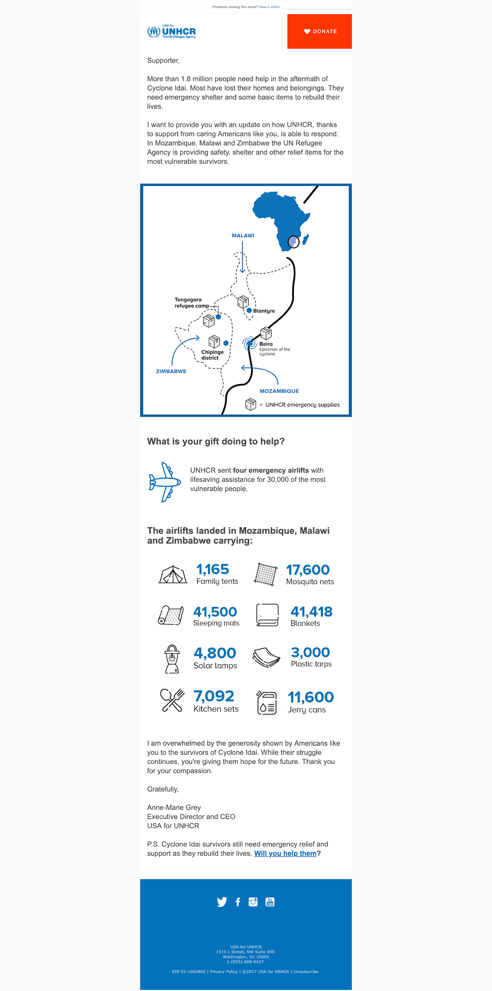
EMERGENCY
Step II

Slide 37
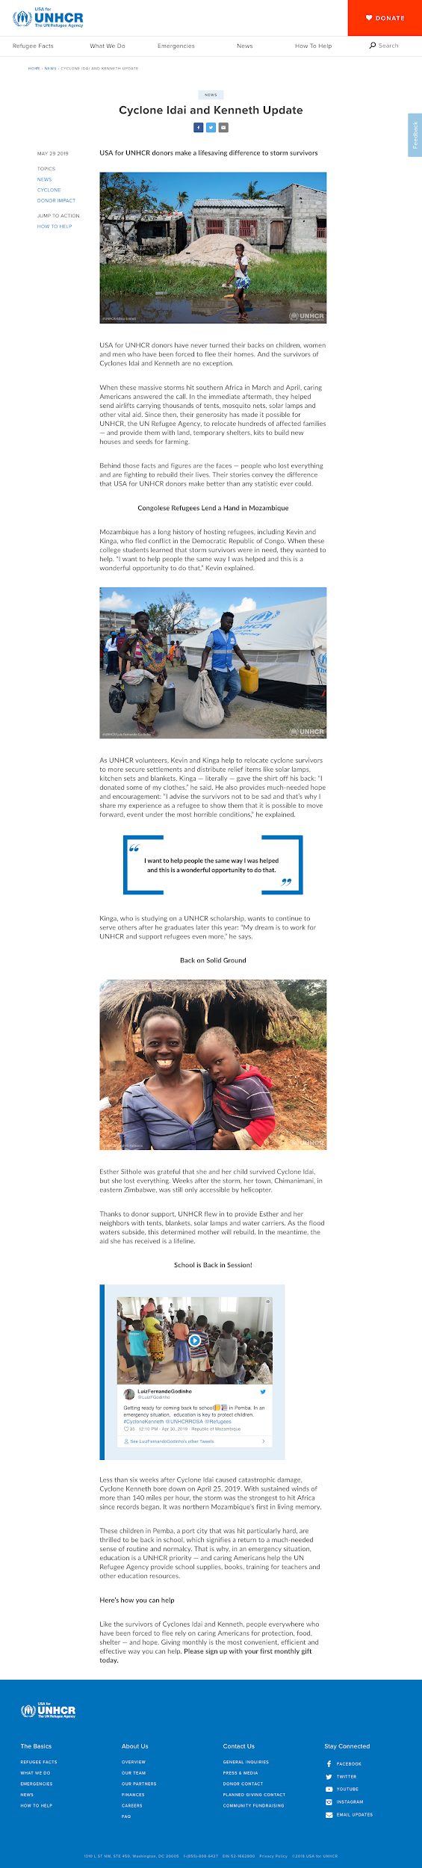
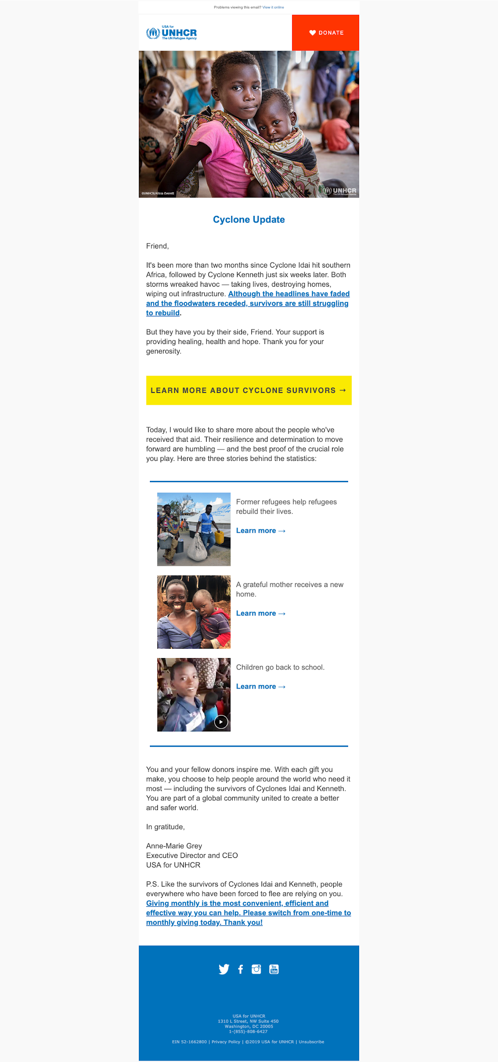
EMERGENCY
Step II

Slide 38

DONOR IMPACT
Set-up/Hope

Slide 39
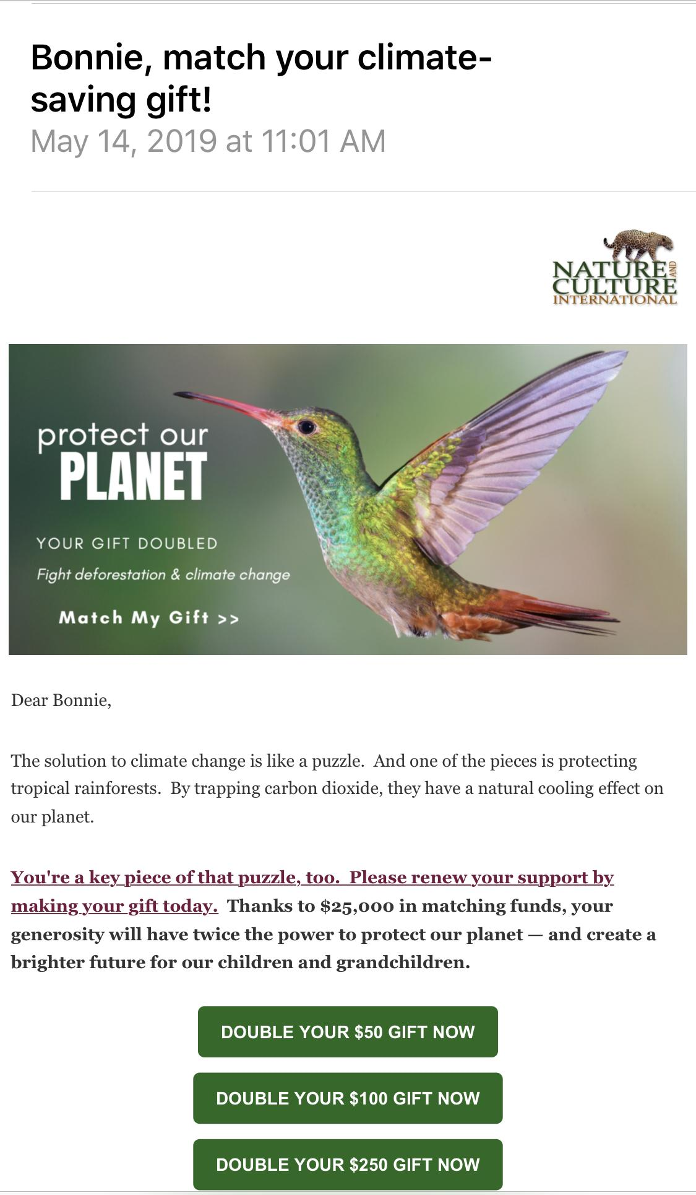
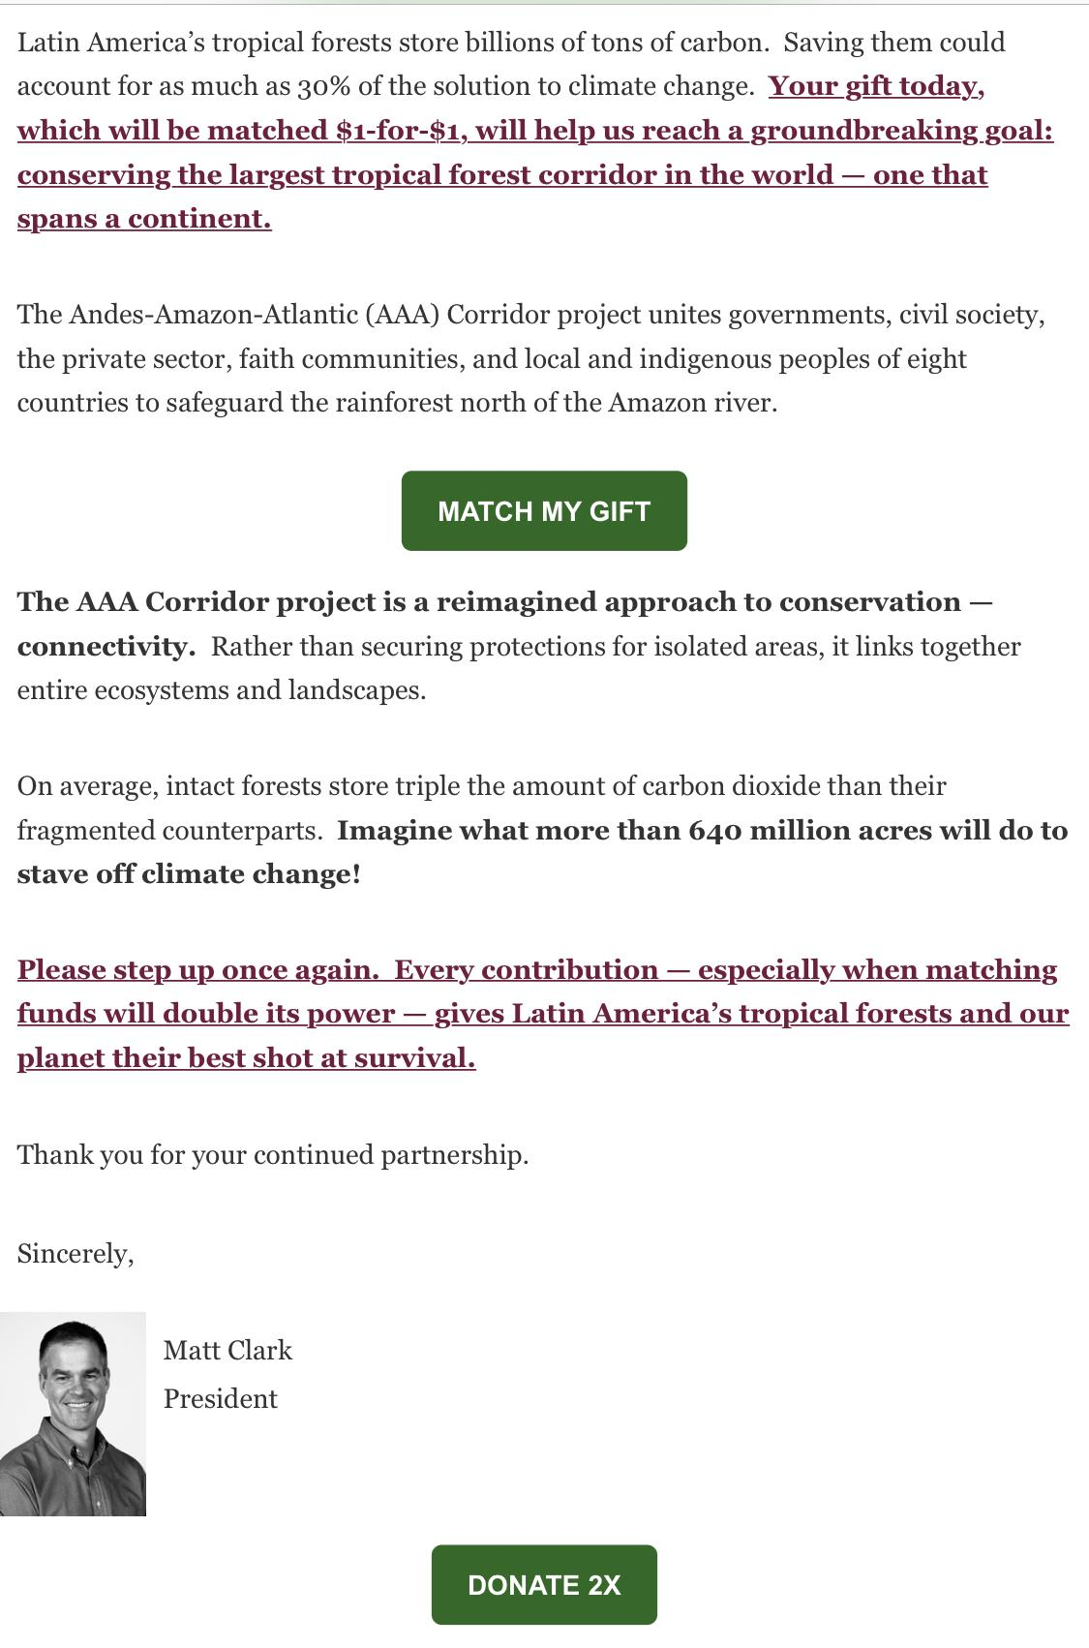
FUNDRAISING
Need

Slide 40
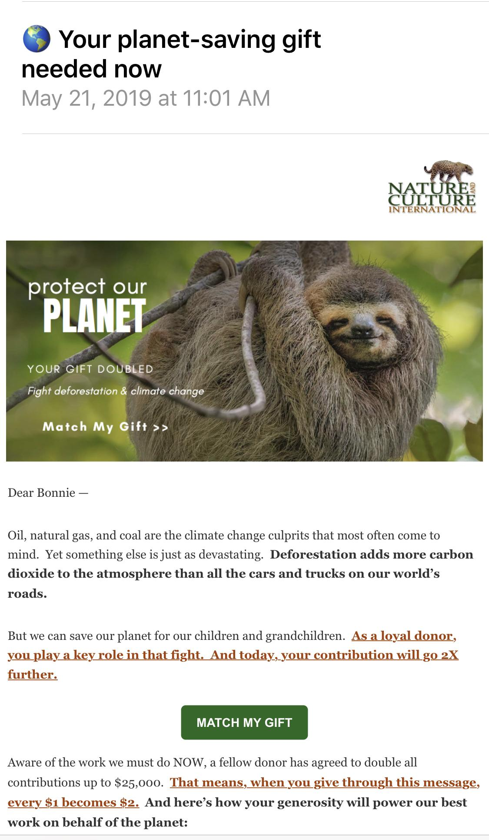
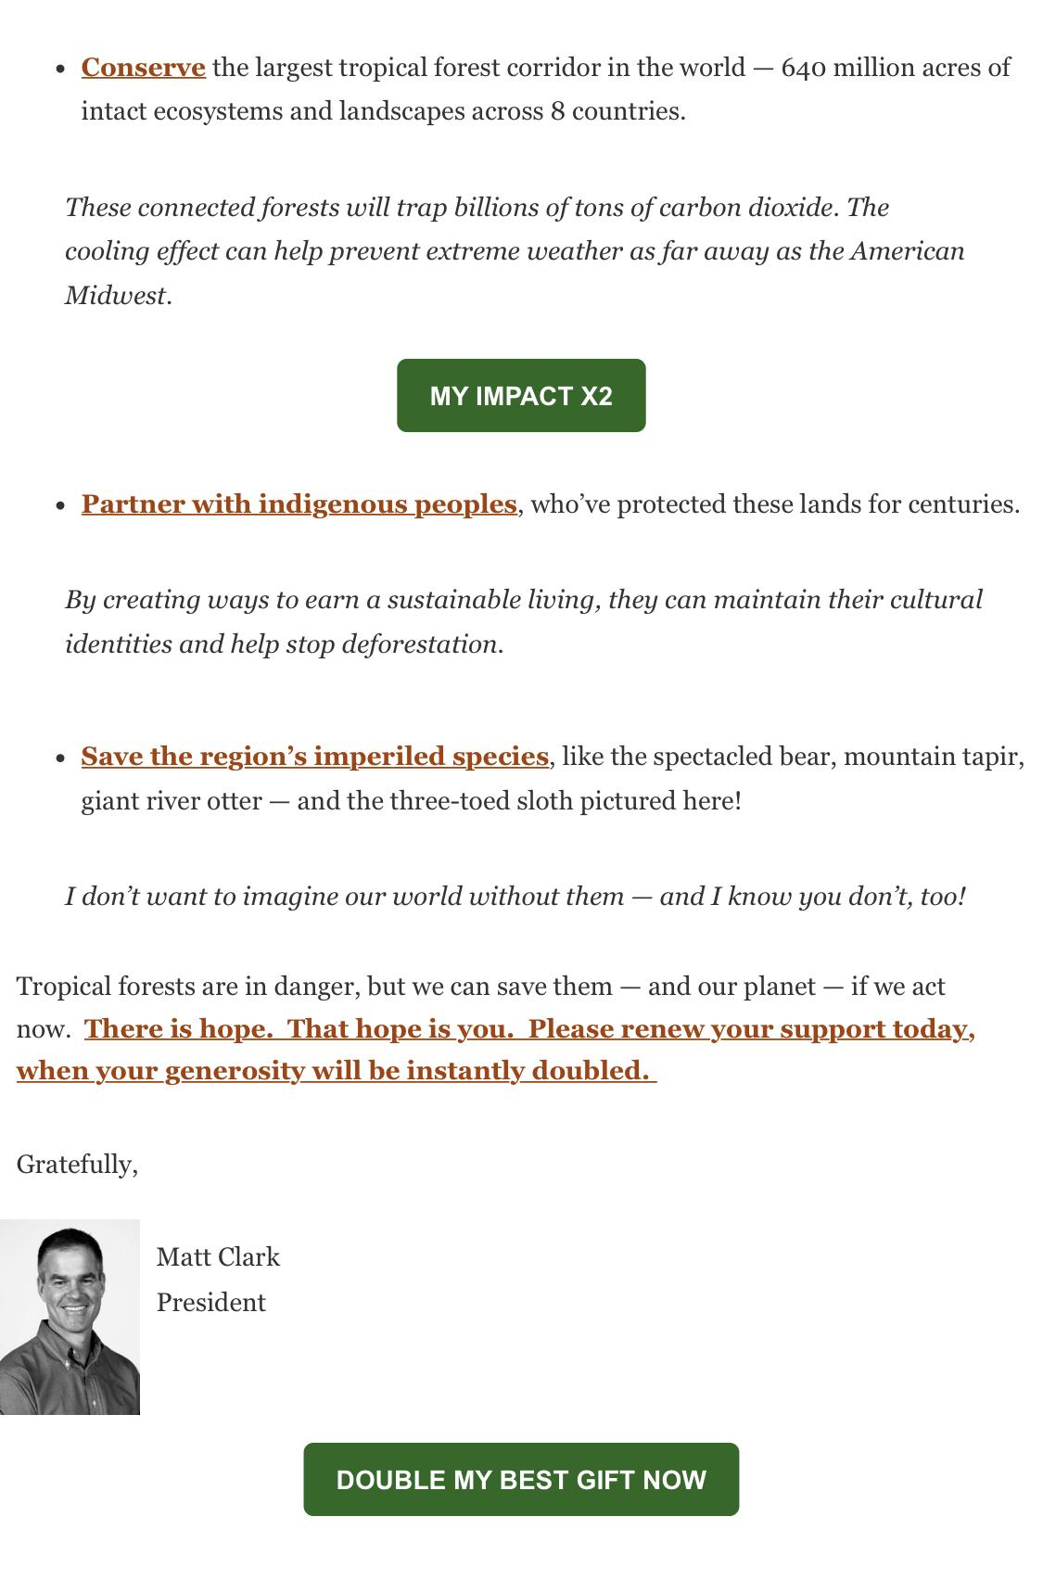
FUNDRAISING
Need

Slide 41
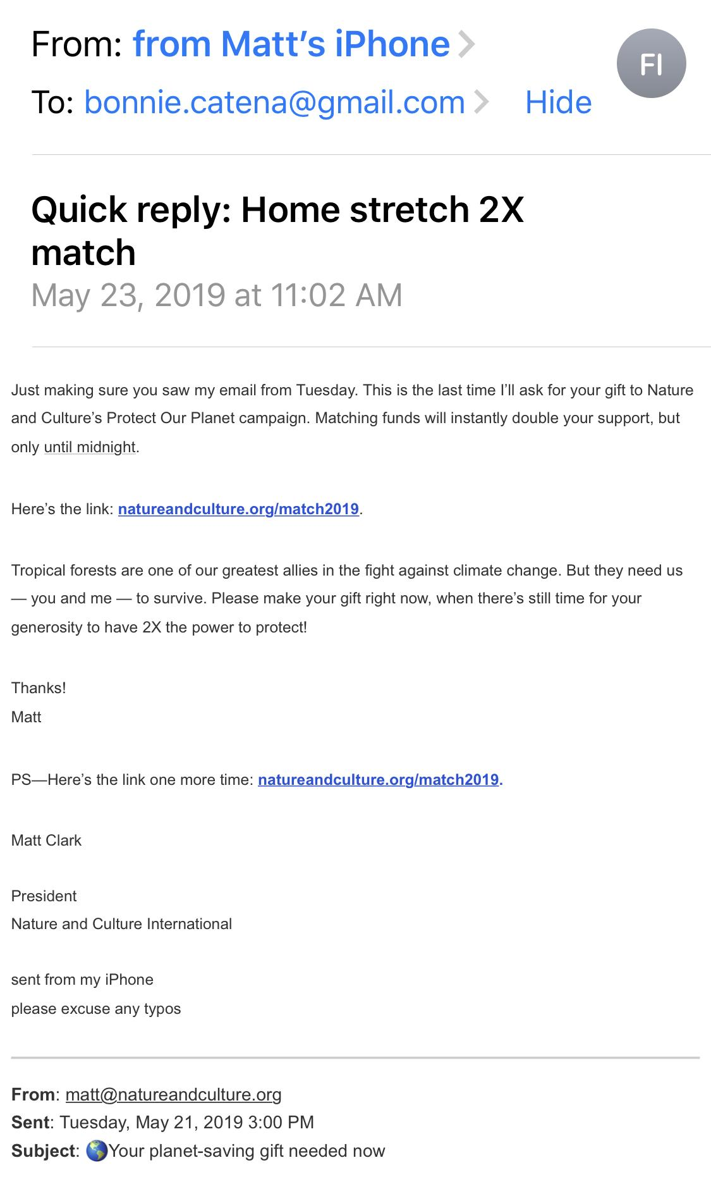
FUNDRAISING
Need

Slide 42
Thank you!
Bonnie Catena Allyson Goldsmith
Catena Connects USA for UNHCR
bonnie@catenaconnects.com Agoldsmith@usaforunhcr.org
#DMAWDigitalDay

