Slide 1







Maximize Moments that Matter with Awesome Automation
aka
The robots are coming, the robots are coming!
Jessica Bosanko Wendy Husman Steve Kehrli
#DMAWDigitalDay

Slide 2
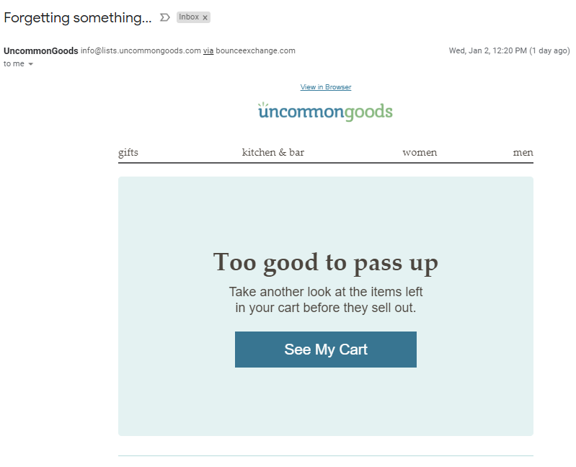
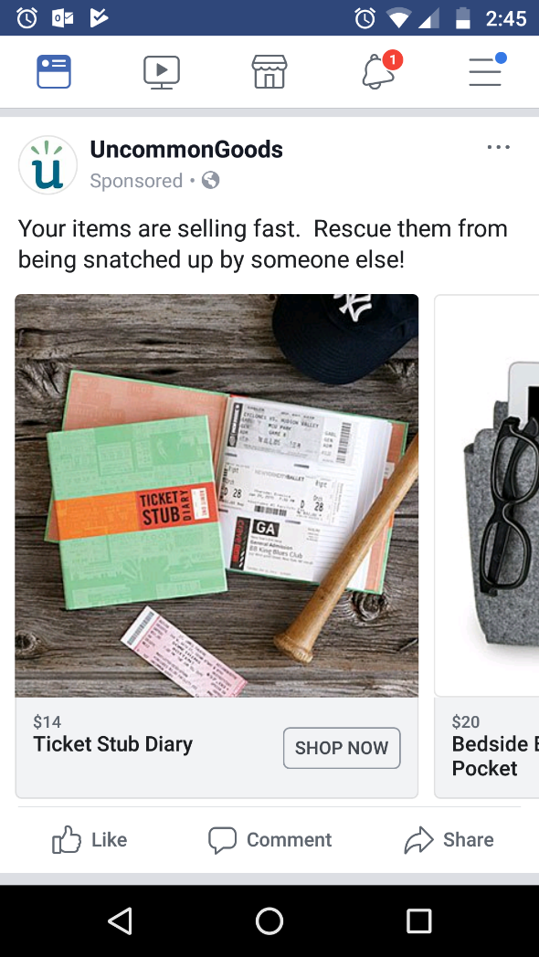
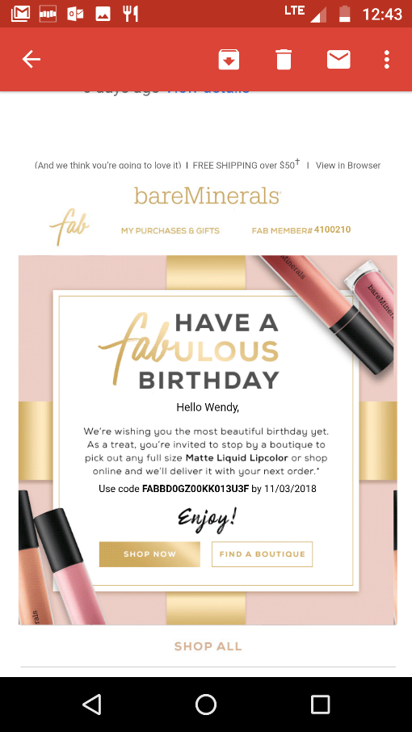
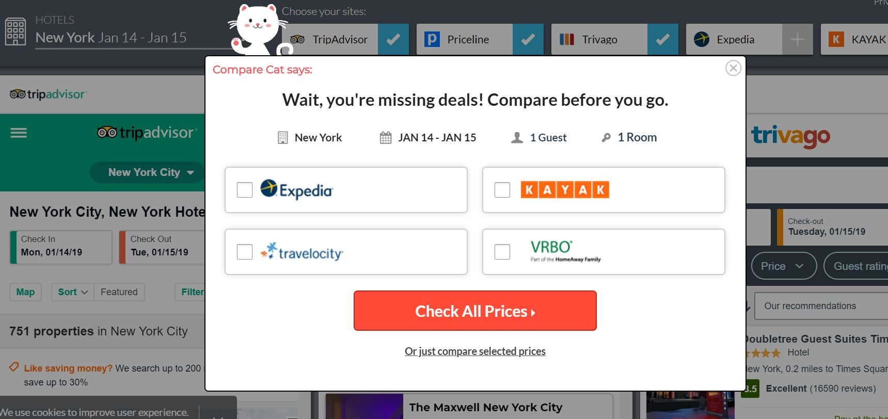
What are we talking about?
Notes:
What is marketing automation and why is it important? It’s a fancy way of explaining the triggered or automatic marketing pieces that are put in front of you because you took a certain sort of action. Digital methods allow this to be set up in advance and we experience it from corporations all the time – emails and ads that follow up after you start the checkout process, emails that give you a happy birthday deal, lightboxes that stop you when you’re trying to leave a purchasing page.
Nonprofits can and should utilize these tactics too!

Slide 3

What are we talking about?
Using automated messaging to:
+ deepen relationships with supporters
+ keep subscribers from going inactive
+ recruit donors & sustainers, upgrade & renew donors, and recapture lapsed sustainers
+ what's working in the world of welcome messaging and automated onboarding
Notes:
Jessica
The moment when browsing becomes clicking. The moment when a donation form is left incomplete. The moment when a one-time donor becomes a monthly donor. The moment when "loyal" becomes "sometimes."
Your fundraising program likely encounters all of these moments and many, many more. So many that it's hard to address each of them efficiently! That's where automation comes in. What if you could identify the moments when something changes for your donor or prospect and you are there with the exact right message? This session will use real-world case studies of organizations that are doing just that, with lots of examples, lessons learned, and tips.

Slide 4

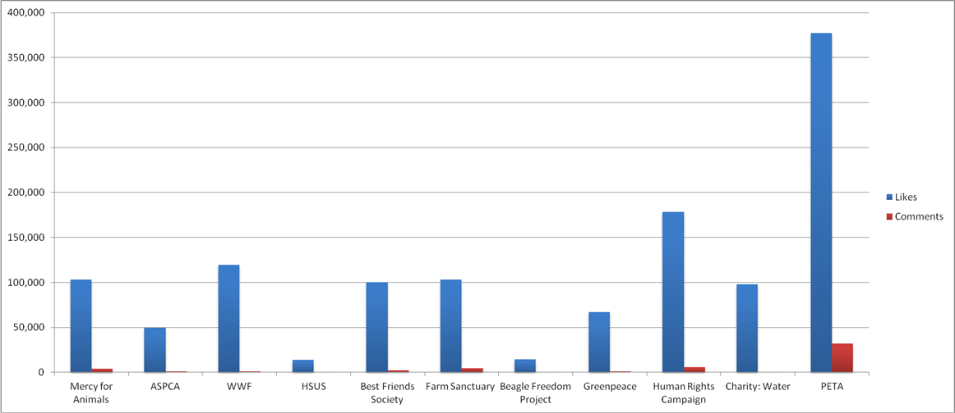
+ People for the Ethical Treatment of Animals (PETA) is the largest animal rights organization in the world, with more than 3 million members and supporters.
+ Instagram likes:
Notes:
Steve

Slide 5
PETA’s fundraising program
+ Direct Mail
+ Telemarketing
+ Email
+ Social Media
+ Mobile
+ Advocacy
+ Advertising
+ Events
+ Planned Giving
Notes:
Wendy

Slide 6

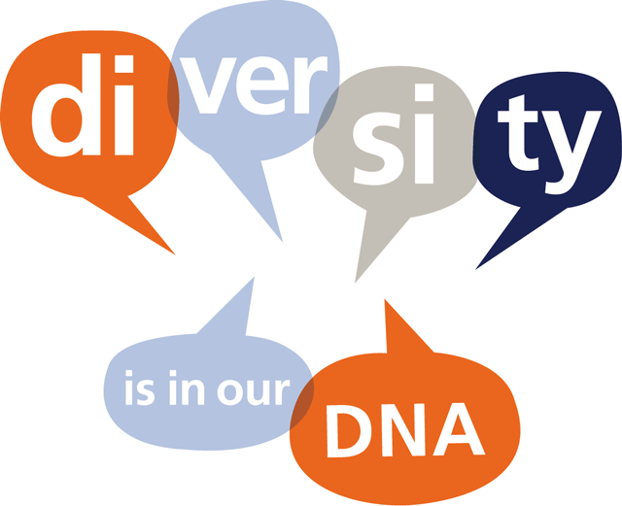

Mal Warwick Donordigital
+ Integrated, multi-channel strategy
+ High-level and granular analysis
+ Copywriting & design creative
+ Production management services
+ Telemarketing strategy & management
+ Mobile fundraising and advocacy
+ Digital strategy, creative & implementation
Donor
Direct Mail
Phone
Email
Mobile
Web
Canvass
Notes:
Wendy

Slide 7
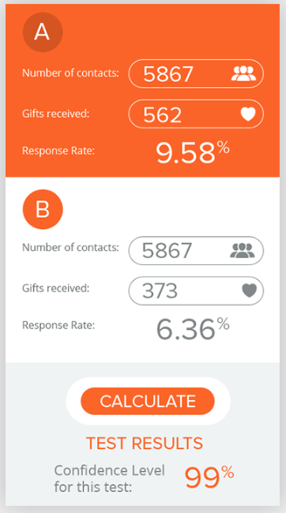
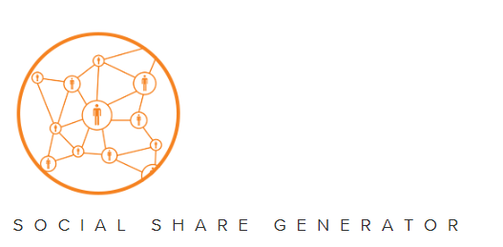
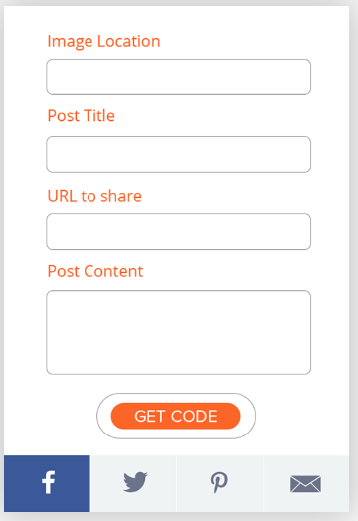
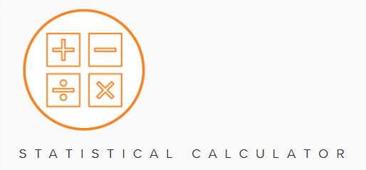
www.MWDagency.com
Notes:
Invite you to visit our website for some great tools that are available for anyone to use.

Slide 8








Online Fundraising + Advocacy
Earned Media
Social Media
Campaign Evaluation + Strategy
Integrated Advocacy Campaigns
Digital Advertising
Analytics + Optimization
Messaging + Identity

Slide 9

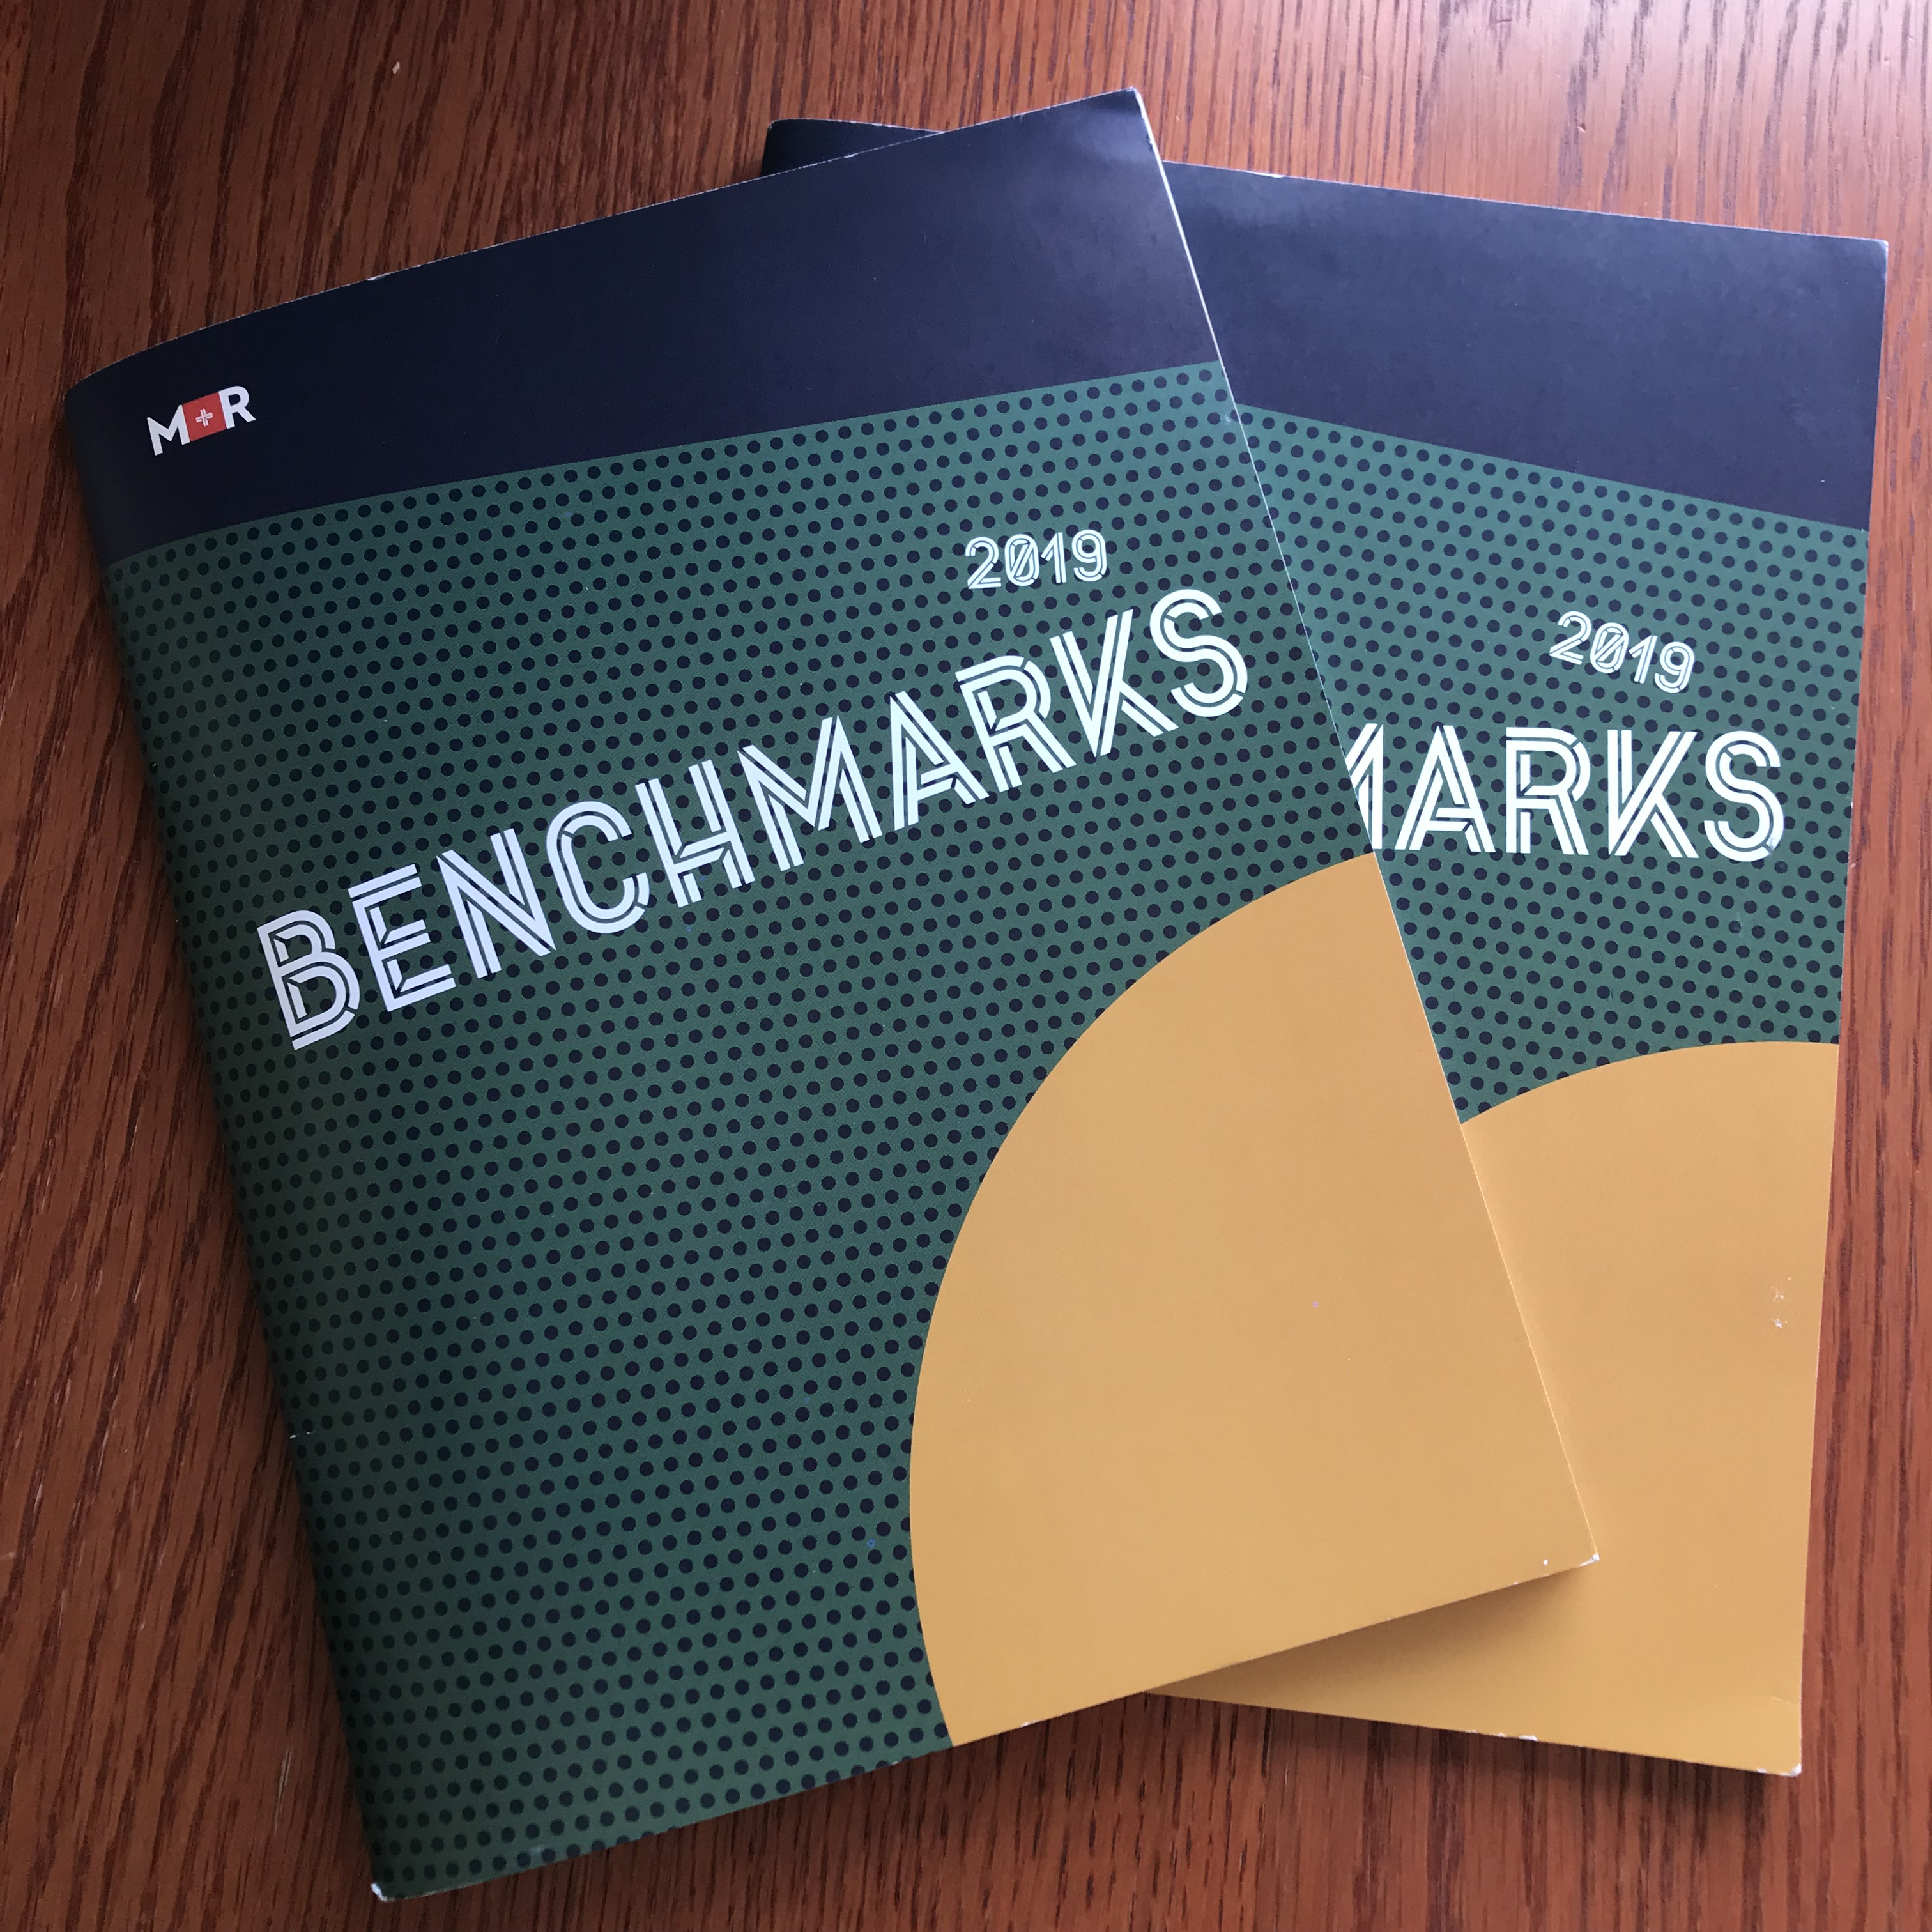
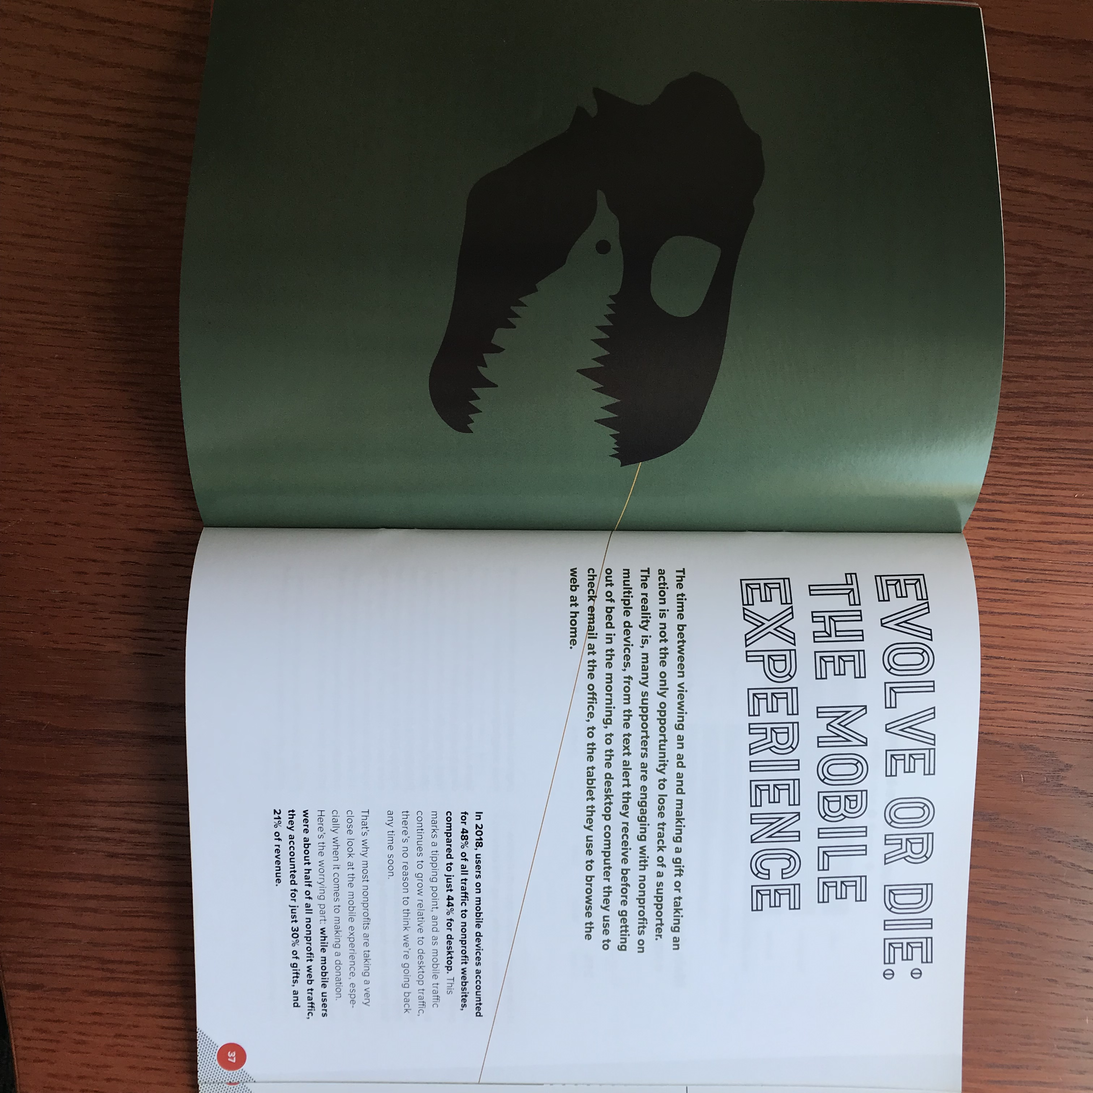
Benchmarks
+ This is our 13th Study!
+ SO MUCH DATA. And pretty charts. And jokes.
+ We analyzed data from 134 nonprofits across 8 sectors.
+ MrBenchmarks.com

Slide 10

Appeals
Show me the $$!
Notes:
Jessica

Slide 11
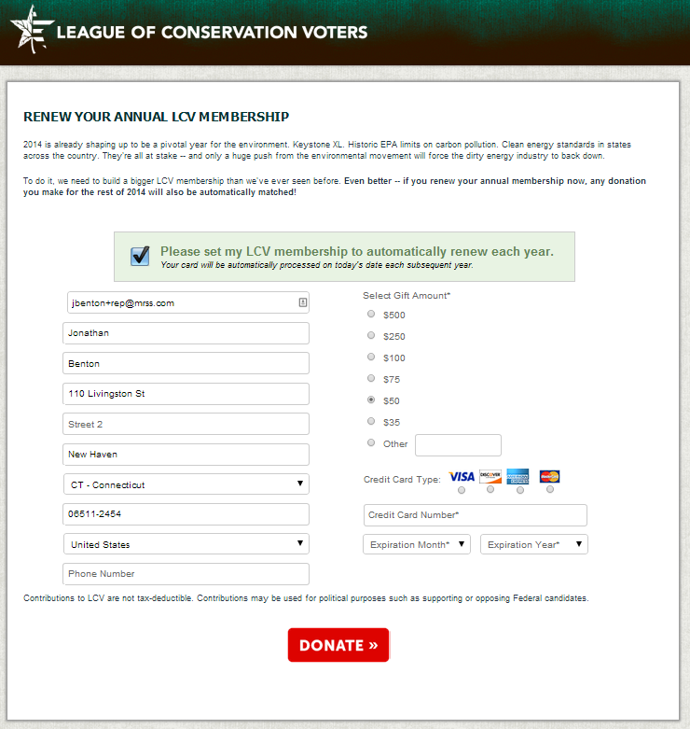
Autorenewals
56%
of people who submitted the form set their membership to autorenew.
Notes:
Jessica

Slide 12
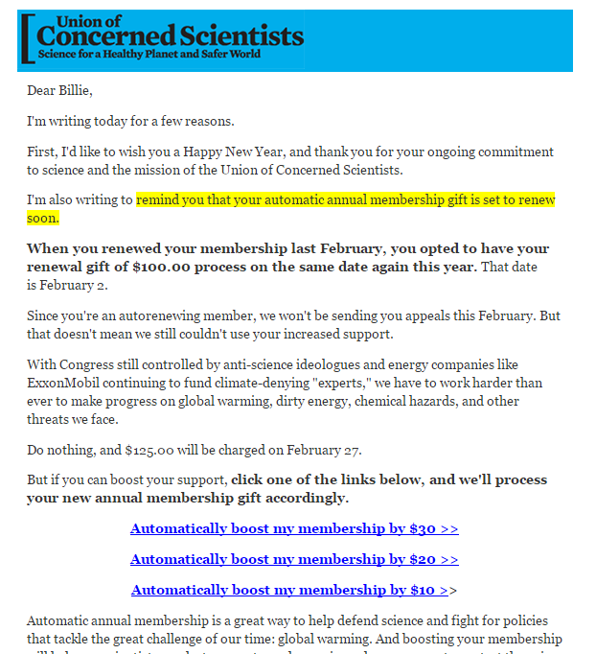
Automatic reminder & upgrade
*Include upgrade ask in reminders!
1 - 2% upgrade response rate & few cancellations
reminder
upgrade ask
Notes:
Jessica
Most of the groups we work with that have annual autorenewing options send out a reminder automatically anywhere from 3 weeks to 1 week before their gift will process. And in some cases, they send 2 of these notifications. Each message reminds them of the upcoming gift AND gives them a chance to upgrade. Roughly 1 to 2% of recipients take us up on the upgrade request, and cancellations are mostly negligible.
NOTE:
PFAW & UCS have automated these messages
LCV launches manually
CPC - unknown

Slide 13
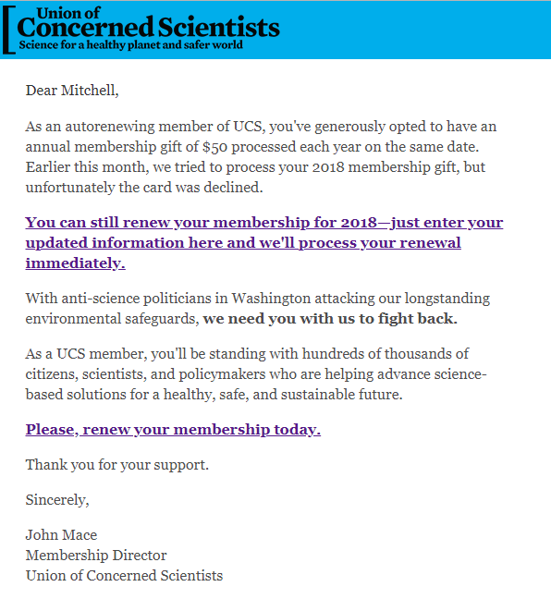
Automatic notice for failed payments
Notes:
Jessica
If someone’s gift fails to process, they’ll receive an automated notification asking them to update their payment information, typically within a week or two of the failed gift. Again, this can be 1 or 2 messages about a week apart.

Slide 14
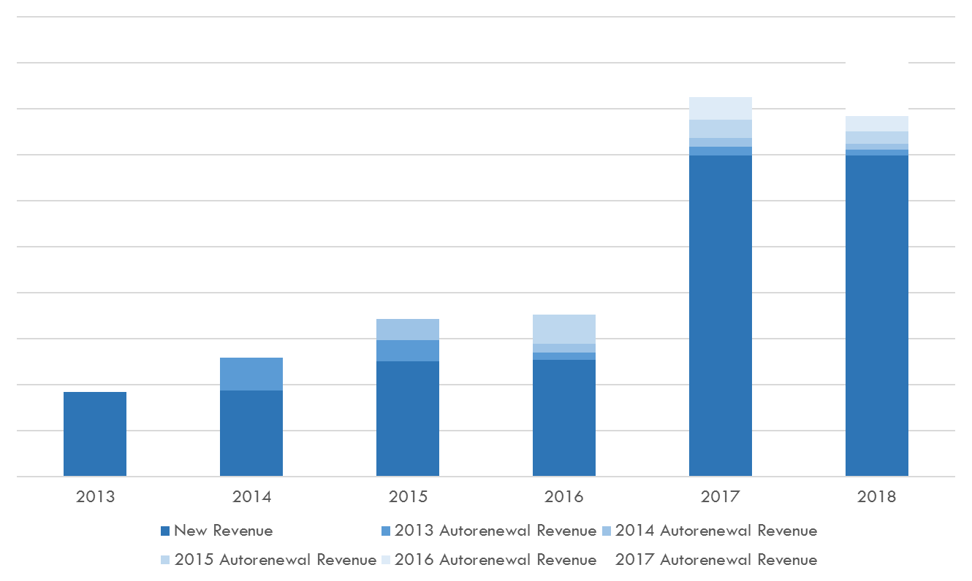
And the results…
In 2018, we got $$$ going all the way back to 2013
Notes:
Jessica

Slide 15
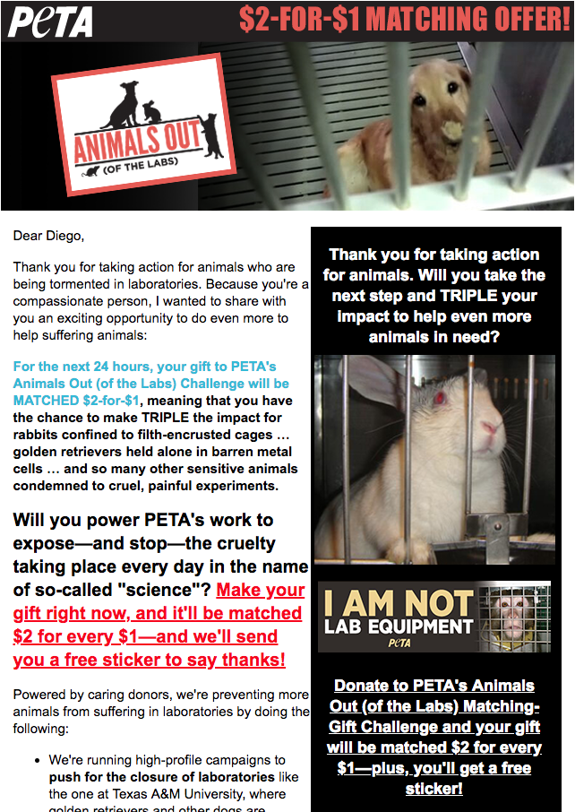
Recent Action Taker Appeals
You took action—now TRIPLE your gift
Notes:
Steve
The afternoon after you took action during one of PETA’s primary campaigns, you’ll receive an appeal like this with a limited time opportunity to give and have your donation matched. These won’t replace an actual appeal - they raise about 10 - 20% what an appeal would, but they have become a nice revenue stream for Peta.

Slide 16
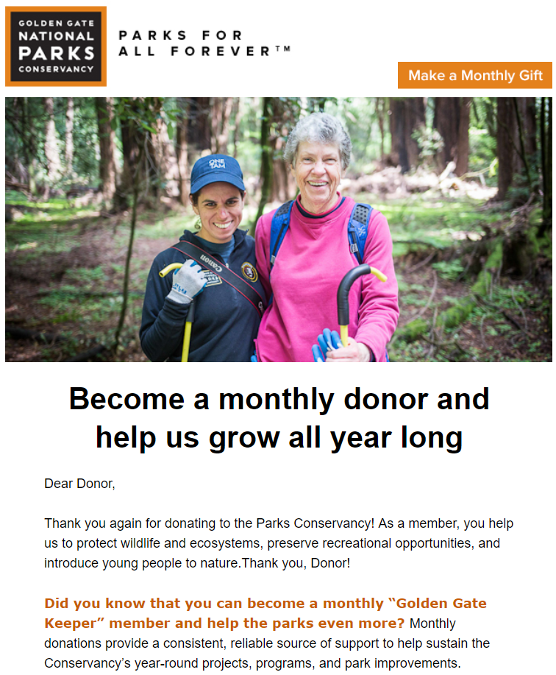
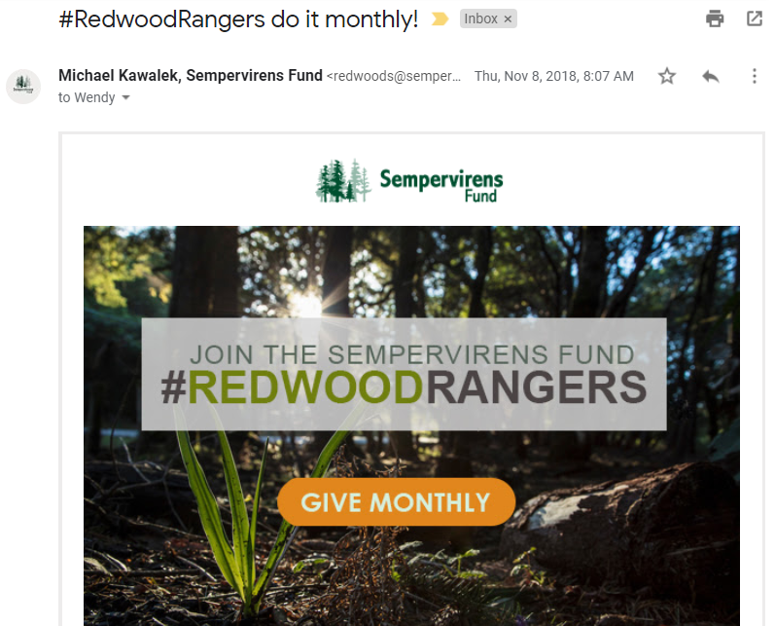
Triggered monthly ask to recent one-time donors
Notes:
Wendy
Another important type of triggered appeal is a monthly giving ask. It’s counterintuitive, but a great window of opportunity to request a monthly gift is right after someone makes a one-time gift.
To be clear, thank them first without requesting anything else. But then, about a week or two or three later, you have a golden moment to invite them to make a monthly gift.
Many organizations include a monthly giving ask in their welcome series to new list members.
The examples above are actually separate from a welcome series – they go out to donors who are NOT new to the email file, but made a one-time gift a week earlier. So they’ve received their thank you autoresponder and hopefully their printed acknowledgement letter, and then they receive this message.

Slide 17

Getting to
Know you
Notes:
Wendy
I just mentioned a welcome series. This is one of the most common triggered email in use by our clients, and for good reason – it welcomes people to your list in a way that helps them understand how they got there (so they don’t spam flag you or ignore you, which is almost worse);
Feel even more excited about your organization because they learn even more about the awesome things you do, beyond what got them excited in the first place!
And because people are joining your list all the time, it’s a perfect thing to set up on a triggered basis, because it would take way too much of your time to send out manually – and you’d miss the crucial timing for doing so RIGHT when people are most excited.

Slide 18
Welcome Series Messages
+ The most engaged, curious and interested someone will ever be
+ Important opportunity to improve email engagement and deliverability to the inbox
+ You can put people into tracks based on interests and behavior
Notes:
Wendy
It seems strange, but when someone first joins your list, it’s the most they are likely to care about you, so you need to jump on the opportunity.
**A need to have, not a nice to have, to implement a welcome series, due to ever-increasing concerns with engagement. Ensure everyone gets delivered to the inbox when you make sure everyone on the list is jazzed to be there.
Track people if possible, for example providing different information to people who joined via different sources, or people who joined due to a specific newsworthy issue, or people who joined by making a gift.

Slide 19

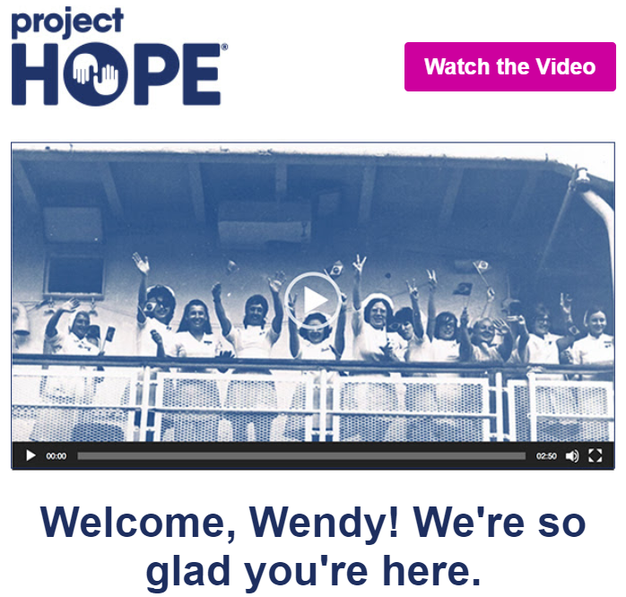

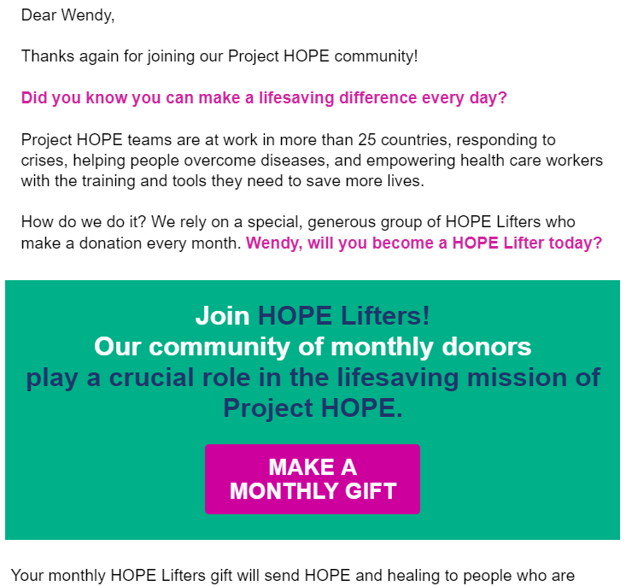
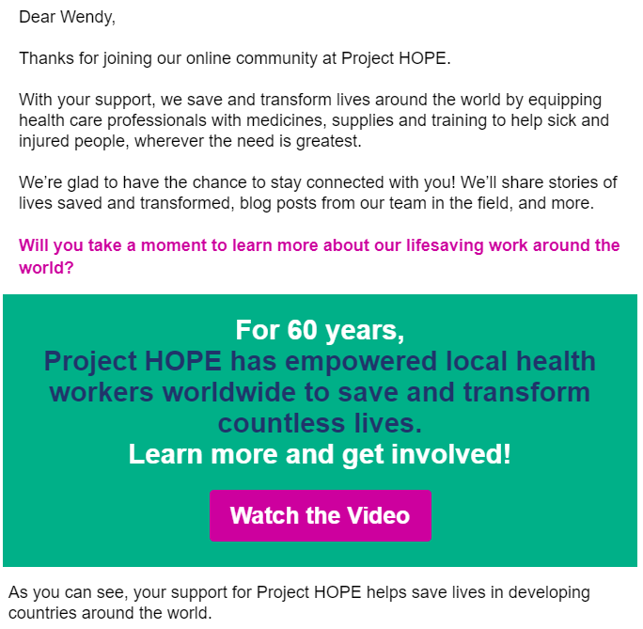
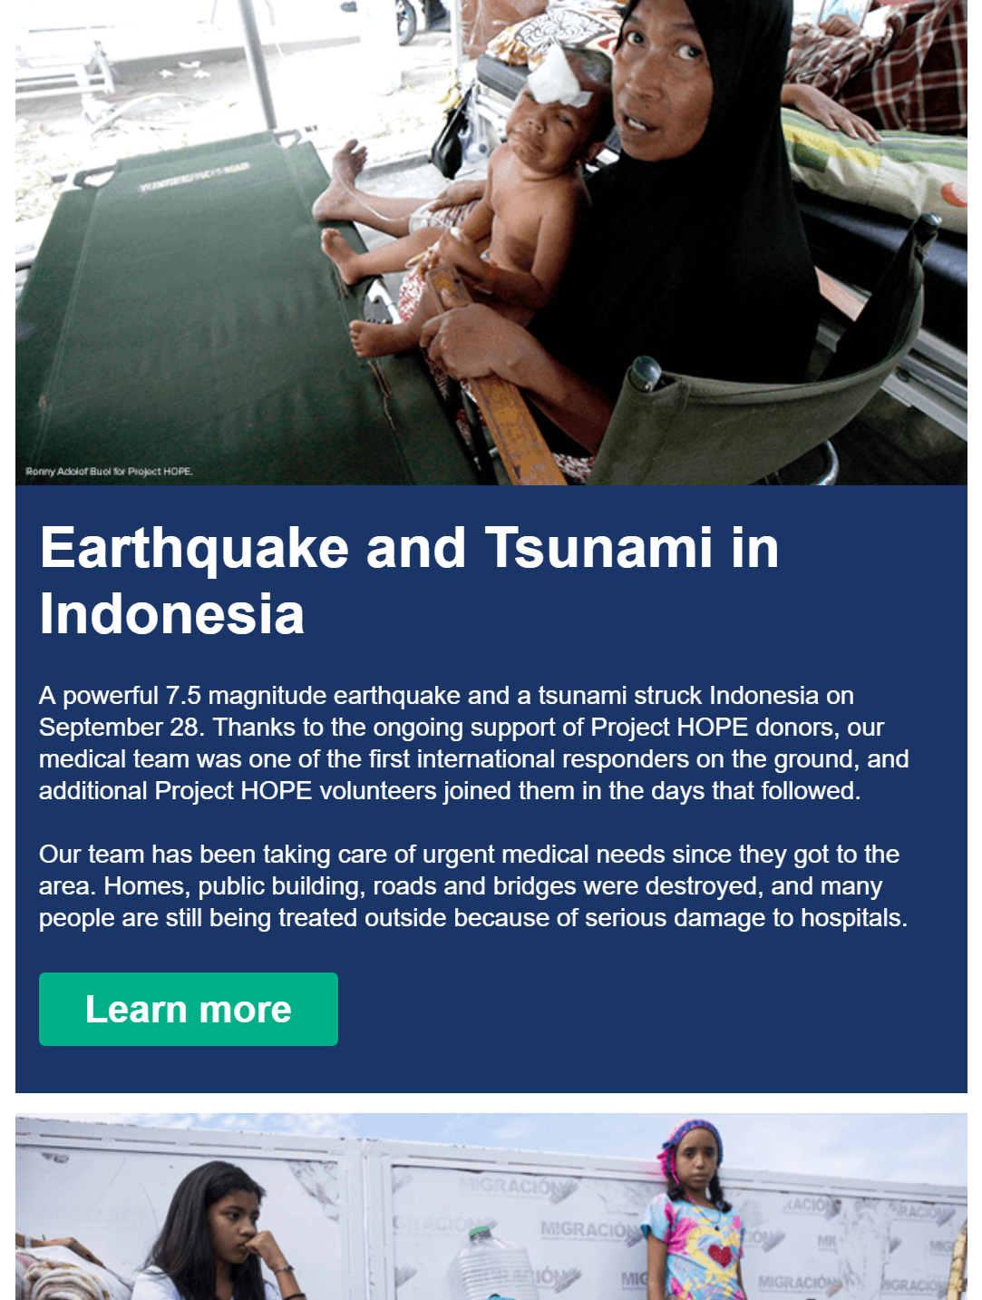
Simple welcome series
Notes:
Wendy
Here’s a very straightforward example of a welcome series.
Timing: 1 day, 5 days, 9 days, suppress from other emails for 11 days
Now, setting up a welcome series is a very good idea, but most systems do not make it easy.

Slide 20
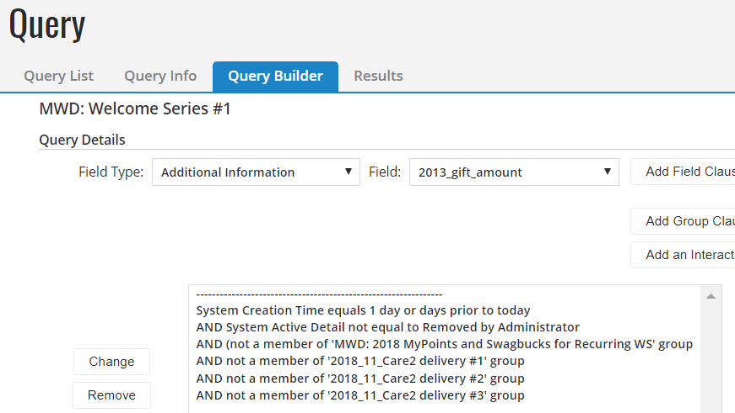
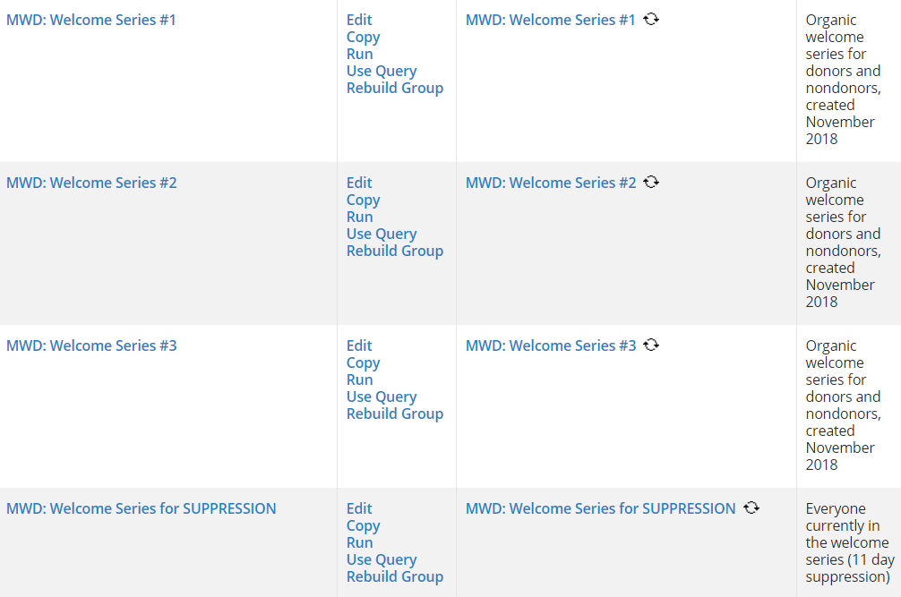
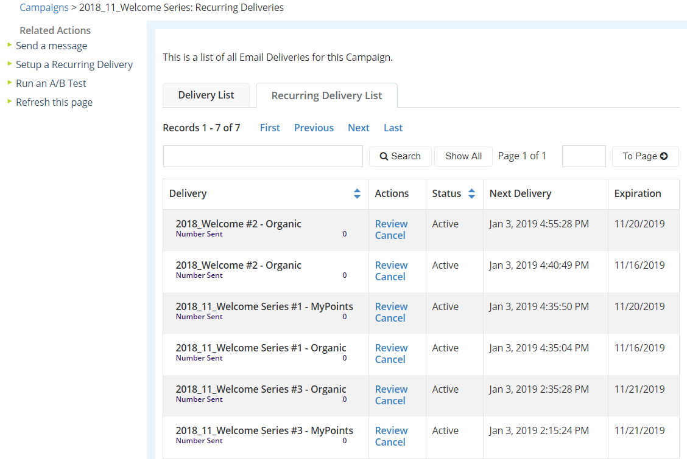
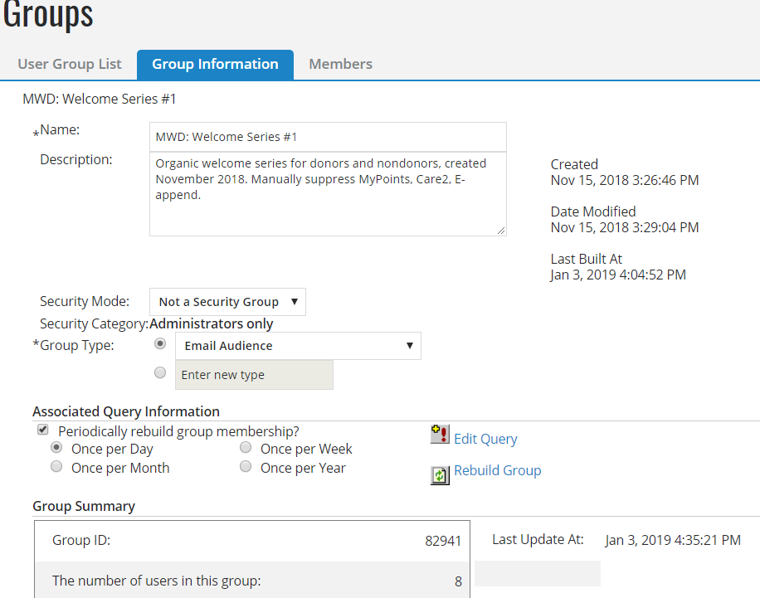
How the vegan sausage is made in Convio
Notes:
Wendy
Here’s how we make it happen in Convio. First, we make sure we don’t pull in anyone who we don’t want to email – particularly, records removed due to fraud and records getting a different welcome series.
Then, we query on people new to the system 1 day ago, 5 days, 9 days.
Those queries build groups that refresh every night
A recurring delivery of each email message in the series pulls in people who are new in that group
It takes a minute to set up, but once you know how, it’s not rocket science.
We have a suppression list of those people so we avoid sending them other messages during that time.

Slide 21
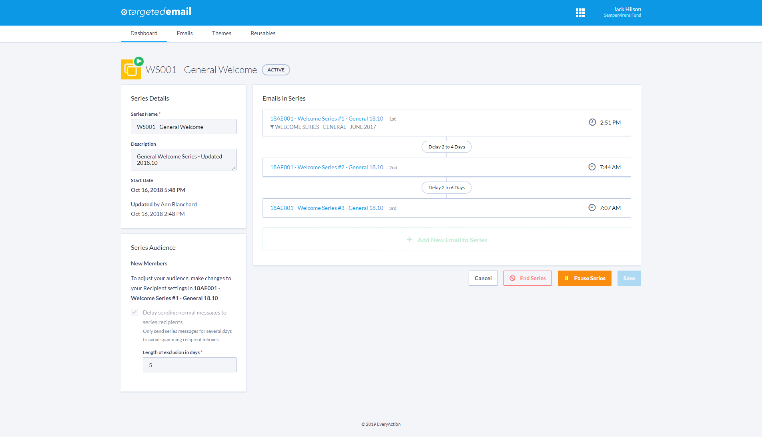
General welcome series in EveryAction
Notes:
Wendy
EveryAction example – this one grabs everyone on the general email list, and sends messages out every day at the following times to people who fit the criteria.
Now might be a good time to talk about Pitfalls. With any triggered effort, it is important to GET THE DATA RIGHT! It is worth whatever time you take to ensure that you’ve set things up correctly, especially as you get fancy with it. If you need to take an action with your own email address and see what happens before you expand your effort to the whole list, than do it.
I’ll share an example of one of my most embarrassing career moments. It was welcome series related, when I used an OR instead of an AND in a query and accidentally welcomed the whole list, including board members and VIPs. It was one of those blood runs cold mistakes where you feel terrible in the pit of your stomach. It all ended up being fine- great, actually, because a lot of those VIPs would never have received email and they LOVED our message and told our CEO how much they loved it. And it was great because now I am extra cautious about avoiding mistakes of this nature. ☺
So, the more complicated you get, the more important it is not to be so confident in your own query writing that you don’t test it.

Slide 22
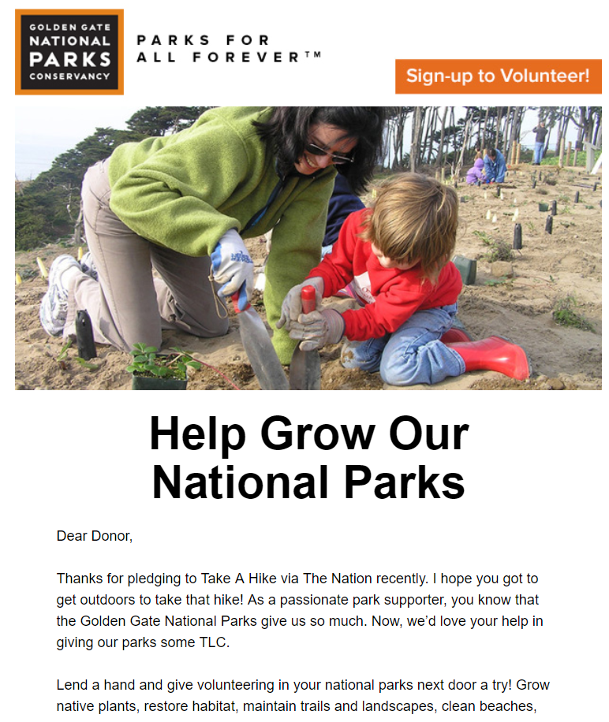
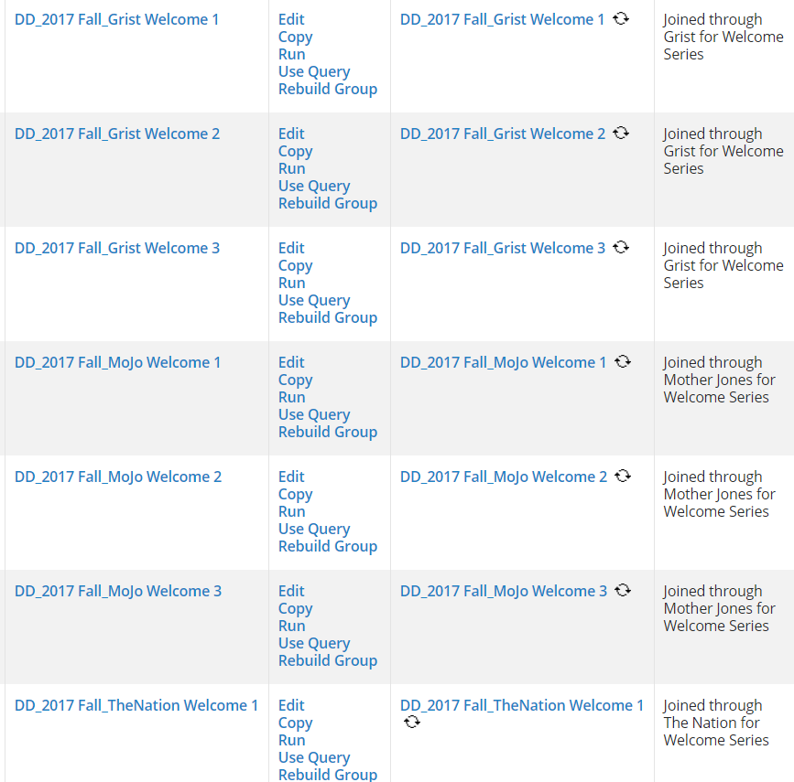
Tracking your welcome series
Notes:
Wendy
Here’s an example of how to get fancier with your welcome series. Rather than having one data flow for everyone on your list, a best practice is to split it into tracks. The most obvious one is donors and nondonors, so you’d send one series of info to people who simply joined your email list, and another to people who made a donation.
In this example, we’re showing how we tracked the welcome series for people who came in through a variety of methods of paid acquisition, which we call out separately in the first sentence of the email. It took a little bit of time to set all of this up, but once it was done, it could just run continuously.
Worth the time to set it up and not worry about it any more.

Slide 23
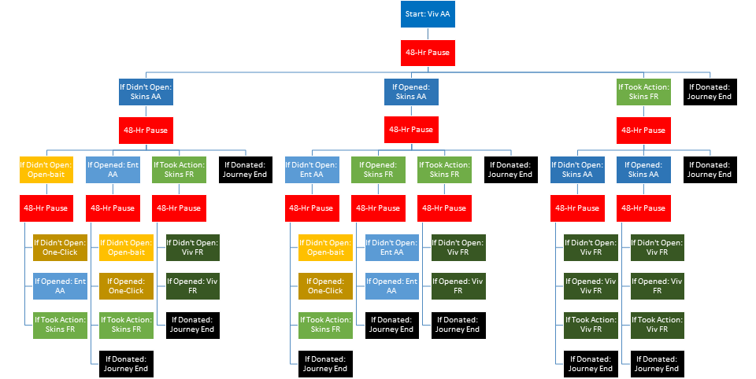
Welcome series: PETA style
Notes:
Steve
PETA’s welcome series consists of 7 emails launching to different audiences depending on how subscribers interact with the messages. But any one subscriber receives as few as one message and as many as 4. All in the span of 8 days. But no one gets all 7!
It starts the same for ALL new joins: a top performing action alert that lands on a donation page. From there, things start to become customized. If you donated, you’re welcome experience is officially over! If you took action but didn’t give, you’ll receive a top performing fundraising appeal next. If you didn’t take action, you get another top performing advocacy action. From there, it gets increasingly splintered, with non openers getting more open-bait type messaging, action takers getting direct appeals and openers getting messaging designed to get them clicking. (it’s actually a little more complicated than that, but that’s the summary!)

Slide 24
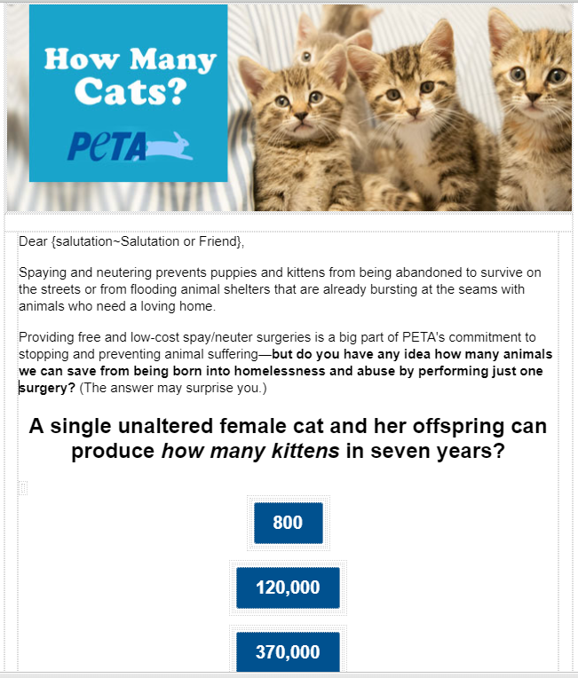
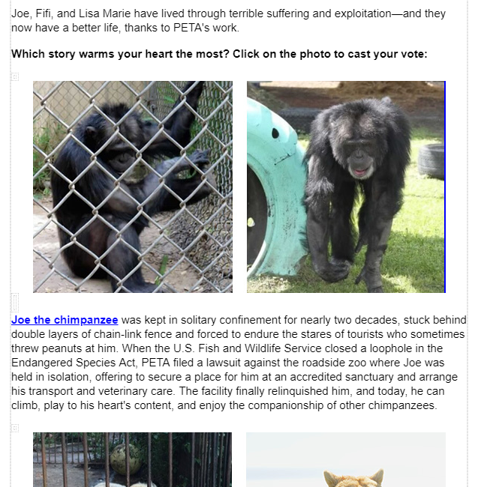
The PETA welcome treatment
Notes:
Steve
open bait msg (photos of rescued animals) and one click msg (one question survey)

Slide 25
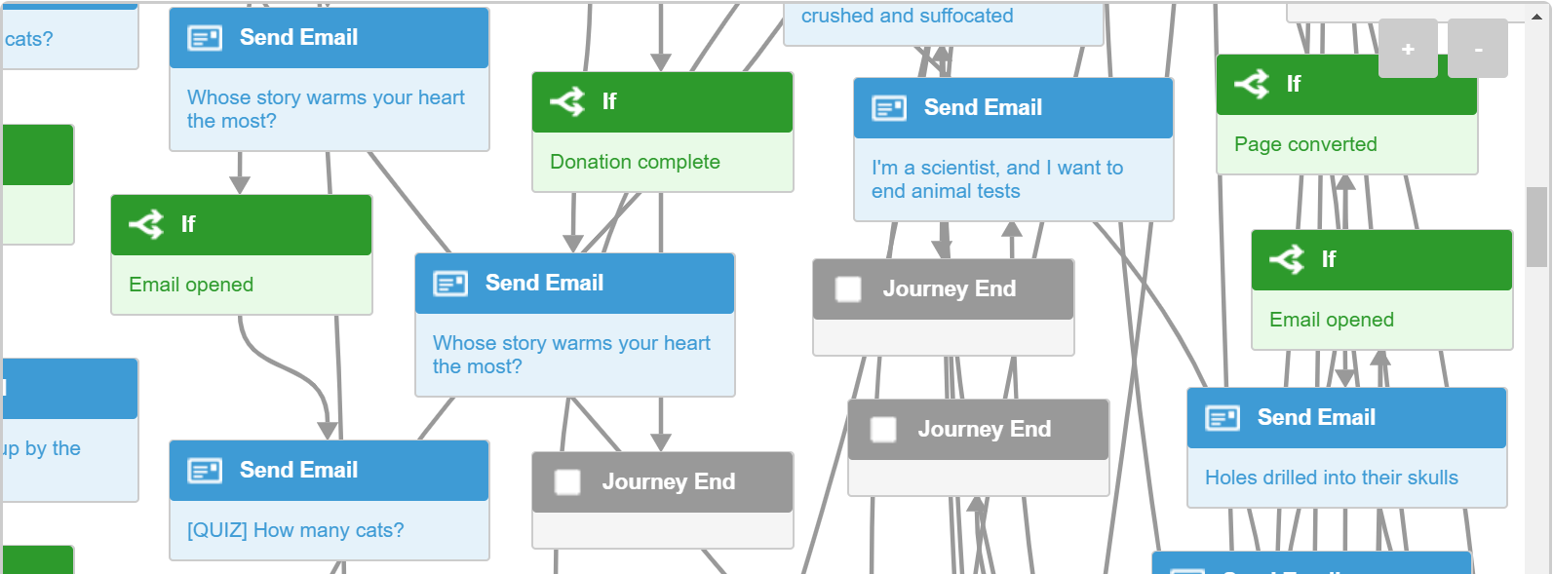
Welcome series
Notes:
Steve
Buyer beware: a welcome series can get complicated FAST...and not all that complication is likely going to pay off in $s and relationships so start SIMPLE

Slide 26

Monthly
Giving
Make it monthly
Notes:
Jessica

Slide 27
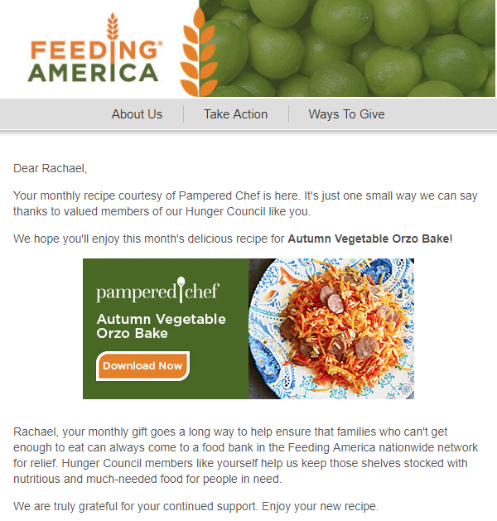
Ongoing Appreciation
Notes:
Jessica

Slide 28
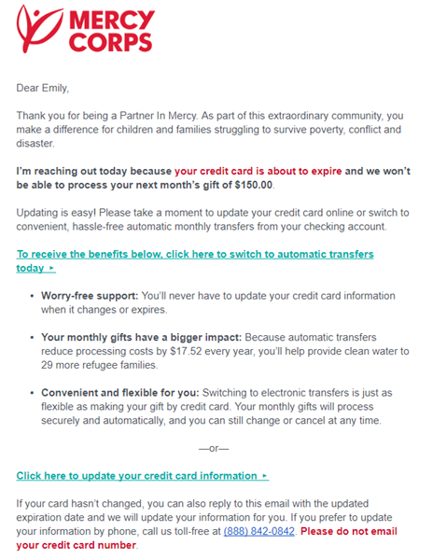
Don’t let them slip away!
Notes:
Jessica
In advance of credit card expiring – pre-lapse message.

Slide 29
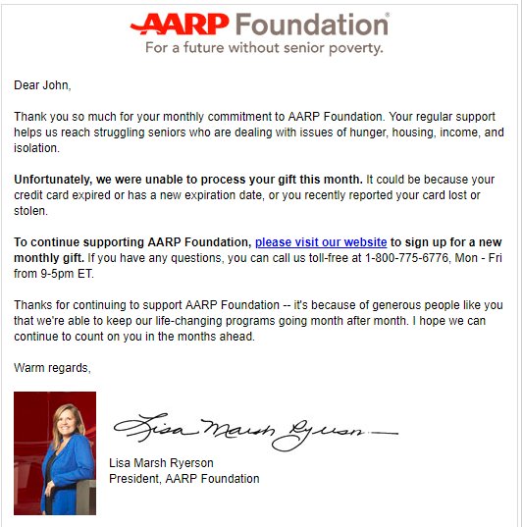
Getting them back!
Recaptured nearly 20% of sustainers that lapsed
Notes:
Jessica
A number of our clients have messages like this one from AARP Foundation which launch shortly after a monthly gift fails to process. It’s a simple message but it’s impact is huge! For Foundation, this email was the 4th largest tracked source of active sustaining gifts in 2018.
And the revenue implications are large. Donors who updated their gifts via this effort accounted for 10% of all monthly giving revenue in 2018!

Slide 30
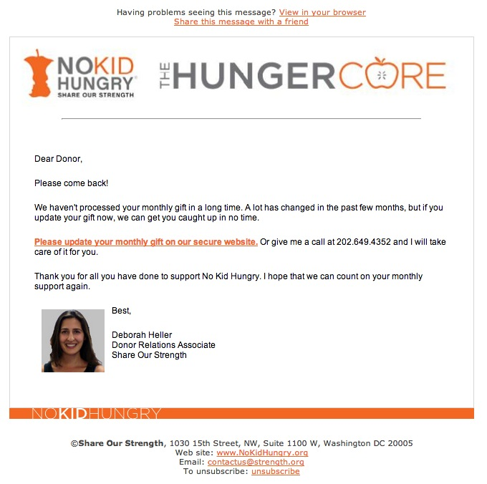
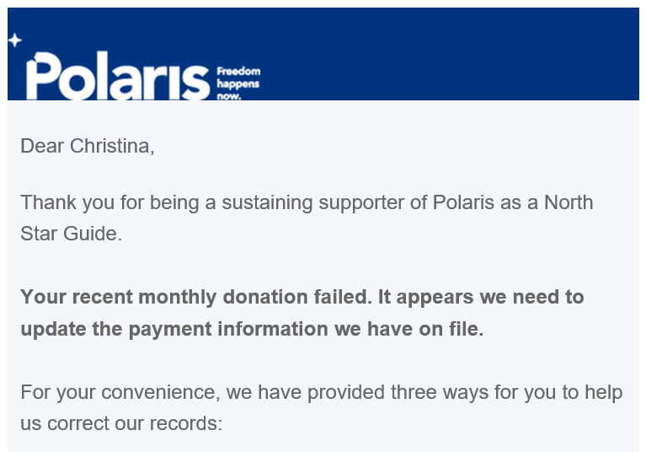
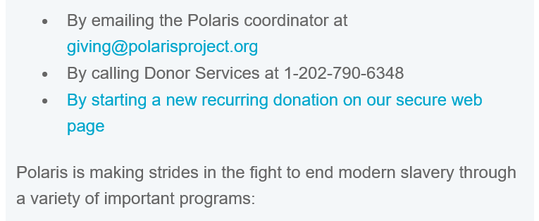
Triggered re-capture for sustainers
Notes:
Wendy
Timing of email setup. Build in more messages to the treatment.

Slide 31
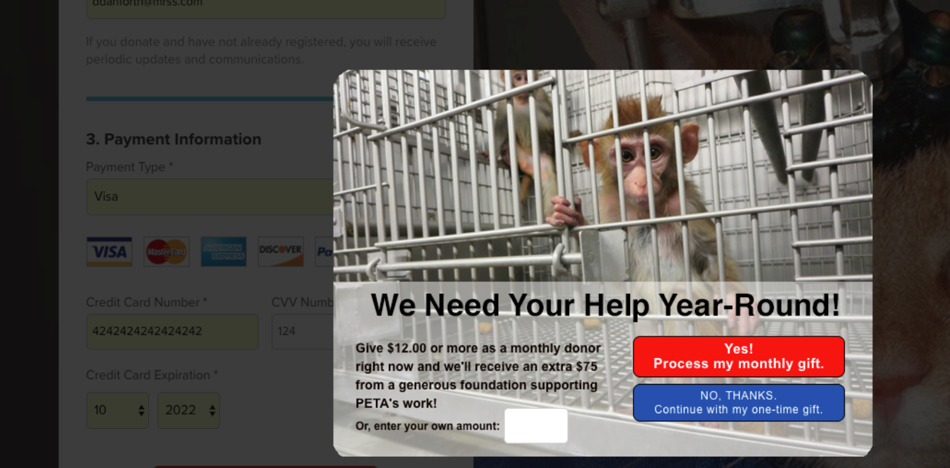
Donation page upsell lightbox
Notes:
Steve

Slide 32
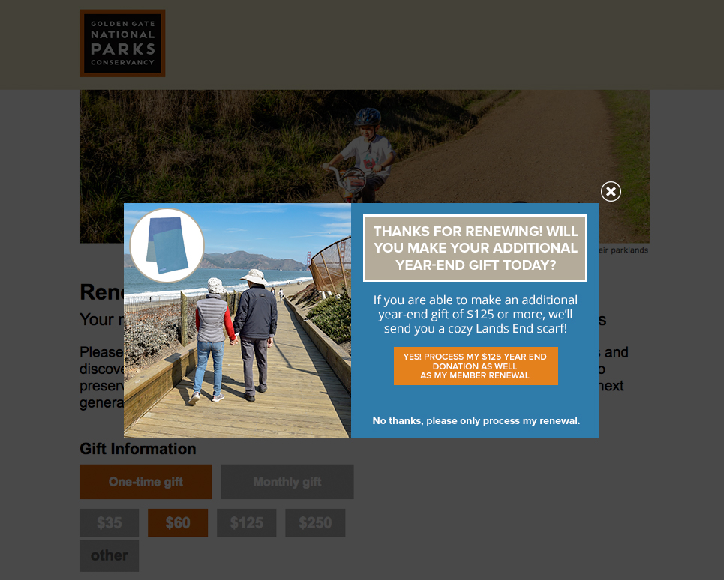
Donation page upsell lightbox
Notes:
Wendy
Will replace with PETA example

Slide 33

Donation Page Abandoners
Don’t abandon me
Notes:
Steve

Slide 34
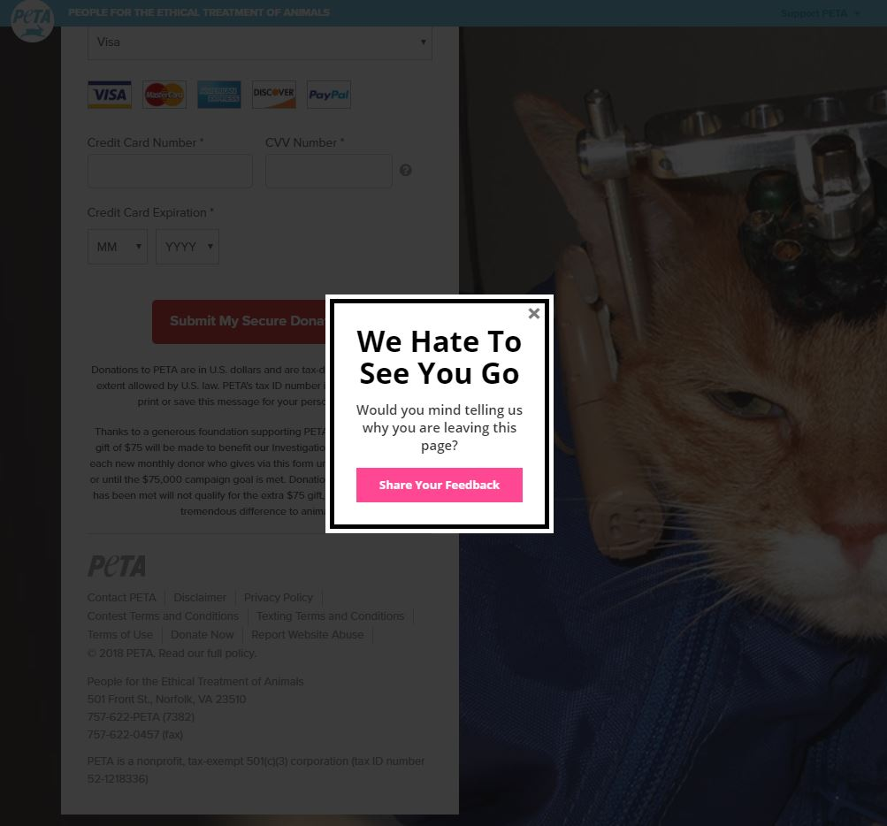
Close the deal
Notes:
Steve
Exit intent lightbox.

Slide 35
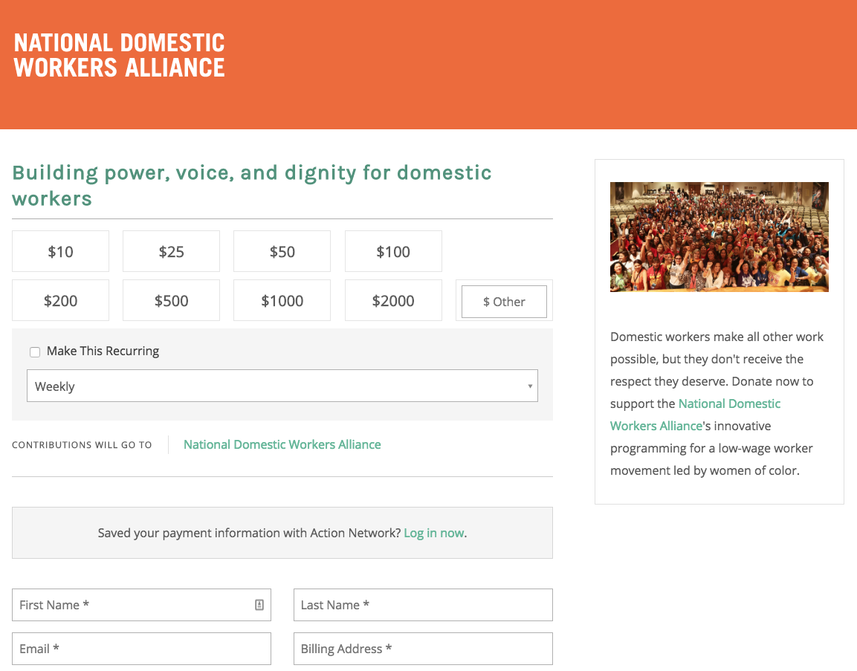
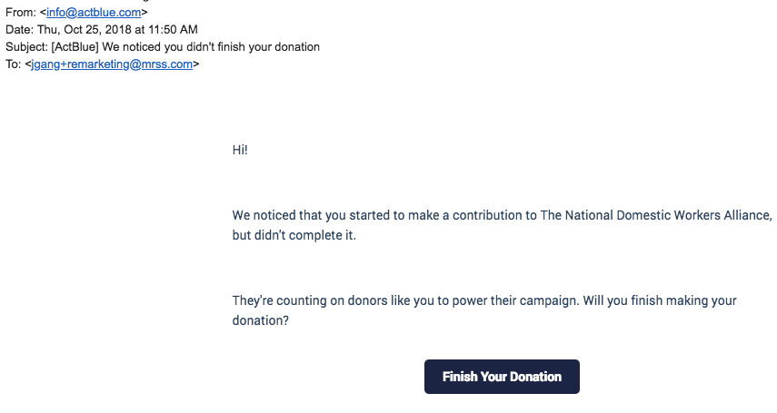
Donation form abandoners
1.5% increase in overall # of gifts
Notes:
Jessica
The setup is very basic at the moment -- see below -- but we figured we'd turn it on just to see how it worked out. We'll plan to update for EOY.
This doesn't seem to drive much revenue for us -- as an example, one form raised $17k over this campaign and just one donation was triggered by a remarketing email.
We've had no less than 10 fundraising messages launch between Oct-Dec with the remarketing activated. Campaigns all varied in response rate (50 gifts to over 1,000 gifts) -- no complaints at all.
And overall, we mainly don't see any new gifts from the remarketing. Most complains don't see anything. We've had one campaign go wildly successful overall, so we saw remarketing lift overall # of gift by 1.5% (18 more gifts, total # of gifts 1,164)
But most moderate campaigns see 1 or 2 gifts added onto the total from remarketing.
So since it's not any real extra work for us, and as long as no one is complaining, we're going to keep it in place.

Slide 36
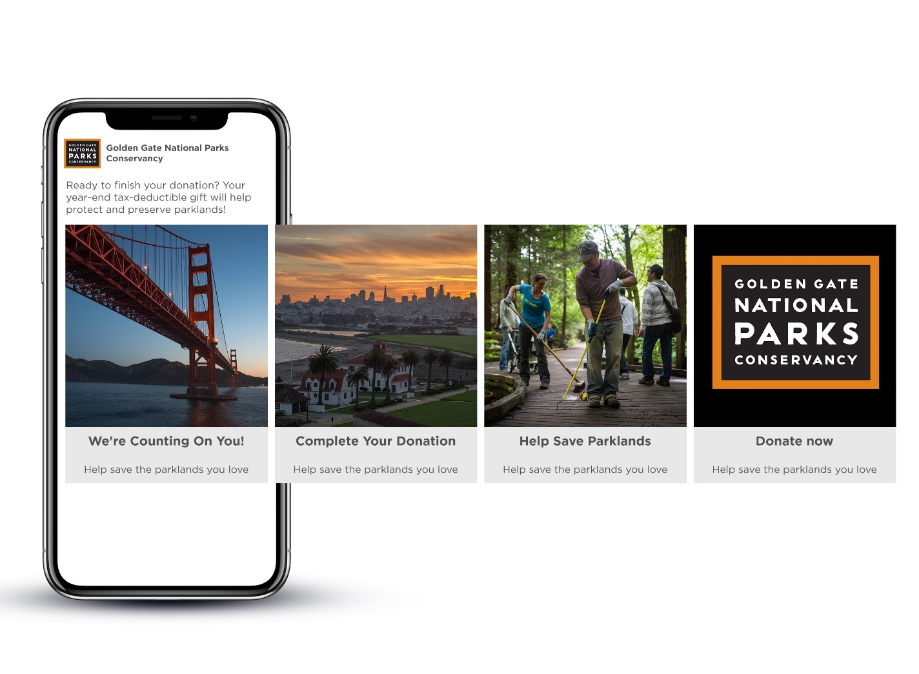
Close the deal
Notes:
Wendy
Facebook ads targeted to people who hit the landing page but did not hit the confirmation page.
We’ll talk even more about ads in a moment.

Slide 37
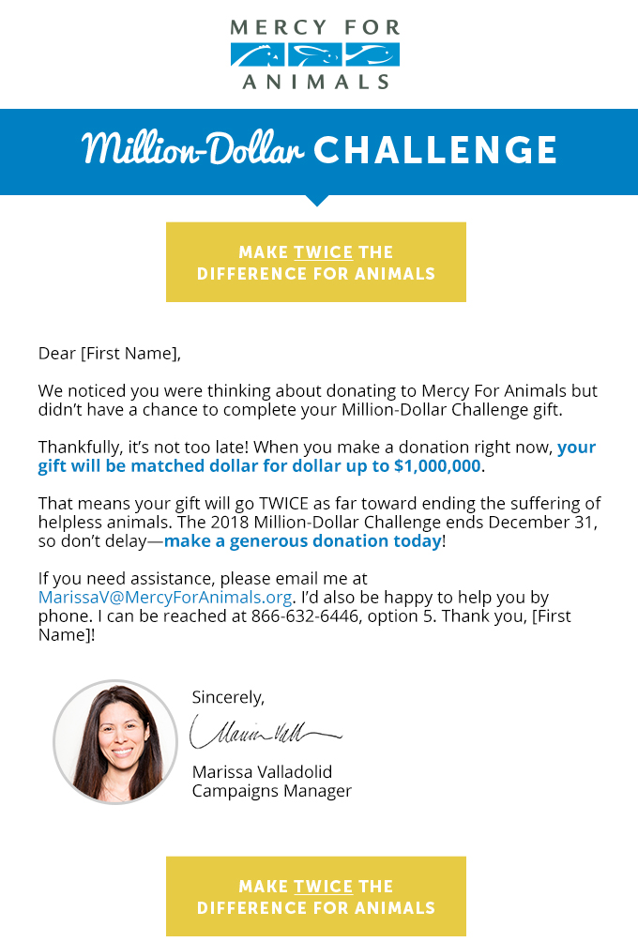
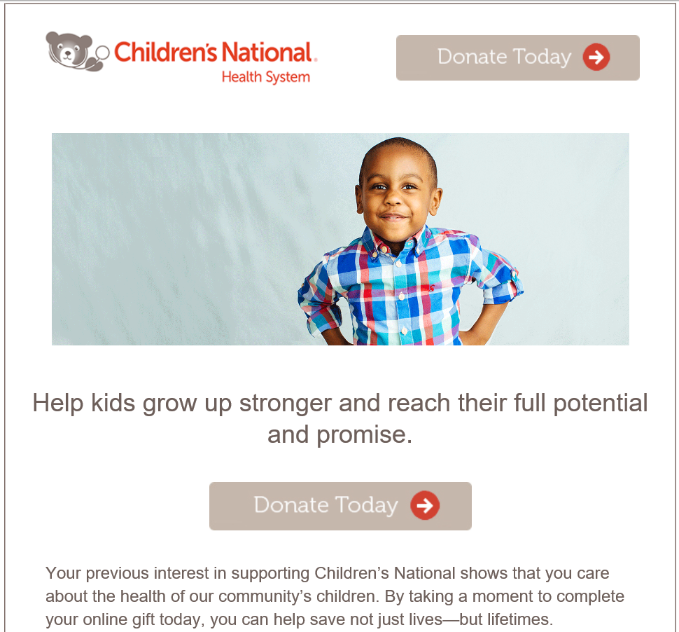
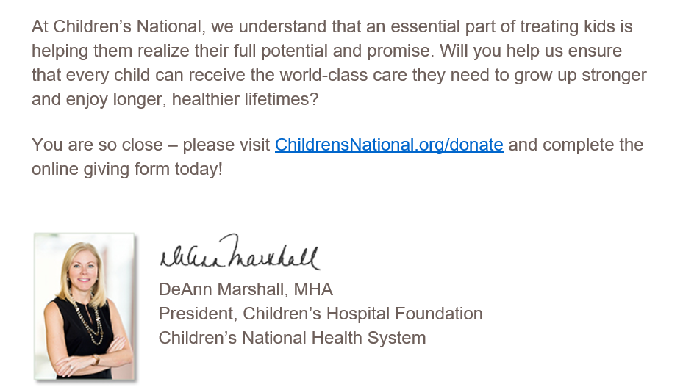
Close the deal
Notes:
Wendy
It’s a piece of JS sitting on the donation form, it hits an API on Azure when user closes the window or changes the URL (leaving the page event). The API determines if the form was left half way done, which in that case logs the email (if it exists on the form’s email field or a hidden field if user is logged in) and schedules an email to go out next day 10AM. If user leaves a form within 72 hours of the email going out, we suppress any other follow ups. Basically we don’t send more than one email/72 hours.

Slide 38
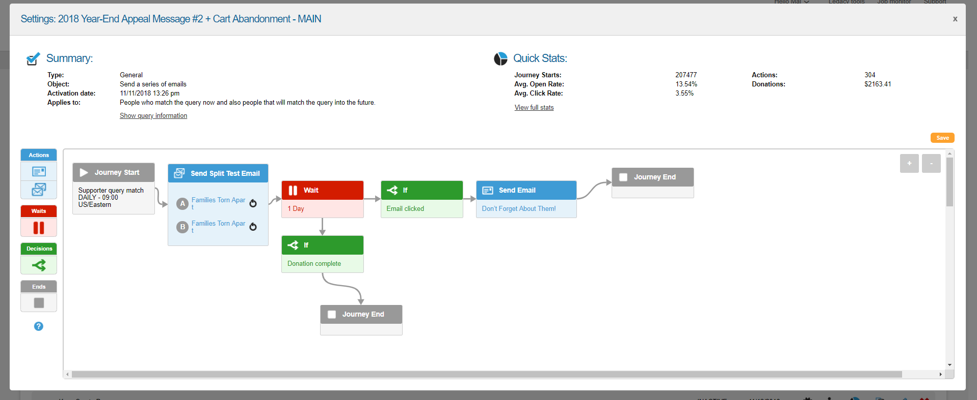
Close the deal
Notes:
Wendy
Name of the game of all of this is that once you know how to do it, it will be faster and easier to do it each time.

Slide 39

Ads FTW
Notes:
Jessica

Slide 40



Creative Sequencing
Retargeting vs. Prospecting
Donation Page Visit
Notes:
Jessica
Another thing to keep in mind when you are shifting into acquisition is to treat creative differently than with retargeting. The message to prospects can be different than what you show people who have visited your site. Test this! But we, for instance, have found that even adjusting the copy on your creative can make an impact.
Obviously you should be careful not to cross the line into creepy, but you do want the message to be relevant to your prospective donors.

Slide 41



Advocacy Dynamic Retargeting
Notes:
Jessica
Dynamic retargeting is a tool that serves an ad based on user behavior - so that if you put a certain pair of shoes in your cart, those specific shoes follow you around in ads.
We’ve run that successfully for WWF’s gift center, but recently, we’ve started testing whether we could use that tool for fundraising too, since WWF has a large number of advocacy actions that rotate in and out.
So now when you visit a Freshwater Force page, you also see Freshwater fundraising creative with a Freshwater donation page. We will be testing ongoing to see how that impacts actual performance.

Slide 42

Dynamic Ad Creative
Notes:
Jessica
You’re probably familiar with retargeting ads (as they’re the core of our advertising work), but basically it just means that we’re serving ads to people who’ve just visited our donation pages.
Usually, we just pick our best creative and run with that – e.g. elephants.
Dynamic ads, however, mean that you can automatically tailor your ad creative to show exactly what someone just looked at.
How’d we do it?
We configure the Facebook pixel to tag which pages people visited, then connected that to a product feed that matched the pixel to specific adoptions. (We got a little lucky here: WWF was on the ball with both of these.)

Slide 43

Why’d you do that?
+ Showcase more products (100+)
+ More responsive to shifting trends
+ Reduced CPA by 77%
Notes:
Jessica

Slide 44

Monthly giving ads to recent donors
Notes:
Jessica
Another thing to keep in mind when you are shifting into acquisition is to treat creative differently than with retargeting. The message to prospects can be different than what you show people who have visited your site. Test this! But we, for instance, have found that even adjusting the copy on your creative can make an impact.
Obviously you should be careful not to cross the line into creepy, but you do want the message to be relevant to your prospective donors.

Slide 45

Building Relationships
Show me the love!!!
Notes:
Jessica

Slide 46

Happy Anniversary!
“This month, we are celebrating your 7 years as a Mercy Corps supporter!”
Notes:
Jessica
You may already be doing some paper acknowledgements to recent donors or milestone / anniversary acknwoledgements. Some of our clients take this into the online space with emails that mirror this kind of milestone content.
Subject: Fwd: {Final mailing 7689} [Count 396] We're celebrating you today, John
The setup is very basic at the moment -- see below -- but we figured we'd turn it on just to see how it worked out. We'll plan to update for EOY.
This doesn't seem to drive much revenue for us -- as an example, one form raised $17k over this campaign and just one donation was triggered by a remarketing email.

Slide 47



Rolling Survey
Notes:
Jessica
Tracking LCV Members. Many organizations run annual surveys to get a sense of the opinions of their supporters. With LCV, we developed a strategy to so that we can track how those opinions change in real time, and identify if there are things we can do to influence them.
We built a system that sends out a survey to a small portion of their members every single day. The survey results get collected, and the day’s results are automatically displayed in a dashboard, compared against responses from the past few weeks. If we find that members view LCV as being particularly effective or ineffective at a certain moment in time – we’ll be able to take a second look at what we were doing right (or wrong!) at that moment. If we learn that members are growing more concerned about a specific issue, we’ll be able to jump on it in our campaigns.
An unexpected benefit – because the survey email goes out every day and the audience is randomized, we can also use the tracking survey to measure list health over time, simply by tracking the number of people who open and click on it!

Slide 48



Stop lapsing & improve deliverability
4 months out:
one-click action
8 months out:
survey
8 months out:
say “yes” &
action menu
+ 8% of recipients reengaged
+ 59% of reactivated subscribers remained active a year later
Notes:
Jessica
Inactivity is a challenge every email marketer faces -- and with deliverability issues at stake you can’t keep folks who aren’t interactiving with your content on file forever. Most of our clients stop emailing subscribers who don’t open or click after 6-12 months depending on a variety of factors.
A re-engagement series is your insurance policy against bleeding email subscribers while still protecting email deliverability. AARP’s goal was to get folks to at the very least OPEN a message and ideally engage with it. The plan was:
Include really prominent unsub links so its easy to remove yourself (as opposed to hitting spam which is the #1 way to tank your deliverability)
Don’t click-bait -- use content specific subject lines so folks who reengage are going to keep engaging and are actually interested in AARP’s content
Use high performing content but make sure it’s indicative of what they’ll get if they stay on file so they don’t just keep lapsing
Monitor and continuously optimize with continued subject line testing
AARP kept hundreds of thousands of subscribers on file EACH YEAR thanks to this series!

Slide 49

Incentivize the behavior you want
Nearly DOUBLE the response in the following year
Notes:
Jessica
Incentives cost $ so it’s something you’ll want to test into, but AARP found it worthwhile.
people who took action on the series when there was a premium offer included took action at nearly double the rate of those who didn't get a premium over the rest of the year. It wasn’t tested head to head but the difference was pretty striking.

Slide 50

Let ‘em go
Notes:
Wendy
Sometimes, you just have to let people go. They may have intentionally signed up and opened/clicked for a while, but if they aren’t opening now, they’re actually hurting the rest of the file.
**How many months do you wait?
**Include donors?
When we incorporated this tactic 2 years ago for GGNPC, we saw an increase in RAW opens and donations – even though the first time we cut the file in half.
For them we run it every 6 months, so this one isn’t actually triggered—but that’s how we were able to see the before/after of performance to know it worked.
Ideally it would go out on a rolling basis as each individual constituents hits their 6 month date.

Slide 51



Reactivation, Winback, Suppress
Notes:
Wendy
This is an organization that has triggered its reactivation and winback. It’s set up so that at 3 months of no clicks, then …

Slide 52


Reactivation Data
Notes:
Wendy
Here’s what it looks like in the back end of Salesforce Marketing Cloud, in the JourneyBuilder tool.

Slide 53

Questions?
Steve Kehrli
Vice President, PETA Foundation
SteveK@petaf.org
Jessica Bosanko
Senior Vice President, M+R
jbosanko@mrss.com
Wendy Marinaccio Husman
Account Director, MWD
whusman@mwdagency.com

Slide 54
Thank you for attending our session!
#DMAWDigitalDay

