Slide 1

Analytic Optimization
Thalamus Hill
SVP, Advanced Analytics RKD Group
#DM201

Slide 2
Talking Points
Background
Philosophy
Discovery
Final Thoughts
$6.6M
$7.6M
$8.6M
$6.9M
$24.2M
$23.8M
$21.7M
$19.4M

Slide 3
Background

Slide 4
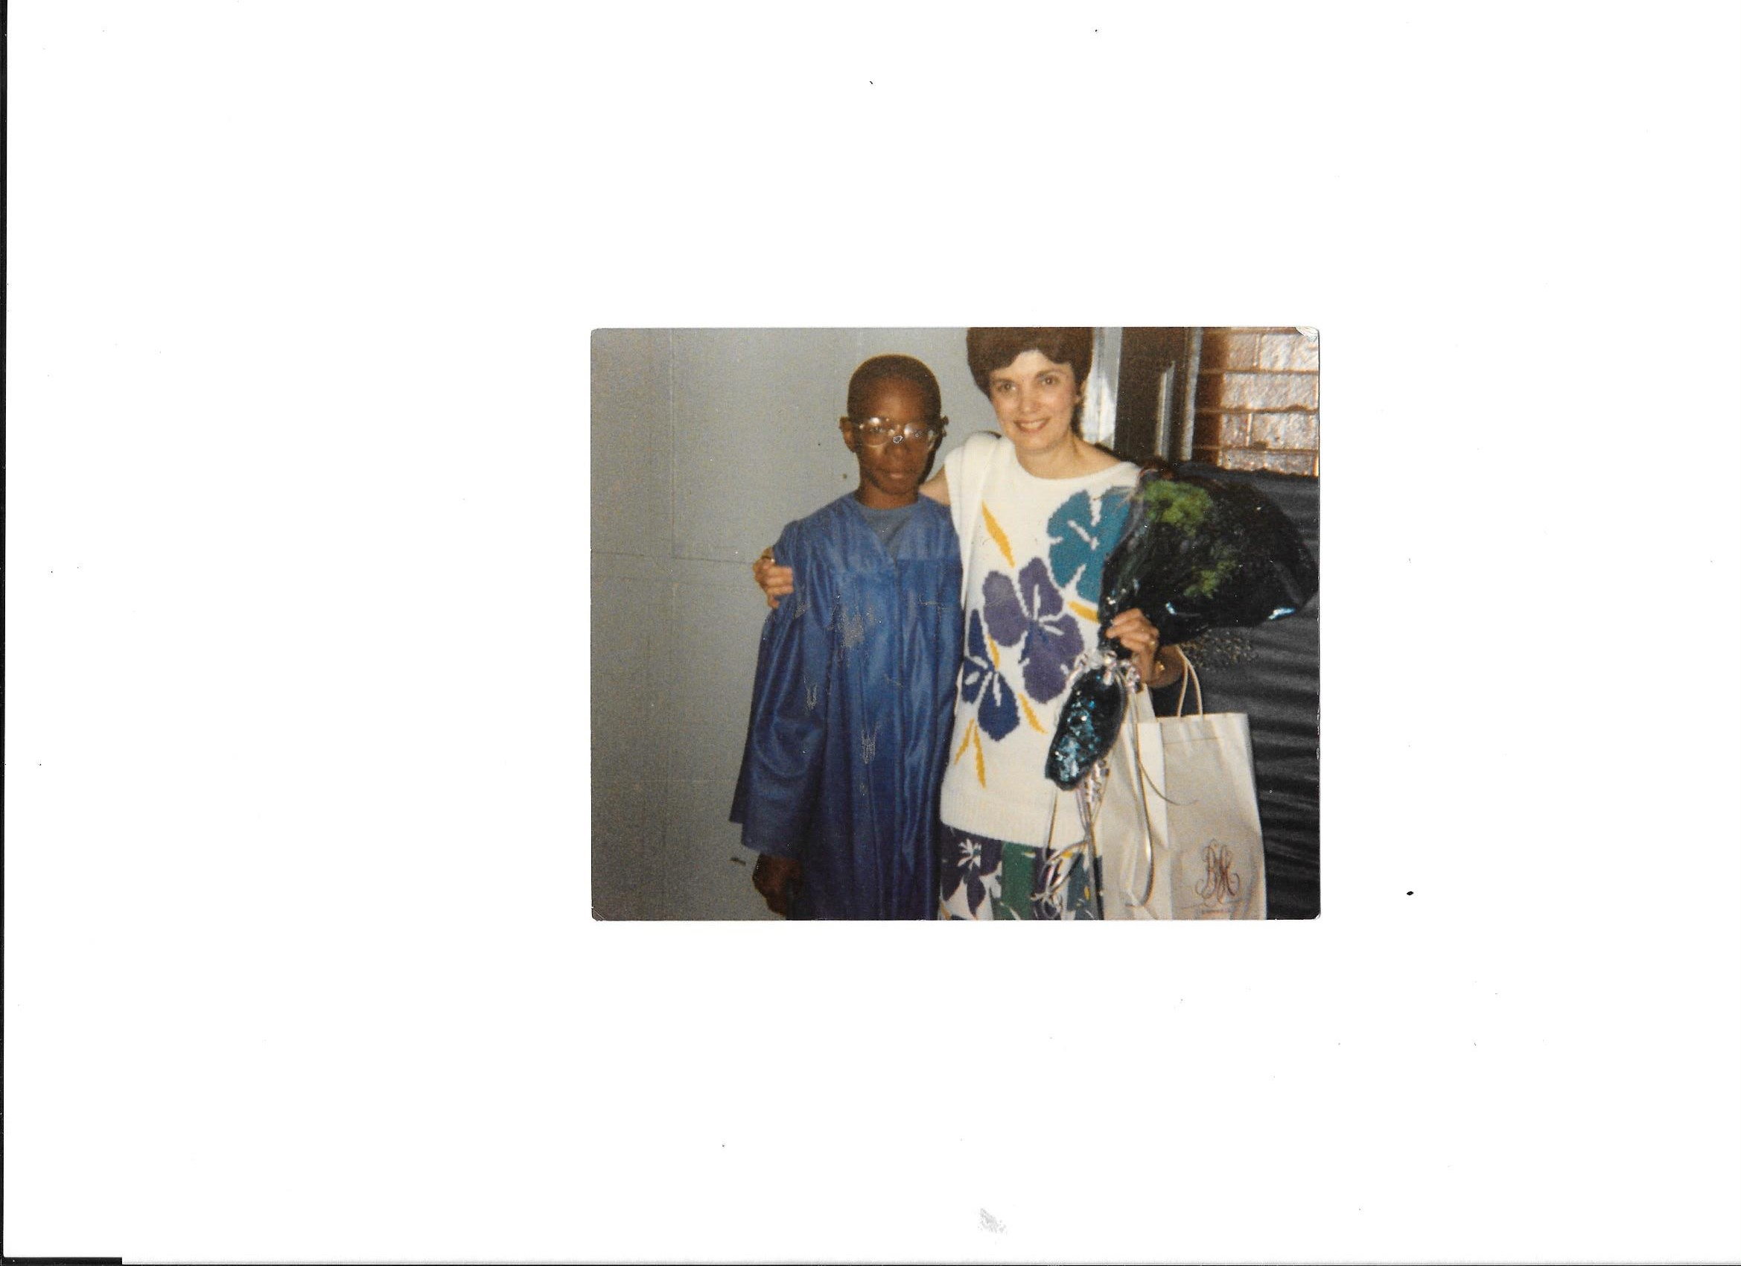
$6.6M
$7.6M
$8.6M
$6.9M
$24.2M
$23.8M
$21.7M
$19.4M

Slide 5
Philosophy

Slide 6

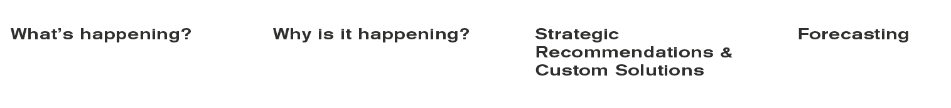
Analytics Drives Strategy
Notes:
Purpose: this is about setting the foundation for how analytics should work and think
Descriptive – what happened: standardized the measurement and reporting process to reduce the time spent to only 20%
Diagnostic – this is where the real magic begins. Tell me something that I can’t see. Tell me why it matters. Uncover the root drivers that…
Prescriptive – acquisition: regional client; service area around 5M HH’s; found that there were about 750K households that they weren’t targeting. We even went as far as to tell them, this is where DM should be heavily used with limited online, Digital should be used with limited offline marketing and then full force of multichannel communication
Predictive – once the root drivers are uncovered, personal benchmarks established and acquisition goals agreed upon then you can forecast with confidence that creates a viable Vision with the appropriate Action plan

Slide 7
Discovery

Slide 8
Analytic Optimization
Problem
National client wanted to transform into a values driven organization.
Solution
Uncover the root drivers that dictate performance
  Long-Term Net (LTN) Study
  Multivariate Testing
  Prime Leads
  Media Mix
Results
Over the last few years, gross and net revenue have increased by 65% and 98% while Long-Term Net (LTN) value has jumped by 6x.

Slide 9
Long-Term Net (LTN) value
It’s the ability to assess a donor’s long-term net worth by any attribute we choose (initial gift amount, seasonality, rental lists, media source, service area, demographics, etc.).
The goal is to enable clients, at the point of acquisition, with the ability to invest more wisely to achieve a higher financial return.

Slide 10
LTN by Acquisition Type
Non-Premium acquired donors generated a 5.2x higher LTN value.
Diagnostic Impact: migrated away from offering premium dominant messaging.
1st Gift Levels | Premium Acquired | % New Donors
<$15 | ($21.94) | 57.7%
$15-$99 | $25.72 | 41.0%
$100+ | $452.34 | 1.3%
 | $11.21 | 100%
1st Gift Levels | Non-Prem Acquired | % New Donors
<$15 | ($17.65) | 30.7%
$15-$99 | $45.97 | 65.7%
$100+ | $551.66 | 3.7%
 | $57.89 | 100%

Slide 11
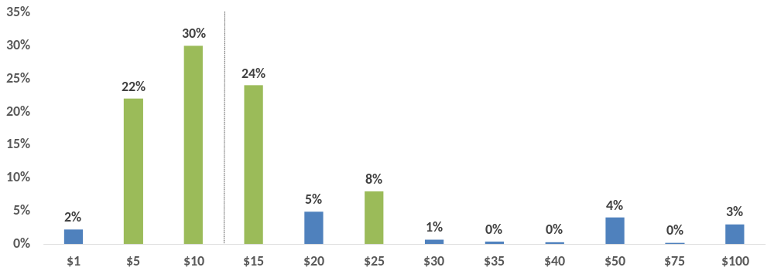
Initial Gift Amount Assessment
People give to what they’re being asked for, so be careful…..
Diagnostic Impact: tested into Acquisition ask array amounts that were above LTN viability.
LTN Viability
Acquisition Ask Array
Control: $5, $10, $15, $25, Other
Tested: $15, $20, $25, $50, $100, Other

Slide 12
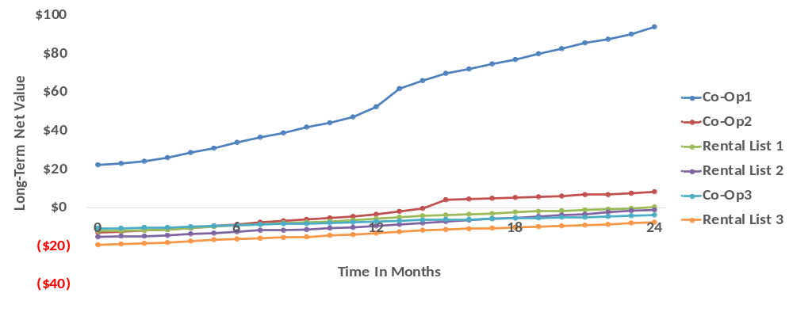
LTN by Primary Lists
6 lists dominated their Acquisition mix but only half led to LTN value.
Diagnostic Impact: uncovered their LTN-ROI relationship (0.66) and right-sized their list mix.

Slide 13
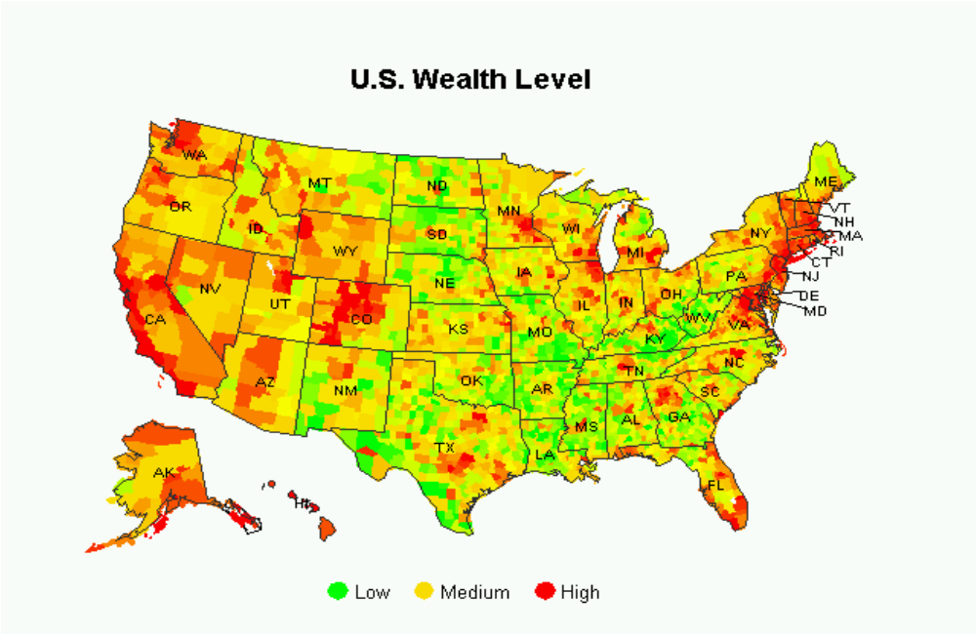
Wealth Concentration
Socio-economic status and becoming a long-term viable donor (net) is correlated.

Slide 14
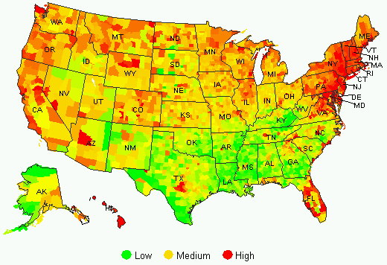
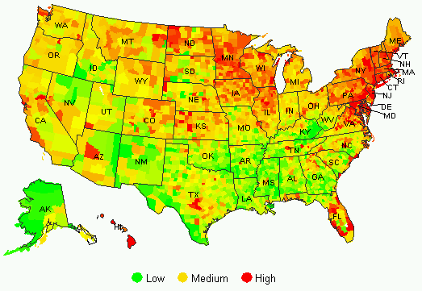
Geographic Footprint
Follow the money
Diagnostic Impact: applied Wealth cluster segmentation strategies to improve targeting.
Market Penetration: 15 Years Ago
Market Penetration: Today
Donor Convergence

Slide 15
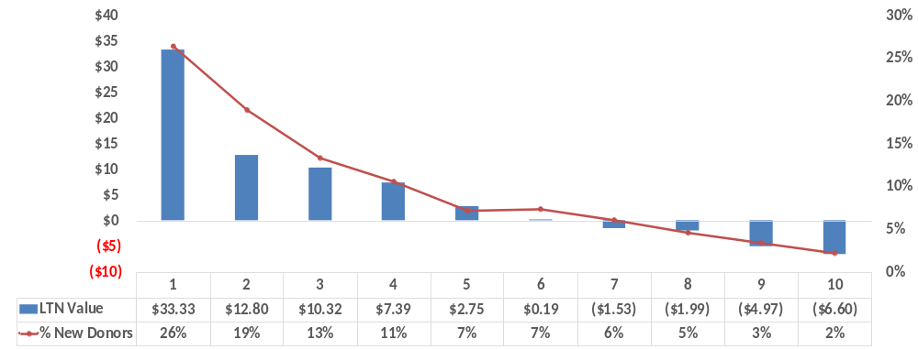
LTN by Wealth Cluster
Optimized organizations acquire 40% of theirs donors from Wealth Cluster 1.
Diagnostic Impact: boosted Acquisition within WC1 and reduced WC’s 7-10 (loses $3.10).
Wealth Clusters
High = 1 (26%)
Medium = 2-4 (43%)
Low = 5-10 (31%)

Slide 16
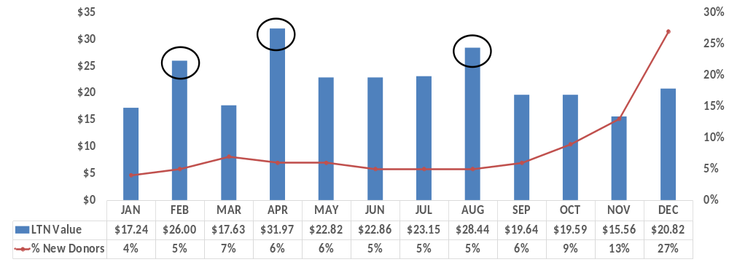
LTN by Seasonality
Diagnostic Impact: targeted more donors in February, April and August.

Slide 17
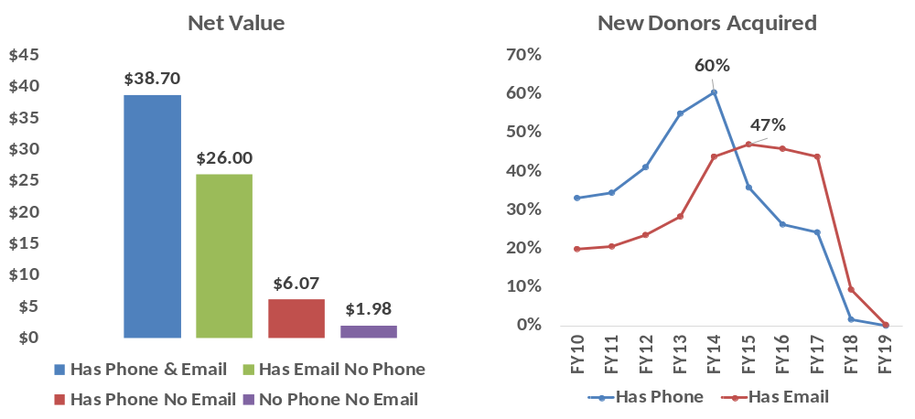
LTN by Multichannel Readiness
Multichannel ready donors are significantly more valuable than those who are not.
Given the intrinsic value, implemented strategies to materialize this financial potential.

Slide 18
Multivariate Testing
Are you tired of the slow learning process and high expenses that are associated within One Factor at a Time (OFAT) testing?
Would you like to know which package elements are truly responsible for driving response rates and average gifts?
Would you like to know which combination of package elements will maximize and/or optimize your financial potential?

Slide 19
Multivariate Testing
It’s an advanced statistical technique used to explore the sophisticated relationship amongst multiple elements within the marketing mix. The goal is to:
Identify the optimal combination of package elements
Uncover the synergy between elements invisible through OFAT
Increase the speed of learning through a fraction of the cost

Slide 20

Approach
Design
2^5 power offers the highest economies of scale
5 factors (ideas) and 2 levels (variation)
Method
Orthogonal Fractional Factorial: to set-up virtual panels
Logistic Regression: to understand the response drivers
ANOVA: to understand the gift amount drivers
Outcome
8 packages mailed at a total of 200K (25K per package)
24 virtual packages created via OFF
32 packages measured at the price of mailing 8 (saved $157K)

Slide 21
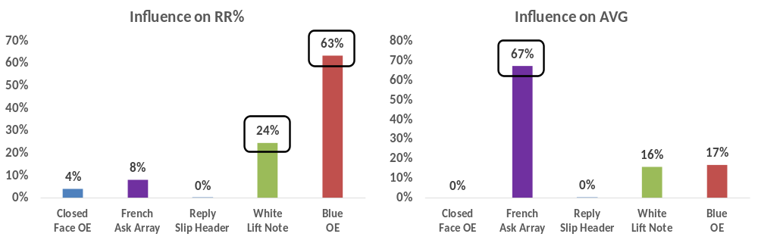
Result
Blue OE and White Lift Note accounted for 87% of RR%; French Ask accounted for 67% of value.
Diagnostic Impact: tested these winning elements to prove findings; rolled-out new control package.

Slide 22
Prime Leads

Slide 23
High Value Fundraising
  Takes time
  Patience
  And a game plan
  It’s about taking the appropriate next steps to ensure that organizations are prepared to experience supercharged financials in the near future.

Slide 24
Analytic Methodology
  Proprietary data overlay
  Wealth screening
  Data mining
  Exploring behavioral patterns (data mining) along with proprietary wealth data improves the predictive power by 7x over the typical method.

Slide 25

Prime Leads
RKD uncovered 7,048 donors who have the potential of becoming high-value contributors if properly cultivated.
The goal: create a coordinated and multi-channel communication strategy to move them through the donor pyramid.
Primary Attributes:
  Core Donor Annual Cume $100+ = 100%
  Charitable Giver = 72%
  5+ Consecutive Year Givers = 25%
  Net Worth $500K+ = 19%
Planned Giving
987
Major Donor
$10,000+
1,348
Midlevel Donor
$1,000 - $9,999
4,713

Slide 26
Media Mix

Slide 27
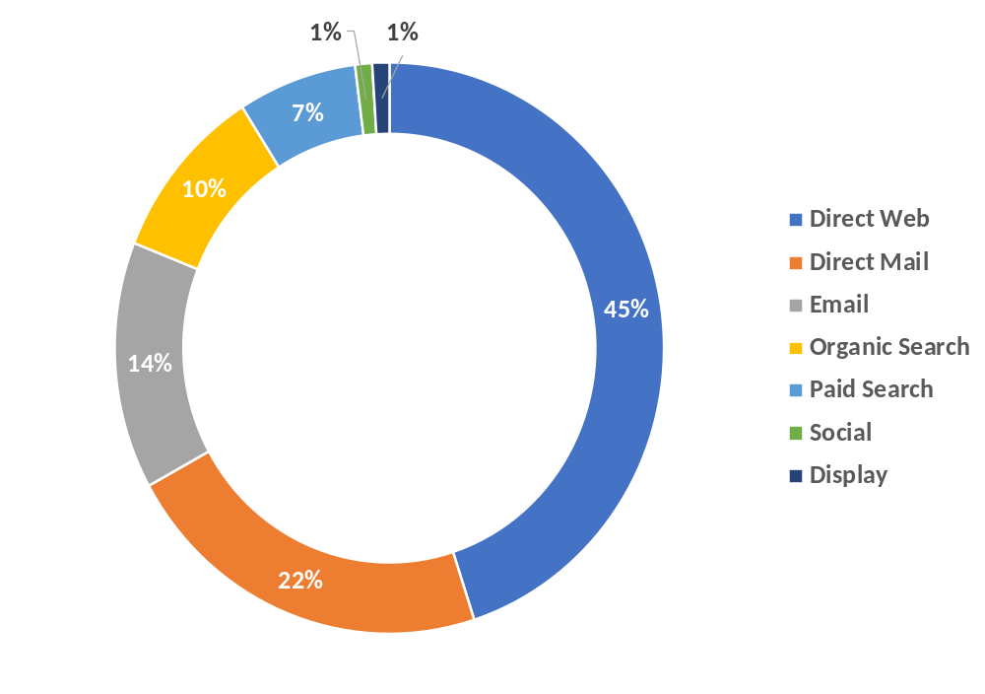
Media Drivers
Display & Paid Social
3~15% each
Paid Search
10~20%
Diagnostic Impact:
Helped set-up eCommerce
Evaluated media drivers
Uncovered the donor journey
Optimized media mix
Direct
35~45%
Email
15~25%
DM
10~15%

Slide 28
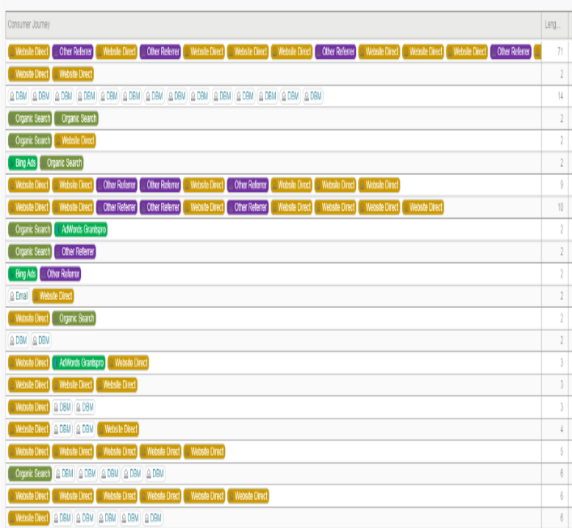
Donor Journey
Use attribution logic to understand the “true” conversion pathway relative to last click insights
Originated via Paid Search
Visited Leadership Team Page via Paid Search
Came back via Paid Search
Visited a donation form but did not convert
Exposed to Display ads
Received a Direct Mail package
Exposed to Paid Social
Came back to the site (direct)
  Visited What We Do page
  Came back and donated $2.5K (credited to direct)
Uncover what initiates, supports and converts in order to properly create your media mix budget

Slide 29
Final Thoughts

Slide 30
Final Thoughts
Leverage analytics to uncover the root drivers that dictate performance
Forget about Long-Term Value (LTV) and embrace Long-Term Net (LTN)
Consider Multivariate Testing to truly uncover what drives response and value
Create and execute some form of Prime Leads to accelerate financials
Embrace attribution to help optimize your media mix

Slide 31
Things to Consider

Slide 32
December Stock Market
  S&P 500 down 9.0%
  DOW down 8.7%
  Worst December since 1931
DOW – in one 7-day stretch, the DOW fell by 350 points or more 6 times. In fact, Christmas Eve was the worst ever for the index.
S&P 500 – was up or down more than 1% 9 times in December 2018 alone, compared to 8 times in all of 2017.
Contributing factors – trade war with China, drama over Brexit, signals from the U.S. Fed to hike interest rates and Goldman Sachs’ (among others) communique to its investors to get defensive, etc.
Great Depression was from October 29, 1929 - 1941

Slide 33
Research
Learnings:
Overall giving dropped by 2.3%
Online giving dropped by 4.4%
1 in 5 donated less in December 2018 versus 2017
More than half that gave less cited feeling less connected as the primary reason
Bottom line: there is more competition for donations, and more noise in the market, which means more of a reason to have a tightly integrated data-driven approach.

Slide 34
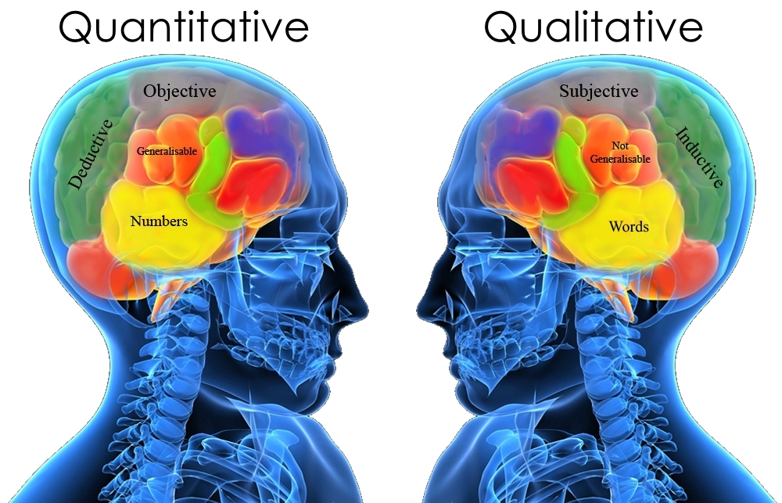
Enterprise Segmentation
People give to their passion points
Familiarity and trust = donor value
Connecting to the different faces of an organization = loyalty
Demographics
Attitudes
Concerns
Behavior
Belief
Familiarity
Giving Heart
Engagement

Slide 35
Thank You!
Thalamus Hill
SVP, Advanced Analytics RKD Group
#DM201

