Slide 1



Retention and Lapsed Strategies
Lynn Waller
Vice President, Client Services
Chapman Cubine and Hussey
Marie Kosanovich
Account Director
Lautman Maska Neill & Company
#DM201

Slide 2
Today’s Discussion
  Retention: Overview & Trends
  Thinking About Your Renewal Program
  Top 10 Tips on Improving Retention!
#DM201

Slide 3
Retention: Overview & Trends
#DM201

Slide 4
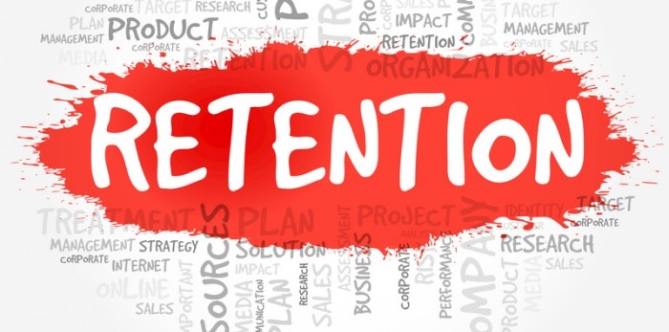
What Is It?
Definition:
  The act of retaining : the state of being retained
    Merriam-Webster Dictionary
In Practice:
  How many donors gave to your organization last year and have given again this year (12 month)
  Retention is also viewed 18 month and 24 month periods

Slide 5
Why Is Retention So Important?
40% Annual Retention | Donors | Average Gift | Income
Year 1 | 1,900,000 | $20.00 | $38,000,000
Year 2 | 760,000 | $22.00 | $16,720,000
Year 3 | 304,000 | $24.00 | $7,296,000
Total | 3,325,000 |  | $62,016,000
Increasing annual
retention of existing
donors from 40% to 50% generates an additional
$8,284,000!
50% Annual Retention | Donors | Average Gift | Income
Year 1 | 1,900,000 | $20.00 | $38,000,000
Year 2 | 950,000 | $22.00 | $20,900,000
Year 3 | 475,000 | $24.00 | $11,400,000
Total | 2,964,000 |  | $70,300,000

Slide 6
What Is Happening In the Market?
Donor Retention was down 4.5% in 2018.
New Donor Acquisition was down 7.3%.
Organizations grew in 2018 thanks to revenue being up from $1,000+ donors.
Underscores need for increased retention and more aggressive new donor acquisition – low $ audiences are key part of the pipeline that builds $1,000+ audiences.
Source: FEP 2018 Q4 Fundraising Report

Slide 7


2018 Overall Donor Retention
44.5%
Source: FEP 2018 Q4 Fundraising Report

Slide 8
2018 Donor Retention Rates
New
Donor Retention
Repeat
Donor Retention
Lapsed
Reactivation
20%
61%
4%
Source: FEP 2018 Q4 Fundraising Report

Slide 9
Thinking About Your Program
#DM201

Slide 10

Back to Basics: What Is a Renewal Program?
What Is This Renewal Magic?
People are conditioned to give when
they hear the word ‘renew’ from subscriptions/benefits, etc.
Donors already know why they give to organizations. Renewals help define when they should give if they aren’t regular givers.
Other ideas?
Annual Giving Messaging Track: Asking donors who have supported your organization to ‘renew’ their commitment and support with an annual gift.
NOTE: Once a donor ‘renews’ and gives their annual gift – they then get moved into a separate track of special donor appeals.
Renewal programs are a fundraising track dedicated to retaining donors and are the best way to improve donor retention.

Slide 11


Renewal Programs For All Types of Organizations
DONOR BASED
MEMBER BASED
Giving to make a difference
Environmental
Health & Human Services
Animal Welfare
International Relief
Societal Benefit
Giving to receive benefits:
Museums
Zoos
Aquariums
Arts & Culture

Slide 12


What Should My Renewal Schedule Look Like?
CALENDAR DATE
EXPIRE DATE
R1 January
R2 February
R3 March
R4 April
Only one notice is mailed at a time.
(Everyone receives R1 in January)
R1 – 2 months prior to expire
R2 – 1 month prior to expire
R3 – month of expire
R4 – 1 month after expire
All notices are mailed each month. (Multiple expire groups at different points in the cycle at one time.)
NOTE: Donor renewals can also be mailed as expire and benefit as calendar – test as quantities allow!

Slide 13
What Does Renewal Messaging Look Like?
UTILIZE DIFFERENT TECHNIQUES
What is motivating these donors to give, and continue giving? Why is their renewed support important to your shared mission/goal?
EMPHASIZE
CONSISTENCY
When members are in danger of losing something they care about, most people don’t need to be oversold with an elaborate package.

Slide 14
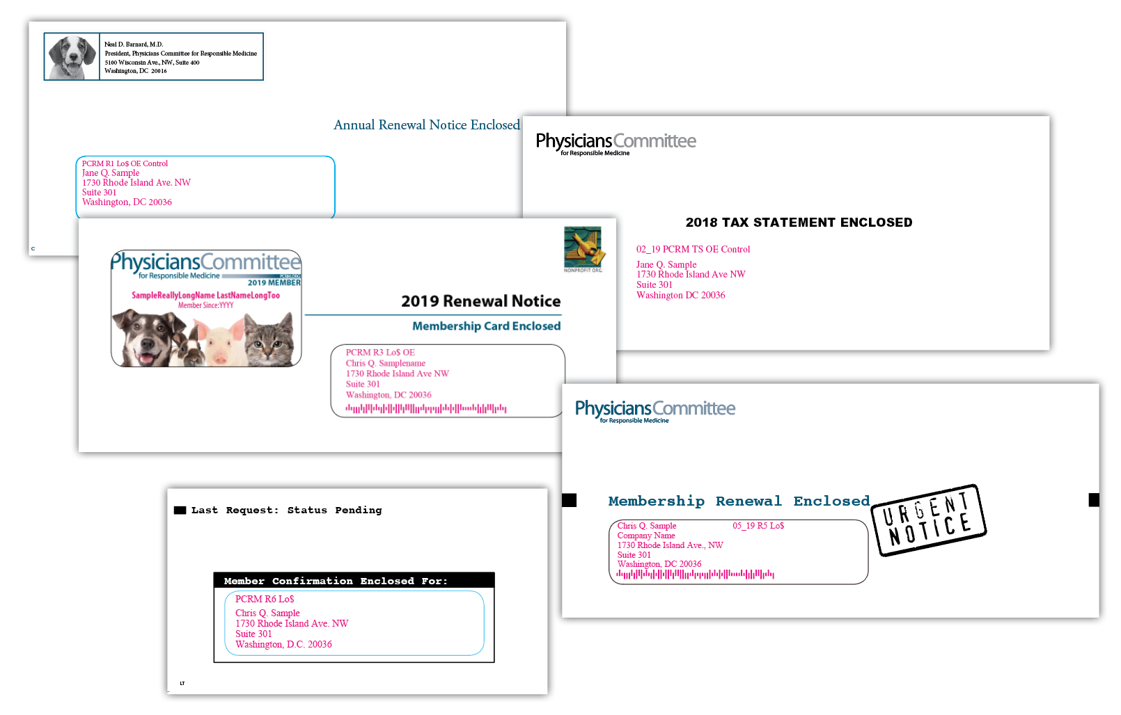

DIFFERENT TECHNIQUES

Slide 15
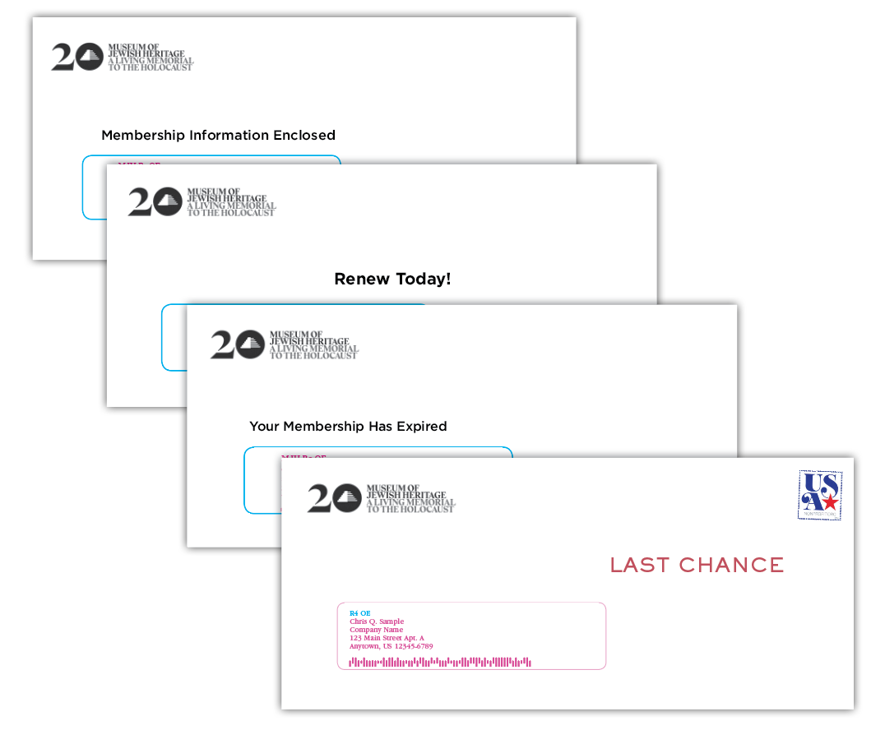

EMPHASIZE
CONSISTENCY

Slide 16
Renewal Messaging
CAUSE-ORIENTED
“Without your support, many lives will be lost…”
VALUE-PROPOSITION
“You won’t want to miss our members-only preview. Renew today so you don’t lose your benefits!”

Slide 17
Renewal Messaging
FIRST YEAR DONORS AND MEMBERS
“We’re so thrilled you were able to join us last year.
Because of you, we were able to accomplish…”
MULTI YEAR DONORS AND MEMBERS
“You’ve been with us for 5 years now,
and we’re so grateful for your support.”

Slide 18
How Many Notices Should I Have?
As many as it takes to break even!

Slide 19
Top 10 Tips to
Improve Retention
#DM201

Slide 20
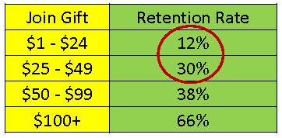
#10 Retention Starts with Acquisition
Establish a long term value driven list strategy so that the donors you are acquiring are more likely to retain in the years to come.
First gift amount is one of the strongest predictors of retention
The higher the join gift, the higher the retention rate
TIP: This is not just offline acquisition. Do the same with your new donors and leads generated online. Online isn’t “free” – target accordingly.

Slide 21
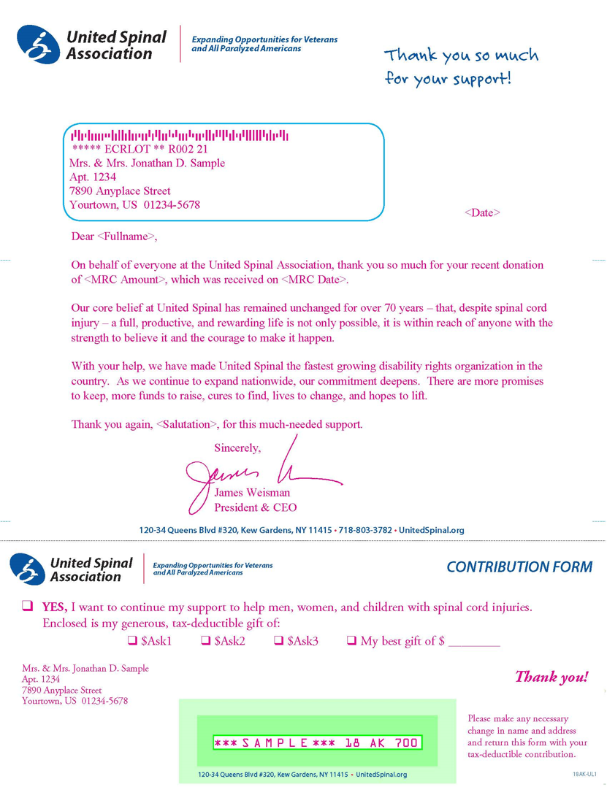
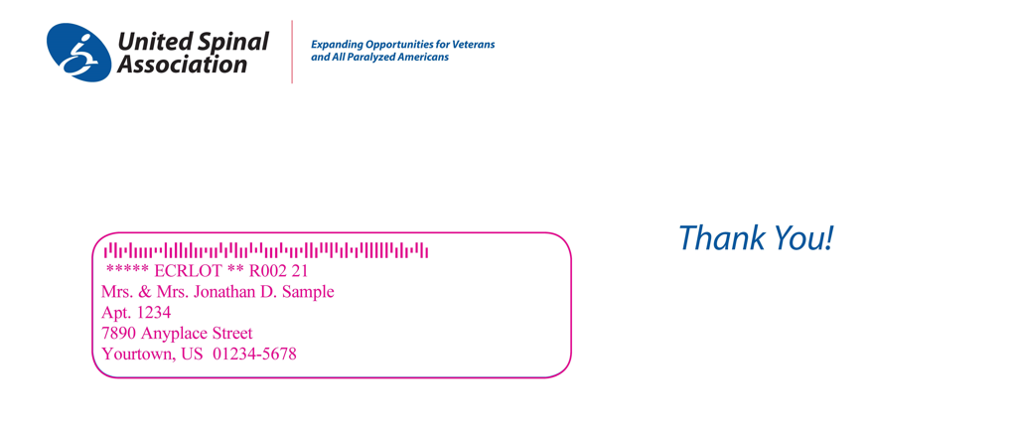
#9 Limit Time Between 1st & 2nd Gift
Acknowledgements
  Don’t delay!
  Email confirmation = thank you
  Tax receipt with ask vs without
Establish a new donor appeal strategy
  Find the right timing
  Find the right message

Slide 22
#9 Limit Time Between 1st & 2nd Gift
Use automation online to time out and build your communication with your new donors and engagers.
  Online Welcome Series to new donors and engagers
  Content specific ‘thank you’ messages
  Close the loop for action takers
  Sustainer invitations

Slide 23
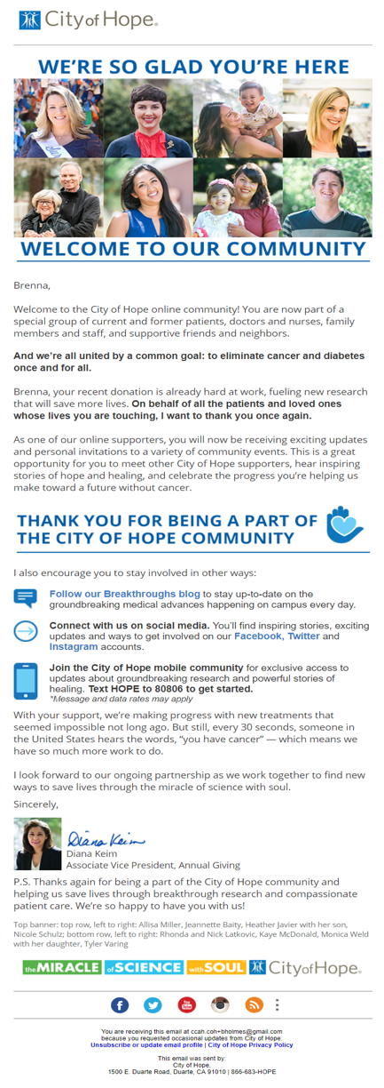
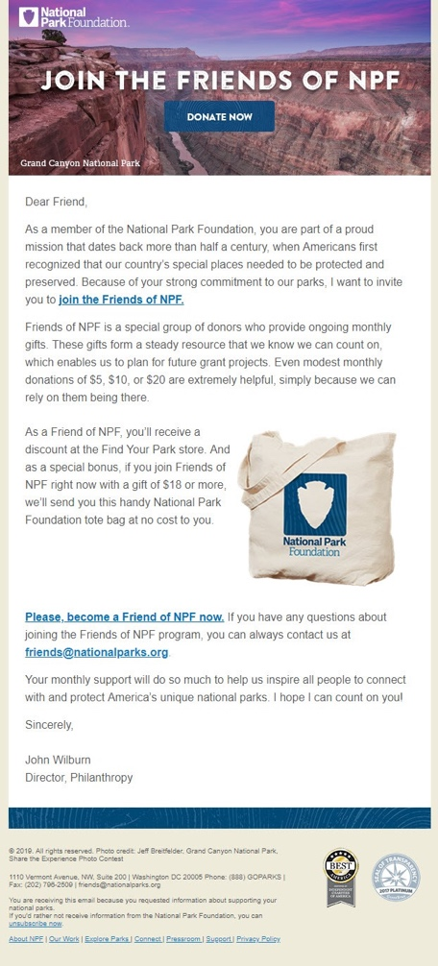
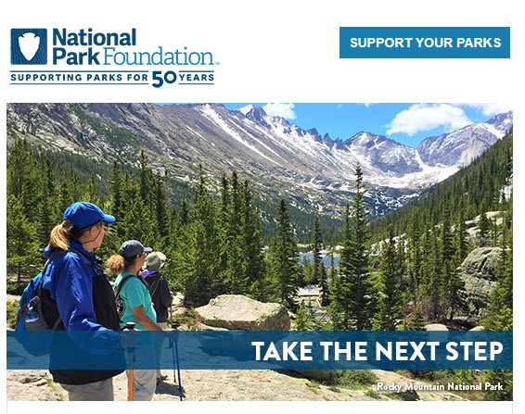
#9 Limit Time Between 1st & 2nd Gift
Use automation online to time out and build your communication with your new donors and engagers.
  Online Welcome Series to new donors and engagers
  Content specific ‘thank you’ messages
  Close the loop for action takers
  Sustainer invitations

Slide 24
#8 Give Donors the Opportunity to Give
Audit and adjust your communication cadence – frequency matters!
Your recent donors are those donors most likely to give again – resist the temptation to hold them out of communications after they give for a specified amount of time.
Before major donors are held out of the direct marketing program – make sure there is a strategy in place to communicate with them and give them opportunities to continue their support.

Slide 25
#8 Give Donors the Opportunity to Give
Number of appeals reduced by 25%
CASE STUDY
Prospecting reduced by 35%
Only 1 newsletter included a solicitation

Slide 26

#7 Think About the Donor User Experience
Be a secret shopper!
  Donate online and through the mail – what is your experience?
  Call your donor / member services phone number
    TIP: Donors who complain can often be some of the best donors if complaints are handled well.
  See how responsive your social media team is – are they listening and responding to what is happening across the web?
Map out your experience and journey as a donor
and establish gaps and areas of opportunity.

Slide 27
#7 Think About the Donor User Experience
Donors are more likely to stick around if you are showing them you know who they are and you value you their support.
  Avoid silos between marketing, development, major donor officers
  Your constituents see you as ONE organization – not separate departments!

Slide 28

#6 Don’t Be Afraid to Reinvent Your Data Strategy
Big question: Does your current database/strategy allow you to have a fully integrated program across channels?
  Digital files should be segmented, too - what needs to happen to make this possible?

Slide 29
#6 Don’t Be Afraid to Reinvent Your Data Strategy
In light of industry trends in acquisition – maximize lapsed donor and non-donor strategies
  Include lapsed donors and nondonors when executing outside list acquisition and digital retargeting campaigns
  Model deep lapsed names to identify who you should be targeting across your program – should you be going deeper in your lapsed donor file in light of acquisition response rates?
Audit your program: Should you be talking to lapsed donors more often as a way to give them more opportunities to ‘renew’?
SPOILER ALERT: Yes. Yes, you probably should. See Slide 19. Continue your renewal series until ‘break-even’ – or, better yet, until you are at least investing as much as you are to acquire a new donor.

Slide 30
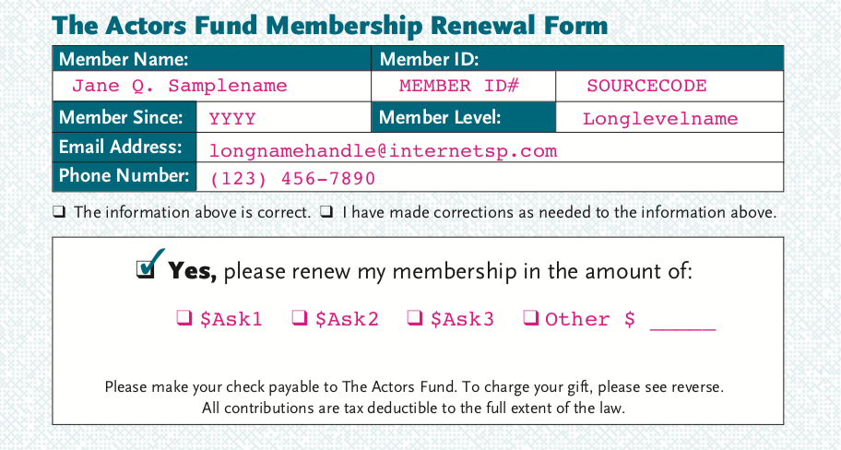
#5 Use the “Write” Language
The word RENEW is powerful!
Your constituents don’t know they are lapsed
  Remind them with: <last gift date>
  Include historic giving for
  donors who have given
  consistently in the past

Slide 31
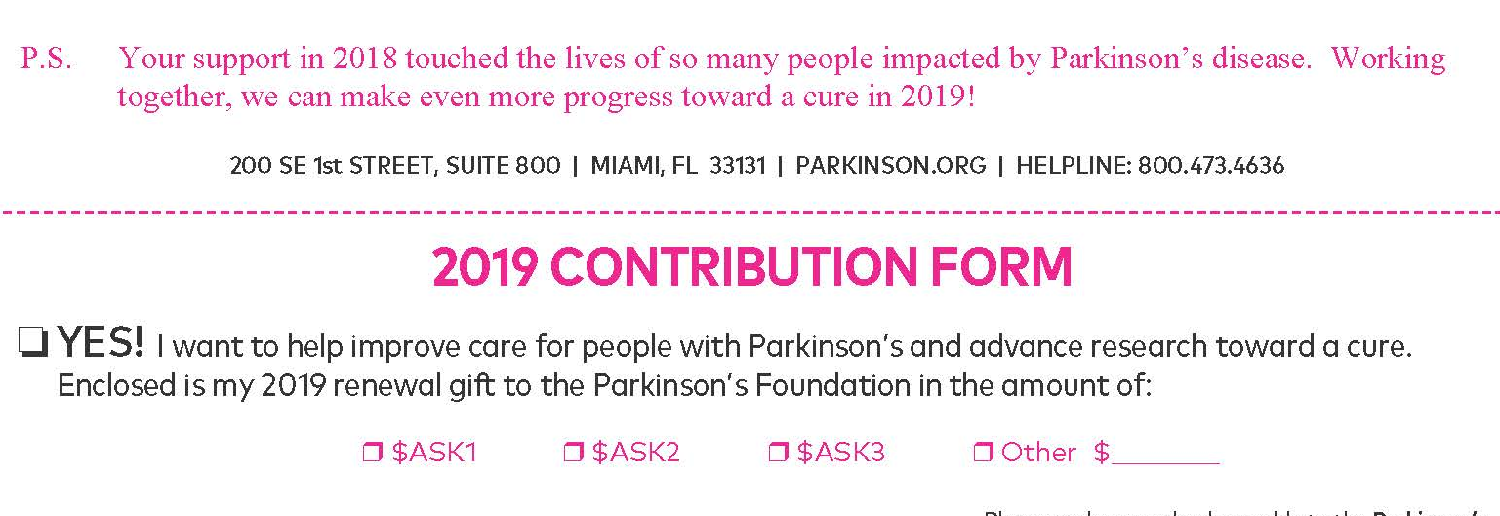
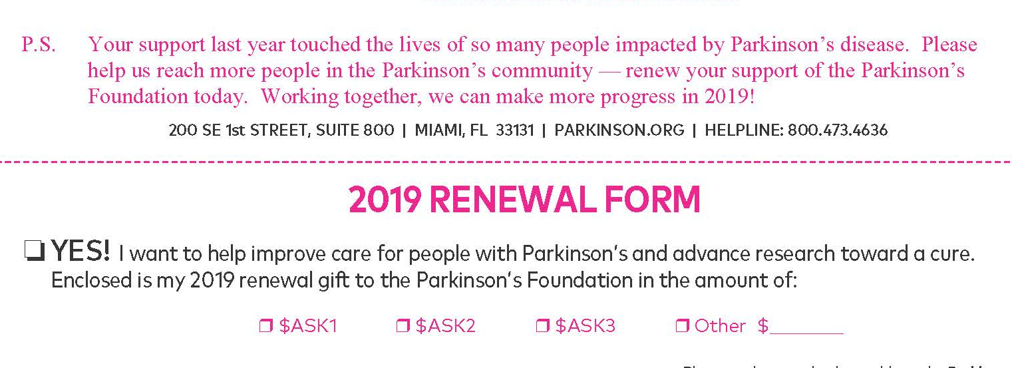
#5 Use the “Write” Language
“Renewal” test increased response by 40%!

Slide 32
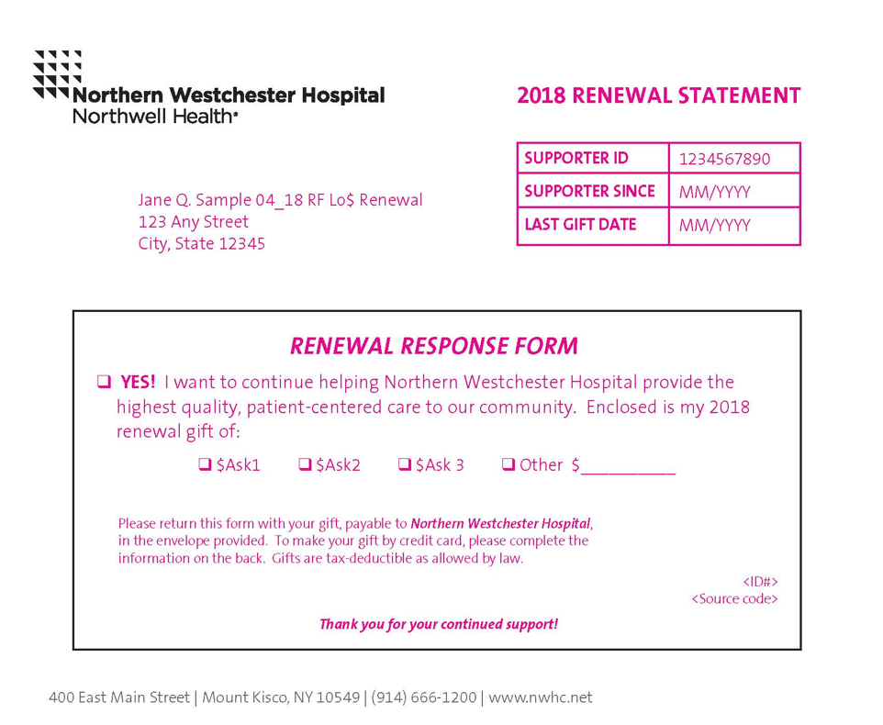
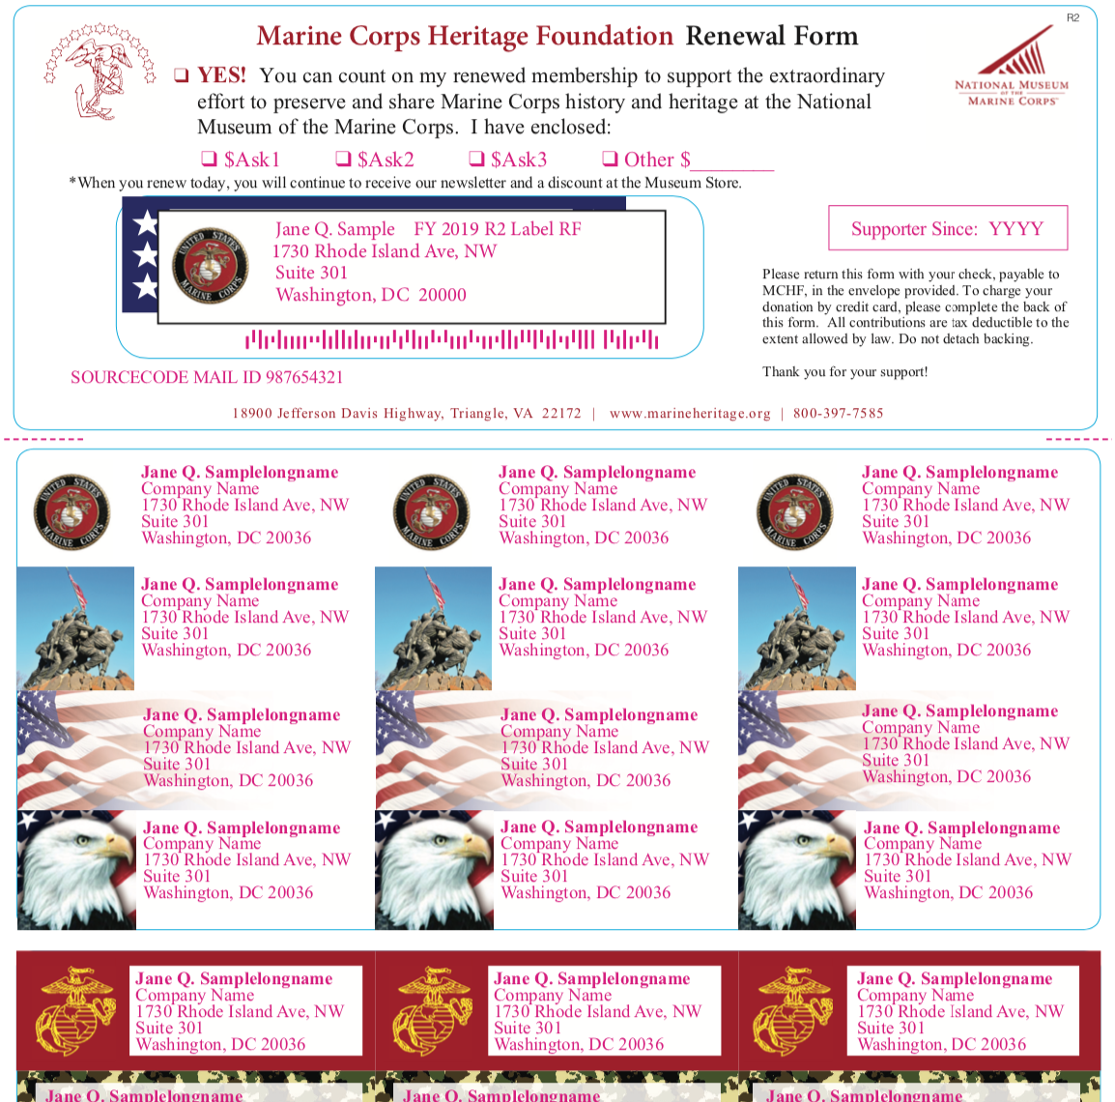
#4 Rely on Tried & True Techniques
Invoice Statements
Address
labels

Slide 33
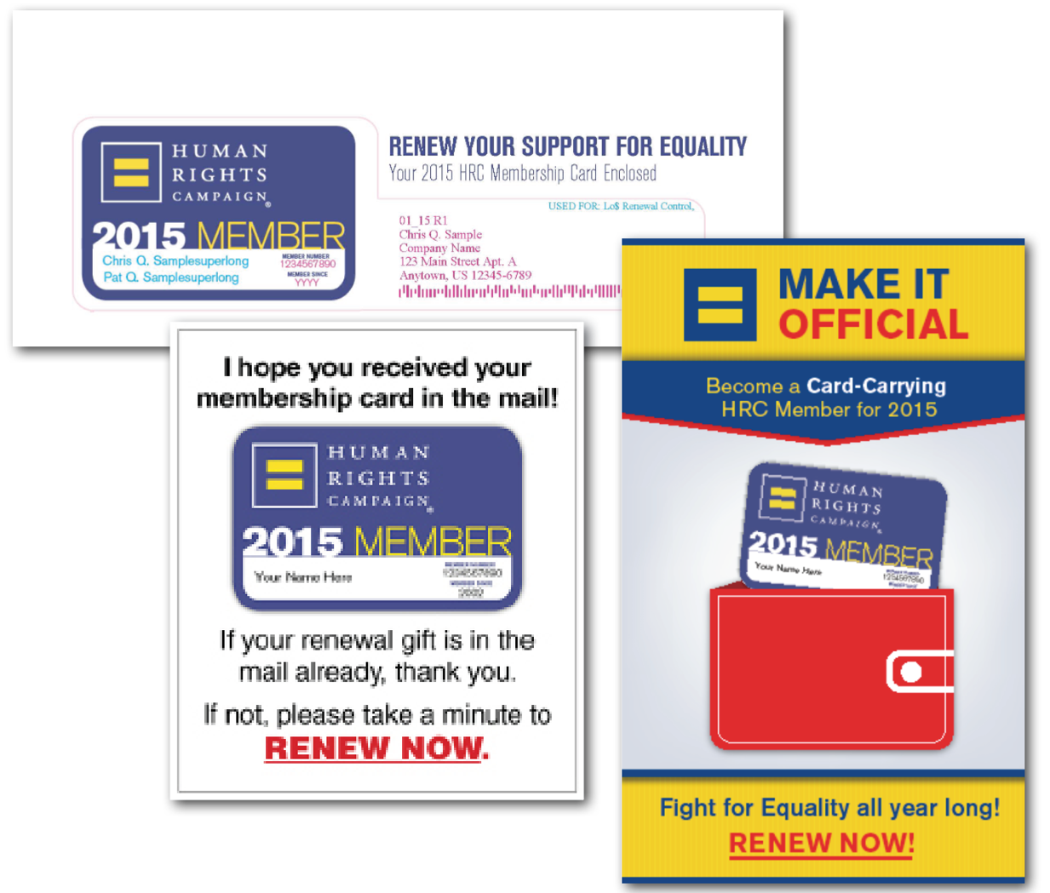
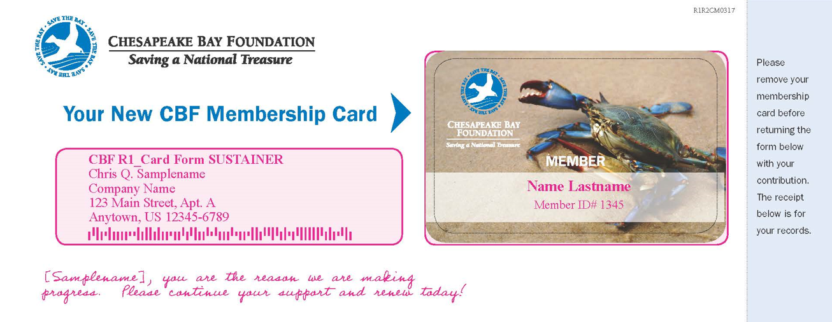
#4 Rely on Tried & True Techniques
Member cards
(in multiple channels)

Slide 34
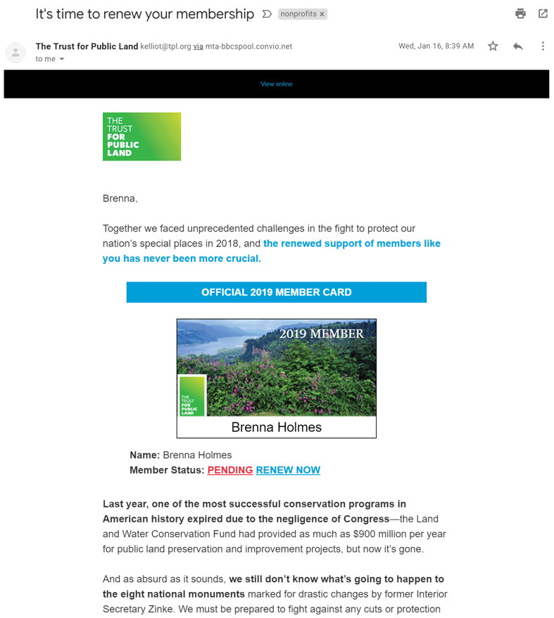
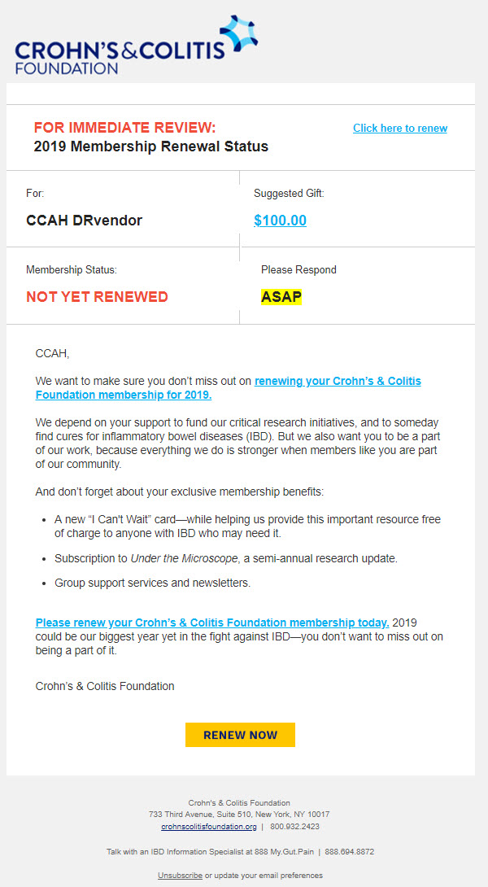
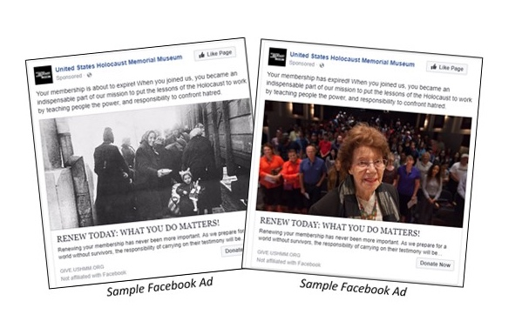
#4 Rely on Tried & True Techniques
Renewal messaging should be prominent in eRenewal campaigns.
Reference what donors are receiving in the mail (member card/labels, etc.) as it makes sense.
Use renewal messaging across digital channel (emails, ads, search, etc.)

Slide 35
#3 Maximize Renewal Results Through Testing
Build on what is working – learn from what is not.
Test timing to determine when in the series it is most successful
Look at your successful acquisition messages. What is motivating new donors to give?
Test to see if this can work with existing donors
Show your donors you know who they are.
Test enhanced messaging/personalization to maximize performance

Slide 36
#2 Budget for Retention Strategies
Break out retention and lapsed donor strategies on your budgets to show their impact and ensure expense and investment is accounted for and expected.
Budgeting specifically for retention and lapsed strategies ensures this becomes part of your roadmap for the year.

Slide 37
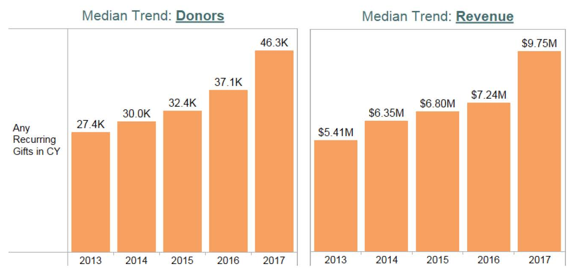
#1 Use Renewals to Convert Sustainers
70% increase in donors since 2013
35% increase in revenue in 2017
Source: Target Analytics, Sustainer Summit, May 2018
Notes:
The retention of monthly donors is among the highest across donor files just by the nature of their giving. Make sure you have conversion strategies in place across channels!

Slide 38
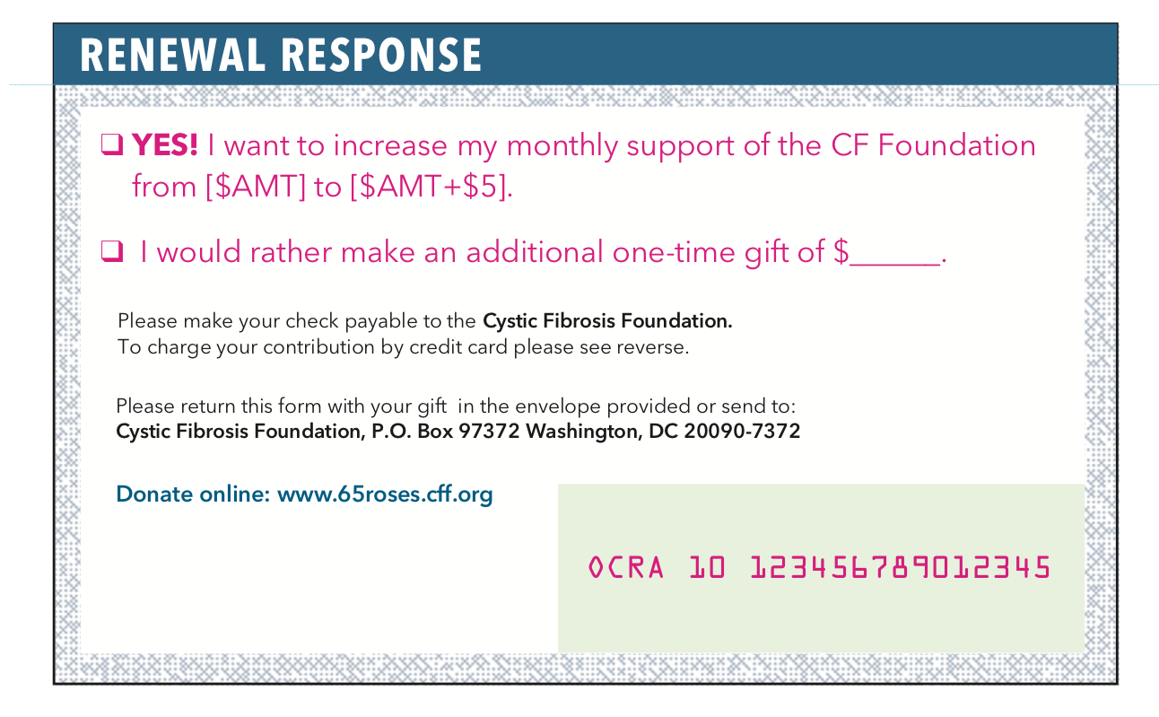
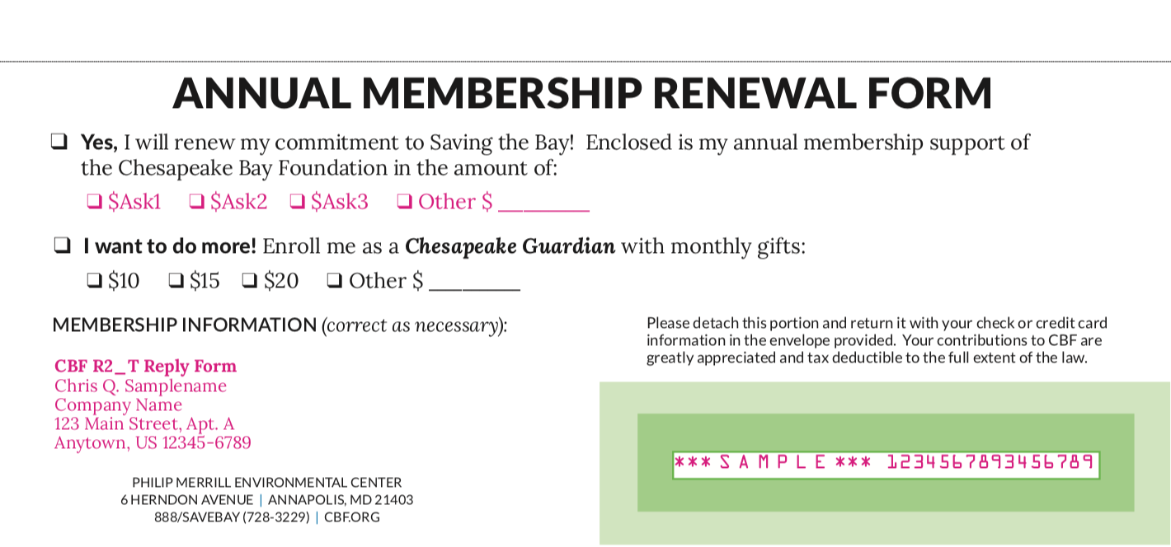
#1 Use Renewals to Convert Sustainers
Notes:
The retention of monthly donors is among the highest across donor files just by the nature of their giving. Make sure you have conversion strategies in place across channels!

Slide 39
Most Important: This Is Just the Beginning!
10. Retention Starts with Acquisition
9. Limit Time Between 1st & 2nd Gift
8. Give Donors More Opportunity to Give
7. Think About the User Experience
6. Don’t Be Afraid to Reinvent Your Data Strategy
5. Use the “Write” Language
4. Rely on Tried and True Techniques
3. Maximize your Renewal Series with Testing
2. Budget for Retention Strategies
1. Convert Donors to Monthly Sustainers.

Slide 40


Questions?
Marie Kosanovich Lynn Waller
Account Director Vice President, Client Services
Lautman Maska Neill & Company Chapman Cubine and Hussey
mkosanovich@lautmandc.com Lwaller@ccah.com
#DM201

