Slide 1
Finding Purpose in Your Path
Becky Spurlock, Ph.D.
Senior Vice President for Student Affairs and Enrollment Management

Slide 2
Notes:
I didn't have the benefit of a great start in life. The path I was on was rocky, then treacherous, then potentially disastrous.

Slide 3
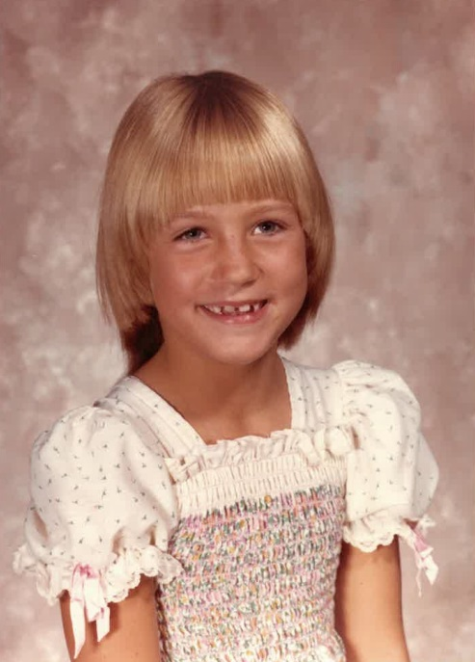
Meet Becky
Also known as:
Becky
Becca
Beckita
Rebecca
Madeline's Mom
Miles' Mom
Dean Spurlock
Dr. Spurlock
Notes:
This is important because we tend to meet people where they are and make assumptions about their lives. Life can look neatly packaged on the surface or even at a particular point in time.

Slide 4
Our Roadmap
We are going to explore the path that brought me to this exact place and time.
We'll examine the decision-making models I used in different eras of my life.
Along the way, we'll highlight the two things I believe most get in the way of making purpose-based decisions: Judgement and Agency.
We'll talk about the pathway to change: Compassion.

Slide 5
What Boondoggles Us
Your unconscious mind, it's the key to everything.
All those things that are alluding you that you think about, whether it's getting a dream job, or improving and strengthening your relationships, or maybe you beat yourself up because you have these health goals, but why can't you seem to do it?
All of this points to your unconscious mind. The answers are there.
Let's connect the dots between your unconscious mind, the little voice that's chipping away at you, and how to change the narrative, how to change how you talk to yourself because it's the key to being a happier, more present, and loving YOU.
Dr. Paul Conti, Psychiatrist & Author

Slide 6
Self-Judgement and Agency
Self-Judgement: This is a coping mechanism to distract us from feeling our feelings. Judging ourselves is easier than feeling heartache, disappointment, grief, or other pain.
It's a form of shaming, which shuts down connection and compassion.
Agency: Agency is the sense of control that you feel in your life, your capacity to influence your own thoughts and behavior, and have faith in your ability to handle a wide range of tasks and situations. Your sense of agency helps you to be psychologically stable, yet flexible in the face of conflict or change.
Agency is being a producer of your life circumstances and not just the product of what's happened.
Notes:
I'm being lazy – i'm resting why can't I change this? - I'm curious about what's getting in my way. Our relationship to agency "bad things come in threes" my day is ruined. Why do bad things happen to me? Reframing through gratitude and grounding
The inner voice in us may be the part of us that is telling us something that we really need to know and need to look at, but that we're afraid of or that we're ashamed of, and that our reflex is to look away from when we actually should be curious about it and come right at. What is that voice? What is it saying? What does it mean? And there's often a running dialog or set of opinions inside of us that are in the background to our experience of life in the present. And this can make a huge difference to how we respond to life in the present, how we think about ourselves and how we think about the world around us. There's a lot more going on inside of us than what we're taking in at the moment.

Slide 7
Let's talk about my path in terms of eras and decision-making style.
Story Time!
The Early Years (14-25)
Follow the leader
My Checklist Era (26-38)
Hustling for your Worth
The Undoing Era (39-47)
When the hustle doesn't cut it anymore
The Era of Radical Honesty (48-present)
When you know the stories aren't true
We live many lives and die many deaths.
Notes:
Each of these stages was necessary along the way. But if I tried to use the same decision making models as I did when I was 20, I wouldn't be living my purpose. And if I judged myself for the choices I made, then shame might prevent me from moving forward.

Slide 8
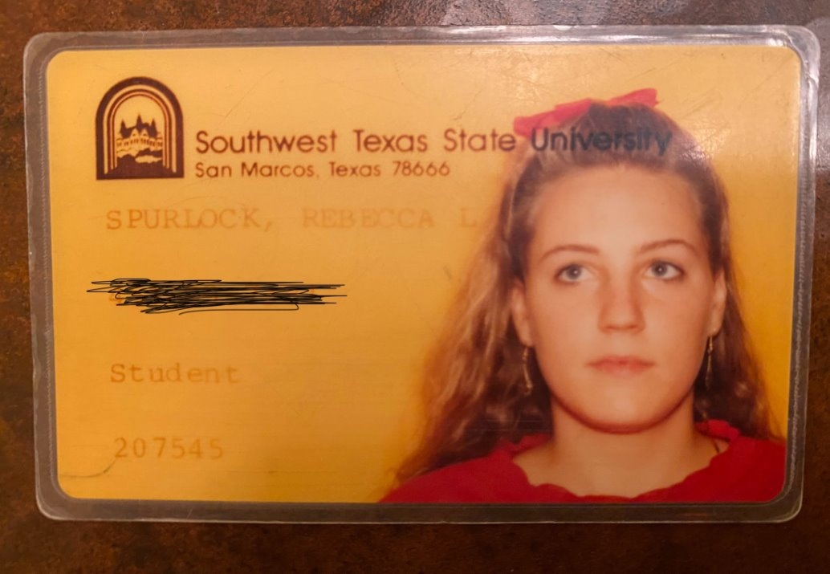
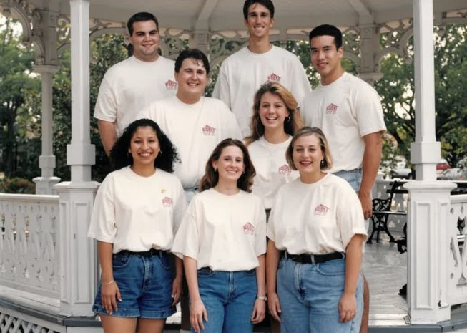
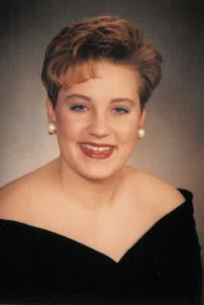
Nothing to see here! Or, how I set my own course by following others.
The Early Years (14-25)
Notes:
Each of these stages was necessary along the way. But if I tried to use the same decision making models as I did when I was 20, I wouldn't be living my purpose. And if I judged myself for the choices I made, then shame might prevent me from moving forward.

Slide 9
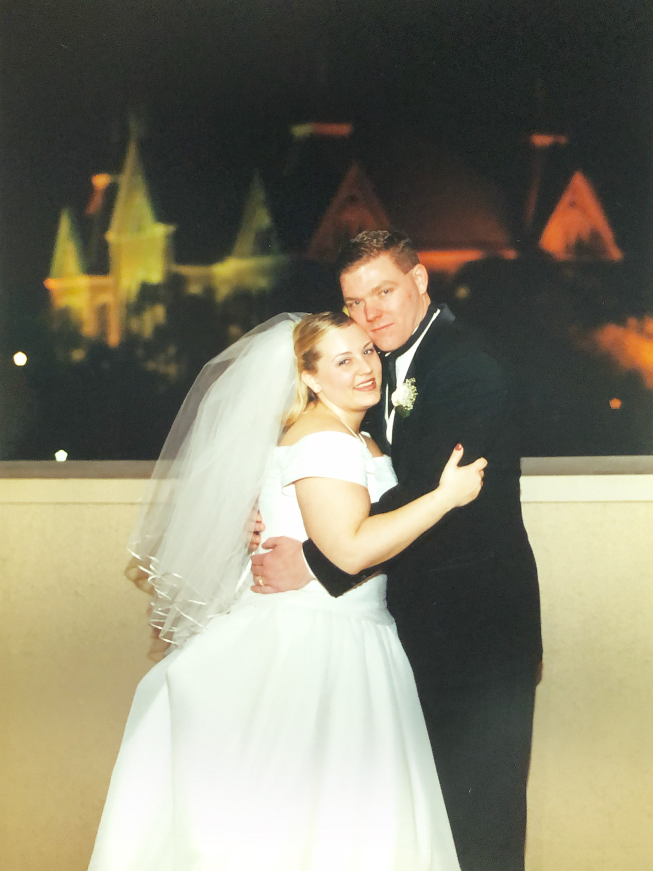
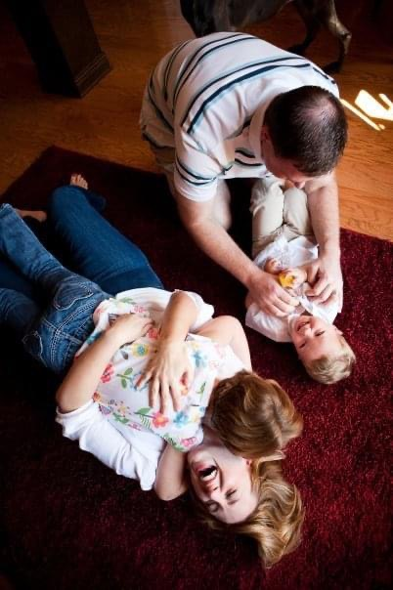
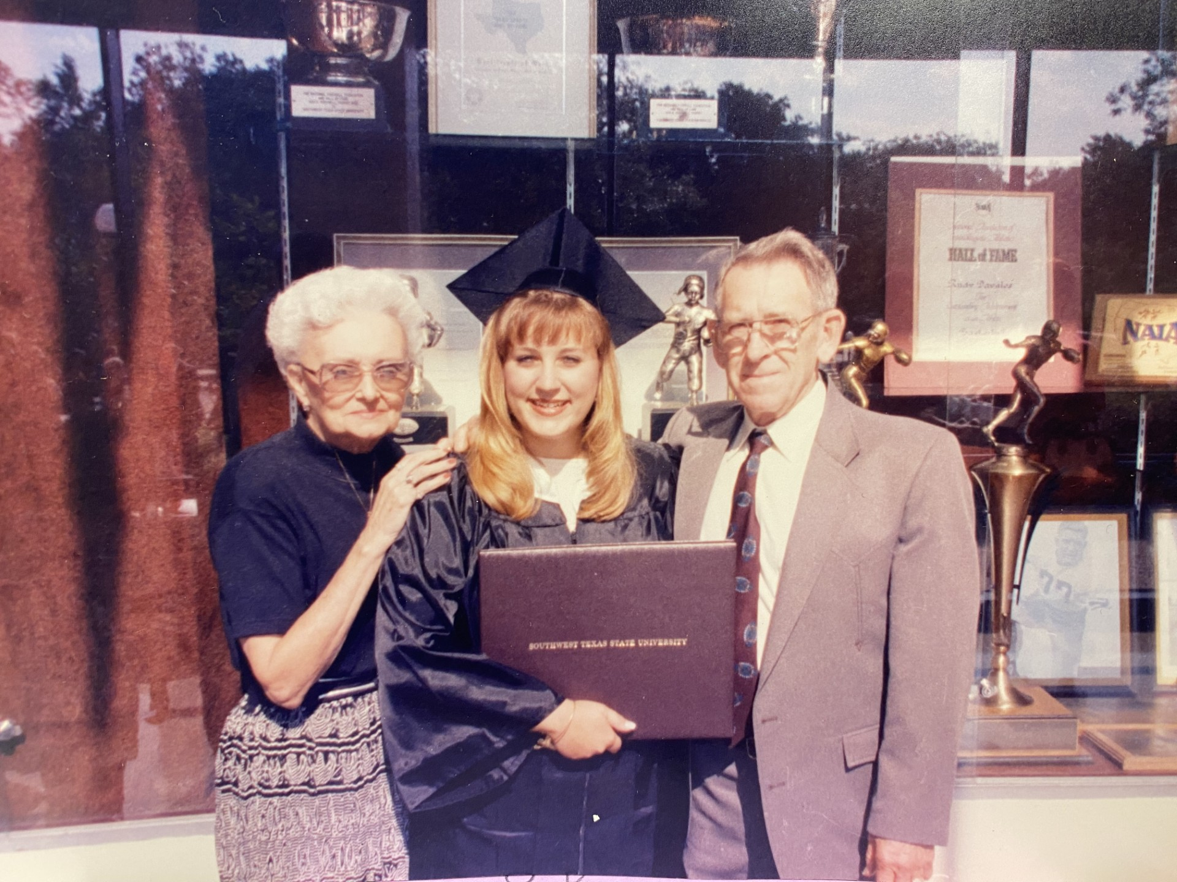
Getting busy with life as evidence that EVERYTHING IS OKAY! Working through the life checklist. Built this persona. I survived – sort of like nothing to see here but also, see here!
My Checklist Era (26-38)

Slide 10
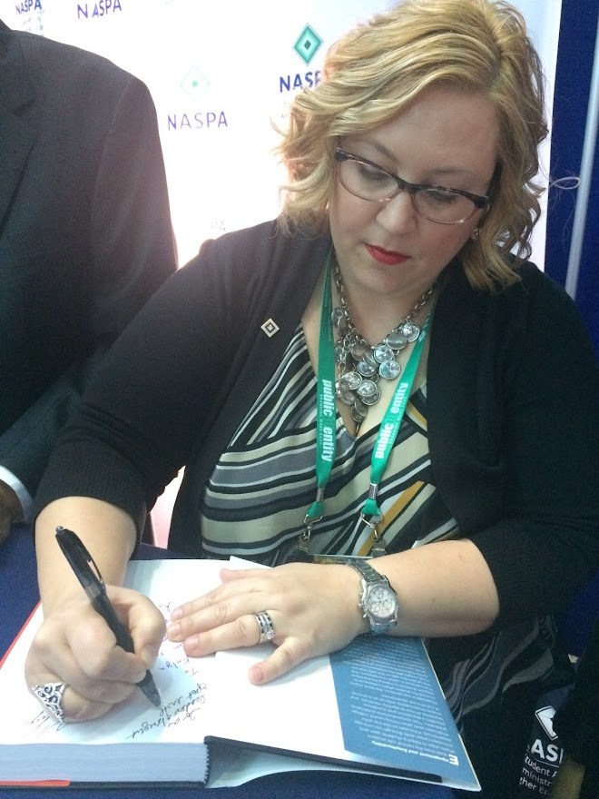
When your identity is in your accomplishments and things fall apart. Having the courage to undo hustling for your worth.
The Undoing Era (39-47)
Notes:
My family moved on without me.

Slide 11
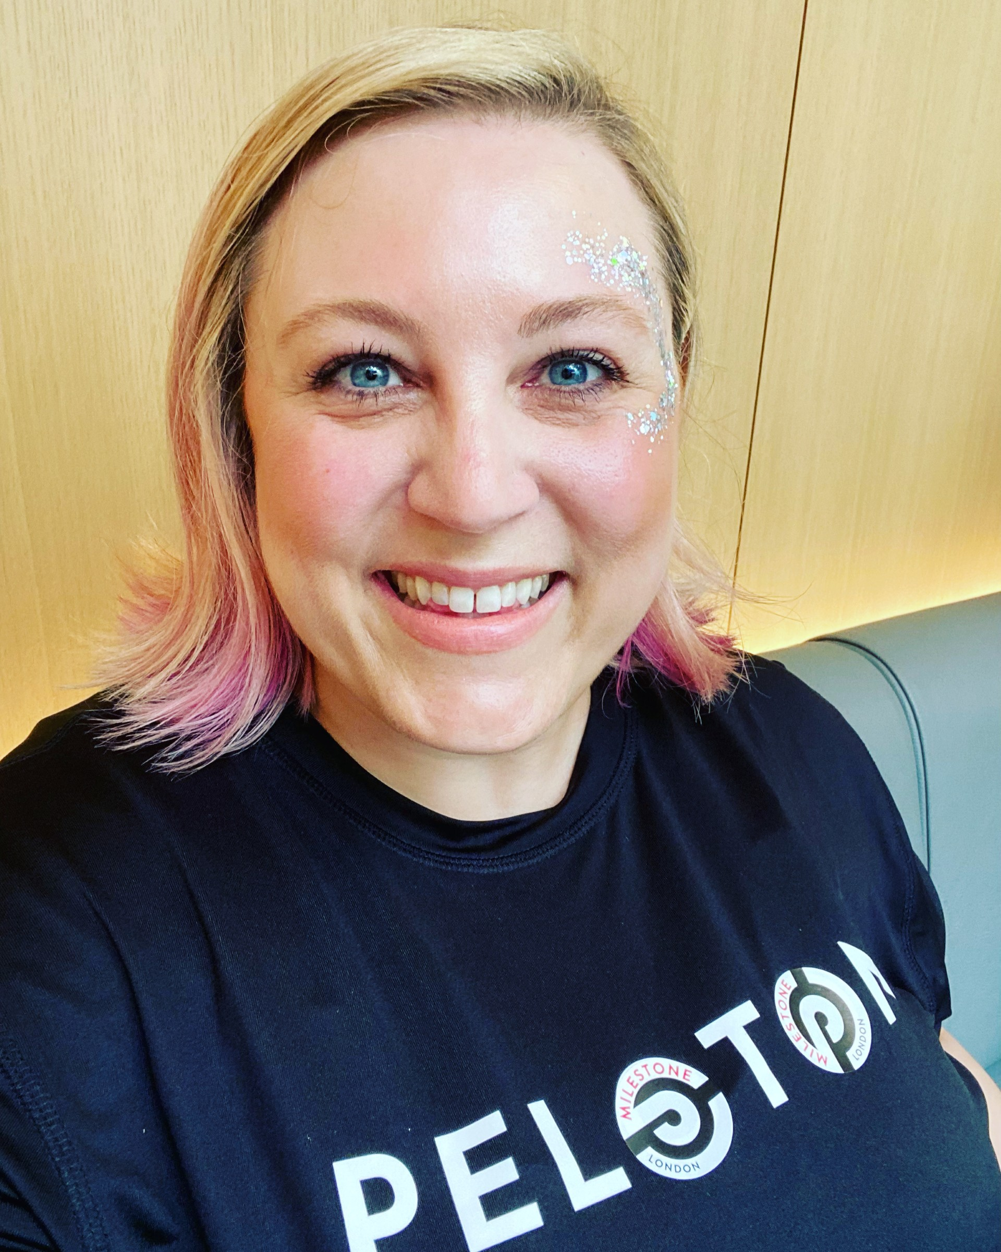
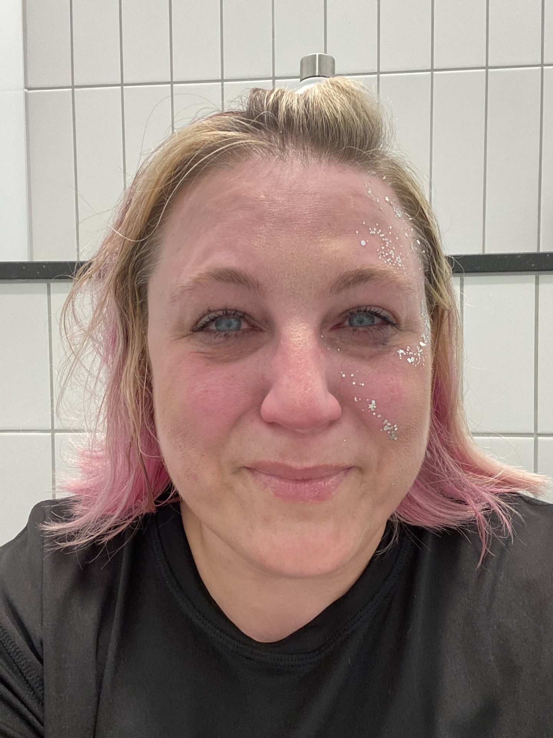
When you know the stories aren't true.
The Era of Radical Honesty
(48-present)
Notes:
Money, health, family, time

Slide 12
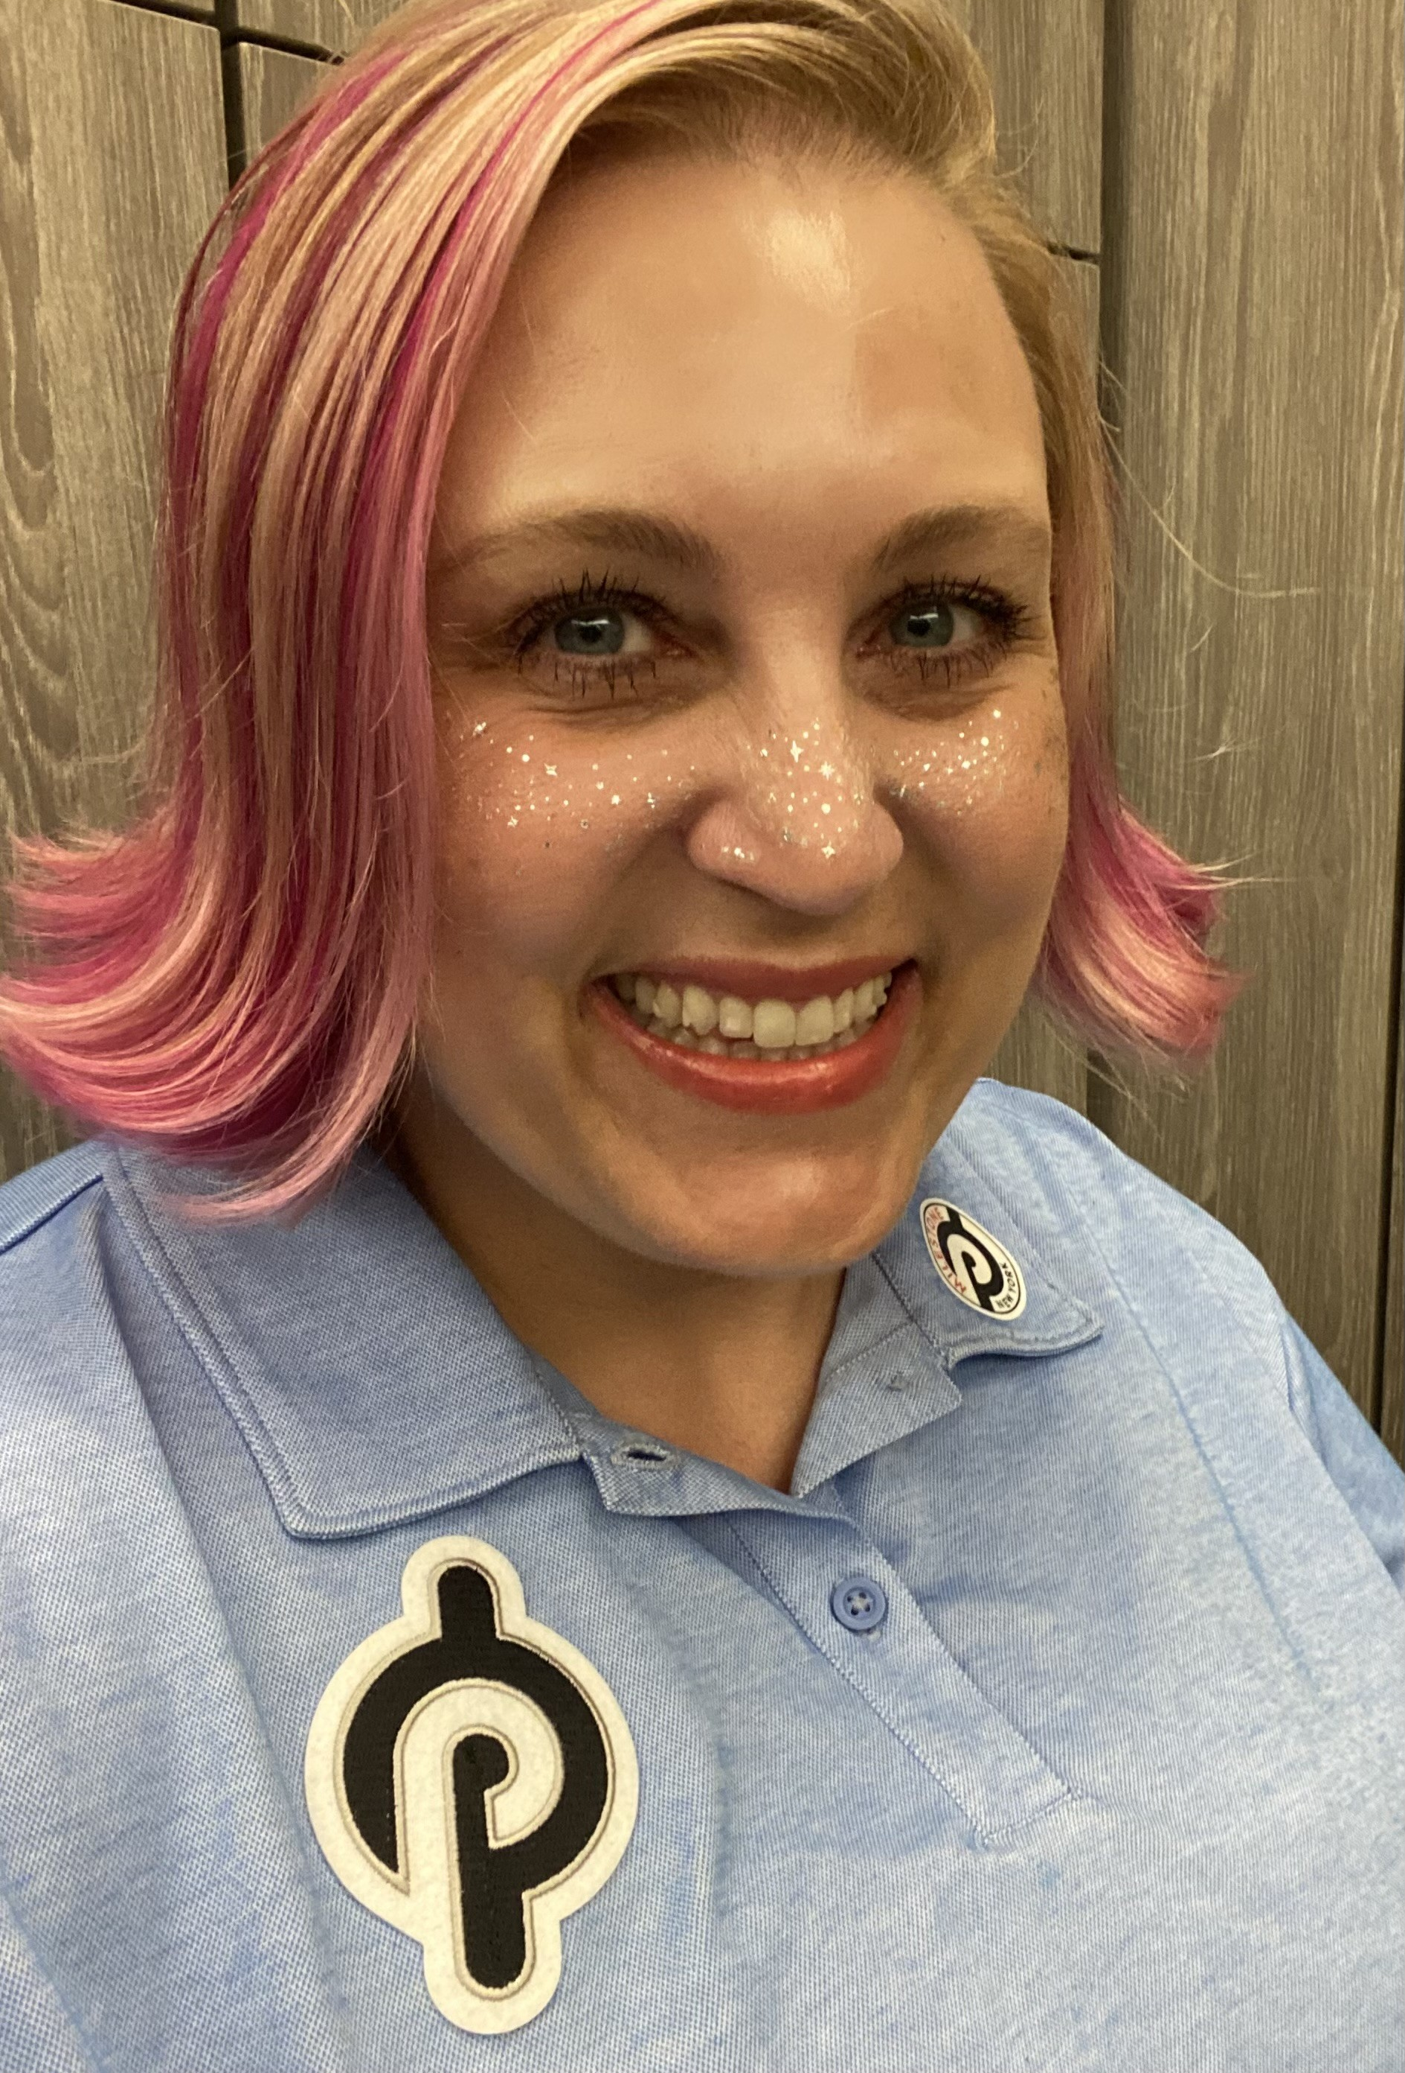
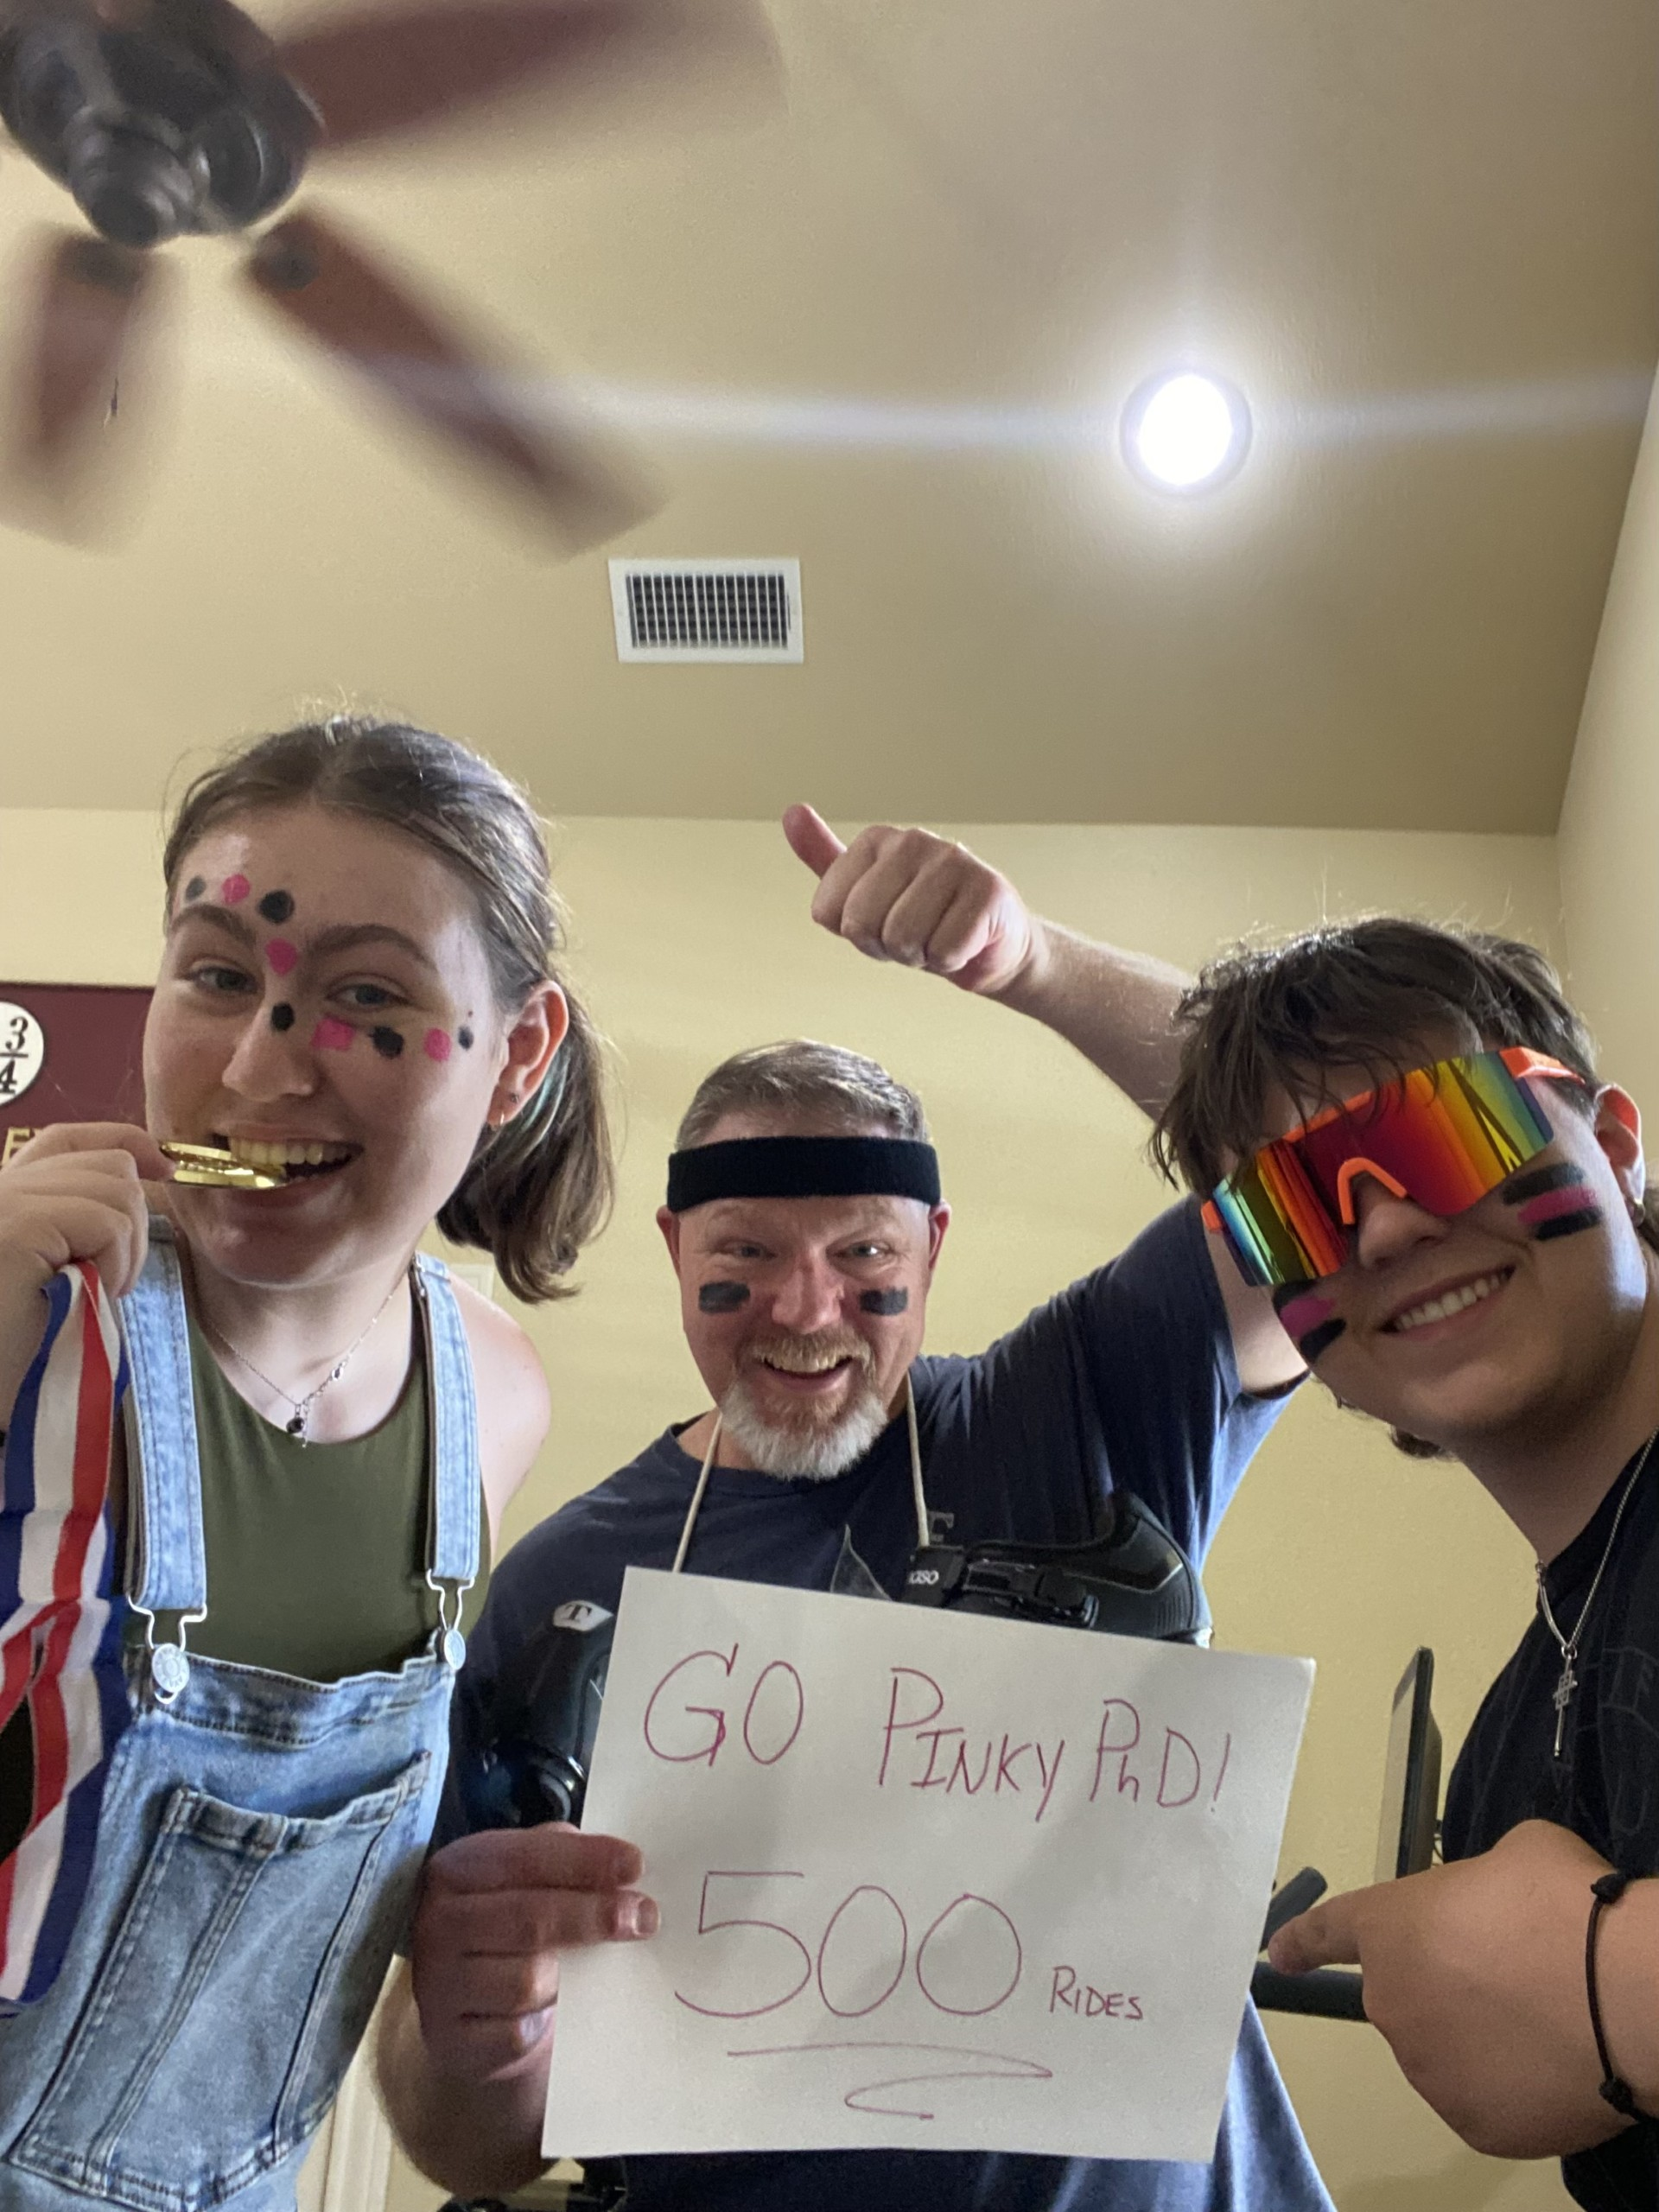
Notes:
Money, health, family, time

Slide 13
Do you have a clear picture of how self-judgement shows up in your life? Can you define your relationship to agency? Commit to a practice of self-compassion.
What do you do Now?
Self-Compassion has three parts:
1. Self-kindness: Treating yourself with care and understanding.
2. Mindfulness: Accurately perceiving your thoughts, feelings, and experiences, without overidentifying with them.
3. A sense of common humanity: Recognizing that challenges are a part of the human experience.
Perfectionism shuts down compassion.
Notes:
Each of these stages was necessary along the way. But if I tried to use the same decision making models as I did when I was 20, I wouldn't be living my purpose. And if I judged myself for the choices I made, then shame might prevent me from moving forward.

Slide 14
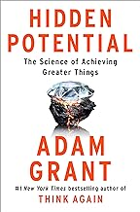
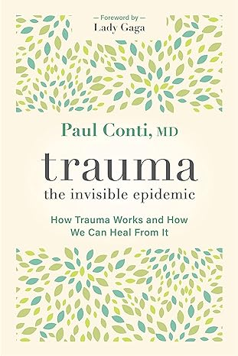
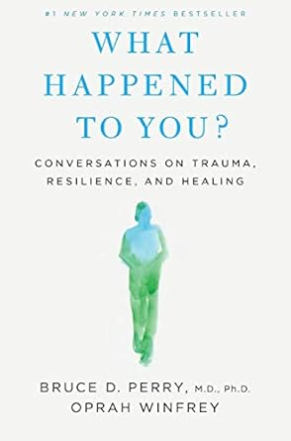
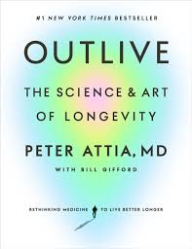
Tools and Resources
The CARE Method
Catch yourself being critical
Acknowledge your experiences
Request your own compassion
Explore the next best step
Notes:
Each of these stages was necessary along the way. But if I tried to use the same decision making models as I did when I was 20, I wouldn't be living my purpose. And if I judged myself for the choices I made, then shame might prevent me from moving forward.

Slide 15
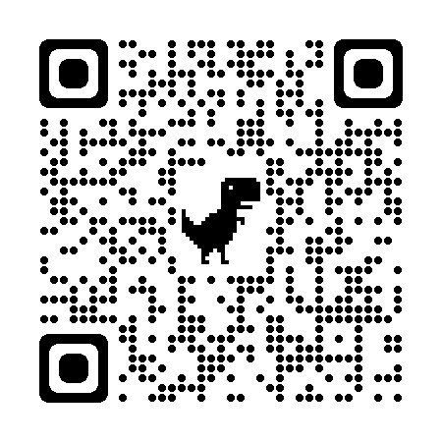
Connect with me on LinkedIn!

Slide 16
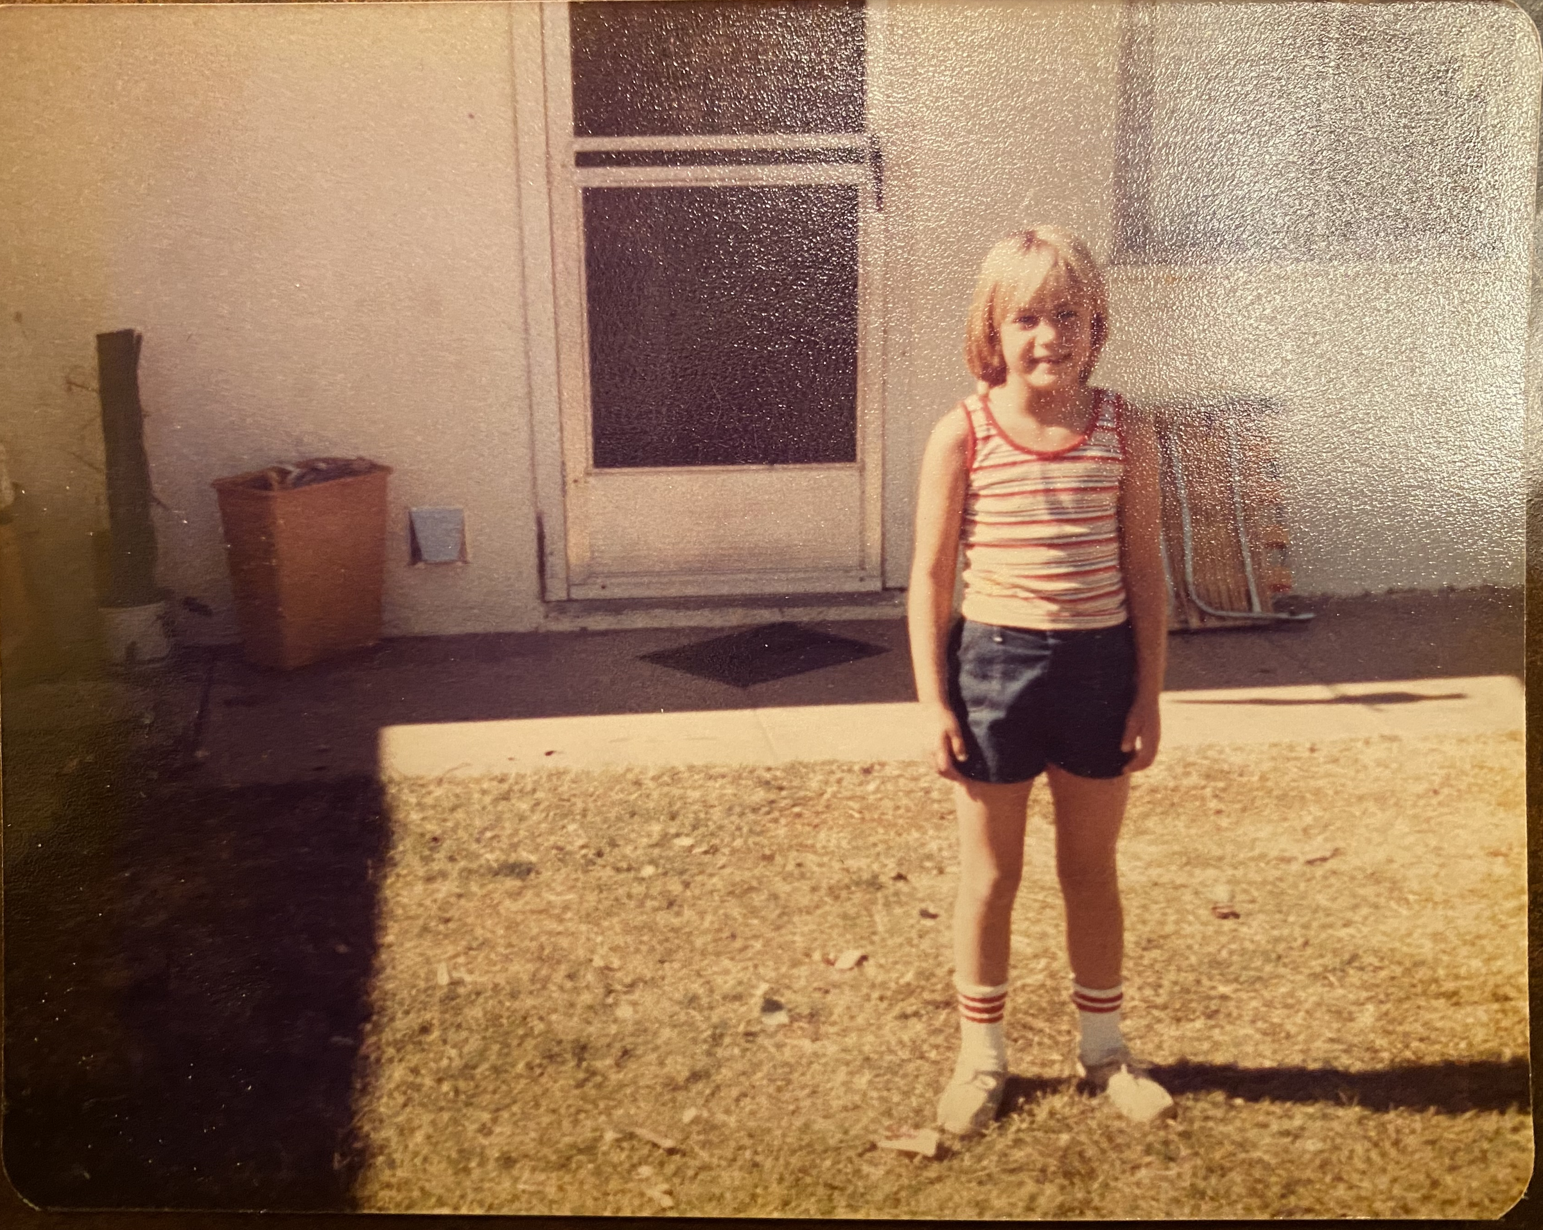
Meet Becky
Also known as:
Becky
Becca
Beckita
Rebecca
Madeline's Mom
Miles' Mom
Dean Spurlock
Dr. Spurlock
Notes:
This is important because we tend to meet people where they are and make assumptions about their lives. Life can look neatly packaged on the surface or even at a particular point in time.

