Slide 1
Conscious Health: Intentional Choices for the Future You
Taylor Wiedenfeld, MPH

Slide 2
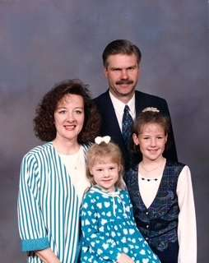
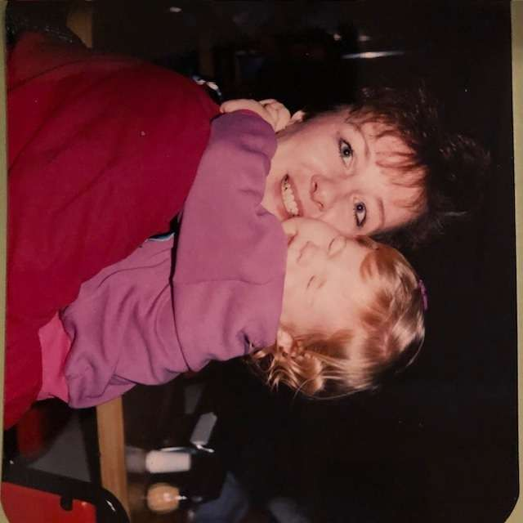
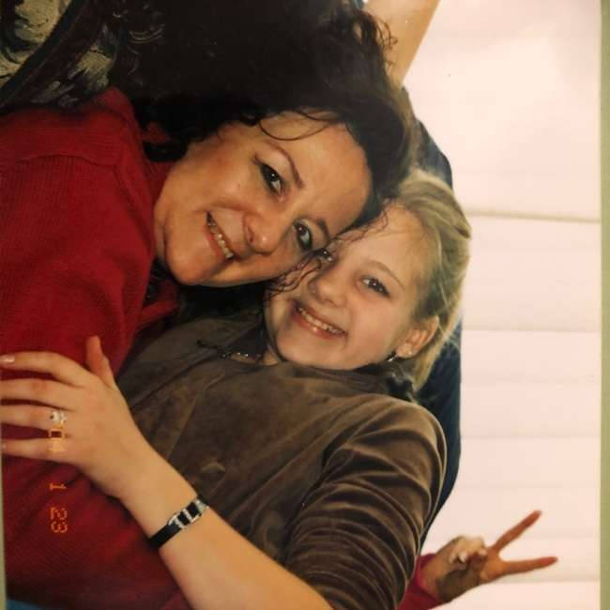
A little about me

Slide 3
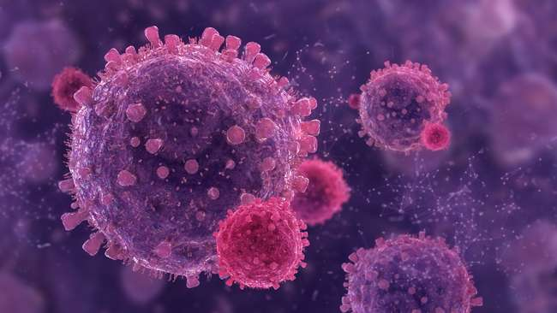
What is Breast Cancer
Breast cancer is the disease when cells in the breast multiply uncontrollably and creating masses or tumors. These masses can be benign (non-cancerous) or malignant (cancerous).
Notes:
Breast cancer is the disease when cells in the breast multiply uncontrollably and creating masses or tumors. These masses can be benign (non-cancerous) or malignant (cancerous).

Slide 4
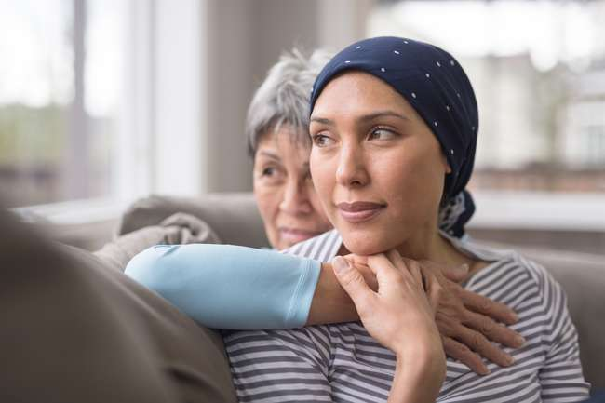
What is Metastatic Breast Cancer
Uncurable breast cancer that spreads throughout your body and organs.
168,000 breast cancer survivors are living with metastatic (stage IV) disease, three-fourths of whom were originally diagnosed with stage I-III cancer
Notes:
Malignant tumors can continue to divide and spread throughout the body and organs resulting in Metastatic Breast Cancer or Stage IV BC.
Metastatic Breast Cancer is majority cause of breast cancer deaths. 1 and 39

Slide 5
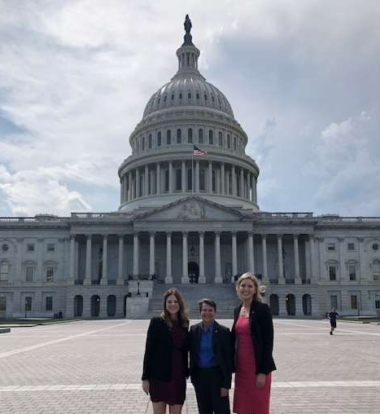
Choosing to help others

Slide 6
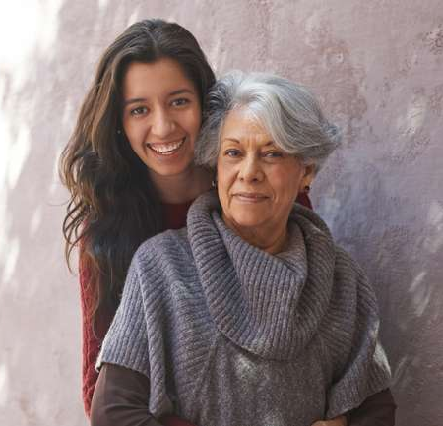
Risk Factors
Notes:
There are many risk factors associated with an increased risk of breast cancer, but the biggest risk factors of developing breast cancer are getting older and being female.
Reminder, you do not have to have a family history to develop breast cancer

Slide 7
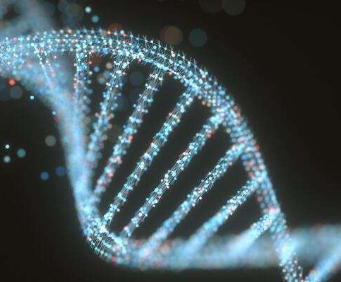
Genetic Testing
Gene Mutation
Inherited vs. spontaneous
APC | ATM | BARD1 | BRCA 1 | BRCA 2 | BRIP1 | CDH1| CDKN2A | CDK4 | CHEK2 | EPCAM | HOXB13 | Lynch Syndrome | MLH1 | MSH2 | MSH6 | MUTYH | NBN | PALB2 | PMS2 | PTEN RAD51C | RAD51D | STK11 | TP53 |
Notes:
Family history increases your risk of developing breast cancer, but about 90% of breast cancers result in spontaneous genetic mutations not inherited (so only 10% are passed down from family).
Breast cancer is most likely the result of several risk factors we currently know and risk factors we still have much to more to learn about. That is why our work for finding breast cancer cures is not done.

Slide 8
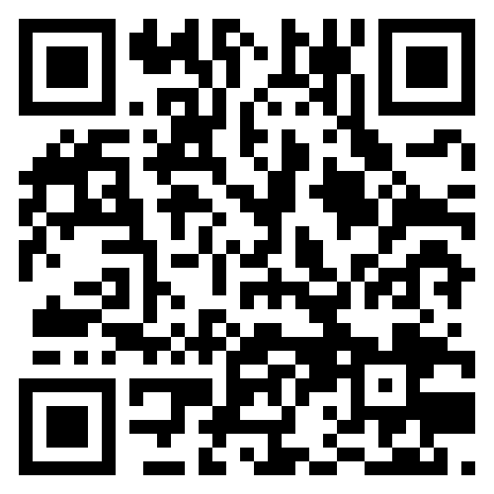
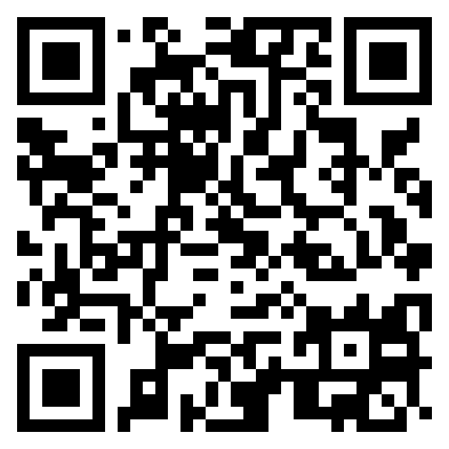
Risk Factors
Don’t know where to start? Scan and take the assessment that’s right for you
https://assess-your-risk.dana-farber.org/
https://magview.com/ibis-risk-calculator/
Notes:
Family history increases your risk of developing breast cancer, but about 90% of breast cancers result in spontaneous genetic mutations not inherited (so only 10% are passed down from family).
Breast cancer is most likely the result of several risk factors we currently know and risk factors we still have much to more to learn about. That is why our work for finding breast cancer cures is not done.

Slide 9
What Can we do?
Know and understand your risk
Get screened and talk to your provider
Know what’s normal for you
Live a health Lifestyle

Slide 10
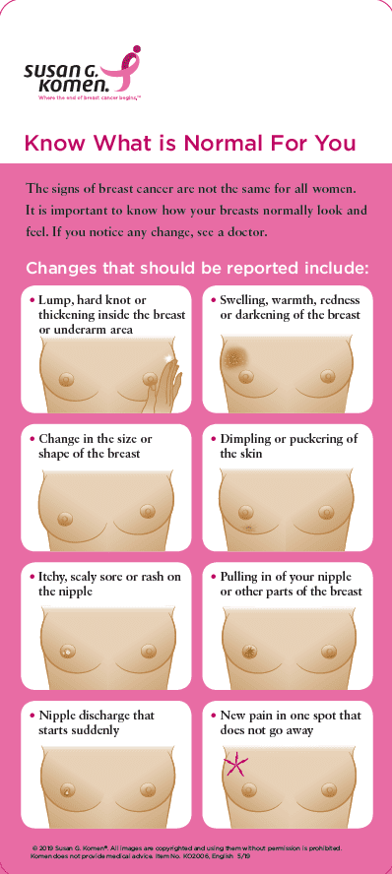
What’s Normal?

Slide 11
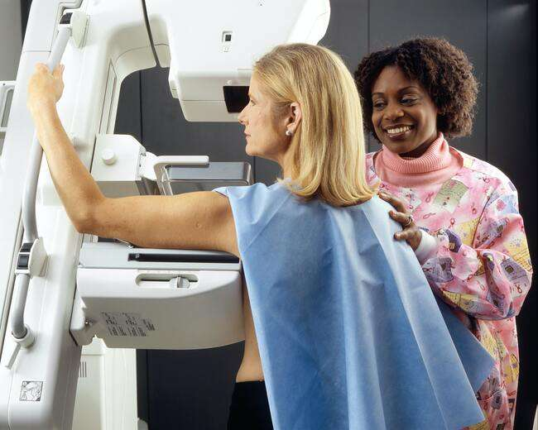
Next Steps in your breast health Journey
Clinical Breast Exams
Mammography
MRI / Ultra Sounds
Biopsies
At average risk you should begin screenings at 40 years old.
If you are at high risk discuss the right time to begin screenings with your provider
Notes:
What is a mammogram it is lots of xrays/images of your breast. A 3D is most standard these days but make sure to ask if you don’t know what kind of mammography is scheduled.
Screening vs. Diagnostic mammograms

Slide 12
Healthy Lifestyle Choices
Limit alcohol consumption
Eating a balanced diet
Fruits & veggies
Exercise
Breastfeed if you can

Slide 13
Choose you and ADVOCATE!
Prioritize your health
Advocate for your health
Choose your health
You can’t be your best for others if you’re not at best.

Slide 14
Resources
American Cancer Society – Cancer.org
Susan G. Komen – Komen.org
National Breast Cancer Foundation – nationalbreastcancer.org
Breastcancer.org
The Breast Center – Midland, TX | 432.221.3040
Pink the Basin | 432.940.7465 or 432.557.3301
Gifts of Hope | Hope Circle - 432.218.8714

