Slide 1



LEVERAGING EVENTS & COLLABORATION TO GROW YOUR LOCAL BUSINESS
(and help others along the way)
Presented by
Ginny Van Doren-Truong
Stacy Livingston

Slide 2


  Introducing Ginny Van Doren-Truong and
Stacy Livingston
  Why Events Matter for Business Growth
  The Power of Collaboration in Events
  Creating an Event Blueprint
  Fostering Long-Term Growth Beyond the Event
  Q&A
AGENDA

Slide 3

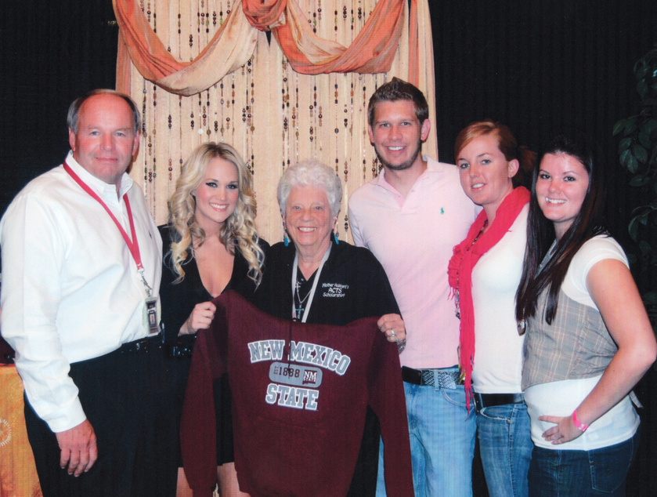
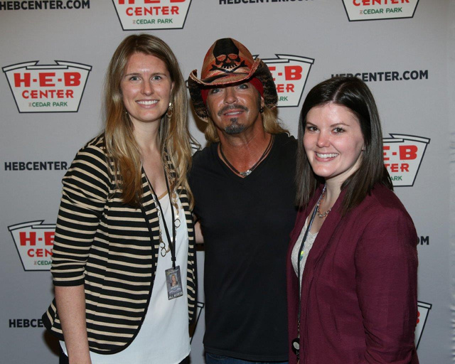
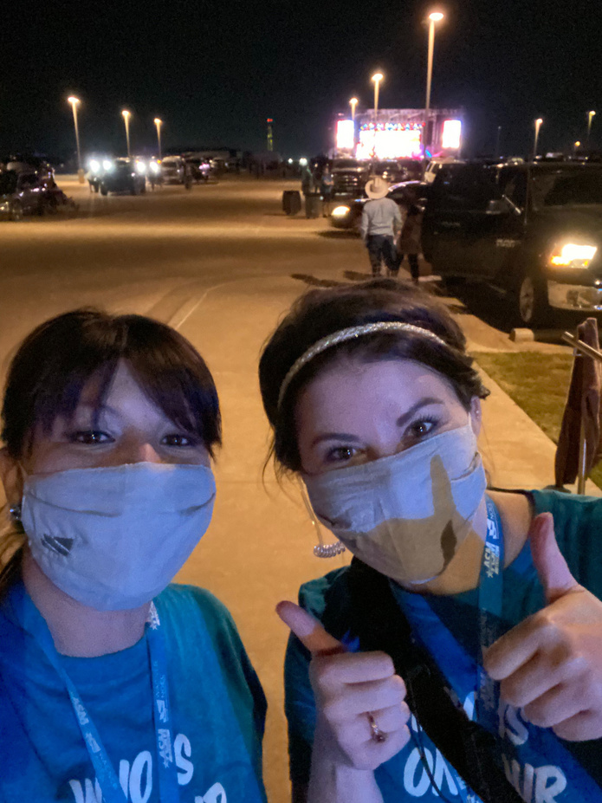
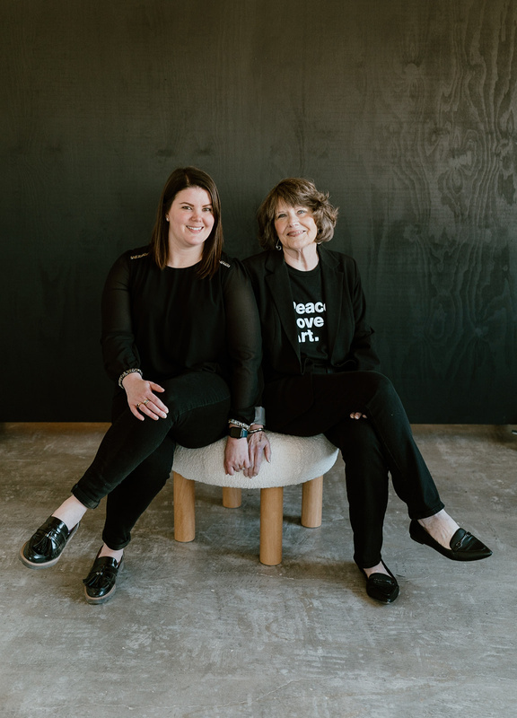
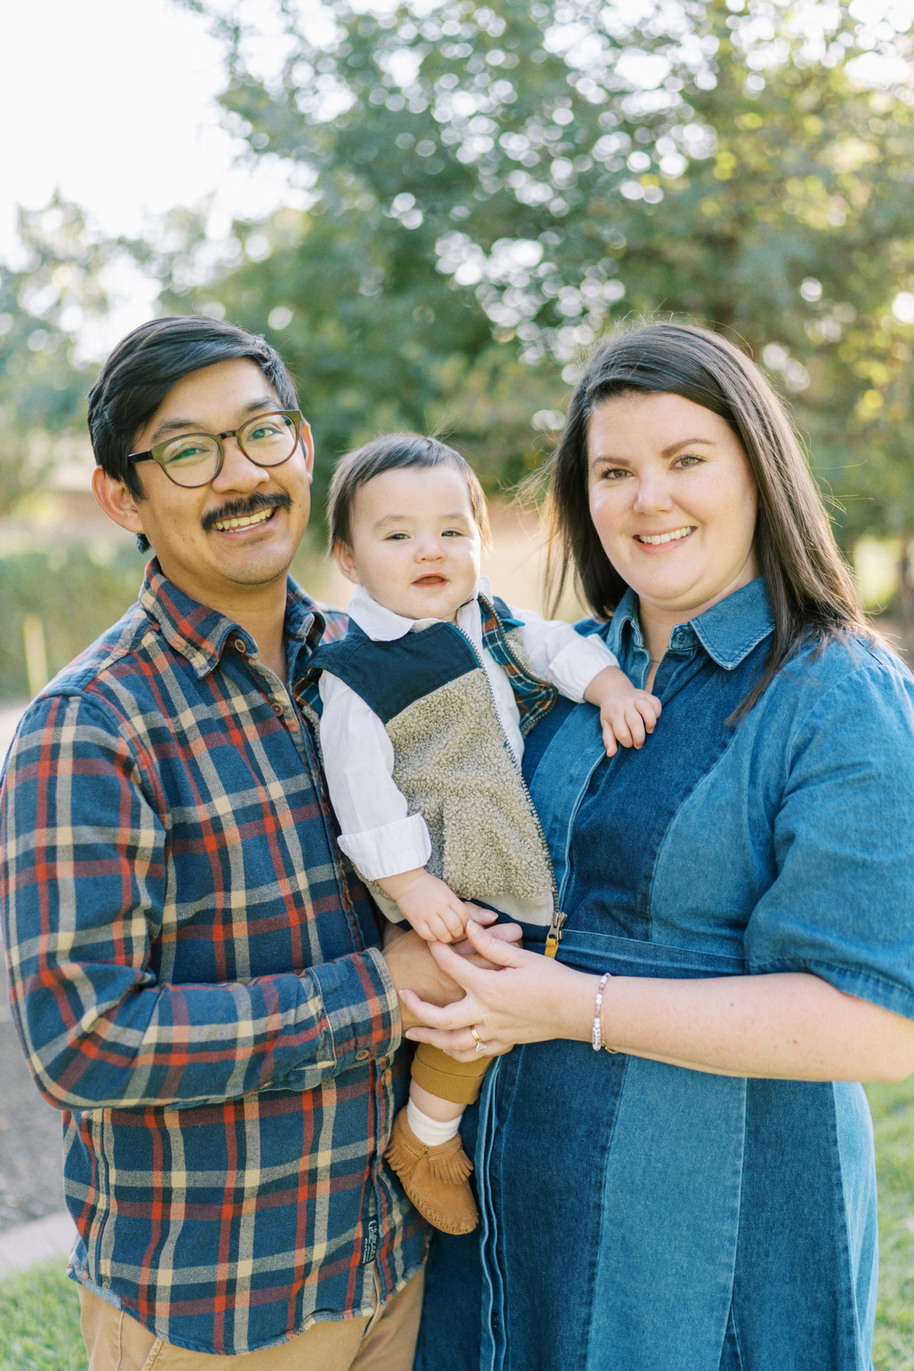
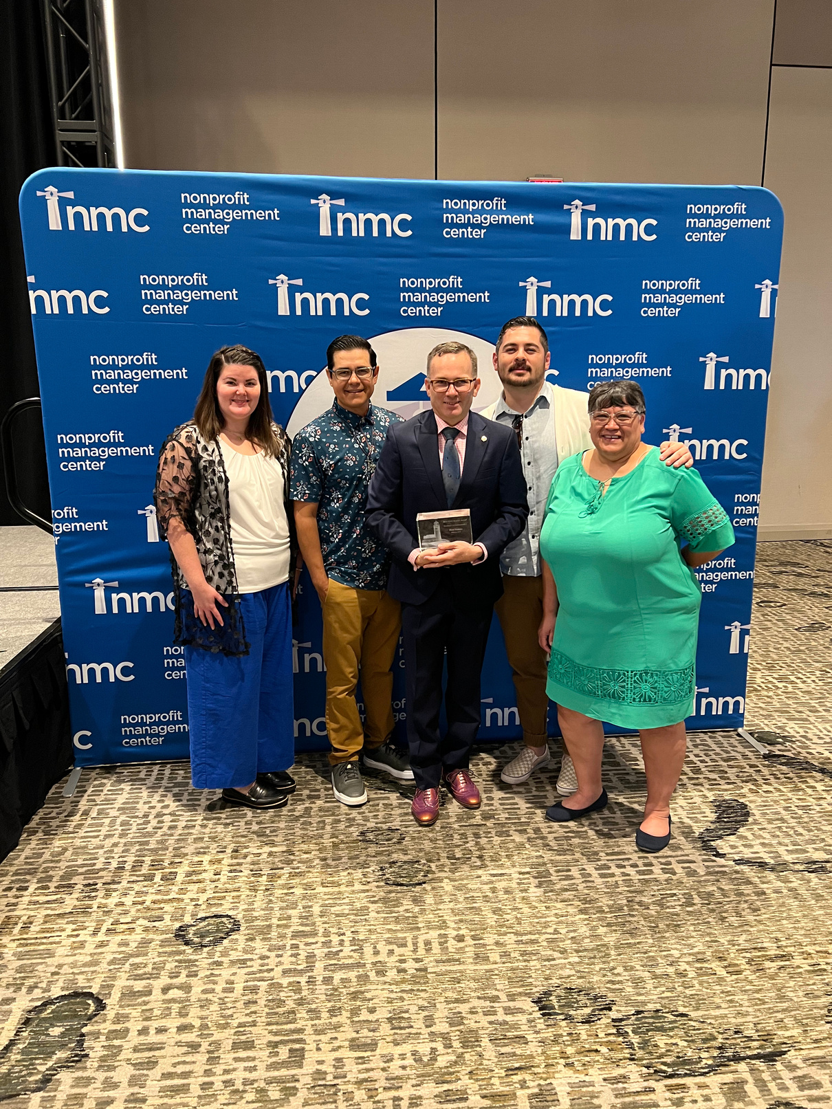
INTRODUCING GINNY VAN DOREN-TRUONG
  2008 First Concert as Official Mint Passer Outter at Carrie Underwood Concert
  2009 - 2011 Served as the Activities Director & Director of Special Events for the Associated Students of New Mexico State University
  2011 - 2013 Served as the Graduate Assistant for the Special Events Department
  2013 - 2017 Marketing Coordinator, Marketing Manager, & Events Manager of H-E-B Center in the Austin, TX Metro
  2017 - 2023 Marketing Manager & Director of Marketing for Wagner Noël PAC
  May 2023 Opened up Backstage Event Marketing with my mom
  January 2024 Welcomed 1st Child Turner

Slide 4
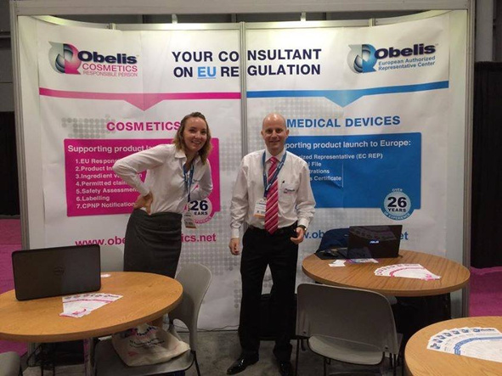
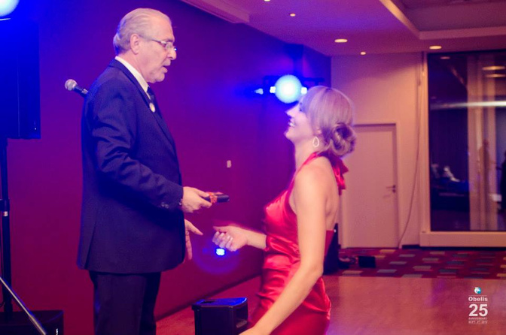
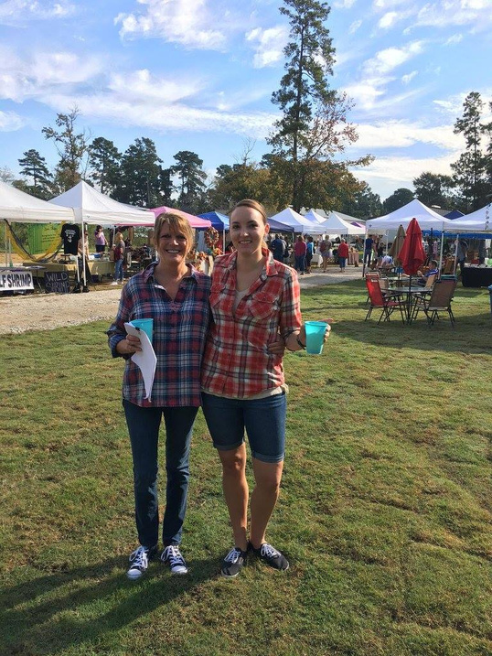
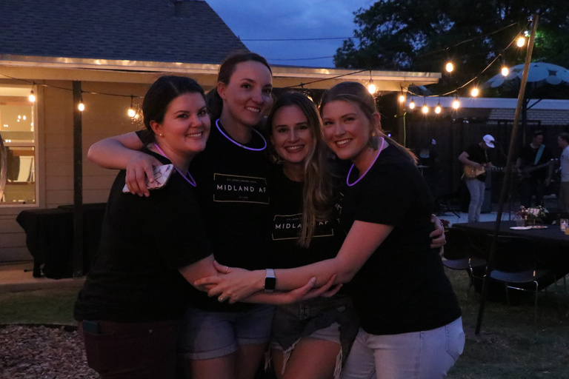
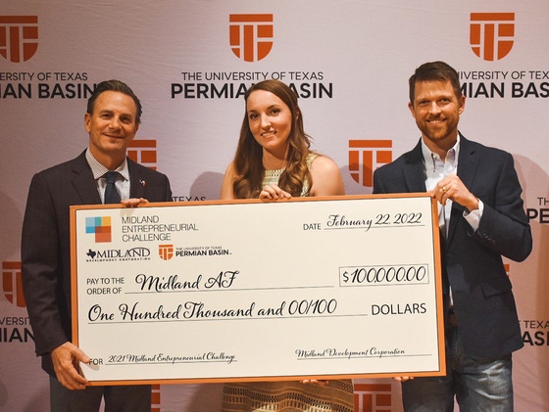
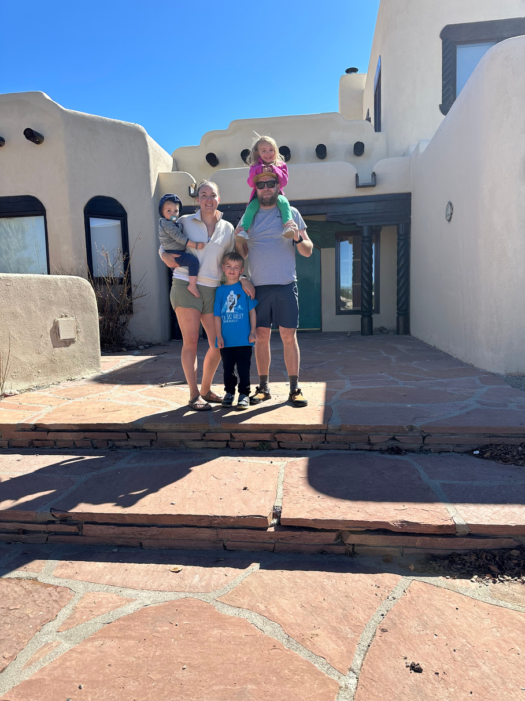
INTRODUCING STACY LIVINGSTON
  2009-2019 US Market Development for international company
  2010- Graduated from U of U, Double Marketing & Psychology
  2016- Started & sold a farmers market in Magnolia, TX
  2019- moved to Midland, started Livlen Media & Midland AF
  2020- started Odessa AF
  2022- started Midland Art Crawl, Midland Entrepreneurial Challenge winner (2021), STR Midland (Brunson Bungalow)
  2023- Midland Art Crawl becomes a non-profit
  2024 Luxury STR Taos, New Mexico (Slope & Sage Hideaway)
Notes:
After having the opportunity to move to Brussels for 3 months for a marketing internship,
It's important to note on this timeline that while progress seems like a straight line, there were several periods in this timeline where I was forced to dial back, prioritize family, deal with unexpected events, and change my perspective on what success looks like at this stage in my life.
You can do everything, just not all at once.

Slide 5
01.
WHY EVENTS MATTER

Slide 6
WHY EVENTS MATTER
  Know, Like, & Trust
  Building connections and loyalty
  Bringing your local business to life in an engaging way
  Sharing an audience with collaborators (on and offline)

Slide 7

THE POWER OF FACE-TO-FACE
Know - Like - Trust Factor
Leads To
Top of Mind and Increase Bottom Line

Slide 8
"EVENTS MAY START WITH A ROOMFUL OF STRANGERS, BUT THEY END WITH A COMMUNITY OF BELIEVERS."
— ANONYMOUS

Slide 9

BUILDING A LOYAL COMMUNITY
  Community vs. Transaction
  Create an Experience
  Belongingness
  Giving a Reason to Celebrate
Notes:
Building on the community of believers at the outcome of a great event - events are, at their core, building community.
We can take this values and apply them not only to in-person events, but also everyday interactions with your business both on and offline. Provide people with a tr
Make creating an experience for your customers be one of the first consideration in your choices to create a sense of community and, on top of that, the feeling of belonging. This is often feedback that comes from our events - it felt "like home" being back in "XYZ".
Many touchpoints along the time of Midland AF that have made me feel that we have successfully created that community is when people tell me that we have made them excited to move to Midland or come away from the event and that Midland now feels like home.
Give people to celebrate- one easy way to do that would be just to start with your anniversary and build from there. How can you make it something people won't want to miss?

Slide 10

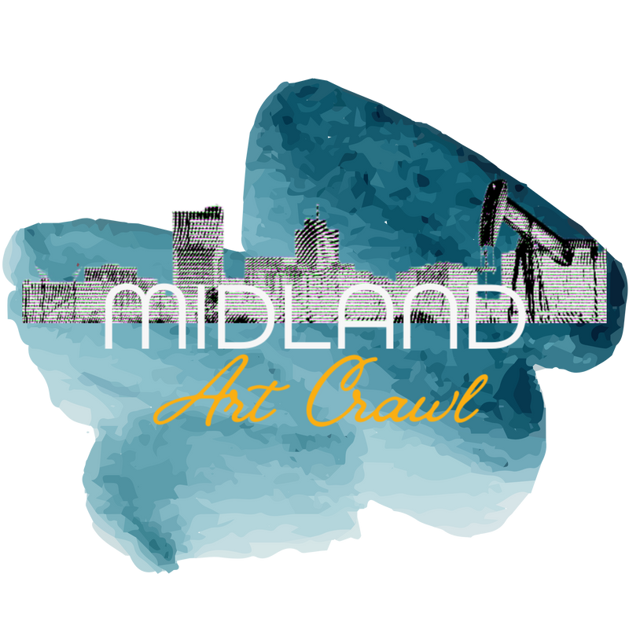
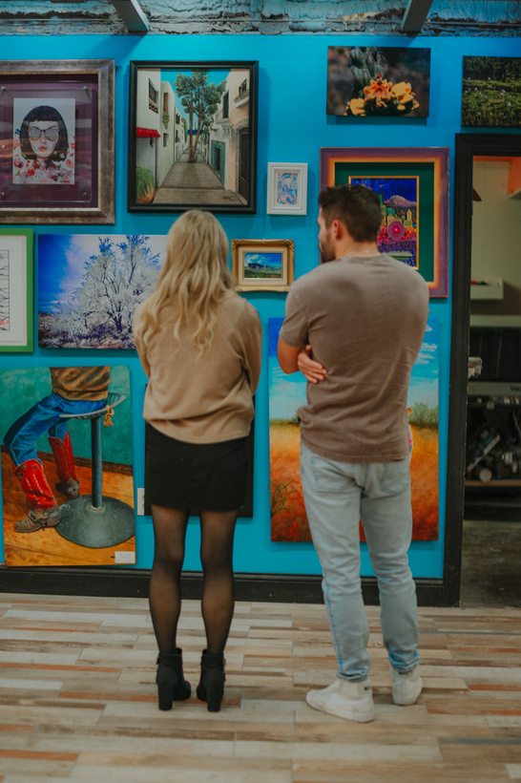
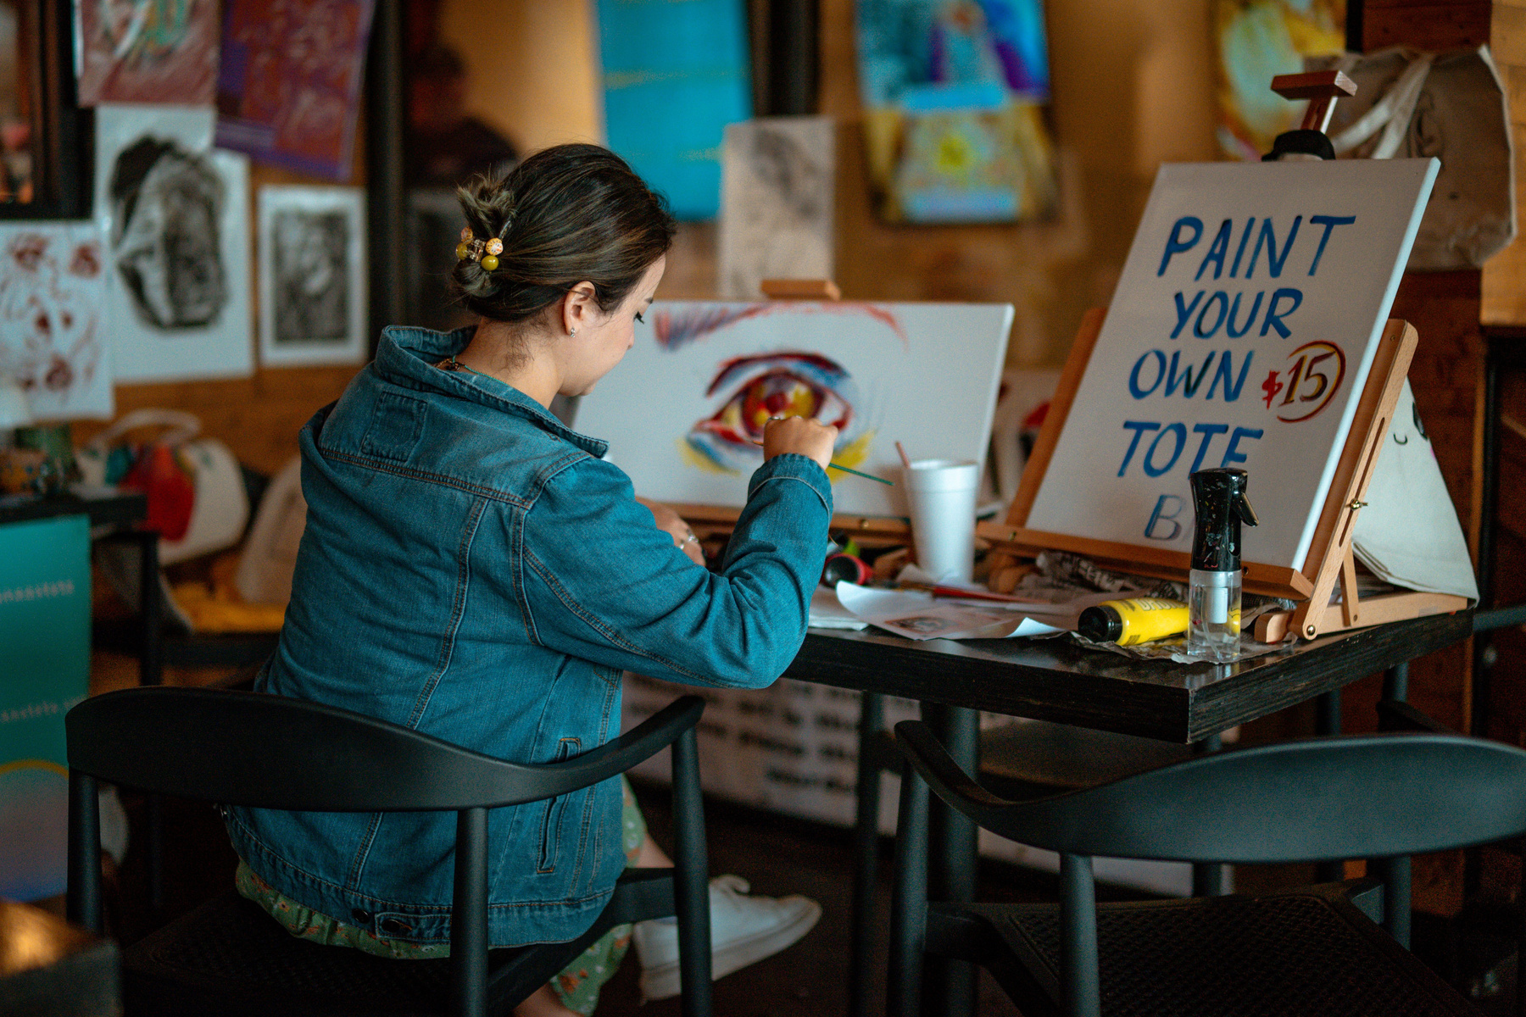
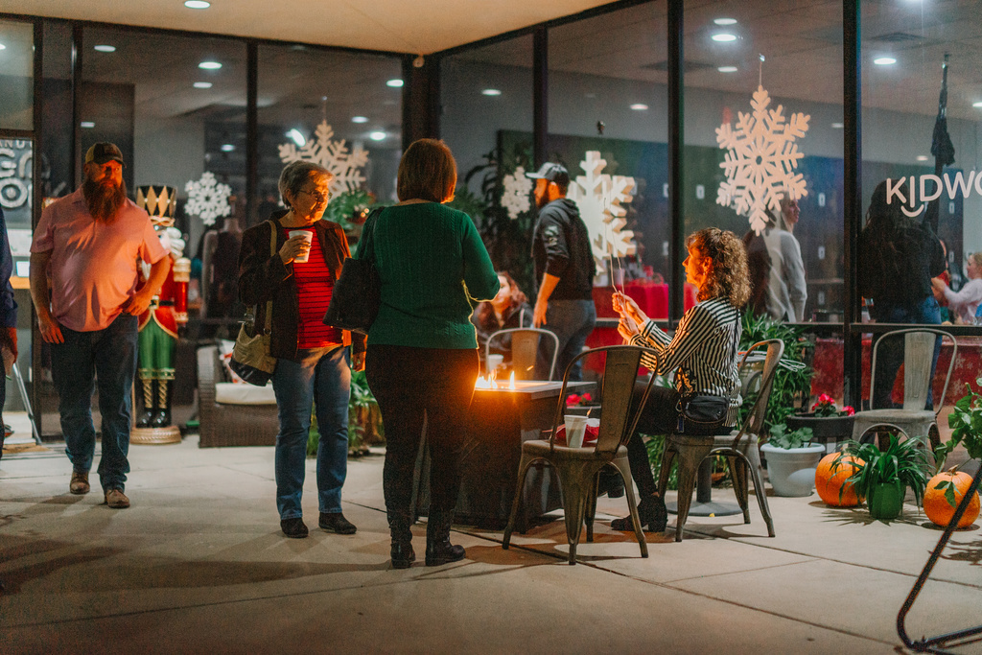
BUILDING COMMUNITY
Notes:
The Midland Art Crawl began as a program of Midland AF and was born out of a need expressed to us in the art community to have a program like the Lubbock Art Trail.
As with all things Midland AF, we put our own spin on it to not only provide a regular in-person quarterly art experience but also an online and offline community for local artists and art lovers alike. We incorporated partnerships with local businesses (most born out of past positive partnership experiences) and provided foot traffic to local businesses, an immersive in-person experience for attendees, and a platform for local artists to learn, grow, and make sales from their business.
We quickly grew to nearly 80 members in the first year or so.

Slide 11
02.
THE POWER OF COLLABORATION IN EVENTS

Slide 12
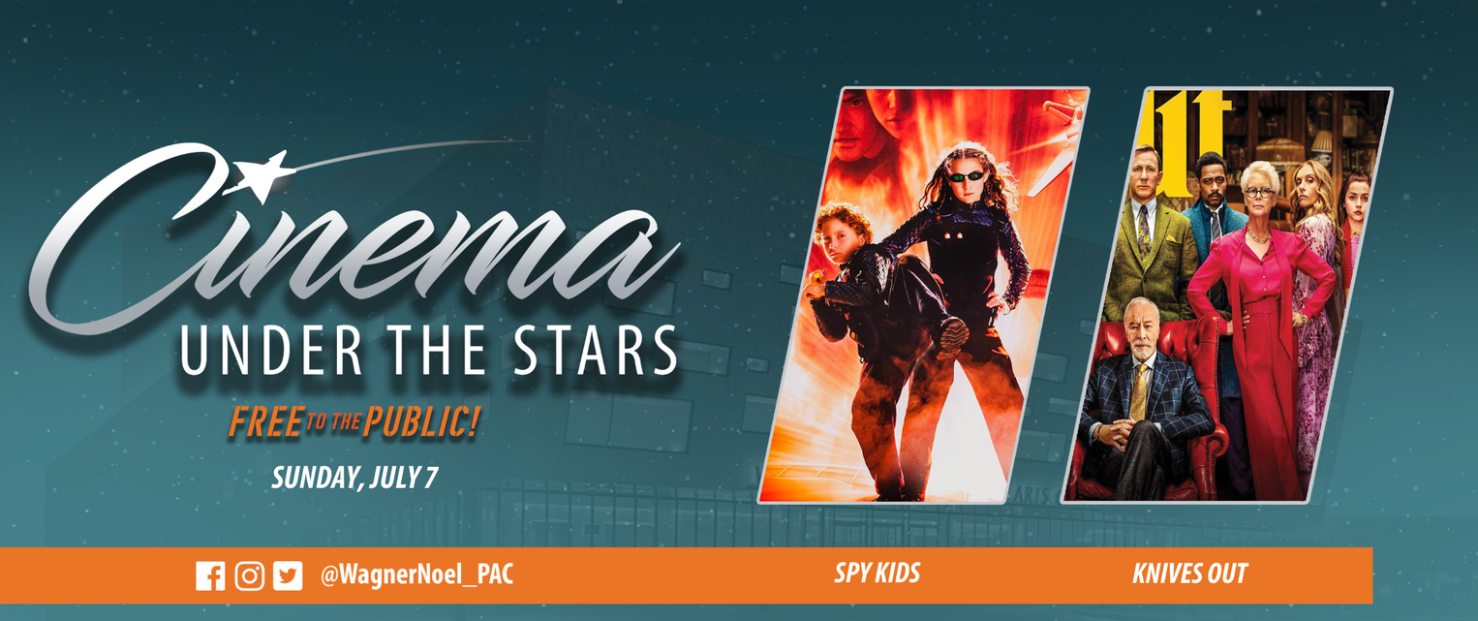
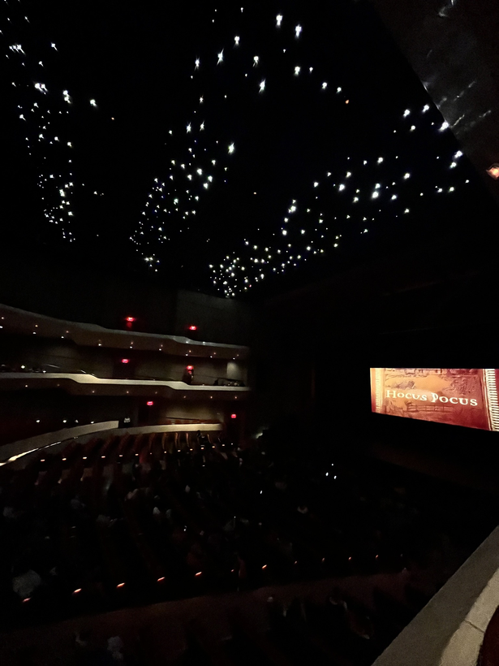
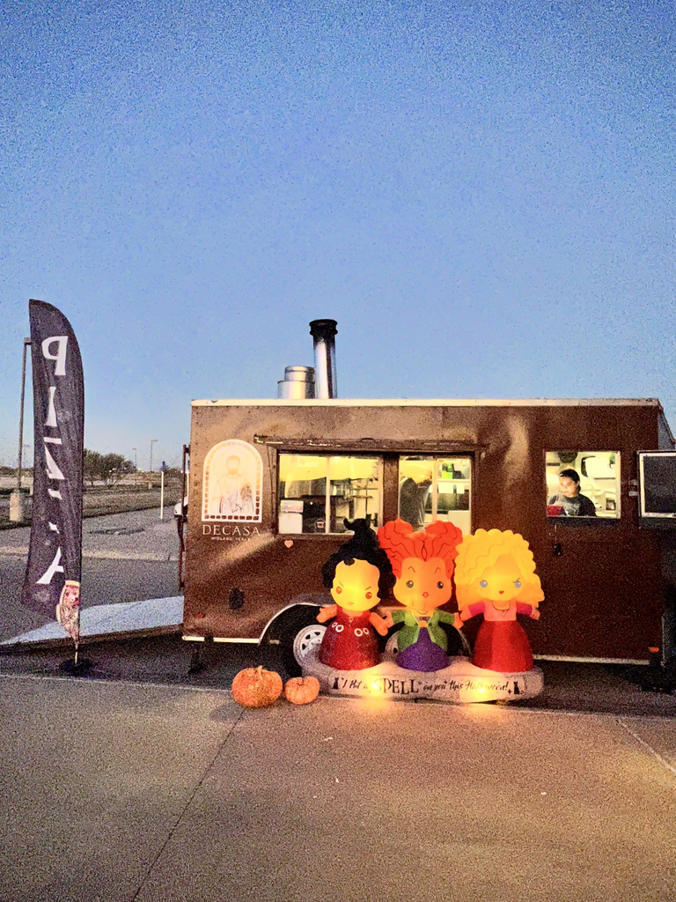
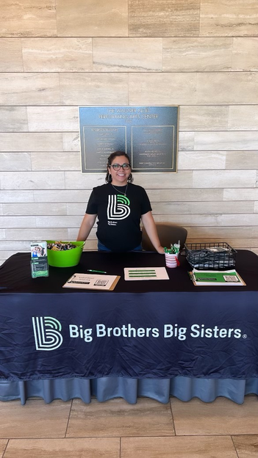
COLLABORATION
SUCCESS STORY

Slide 13

TYPES OF PARTNERSHIPS
IN KIND
More for nonprofits as a donation with a write-off. i.e. No-money exchanged.
PAID
You pay for product or service from a specific business because of your values
TRADE FOR EXPOSURE
COMBO
Partner provides value/product for exposure to your audience
Partial trade and paid partnership

Slide 14
FINDING EQUITABLE PARTNERS
  Value Alignment
  Win-Win Partnerships
  Vetting Collaborators
  Trusting Your Instincts
  Passion or Belief Based Considerations
Notes:
For me, finding equitable partners can be easily understood in looking at choosing a partner in life.
- Value Alignment: Emphasize the importance of aligning values, mission, and goals in collaboration for long-term success - not just now but into the future
Shared objectives, values, and on the same page. Match beliefs and priorities
Not create brand confusion in your choices. Will people think, I don't quite understand that match- does it make sense.
- Win-Win Partnerships: Do they give more than they take? Does everyone have mutaul benefit?
Tiff’s Treats partnership for cookie trade. This was not worth the time to support them despite knowing people were excited that they were testing the market.
- Vet Collaborators: Provide key considerations when evaluating potential partners—talking to others they have worked with, determining whether you can trust them, expectations of communication, shared vision. Look for signals that they may not be on the same page and make sure everything is transparent.
- Follow your Instincts
Even if they other things align, you might find yourself in a situation where the partnerships doesn’t feel right. Whether in a trade or paid partnership where the partner did not deliver on their promise or made unethical decisions that potentially reflected poorly on our brand.
"Successful collaborations thrive on give-and-take. Even when the immediate ROI may not seem balanced, being a supportive partner can pay dividends through referrals, credibility, and long-term relationships that can bring more to the table in the future.

Slide 15
"WHEN YOU COLLABORATE, YOU CREATE A COMPETITIVE ADVANTAGE BY LEVERAGING THE STRENGTHS OF OTHERS AS WELL AS YOUR OWN."
– STEVEN STOWELL
Notes:
In business, this means that partnerships allow you to overcome individual limitations and expand your capabilities. By combining your expertise with that of others, you don’t just add value—you multiply it. This creates a synergy where the whole is greater than the sum of its parts, giving you an edge that’s difficult for competitors to replicate. The result is a more dynamic, adaptive, and formidable presence in any industry or market.
In essence, collaboration isn’t just a choice; it’s a strategic tool that transforms potential into realized advantage, propelling teams and partnerships to achieve more than they ever could alone.

Slide 16
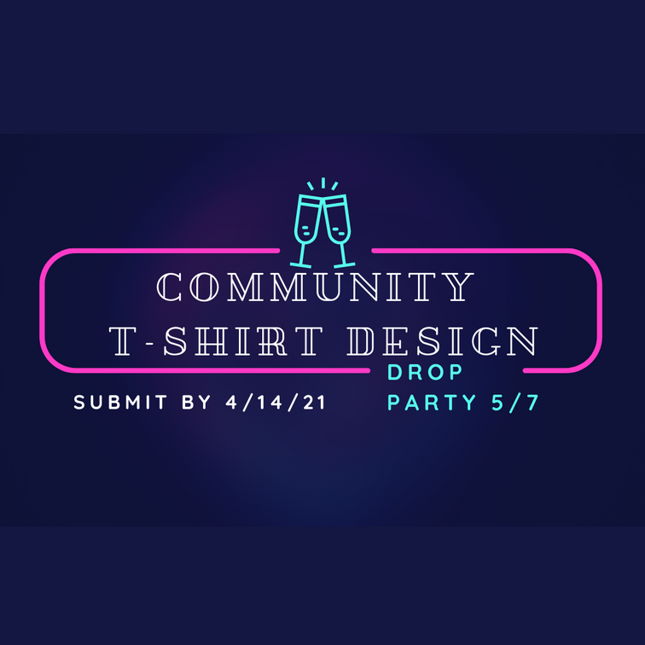
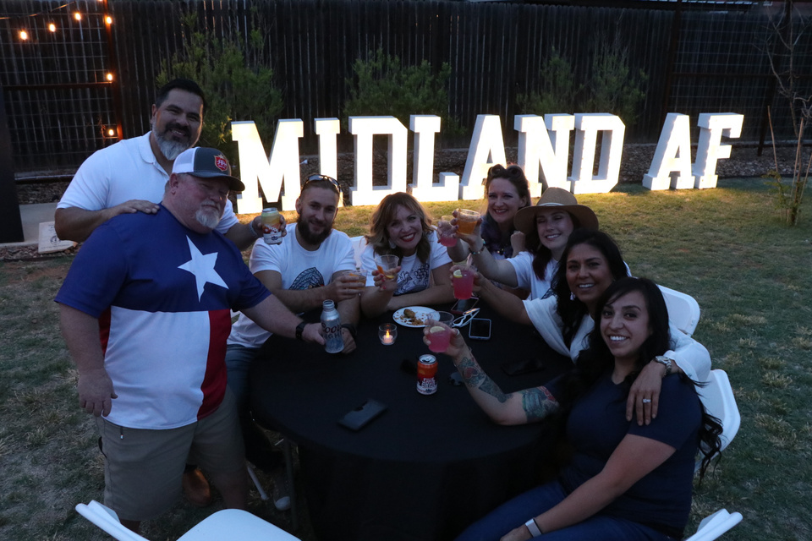
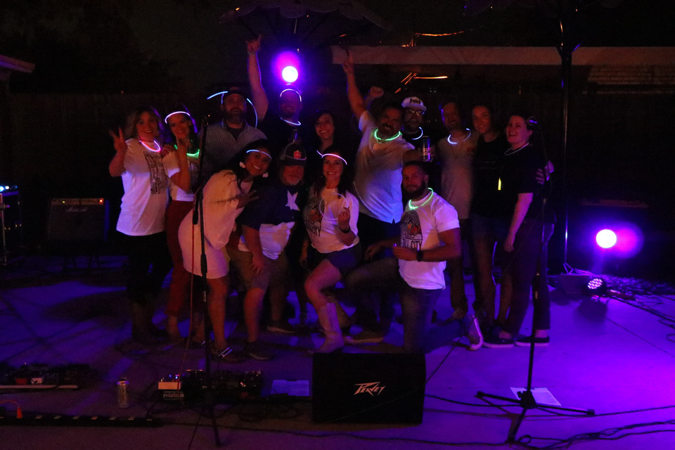
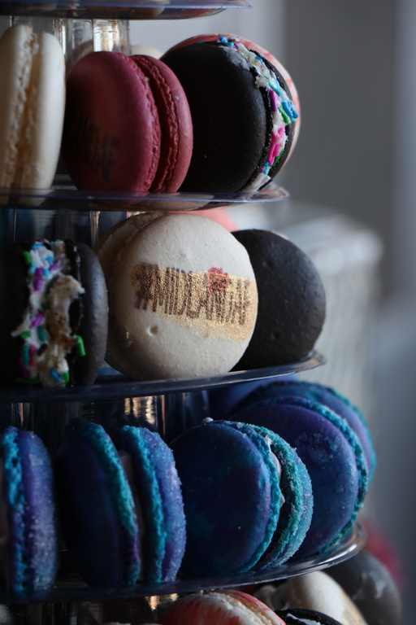
COLLABORATION SUCCESS STORY
Notes:
- Started as an annual t-shirt design contest. The Midland AF community wanted shirts and we wanted them to mean something.
- Locally printed shirts
- Drop party mainly in trade for exposure
- Treaty Oak Revival that Ginny put on my radar
- Venue
- Midland Macs
-Landmarq Letters
- Cody's Red Balloon
- Velvet Mesquite
- The Blue Door
- Local food vendor no trade
Making these purposeful outreach choices to enhance the event made a more memorable and multi-dimension experience while also giving exposure to local groups we wanted to partner with and felt passionate about.
Many of these relationship resulted regular collaboration.

Slide 17
03.
CREATING AN
EVENT BLUEPRINT
FOR SUCCESS

Slide 18



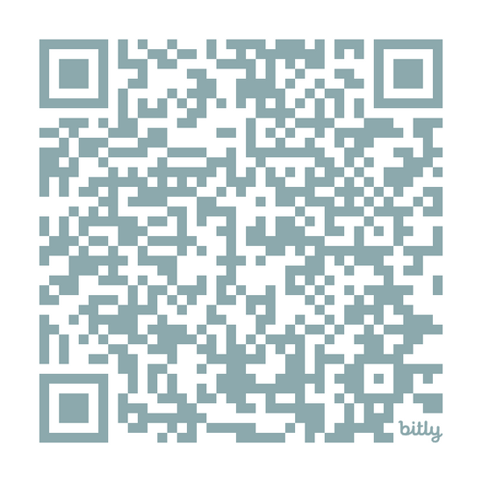
EVENT BLUEPRINT
Plan & Prep
Announce
Execute
Evaluate
FREE EVENT
MARKETING
CHECKLIST
Capture the Event Afterglow

Slide 19
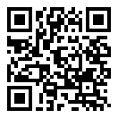
IDEAL COLLABORATORS
  Define your collaboration goals
  Make a list of complementary businesses
  Reach out and start a conversation
  Align goals and set clear expectation
  Promote collaboration together
FREE COLLAB
WORKSHEET

Slide 20
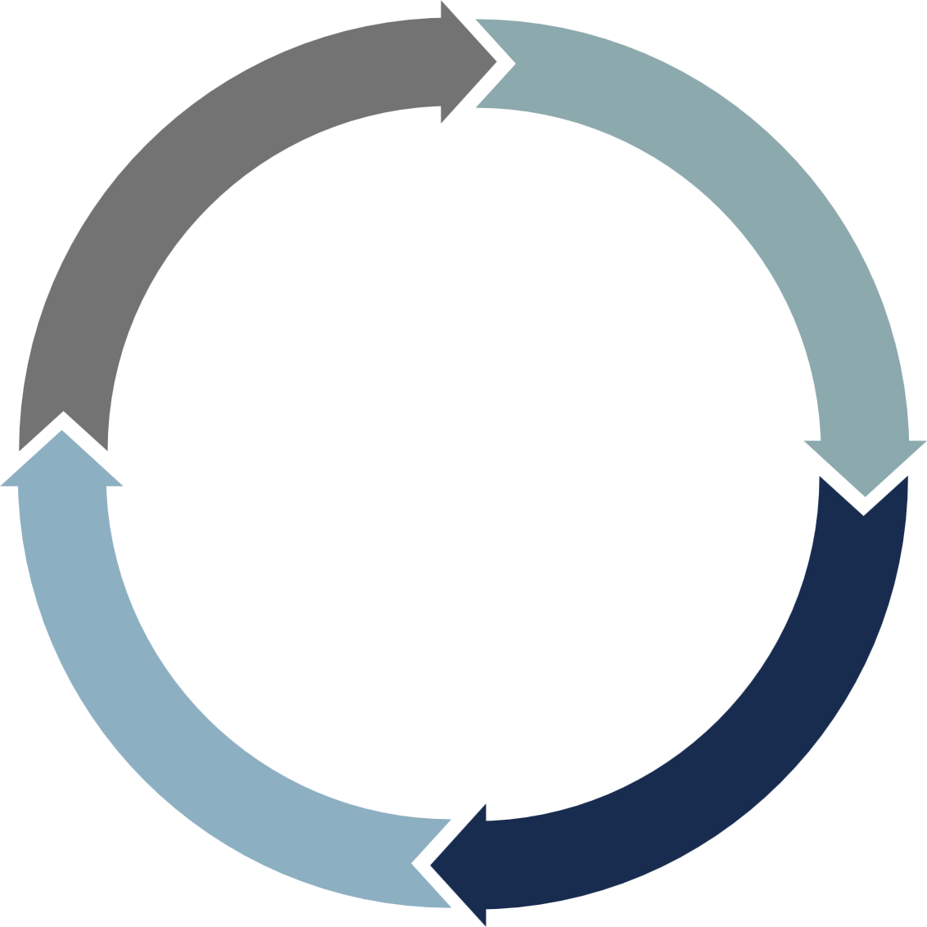

GOOD VS. BAD
Accountability
Delivery
Adaptability
Communication
Notes:
Coming back to the idea of your life partner, what makes a good match versus one we should avoid.

Slide 21
04.
FOSTERING
LONG-TERM GROWTH
BEYOND THE EVENT
Notes:
Ginny is going to give us all of the goods on how to foster long-term growth in these relationships

Slide 22

SUSTAINING RELATIONS BEYOND THE EVENT
  Thank you to the attendees
    Thank you email with a survey
    Share photos
    Ask what you want next:
      Leave a Review
      Become a member
      Get tickets to the next event
  Thank you to the partners
    Social media shoutout
    Physical thank you cards
    Recap with partners
  Plug and play future events

Slide 23
LEVERAGING PARTNERSHIP FOR BRAND GROWTH
  Internal & external recap of the event
  Communication is key
  Creating memorable partnerships/events
  Remaining top of mind in continuing to deliver an experience rather than a transaction
  Video to help the experience live on
Notes:
Once you've considered what you need to do foster long-term relationships and growth after that event or online/offline collaboration as Ginny has shared, you need to consider more how to leverage that partnership for brand growth.

Slide 24
"PEOPLE WILL FORGET WHAT YOU SAID, PEOPLE WILL FORGET WHAT YOU DID, BUT PEOPLE WILL NEVER FORGET HOW YOU MADE THEM FEEL."
— MAYA ANGELOU

Slide 25

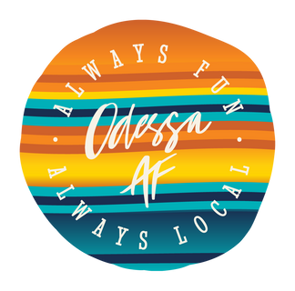





THANK YOU
Do you have any question?
ginny@backstageeventmarketing.com
www.backstageeventmarketing.com
stacy@midlandaf.com
www.mindlandaf.com

