Slide 1
COVID Secretariat
Yellowknife Chamber of Commerce
October 7, 2020

Slide 2
COVID Secretariat: Purpose
Supporting public health orders
  Chief Public Health Officer guidance
  Smooth implementation
Delivering strong response
  Improve communications
  Maintain our gains
  Improve upon what we have
Streamlining operations
  Improve operations
  Save costs

Slide 3
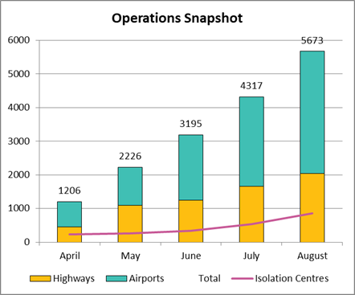
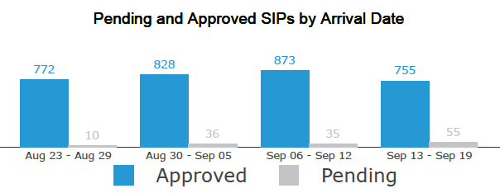
Supporting NWT Residents
Thousands of people have accessed services
Opportunities to improve and reduce costs

Slide 4
Supporting NWT Residents
Supporting communities
  Streamlining and improving services
  Enhanced public information and community engagement
Cost control and efficiencies
  Clear accountabilities
  Coordinated spending
Supporting health system
  Let health system focus on health and wellbeing
  Strong implementation of public health orders
Regular services to full capacity
  Services residents count on

Slide 5
Context: Early Response
COVID support services set-up at breakneck speed
All-hands-on-deck across public service
163 GNWT staff working on COVID-19 across government
  Full-time and part-time staff
GNWT staff redeployed doing multiple jobs

Slide 6
Context: Early Response
Function | Departmental Support
Highway Borders | MACA/EMO Infrastructure
Airport Officers | MACA/EMO
Enforcement | HSS Justice ENR Lands
Non-Health Personal Protective Equipment | MACA/EMO
Isolation Centres | MACA/EMO
ProtectNWT | HSS Redeployed staff
8-1-1 | HSS MACA Redeployed staff

Slide 7
COVID Secretariat Staffing
150 staff dedicated to the response
  Single organization, clear accountabilities
  Fewer staff, focused response
  131 frontline positions, total 10 new positions
  Term positions, no ongoing liability
  Other Departments can return to regular business

Slide 8
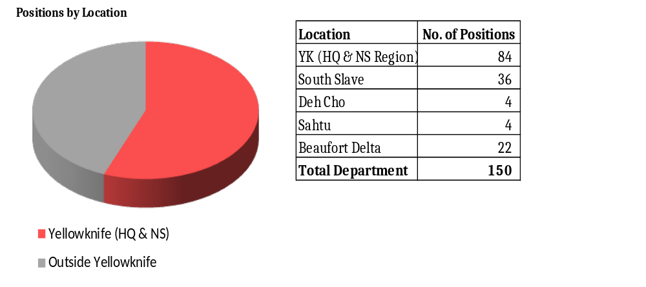
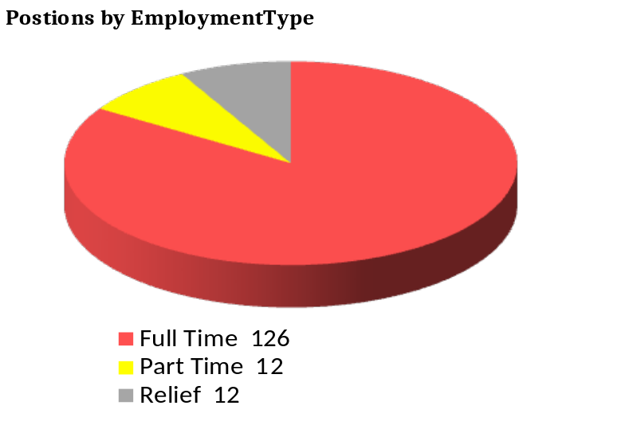
COVID Secretariat Staffing
*Total 10 new positions **131 frontline positions

Slide 9
New Money v. Existing Operations
Total new investment in 2020-21 = $2.7 million
New investments support ongoing operations

Slide 10
Investment By Activity

Slide 11
Cost Savings Opportunities
Maximizing federal contributions
    Some funding already received from federal government will support work of Secretariat
    Seeking additional investments to close the gap
Finding efficiencies
        Easier to control under single structure
        Identify cost-saving opportunities

Slide 12
Benefits for Business Sector
Improved pandemic services
  More seamless experience
  Getting information and support you need
Business opportunities
  Partnering with private sector to run services
Local procurement
  Personal Protective Equipment
  Services and contracting
Maintaining strong protections
  Maintaining stability will benefit business

Slide 13
Questions?

