Slide 1






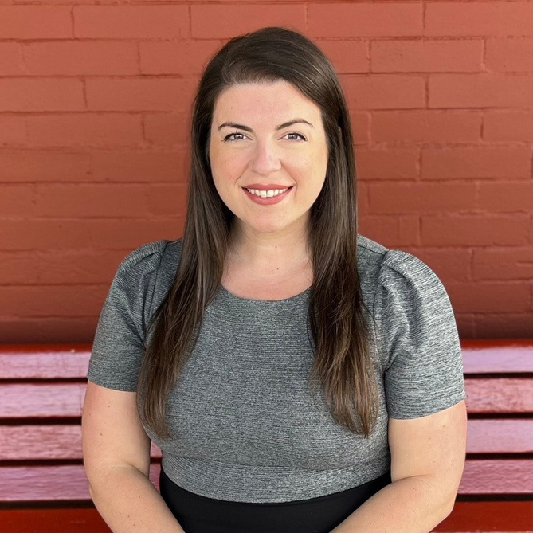



The Power of “Constructing” Your Own Pathway
Opportunities for Women in Trades
Ashley Hutson
Heavy Construction Contractors Association
www.hcca.net

Slide 2



Background
So your Dad is tradesman..
Bathroom Renovation Car Projects
Garage Transformation Multi-level Deck
An air compressor built into the outside of the house
What can you learn from him?
Framing Electrical Installation Drywall & Insallation
Introduction to Power Tools A sense of Accomplishment

Slide 3





Career Path
CNU Class of 2014
Branch Civil, Inc
HCCA
Degree in Spanish Minor in Communication
First “Real Job”
Director of Member Engagement

Slide 4



So many roles are filled by women!
Accounting
Payroll
Business Development
Operations
Human Resources
In 2014, Women represented only 7.5% of the construction industry

Slide 5
In 2024, Women make up 11% of the construction industry
Project Engineer
Scheduling Engineer
Heavy Equipment Operator
Foreman
Executive
More roles are being filled by women!

Slide 6






Construction Career Path
Laborer/Helper/Maintenance of Traffic
Shovels, brooms, stop/slow panel, a hand to help out $16-$18/hour + benefits
Equipment Operator
Operators start in small machines and work into bigger machines with proficiency $20-$27/hour + benefits
Foreman/Crew Leader
Plan reading & execution, leading a task-specific crew $30-$40/hour + benefits
Superintendent
Manage and oversee progress of the people and production on the jobsite and coordinate with Project Manager $70,000-$150,000/year + benefits
Project Manager
Plan and oversee progress of a project and coordinate with Superintendent $70,000-$150,000+/year + benefits

Slide 7



Benefits of
Construction Careers
The construction industry has some of the best, brightest, yet most laid-back, and casual people around. While at work, they are contributing to the future of their community through infrastructure development.
Teamwork
Construct the Community
Career Growth
Unique Insights

Slide 8

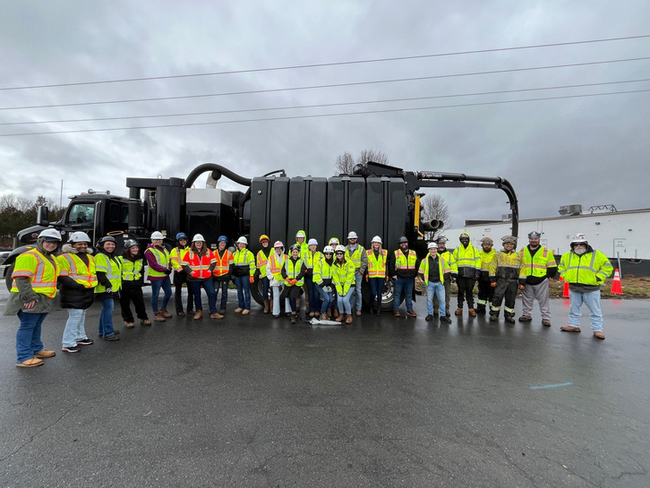
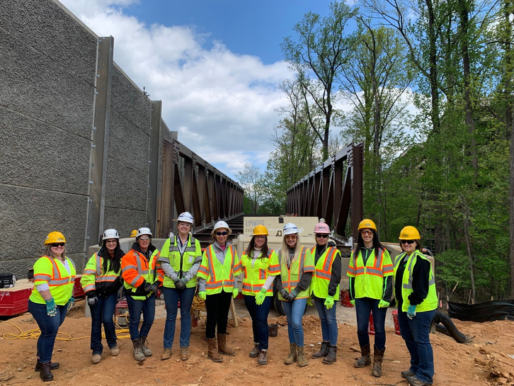

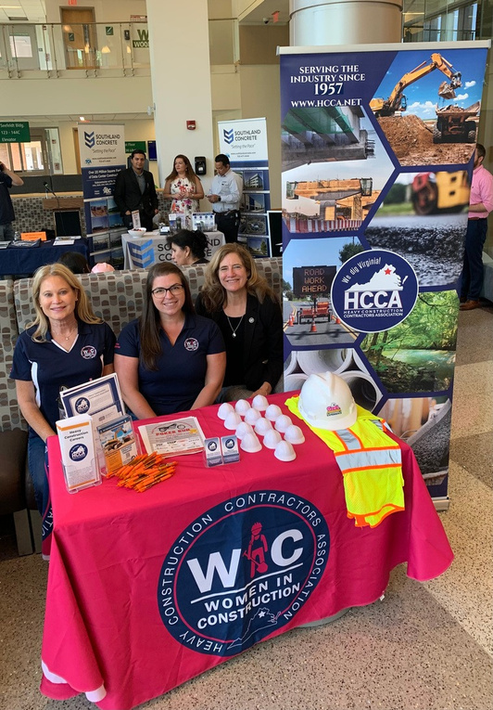
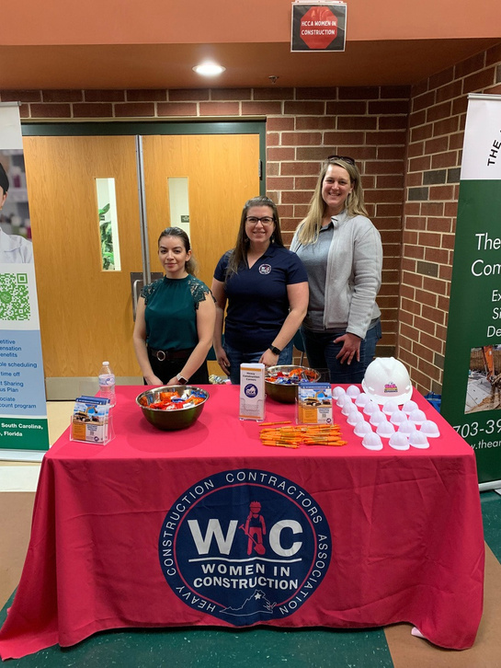
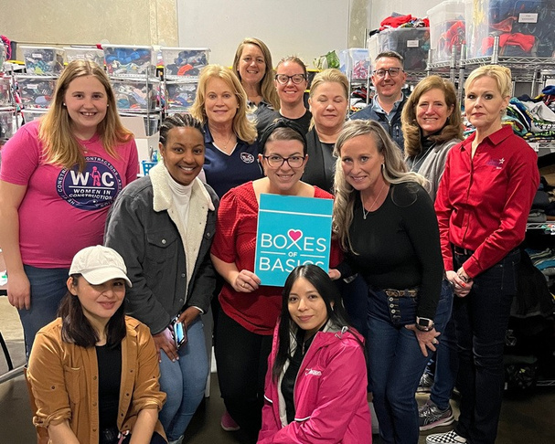
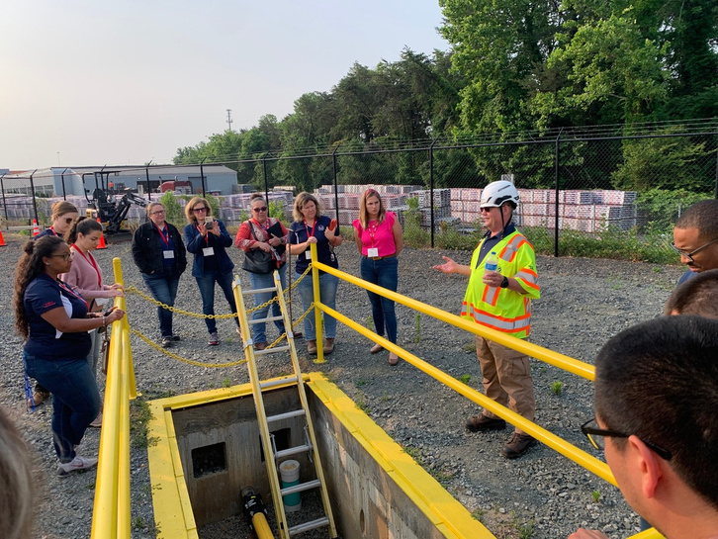
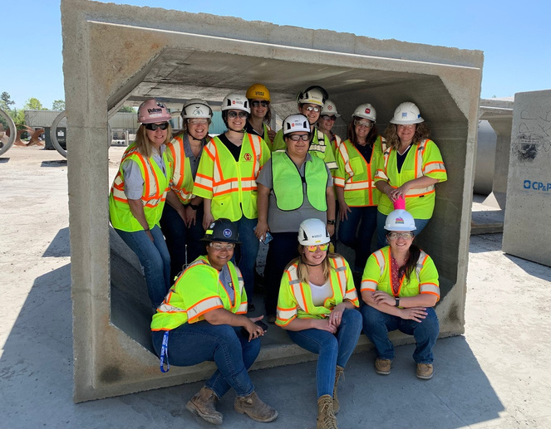
HCCA Women in Construction
Volunteer, Educate, Grow

Slide 9



Whatever pathway you construct..
Be proud of what you do.

