Slide 1

DISCOVER YOUR STRENGTHS & INTERESTS AT THE
CAREER EXPO
October 19th & 20th

Slide 2
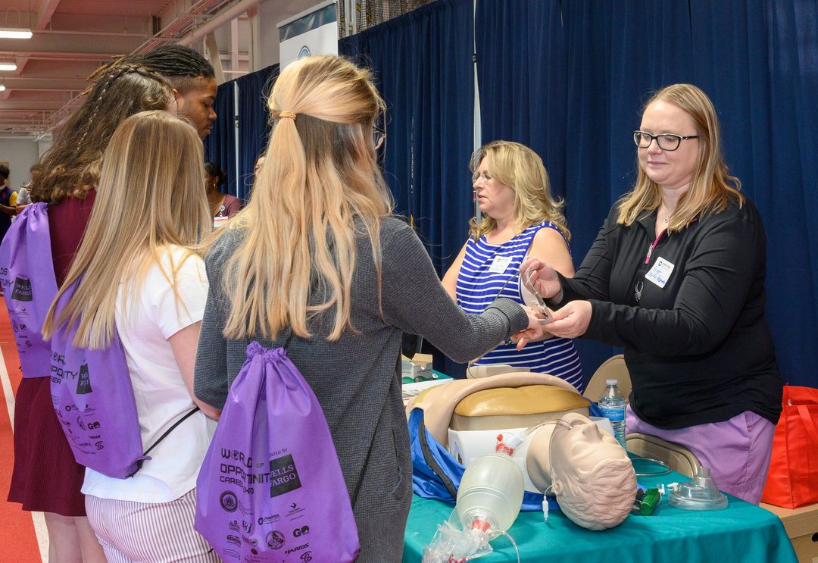

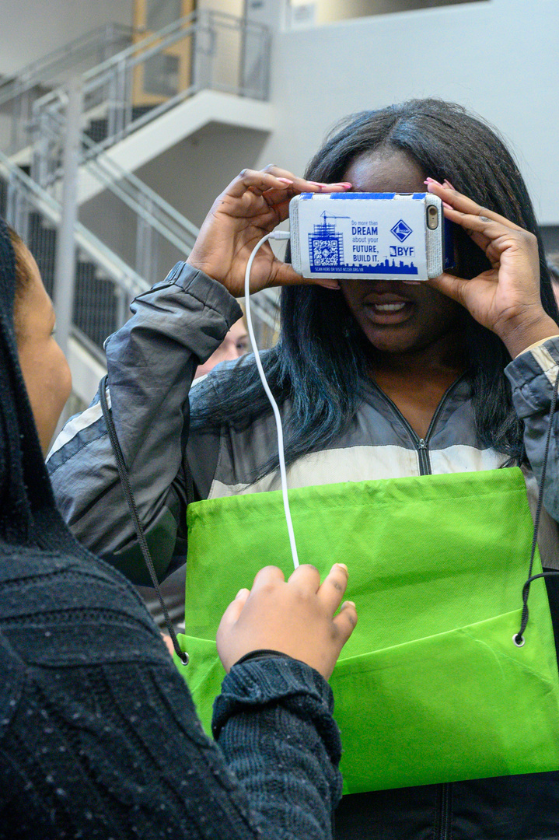
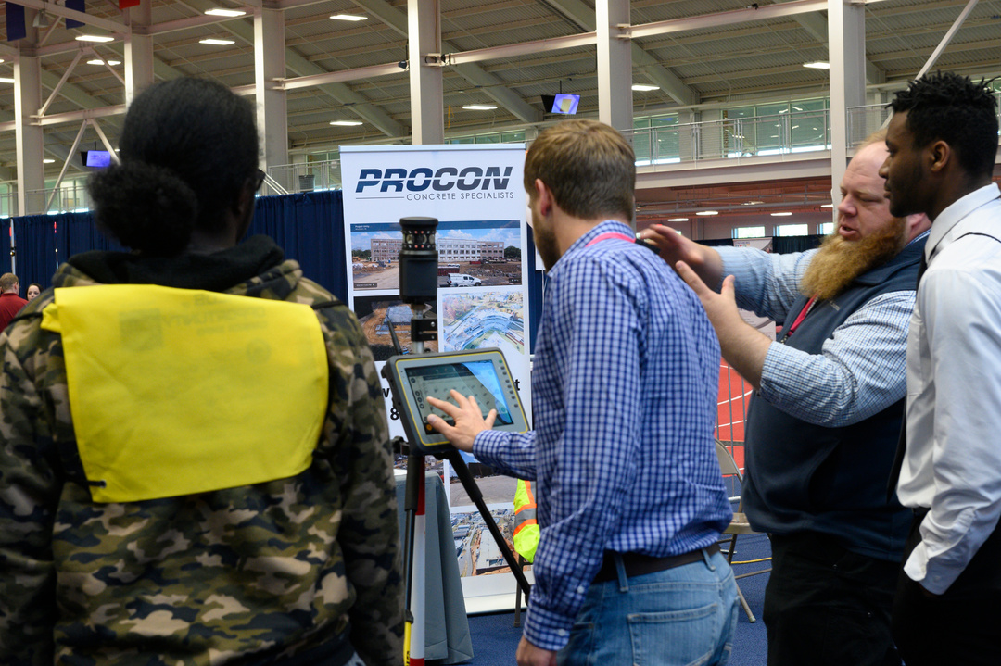
What You’ll See
Businesses in our region will set up a booth or display to show you what they do and allow you to ask questions about careers.

Slide 3

Why
Us?
Now is the Time
to begin exploring careers for your future
You’ll be traveling to four zones, which are identified as potential career pathways to jobs in our area. Each zone will provide hands-on demonstrations and interactive activities to create a relevant job awareness.

Slide 4
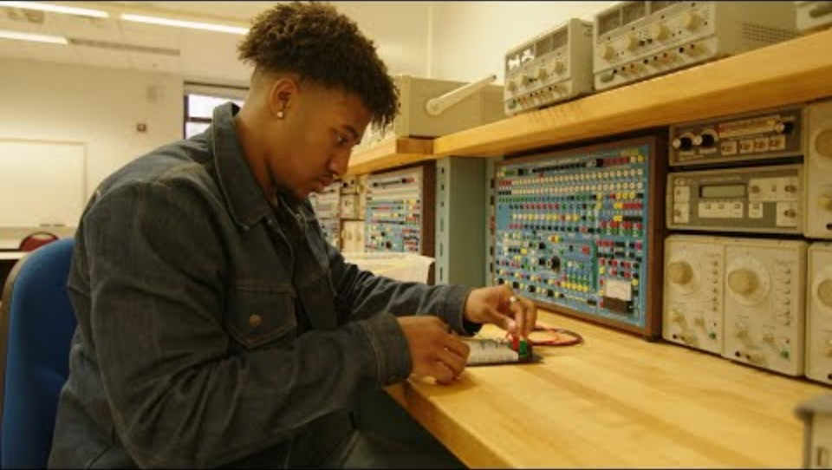
Zone 1
Transportation, Energy/Utilities, Construction

Slide 5
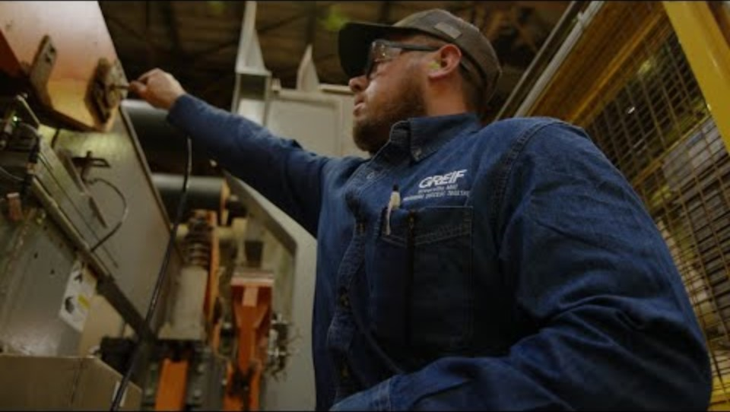
Zone 2
Manufacturing, Automotive/Logistics, Engineering/Environment

Slide 6
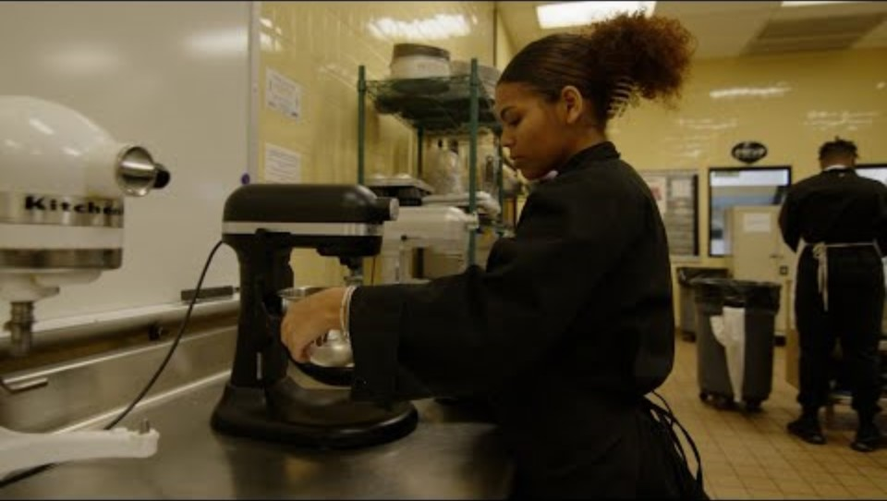
Zone 3
Agriculture, Hospitality/Tourism, Human Services, Public Safety

Slide 7
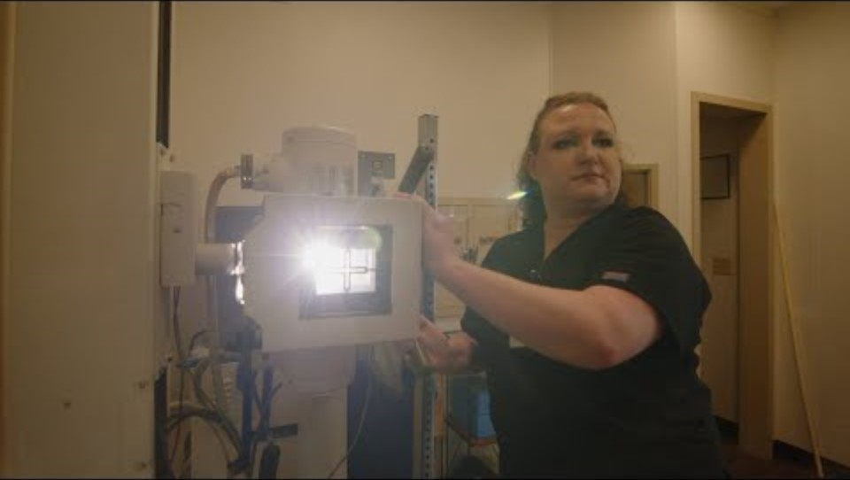
Zone 4
Healthcare/Medical, Technology, Business & Professional Services, Education

Slide 8
Good Questions
Your Possible Question
  How much money do you make?
  Why would I want your job?
  Do I have to go to college?
  How much vacation do I get?
  How do I get a job at your company?
  How do I get experience without a job?

Slide 9
Good Questions
Your Possible Question
A Better Way to Ask the Same Question
  How much money do you make?
  Why would I want your job?
  Do I have to go to college?
  How much vacation do I get?
  How do I get a job at your company?
  How do I get experience without a job?
  What is the average starting salary for your job?
  What do you like most about your career?
  What type of training is required?
  What benefits are offered by your company?
  What can I do to make myself more employable?
  Do you offer internships or apprenticeships?

Slide 10

Good Questions
Your Possible Question
A Better Way to Ask the Same Question
  How much money do you make?
  Why would I want your job?
  Do I have to go to college?
  How much vacation do I get?
  How do I get a job at your company?
  How do I get experience without a job?
  What is the average starting salary for your job?
  What do you like most about your career?
  What type of training is required?
  What benefits are offered by your company?
  What can I do to make myself more employable?
  Do you offer internships or apprenticeships?
What else might I want to know?

Slide 11
On the Field
Trip
1.Represent yourself well (could be a future job opportunity).
2.Be polite (please and thank you).
3.Stay with your group/zone.
4.Stay engaged (ask good questions).
5.Thank the presenters.
6.Walk, don’t run.
7.Keep hands to yourself. No rough-housing.
8. Dress Appropriately for the weather. Half the expo is outside!!

Slide 12


Do you have questions?

