Slide 1
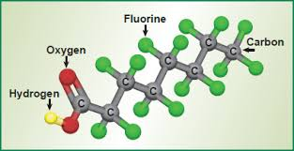
PFAS And Other Update
Pleasanton Chamber of Commerce
Economic and Development Relations Committee
April 28, 2020

Slide 2
Presenters
Dan McIntyre, General Manager, Dublin San Ramon Services District
Valerie Pryor, General Manager, Zone 7 Water Agency
Kathleen Yurchak, Director of Operations and Water Utilities, City of Pleasanton

Slide 3
COVID-19
Your water is safe to drink and use
The EPA recommends that you continue to drink and use your water
Treatment methods kill viruses
DSRSD, Pleasanton and Zone 7 have taken steps to protect employees and maintain operations

Slide 4
Presentation Outline
Zone 7
About PFAS
Regulatory Guidelines – Current and Upcoming
Treatment Options
Zone 7 Results and Actions Taken
Upcoming Zone 7 Activities
Pleasanton
Pleasanton Results
Public Notifications
Actions – Near-term and Long-term

Slide 5
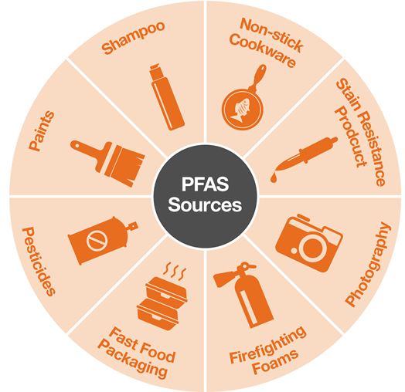
What are PFAS?
Per-FluoroAlkyl and
Poly-FluoroAlkyl Substances
A large family of man-made compounds used in a wide-range of products designed to be waterproof, stain‑resistant, non‑stick, or fire retardant since 1940s
C-F is the shortest and strongest bond in chemistry
Notes:
The abbreviation PFAS comes from Per and poly FluoroAlkyl Substances.
These are a large family of manmade chemicals and are defined by the presence of one or several carbon-fluorine (C-F) bonds, which is the strongest chemical bond in nature.

Slide 6
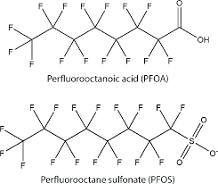
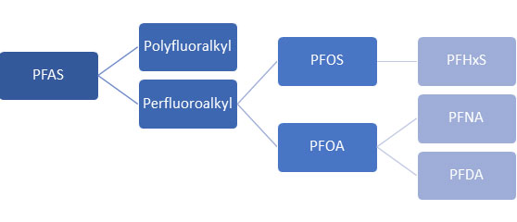
What are PFAS?
PFAS represent >6,300 organofluorine compounds categorized by “long-chain” & “short-chain”
PFOS and PFOA are “long-chain” (C8 = 8 C-F bonds = octane)
GenX is a “short-chain” replacement for PFOA
Notes:
over 6,300 different PFAS may have been manufactured & used in a variety of products…
They can be categorized as “long-chain” vs “short-chain”
PFOS & PFOA are the most well-known “long-chain” (C8) PFAS
C8 = 8 C-F bonds
GenX is short-chain

Slide 7
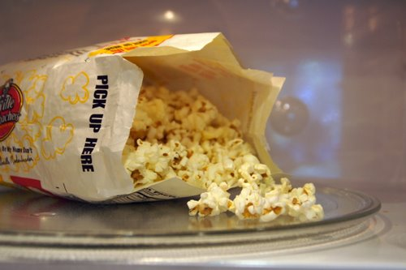
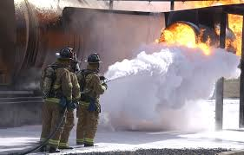
PFAS occurrence is common
Food Packaging →PFOA ←Teflon
AFFF → PFOS ← Scotchgard
Notes:
Examples:
PFOA is the main ingredient in DuPont’s Teflon and many food package materials.
PFOS is the main ingredient in 3M’s Scotchgard and a Class B fire fight foam called “AFFF (A-Triple F)”
- AFFF was first developed by the Navy and the 3M Company to put out jet fuel fires in the 1960s. Since then, it has been used on hundreds of military bases & FAA-regulated airports around the country. However, due to PFAS contamination found in groundwater supplies of hundreds of military bases, the U.S. Department of Defense is currently in the process of replacing it with a newer formulation containing PFAS with shorter C-F bonds (C6), and is actively working on developing fluorine-free alternatives.

Slide 8
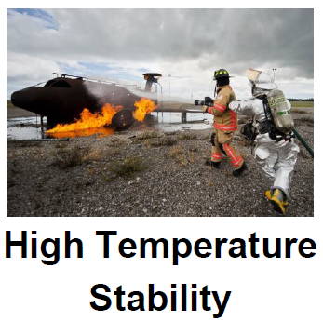
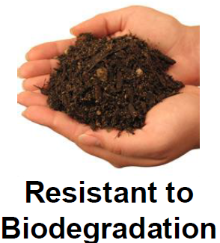
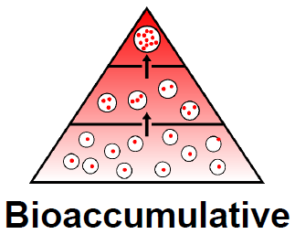
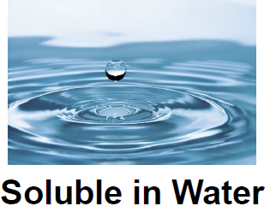
Why are we concerned abut PFAS?
Ubiquitous – clothes, food, water, air, soil, even in human and animal blood samples
Persistent (Forever Chemicals) – extremely stable, do not break down easily, challenging to treat
Potential adverse health effects to developing fetus/infants, immune system, liver, and possible cancers (e.g., testicular, kidney)
Unregulated Emerging Contaminant of Concern (CECs) in Drinking Water
- Widespread contamination in all types of water supplies
- Tend to accumulate in groundwater
- Mobile in groundwater
Notes:
Ubiquitous - because they are used in so many consumer products and industries, they are found everywhere…
Persistent - Some experts call them “forever chemicals” because some PFAS are extremely stable & do not break down in the environment (PFOA half-life ~90 in the environment).
- Therefore, challenging to treat which we will discuss later…
Health Effects - Research is still in the initial stages, but there is concern that some PFAS may have adverse health effects particularly because of their ability to bio-accumulate in body (PFOA/PFOS half-life ~2-6 yrs, medium ~3 yrs in human body).
Some are possible carcinogens (testicular, kidney, etc.)
PFAS are currently not regulated in CA and are CECs in drinking water
Through recent years’ monitoring efforts, we have found widespread contamination in all types of drinking water supplies. In the east coast where many manufacturing facilities are located, high concentrations have been found in rivers and groundwater basins. Also, since AFFF is the required use of fire fighting foams, high concentrations have been bound in hundreds of military bases throughout US.
They tend to accumulate in GW and quite mobile

Slide 9
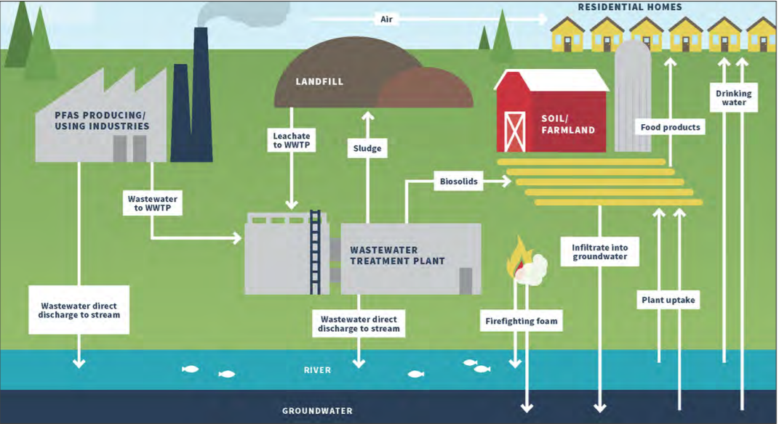
Major Sources of PFAS in Drinking Water
Primary Industrial Manufacturing – 3M, DuPont, etc.
Secondary Industrial Manufacturing – paper, chrome-plating, etc.
AFFF - Military sites, airports, refineries, fire training/response sites
Waste management units – landfills, wastewater treatment plants (WWTPs), biosolids, etc.

Slide 10
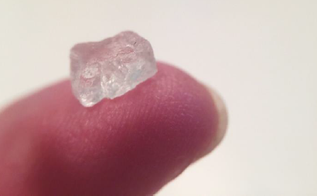
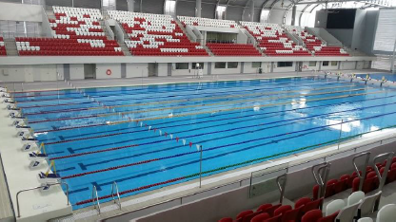
FEDERAL REGULATORY GUIDANCE
In 2016 EPA Issued lifetime health advisories in drinking water
70 parts per trillion (ppt) for PFOA and PFOS, either singly or combined
Moving Forward
PFAS monitoring in next Unregulated Contaminant Monitoring Rule (UCMR 5)
Anticipating proposal in summer 2020 and final rule by late 2021
Monitoring ~2022 - 2026
PFOA/PFOS MCLs
Anticipating proposal in ~2 yrs and final MCLs in ~4 yrs;
Other PFAS MCLs
Under evaluation
1 Parts per trillion (ppt) = 1 grain of salt in an Olympic-size pool
Notes:
1) EPA issued life time Health advisory – May 2016. EPA's health advisories are non-enforceable and non-regulatory.
2) EPA – intends to establish a drinking water legal limit i.e. MCL; EPA announced on 2/20/20 that it is making preliminary determinations to regulate PFOS and PFOA in drinking water. EPA’s decision to regulate PFAS kicks off a 2-yr period for the agency to determine what the new mandatory MCL should be. Once that is formally proposed, EPA has another 18 months to finalize its MCL. Other PFAS MCLs are also under evaluation.
Additional Info:
What is a Health Advisory – EPA’s Health advisories provide information on contaminants that can cause human health effects and are known or anticipated to occur in drinking water. EPA's health advisories are non-enforceable and non-regulatory and provide technical information to state agencies and other public health officials on health effects, analytical methodologies, and treatment technologies associated with drinking water contamination. EPA’s health advisory level for PFOA and PFOS offers a margin of protection for all Americans throughout their life from adverse health effects resulting from exposure to PFOA and PFOS in drinking water.
1 part per trillion (ppt) is equivalent to one drop of water in 20 olympic-sized swimming pools.

Slide 11
Current State Regulations
State Water Board issued guidance
Notification level (NL) - August 2019
PFOA = 5.1 ppt
PFOS = 6.5 ppt
Response level (RL) - February 2020
PFOA = 10 ppt
PFOS = 40 ppt
AB 756 - Effective January 1, 2020
Authorizes Water Board to order additional PFAS monitoring as needed;
If detect any PFAS under AB 756 order, additional notification and response would be required;
Notes:
NL – Non-regulatory health based advisory levels. May be considered for MCL development. Blood levels > 100 times RL.
Previous RL was 70 ppt combined for PFOA & PFOS;
Note that monitoring conducted under previous DDW orders or voluntary monitoring of PFAS are not required to comply with AB 756. Only monitoring conducted pursuant to an order issued under the authority of AB 756 shall establish data & results that triggers the AB 756 reporting requirements.

Slide 12
Upcoming State Regulatory Activities
Release draft Public Health Goals (PHGs) for PFOA/PFOS ~ by the end of 2020
Complete State-wide PFAS source investigation – by the end of 2020
Propose draft Maximum Contaminant Levels (MCLs) for PFOA/PFOS ~ Summer 2022
Adopt final MCLs for PFOA/PFOS ~ Fall 2023
Other PFAS – under evaluation
Notes:
NL – Nonregulatory health based advisory levels. May be considered for MCL development. Blood levels > 100 times RL.

Slide 13
Zone 7 Activities – Source and Treated Water Monitoring
Proactively monitored for 6 PFAS at representative sources in 2013
None detected;
Method Reporting Limits (MRLs) were much higher than current method (~10-45x higher).
Proactively monitored for 14 PFAS at all sources (Nov ‘18 – Jan ‘19)
PFOA & PFOS MRLs are much lower (2 ppt);
PFOA & PFOS detected at some groundwater wells (COL, Mocho & Stoneridge)
PFOA & PFOS not detected in surface water supplies & Hopyard wells
Other PFAS detected, but no regulatory guidelines available
Completed 4 quarters of monitoring (18 PFAS) per State Order in 2019 – All treated water samples below RLs;
Plan to continue voluntary sampling in treated water samples.
Notes:
Zone 7 has been proactive in monitoring for PFAS in our supplies.
Zone 7 was not required to do UCMR3, but followed monitoring protocols
UCMR3 MRL - [20 ppt PFOA; 40 ppt PFOS]

Slide 14
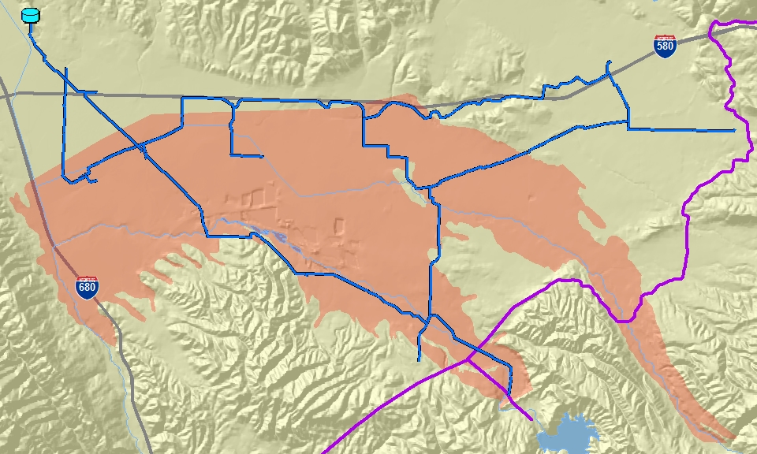
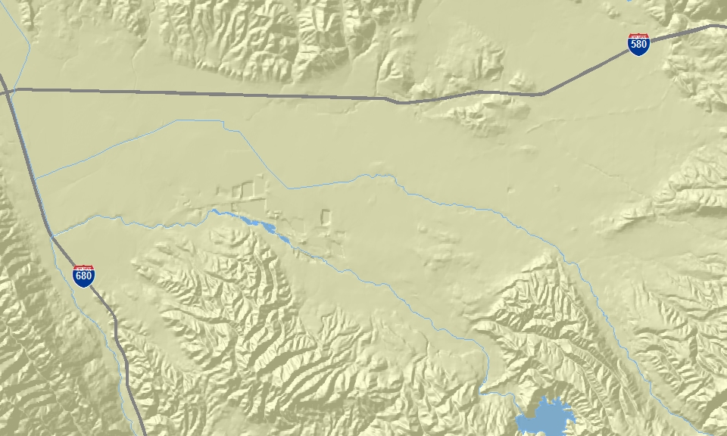
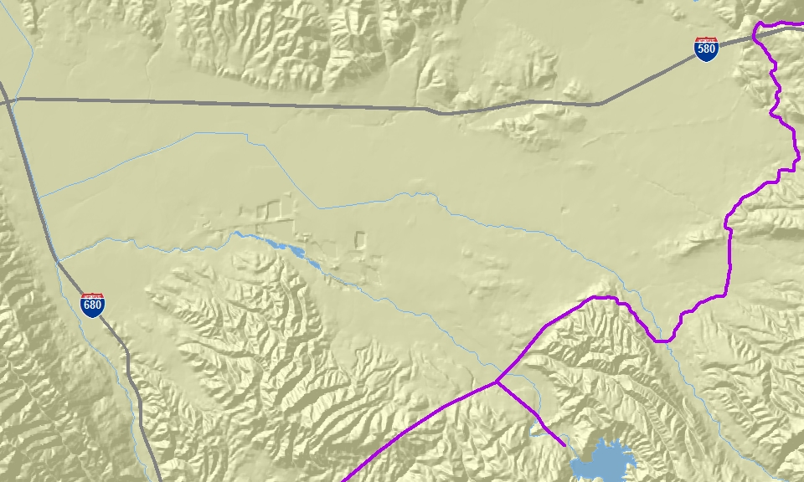
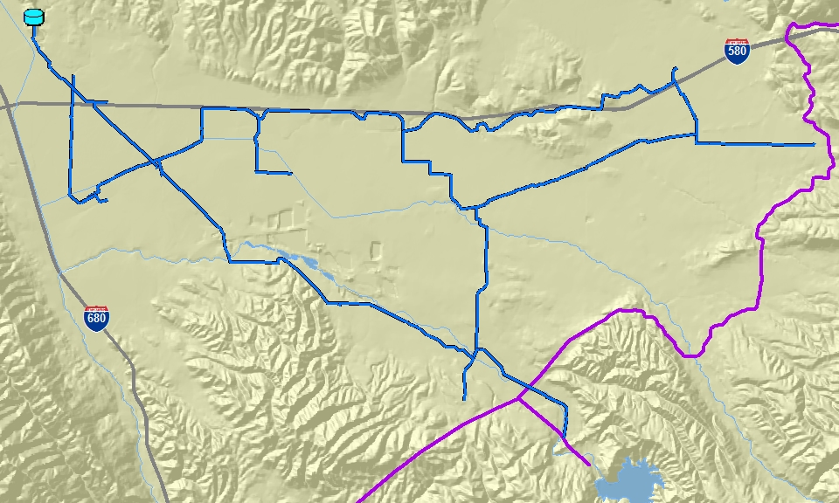
Zone 7 Water System
Dougherty
Reservoir
Stoneridge Well
Transmission Mains
PP WTP
12 mgd
WELLS
43 mgd
Arroyos
Chain-of-Lakes Wells 1, 2 & 5
Hopyard Well No. 6 & 9
GW Basin
SBA
Mocho Well 1 -4 & MGDP
DV WTP
40 mgd
Two Major Supply Sources:
Surface Water (~80%) from Plants
Groundwater (~20%) from 10 Wells
Lake
Del Valle
Notes:
Good news – No PFAS detected in surface water and Hopyard wellfield

Slide 15
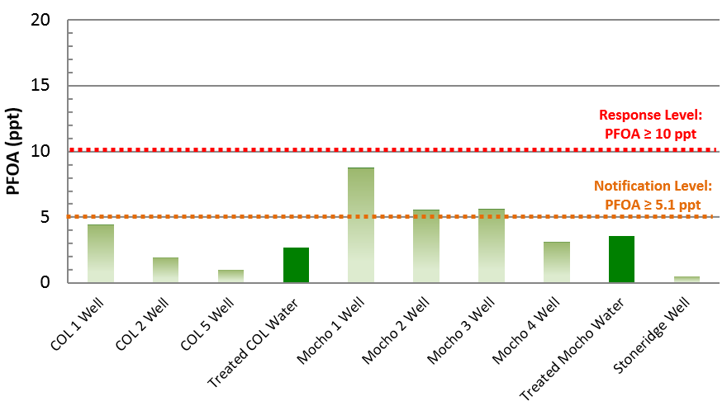
PFOA 2019 Quarterly Averages
Notes:
Although the quarterly average concentrations showed only 3 wells > PFOA NL, COL1 also had exceeded NL in one quarter;
Note that Mocho wells are treated/blended at Mocho Groundwater Demineralization Plant (MGDP). So, we collected samples at the plant’s finished water.
Also, COL wells are blended before our first customer, so we collected samples at the El Charro Pipeline which represents the blended COL wells.

Slide 16
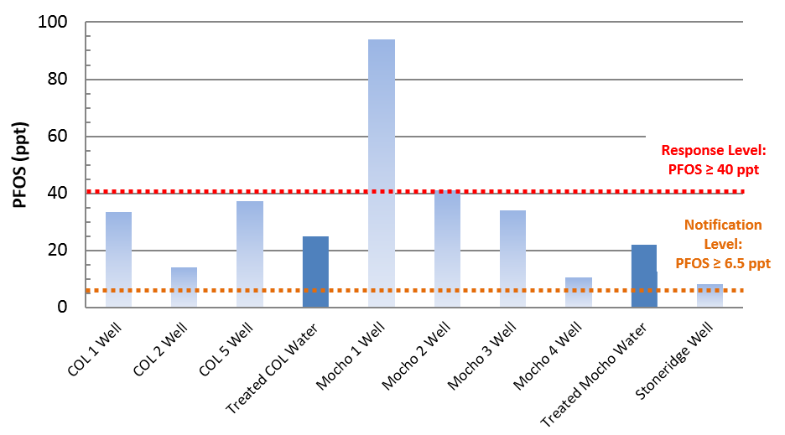
PFOS 2019 Quarterly Averages
Notes:
8 wells > PFOS NL: all 3 COL wells, all 4 Mocho wells & the Stoneridge well.
2 wells (Mocho 1 & 2) > PFOS RL, but Treated < RL (MGDP_FW)
Again, we collected samples at El Charro PL for the blended COL well sample & MGDP’s finished water for the treated/blended Mocho well sample.
Note that Mocho 1 has not been operated much for the last few years due to high levels of sand & silt:
- Mocho 1 Deliveries in 2019 were 16.6 MG,~100 hours run time
- Mocho 1 Deliveries in 2018 were 59.9 MG, ~384 hours run time
- Mocho 1 Deliveries in 2017 were 2.9 MG, ~19 hours run time
- Mocho 1 Deliveries in 2016 were 8.5 MG, ~55 hours run time

Slide 17
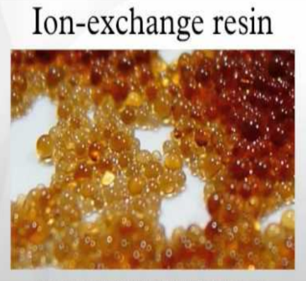
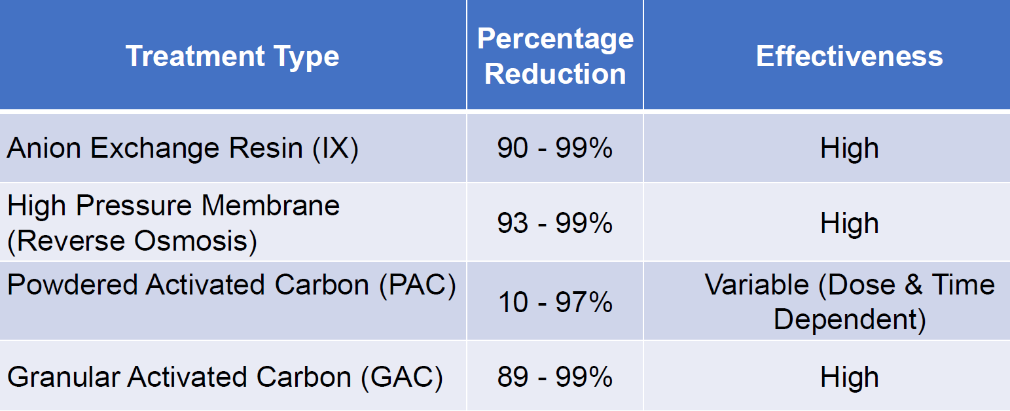
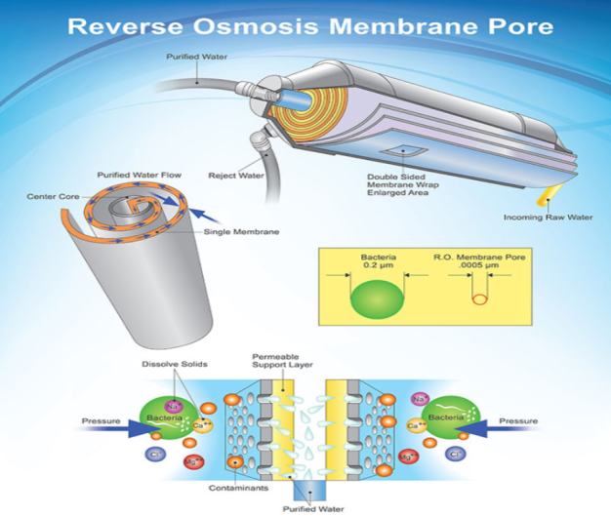
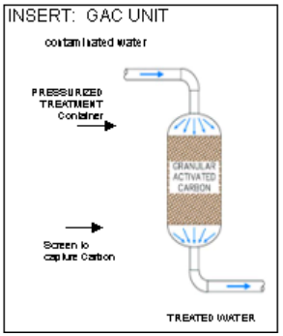
Zone 7 Activities - Treatment
Immediately implemented procedures to reduce PFOS to < RL at Mocho Wellfield by utilizing blending/RO;
Investigating additional treatment options*:
*Disposal of concentrate waste could be problematic.
Treatment Option Feasibility and Cost Estimate Study (March – July 2020) for treating PFAS to:
Anticipated regulatory standards/guidelines;
Lowest technically and economically feasible levels.
Notes:
Treatment Feasibility Study
Board approved a contract with Carollo Engineers in Dec 2019;
Study began in late Feb 2020 and anticipated to be completed in 6 months
To assess treatment options for treating PFAS to:
Anticipated regulatory standards/guidelines
Lowest technically and economically feasible levels
Also to consider other future well treatment facilities in the CIP such as chromium treatment

Slide 18
Zone 7 Activities – Livermore Valley Groundwater Basin Investigation
Zone 7 has sampled 45 of its 200+ monitoring wells.
Low-level PFAS seem to be widespread in the groundwater basin, occurring at various depths with no discernable pattern.
Slightly higher concentrations of PFAS detected near the airport, extending west in the direction of general groundwater flow.
No single source of contamination identified because PFAS are found in thousands of consumer products and there are no known local manufacturing sites.
PFAS Distribution Assessment Report - to be completed by Fall 2020
To better understand the extent of PFAS plumes in groundwater basin;
To assist in identifying potential sources of contamination;
To identify data gaps and recommend future sampling and plume characterization efforts.
Notes:
$400 per test
PFAS Distribution Assessment Report
Board approved to negotiate a consultant service contract in April 2020;
Study to begin soon and anticipated to be completed in 3 months.

Slide 19
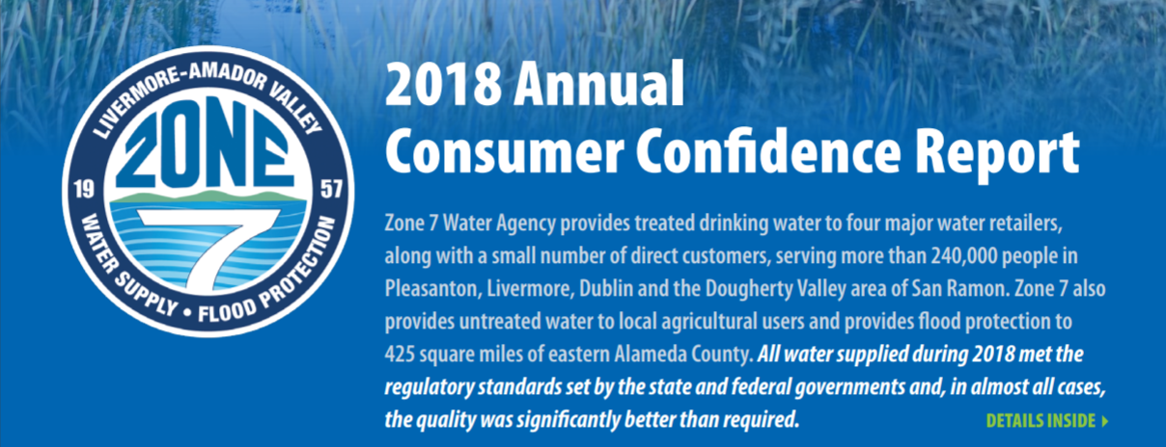
Zone 7 Activities - Communications
Immediately notified State Water Board, Zone 7 Board, retailers and direct customers;
Created a webpage and fact sheet dedicated to PFAS information (www.zone7water.com/pfas-information);
Included PFAS info in 2018 annual Consumer Confidence Report (CCR) and Feb 2020 eNewsletter;
Responded to inquiries via emails and social media;
Provided PFAS briefing to Zone 7 Board, retailers, State & Local Legislators;
Preparing to include 2019 PFAS monitoring data in upcoming 2019 CCR;
Plan to continue to providing updates as new info becomes available;

Slide 20
Pleasanton PFAS Information

Slide 21
Pleasanton Testing Results
The City began testing of its groundwater wells as part of the DDW order issued on March 15, 2019. The table below provides a summary of results to date.
Well Location | Round 1 (ppt) April 19 - June 19 | Round 2 (ppt) July 19 - Sept 19 | Round 3 (ppt) Oct 19 - Dec 19 | Round 4 (ppt) Jan 20 - March 20
PFOA
Well 5 | 4.2 | 3.7 | 3.3 | N/A
Well 6 | 3.8 | 3.3 | 3.6 | 3.9
Well 8 | 8.8 | 8.3 | 7.5 | 8.3
PFOS
Well 5 | 31 | 22 | 21 | N/A
Well 6 | 26 | 22 | 22 | 22
Well 8 | 115 | 100 | 69 | 110
*N/A: Not available. Well 5 is currently out of service.

Slide 22
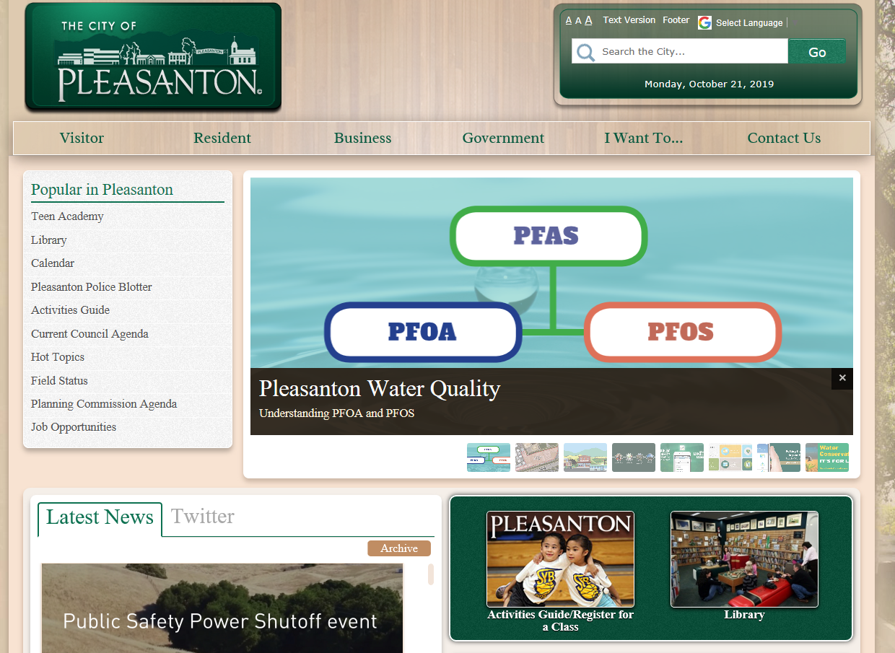
Public Notification
City website posting that provides information updated test results on PFAS
Included PFAS information in Pleasanton Progress Newsletter (Fall 2019)
Mailed and emailed utility customers a brochure on PFAS
Will include City and Zone 7 test data in 2019 CCR

Slide 23
Near-Term Actions - Operational
Continue required testing
Keep Well 8 as last priority to operate
Monitor anticipated changes by DDW to Response Level
Coordinate with Zone 7 testing and operational strategies to confirm turnout water is below Response Levels
Support Zone 7 and DDW groundwater basin monitoring efforts for source identification

Slide 24
Long-Term Actions
1. Evaluate PFAS treatment at Wells 5, 6, and 8
Treatment alternatives include: blending, GAC adsorption, IX resin, and reverse osmosis.
Estimates include: facility upgrades, residual management strategies, staffing impacts/certifications, capital and O&M costs.
Feasibility study
Approved Contract with Carollo Engineers November 2019
Schedule ~ February 2020 (June 2020 w/ bench testing)
Design, Construction, Capital & O&M
Cost ~ varies on treatment option and level of treatment
Schedule ~ 18+ months

Slide 25
Long-Term Actions
2. Legislative Tracking
MCL establishment
Impacts to utilities
Funding opportunities
3. Include PFAS in future regional water supply considerations
2020 Regional Demand - Conservation Study
2020 Urban Water Management Plan
Estimate a range of groundwater pumping allotment (0-1140 MG)

Slide 26
Key Takeaways
Zone 7 is delivering all water below the response level.
The water delivered to our customers continues to meet or exceed all state and federal regulatory guidelines.
We are committed to supplying a safe and reliable water supply.
PFAS is a widespread problem, not just related to water.
Water agencies are looking to regulators to set science based standards and guidelines that are actionable with the understanding that tighter guidelines my require funding assistance for infrastructure investment.
Further research and evaluation of the impact to human health and the environment of the PFAS class of chemicals is needed.
We will continue to closely monitor the quality of the community’s drinking water supplies, utilizing proven technologies and best practices to ensure that any emerging PFAS issues are managed in a transparent and responsible manner.

Slide 27
2020 Looks to be a Dry Year
The Tri-Valley is in good share
Ample reserves for dry years
Zone 7 Annual Sustainability Report models two consecutive dry years and shows demands can be met
Mild conservation messaging

Slide 28
PSPS Events
Traditional start of wildfire season approaching
Will trigger Public Safety Power Shutdown (PSPS) events
Water agencies have plans to operate during PSPS events
COVID-19 will complicate situations

Slide 29
Questions?

Slide 30
PFOA and PFOS Detection Limits
Current Regulations
Notification Level = 5.1 ppt for PFOA
Notification Level = 6.5 ppt for PFOS
Response Level = 70 ppt combined

