Slide 1
If….. Then
Population and Economic Trends in Colorado
State of the Region Summit, June 2024
State Demography Office, Department of Local Affairs
Demography.dola.colorado.gov

Slide 2
Key Takeaways
Everything is connected – Jobs, Population, Labor Force, Housing
Population growing at a slowing rate – births down, deaths up
Migration and mobility slowing
  Harder to attract and retaining the best and brightest
  Demand for labor (new jobs and retirements) drives migration
Aging – impacts everything
  Largest share of future growth is the 65+
  Early working age and youth becoming smaller share of total pop
  Growing race and ethnic diversity.
So What? - Impacts to Market and Labor Force
Notes:
US – 328.2 million, + 1.5 million or .5%
Slowest annual growth rate since 1918
Slower birth rate, increasing deaths, fewer international migrants.
Colorado - - 5,758,736
Ranked 8th fastest 1.2%
7th in total growth 67,449 – slower than great recession
Growth of 725,000 since 2010
Slower births, increasing deaths, fewer net migrants

Slide 3
Big Picture Numbers
 | 2010-2020 |  | 2020-2021 |  | 2021-2022 |  | 2022-23
United States | 22.3MM | 7.4% | 520k | 0.1% | 1.256MM | 0.4% | 1.643 | .5%
Colorado | 744.5k | 14.8% | 26.5k | 0.5% | 27.7k | 0.5% | 36.5 | .6%
Colorado Rank | 9th | 6th | 11th | 20th | 12th | 19th | 9th | 18th
2010 – 2020 - Second slowest decade for US in terms of growth
2020 – 2021 – Slowest ever recorded growth rate -17 states lost population
2021 – 2022 – Some return to pre-COVID - 19 states lost population
2022 – 2023 - 8 states lost population – 19 states natural decline, immigration increases
Notes:
US – Growth is slowing
2010-2020 second slowest decade - +22.3M, 7.4%
2020-2021 – Slowest annual growth rate .1%, +520K
17 states lost population
2021-2022 - +1.256M, .4%, 19 states lost population
CO – Growth is slowing
2010-2020 + 744,500, 14.8%.
6th ranked percent change, 9th in total growth
2020-2021 + 26,500, .5% growth rate
Ranked 20th in percent growth and 11th in total growth
2021-2022 +27,700, .5% growth rate
Ranked 19th in percent growth and 12th in total

Slide 4
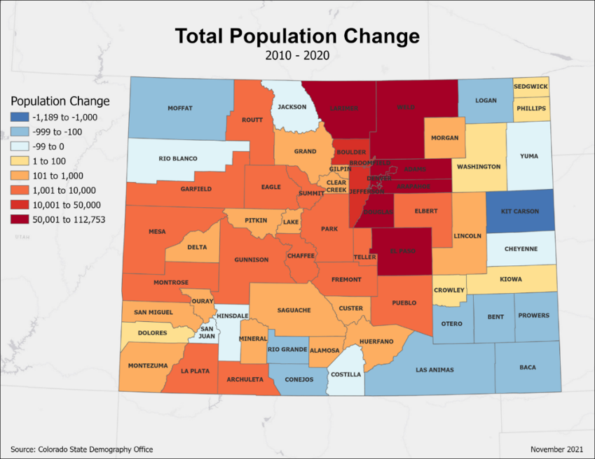
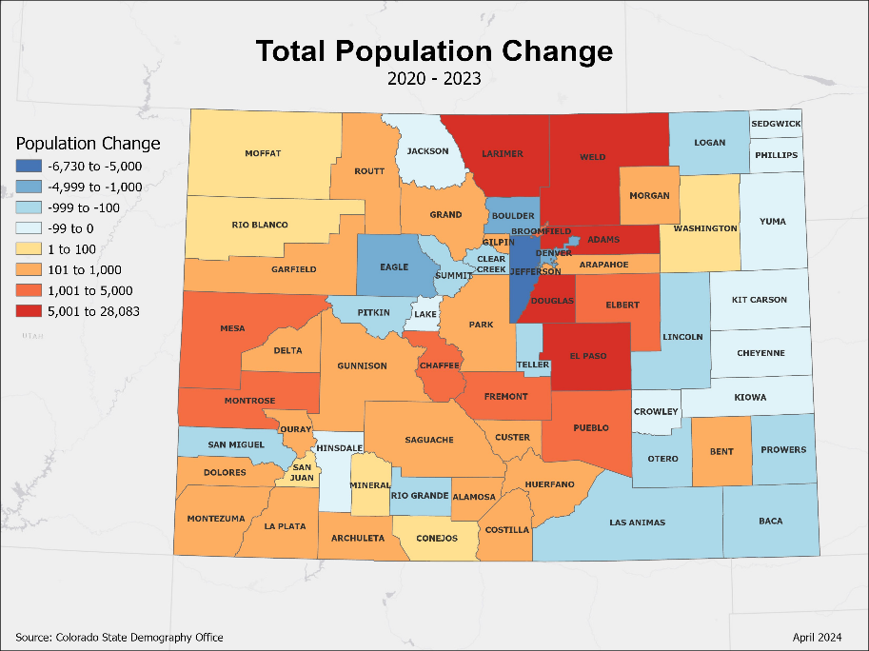
2010 to 2020 - 95% of population and job growth along Front Range
20% of counties decline
2020-2023 – 80% of growth in Front Range
40% of counties decline
Source: Colorado State Demography Office Population Estimates, Accessed March, 2024
https://gis.dola.colorado.gov/ComponentsOfChange/
Notes:
In terms of where growth has been and is going to be in Colorado…

Slide 5
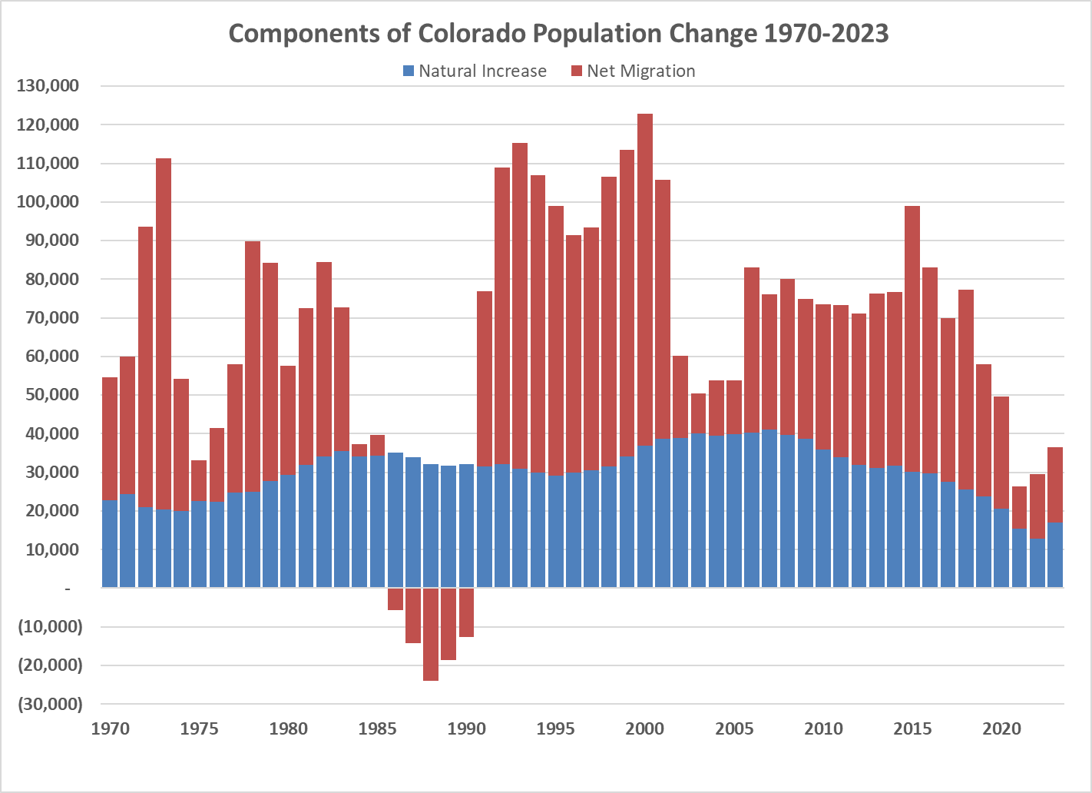
2023
62K – Births
45K – Deaths
20K - Migration
Colorado growth slows from an annual average of 74K last decade to 30,000 average so far this decade
Source: State Demography Office
Notes:
UPDATE to 2019

Slide 6
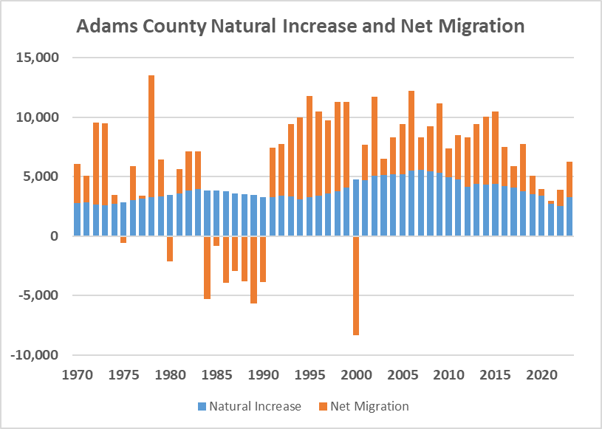
2023
Births – 6,883
Deaths – 3,613
Migration - 3,002
Source: State Demography Office
https://demography.dola.colorado.gov/assets/lookups/county_coc_lookup.html

Slide 7
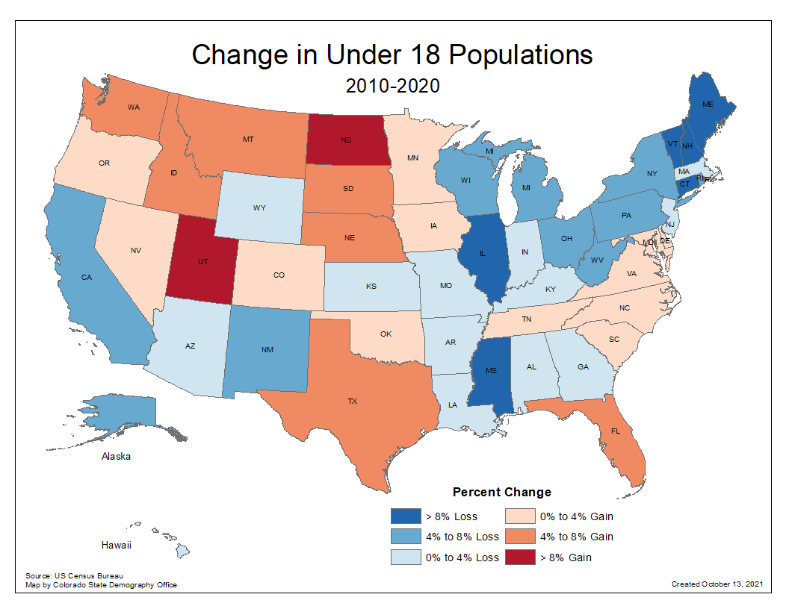
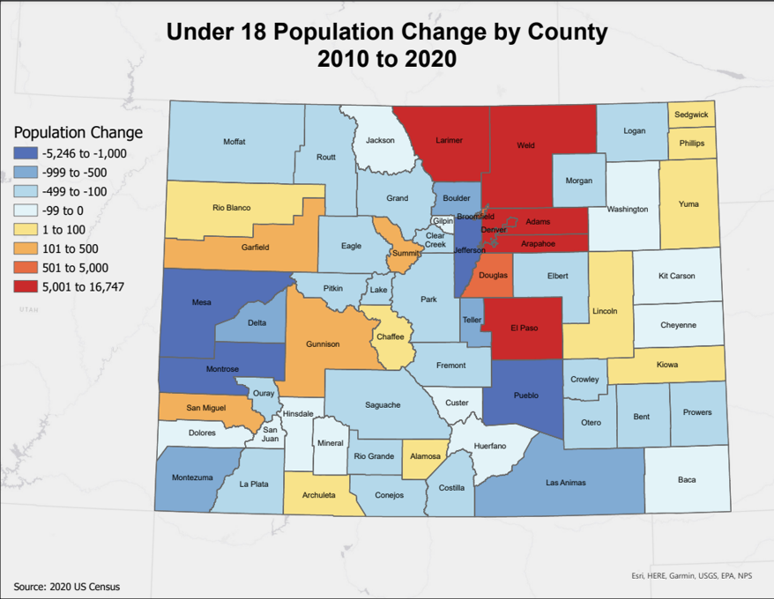
Births down 650,000 in the US compared to peak in 2007.
Population Under 18 Declined by over 1,000,000 over the decade
27 states lost population under 18
Colorado births down 8,000 since 2007. 43 of 64 counties declined
Census 2010 and 2020

Slide 8
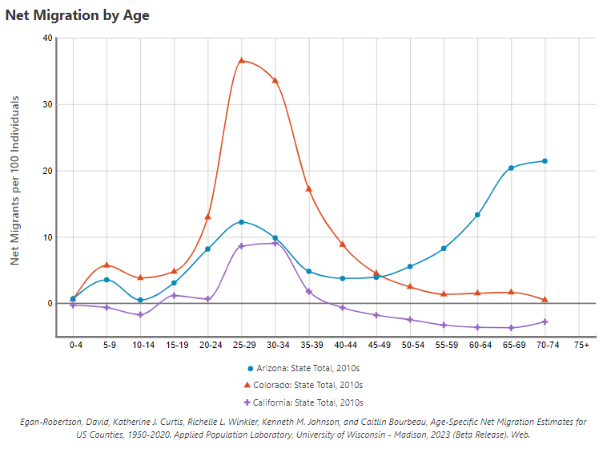
Who does Colorado attract?
With fewer young adults in the future, how could this impact Colorado?
Competition
Labor Force
Higher Ed
Housing
What else?
Colorado
Arizona
California
https://netmigration.wisc.edu/

Slide 9
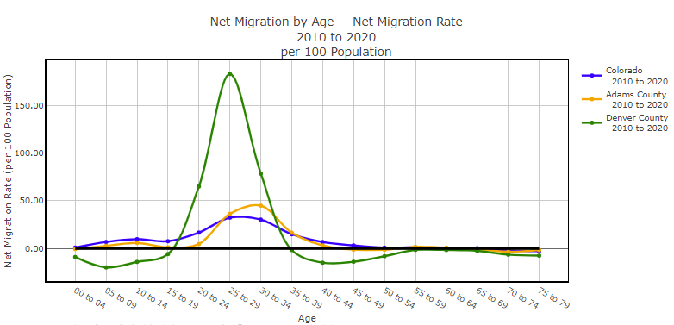
https://demography.dola.colorado.gov/assets/html/gis_applications.html#population

Slide 10
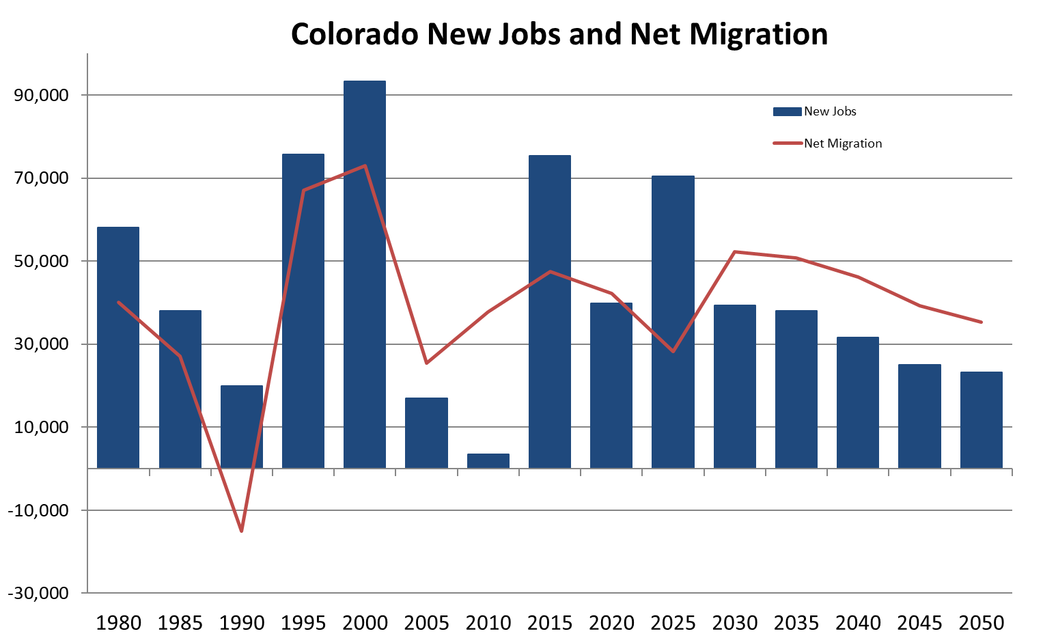
New Jobs + Retirements = Demand for Migration
40K new jobs
40K retirements
?? remote jobs
= 80K+ workers
Retirements
Jobs Are People
https://gis.dola.colorado.gov/Jobs_Migration_Chart/

Slide 11
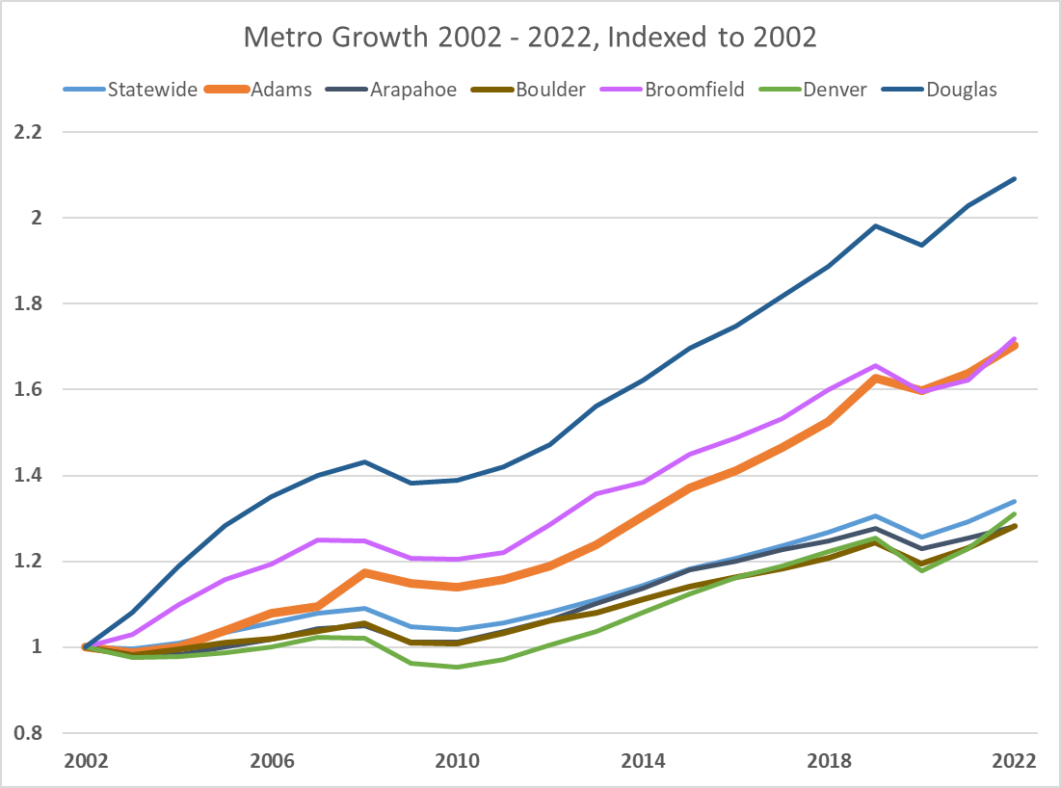

Slide 12
Age Matters
Colorado is young but aging
Preferences – where people shop and what they buy.
Housing – type, size, mobility
Labor Force
Income
Service Demands

Slide 13
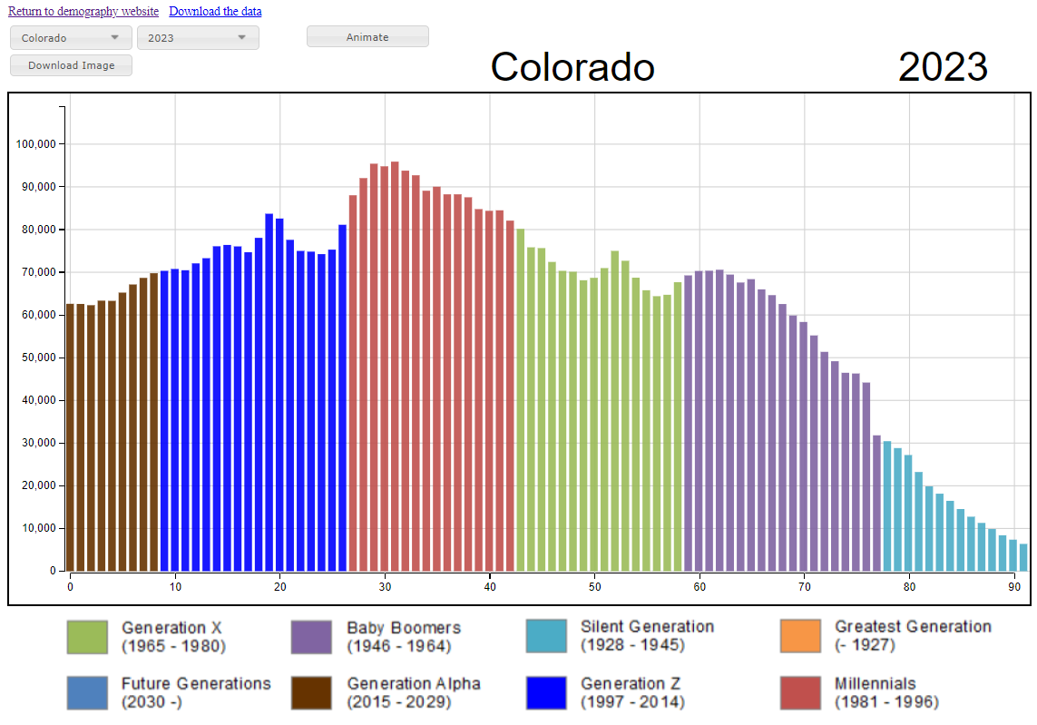
Peak Millennials aging into prime childbearing and home buying
State Demography Office, V2022

Slide 14
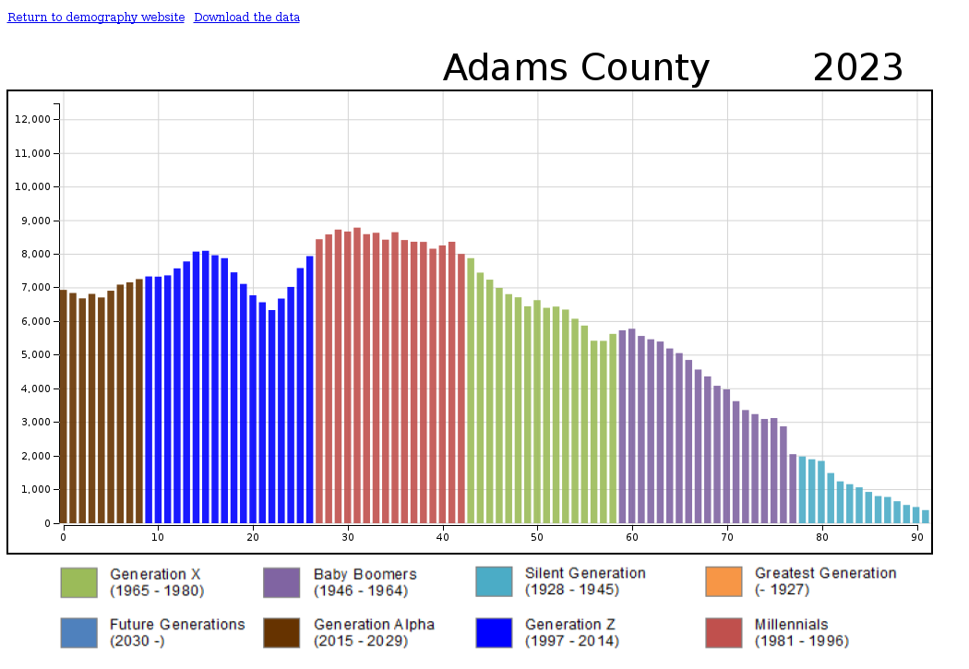
Slow down in births not as severe as state
Peak Age 31 – prime working age
Youngest county – share 65+

Slide 15
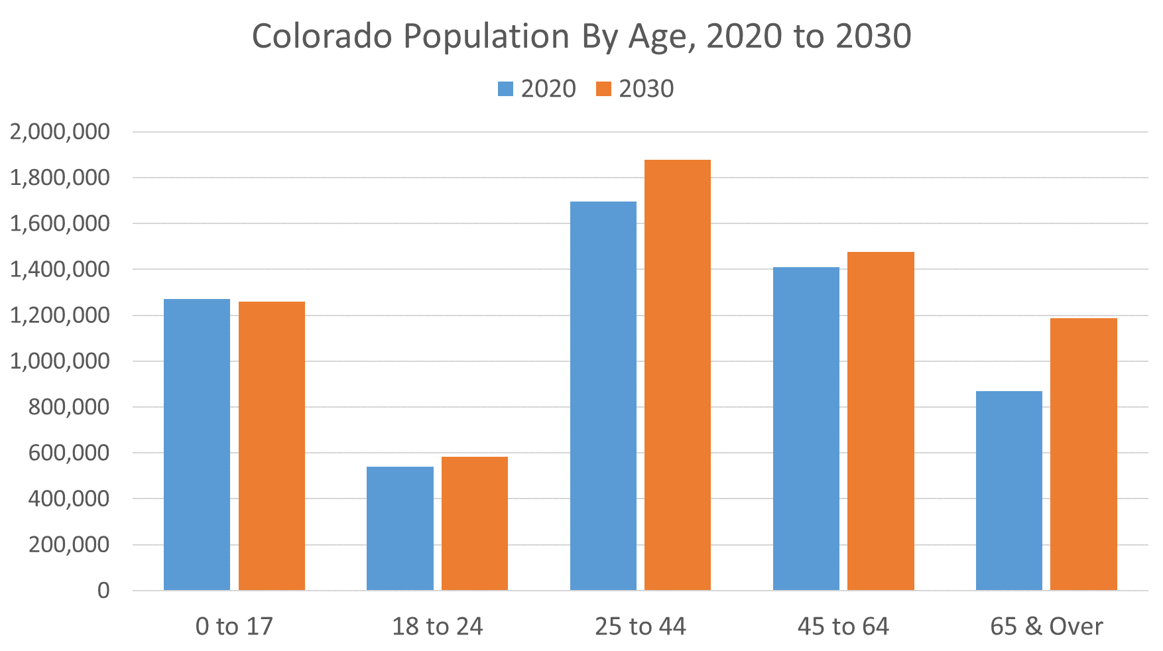
Migration
Most of these folks already live here and most of them own their house.
https://demography.dola.colorado.gov/assets/html/population.html
Notes:
6th Youngest State, 3rd fastest growth in 65+
2015-30 increase 65+ 711,000 to 1,200,000
Economic Driver
Impact on occupational mix. Growing at 5% per year. Wages/Income
Labor Force – growth in retirees
Worker vs. non-worker mix changing
Housing – primarily home owners
Income – Downward Pressure
Health/Disabilities
Transportation
Public Finance – Downward Pressure

Slide 16
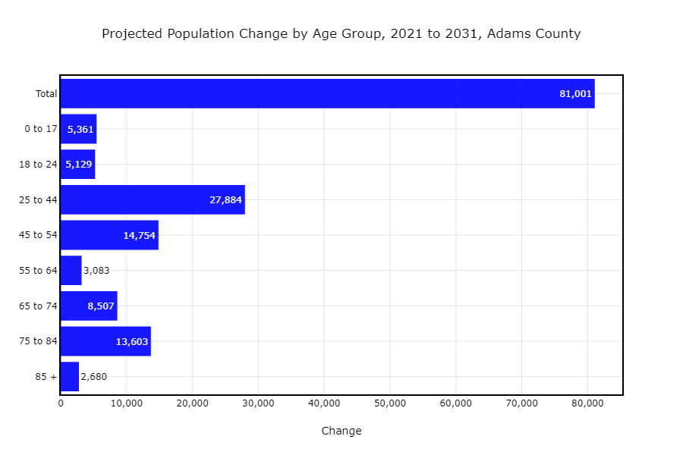
Younger than most counties
Forecast growth in working age – if can attract
30% of growth in 65+
Top 15 in growth in 65+ 2020-2030

Slide 17
Implications From Age and Aging
Consumer demand
  Older – fastest growth, services vs. goods
  Younger – more diverse
Labor force
  Faster growth in retirees (40K/year), slower growth in new entrants
  Young entrants more diverse
  Migration will be needed if jobs are to be filled – its competitive
Housing
  Demand by age: renters, 1st time, move up, retirees
  Aging home owners – rehab, move less, owners, transition planning
  Retirees aging in place

Slide 18
Summary
US and Colorado population growth is slowing
Births have slowed, deaths increase
Migration/Mobility slowing, International?
Aging – 65+ fastest growth, slower growth in young adults.
Labor Force – more competition, new jobs + retirements
  Creative and strategic, retain, retrain, re-enter, education support
Consumers/Jobs – Age drives consumption
  Jobs drive migration – drives demand for housing
Community Services
  Housing, child and adult day care, education, transportation, opportunities

Slide 19
Thank you
State Demography Office
Department of Local Affairs
Elizabeth Garner
Elizabeth.garner@state.co.us
303-864-7750
Demography.dola.colorado.gov

