Slide 1

Legislative Update
Darielle Dannen, Executive Director
July 17, 2025

Slide 2


Big Picture - 2025 Legislative Session
  Major work is to pass the biennial budget for FY26-27.
  Could also pass the “missing” bonding bill.
  State’s fiscal picture for FY 2026 – 2027 was tight at just $456 million.
  The projected general fund shortfall for the FY 2028-29 biennium was $5.995 billion.

Slide 3
Drama - 2025 Legislative Session
  The 2025 Legislative Session was full of surprises!
  The Senate lost two members during the session. This necessitated two special elections. The Senate convened initially under a power-sharing agreement.
  The House didn’t get a power-sharing agreement in place until early February and didn’t transition to the current co-chair structure until after the March special election.
  The Legislature did not complete their work during the regular session – Special Session!

Slide 4
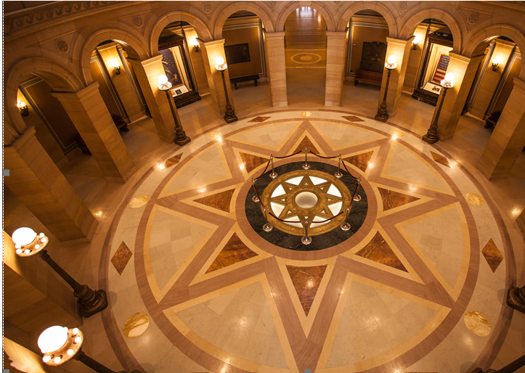
Shocking Events
Just days after the Special Session wrapped up, Speaker Emerita Melissa Hortman and Mark Hortman along with their dog Gilbert were assassinated.
Senator John Hoffman and his wife survived but were shot multiple times in their home.

Slide 5
Joint Budget Targets
Committee | FY26-27 | FY28-29
Housing | $15 million | $3.8 million
Jobs and Workforce | -$30 million | -$40 million
Taxes | -$118 million | -190 million
Total | -$283 million | -$1.805 billion

Slide 6
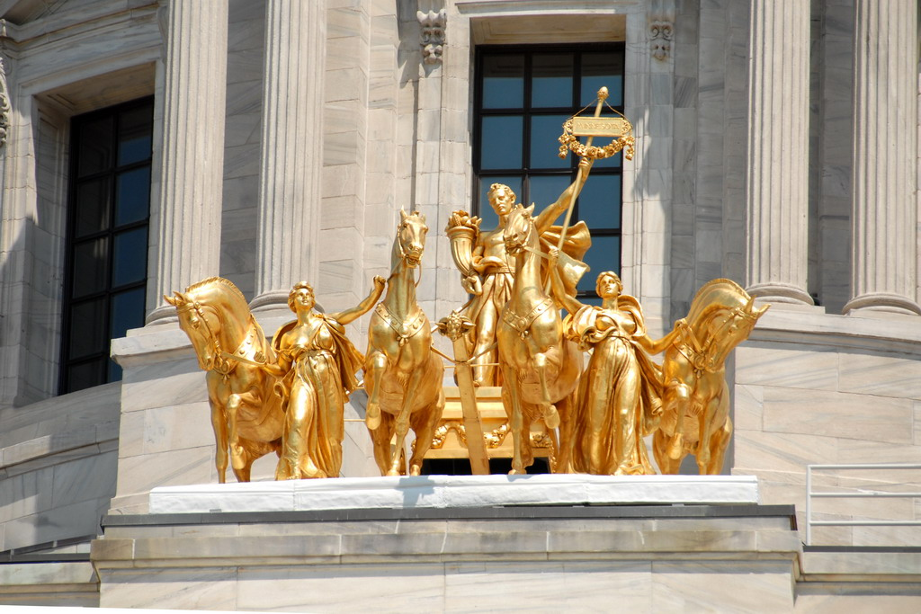
GMNP Legislative Advocacy

Slide 7
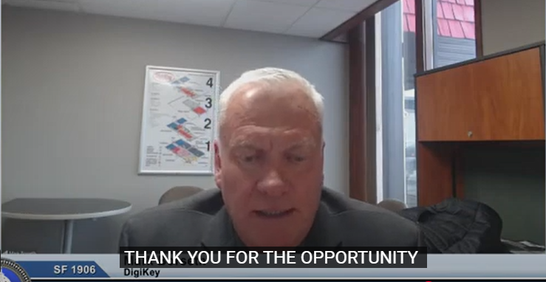
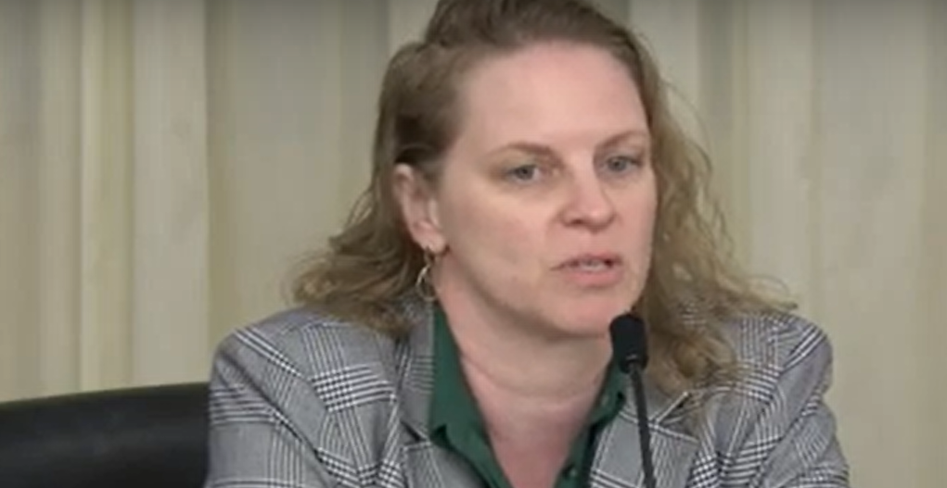
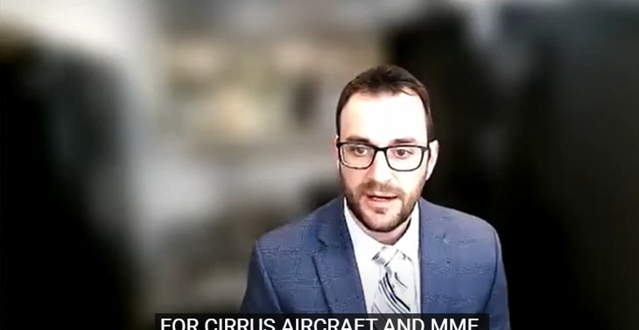
GMNP Advocacy
Multiple GMNP members testified at committee hearings - eight different times during the legislative session. Thank you to everyone who testified!
GMNP submitted 7 different letters weighing in on priorities and programs including housing, taxes and economic development.

Slide 8

Lawmaker Outreach
Issued two calls to action for members to reach out to key lawmakers.
Pushed back against proposed deep cuts to key economic development programs – MIF, JCF, the Redevelopment grant program and Cleanup funds.
Our lobbyist also met with key lawmakers and testified in support of GMNP’s priorities, and against cuts to key programs throughout the legislative session.

Slide 9
Outcomes 2025 Legislative Session

Slide 10

DEED Economic Development Programs

Slide 11
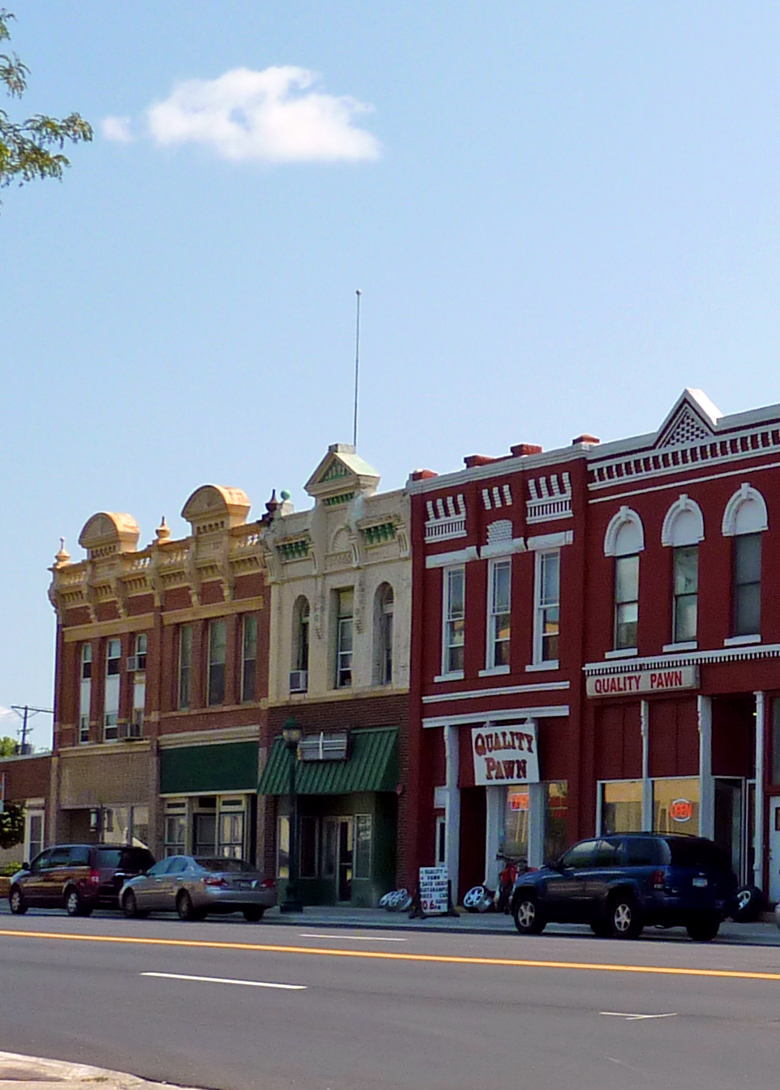
Business and Community Development Programs
 | Jobs Bill FY26-27
Minnesota Investment Fund | $24.74 million (base)
Job Creation Fund | $9.9 million ($6.1 million cut)
Redevelopment Grants | $2.492 million ($2 million cut)
Cleanup Funds | $3.544 million (base) + $1.4 million remediation fund

Slide 12
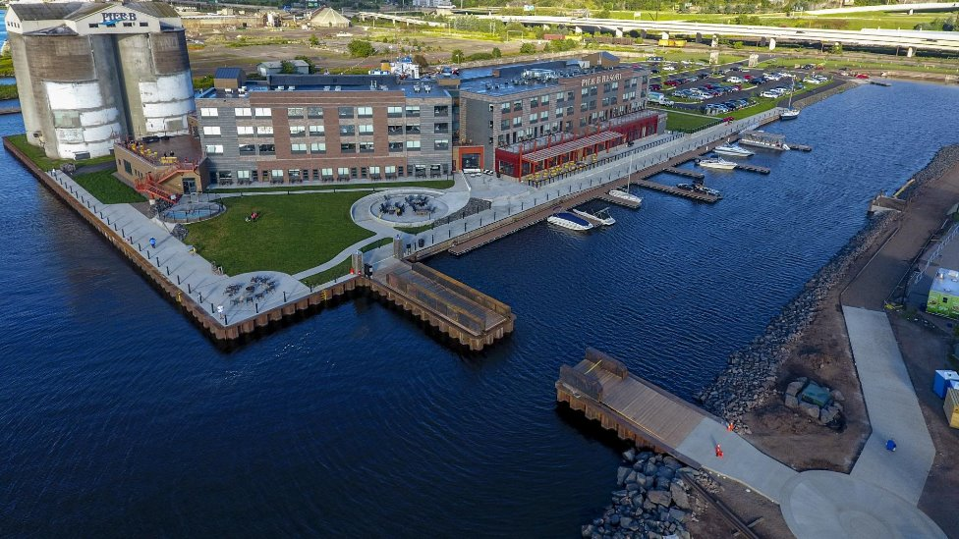
Business and Community Development Programs
 | Jobs Bill FY26-27
Small Business Assistance Partnerships Program | $5.45 million (base)
Child Care Economic Development Grants | $3 million (base)
BDPI | $4.574 million (base)

Slide 13
Business and Community Development – Policy Changes
Business Development Public Infrastructure (BDPI) grant program
Subd. 2 Eligible projects. Added "or plants and plant-based products" to (5) in the list of eligible projects for which a county or city may be eligible to receive a grant:
(5) agricultural processing, defined as transforming, packaging, sorting, or grading livestock or livestock products or plants and plant-based products into goods that are used for intermediate or final consumption, including goods for nonfood use;

Slide 14
Business and Community Development – Policy Changes
Forward Fund – removes the federal matching language
Subd. 2. Purpose. The Minnesota forward fund account is created to increase the state's competitiveness by providing the state the authority and flexibility to facilitate private investment. The fund serves as a closing fund to allow the authority and flexibility to negotiate incentives to better compete with other states for business retention, expansion and attraction of projects in existing and new industries, and develop properties for business use, and leverage to meet matching requirements of federal funding for resiliency in economic security and economic enhancement opportunities that provide the public high-quality employment opportunities.

Slide 15

Workforce Development
Employment and Training Programs | FY26-27 | FY28-29
Drive for Five | $12 million | Not in base
Pathways to Prosperity | $21 million (adds $6.858 million) | $14,300 million (base)
Youth-at-Work Competitive Grant Program | $16.896 million (adds $2 million) | $14.896 million (base)

Slide 16

Childcare
 | Jobs Bill FY26-27
Child Care Economic Development grants | $3 million (base)
DEED CCACP Office - includes LMI research | $1 million (base)
Childcare worker support | $1 million

Slide 17

Housing Programs

Slide 18

Housing
Program | Final S.F. 2298
Greater Minnesota Housing Infrastructure Program | $2 million FY26-27
Workforce Housing Development Program | $2 million annually (base funding)
Challenge Program | $14.925 million FY26, $12.925 million FY27
Housing Infrastructure Bonds (HIB) | $50 million
Notes:
Timelines:
Expect the Greater MN Housing Infrastructure grant program awards to be approved by the board in October.
Expect to release another RFP for the Greater MN Housing Infrastructure grant program in the spring – the Agency believes there are cities and counties that didn’t apply in the first round so do apply if you have projects that could qualify – look for a spring RFP!

Slide 19
Housing Policy – Land Use and Zoning Policy Changes
  Requires Minnesota Housing to award an additional point or points for its competitive development programs to projects within the boundaries of local governments that have:
    Development of Multi-family housing in at least 50 percent of the area zoned for single-family housing
    Allows duplexes, ADUs, or townhomes within 50 percent of the area zoned for single-family
    Parking mandates not greater than one stall per unit of housing for single-family housing or for multifamily
    Lot sizes not mandated larger than one-eighth of an acre for new single-family construction
    Aesthetic mandates limited on single-family construction
    Affordable housing density bonus
    Has adopted an inclusionary zoning policy
  Points for these items are limited to five percent of the total available points.

Slide 20

Taxes

Slide 21

Skinny Omnibus Tax Bill
Cannabis Tax – increased to 15%, local cannabis aid repealed.
Modifies the Data Center Tax Credit – eliminates electricity from the tax credit’s exemption.
Includes some local tax and local TIF provisions.
Modifies the Research and Development Tax Credit
  17.5% refundability in tax year 2025
  25% refundability in tax year 2026 and ongoing.
  Projected refunds not to exceed $25 million per year.
Not Included: Workforce Housing tweaks for the State Housing Tax Credit
Eliminate income restrictions for housing TIF in Greater MN

Slide 22

Bonding
Greater Minnesota Business Development Public Infrastructure program (BDPI) - $1.5 million
Transportation Economic Development Infrastructure (TEDI) - $1.5 million

Slide 23

What's Next?
Will the Federal Budget bill require the Minnesota Legislature to convene another Special Session to adjust the state budget?
  Estimated impacts are $500 million annually due to a decrease in federal Medicaid payments.
Will the lawmaker assassination have a chilling effect on representative democracy?
Can we expect changes to security at the Capitol next session?
Notes:
New federal Medicaid requirements also requires more frequent eligibility checks and recipients to meet/prove they meet 80 hrs/month work requirements

Slide 24

Discussion

