Slide 1
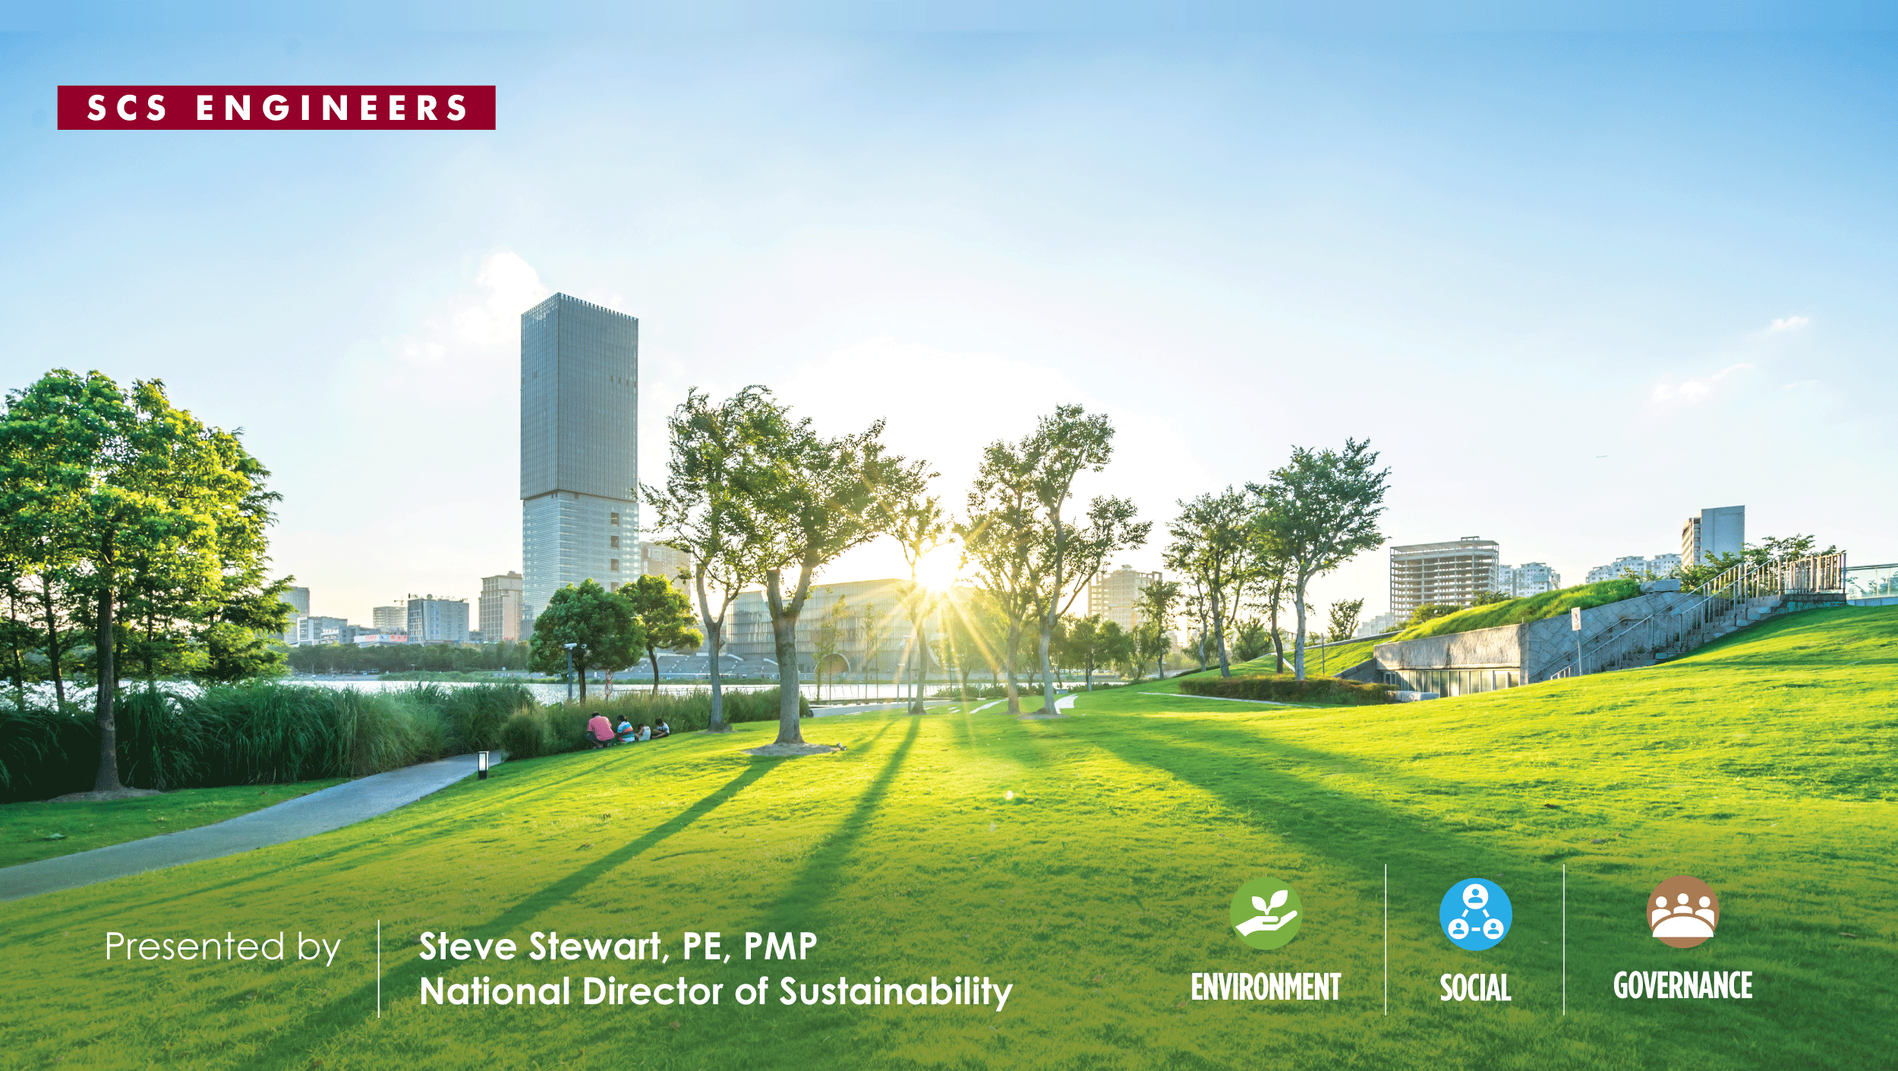
JUL
31
2025
What in the world (of Sustainability) is going on?
2025 Manufacture Alabama EHS Conference

Slide 2


Disclaimer
Neither SCS Engineers, its officers and directors, nor the presenters
and author(s) of this work, their employer, or their employers’ officers and directors, warrant or represent, expressly or by implication, the correctness or accuracy of the content of the information presented.
The user/viewer accepts any legal liability or responsibility whatsoever for
the consequence of its use or misuse.

Slide 3
Topics
Flyover of a typical Company’s sustainability journey
What’s Driving Sustainability? 3 types of companies
    Bucket 1 –”The Volunteers” (such as Big Tech)
    Bucket 2 “ The Targets” (pressure from Stakeholders)
    Bucket 3 “ The Regulated” (global and domestically)
Impacts from the Feds’ “Ds”
    “D“ regulation
    “D” funding
Key Takeaways

Slide 4
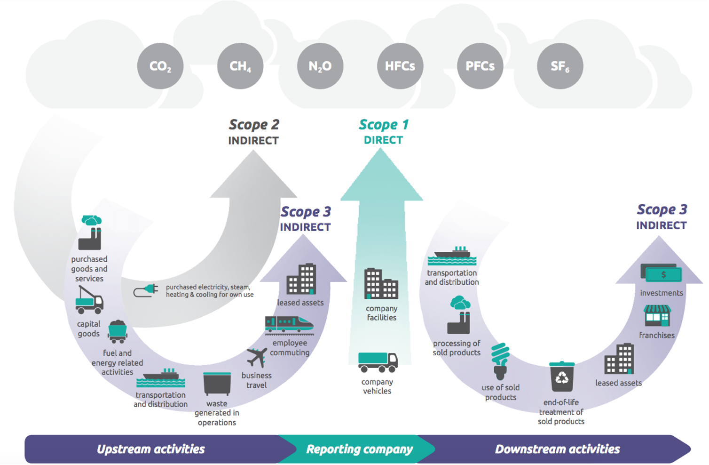
Example of Accounting Framework: Greenhouse Gas Protocol
(15) Scope 3 Categories
Source: Corporate-Value-Chain-Accounting-Reporing-Standard_041613_2.pdf
Notes:
Assuming this looks very familiar. Scope 3 is typically largest of the 3 scopes. Focus today on Category 1 of Scope 3 emissions for corporations is PG&S purchased goods & services, considered in the set of indirect emissions in the upstream activities of a company’s value chain

Slide 5
A typical journey for Company X
Governance and Stakeholder Engagement
Identify the emissions accounting framework for reporting (there are multiple)
Perform GHG Inventory for Scopes 1, 2, and 3
    Scope 3 is an “elephant” (start with screening and increase accuracy with activity-based data)
Financial Climate Risk Assessment (if required)
Validation/Verification by accredited 3rd party
Target Setting – SBTi or other
    Over 10,000 companies signed up for SBTi
Abatement Planning and Implementation
    Decarbonization => Carbon Capture => Carbon Offsets
Report and Disclose

Slide 6

Bucket 1 – “The Volunteers”
“…GHG emissions from major AI-focused companies …rose by an average of 150% between 2020 and 2023.”
Big Tech Companies such as Amazon, Google (Alphabet), Meta, Microsoft
  Spending $Billions on decarbonization
  Supporting New Technology / Innovative Solutions
  Data Centers – “Two steps forward, one step back”
Others such as Walmart…
“In 2024, Walmart announced the company has achieved its Project Gigaton goal to reduce, avoid, or sequester 1 gigaton of emissions from its supply chain six years earlier than expected… equivalent to what Japan emits in a year”

Slide 7

Bucket 2 – “The Targets”
Stakeholder pressures include:
Environmental Advocacy /Public Awareness (i.e. animal care sensitivity)
Consumer behavior (i.e meat alternatives)
Increasing Regulations (CAFO, stormwater runoff)
Investor Demand
Two example sectors in Alabama that have notable GHG emissions are pressured by Stakeholders such as:
Meat and Livestock Industry
    Accounts for more than 14% of CO2 emissions globally
    Sensitivity to animal care
Steel Industry
    Accounts for more than 7% of CO2 emissions globally
Image courtesy of AI

Slide 8
Sustainability Drivers
Bucket 3 – “The Regulated”

Slide 9

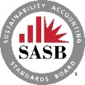















GHG & Climate Risk Disclosure Regulations on the rise globally
  Evolving from voluntary to mandatory
  constellation of accounting frameworks & standards, global & corporate goals, investor-focused raters/rankers, and now regulations for mandatory corporate reporting.
  Requirements beyond the EU, UK
  Australia, Brazil, Canada, Mexico, China, Japan, Singapore, UAE, Mexico and Hong Kong have also adopted or are in the process of adopting similar requirements.
  For example, +23,000 companies are reporting thru CDP
  California Climate Disclosure
  Now: 5 states have proposed legislation
    WA, NY, IL, CO – Corporate GHG Emissions Reporting
    NY and MN – Corporate Risk Disclosure
GLOBAL & CORPORATE GOALS & PRINCIPLES
FRAMEWORKS
AND
STANDARDS
RATERS
AND
RANKERS
REGULATIONS
AND LEGISLATION
CSRD
CSDDD
Notes:
As we have developed from voluntary to mandatory reporting, important to note the constellation of F&S, R&R and G/C G&P, and of the Regs/Legis.
Frameworks and Standards: Relied upon and referenced in the legislation and regulations in the US, CA, EU and now referenced across the globe. High level guidelines like TCFD and their successor -- IFRS for climate-related financial risk reporting. Protocols with specific tools and methodologies such as GHG Protocol.
I was selected to sit on a global Technical Working Group for the GHGP that is working on revisions to their guidance. Clarifications and additional guidance will be put out for public comment coming up for S2 in 2025; and Corp Stand and Sc 3 Gdnce in 2026.
Raters and Rankers – CDP, plus more and others not listed, review submittals and provide their ranking assessments of individual companies for investors and consumers. There are several others not listed here.
Global and Corporate Goals and Principles – quite a group these are not all of them. One of most common is SBTi
Regulations and Legislation: Mandatory climate disclosures required by governments and regulatory bodies. OUR FOCUS TODAY IS ON SEC AND CA. NOTE ALSO THAT EU’s REQUIREMENTS ARE in place UNDER THE 2 SHOWN, CSRD.
Outside of the US – Canada currently requires reporting of Corp Climate Risk, GHG and ESG metrics.
We have clients who provide services to companies outside of the US and have already received questionnaires from their EU and Canadian customers. And Mexico’s SEC-equiv agency has a new rule for reporting of corporate GHG, ESG.
-----
Global Goals, International Policies and Treaties: UNFCCC, Paris Climate Agreement - Legally binding international agreements between governments that influence national and regional policy and action.
TCFD – High level guidelines or approaches that provide organizations with a structure to identify, assess, and disclose on sustainability issues relevant to their operations. Protocols: GHGP, ISO, PCAF. Specific tools, methodologies, or instructions that help organizations to measure, monitor and disclose their sustainability performance in line with the chosen framework and standards.
Standards: Detailed and specific guidelines that outline the precise requirements, metrics and indicators that organizations should use to disclose on certain sustainability topics.

Slide 10
History of Mandatory Climate Reporting Requirements in the US
      First: GHG emissions for facilities, then corporate GHG, plus climate risk
      2005 RGGI – 11 states. GHG reporting, Cap-and-Trade program. Electricity gen facilities.
      2006 California MRR - GHG reporting & Cap-and-Trade program. Industrial facilities.
      2008 USEPA MRR – GHG reporting. 41 source categories. 8,000 Industrial facilities.
      2009 Oregon - GHG reporting. Rules updated in 2020, with verification. Industrial facilities
      2010 1st SEC – Voluntary Climate Disclosure ‘recommendation’. Corporate climate risk
  2021 Washington - Cap-&-invest program with GHG reporting for facilities.
  2023 California - Corporate GHG reporting of GHG emissions (SB 253), climate risk (SB 261).
  2024 2nd SEC - Climate risk and corporate GHG emissions disclosure for large public companies.
  2024 California - Amends SB 253 & SB 261 with SB 219. Governor signed Sept.
  2025 Washington, New York, Illinois, Minnesota & Colorado – Corporate GHG, climate risk
Notes:
Thank you, Steve. Bear with me and my voice today my allergies are happening.
The laws and regulations we will talk about today are game changers – they are game changers because they require a new type of climate reporting, focused at the CORPORATE level.
Our goal with this first slide is to….show you a quick history of mandatory reporting for climate, for both GHG emissions and climate risk. Mandatory reporting history for climate started with a focus on GHG emissions reporting for individual facilities. As you see, this officially began in the US twenty years ago, in 2005.
At the time, this reporting was linked to climate goals that were set in the Late 1990’s and early 2000’s for reduction of GHG emissions and therefore of climate impacts. These goals were FORMALLY established by several states, some were set in legislation.
To implement those GHG reduction goals: accounting for GHG from industrial facilities and power generation was a key focus. This reporting became an important element of programs to incentivize GHG reductions, for Cap and Trade or similar programs like those adopted by RGGI, California, Oregon, and Washington.
Noteworthy, the shift to a corporate focus for climate disclosure, formally starts in 2010, when SEC adopted a voluntary corporate climate risk disclosure ‘recommendation’ based on investor and consumer interest. …….
13 yrs later In 2023 – CA gained 2 climate laws, after 2 yrs of debate, AND after another year for the amendment TO each law. From the state perspective: California led the way.
In 2024. SEC finalized a sweeping new rule for climate disclosures of GHG Emissions and climate risk for public companies. It was two years in the rule making process. Talk more about this later.
5 states with emerging requirements, these are mostly copycats of CA’s laws.
As of March 2025, add NJ to this list. WASH, NY and IL have laws under consideration in 2025 that are copycats for GHG reporting under CA SB 253. NY has AN additional law under consideration that is a copycat for Calif SB 261, requiring a corporate climate risk assessment. CO has postponed their legislation. MN’s law applies to banks and credit unions and addresses climate risk.
April 8 Executive Order Trump to clamp down on state laws on climate change and GHG. We’re expecting you have questions
NEXT SLIDE
---------
Note: we expect more action by states: The U.S. Climate Alliance is a bipartisan group of governors working to achieve net-zero emissions through state-led actions. Members include 24 state governors.
--------------
TRUMP: However, on April 8, 2025, President Trump issued an Executive Order directing the U.S. Attorney General to identify and stop the enforcement of all state laws, regulations, policies and practices “that are or may be unconstitutional, preempted by Federal law, or otherwise unenforceable,” with a focus on prioritizing any such state laws purporting to address “climate change” or involving “greenhouse gas.”
Federal law preempts conflicting state or local laws due to the Supremacy Clause in the Constitution, which makes federal law the "supreme law of the land".
Implied Preemption: Even without explicit language in a federal law, a court may find it implied that the federal law preempts state or local law if it is impossible to comply with both or if the state law hinders the federal law's goals, according to the National Association of Attorneys General.
Powers Reserved to the States
The Tenth Amendment declares, "The powers not delegated to the United States by the Constitution, nor prohibited by it to the states, are reserved to the states respectively, or to the people." In other words, states have all powers not granted to the federal government by the Constitution.
“regulation of industry”
…implies more stringent rules are allowable for public health, welfare and safety – there is a track record for this
--------
Game changers – each with sweeping NEW requirements for mandatory reporting for climate. Not just industrial facilities or industrial or utility companies affected,.
Not just the same old reporting, keeping track of your numbers.
Game changers, who is affected and who has to respond.
2015. Paris Accord
To summarize state requirements who has climate risk req. who has GHG. Actually these state legislative efforts started in 2023 continues today in 2025 for several. MN has adopted their requirement.
California Governor Arnold Schwarzenegger signed an Executive Order in 2005, that established California's first greenhouse gas emissions targets, including a goal to reduce emissions 80% below 1990 levels by 2050. This laid the groundwork for mandatory reporting in CA.

Slide 11
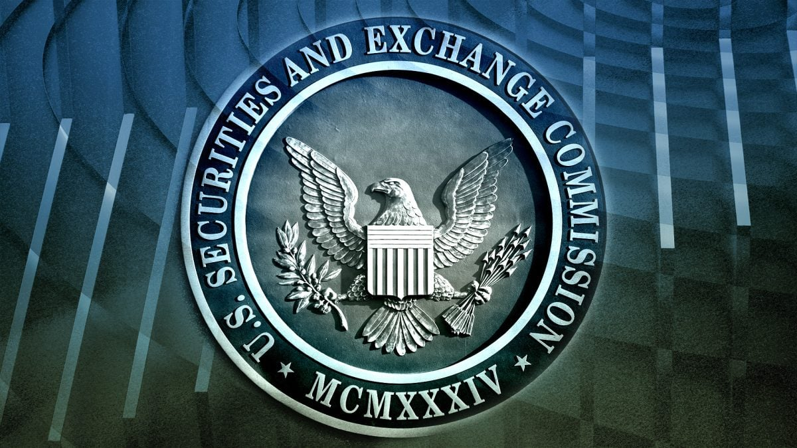
SEC Climate Disclosure and Reporting Rule – DOA?
March 2022 – Climate Risk Disclosure Rule proposed
  Physical and financial risk analysis
  Single Materiality
  Estimated 2,800 large companies affected
  Scopes 1 and 2, not Scope 3
  March 2024- SEC Final Rule adopted then paused:
  multiple legal challenges including U.S. Chamber of Commerce
  presidential administration transition
  April 24, 2025 – Court of Appeals
  directed the SEC to state “whether the Commission intends to review or reconsider the rules at issue in this case”
  July 23, 2025 - SEC responded
    in essences, the SEC declined to revisit or defend the rule and requested the court “rule on the Commission’s jurisdiction and authority.”

Slide 12

California SB 253– GHG Emissions Reporting
Annual Revenue >$1B
Scope and Application
Applies to all entities public or private
“Doing business in California” with >$1 billion in annual revenues.
  Estimated 5,000 companies affected
Covers all greenhouse gas emissions: Scope 1, Scope 2, and Scope 3
Public disclosure must “maximize access for consumers, investors, and other stakeholders”
Implementation
Scopes 1 and 2 reporting required in 2026; Scope 3 in 2027
CARB to provide additional details (due July 1, 2025)
Requires an “assurance engagement” by a “third-party assurance provider”

Slide 13
California SB 261– Climate Risk Disclosure
Annual Revenue > $500M
Scope and Application
“Climate-related financial risk” means material risk of harm to immediate and long-term financial outcomes due to physical and transition risks…and economic health.
Applies to all entities public or private:
“Doing business in California” with >$500 million in annual revenues
  Estimated 10,000 companies affected
Implementation
Climate-related financial risk report due on or before January 1, 2026. Biennially thereafter.
Report must include:
  Risk disclosure in conformity with the Recommendations Report (June 2017) by the Task Force for Climate-Related Financial Disclosures (TCFD) [successor is IFRS]
  Entity’s “measures adopted to reduce and adapt to climate-related financial risk disclosed”

Slide 14
Thresholds for Companies - California Climate Disclosures
Applicable to Companies ‘Doing Business In California’
Term is undefined in each law (SB 253, 261 and 219)
Interpretation: Narrow Definition from the CA Franchise Tax Board
FTB criteria for “doing business” in California is if you meet any of the following:
  Engage in any transaction for the purpose of financial gain within California
  Are organized or commercially domiciled in California
  Your California sales, property or payroll exceed the following amounts:
California sales, property or payroll
Year | CA sales exceed (either the threshold amount or 25% of total sales) | CA real and tangible personal property exceed (either the threshold amount or 25% of total property) | CA payroll compensation exceeds (either the threshold amount or 25% of total payroll)
2024 | $735,019 | $73,502 | $73,502
California Revenue and Tax Code
https://www.ftb.ca.gov/file/business/doing-business-in-california.html
Notes:
Beyond the Annual revenue threshold for public and private companies in each California law, there is an additional APPLICABILITY consideration
Criteria for ‘Doing Business in California’.
And its Not defined in either law. NO existing criteria for “Doing Business in Ca” in the law.
Indicate a perhaps narrow numerical definition here from California FTB.
However, there are additional considerations and possibly a broader interpretation…
VE – invite to David Smith comment on this;
bill’s author wants unbounded and intentions count (persuasive authority).
Cut him off. 2.5 MINUTES MAX

Slide 15
Litigation | Chamber of Commerce of U.S. v. CARB
Case
Status
Challenge to SB 253 and SB 261
Plaintiffs
  U.S. Chamber, American Farm Bureau, L.A. County Business Federation, and Western Growers Association
Primary Allegations
  First Amendment violation – compelled speech
  Supremacy Clause
  Constitutional Limitations on Extraterritorial Regulation
Chamber sought a summary judgment in November 2024, the court refused and granted a discovery request to California.
  3 issues: burden, controversy, do business
In February 2025, the court dismissed two of the three counts in the Chamber’s lawsuit—the Supremacy Clause and extraterritoriality claims.
California did not ask the court to dismiss the First Amendment violation (compelled speech).
On February 25, 2025, the Chamber moved for a preliminary injunction to prevent enforcing either SB 253 or SB 261 until the court decides the merits; hearing was held July 1, expecting Judge’s decision by late Summer 2025.

Slide 16
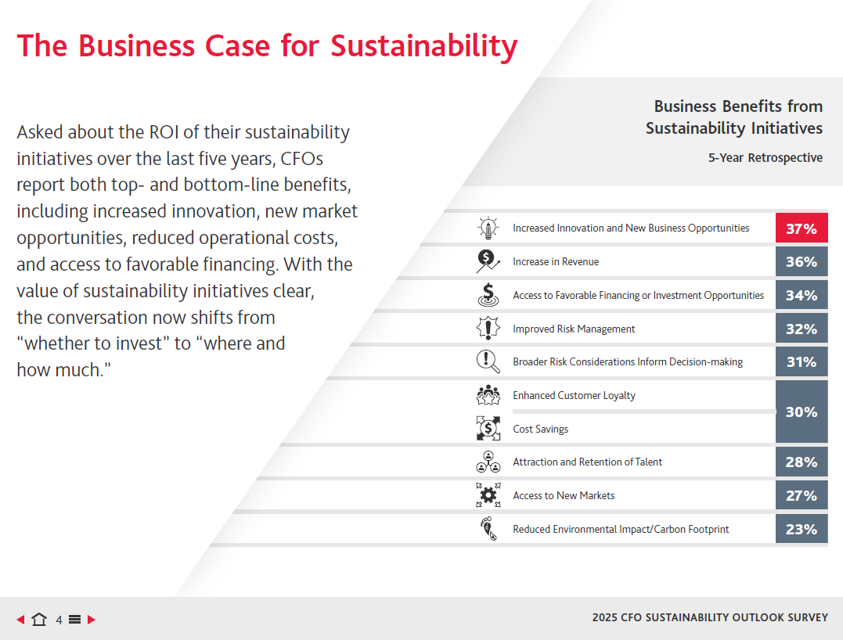
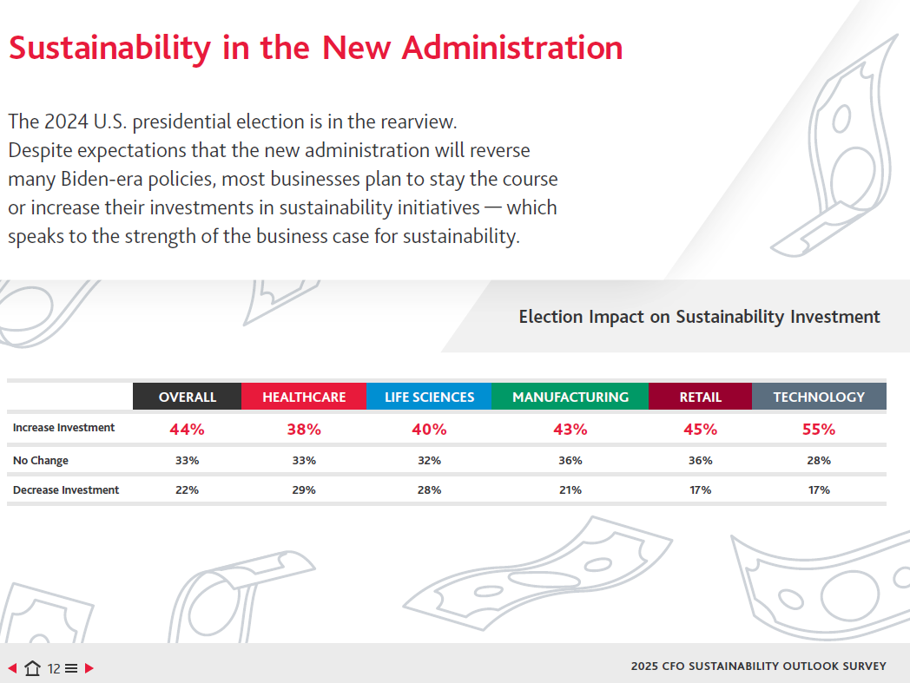
Companies not turning back…
2025 CFO Outlook Survey polled 500 CFOs with revenues ranging from under $250 M to over $3 B in after the U.S. presidential election. The survey was conducted by Rabin Roberts Research Company,
an independent marketing research firm,
“80% of CFOs indicated that Sustainability Funding withing their business would stay the same or increase in 2025”

Slide 17
Key Takeaways
Corporate climate disclosure requirements are part of a global trend.
Keep eye on California laws cover annual reporting and assurance for Scope 1, 2, and 3 emissions, along with biennial climate risk reporting, determine if your company “is doing business in California.”
  5 other states are considering copying California’s climate requirements for both corporate GHG emissions and climate risk reporting.
Companies that aren’t currently required to disclose by US or state regulations could still be affected in the supply chain of companies that are regulated
“Greenhushing” – In US, most companies aren’t slowing down with their sustainability programs, they are looking beyond one or more election cycles
Smart Business -Strong argument for starting Scope 3 now (it is going take a while to complete), climate risk assessment so C-suite can make informed decisions
Notes:
Moving to Key Takeaways.
Takes into account of where you are, where you need to be.
If like to discuss the timeline for you company, pls reach out to me directly.
David Smith – anything Want to Add here.
-----
Very iterative – know that it is. It takes time.
Don’t be a CARB Poster child.
EU –The Corporate Sustainability Reporting Directive (CSRD), enacted by the European Union, mandates companies to disclose their environmental, social, and governance (ESG) performance in a more transparent and comparable way, aiming to enhance accountability and foster sustainable investments. More extensive reporting requested by CSRD.
Rules already adopted – we already have US clients who have received questionnaires from their EU Customers. Under the recent changes to CSRD-Omnibus ---Beware the substance of what needs to be reported will not change. But the # of Companies affected will and the deadlines have been moved.
Canada has similar ones --- already received
Mexico
Other states.

Slide 18
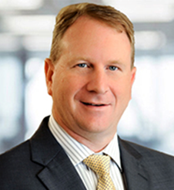
Thank you!
Questions?
STEVEN STEWART, PE
SCS Expert and Director for Sustainability
sstewart@scsengineers.com

