Slide 1

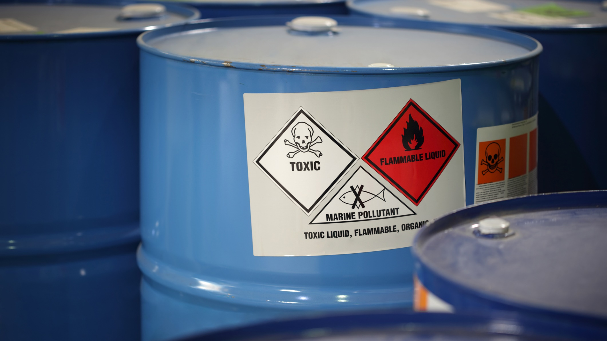
Environmental compliance
Update
Waste issues
Phillip Davis, P.E.
Senior Engineer
Director of Regulatory Affairs
2025 Manufacture Alabama
HR, Safety & Environmental Conference

Slide 2

Emerging Waste issue
Recent revisions to ADEM Admin. Code Chapter 335-13-3 Processing & Recycling
The impact of these revisions on manufacturing facilities in Alabama

Slide 3


SWRMMa
Enacted by the Alabama Legislature in 2008
Provided funding for ADEM Solid Waste and Recycling programs, UAD cleanups & recycling grants
Established a statewide waste reduction & recycling goal
Included definitions related to recycling and recovered materials
Authorized ADEM to develop regulations for “recovered materials processing” facilities
Solid wastes and recyclable materials management
Act

Slide 4
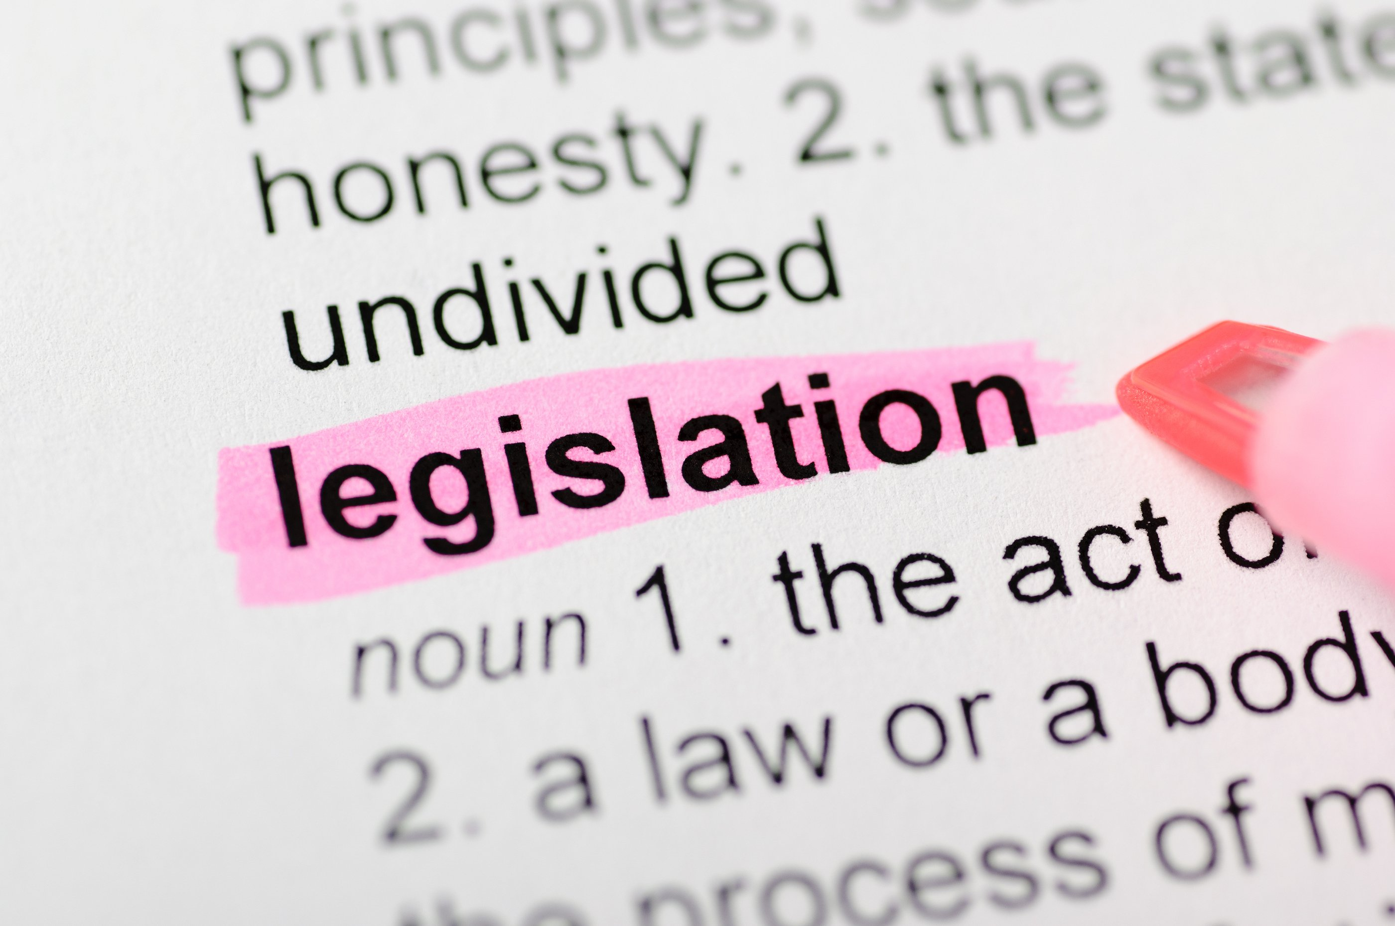
Recovered
Material
Processing
facility
As defined in § 22-27-2 of the SWRMMA:
  “A facility primarily engaged in the storage, processing, and resale or reuse of recovered materials. A recovered materials processing facility is not a solid waste management facility; however, any solid waste resulting from the operation of a facility shall be subject to all applicable laws and regulations relating to solid waste and shall be deemed to be generated for purposes of reporting pursuant to solid waste reduction goals, at the point of collection of the recovered materials from which the solid waste resulted. A recovered material processing facility shall provide notification to the department according to rules adopted by the department.”

Slide 5

ADEM’s 2010
Processing &
recycling
regulations
Registration of recycling facilities
Recordkeeping and reporting requirements for use in gathering data in support of statewide goal
Facility design and operational requirements
Material throughput requirements to expose “sham recycling” operations
Specifically exempted end users

Slide 6

Key changes in 2025 revisions
Adds definition of “End-use manufacturing facility” to 335-13-1-.03
“A site that converts a recovered or recyclable material to be utilized in place of a raw material and adds value as a final product or as an ingredient in a subsequent product... An end-use manufacturing facility shall provide notification to the Department according to the rules adopted by the Department.”
ADEM considers EUMFs to be a subset of RMPFs
Removes exemption for manufacturing facilities
Requires registration by EUMFs (335-13-3-.07)
  Within 180 days for existing facilities, 45 days for new
  Name. location, contact info, types of materials used
Triennial reporting requirement (Due by Feb. 15, 2029)
  Type(s) of recovered materials utilized
  Other “voluntary” information
Facility closure notification requirements
Adopted by EMC June 13; effective date August 14

Slide 7

Key points
Much of Alabama manufacturing utilizes recovered materials as raw materials
Existing manufacturers must register with ADEM as an “EUMF” by mid-February 2026
New “EUMFs” must register within 45 days prior to receipt of recovered materials
ADEM must be notified of a change in ownership of “EUMFs” within 30 days
Initial triennial reports for 2026-2028 are due by February 15, 2029

Slide 8


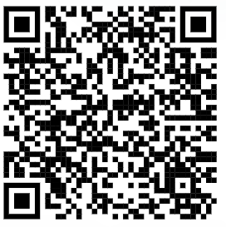
  Thank you!
Phil Davis, p.e.
Senior engineer – regulatory affairs
(334) 239-6450
pdavis@LaBellaPC.com
https://www.labellapc.com/markets/waste-recycling/

