Slide 1
Land Division Update
Stephen A. Cobb, Chief
Land Division
Manufacture Alabama HR, Safety, and Environmental Conference
July 31, 2025
Birmingham, Alabama

Slide 2

Land Division Update
Personnel Update
EPA Initiatives
Emerging Contaminants – PFAS
CCR Update
Compliance Activities
Recycling Update
Rulemaking Update
Program Modernization

Slide 3
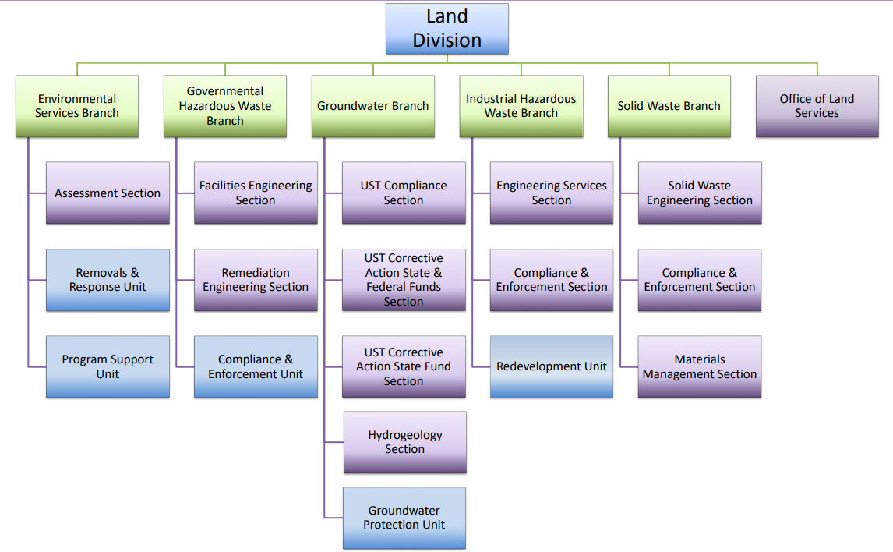
Land Division Organizational Chart

Slide 4
Land Division
Branch Chiefs
Clethes Stallworth, Chief – Environmental Services Branch
  334-271-7743 – cs@adem.alabama.gov
Ashley Mastin – Governmental Hazardous Waste Branch
  334-271-7789 – atmastin@adem.alabama.gov
Chip Crockett, Chief – Groundwater Branch
  334-271-7832 – vhc@adem.alabama.gov
Sonja Favors, Chief – Industrial Hazardous Waste Branch
  334-270-5627 – smb@adem.alabama.gov
Jason Wilson, Chief – Solid Waste Branch
  334-271-7755 – jwilson@adem.alabama.gov

Slide 5

Recent Personnel Changes
Facilities Engineering Section Chief
Richard Jannett
334-271-7786
richard.jannett@adem.alabama.gov
Remediation Engineering Section Chief
Mary Catherine Muscha
334-271-7797
mary.muscha@adem.alabama.gov
IHWB C&E Section Chief
Jennifer McCord
334-271-7894
jennifer.mccord@adem.alabama.gov

Slide 6
EPA’s Powering the Great American Comeback Initiative
Pillar 1: Clean Air, Land, and Water for Every American
Pillar 2: Restore American Energy Dominance
Pillar 3: Permitting Reform, Cooperative Federalism, and Cross-Agency Partnership
Pillar 4: Make the United States the Artificial Intelligence Capital of the World
Pillar 5: Protecting and Bringing Back American Auto Jobs See the link below for additional information:
https://www.epa.gov/newsreleases/epa-administrator-lee-zeldin-announces-epas-powering-great-american-comeback

Slide 7

  CCR Authorization Update
  Program Authorization
    Package submitted to EPA - December 29, 2021
    Final denial by EPA (effective July 8, 2024)
  Next Steps
    Appeal EPA Decision ?
    Amend state regulations as federal rules are updated
    Department continues implementation of closures and corrective measures
    Monitoring recent developments
      EPA’s July 10, 2025, “Disinvestment” from April 22, 2024, EPA’s Free Liquids Memorandum
      Proposed ND CCR Program Approval
      Anticipate Wyoming’s CCR Program Approval
  CCR facilities are subject to both state and federal rules
      Until Alabama program approved by EPA

Slide 8
  CCR Authorization Update
    Updated federal rules:
      Legacy Units ( Final Rule Effective November 8, 2024)
        Currently under appeal
        Currently under EPA re-evaluation?
      CCR Management Unit Deadline Extension Rule
        Federal Register publication: July 22, 2025
      Federal permitting program – timeline still uncertain

Slide 9
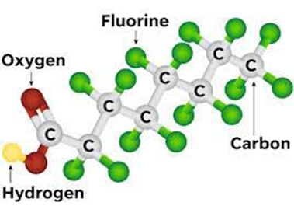
Emerging Contaminants
PFAS
Designation of PFOA and PFOS as CERCLA Hazardous Substances
  Published in the Federal Register on May 8, 2024
  Currently under appeal
  MCLs for six PFAS in drinking water
    Published in Federal Register on April 26, 2024
    May 14, 2025 - https://www.epa.gov/newsreleases/epa-announces-it-will-keep-maximum-contaminant-levels-pfoa-pfos
Listing of 9 Specific PFAS as RCRA Hazardous Constituents
  Proposed rule published February 8, 2024
  Public comment ended April 8, 2024
  EPA Interim Guidance on Destruction and Disposal of PFAS
  released March 2024
  Additional PFAS Information can be found at https://www.epa.gov/pfas/key-epa-actions-address-pfast

Slide 10

Hazardous Waste
Enforcement Update
On-going compliance assistance to reduce the number of significant non-compliers (SNCs) in program
  Quarterly outreach to TSDFs and Large/Small Quantity Generators
    via email
  Presentations at various conferences around state
  Video calls/discussions
  Development of videos for website posting
#1 Common Inspection Finding Leading to SNC Determination
  TSD Storage > 1 year or storage in unpermitted areas
  LQG Storage > 90 days
  SQG Storage > 180 days
Compliance Assistance Videos can be found on ADEM’s new website: https://adem.alabama.gov/compliance-assistance

Slide 11
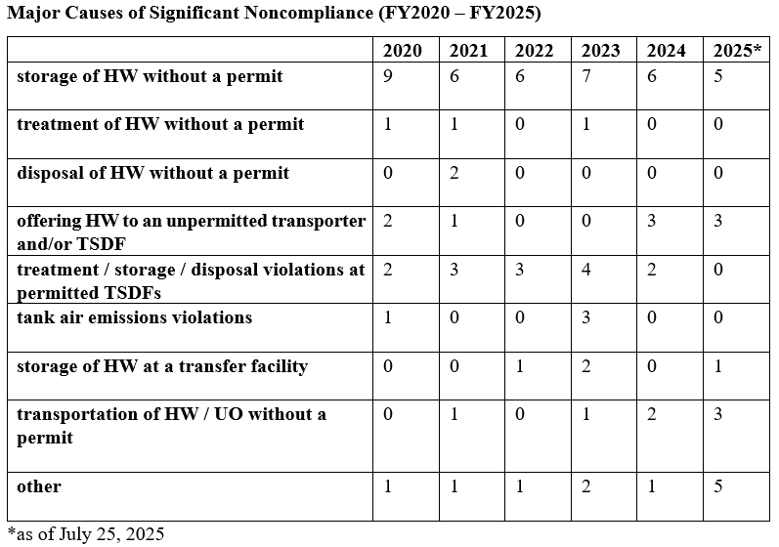
Hazardous Waste
Enforcement Update

Slide 12
Land Division Inspections
Records Availability During Inspections
On-site inspections often include reviewing documents or logs at the facility.
With today’s technology evolving, document handling methods are evolving too.
If the facility’s documents are kept electronically, then records should be made available to review electronically from the permittee’s computer.

Slide 13

Solid Waste
Enforcement Update
SW Compliance Priorities
  Failure to Cover
    Lack of over at end of day/week
    Exposing waste during new cell construction/liner tie-in
  Leachate
    Failure to properly collect/dispose
    Depth on liner > 12 inches
    Discharge to a water of the State
  Disposal in Unpermitted area
    Cell certification
    Lack of disposal boundary markers
  Disposal of Hazardous Waste
  Fire

Slide 14
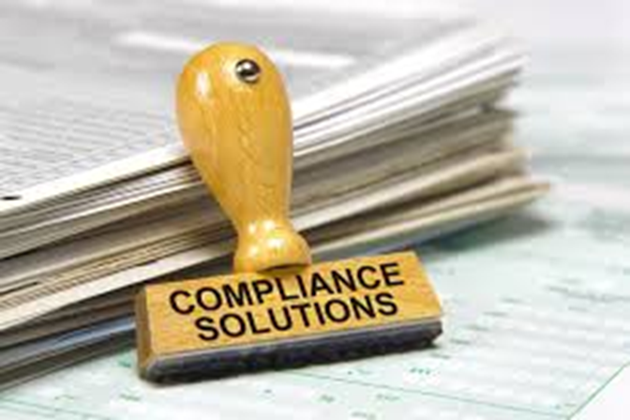
Solid Waste
Enforcement Update
Continued Focus Area
  Early morning inspections
    Conducted at the beginning of operations to observe opening conditions
  Increased follow-up presence to confirm observations or remedial actions
  Potential heightened enforcement/penalties for more serious violations

Slide 15
Recycling Update
Updated regulations, improving recycling information
  Statewide Recycling Study
  Improving reporting & collection of accurate recycling data
  Continued emphasis on expanding and upgrading collection and processing of recyclable materials
  Continued emphasis on public outreach and education
Alabama is where recycling happens:
    Iron and Steel
    Pulp and Paper
    Plastics
    Aluminum
    Rubber
    Glass
    Other
  Increased emphasis on connecting collection/processing with end use manufacturing

Slide 16
Rulemaking Update
  Scrap Tire (Division 4) –Effective August 12, 2024
    Updated scrap tire management requirements, including registration renewals requirements, scrap tire processing incentives, etc.
  Solid Waste (Division 13 – Recycling & SWMP) – Effective October 14, 2024
    Updated Statewide solid waste reduction goal from 25% to 40%, updated state SWMP and waste diversion calculation.
  UST – Tank Trust Fund (Division 6, Volume II) - Effective December 15, 2024
  Clarified provisions for payment of Emergency Response Costs up to $150,000 per emergency incident
  Solid Waste (Division 13 – Landfill Disposal) – Effective December 15, 2024
Restricts the disposal of whole tires in landfills after December 31, 2027
Requires that tires be cut into thirds or smaller pieces before disposal

Slide 17
Division 13
Recycling - Chapters 1 and 3
Anticipated Effective Date – August 14, 2025
  Chapter 1
    Updated definitions for consistency
    Added definitions for Energy Recovery Facilities (ERF), End-Use Manufacturing Facilities, and Whole Tires.
  Chapter 3
    Updated provisions and guidelines for Materials Recovery Facilities (MRF), Recovered Materials Processing Facilities (RMPF), Energy Recovery Facilities (ERF), and End-Use Manufacturing Facilities (EUMF).

Slide 18
Division 17
Medical Waste - Phase 1 & 2
Phase 1 - Effective Date – February 13, 2025
  Reorganization and clarification of rules by better grouping and consolidation of various regulatory components
Phase 2 – Anticipated Effective Date – August 14, 2025
  Updates to improve clarity and organization of the rules based upon experience gained and lessons learned.
  Added a new chapter, 335-17-8, for registration and permitting of medical waste facilities.

Slide 19
Future Rulemaking
Hazardous Waste - Div. 335-14
Anticipated Updates include:
  Conditional Exclusion for Carbon Dioxide (CO2) Streams in Geologic Sequestration Activities
    Published in the Federal Register on January 3, 2014
  Disposal of Coal Combustion Residuals From Electric Utilities
    Published in the Federal Register on April 17, 2015
    Codifying list of fossil fuel combustion related wastes that are not subject to hazardous waste regulations when co-disposed with CCR.
  Test Method for Standards to Control Organic Emissions
    Published in the Federal Register on March 20, 2023
  Technical Corrections for the Hazardous Waste Generator Improvements Rule, the Hazardous Waste Pharmaceuticals Rule, and the Definition of Solid Waste Rule
    Published in the Federal Register on August 9, 2023

Slide 20
Future Rulemaking
Anticipated Updates include (continued):
  Integrating e-Manifest With Hazardous Waste Exports and Other Manifest-Related Reports, PCB Manifest Amendments, and Technical Corrections
    Published in the Federal Register on July 26, 2024
  Management of Certain Hydrofluorocarbons and Substitutes Under the American Innovation and Manufacturing (AIM) Act of 2020
    Published in the Federal Register on October 11, 2024
  Second Technical Corrections to Hazardous Waste Generator Improvements, the Hazardous Waste Pharmaceuticals, and the Definition of Solid Waste Rules
    Published in the Federal Register on December 11, 2024
May include additional updates and clarifications.
Targeting December EMC Meeting

Slide 21
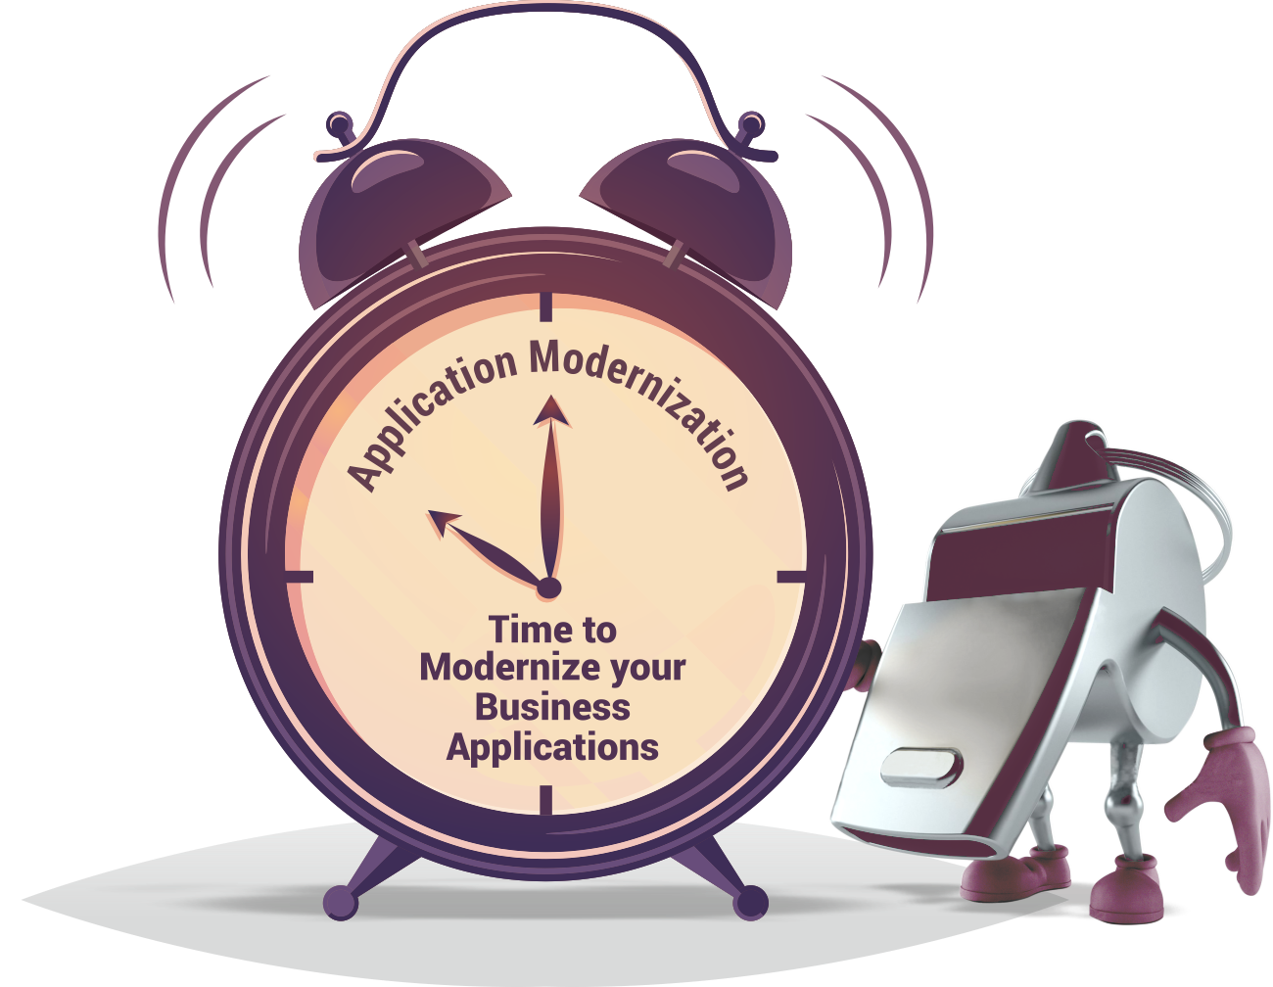
Program Modernization: AEPACS
Alabama Environmental Permitting and Compliance System (AEPACS)
Department’s new electronic data system
  Facilities can apply for and maintain permits
  Apply for registrations and certifications
  Allows payment of application fees
  Allows facilities to electronically submit required compliance reports and other information to ADEM
  Goal is to reduce paper and improve efficiency

Slide 22
Program Modernization: AEPACS
Land programs currently operating in AEPACS:
  Beneficial Use
  Recycling Program (Registrations and Grant Fund)
  Scrap Tire Program (Registrations/Permits & Grant Fund)
  Unauthorized Dump/Scrap Tire Sites
  County Right of Way Program – Scrap Tire and Unauthorized Dumps
  UST Program (Compliance & Corrective Action)
Development of other Land program components scheduled for 2025/2026:
  Solid Waste (Landfills/CCR/Composting) – September 8, 2025, Production Date
  8700-12 (data migration), Hazardous Waste Transporters, and Medical Waste

Slide 23
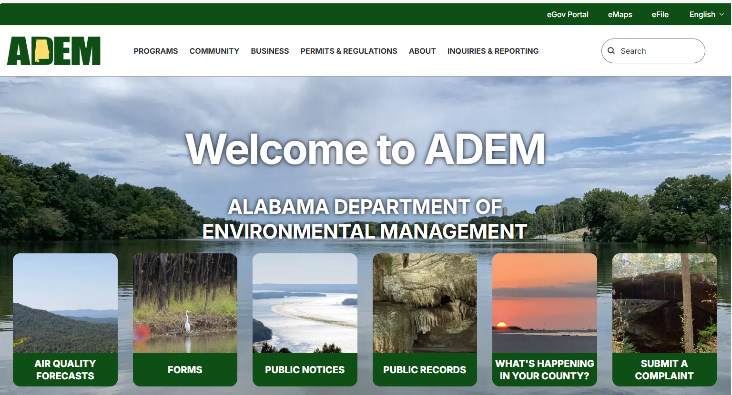
Program Modernization:
NEW Website (New Look)
  To Report Website Issues: email webmaster@adem.alabama.gov with any concerns.
  Please note the webmaster cannot answer regulatory questions, complaint questions, etc.

Slide 24

  Contact Information
Stephen A. Cobb, Chief
Land Division
(334) 271-7730
sac@adem.alabama.gov

