Slide 1
On the Economic, Business & Political Climate Roger Tutterow, Ph.D. Coles College of Business Kennesaw State University rtuttero@kennesaw.edu
Manufacture Alabama
Annual Meeting
September 13, 2024
Point Clear, AL

Slide 2
Topic #1:
In the post-Covid world, was the “recession talk” premature?

Slide 3
Contributions to GDP Growth (source: Bureau of Economic Analysis; Gross Domestic Product)
 | GDP = | Consumption | Gross Investment | Net Exports | Government
2022: Q1 | -2.00% | -0.03% | 1.16% | -2.59% | -0.52%
2022: Q2 | -0.60% | 1.32% | -2.10% | 0.56% | -0.34%
2022: Q3 | 2.70% | 1.05% | -1.45% | 2.58% | 0.49%
2022: Q4 | 2.60% | 0.79% | 0.62% | 0.26% | 0.90%
2023: Q1 | 2.20% | 2.54% | -1.69% | 0.58% | 0.82%
2023: Q2 | 2.10% | 0.55% | 0.90% | 0.04% | 0.57%
2023: Q3 | 4.90% | 2.11% | 1.74% | 0.03% | 0.99%
2023: Q4 | 3.40% | 2.20% | 0.15% | 0.25% | 0.79%
2024: Q1 | 1.40% | 0.98% | 0.77% | -0.65% | 0.31%
2024: Q2 | 2.80% | 1.57% | 1.46% | -0.72% | 0.53%
 | Gross Investment | Nonresidential | Residential | Inventory
2022: Q1 | 1.16% | 1.32% | -0.09% | -0.07%
2022: Q2 | -2.10% | 0.68% | -0.73% | -2.05%
2022: Q3 | -1.45% | 0.62% | -1.41% | -0.66%
2022: Q4 | 0.62% | 0.24% | -1.23% | 1.61%
2023: Q1 | -1.69% | 0.76% | -0.22% | -2.22%
2023: Q2 | 0.90% | 0.98% | -0.09% | 0.00%
2023: Q3 | 1.74% | 0.21% | 0.26% | 1.27%
2023: Q4 | 0.15% | 0.50% | 0.11% | -0.47%
2024: Q1 | 0.77% | 0.59% | 0.59% | -0.42%
2024: Q2 | 1.45% | 0.69% | -0.05% | 0.82%

Slide 4
Industrial Production: From Peak (source: Federal Reserve)

Slide 5
Industrial Production: From Peak (source: Federal Reserve)

Slide 6
Consumer Sentiment (source: University of Michigan, Survey Research Center)

Slide 7
Retail Sales: YoY Change (source: U.S. Bureau of the Census, Federal Reserve Bank of St. Louis)

Slide 8
Personal Savings (source: U.S. Bureau of the Census)

Slide 9
“Excess” Personal Savings (source: data from U.S. Bureau of the Census, in Billions)

Slide 10
Leading Economic Indicators (source: Conference Board, 6 month change)

Slide 11
Topic #2:
Tight labor markets – Is the challenge easing?

Slide 12
Change in Payroll Employment (Source: Bureau of Labor Statistics)

Slide 13
Change in Payroll Employment (Source: Bureau of Labor Statistics)

Slide 14
Payrolls Growth (Source: Bureau of Labor Statistics; 3-month & 12-month growth rate)

Slide 15
Employment: by Sectors (source: Bureau of Labor Statistics, thru July 2024)

Slide 16
Recovery from Bottom (Source: Bureau of Labor Statistics)

Slide 17
Employment: Alabama [thru 2/20] (source: Bureau of Labor Statistics)

Slide 18
Employment: Alabama [thru 7/24] (source: Bureau of Labor Statistics)

Slide 19
JOLTS: Openings (Source: Bureau of Labor Statistics)

Slide 20
Topic #3:
Are supply chain imbalances resolved?

Slide 21
Freight: Shipments & Rate (source: Cass Freight Index, Seasonally Adjusted)

Slide 22
Global Supply Chain Pressure (Source: Federal Reserve Bank of New York)

Slide 23
Topic #3:
Inflation returned, now falling. Are we approaching the 2% target?

Slide 24
Inflation: Transitory or Persistent? (source: Bureau of Labor Statistics)
CPI up 0.1% in July – after being down 0.1% and flat in two previous months. Overall CPI up 2.9% over last 12 months.
Core CPI up 0.2% in July – after being up by 0.1% and 0.2% in two previous month. Core up 3.2% over last year.
Energy component was unchanged in July. The energy component is up 1.1% over the last 12 months.
PCE up 2.5% for 12 months ending in July, core PCE up 2.6% over the same period.

Slide 25
Inflation Expectations: Next 12 Months (source: University of Michigan)

Slide 26
Energy Cost: Oil & Natural Gas (source: U.S. Energy Information Administration)

Slide 27
Construction Cost thru June 2024 (source: Bureau of Labor Statistics; Associated Builders & Contractors)

Slide 28
Topic #5:
Fed signals “peak rates”, but when do rate cuts start?

Slide 29
Federal Funds Rate (source: Board of Governors of the Federal Reserve System)

Slide 30
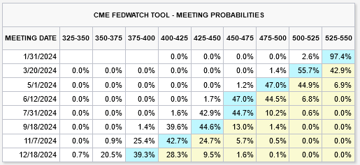
Market’s Expectation for Federal Funds Rate: Jan 18, 2024 (Source: CME Group)

Slide 31
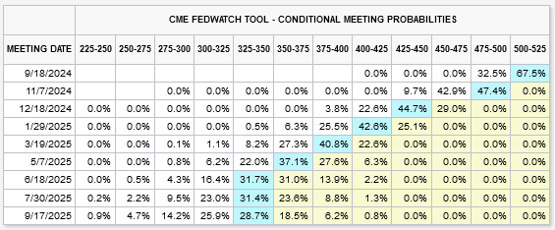
Market’s Expectation for Federal Funds Rate: August 30, 2024 (Source: CME Group)

Slide 32
10-Year Treasury Bonds (source: Board of Governors of Federal Reserve System)

Slide 33
Fed: Securities Held Outright (in millions, source: Board of Governors of Federal Reserve System)

Slide 34
Foreign Exchange: Broad Dollar

Slide 35
Mortgage Activity: Purchase & Refinance (Source: Mortgage Bankers Association)

Slide 36
C&I Loan Standards: Net Tightening (Source: Federal Reserve System, Senior Officers Lending Survey)

Slide 37
90+ Days Delinquent by Loan Type (source: Federal Reserve Bank of New York Credit Panel/Equifax)

Slide 38
Charge Off Rates at Banks (source: Board of Governors of the Federal Reserve System)

Slide 39
Topic #6:
Did Covid signal the death of “big box” and office?
And is housing market getting “frothy” again?

Slide 40
Construction Spending

Slide 41
Infrastructure Construction (Transportation, Power, Highway, Sewer, Water & Conservation; Source: U.S. Census Bureau)

Slide 42
Non-Residential Construction (Source: U.S. Census Bureau)

Slide 43
NAHB: Housing Market Index

Slide 44
US Housing Permits: SF and Total (source: U.S. Census Bureau)

Slide 45
US Housing Permits: Multi-family (source: U.S. Census Bureau)

Slide 46
AL Housing Permits: SF and Total (source: U.S. Bureau of Census)

Slide 47
AL Housing Permits: Multi-family (12 month moving average)

Slide 48
Permits by MSA:2023 (source: Standard & Poor’s Case-Shiller)

Slide 49
Case Shiller: National Index (source: Standard & Poor’s Case-Shiller)

Slide 50
Home Prices: Alabama (w/post-pandemic surge)

Slide 51
Home Prices: Alabama (pandemic surge)

Slide 52
Housing Affordability: Rate Effect (source: S&P Case-Shiller, Freddie Mac)

Slide 53
Comments on Risk & Capital Markets
Can we accurately access the impact of rising rates on credit risk?
Will tighter underwriting restrict ability to refinance/refund debt markets? Credit tightening may be more about leverage more than rates.
Will rise in private debt market continue?
Is there risk in liquidation of assets that support credits?

Slide 54
Topic #7:
Shared governance in 2024 . . . But can the parties govern themselves?
And what about demographic trends?

Slide 55
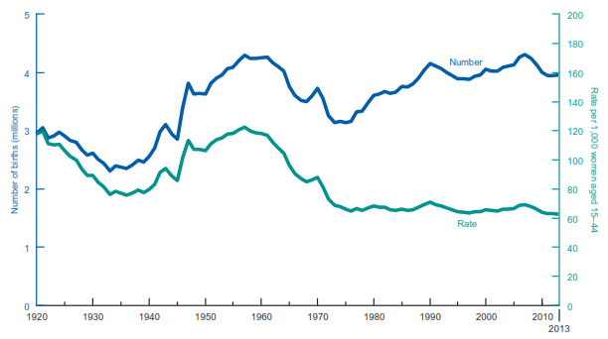
The Demographics: Boom & Bust (source: U.S. Census Bureau)

Slide 56
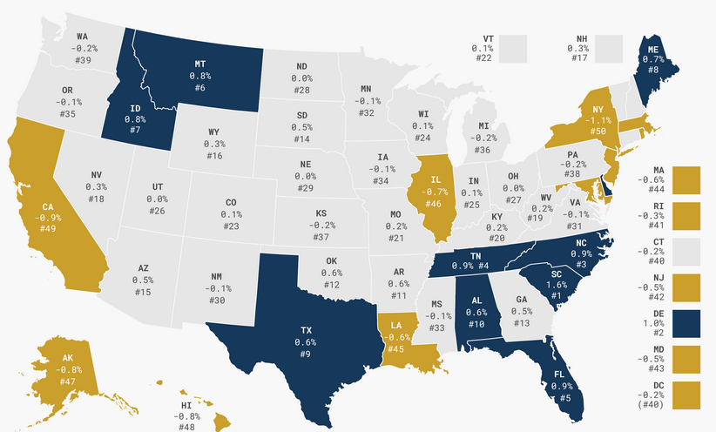
Internal Migration (source: Tax Foundation, 2023)

Slide 57
U.S. Federal Debt/GDP (T12M, in $MM, source: U.S. Treasury)

Slide 58
U.S. Federal Debt “Service”/GDP (Quarterly, Debt times 10YR Treasury. source: FRED, U.S. Treasury)

Slide 59
Comments on Shifting Fiscal Policy
2017 TCJA (Tax Cuts and Jobs Act)
Corporate Tax Rate
Shifted to flat 21%
Shift between Global & Territorial Tax regimes
Changes in Depreciation & Net Loss Carryback
Individual Tax Rates
Cut in marginal tax rates
Treatment for Pass-Through Entities
Carried Interest
Estate Tax Structure
Increase in Credit
Step-up in Basis
Funding of IRS audit function

Slide 60
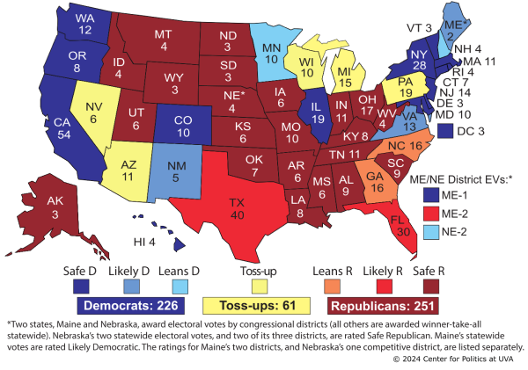
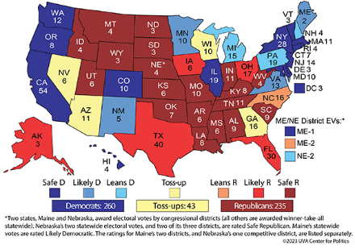
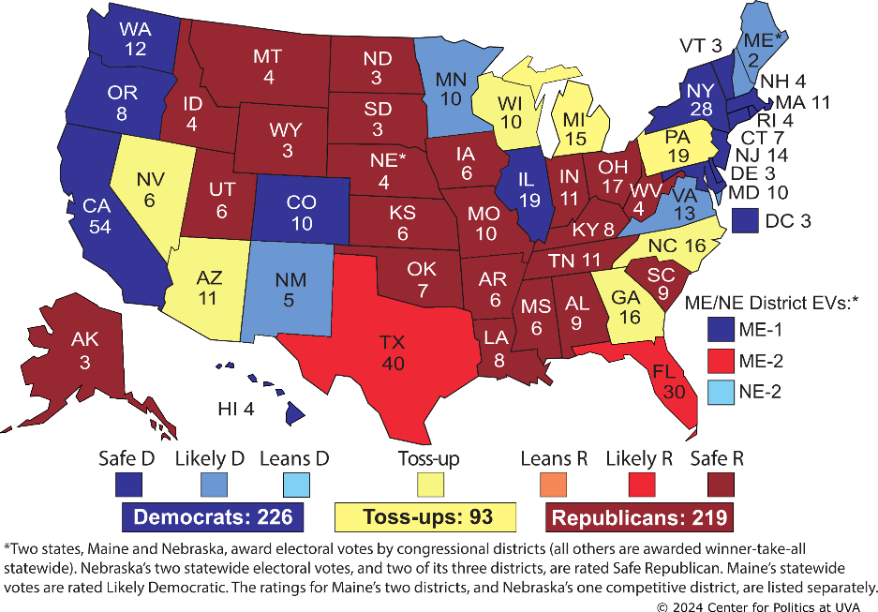
Election 2024: President (source: Sabato’s Crystal Ball; UVA)

Slide 61
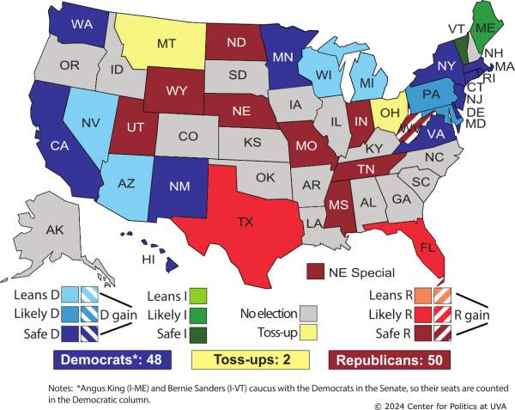
Election 2024: Senate (source: Sabato’s Crystal Ball; UVA)

Slide 62
On the Economic, Business & Political Climate Roger Tutterow, Ph.D. Coles College of Business Kennesaw State University rtuttero@kennesaw.edu
Manufacture Alabama
Annual Meeting
September 13, 2024
Point Clear, AL

