Slide 2
Youth Apprentices in Manufacturing
Employment Landscape
Typical Objections
Strategies for implementation

Slide 3
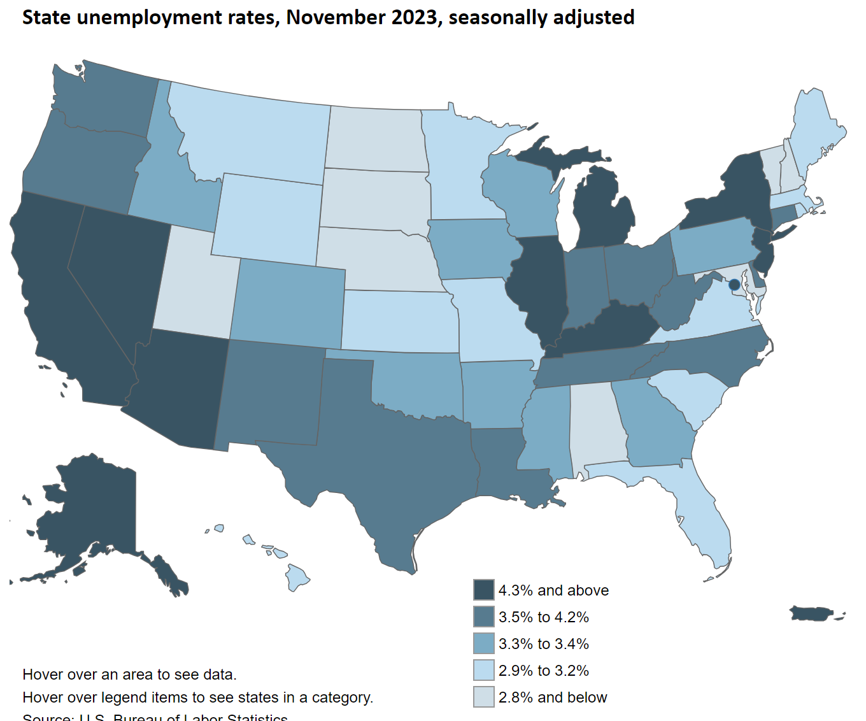
2.4%
~55k people
Source: U.S. Bureau of Labor Statistics.
Notes:
Nearly two open jobs for every one person looking for work.

Slide 4
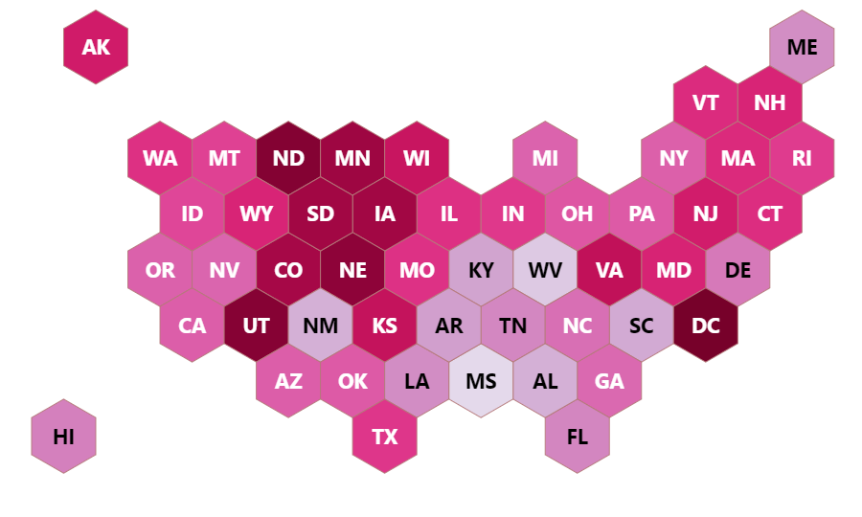
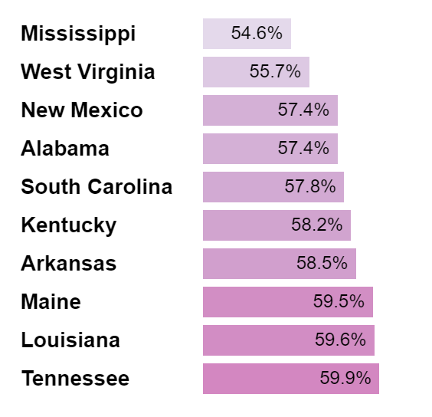
Labor Force Participation Rate- June 2023
National Avg: 62.8%

Slide 5
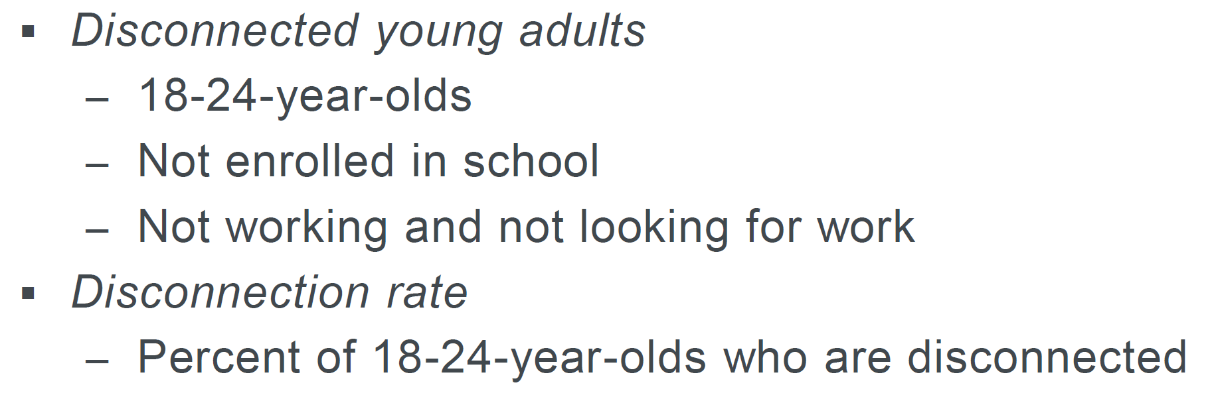
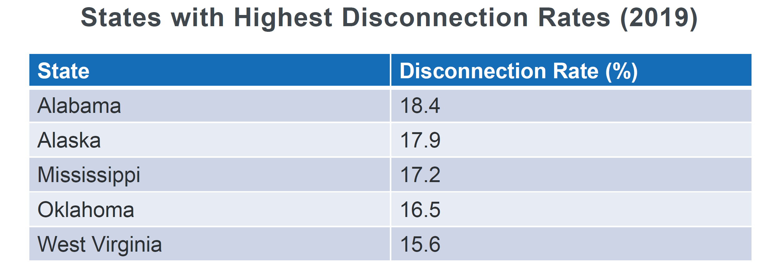
Disconnected Young Adults
Source: Dallas Federal Reserve
Notes:
June 2024- .19% of employed individuals in Alabama are apprentices (June Labor force “People Counted as Employed” 2,273,759. 4,339 active apprentices.)
June 2021- 2693 active apprentices/

Slide 6
548 (12.6%) of these apprentices are 16-18

Slide 7
Typical Objections
#1 - “THE LAW”
Alabama law does not restrict the employment of youth (16+) beyond the federal restrictions.
Federal law has specific exemptions for apprentices in many of the hazardous occupations.
#2 – “THE INSURANCE”
Worker’s compensation insurance is not calculated based on the age of the employee.
Younger workers typically recover more quickly from injury and have fewer days lost to injury.
#3 – Corporate Policy: THIS ONE IS ON YOU!

Slide 8
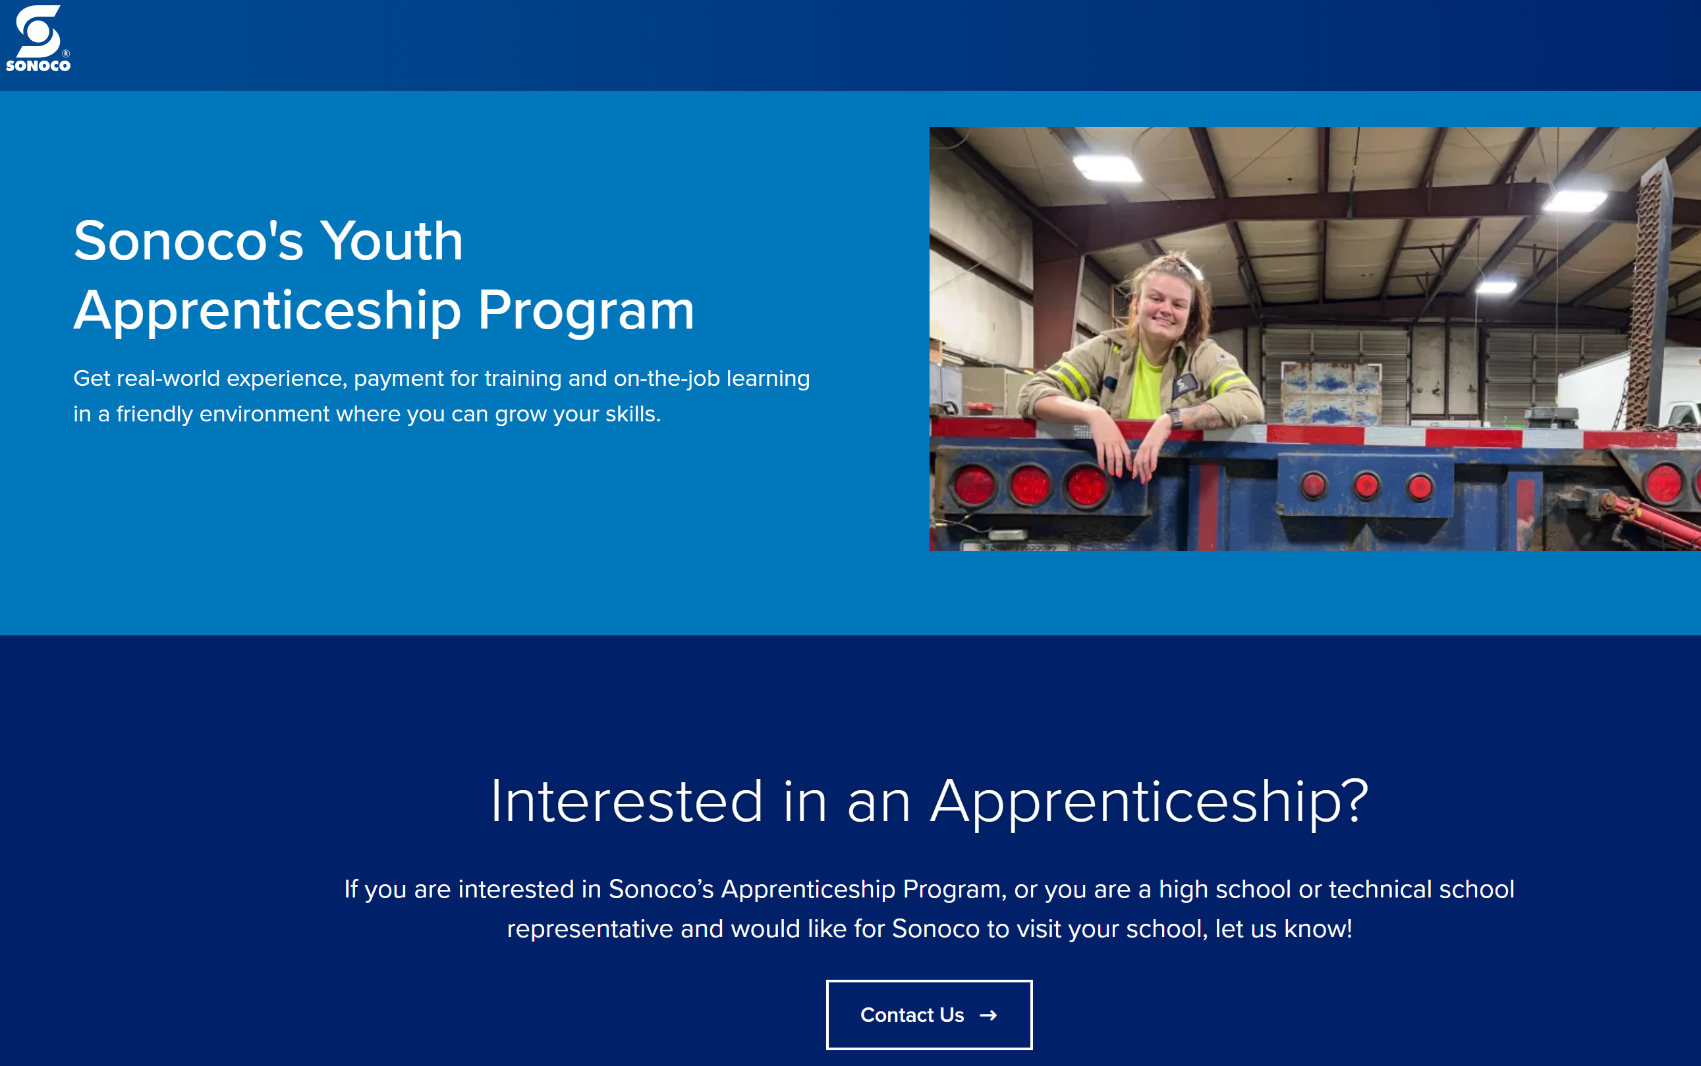
16
Hartselle High School (Sonoco)
Marathon Electrical Contractors
Mercedes-Benz U.S. International, Inc.
Southland International Trucks, INC. Southland Transportation Group
17
Airbus Americas, Inc.
BASF Mobile Emissions Catalysts LLC
Big River Electric, Inc.
Birmingham & Associates Inc.
Birmingham Ironworker Training Program Trust
Chickasaw City Schools
Coastal Alabama Community College
Dallas County/Selma City Schools
Hydro Green Erosion Control, LLC
Marathon Electrical Contractors
Mercedes-Benz U.S. International, Inc.
Midsouth Carpenters JATC (Birmingham)
Mid-South Carpenters Regional Council Training Trust Fund w/ N AL Carpenters (Florence) LU 1209 JATC
North Alabama Electrical Training Alliance
Northeast Alabama CC
Plumbers & Steamfitters Local Union 760 JAC
Southland International Trucks, INC. Southland Transportation Group
Southland Training Solutions, LLC.

Slide 9
Strategies for Implementation
Envision your workforce pipeline like your material supply chain
Let AOA help you design a program to meet YOUR needs
Designate a POC and make time for them
Start small

Slide 10
Josh.Laney@Commerce.Alabama.gov
Cell: 706-326-1324
LinkedIn.com/in/LaneyWorks

