Slide 1
Championing Change
Emily Buckman, Collins Aerospace
Claire Gini, Airbus

Slide 2
What is a Change Champion?
ⓘ Start presenting to display the poll results on this slide.

Slide 3
Which of the 4 do you need to attach greater intention?
ⓘ Start presenting to display the poll results on this slide.

Slide 4
What's still left undiscovered?
ⓘ Start presenting to display the poll results on this slide.

Slide 5
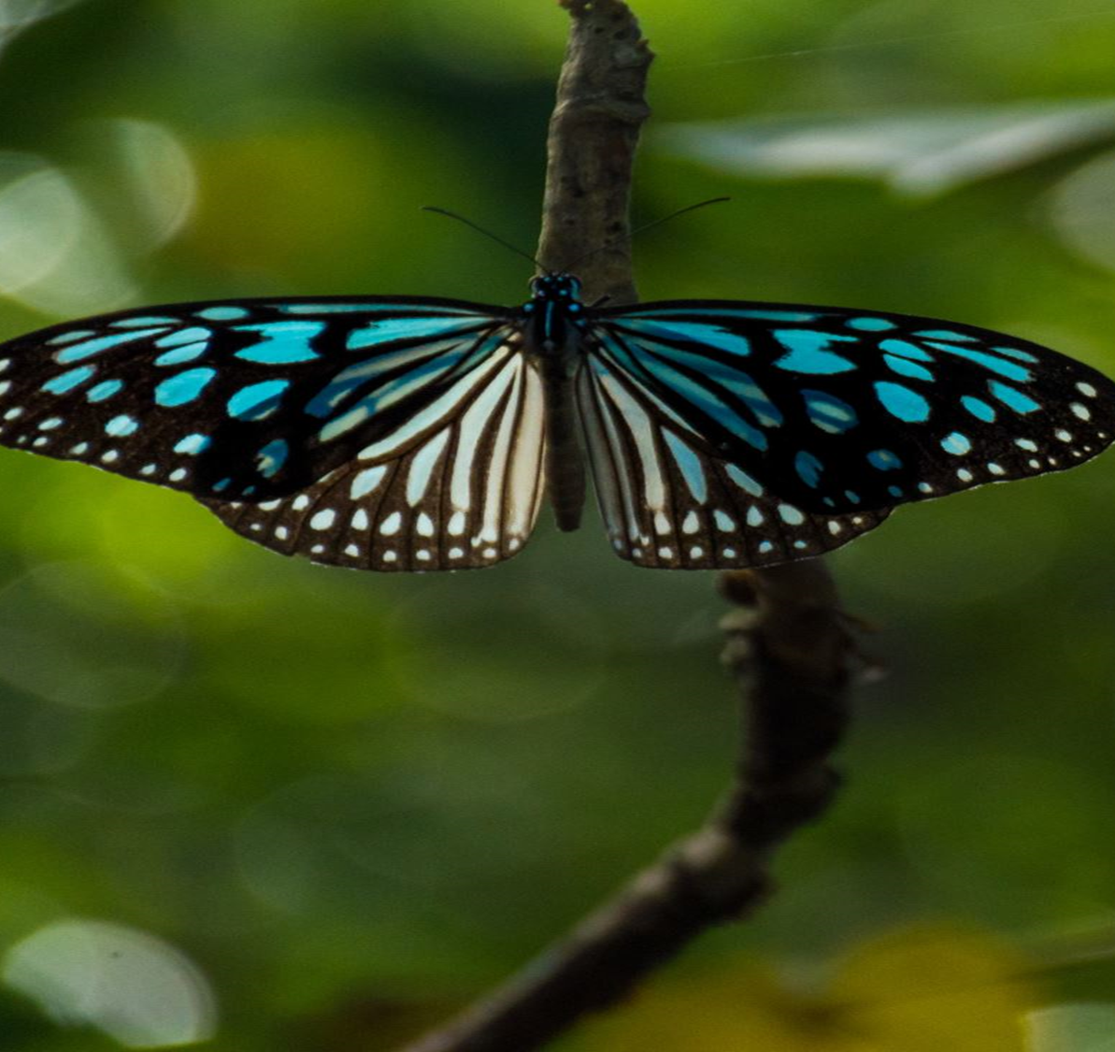
“We delight in the beauty of the butterfly but rarely admit the change it has gone through to achieve that beauty”
Maya Angelou

