Slide 1
Strategies for Career Ownership – Building Your Network and Personal Brand
Ali Snyder

Slide 2
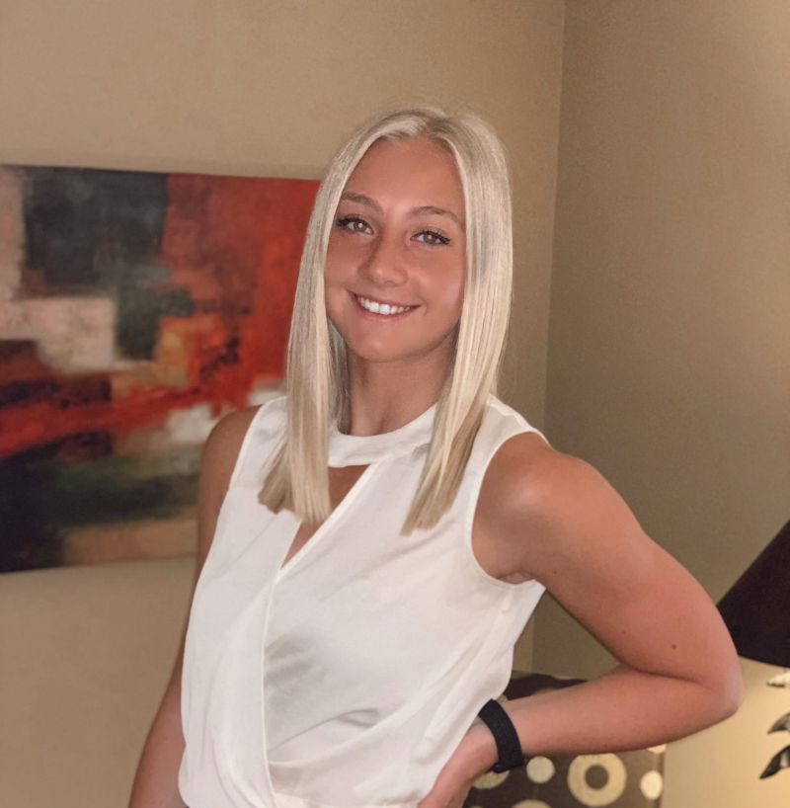
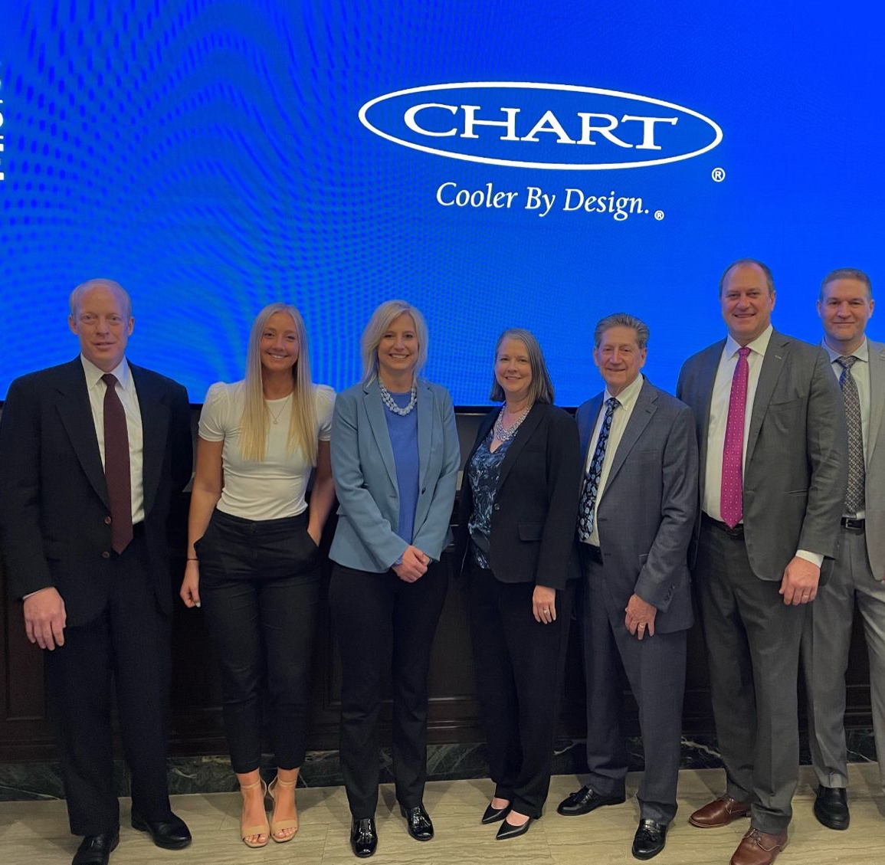
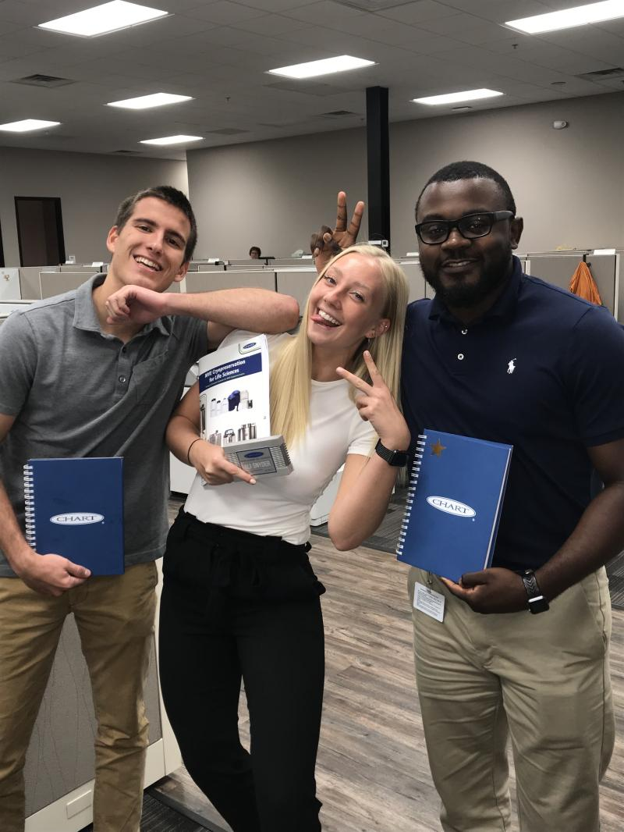
Personal Story: How Networking Has Led to Career Advancement
2019
2024
Moral of the Story: Say Yes to Every Opportunity!
Notes:
Construct(s): Timeline
Layout: Enhanced
Style: Basic

Slide 3
Why is Networking Important?
01
Makes you noticeable.
02
Leads to greater self-confidence.
03
Develops long-lasting relationships.

Slide 4
Building and Maintaining Professional Relationships
Communicate effectively.
Be reliable and dependable.
Don’t be afraid to speak up.
Be kind!

Slide 5
Creating a Strong Personal Brand
Your personal brand is how you want others to see you.
Identify your strengths and weaknesses.
Network internally beyond your current team.
Build a strong online presence (LinkedIn!).
Be positive, authentic, and consistent.

Slide 6
Questions?

