Slide 1
BEST TIPS FOR AWARD-WINNING REGAL ENTRIES
www.RegalAwardsDE.org
Notes:
DF – Hello Everyone and welcome to the 2025 Best Tips for Award-Winning Regal Entries.

Slide 2
WELCOME!
www.RegalAwardsDE.org
Notes:
DF –Today’s webinar is brought to you by the Sales & Marketing Committee of the Home Builders Association of Delaware. Please put your cell phones on vibrate and get to a quiet place so we lessen background noise and distraction. Also, the chat window is open, if everyone can just type in your name to introduce yourself, that will confirm you can hear us ok. We’ll answer questions throughout the webinar when possible AND also at the end. As a disclaimer, we are sharing tips today. Entering to win a Regal Award does not guarantee winning one, BUT we are hopeful that by using the tips we share, you’ll have an edge over your competition when entering to win a Regal Award! Alright, let’s get to it!

Slide 3
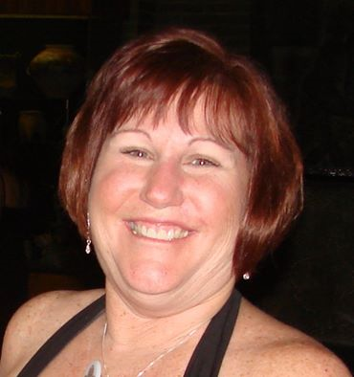
TODAY’S PRESENTERS
Dottie Fawcett – President Home Marketing Solutions, LLC
Jay Greene – President
Jay Greene Photography
regalawardsde.org
Notes:
DF – I am Dottie Fawcett, Owner of Home Marketing Solutions, LLC. Your host, moderator and one of the presenters today. I have submitted many award–winning Regal entries for clients, and have and been a national judge for numerous years, hopefully giving you lots of great suggestions. Jay Greene, President of Jay Greene Photography, is also co-presenting today. Jay creates advertising photography for top builders, architects and more. Plus, he has won Regal awards for clients and himself.

Slide 4
OVERVIEW OF TODAYS SEMINAR
• What are the Regal Awards?
• Why enter the Regal Awards?
• How to enter and possibly win a Regal Award.
• Regal Award category list
• Best tips & practices to help your chances of winning.
• Important deadlines and dates.
• When/Where is the Regal Award ceremony?
• BONUS: Enter by Jan 10, 2025 and enjoy 20% Discount TAKE ADVANTAGE!
regalawardsde.org
Notes:
DF - In today’s webinar we’ll cover… What are the Regal Awards?
• Why enter the Regal Awards?
• How to enter and possibly win an Award.
• Regal Award categories list – where to find it on the website
• Best Tips & Practices
• Important deadlines and dates.
• When/Where the Regal Award ceremony will be.
• BONUS: Enjoy a 20% Discount by entering by January 12, 2024 – so TAKE ADVANTAGE!
AND WITH THAT, I’ll turn it over to Jay!

Slide 5
WHAT ARE THE REGALS?
regalawardsde.org
Notes:
JG For over 30 years, the Home Builders Association of Delaware has been spotlighting outstanding achievements in Delaware’s Home Building Industry

Slide 6
WHY ENTER TO POSSIBLY WIN A REGAL AWARD?
regalawardsde.org
Notes:
JG – First off, it’s an opportunity for you to highlight your work, community, employees and more…

Slide 7
TOP 4 REASONS TO ENTER & POSSIBLY WIN A REGAL AWARD…
1. If you win, it positions your company as an expert in your field.
2. It is a great way to show your support for your team, staff and the Home Builders Association of Delaware.
3. And if you win, you gain bragging rights among your industry peers. Friendly competition is always good, right!
4.When you prepare a Regal Award entry, you are PREPARING CONTENT FOR YOUR ADVERTISING AND MARKETING!
regalawardsde.org
Notes:
JG – Here are the Top 4 reasons (read slide) Now back to you Dottie

Slide 8
BEFORE YOU ENTER
Visit HBADE.org/regal-awards/ & click Regal Award Entry Categories & Guidelines PDF. Pick the category(s) you’d like to enter. Then organize all your content, photos and/or art electronically to prepare for entering…
BEFORE you actually start entering data online.
regalawardsde.org
Notes:
DF

Slide 9
HOW TO ENTER
regalawardsde.org
Notes:
DF – At this point I am going to take you through our new Regal Award website.

Slide 10
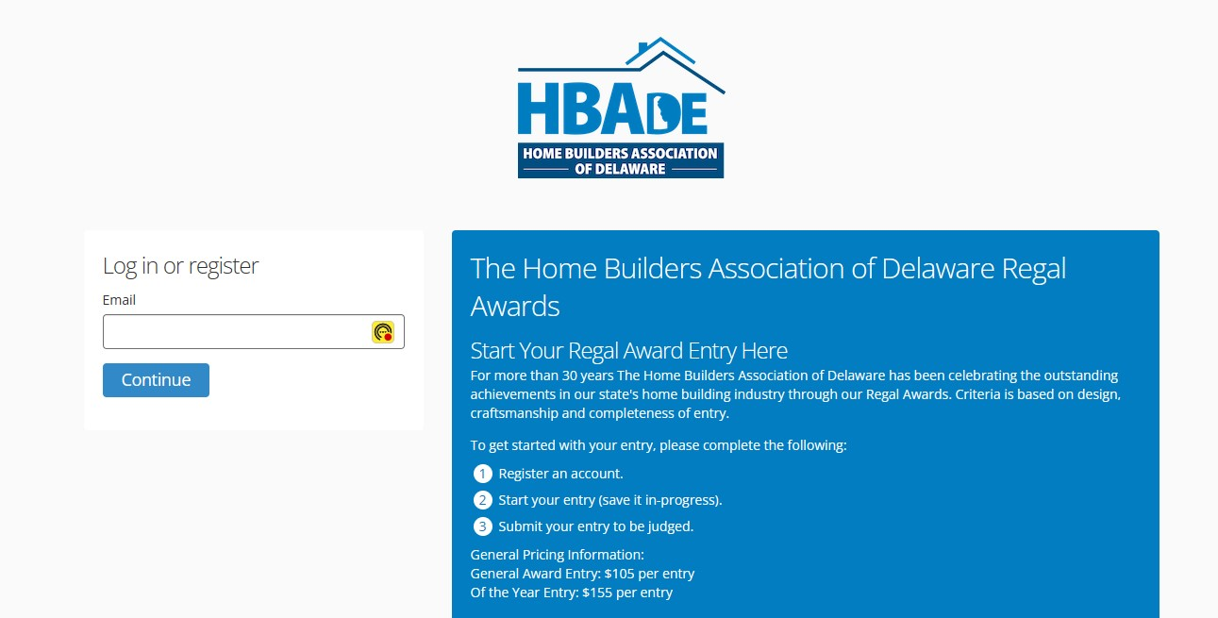
Visit RegalAwardsDE.org. It will forward you over to the Regal Award entry website https://regalawardsde.awards platform.com/
If you are a first time visitor, go ahead and fill in your Email address and click on the blue “Continue” button.
Then each time you come back to this page, you’ll just log in.
regalawardsde.org
Notes:
DF-

Slide 11
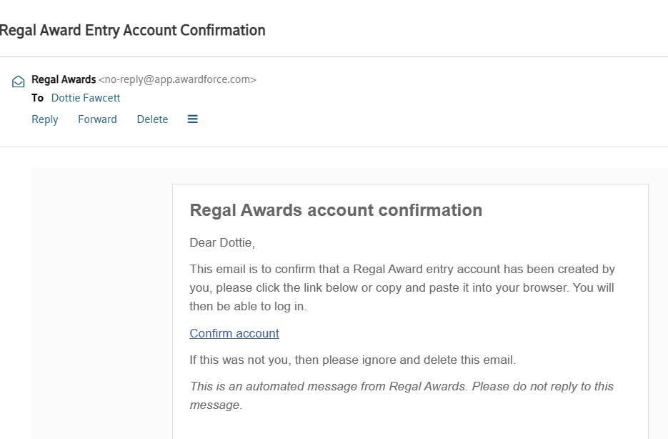
regalawardsde.org
Notes:
DF

Slide 12
regalawardsde.org
Notes:
DF

Slide 13
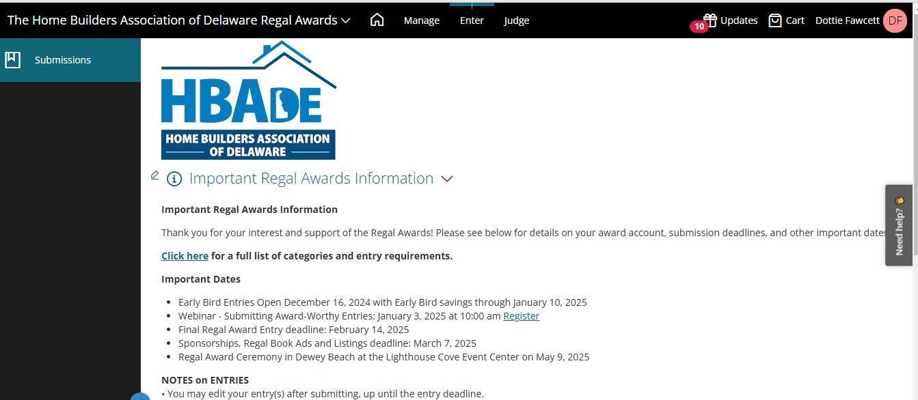
Notes:
DF

Slide 14
regalawardsde.org
Notes:
DF

Slide 15
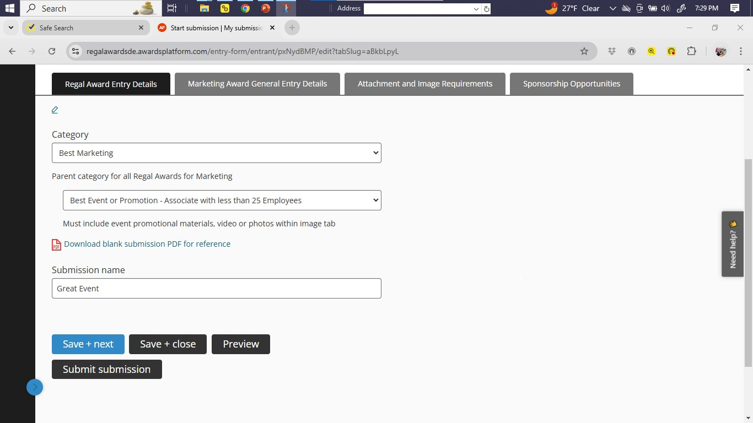
regalawardsde.org
Notes:
DF

Slide 16
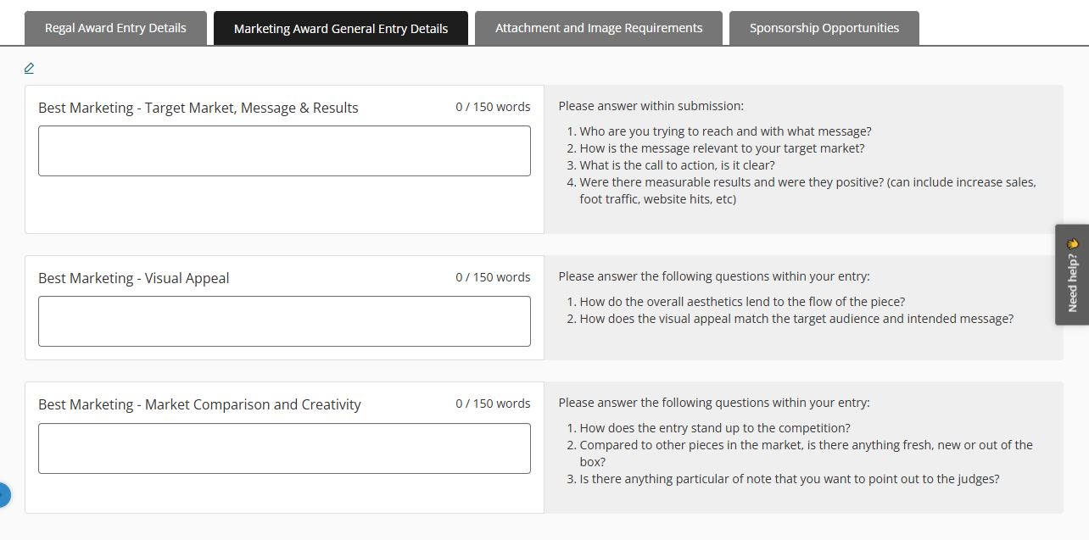
ANSWER THE QUESTIONS
ANSWER THE QUESTIONS
ANSWER THE QUESTIONS
Provide information you deem necessary to best present your entry to judges in the box. BE SURE TO ANSWER THE QUESTIONS!
regalawardsde.org
Notes:
DF

Slide 17
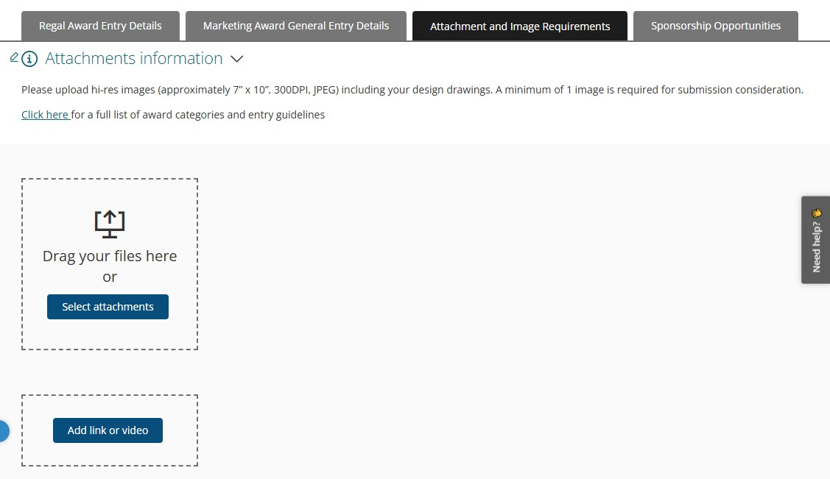
regalawardsde.org
Notes:
DF and then turn it over to Jay.

Slide 18
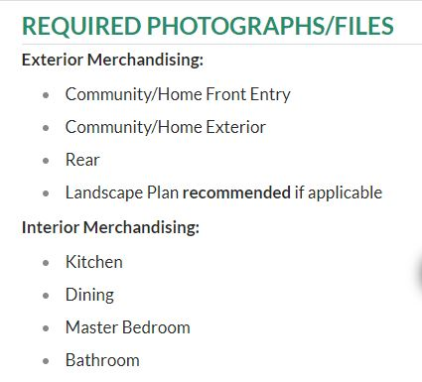
PHOTOGRAPHY REQUIREMENTS
TIP:
Remember to follow what is requested in the “Regal Entry Categories & Guidelines pdf”
regalawardsde.org
Notes:
JG – Thank you Dottie. In this example, Exterior Merchandising needs at least 3 photographs and a Landscape Plan. Refer to the Entry Guidelines to find the lists of necessary photographs in your entry category. I’m going to assume that you know how to follow directions and upload photographs. I will point out that if you are entering a Best of the Year category on page 2, that is an additional entry to the 3 or 4 mandatory categories listed beneath it. In other words, entering the 3 required categories does not automatically put you in the race for Best of the Year.

Slide 19
PHOTOGRAPHS & FILE SUBMISSIONS…
are used in the Regal Book - a professional publication. Image quality is very important and is a reflection of HBADE and your company.
All photographs must be at least 7 x 10 or 10 x 7, 300 DPI, Hi Resolution & JPEG Format Only.
regalawardsde.org
Notes:
JG: The RegalAawrdsDE.org website will accept any size photograph you send. You need to upload PDF or JPEG in 7”x10”. It will not accept TIFF, HEIC, RAW, DNG or any other file type. For example, use Preview or Photoshop, etc., to convert to JPEG for your upload. And make sure it is 300dpi. Should you win, this is the resolution needed for print.

Slide 20
START WITH WHY
WHY ENTER A REGAL AWARD?
Notes:
JG: Start with Why is a great book by Simon Sinek. Starting with WHY provides the answers to how and what to do. Too often we start with what. This time, let’s start with why.

Slide 21
WHY ENTER A REGAL AWARD?
WIN AWARD!
Notes:
JG: The intention to win an award does not give you a reason for its content. Winning the award is what you want, not why you want it.

Slide 22
WHY ENTER A REGAL AWARD?
CREATE MARKETING MATERIAL
Notes:
JG: Yes, a benefit of entering is that you will have marketing material, but it is actually answers HOW you enter the Award.

Slide 23
WHY ENTER A REGAL AWARD?
ATTRACT BUYERS!
Notes:
JG: The reason WHY you enter Regal Awards is to ATTRACT BUYERS. Now look at these answers in reverse.

Slide 24
HOW DO I ATTRACT BUYERS?
CREATE COMPELLING MARKETING MATERIALS
Notes:
JG: How you ATTRACT BUYERS is done many ways. One of which is through your Marketing and Advertising.

Slide 25
WHAT GOES INTO COMPELLING MARKETING MATERIALS?
ATTRACTIVE PHOTOGRAPHS
AND
RELATED TEXT
Notes:
JG: The photographs and text are the potential buyer’s link to your product. This fits the requirements of the Regal Award entry. The sale is made on an emotional level. Good photographs matter!

Slide 26
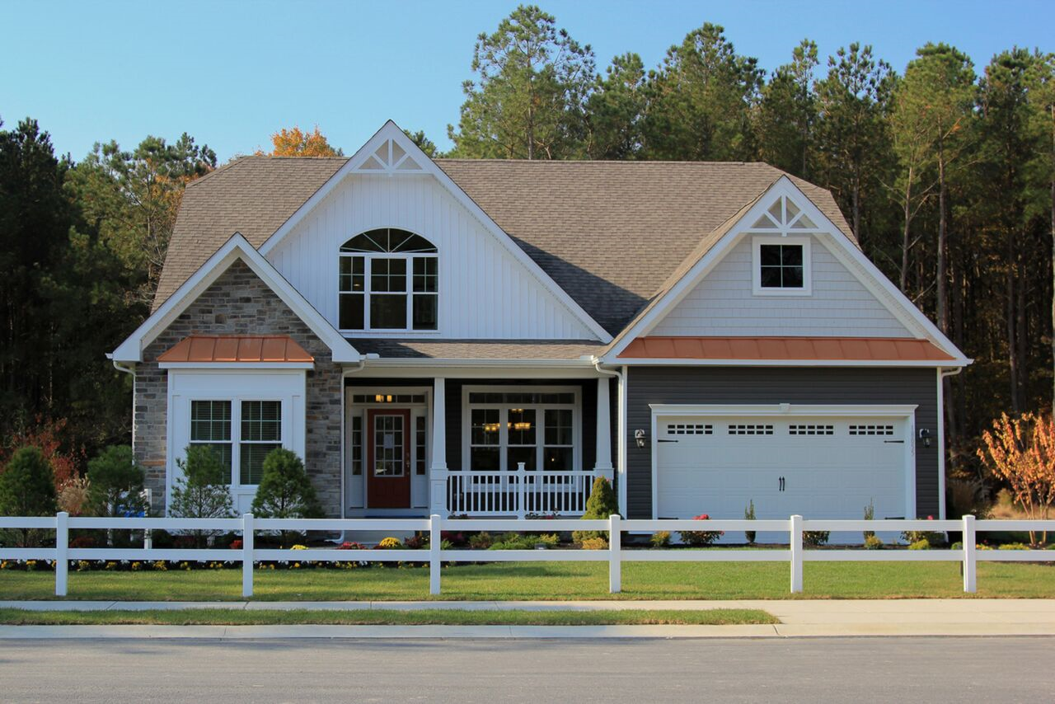
regalawardsde.org
Notes:
JG: The front elevation is the key to the entry. Try to make your photographs in a way that puts light on your subject (the front door). Is the street important?

Slide 27
regalawardsde.org
Notes:
JG: Same Builder, same model, but emphasis is given to the house with added light. Drama is created by capturing the intense blue sky and interior at the same time. It happens during a few minutes after sunset or before sunrise.

Slide 28
regalawardsde.org
Notes:
JG: A photograph at night is dramatic. It is my specialty.

Slide 29
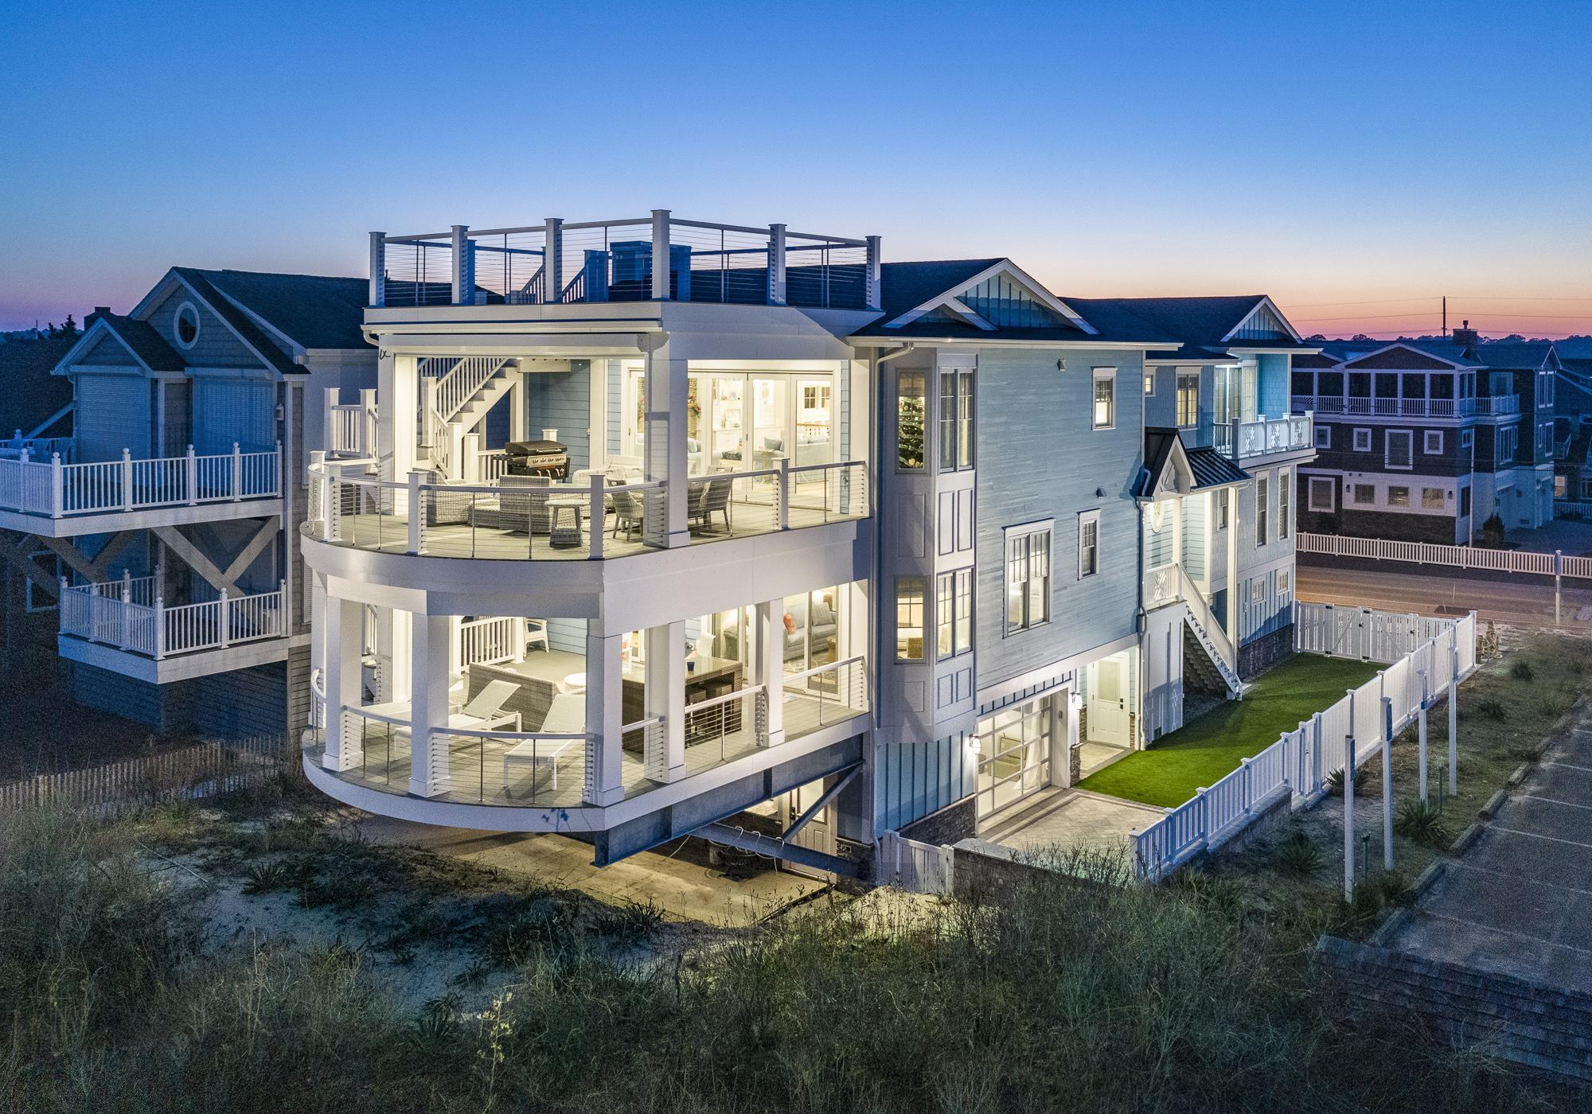
regalawardsde.org
Notes:
JG: But an Aerial photograph at night is Amazing!

Slide 30
regalawardsde.org
Notes:
JG: This is what you might get hand holding a camera on a cloudy day.

Slide 31
regalawardsde.org
Notes:
JG: This is how it looks if I add some sun using flash units. It is a sunroom after all.

Slide 32
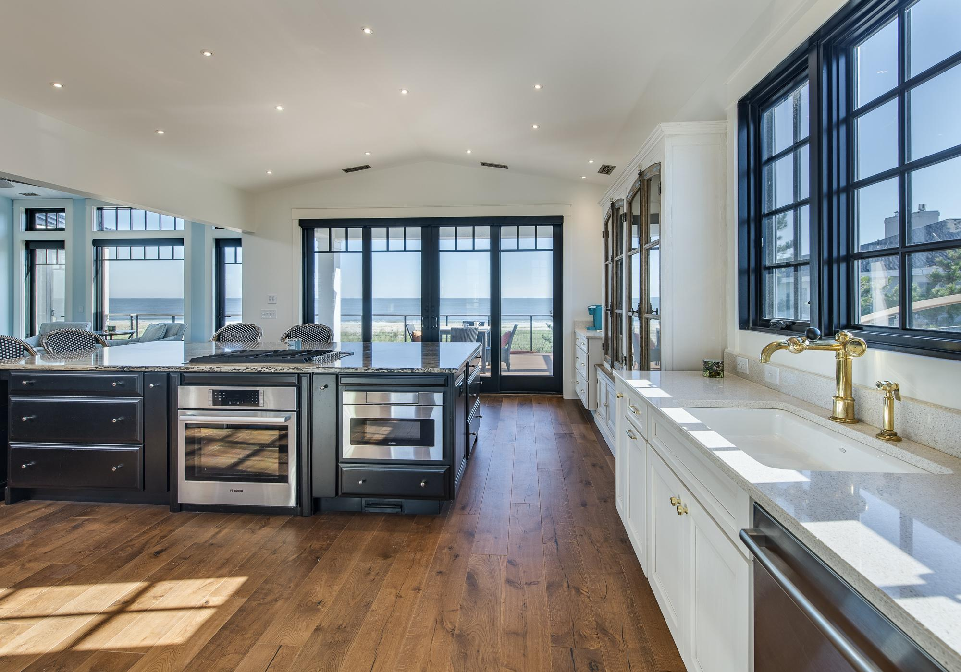
regalawardsde.org
Notes:
JG: In any photograph, Show what is important.

Slide 33
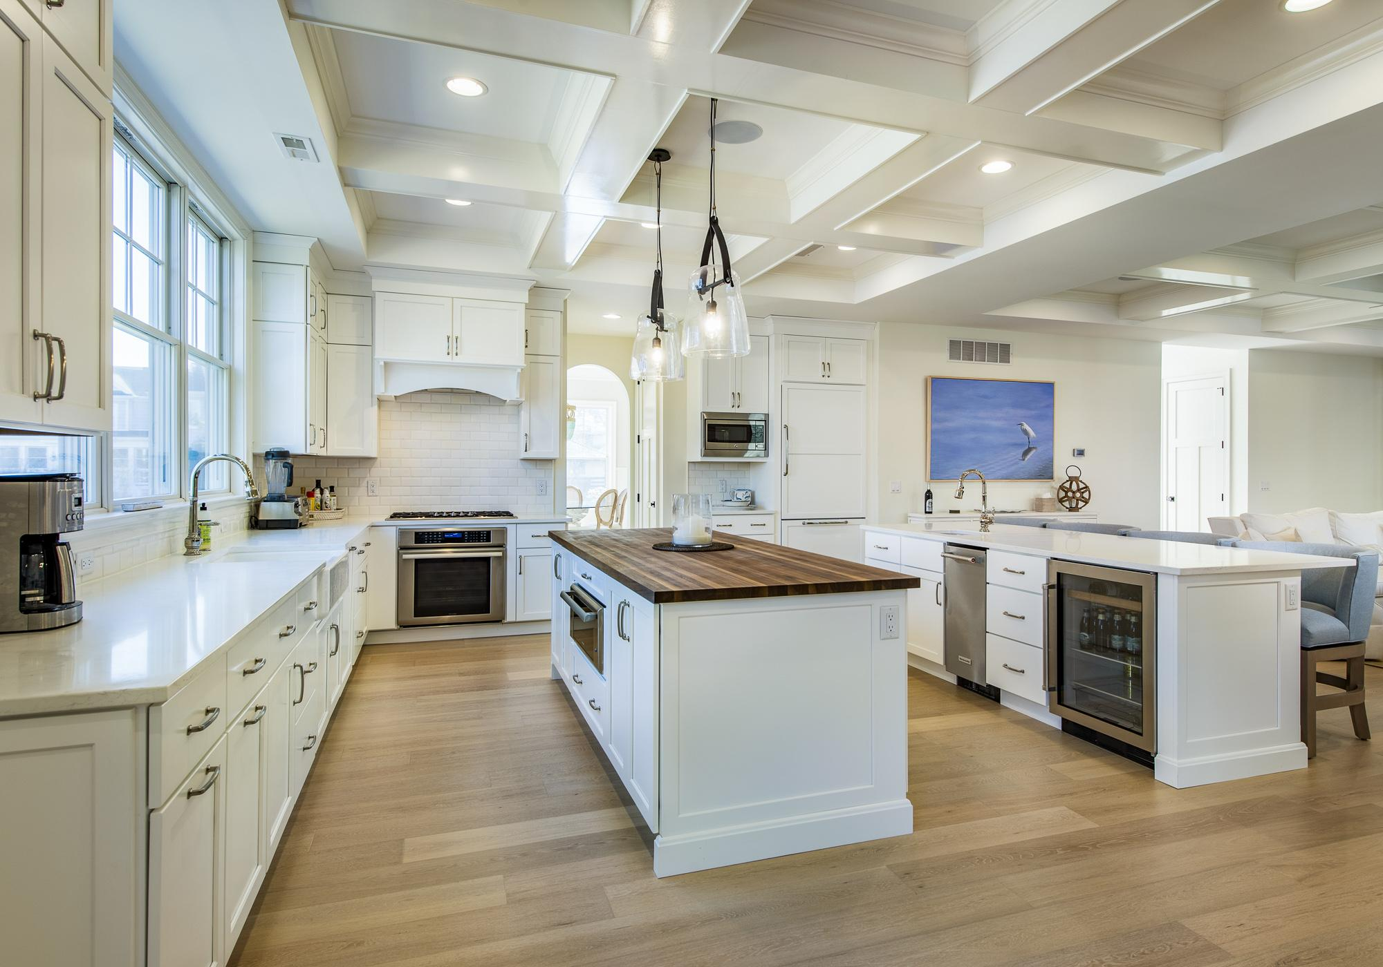
regalawardsde.org
Notes:
JG: If a kitchen has 2 islands, show both of them.

Slide 34
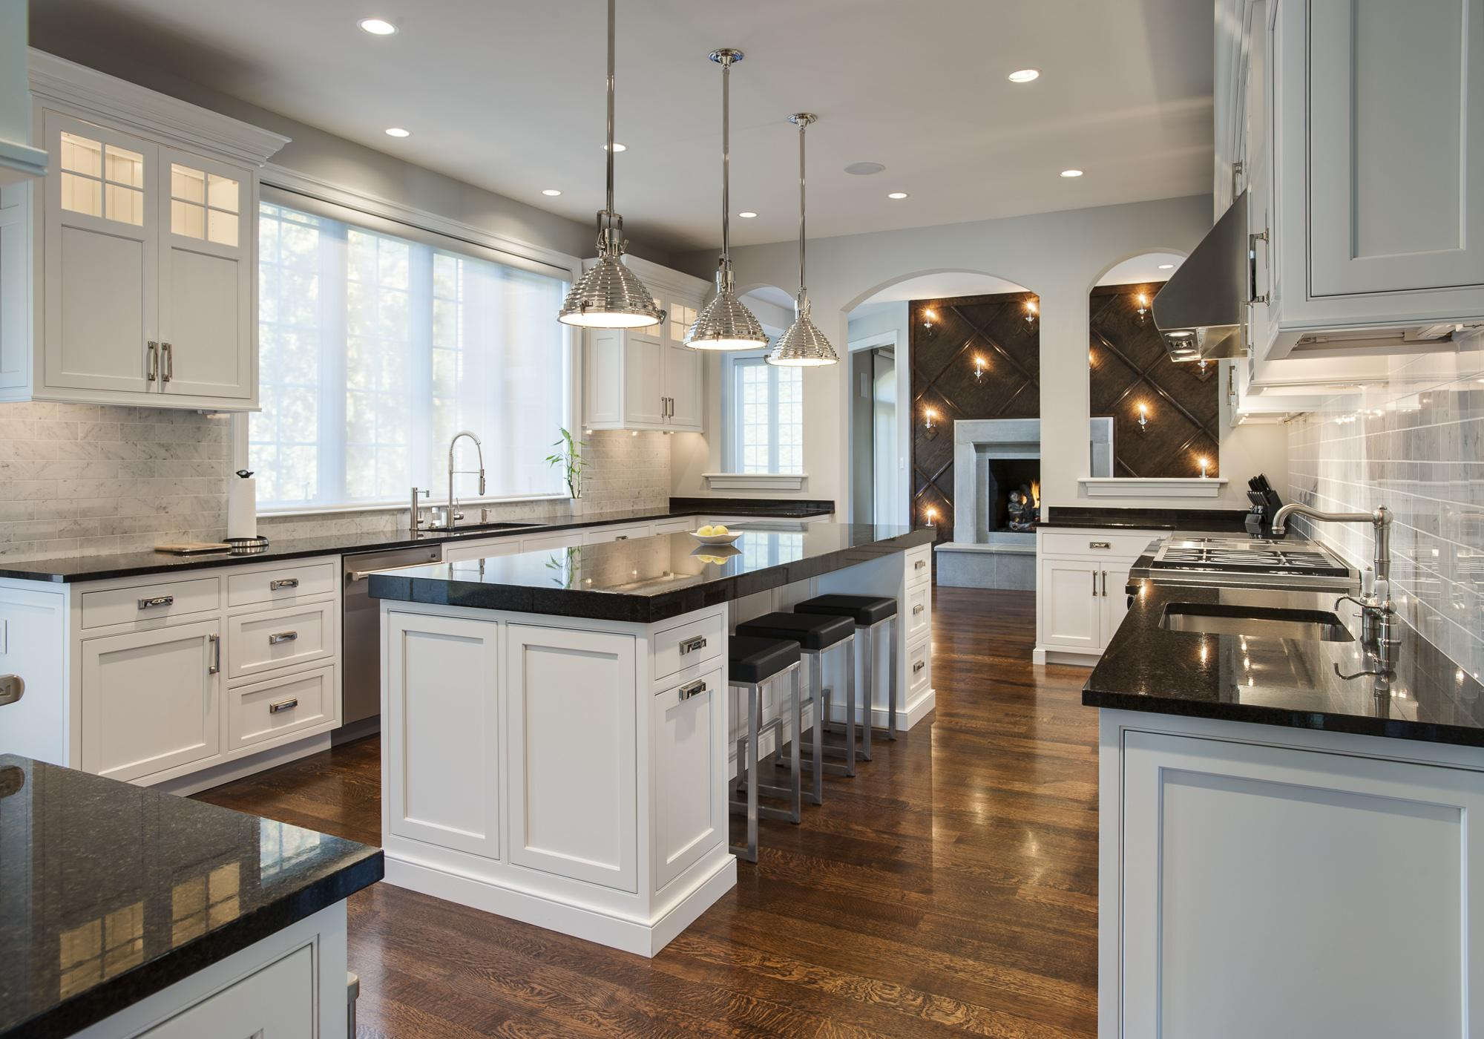
regalawardsde.org
Notes:
JG: There are many ways to Hide what is not important.

Slide 35
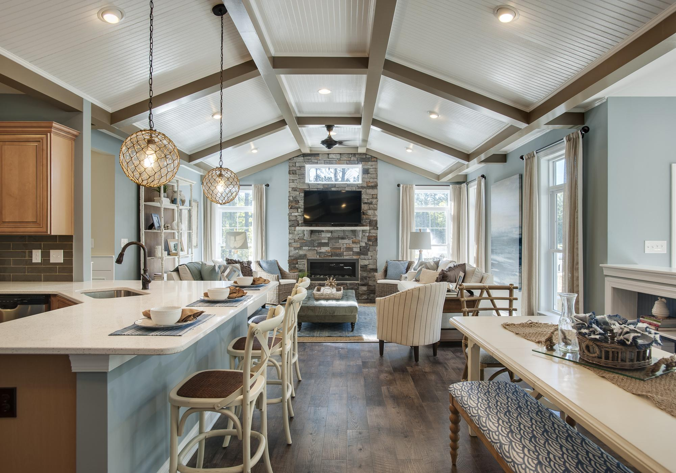
regalawardsde.org
Notes:
JG: Show how the rooms relate to one another.

Slide 36
regalawardsde.org
Notes:
JG: Show what a buyer wants to see.

Slide 37
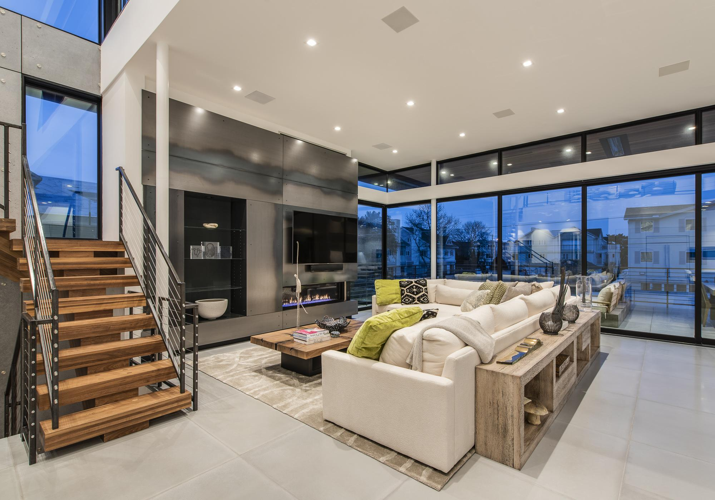
regalawardsde.org
Notes:
JG: Make photographs at dawn or dusk. They are more dramatic!

Slide 38
TIP
BEFORE AND AFTER PHOTOGRAPHS
Do not need to be made from the exact same vantage point.
They need to relate to one another.
regalawardsde.org
Notes:
JG: Remodelers need advertising quality photographs to attract buyers. They need to show how impressive the space looks now that you have done your work. The After photograph needs to include enough of the Before so that they are relatable.

Slide 39
TIP
When it comes to photography, not all photos are equal! Most smart phones have great photographing capabilities, and they work well for before photos. For your after photos however, seriously consider hiring a professional.
Your brand depends on it.
regalawardsde.org
Notes:
JG: And, as we have seen, good photographs are an important means to attract buyers! Back to you Dottie.

Slide 40
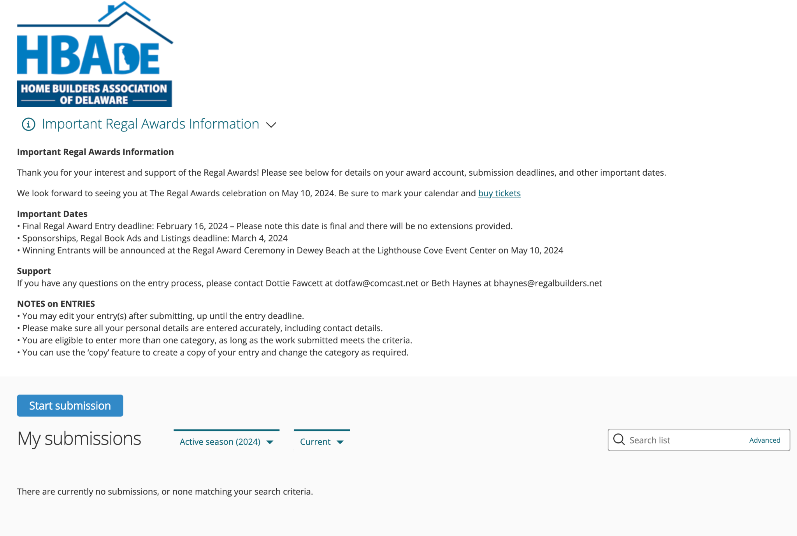
SAMPLE PREVIOUS REGAL AWARD ENTRY & WINNER: SEA LIGHT DESIGN-BUILD • BEST KITCHEN DESIGN for a REMODELER
regalawardsde.org
Notes:
DF - Thanks Jay for your valuable insight. Here’s an example of a previous entry that won a Regal Award

Slide 41
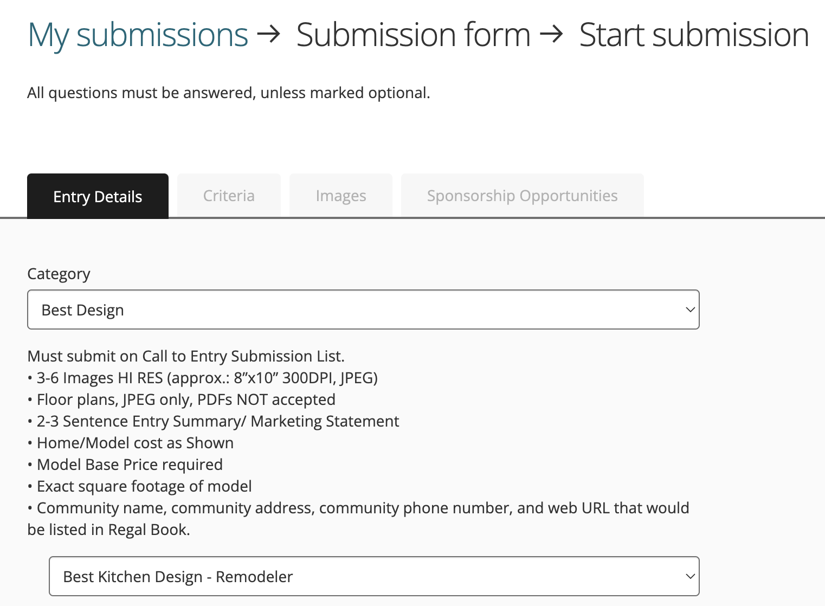
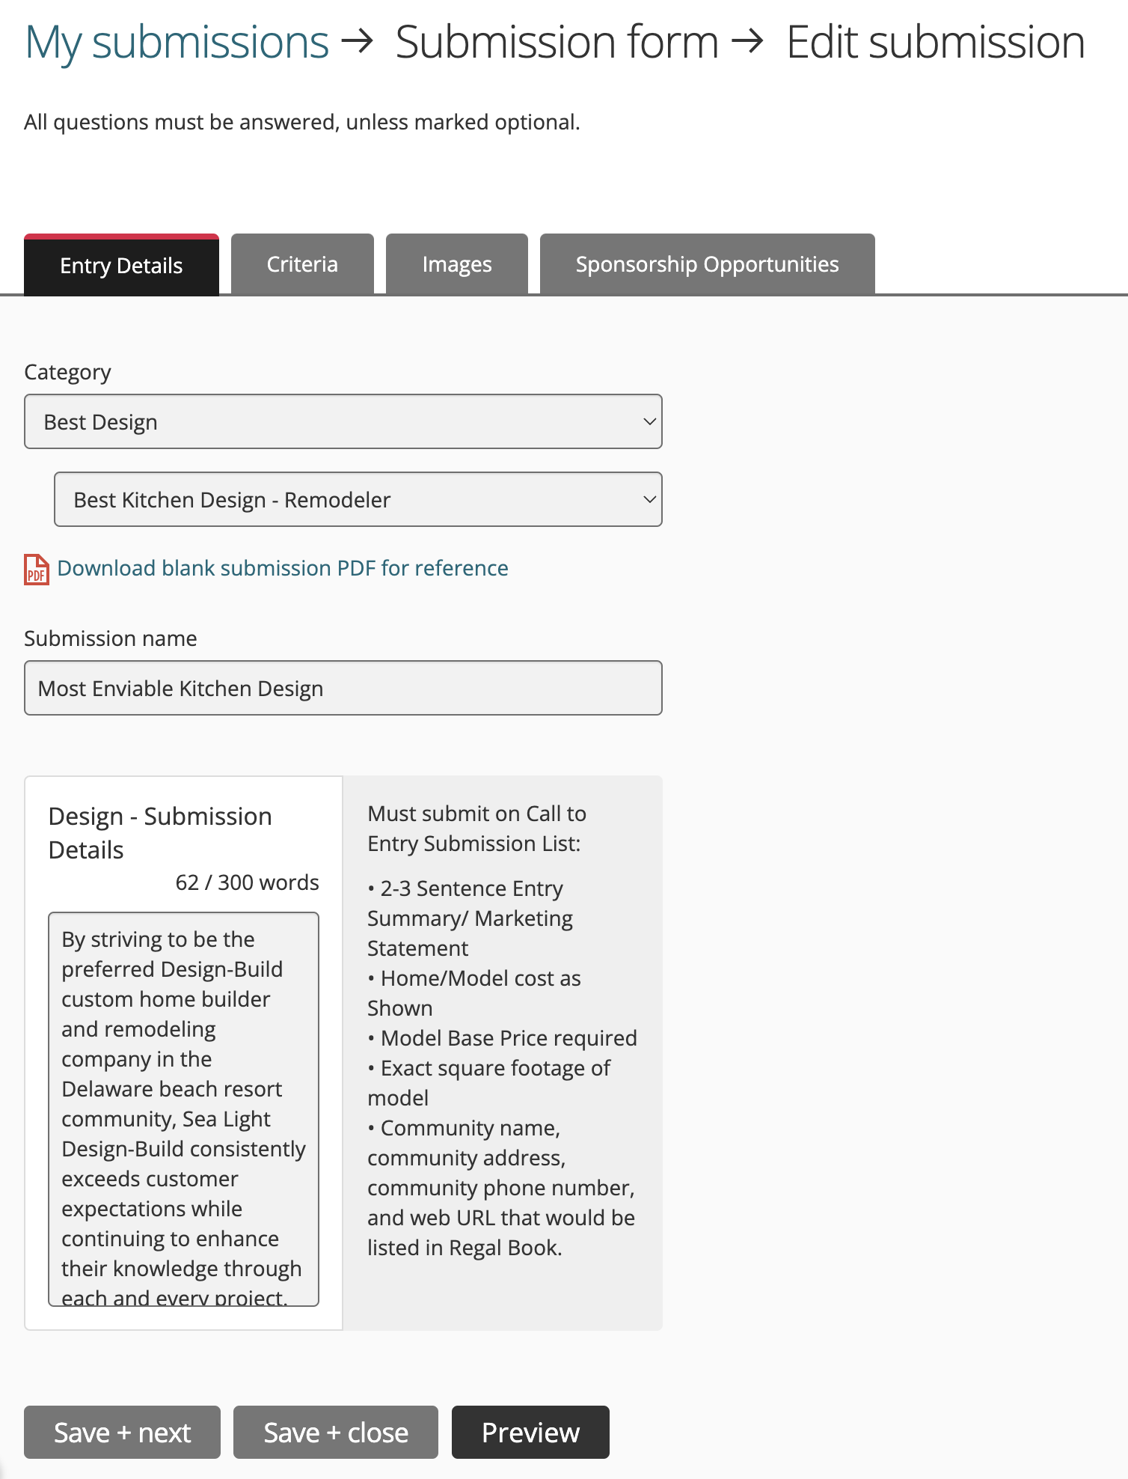
regalawardsde.org
Notes:
DF – After selecting BEST DESIGN, Best Kitchen Design – Remodeler was selected. Then all entry points were filled in. Follow the prompts at the right of each entry box. The website team is consistently making updates, so don’t be alarmed if your page looks slightly different than the screenshots we are showing. And also, if you run into anything confusing or not working, just reach out to Dottie for clarification or help.

Slide 42
TIP
Answer the category questions completely! Within your electronic document, such as a Word doc, enter each category question completely, along with your answers, and then copy/paste your answer online.
regalawardsde.org
Notes:
As previously mentioned, It’s best to keep a copy offline with all your entry info in it, such as a Word doc. Then you can just copy/paste the info over to the online entry portal. Also if your screen freezes, a power outage occurs, or some other mishap, you won’t have to recreate the content again from scratch.

Slide 43
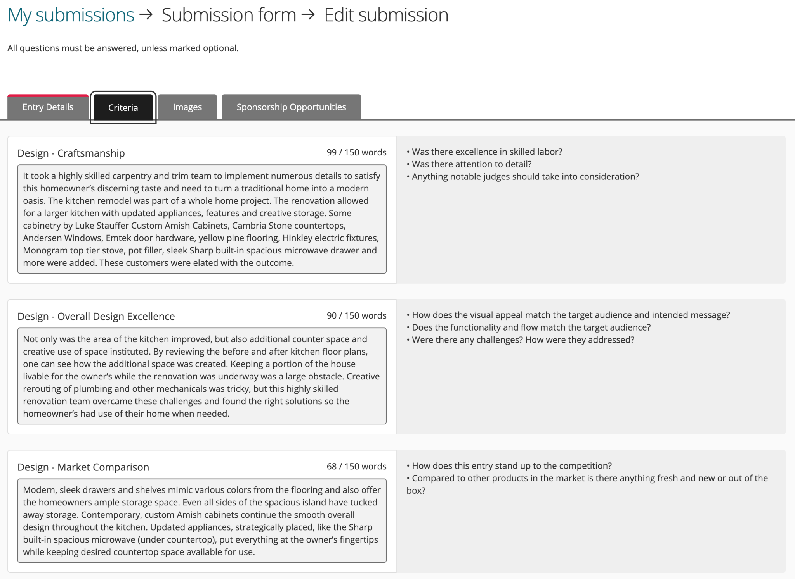
regalawardsde.org
Notes:
DF –For this particular entry, the judges were looking for specific answers to the Craftmanship, Overall Design Excellence and Market Comparison for this project. And because the judges can’t visit every project or site, YOU will need to provide concise and crystal clear descriptions for the judges to visualize the project.
Also, copying and pasting the same canned answer for each section will not go over well for the judges or your entry. PLEASE do not do that.
Also, You’ll notice a word count above each box so you can edit if needed. If it says 150 words, you’ll only be able to enter 150 words. Be specific and remember, a Bulleted List is acceptable also.

Slide 44
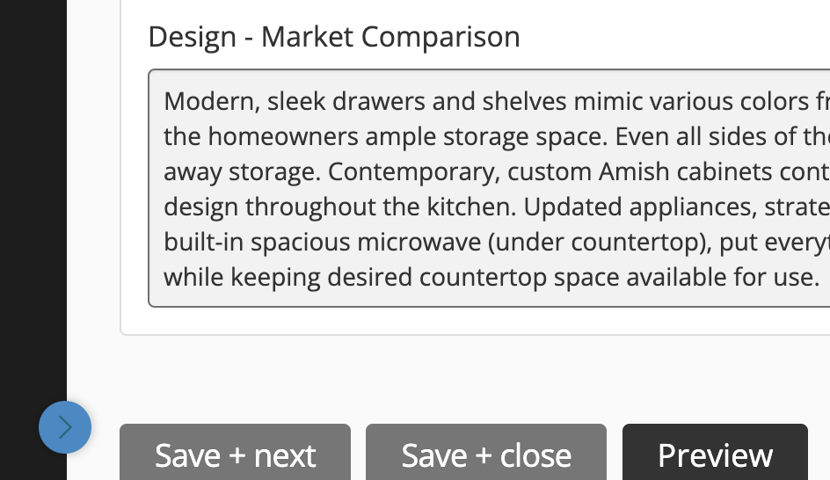
regalawardsde.org
Notes:
DF – When finished, you’ll click the Save + Next button at the bottom of the page.

Slide 45
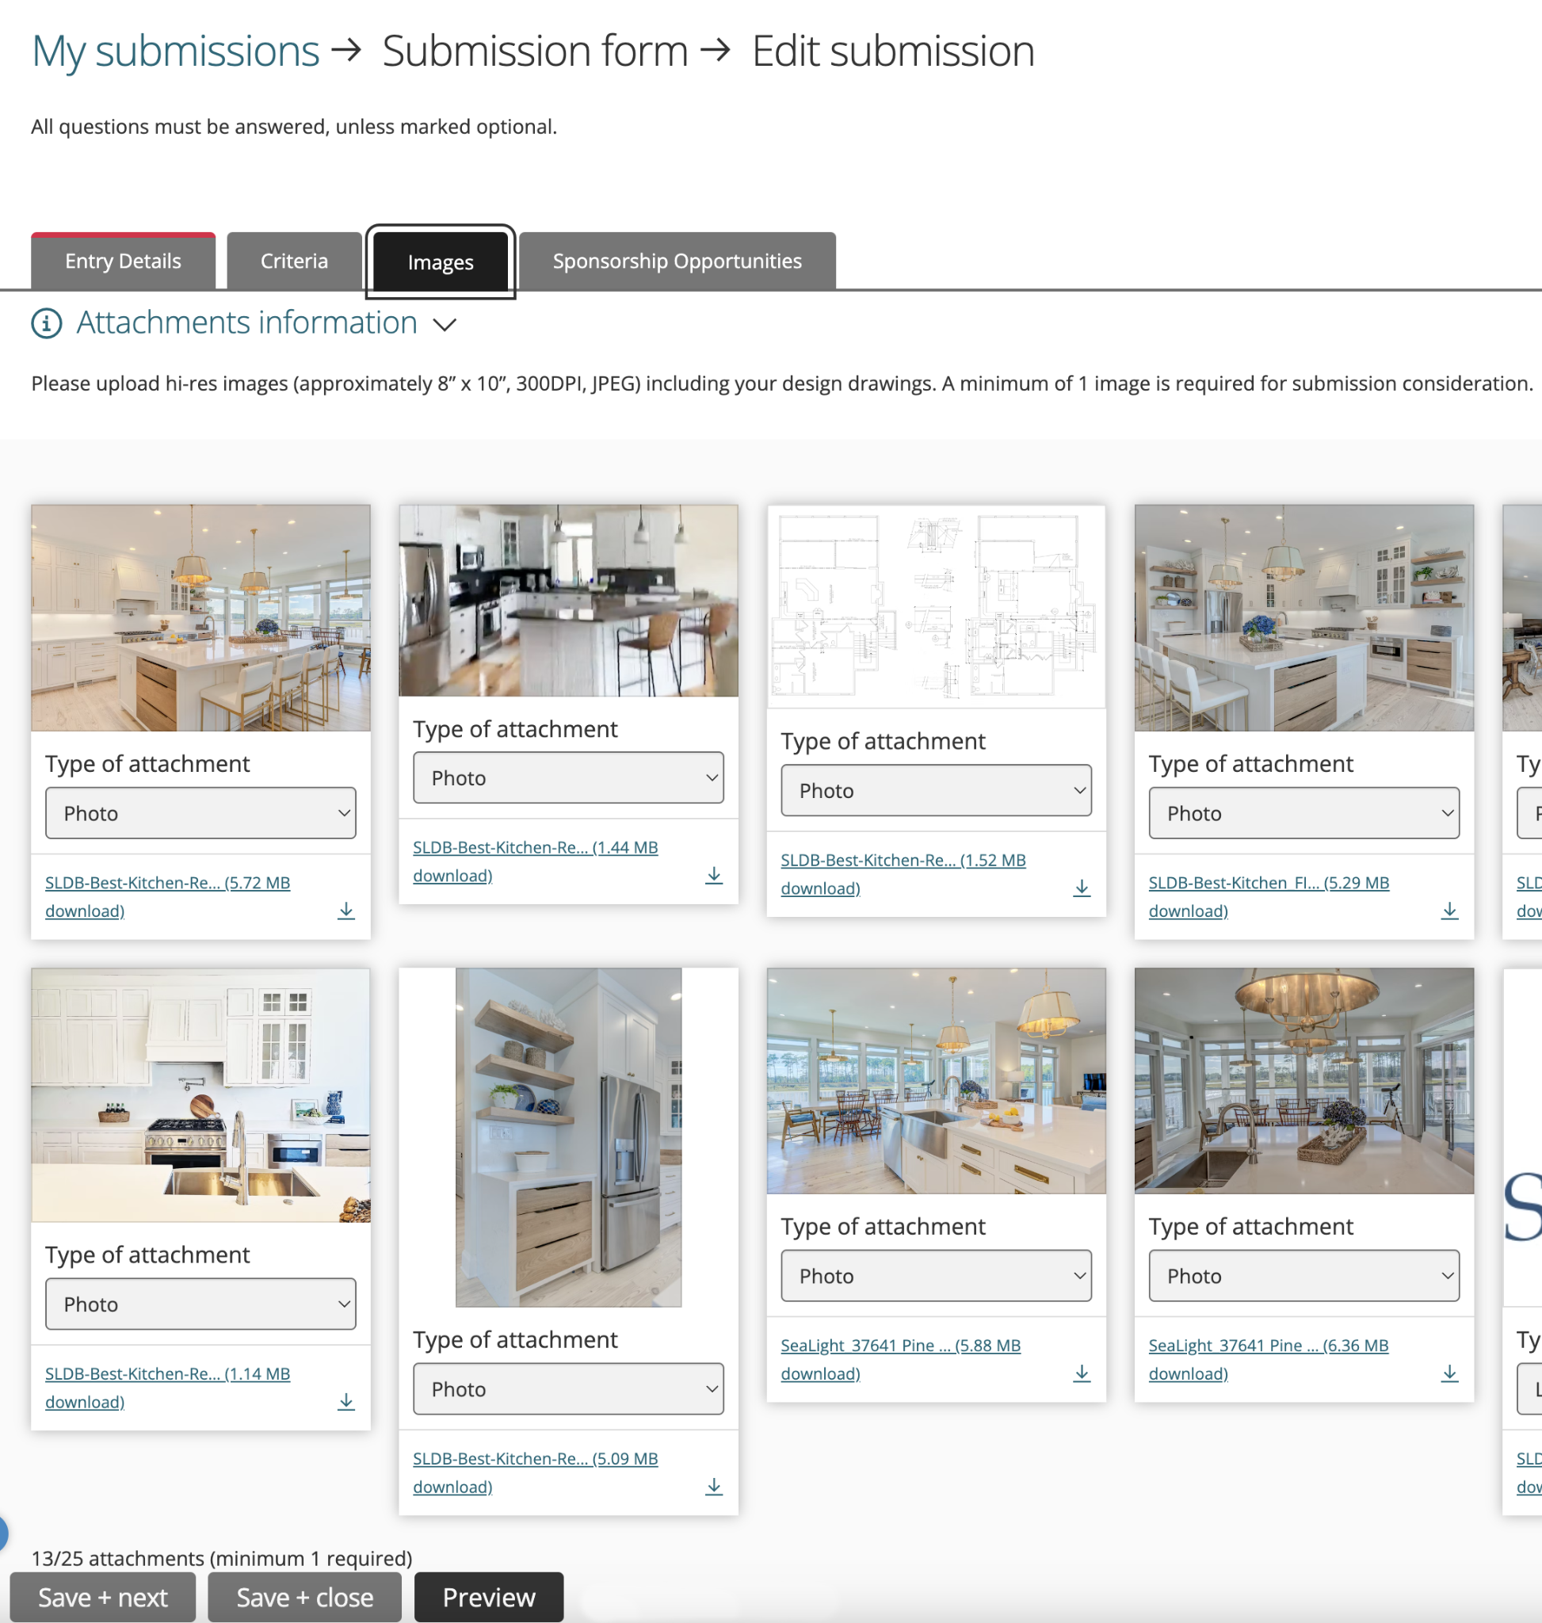
regalawardsde.org
Notes:
DF – Next, if applicable, move onto the Images tab to upload your corresponding images for your entry. Be sure to upload all the images you can. If it says to upload 3-6, upload 6 of your best shots. If you don’t have 6, but have at least 3 – upload those. And remember, they must be 7x10”, 300dpi, JPEG formatted images labeled. And with that, I’ll turn it back over to Dottie.

Slide 46
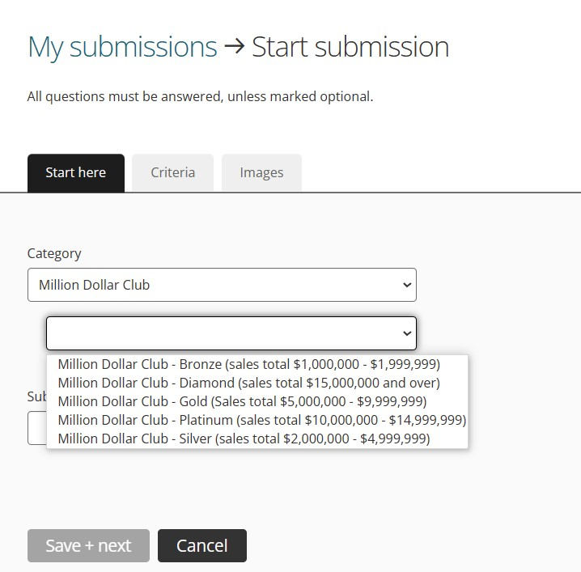
regalawardsde.org
Notes:
DF

Slide 47
INDIVIDUAL ACHIEVEMENT
MARNIE OURSLER
regalawardsde.org
Notes:
DF

Slide 48
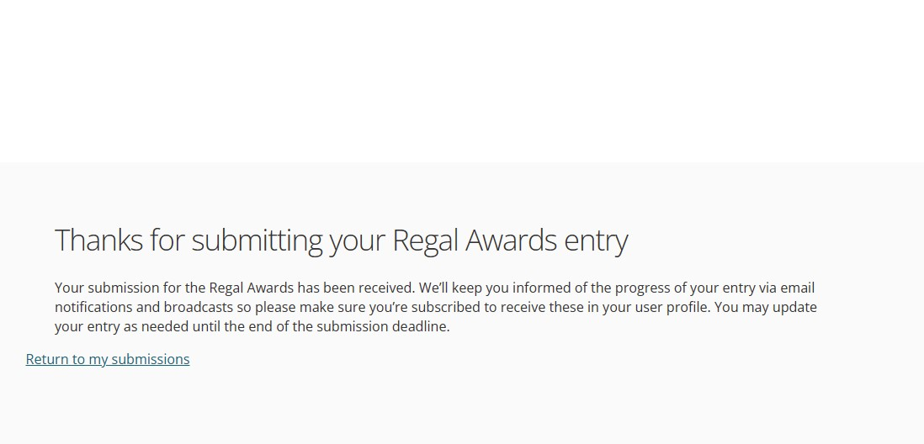
regalawardsde.org
Notes:
DF

Slide 49
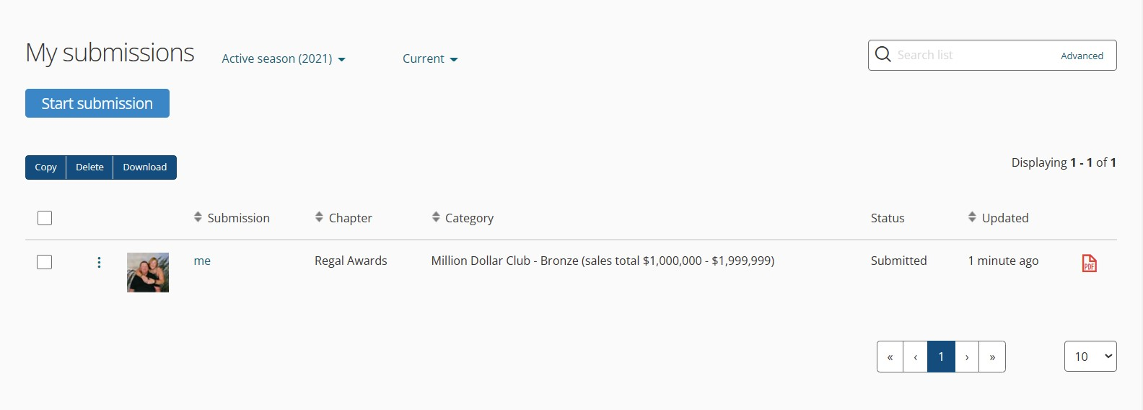
regalawardsde.org
Notes:
DF

Slide 50
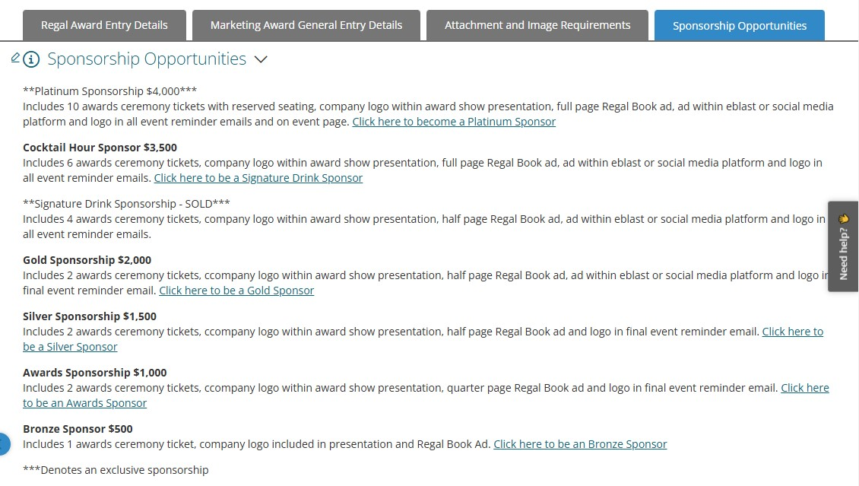
Notes:
DF Before I wrap up todays webinar lets look at Sponsorship Opportunities. Back to you Jay

Slide 51
IMPORTANT DEADLINES & DATES
CALL FOR REGAL ENTRIES NOW OPEN! • 20% OFF Early Bird Discount Entry Deadline ~ Fri., Jan.10, 2025 • Final Regal Entry Deadline ~ Fri., Feb. 14th, 2025 • Sponsorships, Regal Book Ads & Listings Deadline ~ Mon., Mar. 7th, 2025
• 33nd Annual Regal Awards Ceremony Lighthouse Cove Event Center Hyatt Place Dewey Beach 1301 Coastal Highway, Dewey Beach, DE ~ Fri., May 9th, 2025
regalawardsde.org
Notes:
JG – Thank you everyone for joining us today. A recording of today’s webinar will be available soon on the HBADE.org website for anyone who needs it. (Read above slide) And with that, I’ll let Dottie wrap up today!

Slide 52
BEST OF LUCK!
Remember, 20% OFF Early Bird Discount Entry Deadline is Friday, Jan.10, 2025 – so TAKE ADVANTAGE of the savings.
If you have further questions contact Dottie Fawcett email: dotfaw@comcast.net or phone 610-740-4266
If you have photography questions contact Jay Greene email: jg@jaygreenephoto.com or phone 302-593-0448
regalawardsde.org
Notes:
JG

Slide 53
QUESTIONS?
www.RegalAwardsDE.org
Notes:
JG (REV by DF 6 JAN 2025)

