Slide 2
Welcome!
¡Bienvenidos!
Bem-vindos!

Slide 3
ICOLD Regional Clubs
Europa Zone
S. Lazaridou
Asia Zone
D. Sharma
America Zone
M. Teal
J. Wolfhope
Africa Zone
Q. Shaw

Slide 4
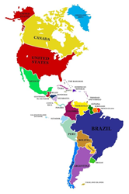
ARGENTINA
BOLIVIA
BRAZIL
CANADA
CHILE
COLOMBIA
COSTA RICA
DOMINICAN REPUBLIC
GUATEMALA
HONDURAS
MEXICO
PANAMA
PARAGUAY
PERU
URUGUAY
USA
VENEZUELA

Slide 5
Presidency passed from Peru to USA in Marseille for 2-year period
Goals
Web site – www.icoldinca.com
Dam Safety Symposium
Training

Slide 6
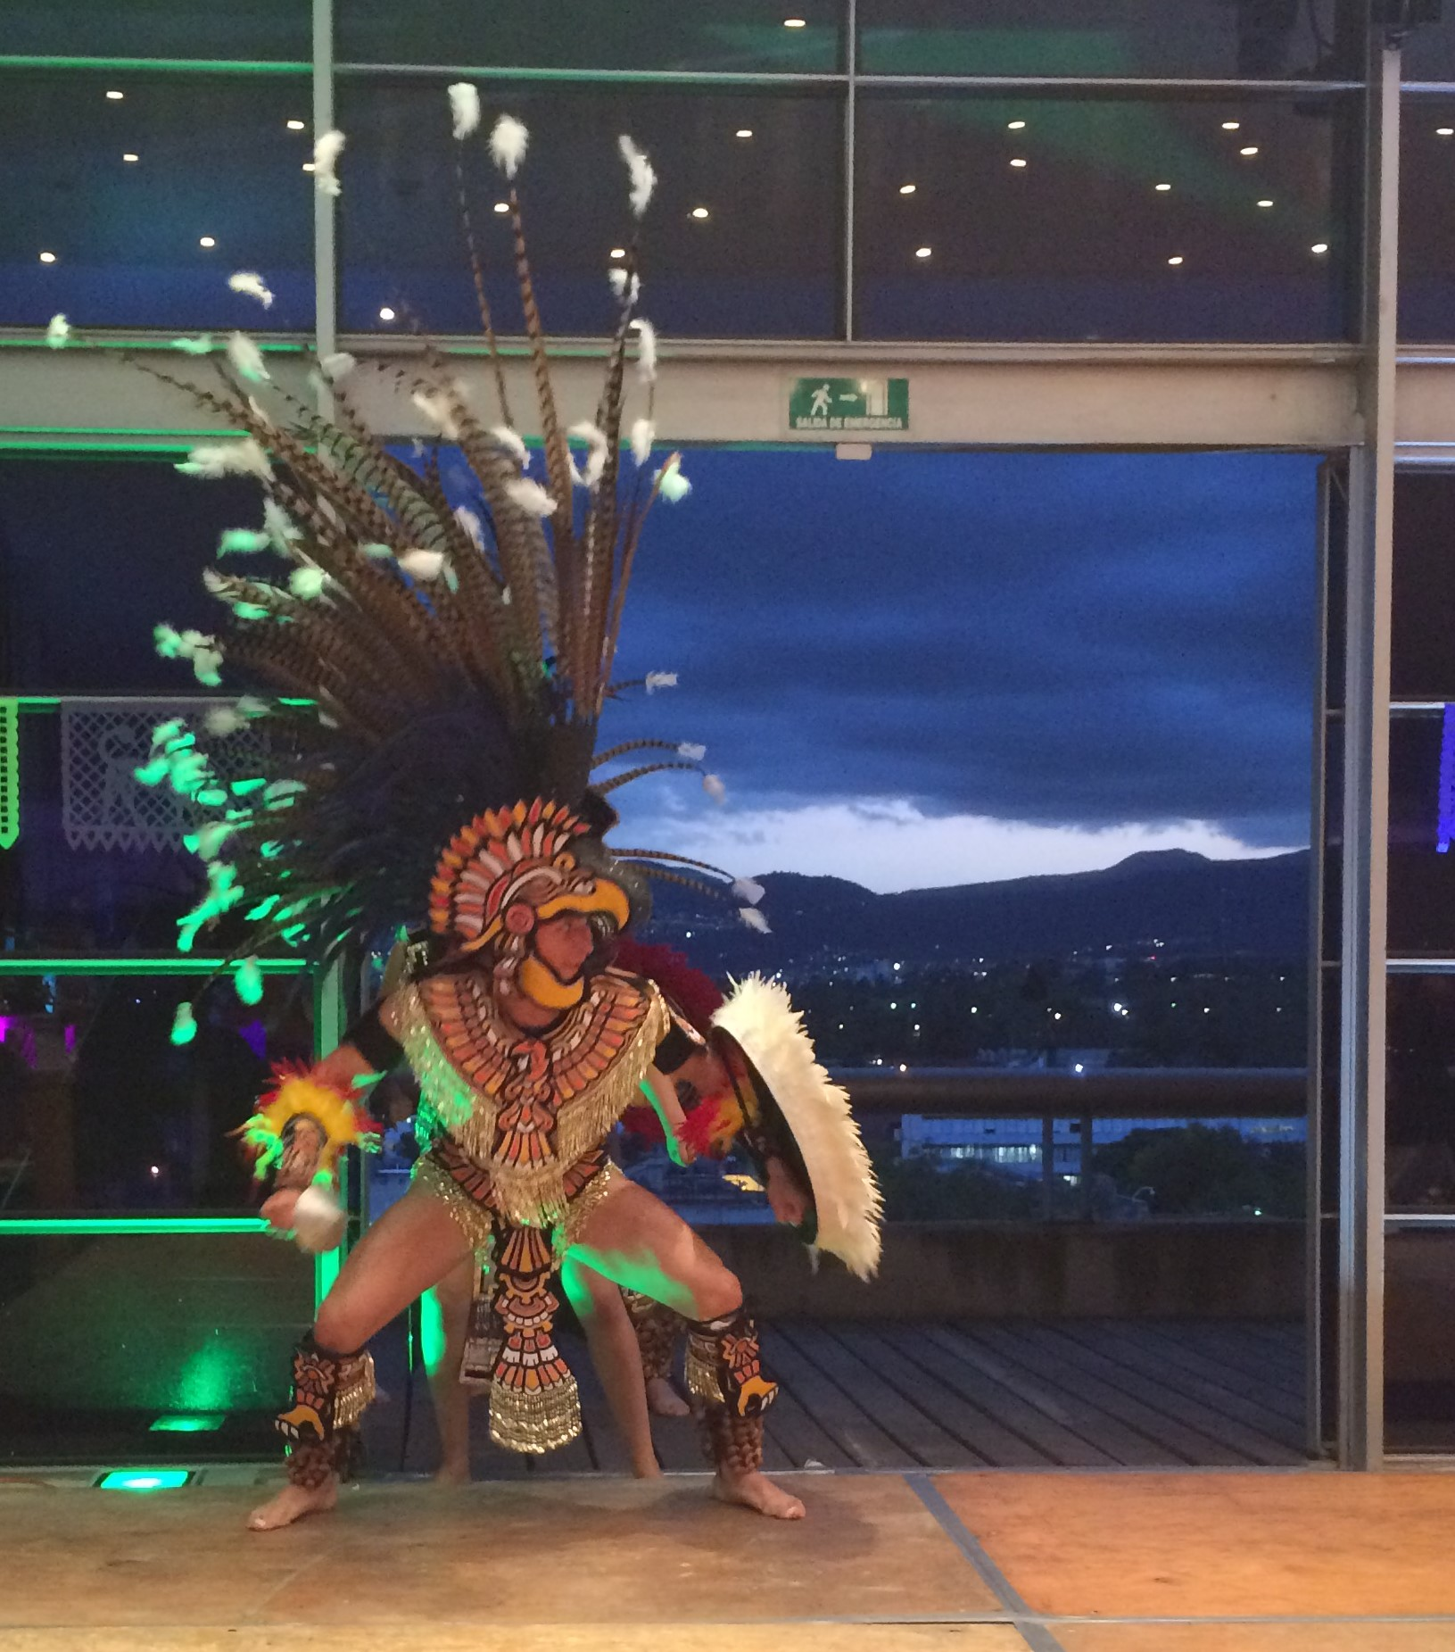
Symposium History
México 2016

Slide 7
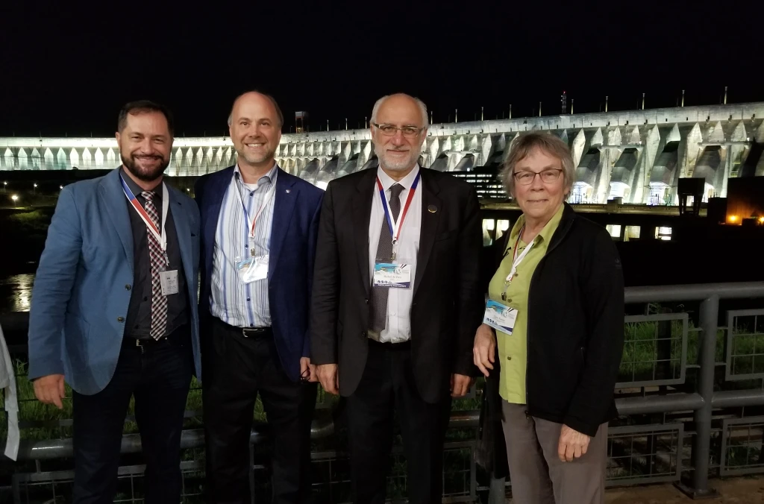
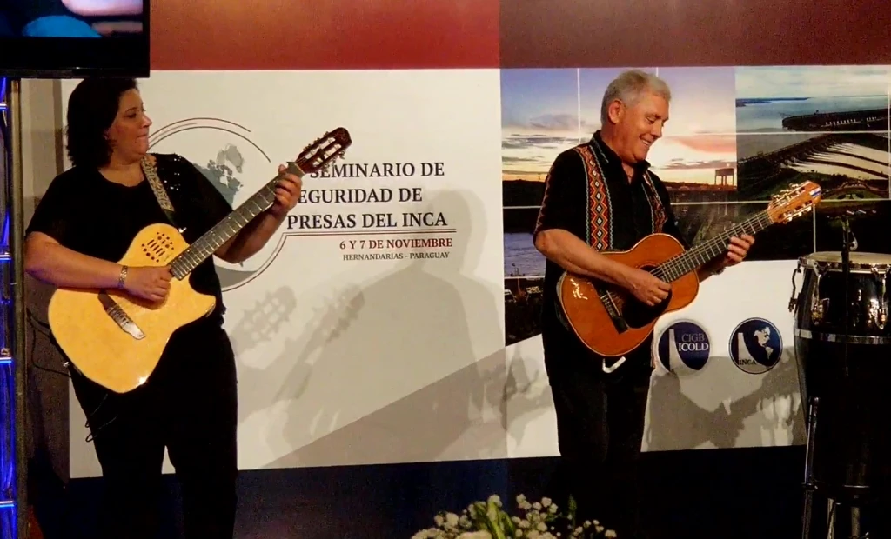
Symposium History
Paraguay 2019

Slide 8
Puerto Rico, USA 2024
Tuesday, 21 May
8:15 – 10:00 Opening Session
Welcome and Conference Overview - INCA Co-President Marty Teal, WEST Consultants, USA
Welcome from ICOLD - VPs of the Americas - Dean Durkee, Gannett Fleming, USA and Joaquim Pimenta de Ávila, Consultant, Brazil, ICOLD
Welcome to Puerto Rico
USA National Dam Safety Program – Kayed Lakhia, Federal Emergency Management Agency, USA
Water Resources in Puerto Rico - Pully Torres, Torres-Rosa Consulting Engineers, USA
Special Award –Luis Vellacich, ITAIPU Binacional, Paraguay

Slide 9
Puerto Rico, USA 2024
Tuesday, 21 May
10:30 – 12:30 Dam Safety Legislation, Why Needed & Barriers (Moderator: Erick Campos, Instituto Costarricense de Electricidad, Costa Rica)
13:30 - 15:30 Emergency Planning and Response (Moderator: Alejandro Pujol, Consultant, Argentina)
16:00–17:25 Dam Safety Incidents & Case Studies (Part 1, Moderator: Pascual Perazzo, Carpi, Venezuela)
19:00 – 21:00 Dinner and Entertainment

Slide 10
Puerto Rico, USA 2024
Wednesday, 22 May
8:30 – 10:15 Dam Safety Incidents & Case Studies (Part 2, Moderator: Angel Gutierrez, US Bureau of Reclamation, USA)
10:45 – 12:30 Sedimentation (Moderator: Marty Teal, WEST Consultants, USA)
13:30 – 15:00 Sedimentation – cont. (Moderator: Axel Montalvo-Bartolomei, USACE, USA)
15:30 – 16:00 Overview of Field Tour (Greg Morris, USA)
19:00 – 21:00 Dinner and Entertainment

Slide 11
Thursday, 23 May
8:30 – 15:30 Field Tour
Lago Loiza & Carraizo Dam
Rio Blanco Dam
Lunch at Kioscos, Liquillo, Puerto Rico

Slide 12
Thank You
Laura Wright, Catrice Jones, Myla Harris, Sarah Easter at USSD
Greg Morris
Technical Planning Committee
Moderators
Authors

