Slide 1
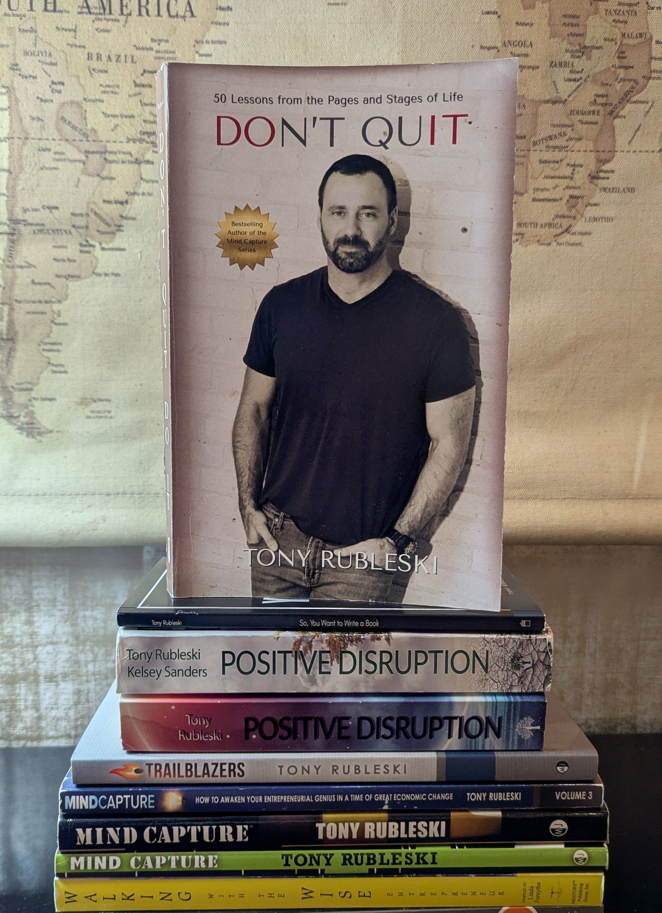

The “Don’t Quit Do It” Philosophy to Build A Stronger Chamber
September 2nd, 2026

Slide 2
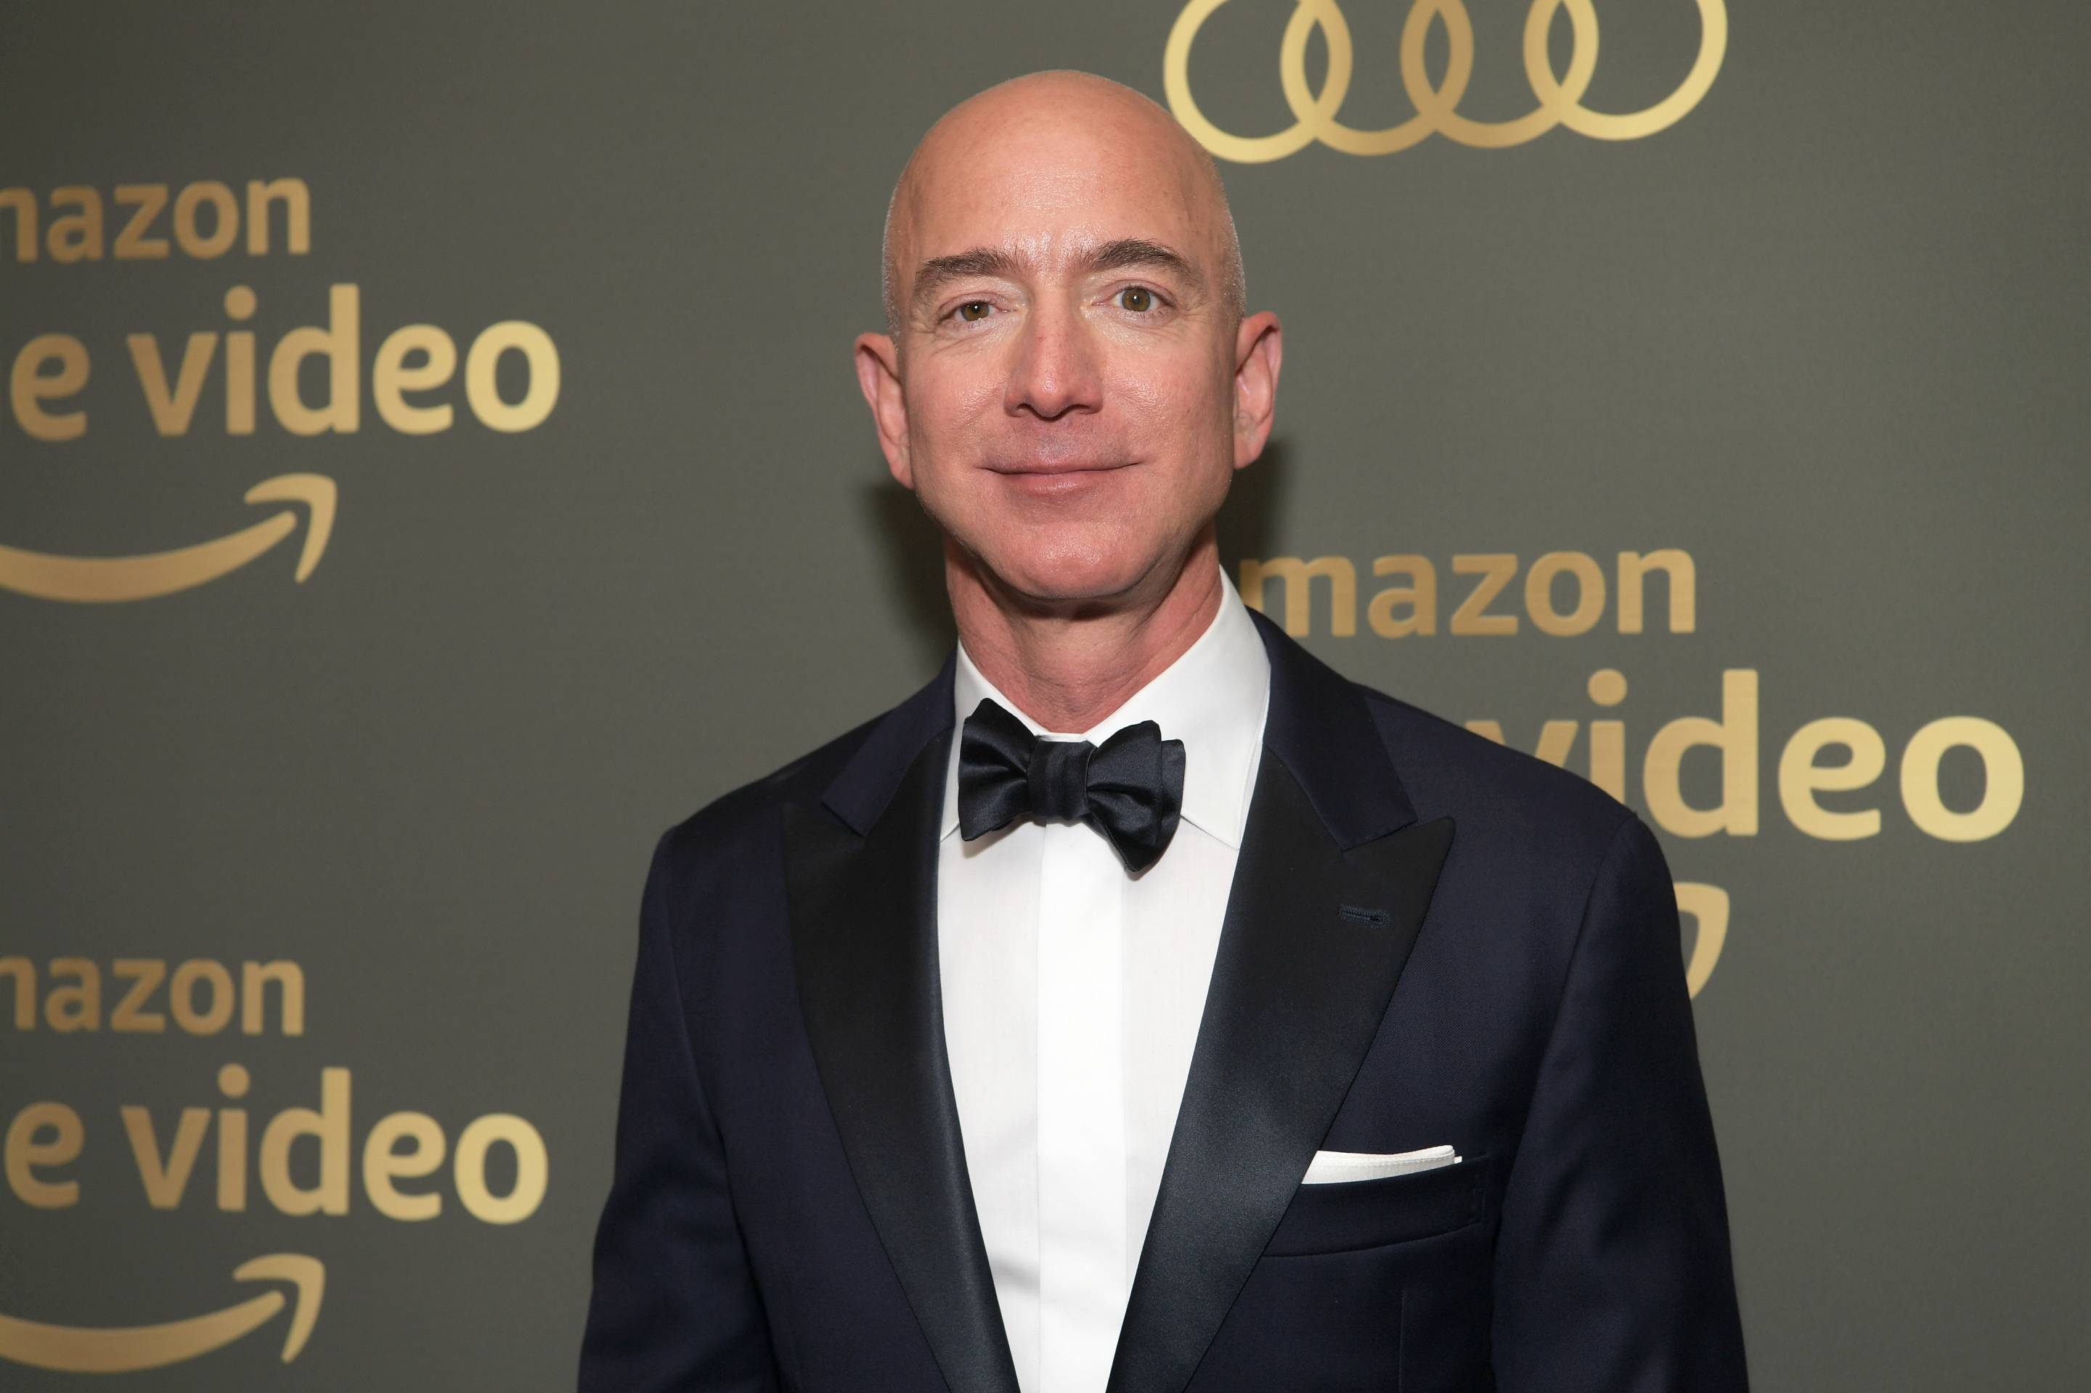
BIG Lesson from a Major Trailblazer

Slide 3
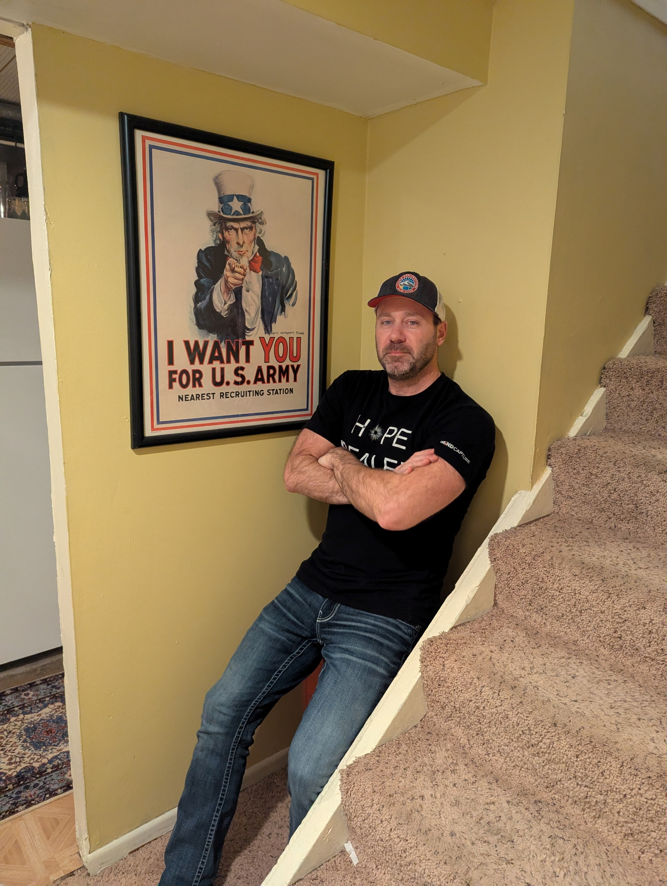
The Big 3 Goals of Today:
#1: Help you get MIND CAPTURE
-Clearly Stand Out
#2: Share ways to GET MORE DONE
-Even when you want to stop or quit
#3: DO MORE with LIFE and WORK
-Harmony vs. Grind, grind, grind

Slide 4
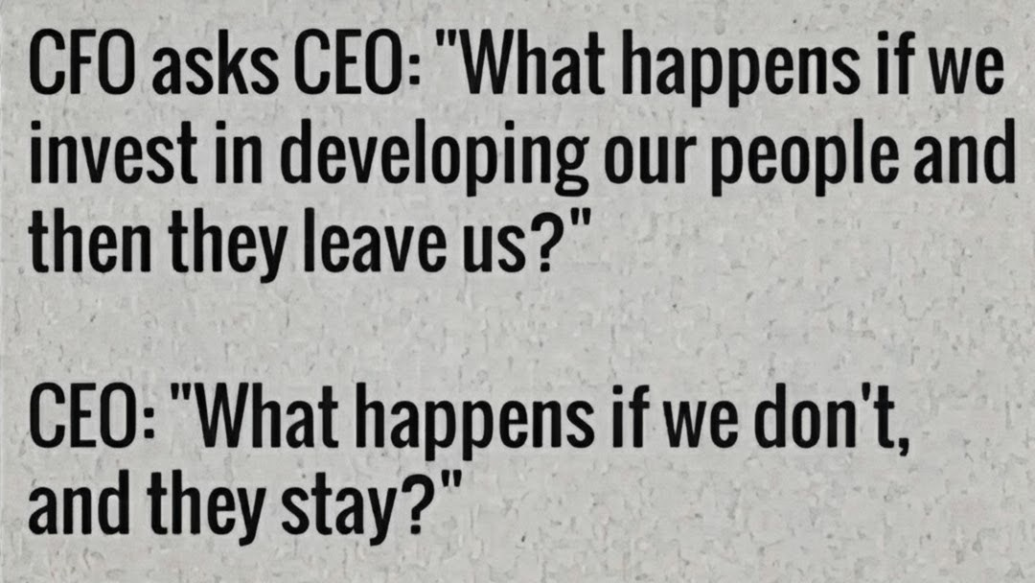

Slide 5
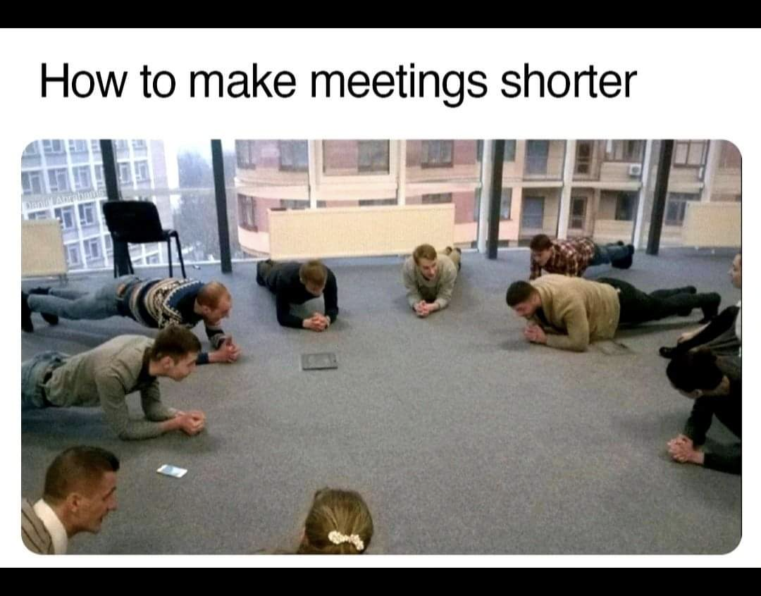
Simple, direct, communication is good.

Slide 6
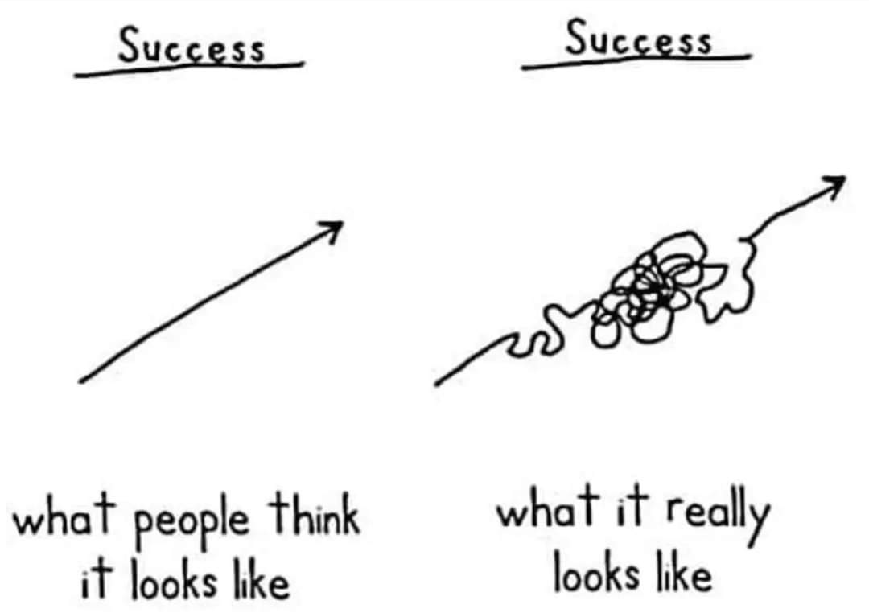

Slide 7
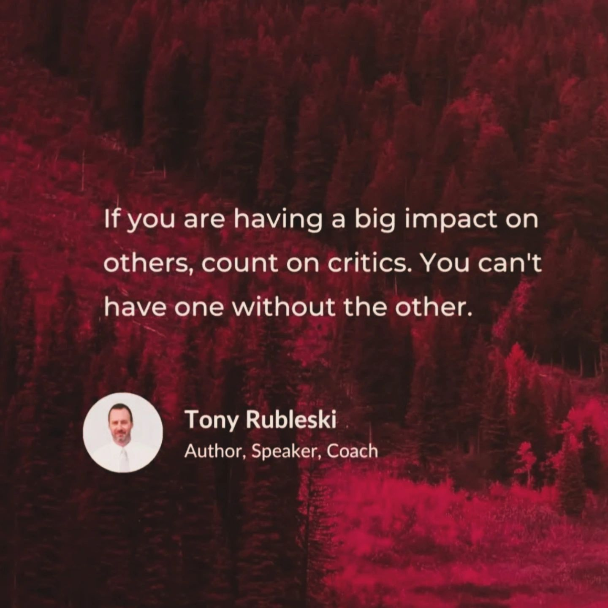
Lesson #1
The Critics
External & Internal

Slide 8


Slide 9
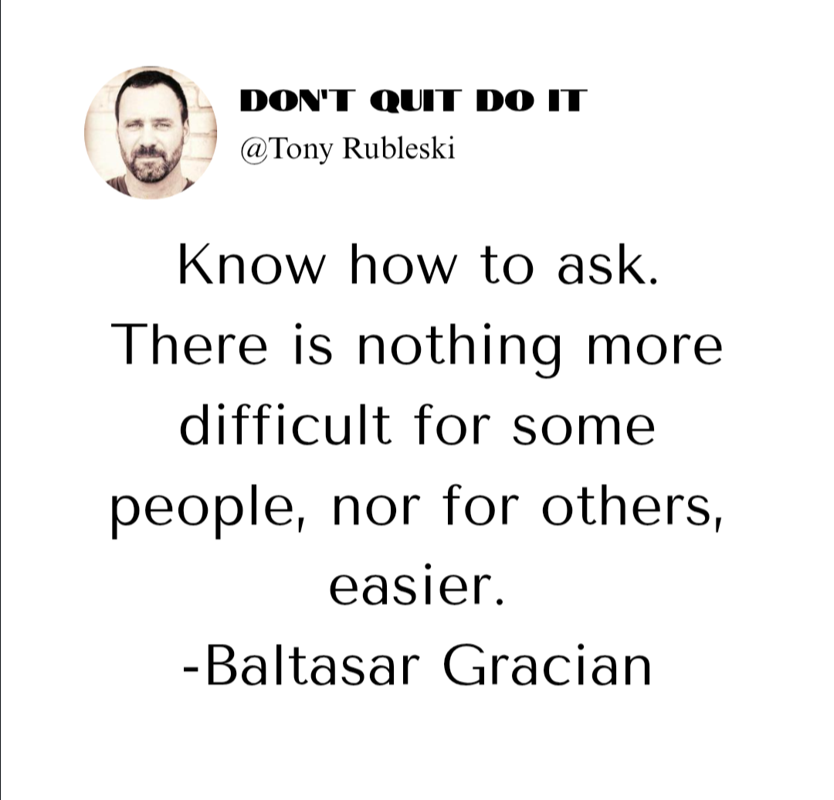
Lesson #1
The Critics
External &Internal
Lesson #2
ASK FOR MORE

Slide 10
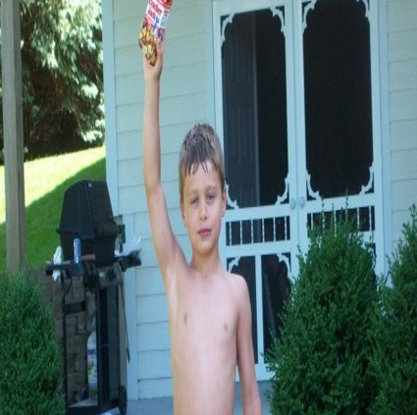
The BEST salespeople on the planet?

Slide 11
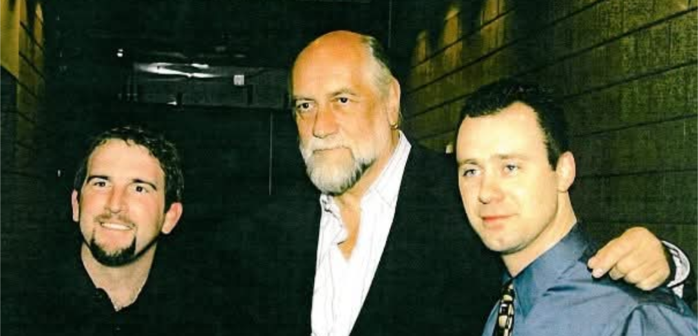
Don’t Stop Thinking About Tomorrow…

Slide 12
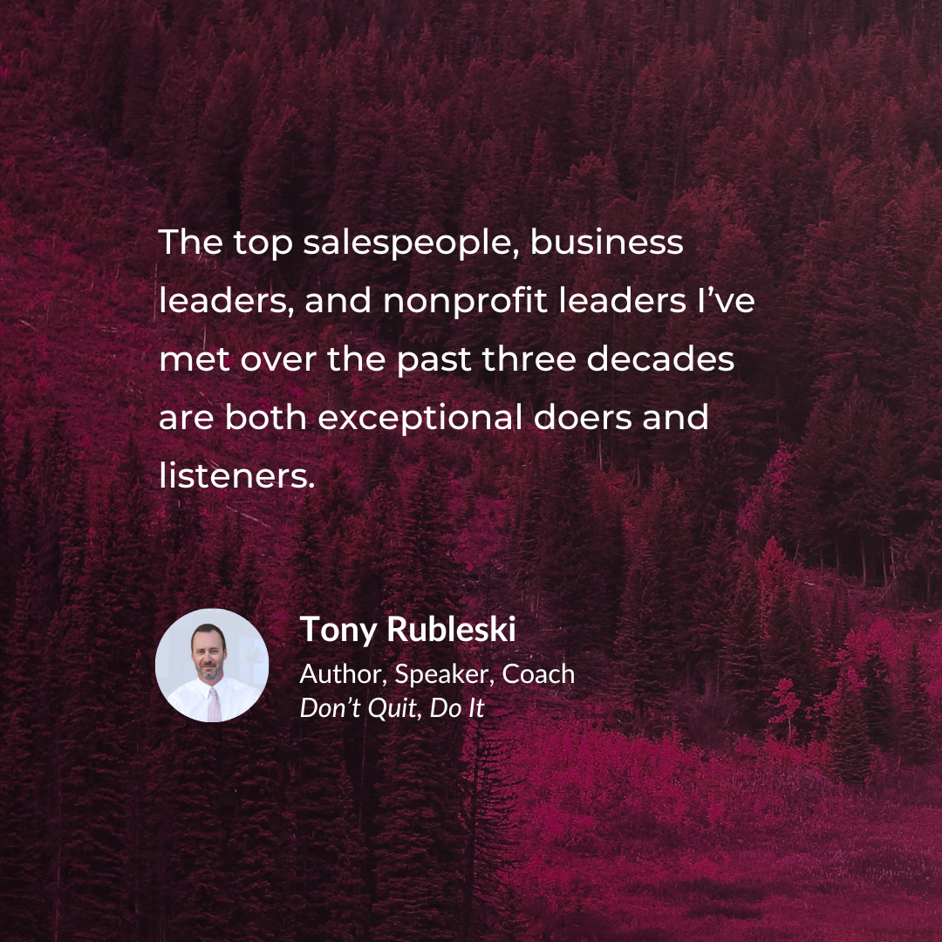
Lesson #3: Listen Well

Slide 13
Employ Active Listening
Employ Active Listening
Use great questions
Shut your damn phone off
Focus and take notes
Shut up and listen 80-90% of the time
Confirm back key points
Make a recommendation of 1-2 options based on what they’ve shared

Slide 14
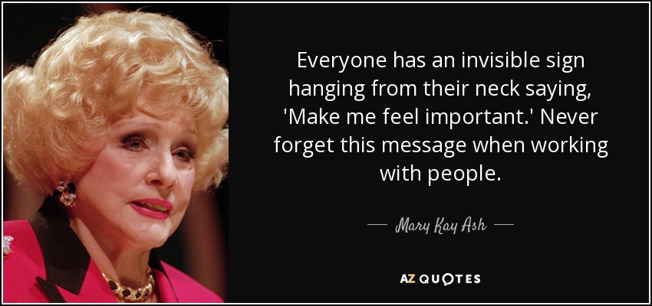

Slide 15
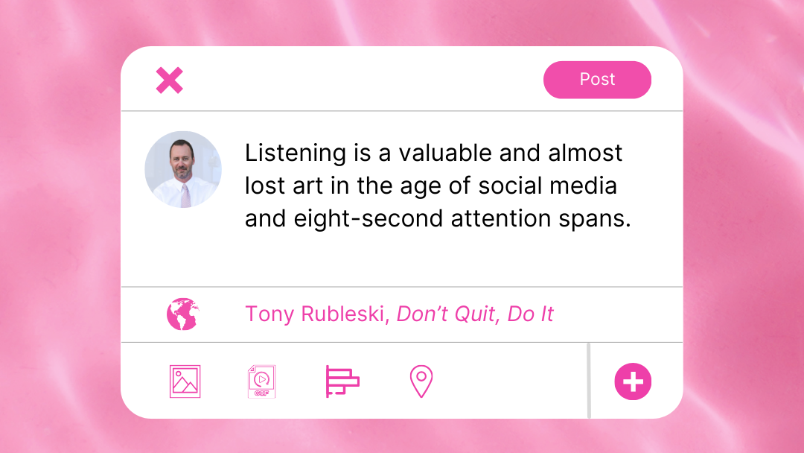

Slide 16
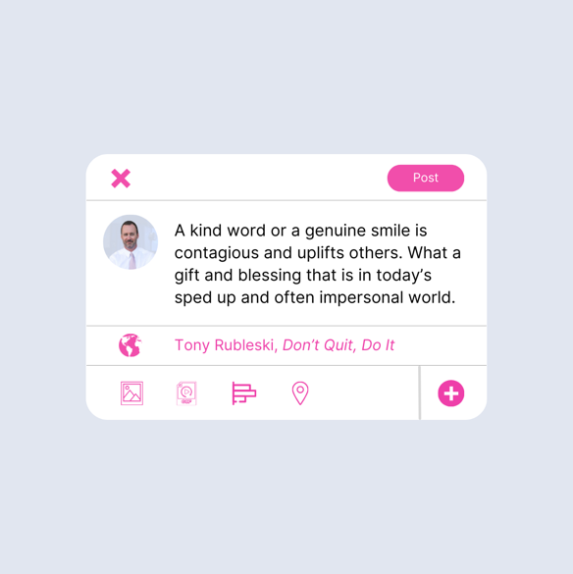
Lesson #4: Positive Attitude

Slide 17
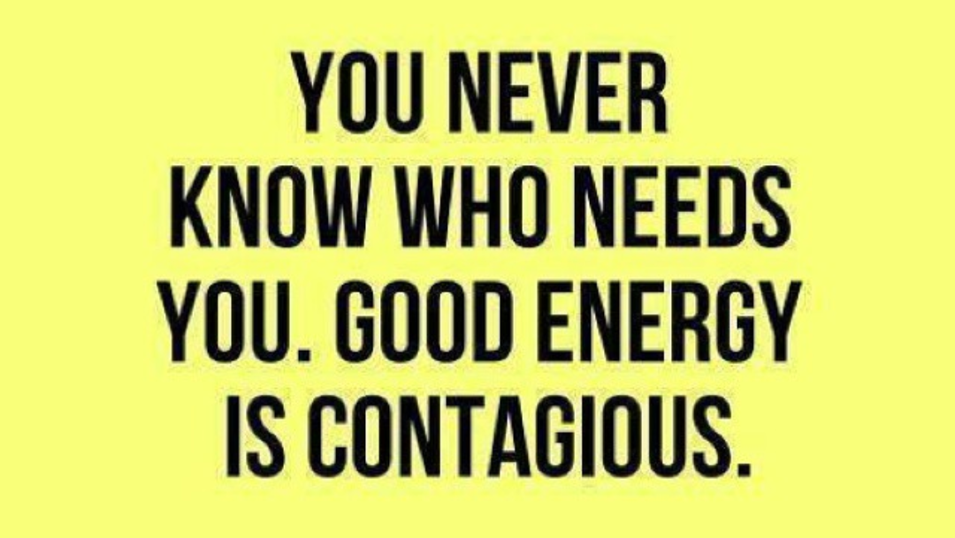

Slide 18
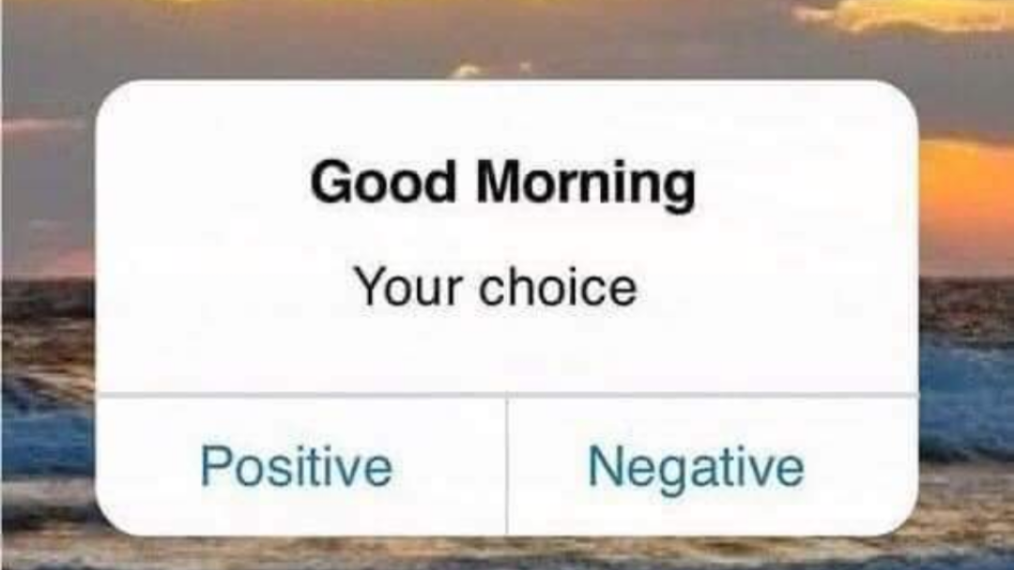

Slide 19
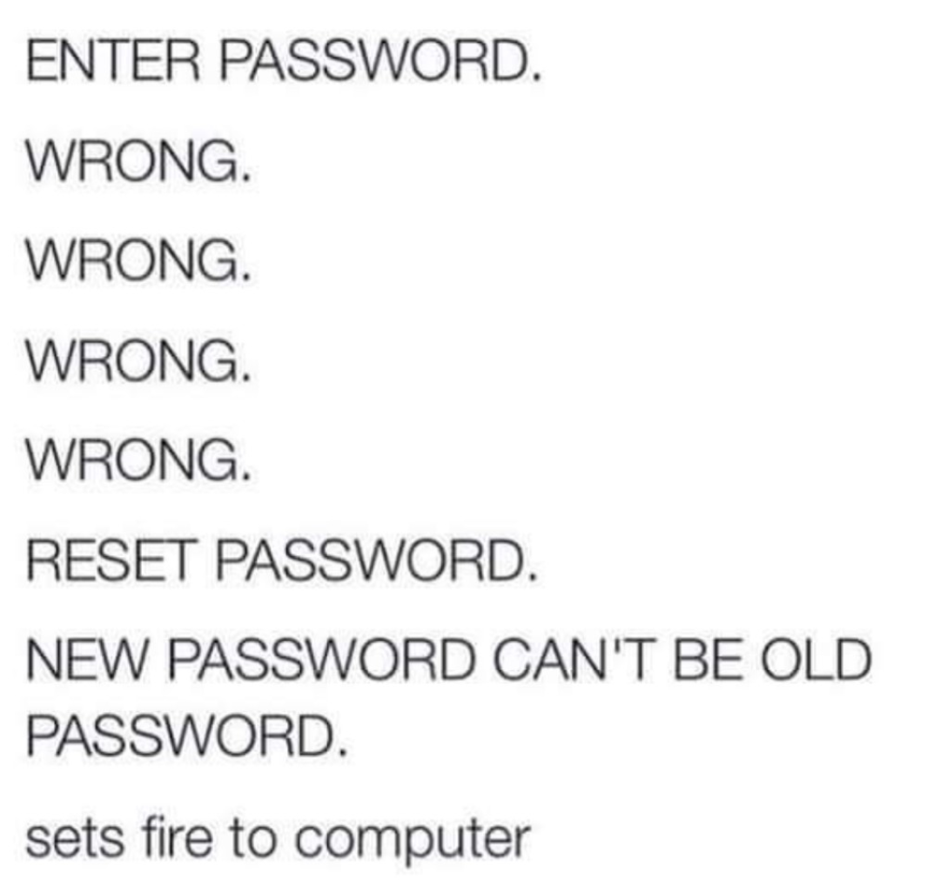

Slide 20
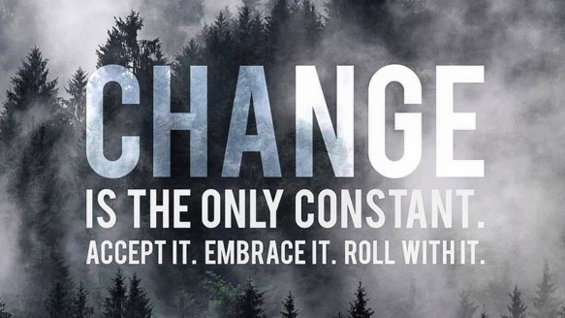

Slide 21

Are you or your phone a bigger priority? A shift in perspective.

Slide 22
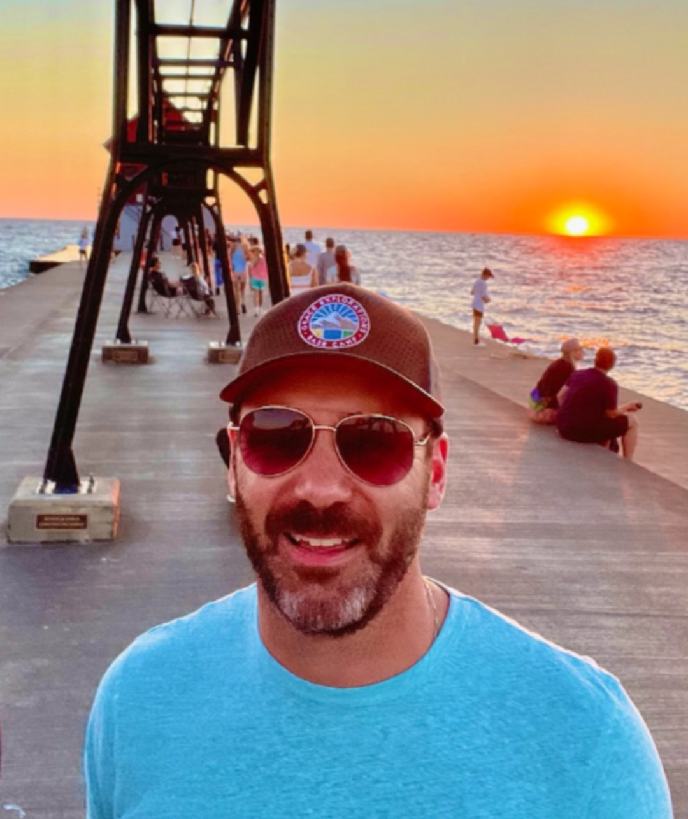
A Few Tips to Tune Your Mindset and Build a Stronger You in 2026
Gratitude list each day
Employ Laughter – YouTube/Netflix
Quiet prayer/meditation time
Monitor time on social media Ex. - “BitchBook”
Read/Listen to books/biographies Ex. - Today’s event
Music – perfect pattern interrupt
Movement – health is wealth
Get out into nature Ex. – Lake Michigan
A few tips to positively tune up your mindset daily for the better

Slide 23
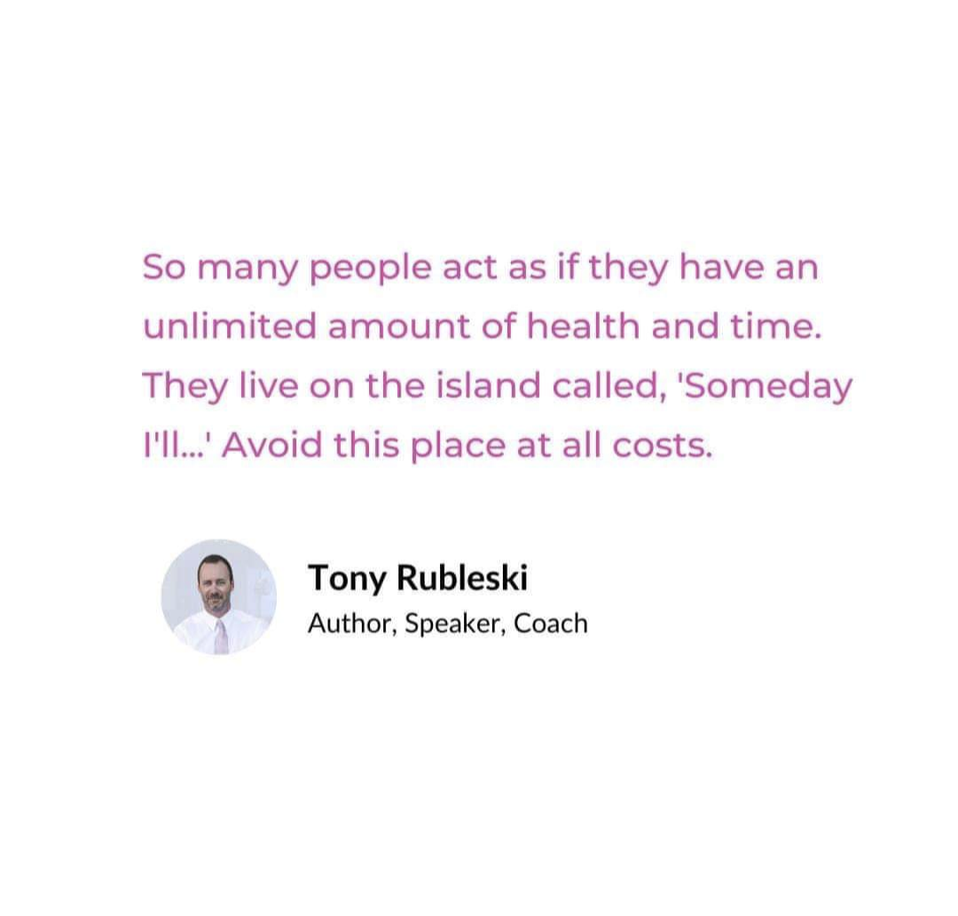

Slide 24
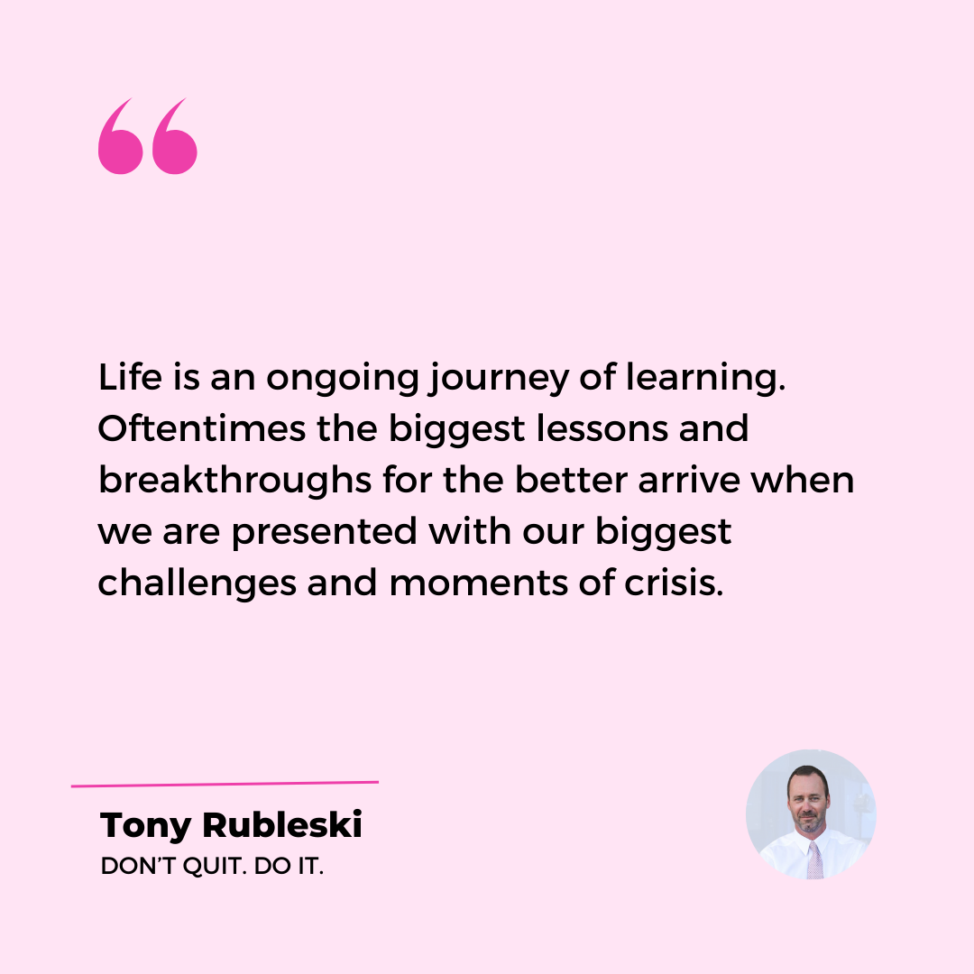
Lesson #5: Persistence

Slide 25
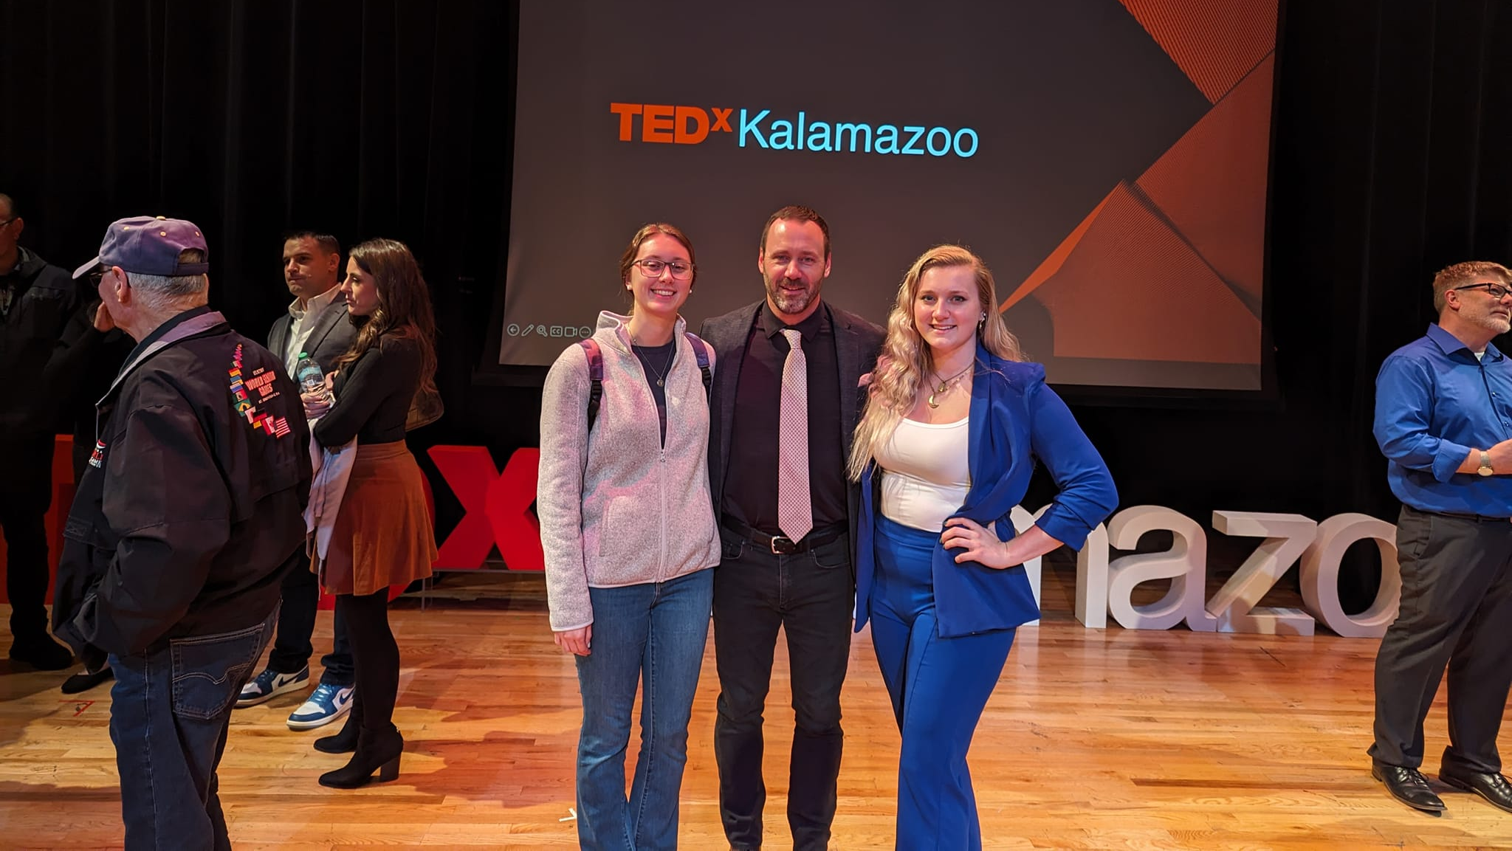
Ten years

Slide 26
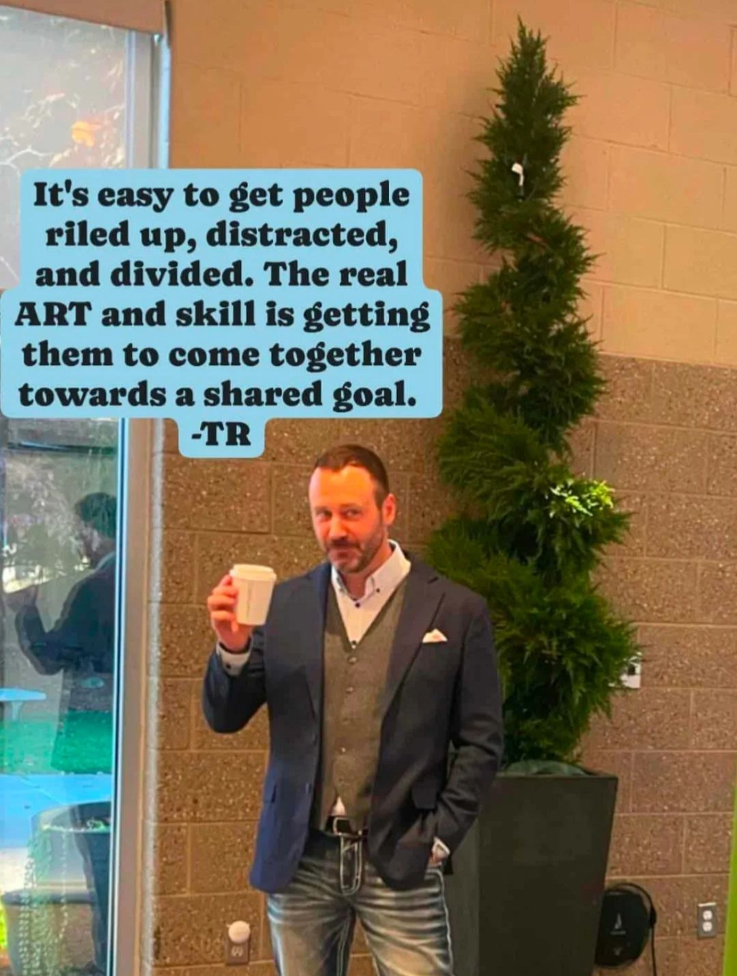
The Goal: 2026 Onward
Help 1,000,000+ People the next 10-years via my books, teaching, and at “live” events.

Slide 27

YOU Matter

Slide 28

Never Forget: Don’t Quit – Do It!
Get after Life Today. Not Tomorrow.

Slide 29
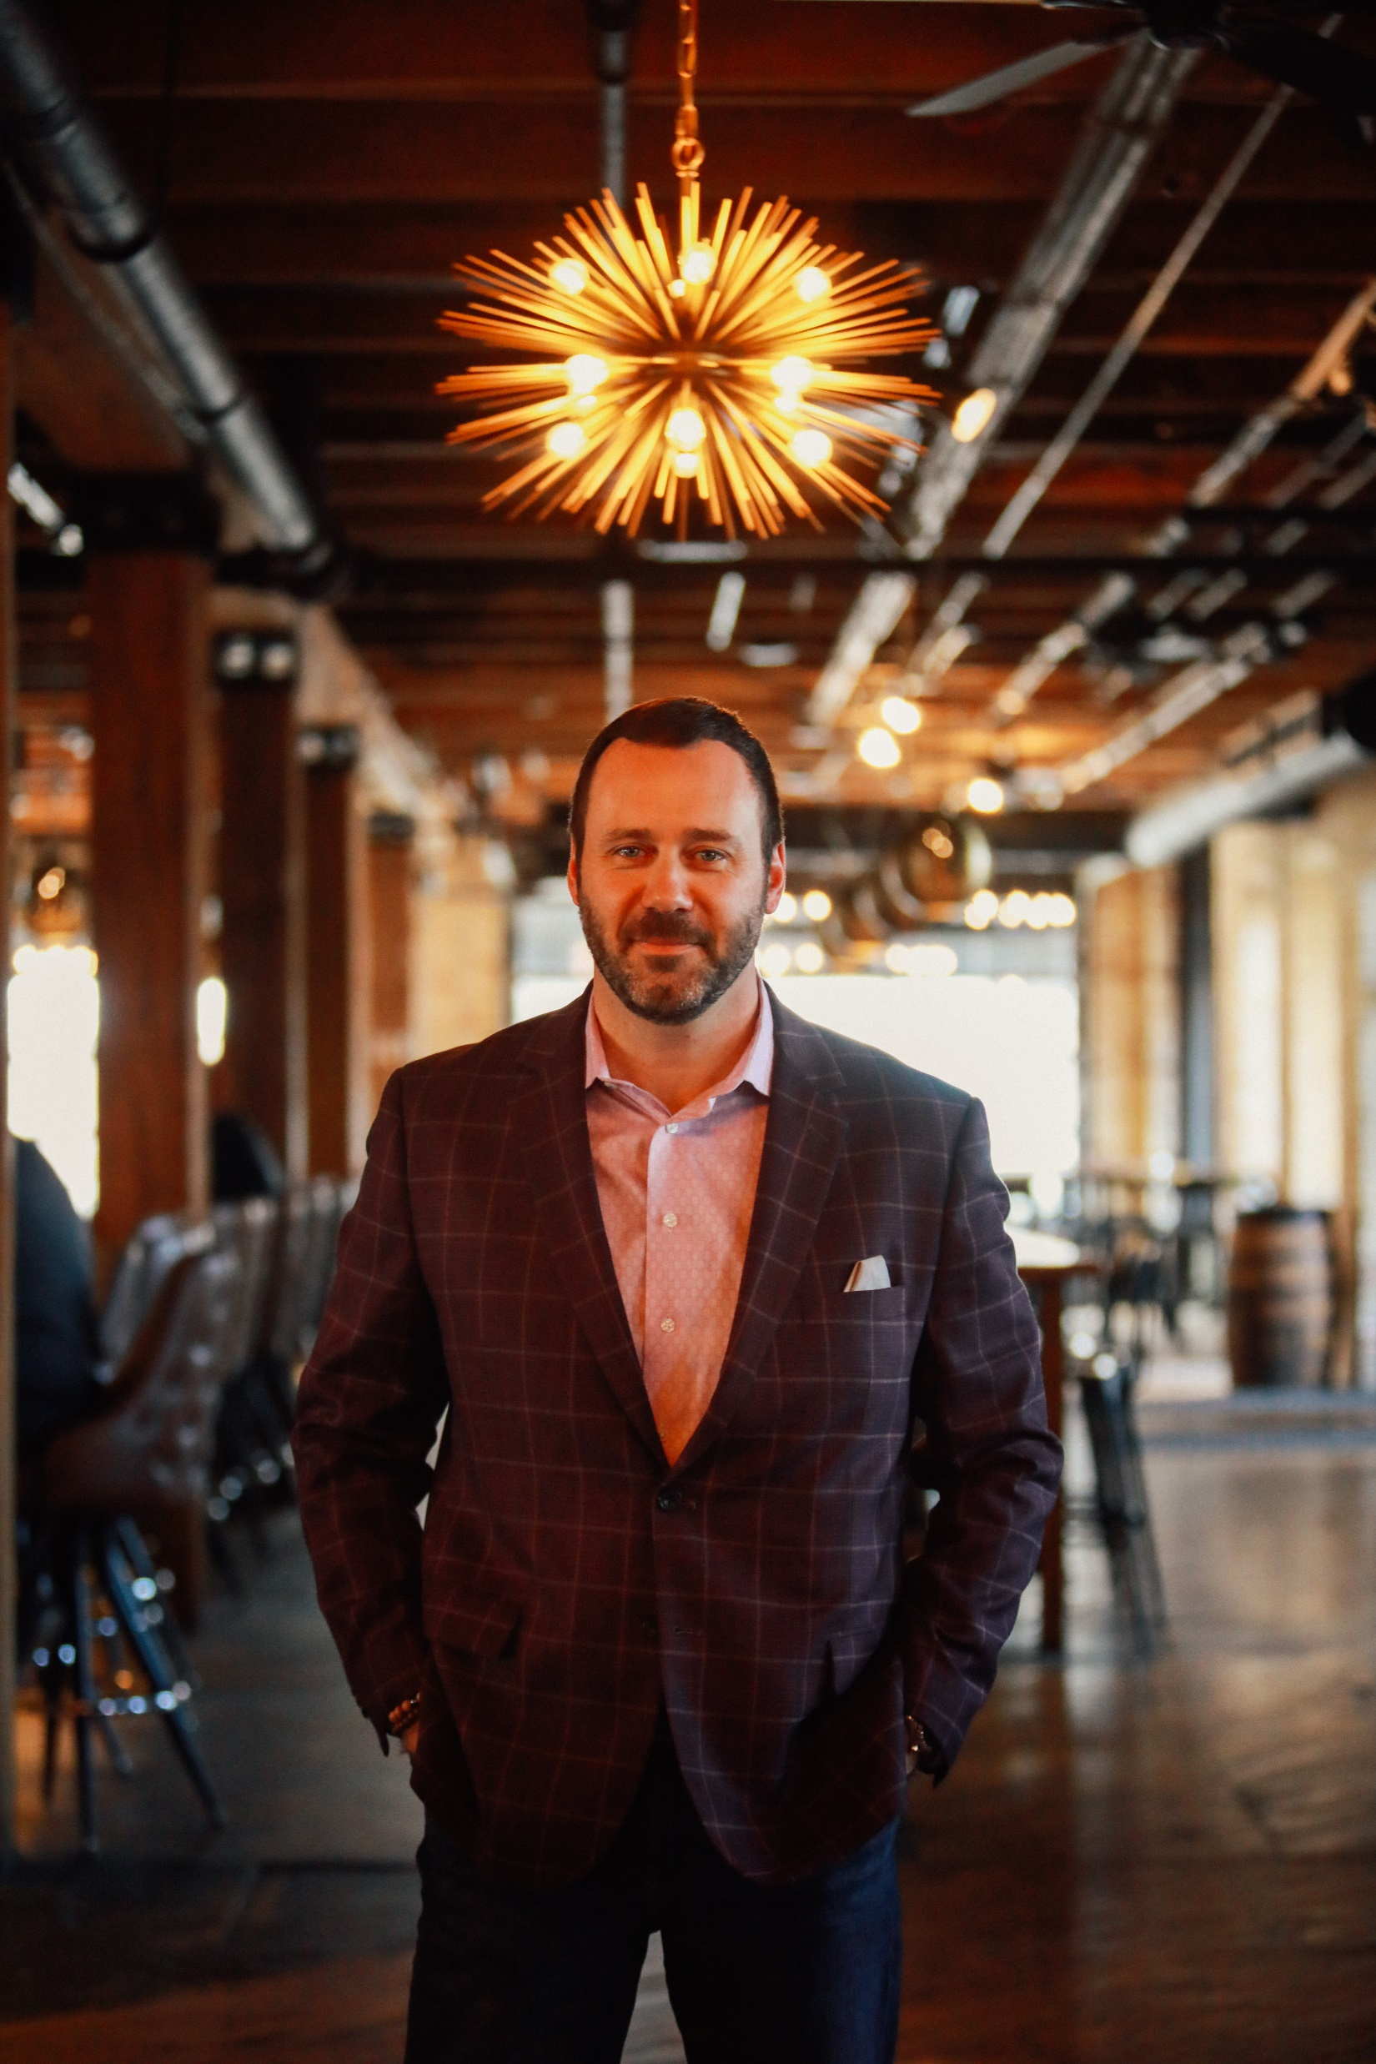




To stay in touch please connect with Tony at:
tony@mindcapturegroup.com
mind capture
@tonyrubleski

