Slide 1





CREATING AN EFFECTIVE GOV’T AFFAIRS PROGRAM
Presented by Greg Blose, MBA, IOM
www.Nexus360.ai

Slide 2

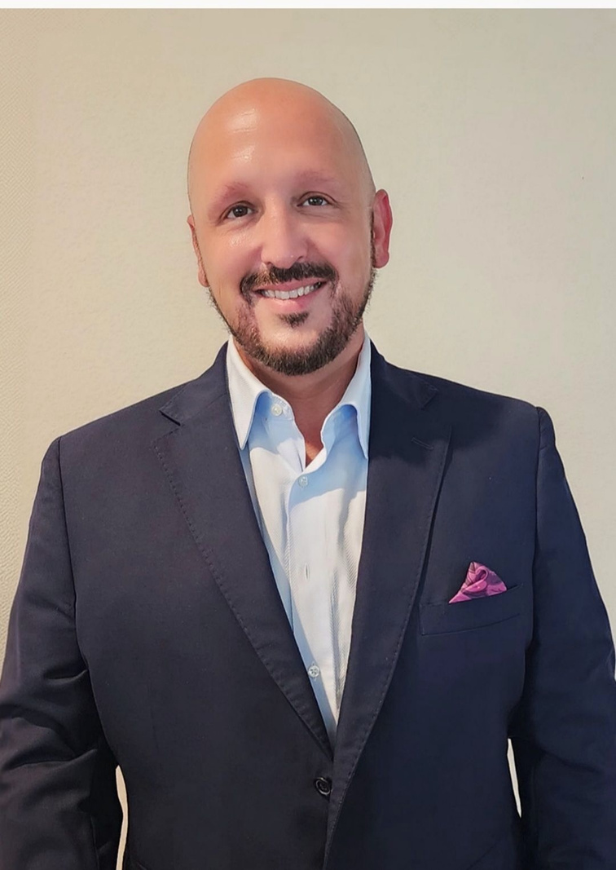
INTRODUCTION
Greg Blose, CEO, Nexus 360
Experience:
  Fmr. President & CEO- Palm Coast-Flagler Chamber
  Fmr. Executive Officer- Volusia Home Builders Association
  8 years @ Florida Chamber of Commerce
  10 years of news radio broadcasting
  Earned IOM in 2020
Nexus 360
  Advocacy
  Economic Research
  Marketing
  Business/Non-Profit Growth
  Greg@Nexus360.ai

Slide 3



OVERVIEW
  Foundational Elements of Gov’t Affairs Program
  Maximizing Influence
  Building Stronger Relationships w/ Elected Officials
  Proactively Shape Policy Discussions
  Generating Non-Dues Revenue via Advocacy
  Showcasing Measureable Value to Stakeholders

Slide 4




FOUNDATIONAL ELEMENTS
OF EFFECTIVE GOVERNMENT AFFAIRS PROGRAM
Research
Communication
  What is the problem?
  What is the data?
  Who decides? (Elected & Managers)
  What’s the process?
  Simple, easy to understand
  Consistent
  Include research, data
  Targeted list vs mass communication
Agenda
BUILDING A RELATIONSHIP
  What are the issues that address the problem?
  Do your members support/oppose?
  Board votes to support agenda
  See communication
  I.D. elected officials & managers
  Ask for meeting
  Share agenda
  Invite to events
  Understand their agenda

Slide 5



MAXIMIZING INFLUENCE
OWN THE DATA
BUILD PARTNERSHIPS, coalitions
BE PROACTIVE W/ AGENDA
  Unemployment Rate
  Population Growth
  Top Industries
  Largest Companies
  Labor Force
  Real Estate
    Commercial
    Residential
  Home Builders Association
  Realtors Association
  Local Non-Profits (members)
  Economic Development
    Gov’t, Public Private Partnerships
  Education System & Foundation
  Partner w/ Elected Officials
  Testify @ Gov’t Meetings
  Update @ Chamber Events
  Write Op-Ed
  Record a Video, Share Video
  Gov’ts Comprehensive, Strategic Plans

Slide 6

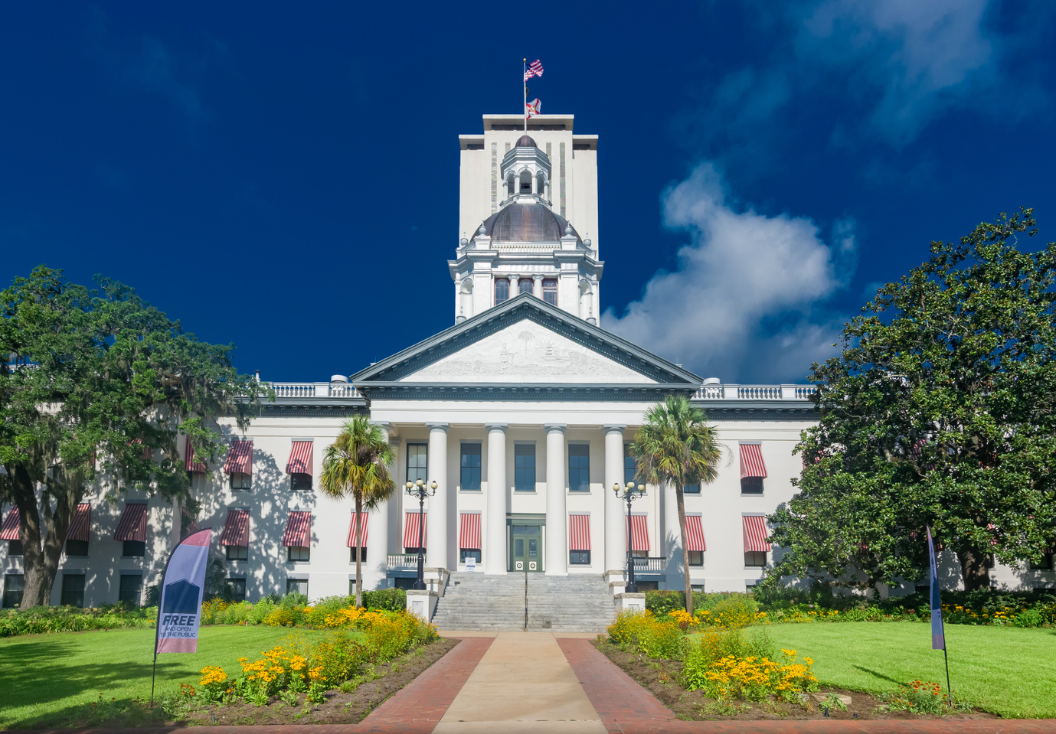
BUIDING STRONGER RELATIONSHIPS W/ ELECTED OFFICIALS & MANAGERS
Be Honest
  Honesty is the best policy.
THEY ARE PEOPLE, TOO
  Find out what they like
  Invite to events
  Highlight votes in support of Chamber initiatives
TWO-WAY STREET - ALWAYS TRY TO DELIVER WHEN...
  Ask for info
  Need people to show up
  $$$
*plus all of communication (slide #4)

Slide 7
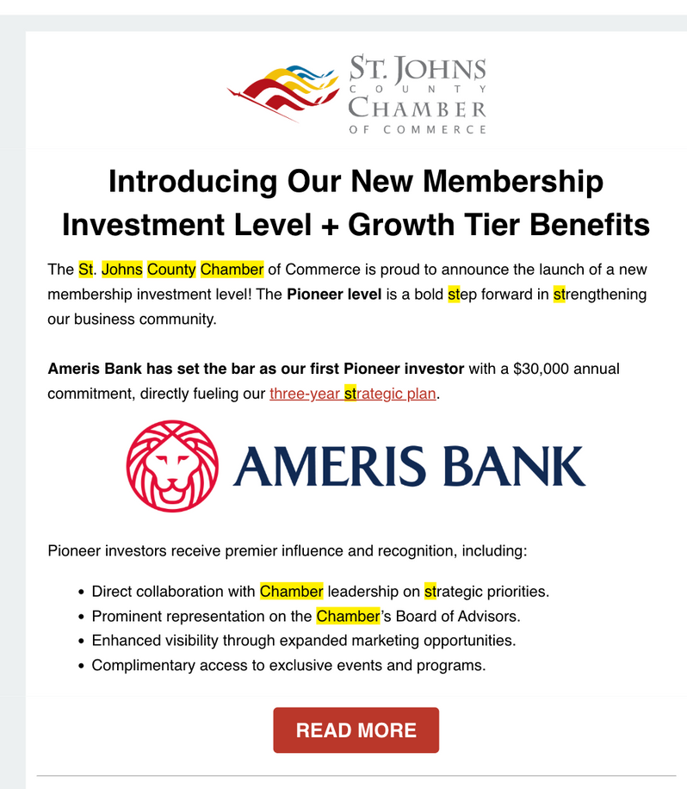
GENERATING NON-DUES REVENUE
  Events
    Quarterly/Annual “Economic” Event
    Legislative/Political Event
  Economic Council - CEO Roundtable
    Higher dues level unlocks increased access to briefings, data, etc.
  Local Government Grants
  Local Tourism Grants
  Political Action Committee
  Economic Development Partnership

Slide 8


SHOWCASING MEASURABLE VALUE
  When you have the meeting...
    Only upper-level members have access
    Be prepared (agenda, manage time)
    Take pictures
  Your performance in the meeting will impress members.
  Use photos, storytelling in Chamber comms
    Highlight members
    Ask for testimonials
  Feature elected officials at key events
    The bigger, the better (local, state, fed)
  Always tie back to the mission of the chamber
  Highlight key wins, partnerships

Slide 9


GET IN TOUCH
Greg@Nexus360.ai
386-846-1864
www.Nexus360.ai

