Slide 1
Understanding Certificates of Origin
In partnership with
The American World Trade Chamber of Commerce (AWTCC)

Slide 2
Key Takeaways
Learn the who, when, why of the certificate of origin
Get sample registration and certificate of origin templates to use
Learn about evolving needs around certificates of origin
Introduction to free trade certificates and their difference
Introduction to rules of origin

Slide 3
Who are we?
Processing partner for 140 other US entities (mostly chambers)
First US International Chamber of Commerce accredited chamber on certificate of origin issuance
Full staff formally tried via ICC
US representative to World Chamber Federation Certificate of Origin Council
Major CO processor in the US (65,000 documents last year)

Slide 4
The Cover Letter to your shipment
A Certificate of Origin (CO) is a document attesting that goods exported in a shipment have been wholly obtained, produced, manufactured or processed in a particular country. COs may be requested by customs administrations, importers, freight forwarders or banks for clearance of letters of credit.
The certificate of origin serves as the cover letter to all other documentation and often will give the first impression of the rest of the supporting documents.
Origin is used when determining what duty will be assessed on the goods or, in some cases, whether the goods may be legally imported at all.

Slide 5
Important Trends in Certificates of Origin
Increase in international demand for chamber stamped certificates of origin.
Increase fueled by increase in international fraud
Increase fueled by general crackdowns on incorrect origin claims.
Increase crackdown in US FTA countries fueled by US companies not understanding the free trade agreement.
“I’ve never had to have this certificate of origin stamped before. Why do I need it now?” – Common question

Slide 6
What is the chamber role?
Simply put, the chamber has three functions.
Legitimize the exporting business
Certify that a declaration of origin has been made to a party in the United States.
Should be able to answer basic questions about origin.
The 1923 Geneva Convention and subsequent Kyoto Convention have seen governments formally recognize the important role chambers play in this domain, deeming them competent authorities and credible trusted third parties in the issuance of COs.

Slide 7
When do chambers issue?
For shipments of US origin goods or for shipments by US exporters regardless of origin.

Slide 8
Why should chambers have a CO option?
Chambers are uniquely qualified to issue certificates of origin
Need for documents in your community
Opportunity for non-dues revenue and new members

Slide 9
What countries require a chamber stamp?
Broadly, a stamped certificate of origin is common in the Middle East, Africa, South America, Asia and less common in Europe and Central America. Europe may be changing.
Depends on product, total value, and country.
Depends further on partnership between importer and exporter. Importer may want to legitimize exporter.
Uncommon in countries with US free trade agreement.

Slide 10
Two Paths – What we provide
Chamber DIY
AWTCC Partnership
AWTCC still provides
Sample Certificate of Origin Template
Sample formal undertaking
Relevant links
AWTCC managed
AWTCC takes on responsibility and liability to issue documents
Revenue shared between AWTCC and partner chamber
*Some chambers opt for a hybrid solution.

Slide 11
Step One: Formal Undertaking / Chamber Affidavit

Slide 12
Step Two: Certificate of Origin Template

Slide 13
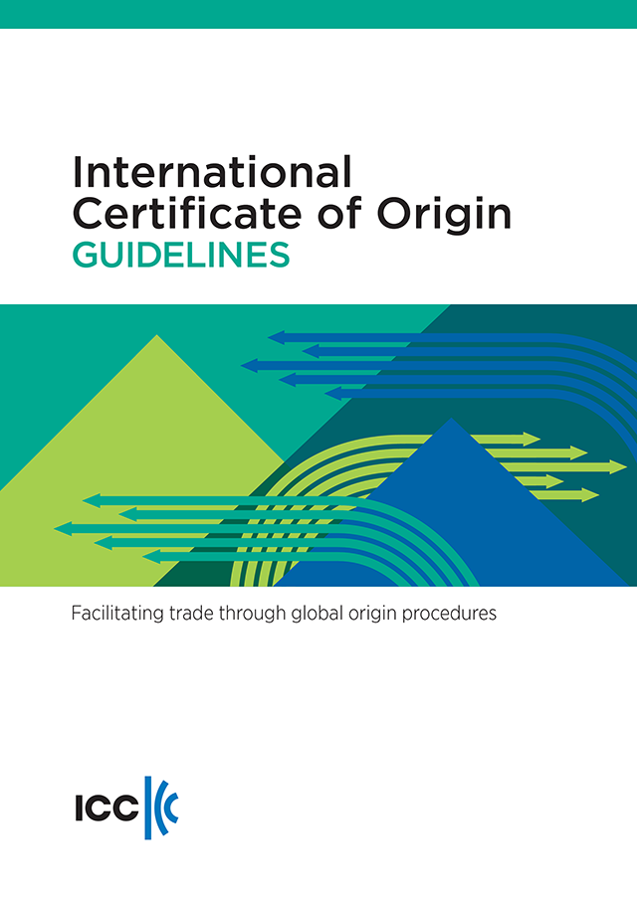
DIY – Best Practices
International Chamber of Commerce (ICC) does provide a guidelines book and provides training
At a minimum chambers should purchase a copy of the guidelines
Chamber copies (backups) need to be maintained
Minimum 7 years for legal documents
Every company needs to have completed formal undertaking
Chamber should have professional services and errors and omissions liability insurance
Often not part of general liability insurance
Appropriate declarations need to be on formal undertaking and each certificate of origin issued

Slide 14
Chamber process for issuing
Company completes formal undertaking with the chamber, establishing a reference point to compare signatures and minimizing chamber liability.
Chamber matches invoice to certificate of origin.
Chamber retains a copy of the certificate of origin presented.

Slide 15
Substantial Transformation HS Code Shift
Qualifies
Does not qualify
Tomatoes, onions, basil, and garlic imported from all different countries than turned into tomato sauce
Electronic components from different countries turned into computer
Individual piece is not the final product
Repacking existing product
Diluting tomato sauce with water
Putting a new label on a jar of tomato sauce
Freezing imported tomatoes
Phone with case added (may be mixed)
May Qualify
Assembly/Disassembly

Slide 16
Understanding Free Trade Agreements
Certificates of origin for US FTA qualification do not require a chamber stamp.
The US has FTA agreements with many countries.
Being an exporter in the US does not automatically mean you qualify for the FTA.
Requires origin to be outlined in specific ways. Does not outline a dedicated template.

Slide 17
Origin Declarations and Free Trade Agreements
Origin
Based on product
A product can have one origin
A shipment may have multiple products of different origins
Not based on export location
Company address, export address not relevant
Free Trade Agreement (FTA)
Agreement between two or more countries
Covers specific products to reduce or remove customs duties
Makes products more competitive
Origin declarations can be outside of standard for non-preferential
Full text tends to be available at trade.gov

Slide 18
Thank you!
Alex Sonifrank
VP Partnerships
asonifrank@awtcc.org

