Slide 1
Presentation to the Florida Association of Chamber Professionals
J. Alex Kelly, Secretary
FloridaCommerce

Slide 2
COMMERCE IN FLORIDA
Florida Defense Alliance

Slide 3
FloridaCommerce
Economic Development
Workforce Development
Community Development
International Commerce

Slide 4
Readiness for Job Seekers and Job Creators
Infrastructure/Site Readiness
Workforce/Talent Readiness
Financial Readiness
Cost and Quality of Living
Small Business is our Benchmark

Slide 5
Confidence in Capital Formation
#1 in new business formations since 2019 – 3.3 Million
#1 for entrepreneurship (The Digital Project Manager)
#1 talent development 2022-2023 (Lightcast)
#1 for higher education – state colleges & universities (U.S. News)
#3 in K-12 achievement (Education Week’s Quality Counts)
AAA credit rating (Fitch, Moody’s, S&P)
#4 tax climate (Tax Foundation)
$1.6 Trillion GDP

Slide 6
High Impact Gains and Focus Areas
#10/#11 in manufacturing jobs
Greater than 25% growth in manufacturing establishments since 2019
#1 for new high tech business establishments
Fastest venture capital growth in nation
Florida Entrepreneurial Nexus found 1,100+ small business partners (accelerators, incubators, investors, mentors, etc.) floridanexus.org
2023 led nation with corporate HQ relocations
Since 2019, 45% increase in the number of registered apprentices, 100% increase in the number of preapprentices, 41% increase in apprenticeship and preapprenticeship programs
For the first time in years, property insurance rate filings are trending downward

Slide 7
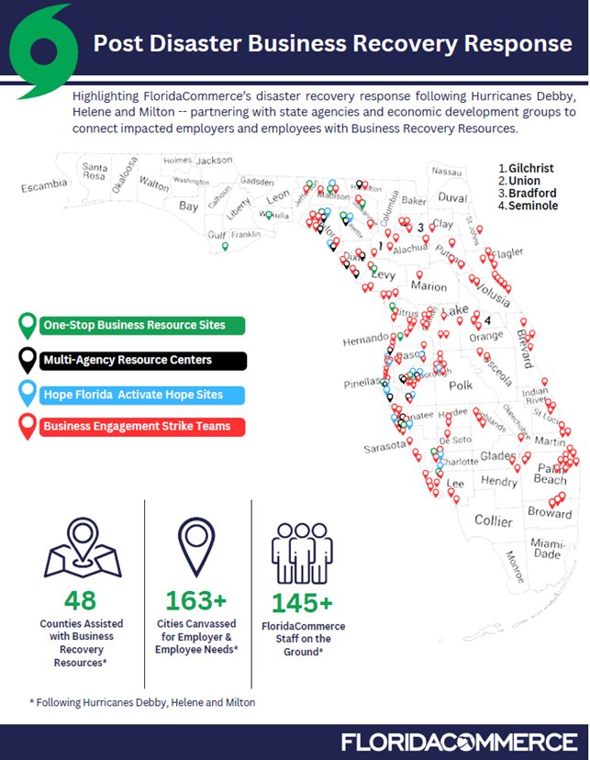
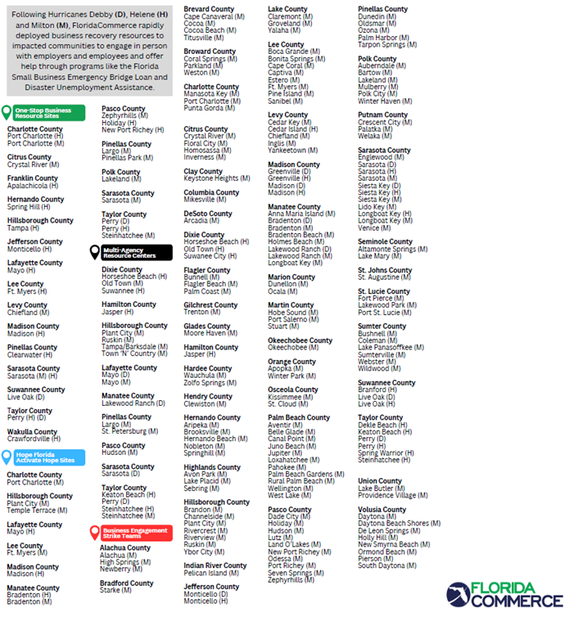

Slide 8
Business Recovery Response
$84.1 million approved 2,120 of Florida’s small businesses impacted by Hurricanes Debby, Helene, and Milton through the Florida Small Business Emergency Bridge Loan program:
Debby: 117 approved for $4,788,500 avg. = $37.8K
Helene: 638 approved for $25,466,400 avg. = $40.1K
Milton: 1,365 approved for $53,829,082 avg. = $38.9K
Disaster Unemployment Assistance (DUA) – 13,467 claims submitted:
Debby: 1,165 claims apps. due 11/18
Helene: 6,481 claims apps. due 12/9
Milton: 5,821 claims apps. due 12/10

Slide 9
Emergency Bridge Loan Program
Loans up to $50,000 per business, per applicant.
Up to $150,000 per agricultural business (including aquaculture, citrus, etc.).
Previously 0% interest for 1 year – New: 0% interest for 2 years.
Previously 600 credit score minimum – New: 550 credit score minimum.
New: Secretary’s discretion to waive credit score requirement in hardest hit coastal and rural areas.

Slide 10
Emergency Bridge Loan Program
New: Borrowers can take loans on multiple businesses (i.e., a restaurant owner who owns more than one restaurant).
New: Borrowers can take multiple loans on the same business if impacted by multiple storms (i.e., a business impacted by Debby, Helene, and Milton).
New: Extended due date to apply to either the end of the emergency orders or until funds are fully obligated.

Slide 11
Emergency Bridge Loan Program
Emergency Bridge Loans are personal business loans, and the applicant is required to repay them.
New: However, if the borrower cannot repay or “bridge out” into insurance proceeds, a SBA loan or some other loan, those borrowers are referred to the Florida Small Business Development Center network for no-cost consulting, and if the borrower agrees to receive those no-cost services, the borrower receives a rate reduction from 12% to 6% and a 36-month repayment term.

Slide 12
www.floridadisaster.biz

Slide 13
Office of Small Business Innovation
Small Business Loan/Investment/Support Programs:
State Small Business Credit Initiative (SSBCI)
Rebuild Florida Business Loan Fund (RLF)
Small Business Emergency Bridge Loan Program (EBL)
Microfinance Loan Guarantee Program (MFG)
Black Business Loan Program (BBLP)
Partners:
Florida Small Business Development Center Network (SBDC)
Hispanic Business Initiative Fund (Prospera)
Florida Opportunity Fund (FOF)

Slide 14
Incentives, Grants and International
SelectFlorida: 18 offices in 16 countries, international trade shows and sales/trade missions, export assistance, certificates of free trade
Capital Investment Tax Credits (CITC), High Impact Performance Incentives (HIPI)
Semi-Conductor, Defense, and Space Technology Tax Exemption, Brownfield Redevelopment, and numerous other sales and use tax breaks
Job Growth Grant Fund (JGGF), Rural Infrastructure Fund (RIF), Small Cities CDBG, Broadband Grants
Defense Grants (DIG, DRG, FL Defense Support Commission)
Community Planning Technical Assistance (CPTA) and Competitive Florida

Slide 15
Thank you! alex.kelly@commerce.fl.gov floridajobs.org selectflorida.org floridadisaster.biz

