Slide 1
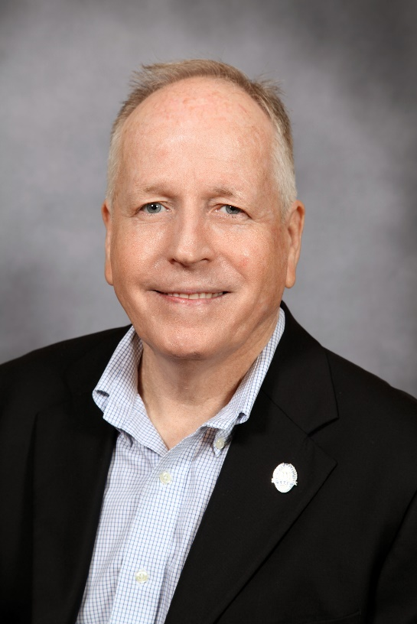
Hope and Opportunity Pandemic, Economic and Societal Recovery Comprehensive Approach

Slide 2
FACP = Strong Chamber Community
Resilient
Sharing Resources, Collaborating
THANK YOU.
Affirmation – You’re doing things Right!

Slide 3
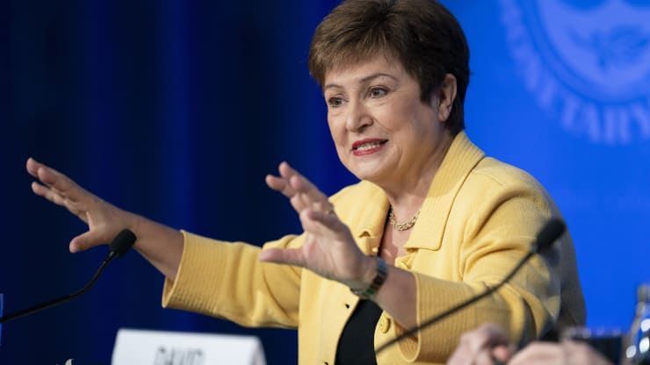
International Monetary Fund (IMF)
“…we will get through this, but how fast and how effectively will depend a lot upon the actions we take.”

Slide 4
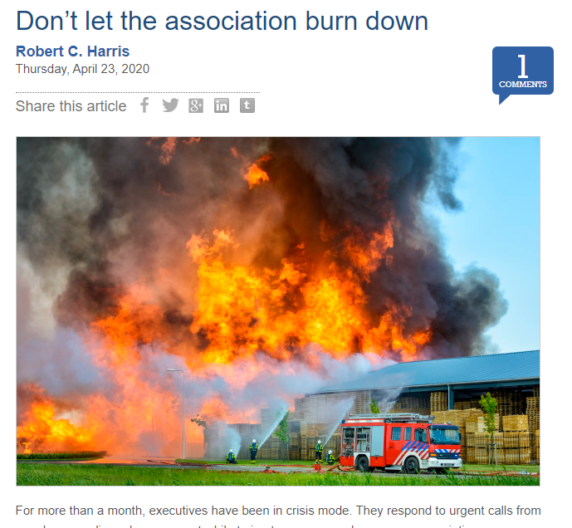
Don’t Let Your Chamber Burn to Ground

Slide 5
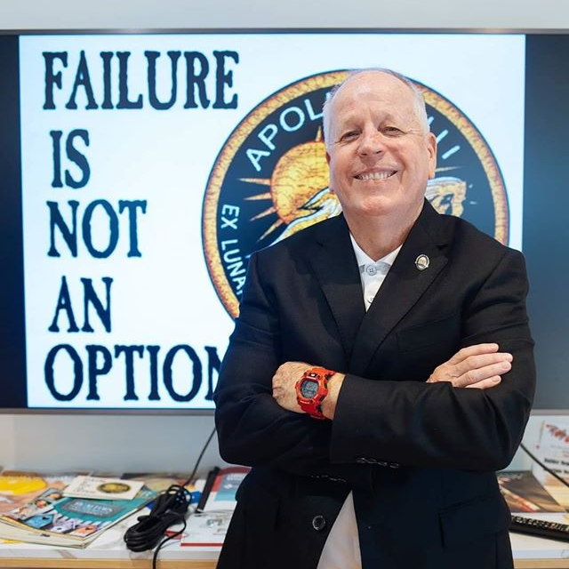
“In the long-run, members will judge us on how we responded during a crisis.”

Slide 6
Rebound ! Associations and Chambers
TECHNOLOGY – Investment and familiarity with technology allowing seamless adaptation for remote working, board and committee meetings, training and communications.
RESERVES – Adequate savings established in case of emergency; ability to survive at least 6 months. NOW is the time to make best use of reserves.
PEOPLE - The board of directors and professional staff are embracing opportunities to make a better organization.
bob@rchcae.com

Slide 7
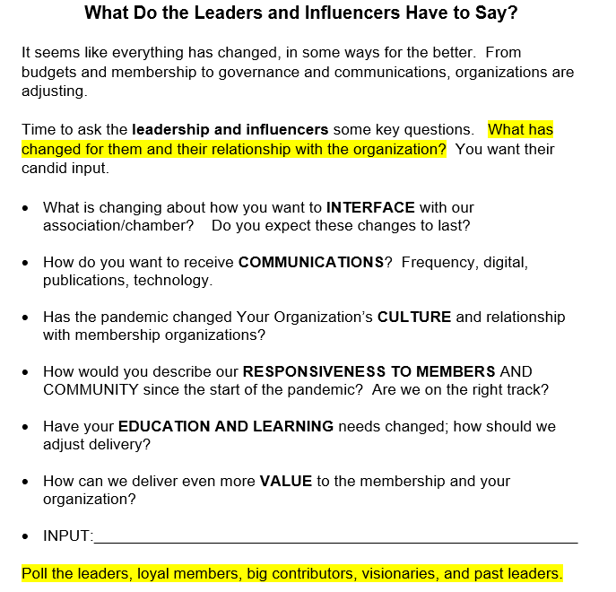
Take the Pulse of Stakeholders

Slide 8
SWOT – Board/Staff Perspectives (<1hour)
Strengths | Weaknesses
Innovation Leadership Advocacy Collaboration Vision Responsive to Membership Solid Reputation | Paralysis “How we used to do it.” Program Income Loses
Opportunities | Threats
Community Leadership Foundation Purpose/Repurpose Stimulus Funds Grant Management Opportunities Create new Benefits Becoming Indispensable Serving as the Trusted Resource | Pandemic – Second Wave Economic Impacts Societal Justice Business Closures Negative Images

Slide 9
Strengths of Chambers
Empathy, Listening to Members
Trusted Source, Relationships
Leadership Team, Passionate
Publications, Communication Channels
Technology Use, Internet, Social Media
Resourceful
Advocacy
Coalitions, Collaboration.
Planning, Strategic Thinkers
Grant Application and Administration

Slide 10
Execs Voice Concerns
Societal Concerns
Virus-Fatigue/Messaging
Membership/Dues
Board/Committees
Financial Forecasts/Budget
Staffing
Cancellations/Legal
Strategic and Plans
Advocacy
SURVIVE/PROSPER

Slide 11
Societal Concerns

Slide 12
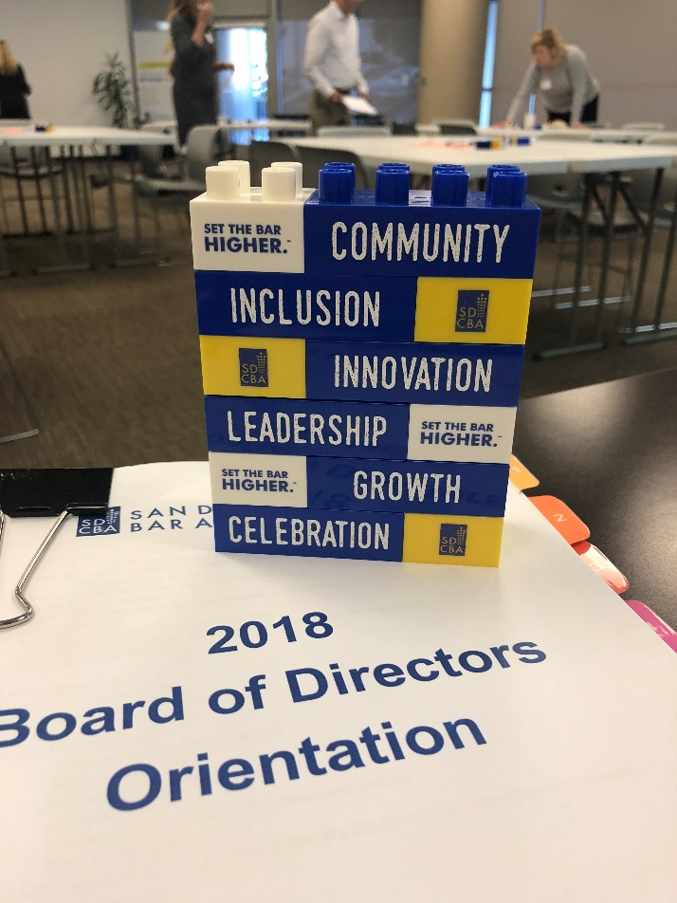
Values Statement
The leadership and professional staff are driven by these organizational values…
Example

Slide 13
Virus Fatigue and Messaging
“Pandemic and Economic Recovery”
Do not REGURGITATE
Appoint a Spokesperson
Avoid Rumors/Apparent Authority
Enhance Elevator Speech
Track Good Deeds

Slide 14
Membership – Dues - ROI
Indispensable Partner and Trusted Resource
Listen, Empathize, Categorize
Transform Challenges into Assoc. Opportunities
Delay of Dues, Waivers, Credits, Extensions
Be Proactive
Communicate Value – “ROI Value Calculator”
“We are working to help members through pandemic and economic recovery.
To provide relief, we are extending dues by ____ months. The board is ready to respond to individual hardships with waivers and credits.”
Question: How are you handling membership? Getting new members?

Slide 15
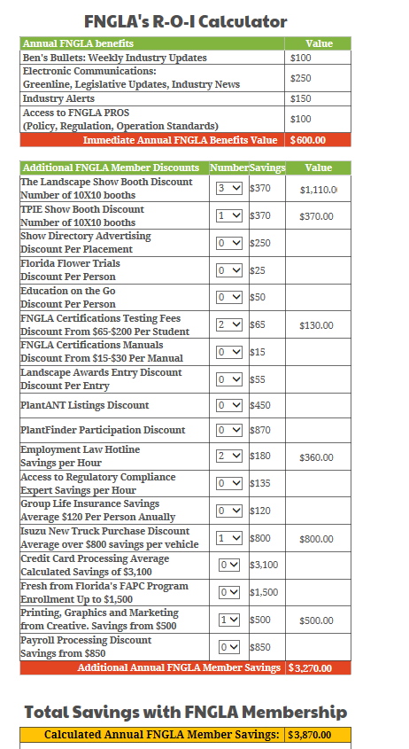
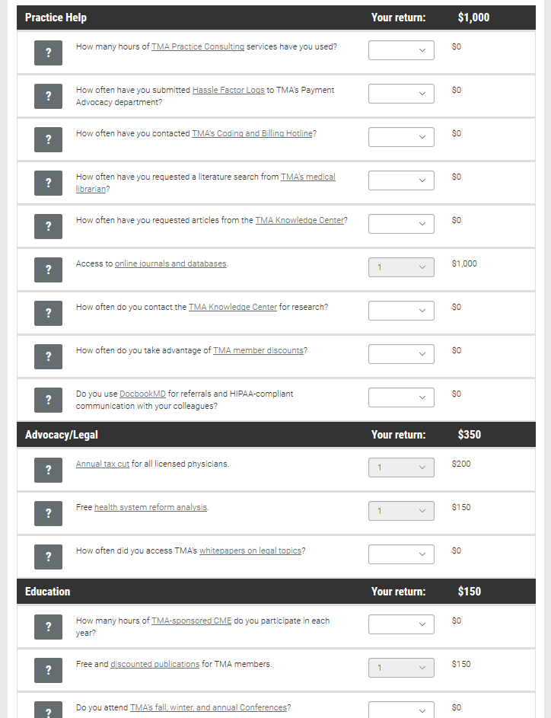
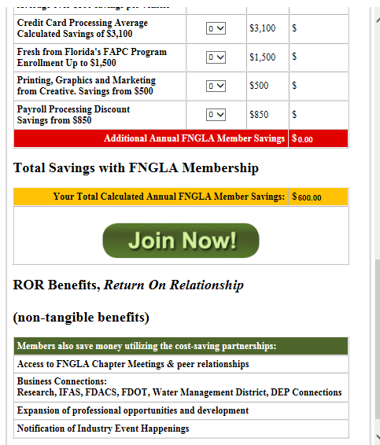
ROI Dues Value Calculator

Slide 16
Board Governance
AWOL < > Micro-Management?
Extend Terms if Needed
Empower the Executive Committee
Authorize the Executive Director
Meetings without Quorums; OK
Reduce Meeting Agenda Format
Question: What’s happening with your board?

Slide 17
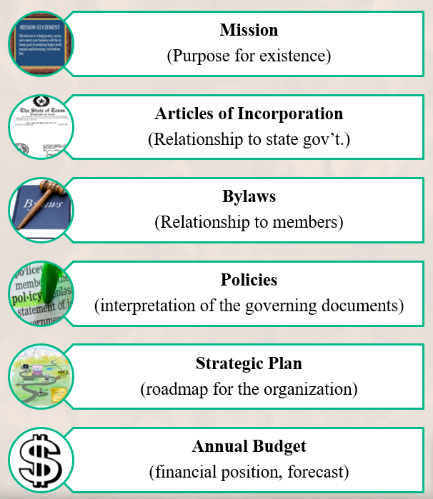
Governing Documents
Temporary Relaxation
Rules of Order
Dates and Deadlines
Committees
Document the Rationale for Omissions
Record in Future Minutes
Don’t Break any Laws

Slide 18
Committee Assignments
Appoint Strike Forces, Task Forces, Project Teams, Quick Action Teams, Micro-Tasks
Pause Standing Committees (i.e. bylaws review, etc. )
Governance Altimeter:
Board 50,000 foot
Committees 30,000’
Staffing 10,000’

Slide 19
Financial Forecasts
Assess Impact (Finance Committee)
Adjust/Contingency Budget
June – December 2020
Reserves – “Rainy Day Fund”
Repurpose the FOUNDATION
Search Stimulus Packages (CPA)
Repurpose Sponsors

Slide 20
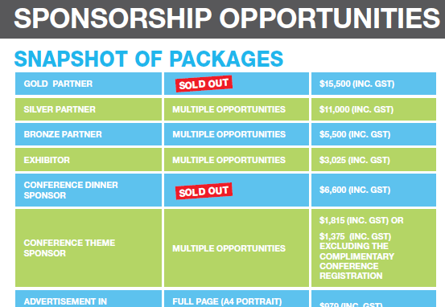
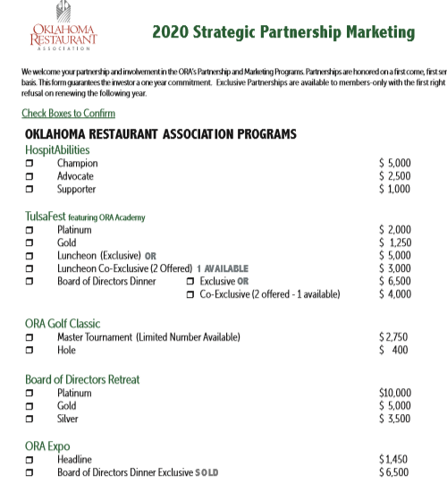
Sponsor Opportunity Menu

Slide 21
Staffing
Remote Work and Equipment
HR Policy Manual
Convey Value, Confidence
Re-Assess in Summer
Furloughs, Layoffs
Salary Contributions
Job Sharing Responsibilities
Stimulus Packages (CPA Support)
Rely on legal counsel.
Question: Staffing considerations in your organization?

Slide 22
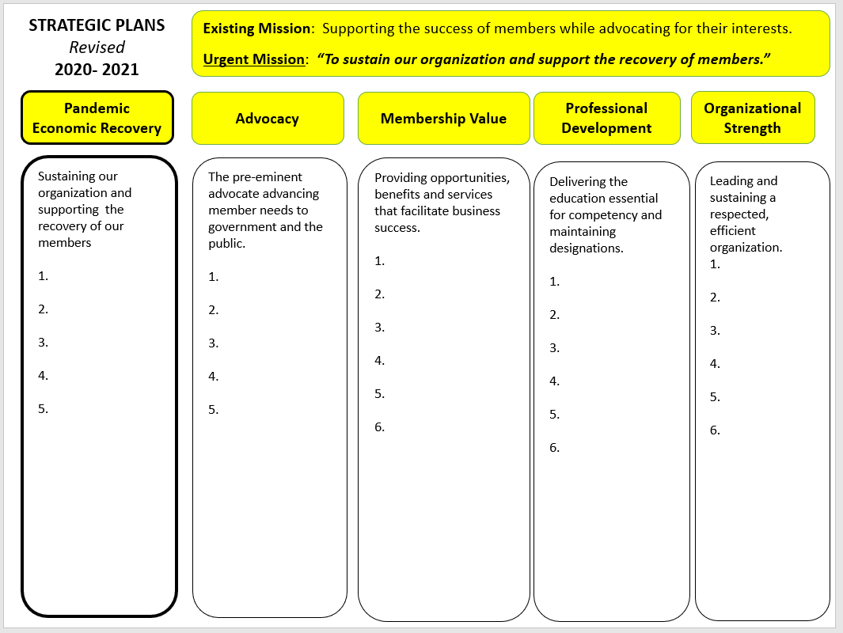
Planning - Strategy
Pause Long-Term Plan
RECOVERY PLAN
During Pandemic
Post Pandemic
Purposeful Abandonment now
Integrate “Pandemic & Economic Recovery” Future Plans
Question: Did you create a shortterm plan?

Slide 23
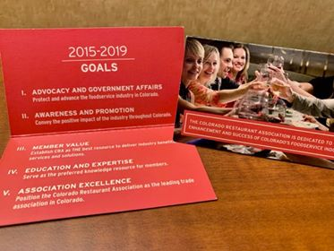
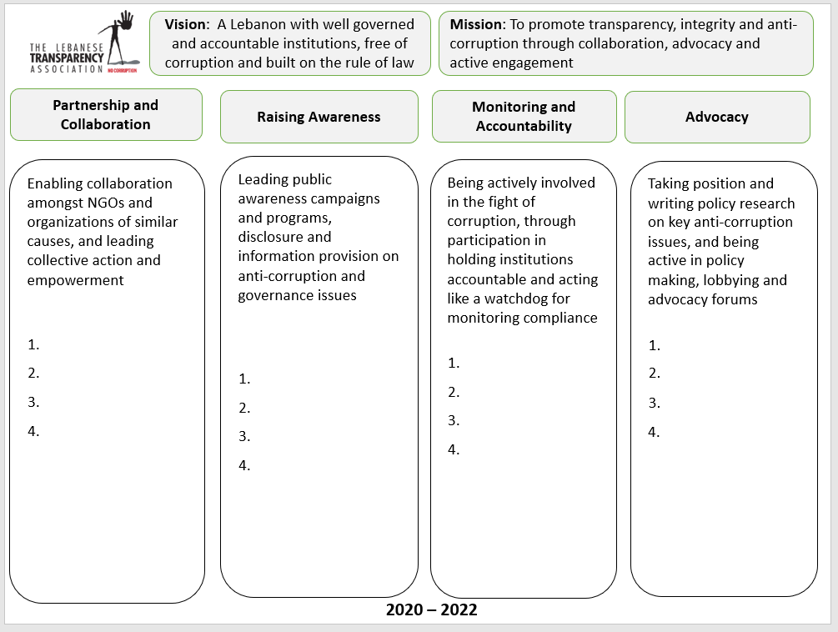
The 4 x 4 Strategic Plan

Slide 24
Advocacy
Champion for Member Interests
Repurpose Lobbying Team
Reaching Lawmakers in “Stay at Home” Settings
Coalitions, “Seat at the Table”
Tell Members What You’re Doing
Community Deeds support Advocacy
Question: What advocacy wins are you working on or have passed?
How are you cataloging good deeds for future?

Slide 25
Cancellations
Proceed with Caution
Meeting Cancellation Insurance?
Force Majeure Clause?
Facility Policy & Gov’t Advisories?
Repurpose Events
Work with Vendors’ Unique Needs

Slide 26
Survive and Thrive
Stay Positive, Encouraging
Catalog and Share Good Deeds
Celebrate Achievements
Pace Yourself – Don’t Burn Out

Slide 27
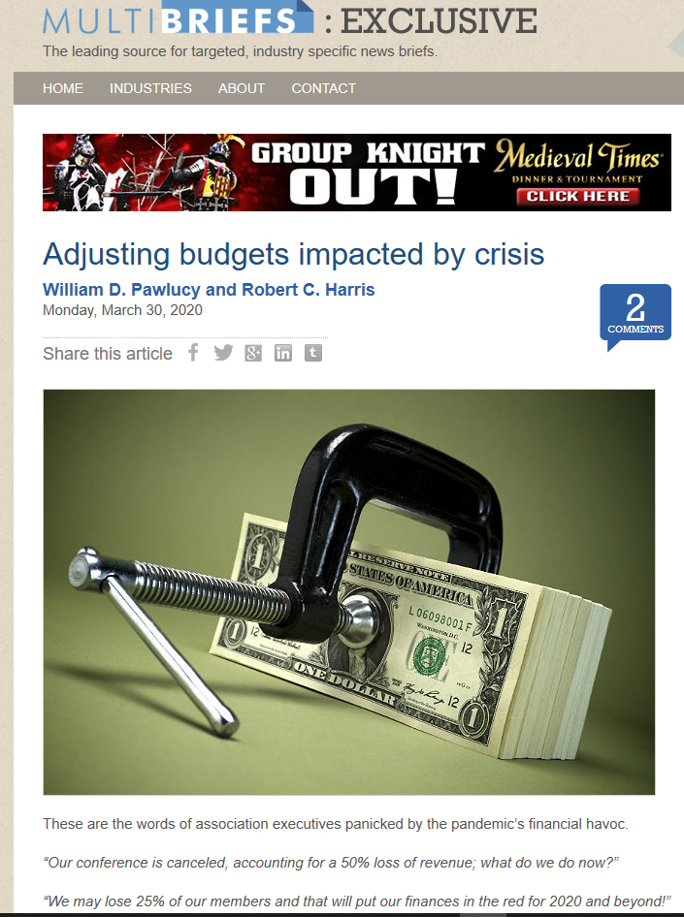
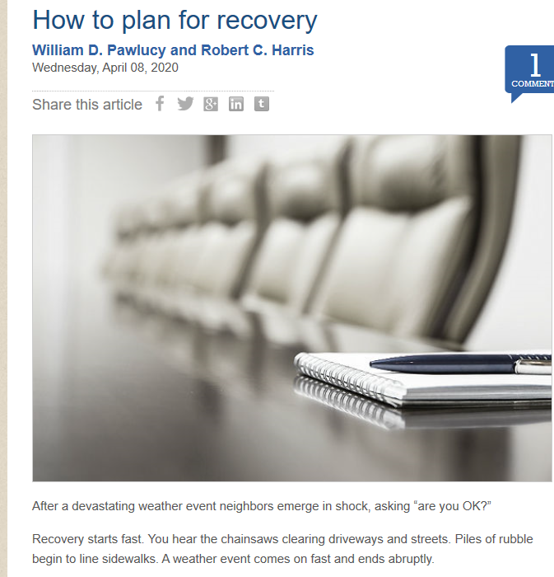
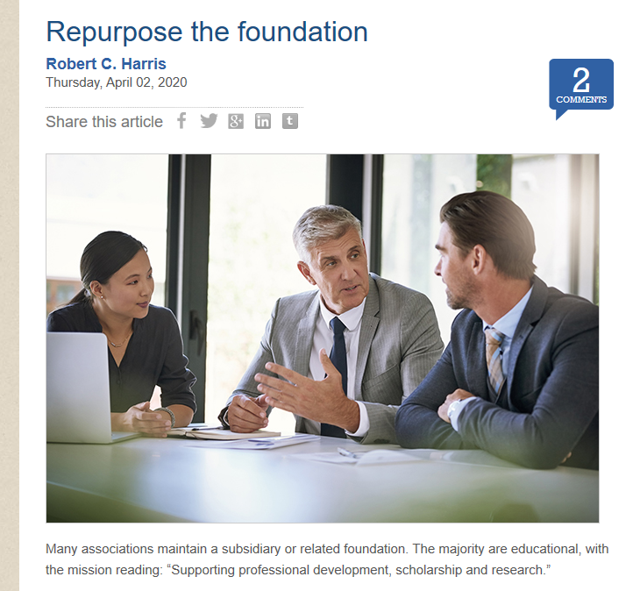
Recovery Articles
www.multibriefs.com

Slide 28
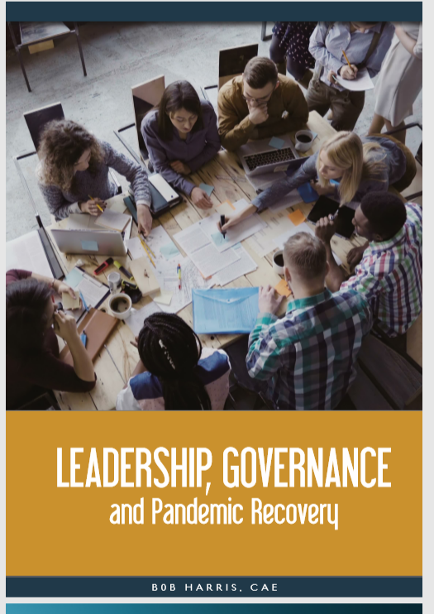
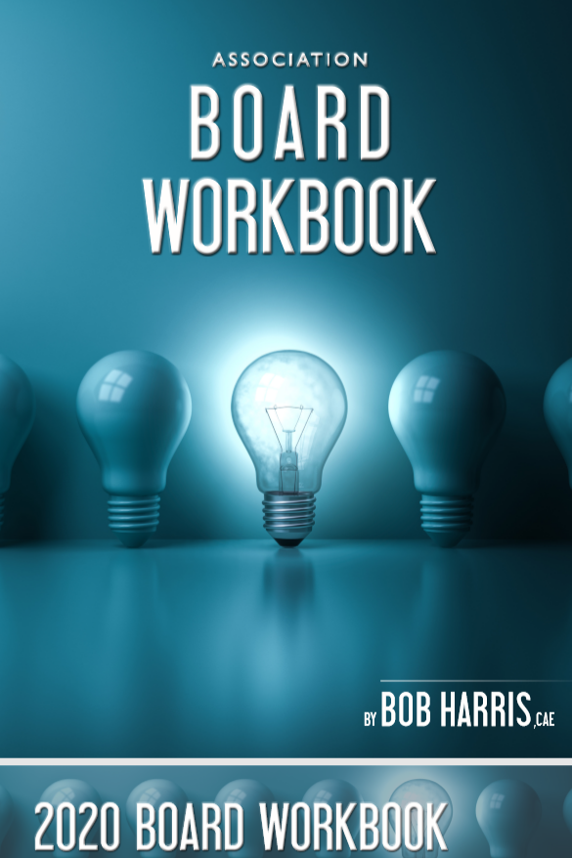
Free Resources - bob@rchcae.com
40-pages
20-Page Board Workbook

Slide 29
Governance - Management Model
Performance
Structure
Strategy
Sustainability
Relevance

