Slide 1
Employee Retention Credit
Is your Chamber eligible to receive the Employee Retention Credit?

Slide 2
Overview
Refundable payroll tax credit.
Applies to wages and certain health plan costs.
Equal to 50% of qualified wages up to $10,000 for 2020
Equal to 70% of qualified wages up to $10,000 for 2021

Slide 3
Eligibility in 2020
To be eligible, employers must have met one of the following tests:
Operations were fully or partially suspended due to a governmental order related to COVID-19.
Experienced a 50% decline in gross receipts during a 2020 calendar quarter compared to the same quarter in 2019. Significant decline must be on the basis of accounting your tax return is filed on.
Remains “eligible quarter” until the end of the first quarter in which gross receipts exceeds 80% of the receipts of the same quarter in 2019.

Slide 4
Eligibility in 2021
To be eligible, employers must have met one of the following tests:
Experienced a 20% decline in gross receipts during a 2021 calendar quarter compared to the same quarter in 2019. Significant decline must be on the basis of accounting your tax return is filed on.
No eligibility based on government shutdown orders in 2021.
First quarter of 2021, you can use the fourth quarter gross receipts of 2020 compared to the fourth quarter of 2019 gross receipts test.

Slide 5
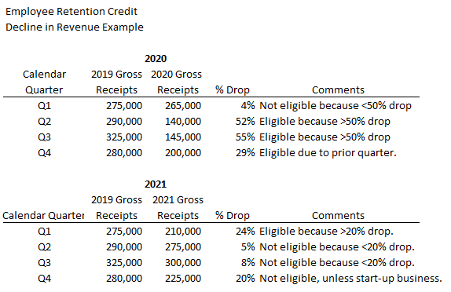
Eligibility Example

Slide 6
PPP and ERC
Any wages used for PPP forgiveness calculations cannot be used as ERC qualified wages.
Employers may not consider wages used for paid family and medical leave credits (COVID-19 pay) for the Employee Retention Credit

Slide 7
How do I claim the credit and documentation requirements?
Form 941, Federal employment tax return
Must file an amended return (941-X)
Documentation supporting eligibility – income statements or proof of government shutdown orders.
Wage reports used in calculating eligible wages
941 reports (original and amended)

Slide 8
When to File?
As soon as possible.
Statute of limitations
3 years from the date your original 941 was file.
Generally takes 6 to 9 months to receive refund.
The rules to the program can change at any time.

Slide 9
More Information
https://www.irs.gov/newsroom/faqs-employee-retention-credit-under-the-cares-act
Questions? Feel free to call Angie or Dustin at Hamilton & Associates CPA – 813-532-2000 or email angie@cpahamilton.com or dustin@cpahamilton.com

